Slide 1
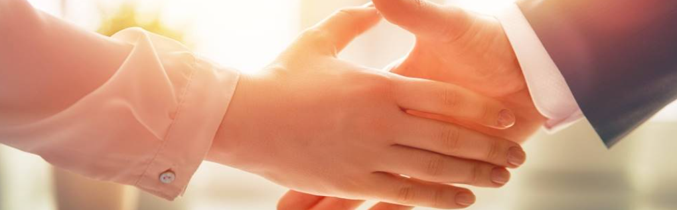
Welcome to our services
New Lebanon Church of Christ
We are Simply Christians.
Our Emphasis is Spiritual, Not Material or Social.
We are striving to be The Same Church as Described in The New Testament.
Please Come Back Again

Slide 2

Notes:
The Bible is one of the most popular and most misunderstood books in the world. It is possible to know a lot about the Bible without really understanding the Bible.
God could have written the Bible so that only Greek scholars or Phd theologians could have understood it. He could have written so that only Rocket scientists could understand it.
Instead it was written so that it could only be understood by someone with the heart of a little child.
We are going to get in an airplane and take a 20,000 foot view of the Bible.
We start by looking t a few basic facts about the Bible.

Slide 3





The Incredible Book
66 Books: 39 OT + 27 NT
Written over 1500 years
(1450 BC – AD 100)
40 different authors
From 3 different continents, different nations, and varying cultures
Contains 3 different languages (Hebrew, Aramaic, Greek)
HEBREW
ARAMAIC
GREEK

Slide 4

1
40 Authors…6 Major Empires…
1500 Years… 66 Books…
3 Continents…3 Languages
One Theme!
amazing
God’s Plan of Redemption
Notes:
How could men have written this book? It would be impossible. There are many evidences we could look at in considering the case for a Creator: scientific, archiological, historical, etc. The internal evidence of this book is one of the most powerful evidences that this book was written by God.

Slide 5

An Urgent and Important Command
THE GREAT COMMISSION
“Go into all the world and
preach the gospel
to all creation.”
Mark 16:15

Slide 6
The Gospel –
The Power of God
“I am not ashamed of the gospel
for it is the
power of God
for salvation...”
Romans 1:16
Notes:
6
The gospel stands between man and salvation
The gospel is the power of God – not a fuzzy feeling, not money, or wealth or fame – but the gospel
<Here we learn additional information about the gospel>

Slide 7

The Gospel…Must be Obeyed
“...when the Lord Jesus will be revealed from heaven with His mighty angels in flaming fire, dealing out retribution to those who do not know God and to those who do not obey the gospel of our Lord Jesus. These will pay the penalty of eternal destruction, away from the presence of the Lord and from the glory of His power...”
do not obey the gospel
2 Thessalonians 1:7-9
Notes:
God will absolutely condemn anyone who rejects the gospel
The gospel is critically important
<TR> It gets even scarier

Slide 8

A Serious Warning…To Christians
“I am amazed that you are so quickly deserting Him who called you by the grace of Christ, for a different gospel; which is really not another; only there are some who are disturbing you and want to distort the gospel of Christ.
But even if we or an angel from heaven should preach a gospel other than
the one we preached to you,
let him be eternally condemned!”
Galatians 1:6-12 (see also Acts 20:28)
Notes:
There is only one gospel and we have to get it right.
Whose responsibility is it to know the one gospel? Preachers. Pastors? No. Individual Christians.
Do you know the one gospel? If I asked you to write it down.
The one gospel is the differentiator of various Christian religions. It is exactly the fact that not everyone is teaching the same or the one gospel.
Our salvation is completely dependent upon our ability to know and respond to the one gospel. Let me put this negatively as well, we will not go to heaven if we believe or teach a different gospel, even if it is taught by a famous or influential person
<TR> The gospel is this sense is part of a larger picture

Slide 9
The ONE Gospel
1
“I am amazed that you are so quickly deserting Him who called you by the grace of Christ, for a different gospel; which is really not another; only there are some who are disturbing you and want to distort the gospel of Christ.
But even if we or an angel from heaven should preach a gospel other than the one we preached to you, let him be eternally condemned!”
Galatians 1:6-12
How can I be certain?
Where would we start?
GOSPEL
Notes:
So, There is only one gospel and we have to get it right.
How can we be sure that we get this right, for we must get this right!
<The NT gives us a pointer or direction of where to begin to understand the theme of the Bible

Slide 10
Galatians 3:24
Also: Rom. 15:4
For whatever things were written before were written for our learning, that we through the patience and comfort of the Scriptures might have hope.
1 Cor. 10:11
Now these things happened to them as an example, and they were written for our instruction
(see also 2 Tim 3:14-15)
OLD LAW
TEACHER
TO BRING US TO CHRIST
JUSTIFIED BY FAITH
Notes:
There’s gold in them thar hills.
The OT is supposed to teach us something. Something very important.
What we learn from the OT is to “bring us to Christ” so that “we may be justified by faith”
<TR> There are some fundamental things we need to look at and learn from the history of the OT

Slide 11





GOD IS HOLY
Notes:
This is it. God is holy. All of the interaction that we have with and from God is determined by this fact.
We could spend all of out time just examining the various facets of God’s holiness.
<But we must grasp the importance of this fact and what it means to us>

Slide 12



A DESIRED RELATIONSHIP:
SPIRITUAL FELLOWSHIP
WITH A HOLY GOD
Notes:
When man can exhibit the characteristic of holiness God has a union and relationship with man that is called spiritual fellowship.
We are really spirit beings that inhabit these earthly physical bodies. The earthly bodies are temporary and mortal. Our spirit bodies will soon leave these bodies and inhabit the true reality that God has prepared for eternity. This world is the Matrix.
This is why we try to get our kids to be holy.
<TR> This relationship is only possible if man can be found in a state of holiness because this is the only realm of existence with God…but alas this is the problem of man

Slide 13

God exhibits an attitude of abhorrence and hatred to all that is wrong
“You are of purer eyes than to behold evil, and cannot look upon wickedness.”
Hab 1:13
Notes:
God is of such purity and sin is such a revulsion that he cannot look upon sin. (Charged filings when confronted with a magnet).
<TR> It is even worse

Slide 14
Sin Separates us from God
“Your iniquities have separated you from your God; and your sins have hidden his face from you.”
Is 59:2
Notes:
God is of such purity and sin is such a revulsion that he cannot look upon sin. (Charged filings when confronted with a magnet).
<TR> It is even worse

Slide 15




SPIRITUAL
DEATH
“you were dead in your trespasses and sins” Eph 2:1
Notes:
That’s why when sin (any sin) separates us from God is described in most drastic terms.
Spiritual Death – (not 5 minutes in the naughty corner for you Supernanny fans)
Our culture continues to diminish sin, while God demands holiness
<TR> This is what Romans 6:23 tells us about the wages of sin…

Slide 16
Romans 3:23
...for all have sinned and fall short of the glory of God
Romans 6:23
...for the wages of sin is death
SIN
DEATH
Notes:
Notice how the terms SIN and DEATH are related
<TR>But here is where the problem gets serious…

Slide 17
The CONSEQUENCES of Sin
SPIRITUAL
DEATH
MORTAL
“For out of the dust you were taken; for dust you are, and to the dust you shall return.”
Genesis 3:19
Notes:
– these can be called the consequences or penalty for sin
<TR>When we have suffered the consequences of sin have we done anything that takes care of sin (removes or covers sin)?

Slide 18
The PRICE for SIN
LIFE
DEATH
“without the shedding of blood there can be
no remission of sins.”
Heb. 9:22
no remission of sins
Romans 3:23
...for all have sinned and fall short of the glory of God
Notes:
– these can be called the consequences or penalty for sin
<TR>When we have suffered the consequences of sin have we done anything that takes care of sin (removes or covers sin)?

Slide 19


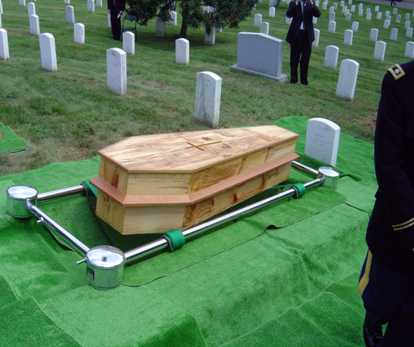

Three Deaths
SPIRITUAL
MORTAL
JUDICIAL
Separation
From God
Death of our bodies
Life payment
for sin
Result of individual sin
Result of Adam and Eve’s first sin
Required of every sinner
“The wages of sin
is death”
Romans 3:23
“for dust you are, and to the dust you shall return.”
Genesis 3:19
“without the shedding of blood there can be no forgiveness of sin”
Hebrews 9:22
Notes:
Who deserves to die for my sins?

Slide 20
God’s Justice Demands Death as Payment for Sin
We find ourselves in a very desperate situation:
We have broken the laws of the God of the universe, this has separated us from a Holy God, and the price of death hangs over our head
(which we cannot pay!)
by a just God!
Notes:
The principle so many overlook is that the price for sin is personal – no thing or no one else is responsible for the price for my sin – it is on my head – it is on your head – it is on the head of everyone who sins
Being good will not take care of this problem.
<TR> So man is in a miserable situation. He has a price on his head that he cannot pay. Is there any hope? What is the remedy?

Slide 21
God’s Love Provides a Way to Pay the Price
LIFE!
GRACE
God gives
what is not deserved
(Romans 3:23-26; 5:6-11)
God does not give
what is deserved
(Romans 1:18)
DEATH!
MERCY
Notes:
If we only experienced the JUSTICE of God it would be a short story for all of us.
But the other side of His holiness is His LOVE as demonstrated in His grace and mercy.

Slide 22
MERCY
BLOOD
Notes:
This is where we see that God’s lovingkindness comes in to help man out from the penalty demanded by His justice.
All that blood in the OT is the mechanism that God uses to demonstrate His mercy
This is why the Bible is a book that drips blood. This is what animal sacrifice was all about. It was God’s way to demonstrate His grace or mercy
<TR>Man’s redemption is all wrapped up in the idea of Atonement

Slide 23

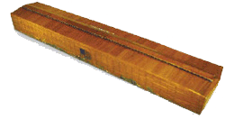
Atonement
Kaphar: to cover, purge, make an atonement, make reconciliation, cover over with pitch
Notes:
Atonement is the mechanism of reconcilation
Atonement is the result of reconcilitation between man who broke God’s laws and God himself so that spiritual reunion can take place.
<TR> And atonement is offered by the blood of animals

Slide 24
Atonement
“...for it is on this day that atonement shall be made for you to cleanse you; you will be clean from all your sins before the LORD” Lev 16:30
SANCTIFICATION
Notes:
When man can exhibit the characteristic of holiness God has a union and relationship with man that is called spiritual fellowship.
Holiness for man can only take place if the price for sin can be paid thereby removing sin.
<TR> This relationship is only possible if man can be found in a state of holiness because this is the only realm of existence with God…but alas this is the problem of man
<TR> It is even worse

Slide 25
Atonement
Leviticus 17:11
'For the life of the flesh is in the blood, and I have given it to you on the altar to make atonement for your souls; for it is the blood by reason of the life that makes atonement.'
Notes:
Life makes atonement.
One thing we must realize is that God is not a God with some sort of bloodlust. Like the “throw the virgin in the volcano and appease the gods” kind of God.
(Animal sacrifice is another tremendous evidence of God. Every culture in the world, all over the world, has practiced sacrifice. I read that the scholars are puzzled as to how man could have gotten this universal idea that killing something would bring good fortune)
<TR> No. God uses blood (or life) to make atonement due to its representative nature and the seriousness of the crime

Slide 26
Payment
REPRESENTS
BLOOD
LIFE
ATONES FOR
Innocent LIFE
SINNER
REPRESENTS or
SUBSTITUTES for
Guilty LIFE
Innocent LIFE
Heb 9:22 …without the shedding of blood there can be no forgiveness
Notes:
<Sin is bad>

Slide 27


Animal Sacrifice
SINS
(FIGURATIVE)
JUSTICE
MERCY
REPRESENTATIVE DEATH
INNOCENT SACRIFICE
SINNER
SANCTIFIED
DEATH
Notes:
SO here is a visual of how animal sacrifice worked.

Slide 28

What Made it Work?
FAITH
Notes:
The biblical concept of faith is even seen in animal sacrifice.
Couldn’t just believe in animal sacrifice. The animal had to be killed
Heb 9:22
Dad didn’t want to do it because it is raining and cold.
Son does it because dad always did it.
<The Bible is replete with examples of faith

Slide 29
By Faith…
Abel
Noah
Abraham
Sarah
Abraham
Isaac
Israelites
Walls of Jericho
OFFERED
PREPARED
OBEYED
CONCEIVED
OFFERED
BLESSED
PASSED THROUGH
ENCIRCLED
ROM. 10:17
Genuine FAITH requires
Belief-based ACTION
Notes:
Notice what they all had in common (Faith, action)
Suppose it was time for animal sacrifice and you decided it was too cold and the lambs had to be chased down and you decided that God knew your heart so you would just skip the yearly sacrifice.
Couldn’t just BELIEVE in animal sacrifice
Likewise just killing the animal without having belief wasn’t animal sacrifice.
Believe alone was no good, action alone was no good. Required both.
Naaman is another great example
Romans 10:17 So then faith comes by hearing, and hearing by the word of God.

Slide 30


Genuine Faith – Hebrews 11:6
But without faith it is impossible to please Him, for he who comes to God
must believe that He is, and that He is a rewarder of those who diligently seek Him.
must believe
diligently seek Him.

Slide 31
BELIEF ALONE? (James 2:14-26)
(v14) Can that type of faith save a man?
(v17) Faith without action is dead
(v18) Faith is shown by action
(v20) Faith without action is “useless”
(v21-23) Abraham’s faith was perfected by belief working with his actions
(v24) Justified by action, not “faith alone”
(v26) Faith without action is dead
(v19) Devils are believers!
THERE ARE BELIEVERS IN HELL!

Slide 32
The OT “Teacher”
SACRIFICE
SIN
HOLINESS
GRACE
FAITH
SINS
(FIGURATIVE)
REPRESENTATIVE DEATH
TEACHER
Gal 3:24
ATONEMENT
JUSTICE
MERCY
REDEMPTION
RECONCILIATION
BLOOD
DEATH
REPRESENTATIVE
DEATH
SANCTIFICATION
Notes:
Look at what we’ve learned from OT animal sacrifice.
<TR> Thousands of years go by with millions of innocent animals being slain representatively. Why?
God was preparing for this moment in time.
This is certainly one of the most climatic moments in history.
John the baptist is baptizing and looks up and sees Jesus approaching for the first time and he announces Him….

Slide 33
“Behold the
LAMB OF GOD
that
takes away the sin of the world”
Notes:
There it is. The plan of redemption in a nutshell
Why did he call Jesus an animal?
What was he communicating to the Jewish mind by calling Jesus and animal? Particularly a lamb?
God’s lamb. Did Jesus come to die by accident? Hardly. He was announced to be God’s lamb which meant he had to be God’s sacrifice.
[Explain that OT contains much more information – the promises made to Abraham, the chosen people the Jews, the law and the covenants – but the reason for all of those was ultimately the choosing of His people through Christ]

Slide 34
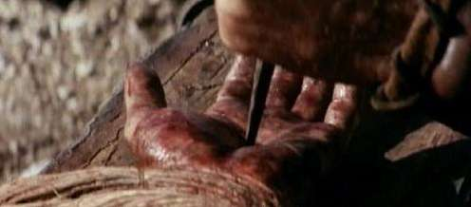
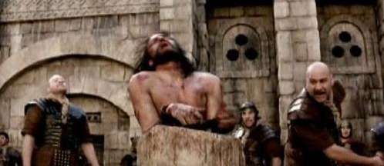
Christ’s Blood in Prophecy
Isaiah 53 – 750 years before Christ!
Surely our griefs He Himself bore, And our sorrows He carried…
He was pierced through for our transgressions, He was crushed for our iniquities;
The chastening for our well-being fell upon Him, And by His scourging we are healed.
6 All of us like sheep have gone astray, Each of us has turned to his own way;
But the LORD has caused the iniquity of us all To fall on Him.
Notes:
1

Slide 35
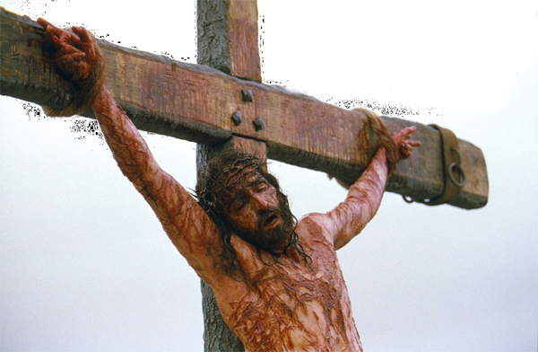
Christ’s Blood in Prophecy
Isaiah 53 – 750 years before Christ!
8 He was cut off out of the land of the living For the transgression of my people, to whom the stroke was due
10 But the LORD was pleased To crush Him, putting Him to grief; the Righteous One, My Servant, will justify the many, As He will bear their iniquities.
12 He poured out Himself to death, And was numbered with the transgressors; Yet He Himself bore the sin of many, And interceded for the transgressors.
Notes:
1

Slide 36
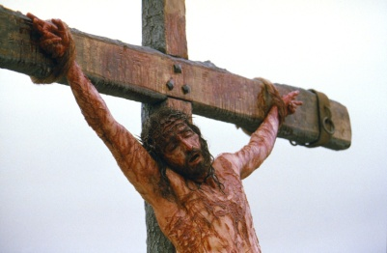
Christ’s Sacrifice
OT Fulfillment
SINS
1 Pet 1:18-19, Mt 5:17
A Judicial Death
1 Pet 2:24
Sin Bearer
REPRESENTATIVE DEATH
2 Cor 5:21
INNOCENT SACRIFICE
Reconciliation
SINNER
SANCTIFIED
Col 1:22
Removes Sin
DEATH
Rom 6:6
Heb 9:22 …without the shedding of blood there is no remission.

Slide 37
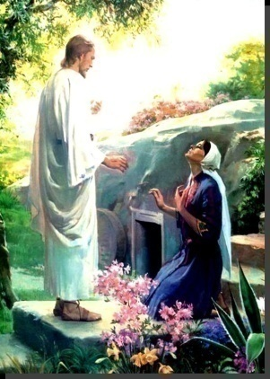
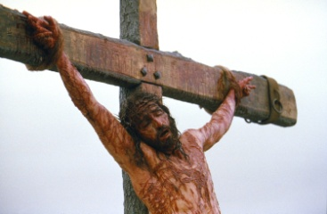
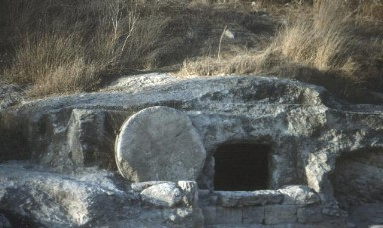
“…who [Christ],
was declared the Son of God
with power by the resurrection
from the dead…” Romans 1:4
DEATH & BURIAL
RESURRECTION!

Slide 38
Propitiation – By Faith
Romans 3:23-25
for all have sinned, and fall short of the glory of God; being justified freely by his grace through the redemption that is in Christ Jesus: whom God set forth to be a propitiation, through faith, in his blood...
SINS
REPRESENTATIVE DEATH
DEATH
Heb 9:22 …without the shedding of blood there is no remission.
Notes:
<TR> Who died?

Slide 39
Christ’s Sacrifice – Who Died?
1 Peter 2:24
He Himself bore our sins in His body on the cross, that we might die to sin.
SINS
1 Peter 1:18-19
you were redeemed with precious blood, as of a lamb unblemished and spotless, the blood of Christ.
Romans 6:8
Our old self was crucified with Him,
That our body of sin might be done away with.
JUDICIAL
DEATH
REPRESENTATIVE DEATH
DEATH
Heb 9:22 …without the shedding of blood there can be no forgiveness

Slide 40
The Death of the Believer
2 Tim 2:11 – “died with Him”
Gal 2:20 – “crucified with Christ”
2 Cor 5:14 – “all died”
Christ’s death results in the death of the believer!
Notes:
Notice these are things written by Christians referring to a point in time in the past where they died with Christ (past tense)

Slide 41
Our sins can not and will not be forgiven
UNLESS:
We have died with Christ
We have been united with Christ in His death
We have been crucified with Christ
We have died to sin
This is according to the scheme of redemption for “without the shedding of blood
there is no forgiveness of sins.”
Notes:
Whew all this death – the death of the believer!

Slide 42
The fundamental question of the gospel is:
When?
Or How?
At what point in my faith . . .
do I die to sin?
do I die with Christ?
When does God view me as . . .
uniting with Christ in his death?
crucified with Christ?
Notes:
Now if you ask this to people today you get a lot of different answers. Why? Different gospels. Believe? (James says No) Pray?
Do you suppose that God would put in place the scheme of redemption and have millions of animals killed over thousands of years just to prepare the way for His son (the Lamb of God) and then have Christ go through the anguish, suffering, and cruel death on the cross – to die in my place – and then leave us in confusion as to where Christ’s death became mine! Can you believe it.
The confusion doesn’t come from God. It comes from man.
We need a Bible answer, not an answer based on human reasoning, traditon, or human emotion. We want God to answer the question and we want to accept His answer.
<TR> Let’s go to the book

Slide 43
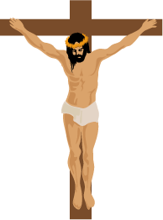
ROMANS
6:1-6
INTO DEATH
NEW LIFE
United with Christ in the
likeness of His death
Notes:
Ro 6:1-6
1 What shall we say then? Shall we continue in sin that grace may abound?
2 Certainly not! How shall we who died to sin live any longer in it?
3 Or do you not know that as many of us as were baptized into Christ Jesus were baptized into His death?
4 Therefore we were buried with Him through baptism into death, that just as Christ was raised from the dead by the glory of the Father, even so we also should walk in newness of life.
5 For if we have been united together in the likeness of His death, certainly we also shall be in the likeness of His resurrection,
6 knowing this, that our old man was crucified with Him, that the body of sin might be done away with, that we should no longer be slaves of sin.

Slide 44
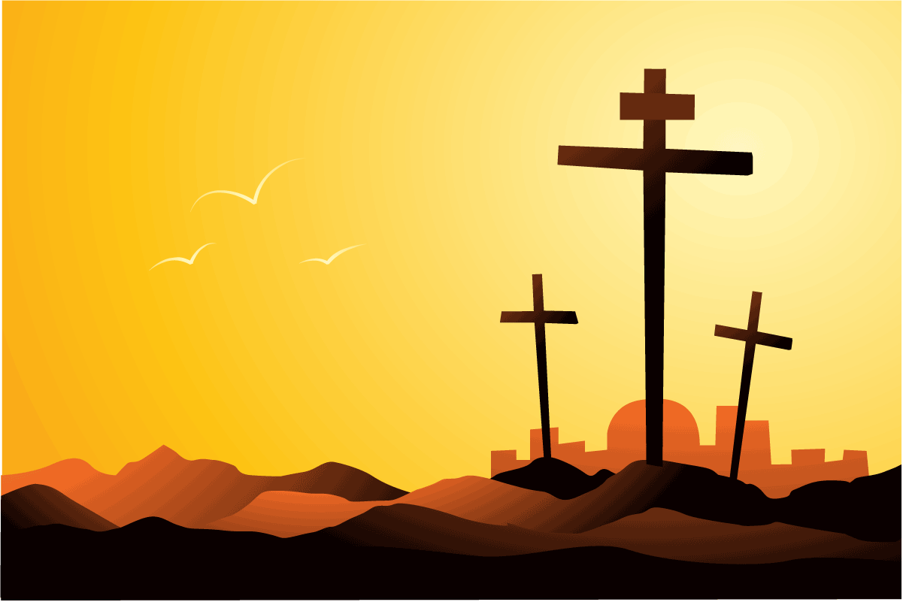

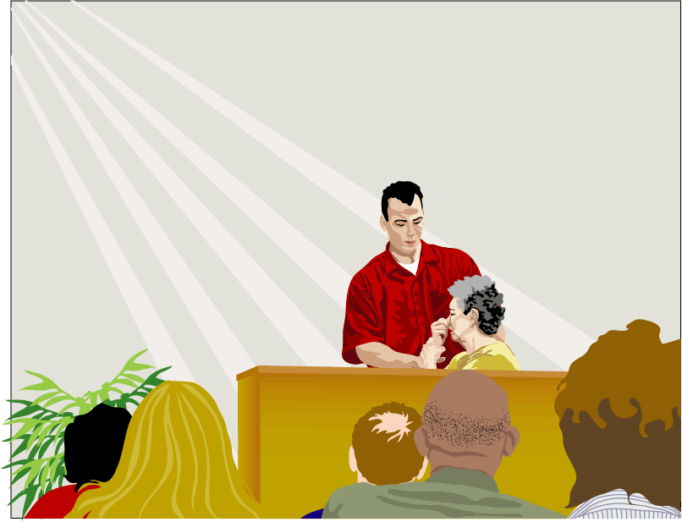
Have you died with Christ?
Notes:
Won’t you accept the promise and gift of God’s son today? And be baptized for the remission of your sins by faith in the blood of Christ.
If you believe in Christ and have faith in His blood, and are willing to repent of your sins and confess His name… then you are ready to die with Him and have your sins removed, and enter His kingdom and live a life of faithful loving obedience to Christ as king and have every confidence that you will spend eternity in heaven.
But if you reject this gift there will be no hope for you… there is no other basis on which God will forgive sin…nothing but the blood of Jesus.
In the Seychelles a couple of years ago a young man responded to the gospel message and as we were about to immerse him in the Indian Ocean he looked up at me and said, “It is a good day to die.” He got the message. Did you?

