Slide 1
Welcome to our services
New Lebanon Church of Christ
We are Simply Christians.
Our Emphasis is Spiritual, Not Material or Social.
We are striving to be The Same Church as Described in The New Testament.
Please Come Back Again

Slide 2
Luke 18:9 Also He spoke this parable to some who trusted in themselves that they were righteous, and despised others:

Slide 3
The Sin Of Self-Righteousness
Self-Righteousness
A moral self-confidence and superiority arising from satisfaction in one’s own achievements.
- hypocrisy

Slide 4
The Sin Of Self-Righteousness
Luke 18:9 Also He spoke this parable to some who trusted in themselves that they were righteous, and despised others:
10 "Two men went up to the temple to pray, one a Pharisee and the other a tax collector.
11 "The Pharisee stood and prayed thus with himself, 'God, I thank You that I am not like other men--extortioners, unjust, adulterers, or even as this tax collector.
12 'I fast twice a week; I give tithes of all that I possess.'
13 "And the tax collector, standing afar off, would not so much as raise his eyes to heaven, but beat his breast, saying, 'God, be merciful to me a sinner!'
14 "I tell you, this man went down to his house justified rather than the other; for everyone who exalts himself will be humbled, and he who humbles himself will be exalted."

Slide 5
PARABLE OF THE TWO SONS
Matthew 21
Matthew 21
“²⁸But what think ye? A certain man had two sons; and he came to the first, and said, Son, go work to day in my vineyard . . .”

Slide 6
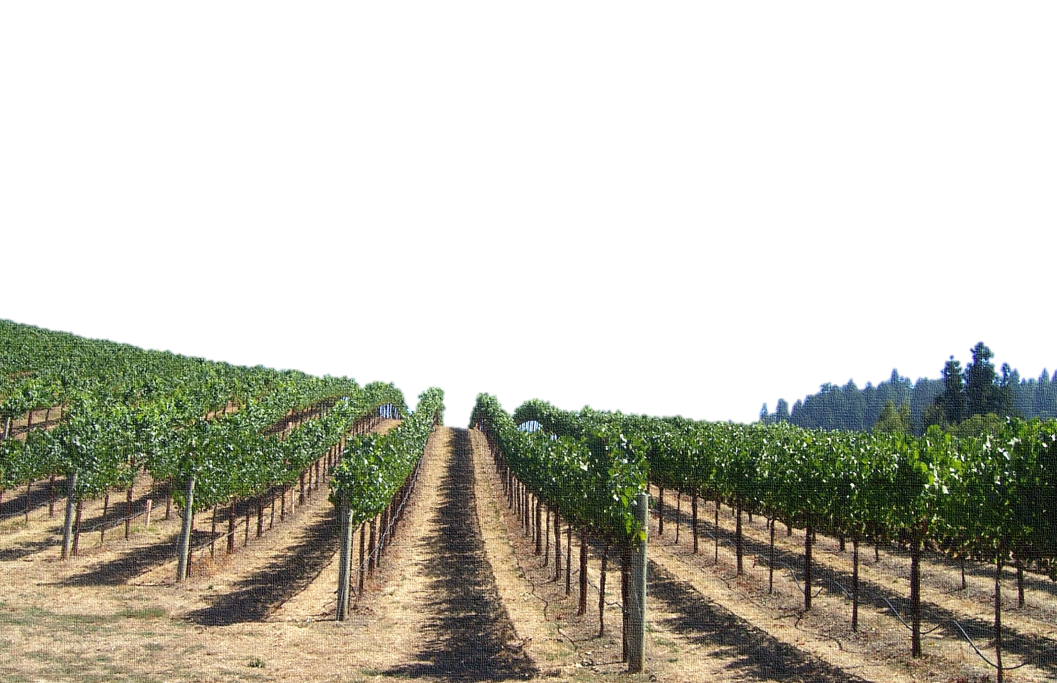
Matthew 21
“²⁹He answered and said, I will not: but afterward he repented, and went. ³⁰And he came to the second, and said likewise. And he answered and said, I go, sir: and went not. ³¹Whether of them twain did the will of his father? ”

Slide 7
Matthew 21
“³¹. . . They say unto him, The first. Jesus saith unto them, Verily I say unto you, That the publicans and the harlots go into the kingdom of God before you. ³²For John came unto you in the way of righteousness, and ye believed him not: but the publicans and the harlots believed him: and ye, when ye had seen it, repented not afterward, that ye might believe him.”
PUBLICANS AND HARLOTS—
“These chief priests, elders, and scribes among the Jews looked upon publicans and harlots as the vilest of earth and beneath their attention. . . . What a stinging rebuke Jesus gave them when he said ‘the publicans and the harlots go into the kingdom of God before you.’”
A COMMENTARY ON THE GOSPEL BY MATTHEW
“Self-righteousness, self-sufficiency, or satisfaction with oneself have never commended men to God. He has placed before us a divine model in Christ Jesus; with much help and many blessings to encourage us in the work we can never feel we have come up to the model.”
A COMMENTARY ON THE GOSPEL BY MATTHEW

Slide 8
The Sin Of Self-Righteousness
Why did the publicans and the harlots enter into the kingdom of God before the Pharisees?
The class composed of publicans and harlots were conscious of sins, but the Pharisees were not, (as shown by Luke’s account of the Pharisee and the publican Luke 18:9ff), indicating that no sin is greater than being conscious of none.
(2) The publicans and sinners heard him (Luke 15:1), but the Pharisees refused to hear. (3) They believed him (Matt. 21:32). (4) They repented. (5) They were baptized (Luke 3:12; 7:29, 30). If the Pharisees had been willing to do this, they too might have entered into the kingdom.

Slide 9
The Sin Of Self-Righteousness
In the very next words, Christ shows how they failed.
Matt. 21:32 "For John came to you in the way of righteousness, and you did not believe him; but tax collectors and harlots believed him; and when you saw it, you did not afterward repent and believe him.

Slide 10
PARABLE OF THE
Wicked Husbandman
Luke 20:9-16

Slide 11
Luke 20
“⁹Then began he to speak to the people this parable;
A certain man planted a vineyard, and let it forth to husbandmen, and went into a far country for a long time. ¹⁰And at the season he sent a servant to the husbandmen, that they should give him of the fruit of the vineyard: but the husbandmen beat him, and sent him away empty.”
PHOTO: Wikimedia / Public Domain

Slide 12
Luke 20
“¹¹And again he sent another servant: and they beat him also, and entreated him shamefully, and sent him away empty. ¹²And again he sent a third: and they wounded him also, and cast him out.”

Slide 13
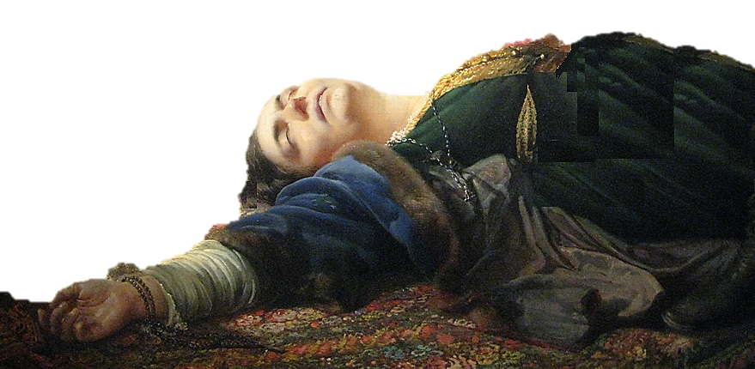
Luke 20
“¹³Then said the lord of the vineyard, What shall I do? I will send my beloved son: it may be they will reverence him when they see him. ¹⁴But when the husbandmen saw him, they reasoned among themselves, saying, This is the heir: come, let us kill him, that the inheritance may be ours.
¹⁵So they cast him
out of the vineyard,
and killed him.”
PHOTO: Wikimedia / America over 100 years old

Slide 14
Luke 20
“¹⁵. . .What therefore shall the lord of the vineyard do unto them? ¹⁶He shall come and destroy these husbandmen, and shall give the vineyard to others. And when they heard it, they said, God forbid.”
“The parable has a close connection with the events of the succeeding days of the Last Week. They sought to draw from Jesus a claim to be the Son of God, so that they could condemn him for blasphemy.”– H. Leo Boles

Slide 15
PARABLE OF THE
King’s Son
Matthew 22:1-14

Slide 16
Matthew 22
“¹And Jesus answered and spake unto them again by parables, and said, ²The kingdom of heaven is like unto a certain king, which made a marriage for his son, ³And sent forth his servants to call them that were bidden to the wedding: and they would not come.”

Slide 17
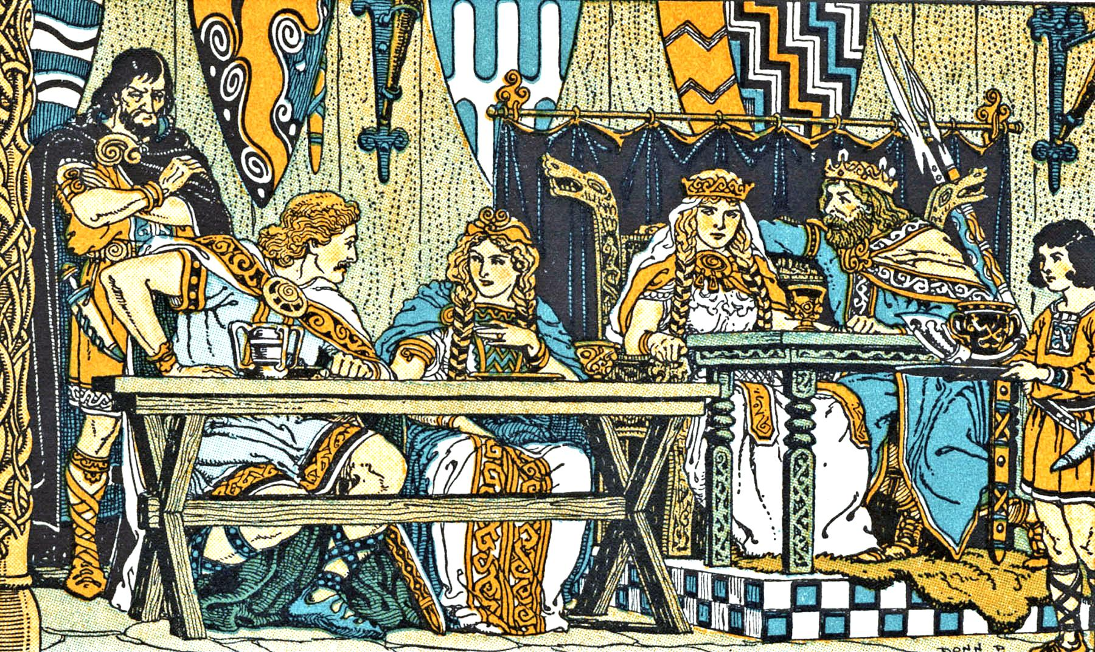
Matthew 22
“⁴Again, he sent forth other servants, saying, Tell them which are bidden, Behold, I have prepared my dinner: my oxen and my fatlings are killed, and all things are ready: come unto the marriage.”

Slide 18
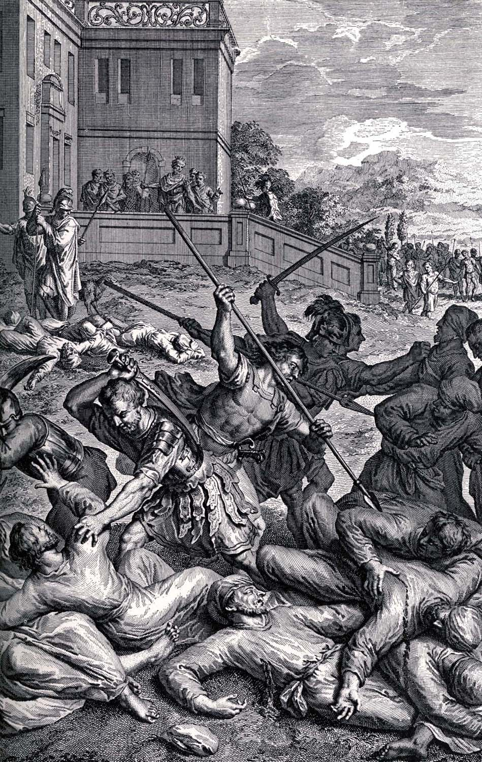
Matthew 22
“⁵But they made light of it, and went their ways, one to his farm, another to his merchandise: ⁶And the remnant took his servants, and entreated them spitefully, and slew them.”

Slide 19
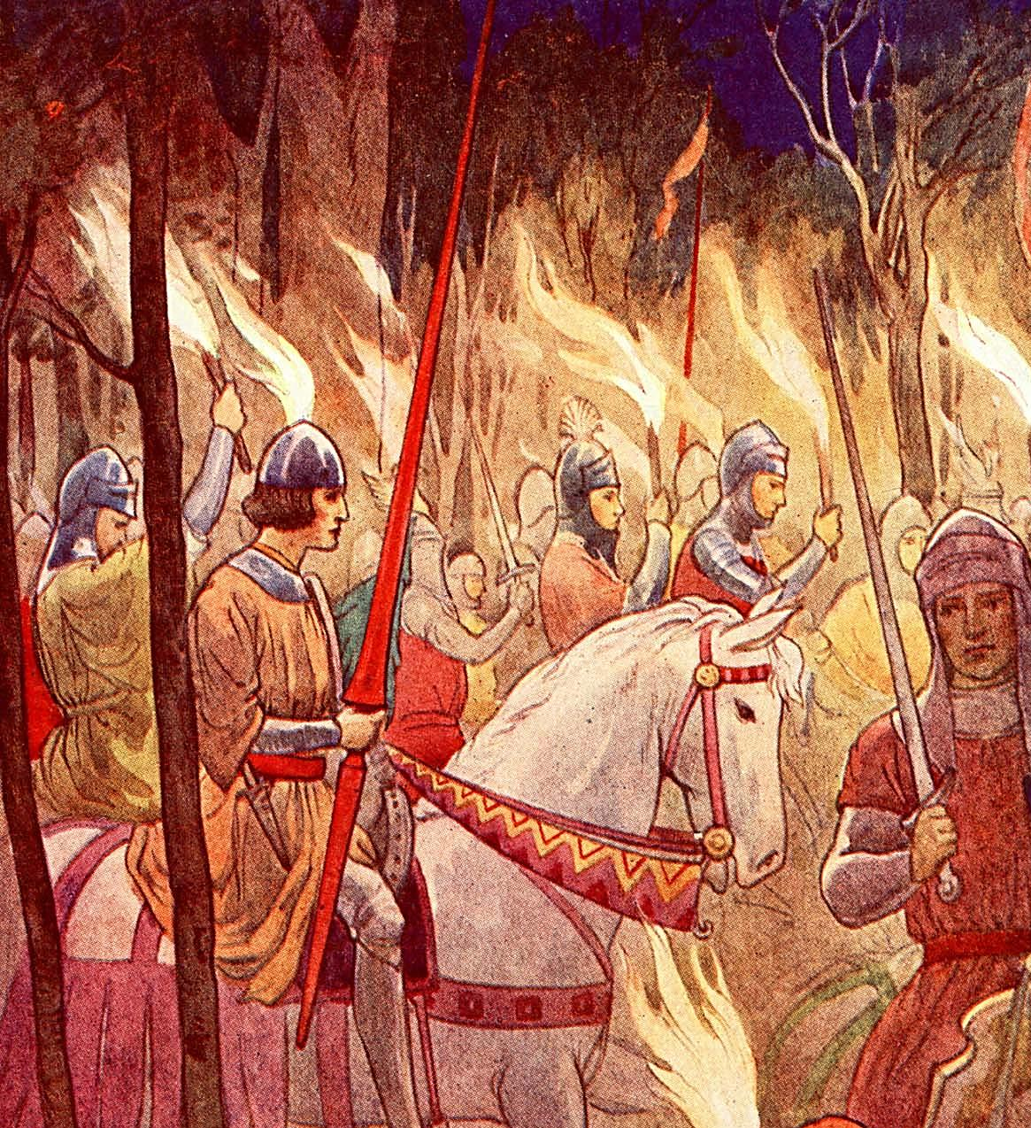
Matthew 22
“⁷But when the king heard thereof, he was wroth: and he sent forth his armies, and destroyed those murderers, and burned up their city.”

Slide 20
Matthew 22
“⁸Then saith he to his servants, The wedding is ready, but they which were bidden were not worthy. ⁹Go ye therefore into the highways, and as many as ye shall find, bid to the marriage. ¹⁰So those servants went out into the highways, and gathered together all as many as they found, both bad and good: and the wedding was furnished with guests.”

Slide 21
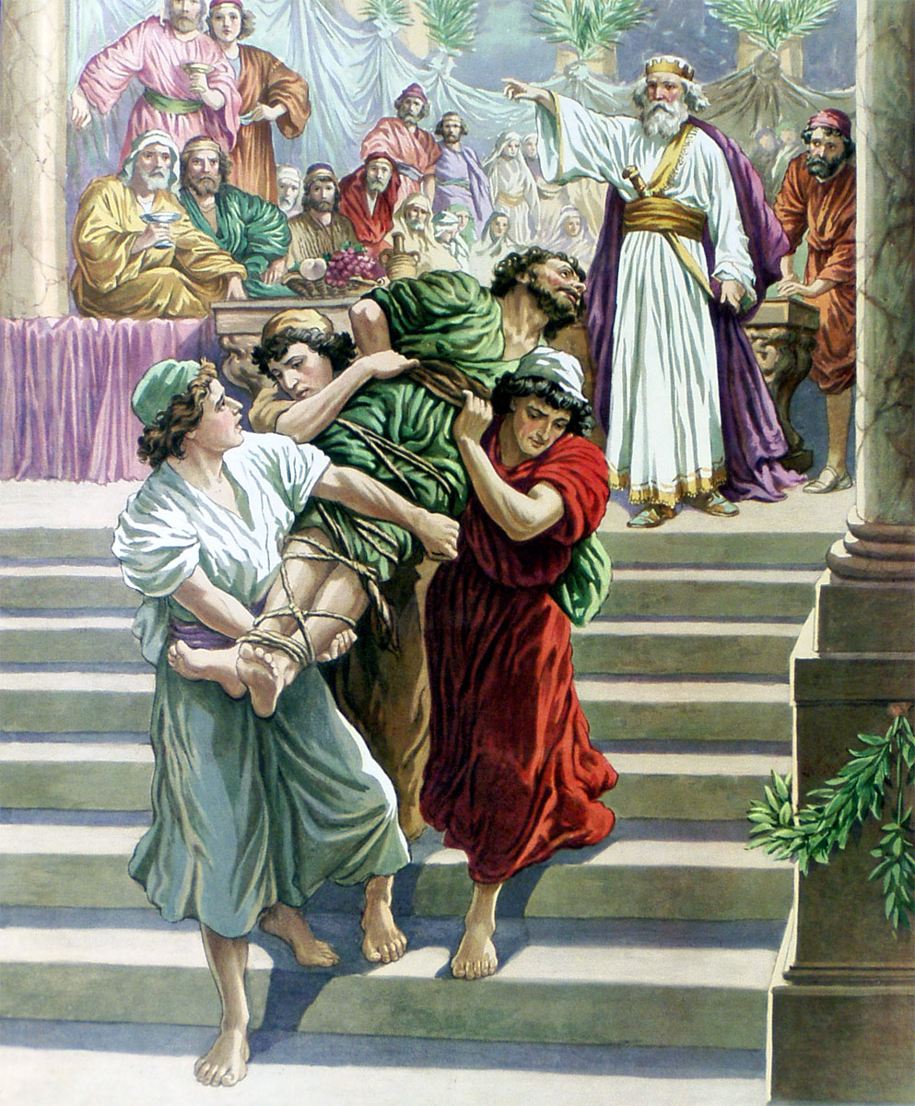
Matthew 22
“¹¹And when the king came in to see the guests, he saw there a man which had not on a wedding garment: ¹²And he saith unto him, Friend, how camest thou in hither not having a wedding garment? And he was speechless. ¹³Then said the king to the servants, Bind him hand and foot, and take him away, and cast him into outer darkness; there shall be weeping and gnashing of teeth. ¹⁴For many are called, but few are chosen.”

Slide 22
The Sin Of Self-Righteousness
“The king asked, ‘Friend, how camest thou in hither not having a wedding-garment?’ The man made no excuse, hence ‘he was speechless’; this shows that he was responsible for his unprepared condition.
“Jesus draws from the parable this conclusion, ‘For many are called, but few chosen.’ The high and the low, the good and the bad, were called to the marriage feast; all were invited, hence ‘many are called.’ Many of the Jews were called, but few accepted the call; many who accepted John’s teaching at first failed to accept the Christ when he came. Those who were first called, who slighted the invitation and insulted the king, were the Jews. . . . Those who were called from the highways may represent the Gentiles and some of them prove unworthy of the final blessings of the gospel.”

Slide 23
The call of the Gospel goes out to all the world but few are chosen to enter heaven and receive eternal life. Those who are chosen to enter will have proven themselves obedient and faithful to the Word of God.
PHOTO: Wikimedia / Public Domain / Author- Tinus Badenhorst

Slide 24
The Sin Of Self-Righteousness
Matt. 11:28 "Come to Me, all you who labor and are heavy laden, and I will give you rest.
29 "Take My yoke upon you and learn from Me, for I am gentle and lowly in heart, and you will find rest for your souls.
30 "For My yoke is easy and My burden is light."

Slide 25
The Sin Of Self-Righteousness
Matt. 22:14 "For many are called, but few are chosen.“
Eph. 1:4 just as He chose us in Him before the foundation of the world, that we should be holy and without blame before Him in love,
2Thess. 2:13 ¶ But we are bound to give thanks to God always for you, brethren beloved by the Lord, because God from the beginning chose you for salvation through sanctification by the Spirit and belief in the truth,

Slide 26
The Sin Of Self-Righteousness

Slide 27
Are You A New Testament Christian?
Hear the Gospel (Rom.10:14).
Believe the Gospel (Heb. 11:6).
Repent of Sins (Acts 3:19).
Confess Christ (Rom.10:9).
Be Baptized Into Christ (1 Cor.12:13).
1 Timothy 4:16
“Take heed unto thyself, and unto the doctrine; continue in them: for in doing this thou shalt both save thyself, and them that hear thee.”

