Slide 1
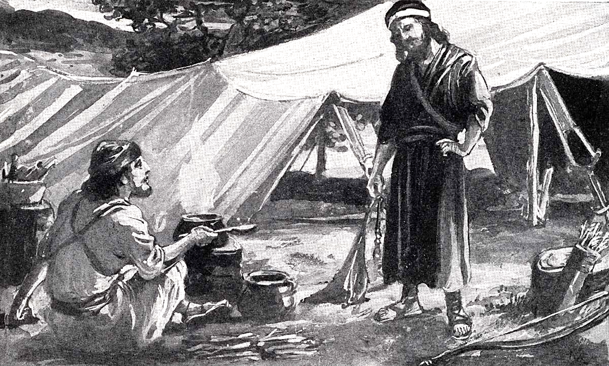
Jacob and Esau Gen. 25-35
Genesis 25:29 Now Jacob cooked a stew; and Esau came in from the field, and he was weary.
30 And Esau said to Jacob, "Please feed me with that same red stew, for I am weary." Therefore his name was called Edom.

Slide 2
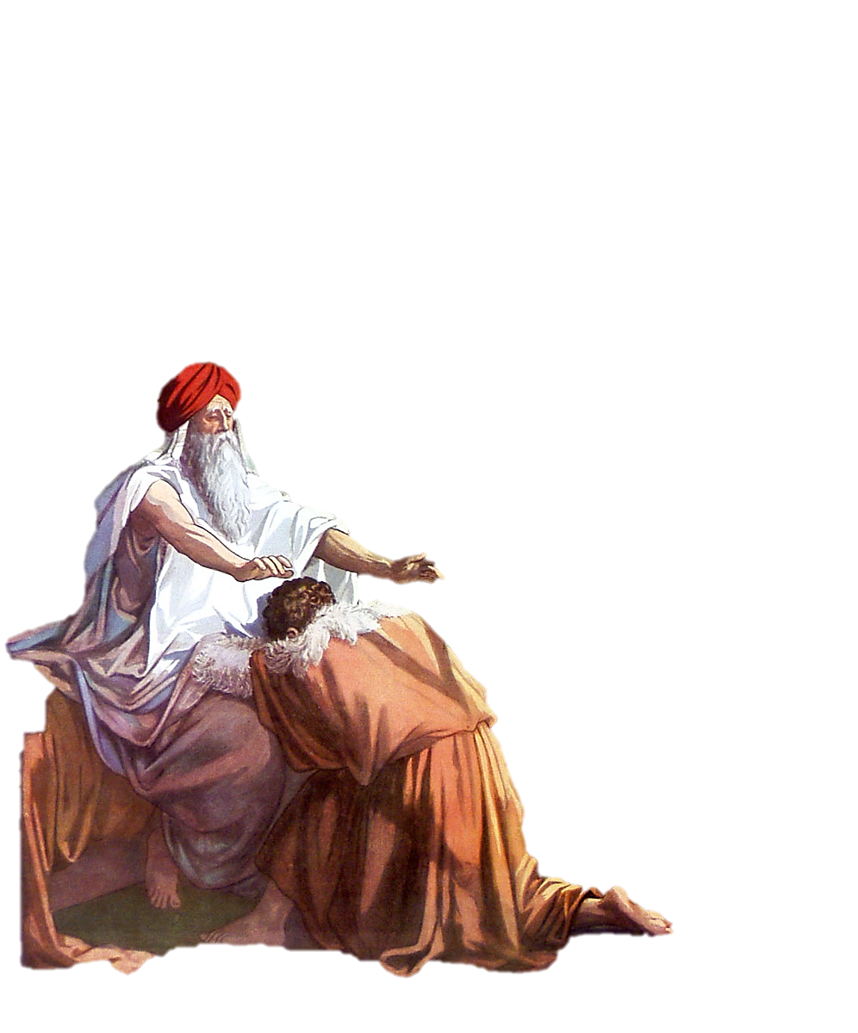
Jacob and Esau Gen. 25-35

Slide 3
Adam
Noah
Abraham
Isaac
Jacob & Esau
Job
Joseph
Moses
Joshua, Judges, Ruth
Samuel
Saul, David, Solomon
Divided Kingdom
Elijah & Elisha
Jonah
Northern Kingdom/Israel taken into Assyrian Captivity
Southern Kingdom/Judah taken into Babylonian Captivity
Daniel & Ezekiel in Babylon
Persia takes Babylon – becomes world power
Return to Canaan begins – rebuilding of the temple / Ezra
Esther Persian Queen
More Jews return – rebuilding of the wall / Nehemiah
Malachi
TIMELINE OF THE OLD TESTAMENT
The accounts of Jacob and Esau are in the book of Genesis in the Patriarchal Age.
It is important to understand how God communicated to man in each age of the Bible to read it in the proper context.

Slide 4
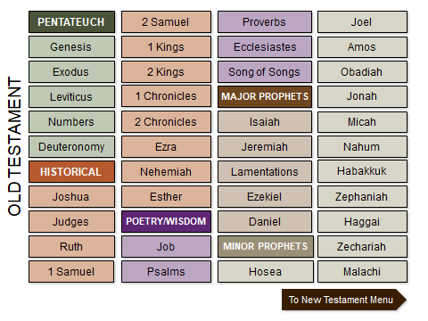

Slide 5
Abraham to the Sojourn in Egypt
Joseph (c. 1914-1805)
Abraham (c. 2166-1991)
Abrahamic Covenant
Job (Dates unknown)
Ishmael (c. 2080-1943)
BIBLE HISTORY
Isaac (c. 2066-1886)
Jacob (Israel) (c. 2005-1859)
Jacob flees to Haran (c. 1929)
Earliest forms of writing (cuneiform) (c. 3200)
Sumer
First Ziggurats built by Ur-Nammu (c. 2112-2095)
WORLD HISTORY
City of Ur falls (c. 2004)
Old Kingdom pyramids built (c. 2700-2200)
Egypt
Middle Kingdom, 11-12th Dynasty (c. 2050-1800)
MIDDLE EAST HISTORY
2200 BC 2100 BC 2000 BC 1900 BC
Notes:
Some scholars place Abraham’s birth at 1952 BC. In this case, biblical events through Joseph would slide to the right 214 years.
c. = circa (approximate date). The green bars indicate time span. These time line slides display Bible history, World history, and Middle East history side by side.

Slide 6
Patriarchal Period
Life of Jacob
Jacob marries Leah and Rachel Gen 28:10–29:30
Jacob’s Children Gen 29:31–30:24
Jacob leaves Laban Gen 30:25–32:2
Jacob faces Esau Gen 32:3–32
Jacob wrestles with God Gen 32:22–32
Jacob and Esau make peace Gen 32:13–21; 36:6–8
Esau settles in Edom Gen 36:6–8
Jacob meets Esau Gen 33:1–16

Slide 7
Gen 22:17 That in blessing I will bless thee, and in multiplying I will multiply thy seed as the stars of the heaven, and as the sand which is upon the sea shore;
Abraham
Ishmael & Isaac
Isaac
Jacob & Esau
Ishmael had 12 sons
Gen 25:12-18
Jacob had 12 sons
Gen 49
Ishmaelites
Israelites
Edomites
Jacobs name changed to Israel
Esau = Edom
All descendants of father Abraham. Gen

Slide 8
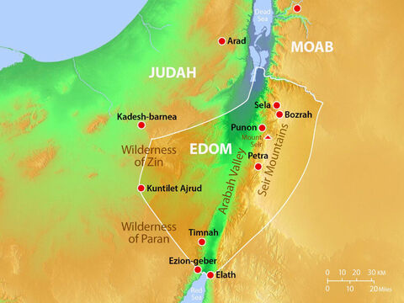

Slide 9
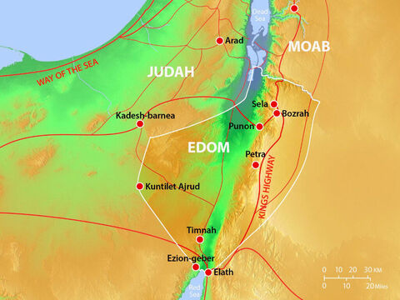

Slide 10
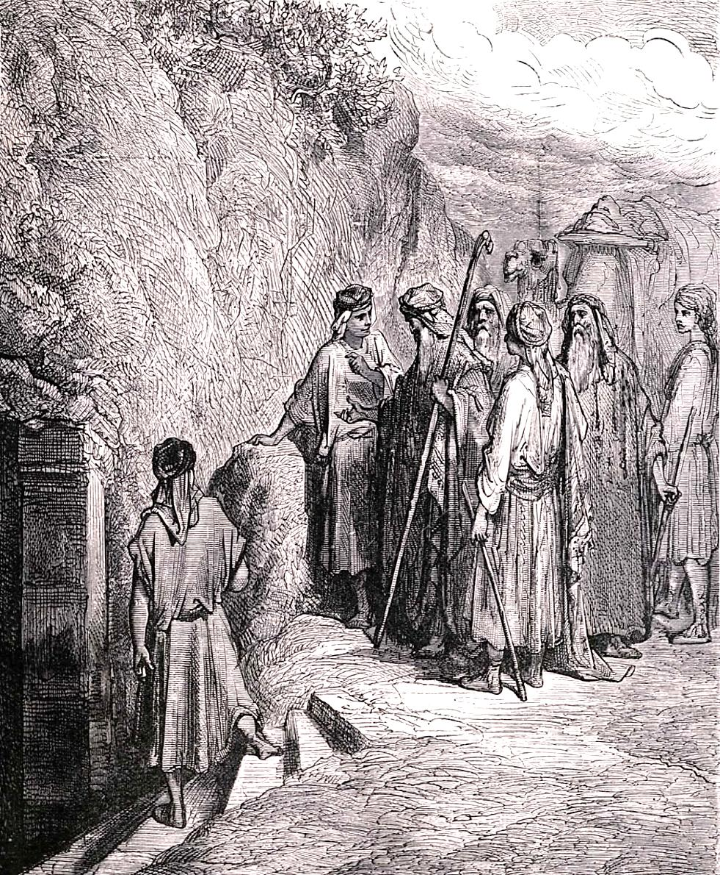
Abraham married again after the death of Sarah and had more children.
He lived to the age of 175 which was actually a young age compared to the longevity of people in previous generations, but since Noah’s flood people were living shorter and shorter lives. Adam lived 930 years, and all those before the flood lived equally long lives.
Isaac and Ishmael buried their father Abraham with Sarah in the cave of Machpelah.

Slide 11
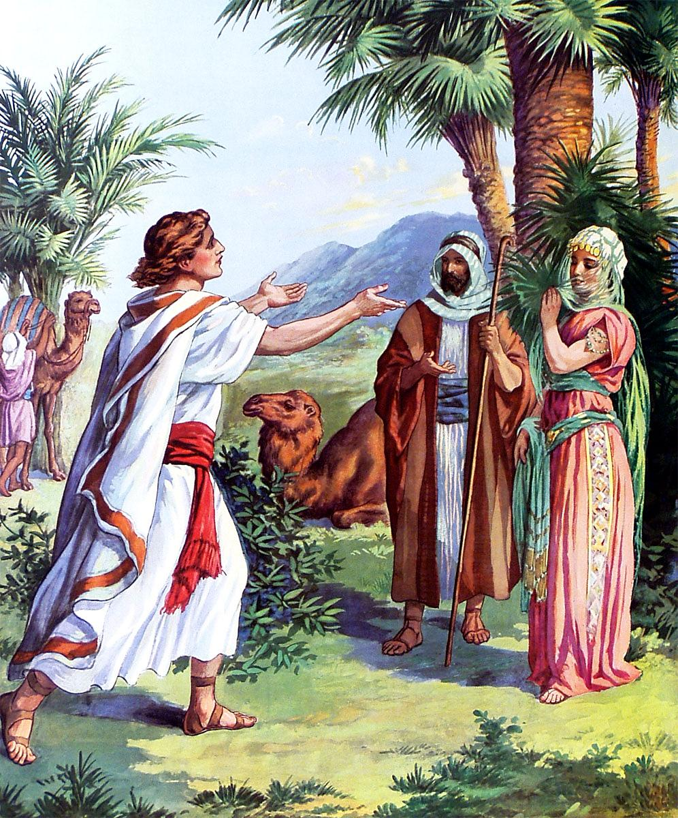
Isaac was 40 years old when he and Rebekah married.

Slide 12
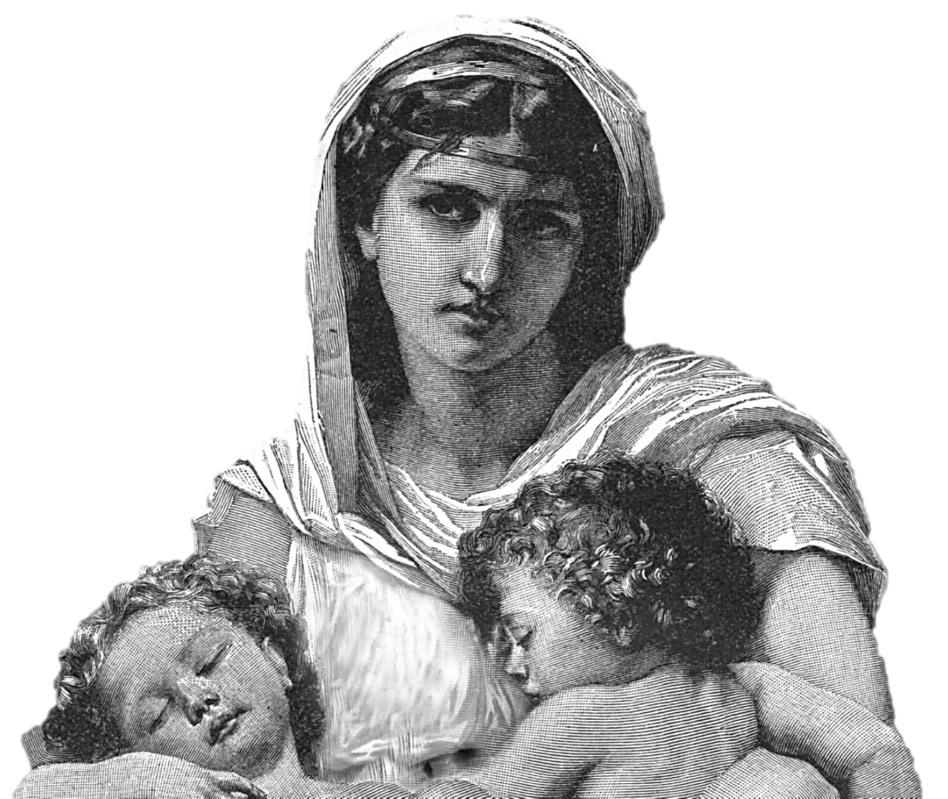
She was barren for 20 years.
Isaac entreated the Lord for her, and she brought forth twins, Jacob and Esau.
Esau was born first. He was red and hairy all over like a garment.

Slide 13
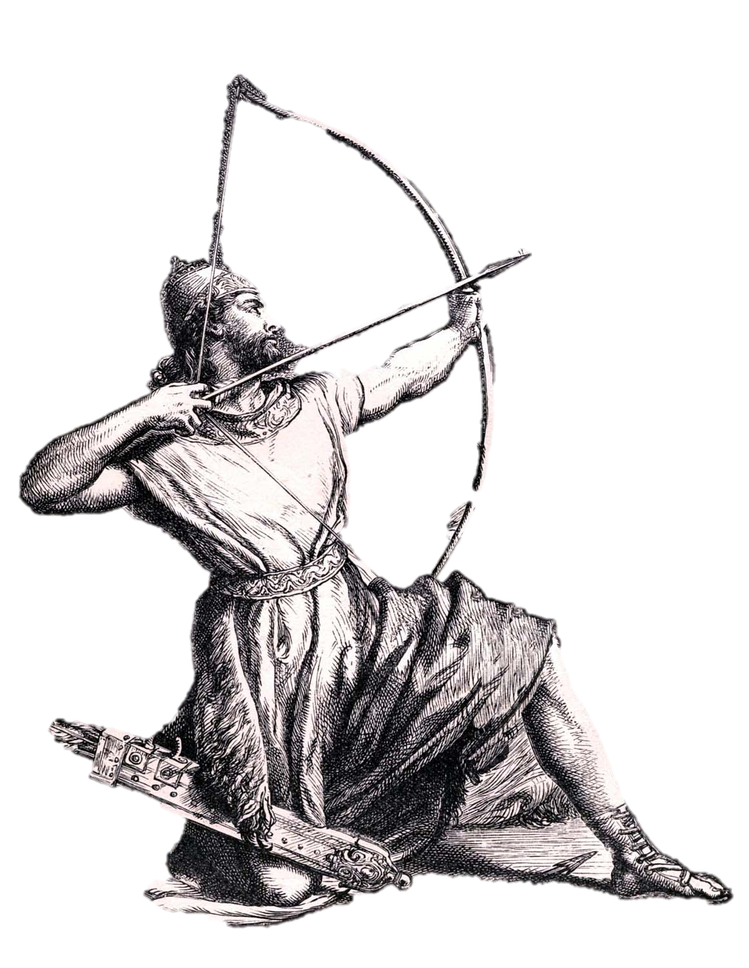
Esau was a cunning hunter, a man of the field. His father, Isaac, favored Esau, and loved the venison he hunted.

Slide 14
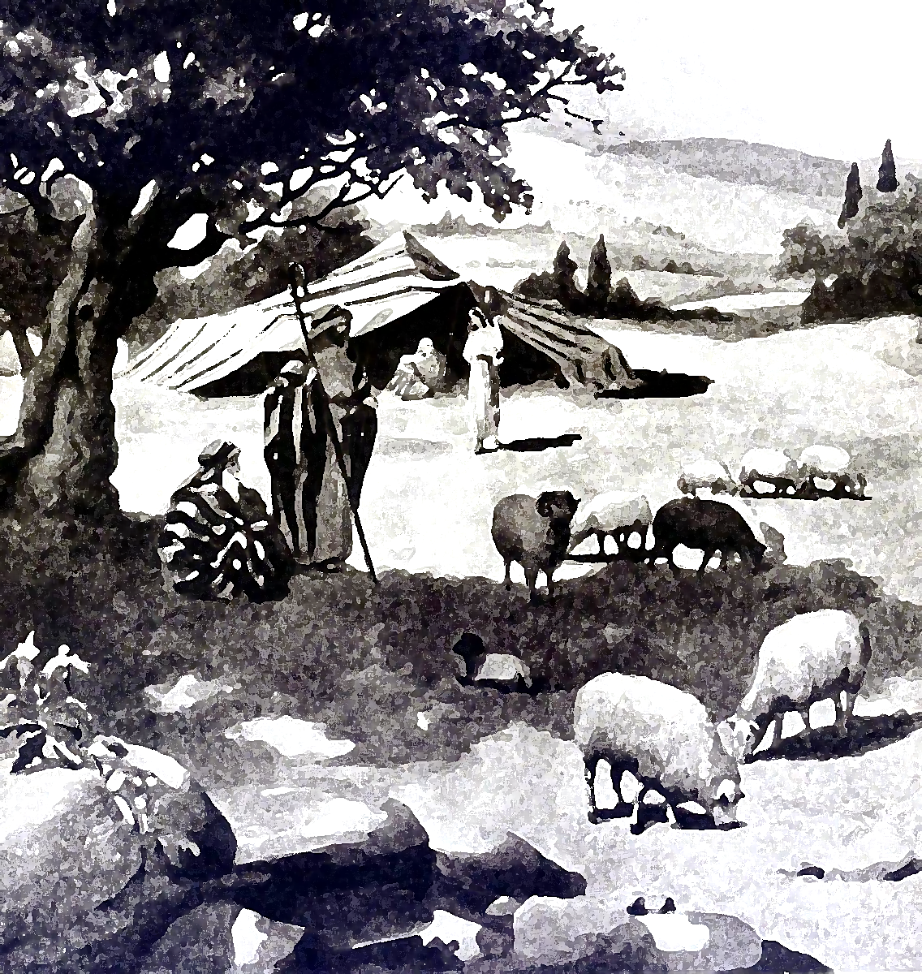
Rebekah favored Jacob, the shepherd.
This favoritism caused jealously.

Slide 15
Jacob and Esau Gen. 25-35
Genesis 25:29 Now Jacob cooked a stew; and Esau came in from the field, and he was weary.
30 And Esau said to Jacob, "Please feed me with that same red stew, for I am weary." Therefore his name was called Edom.

Slide 16
Genesis 25
“³¹And Jacob said, Sell me this day thy birthright.”
Esau swore to Jacob that he could have his birthright if Jacob would give him pottage to eat.
Genesis 25:34 says, “Esau despised his birthright.”

Slide 17
Hebrews 12:14-17
“¹⁴Follow peace with all men, and holiness, without which no man shall see the Lord: ¹⁵Looking diligently lest any man fail of the grace of God; lest any root of bitterness springing up trouble you, and thereby many be defiled; ¹⁶Lest there be any fornicator, or profane person, as Esau, who for one morsel of meat sold his birthright. ¹⁷For ye know how that afterward, when he would have inherited the blessing, he was rejected: for he found no place of repentance, though he sought it carefully with tears.”
Esau's sin. - He profanely cast away his spiritual privilege for the gratification of his palate. Ge 25:34 graphically portrays him. An example well fitted to strike needful horror into the Hebrews,
for one morsel--The smallness of the inducement only aggravates the guilt of casting away eternity for such a trifle

Slide 18
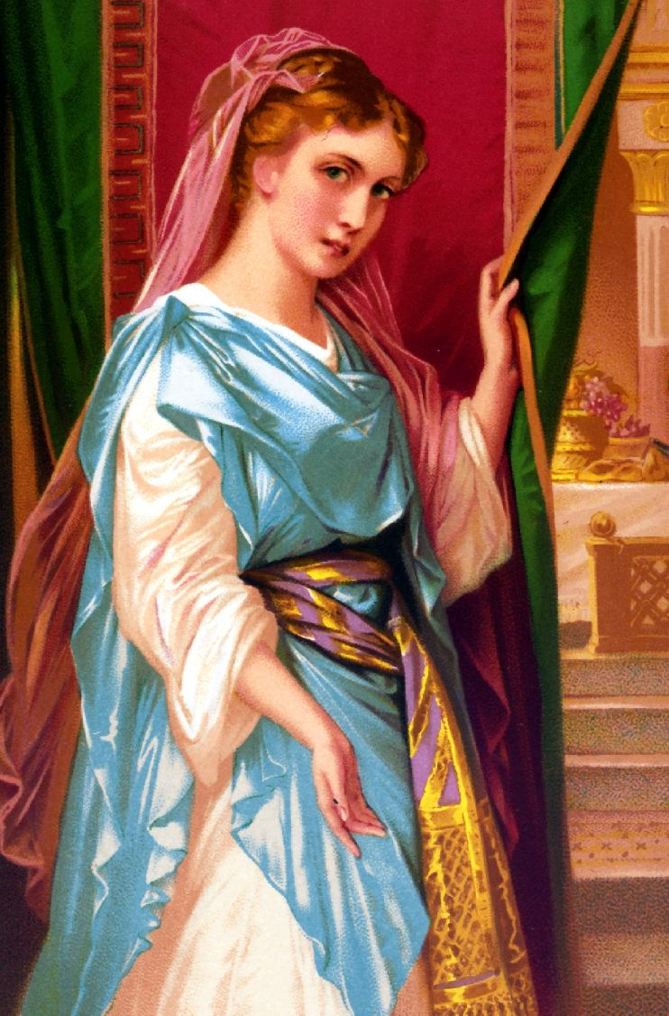
Esau had also greatly grieved his parents by his marriage, yet they had not expelled him, but made the best of it.
He married Mahalath the daughter of Ishmael (Genesis 28:9).
Abraham
Isaac Ishmael
Jacob 12 sons
Esau Mahalath

Slide 19
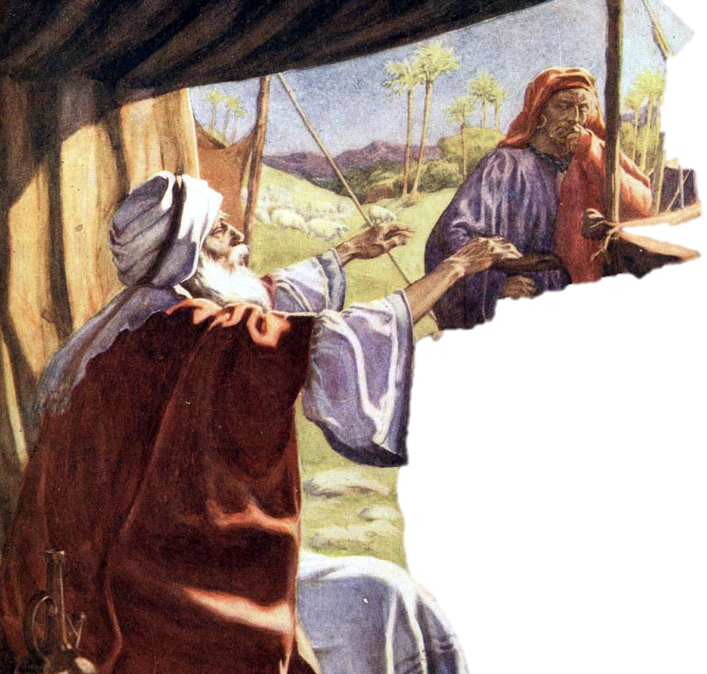
As Isaac grew old he lost his eyesight.
Rebekah used this as an opportunity to trick Isaac into giving his blessing to Jacob.

Slide 20
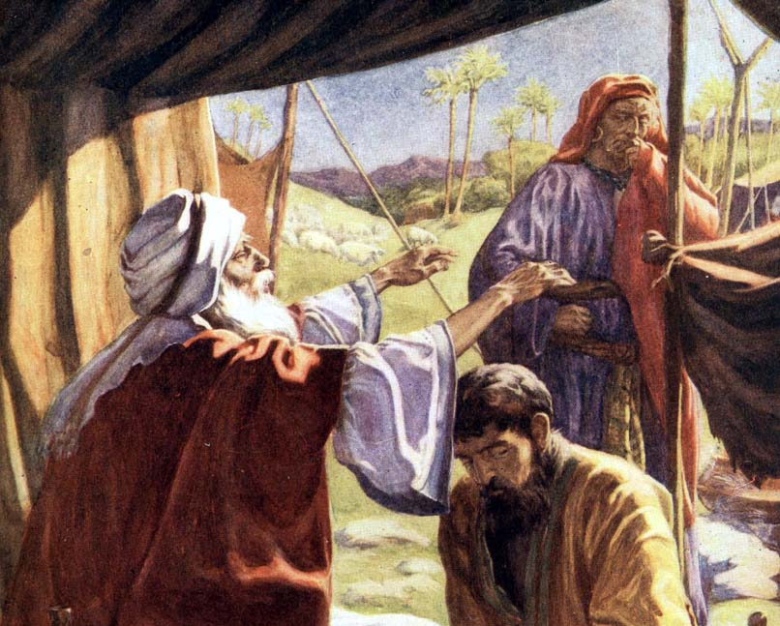
Genesis 27
“²And he said, Behold now, I am old, I know not the day of my death: ³Now therefore take, I pray thee, thy weapons, thy quiver and thy bow, and go out to the field, and take me some venison.”
Genesis 27
“⁴And make me savoury meat, such as I love, and bring it to me, that I may eat; that my soul may bless thee before I die.”
Rebekah heard Isaac give instructions to Esau so he might bless him.
She overheard her husband, Isaac, call his oldest and favorite son, Esau, to him.
Isaac loved the venison Esau often brought back from hunting and made a request and a promise to Esau.

Slide 21
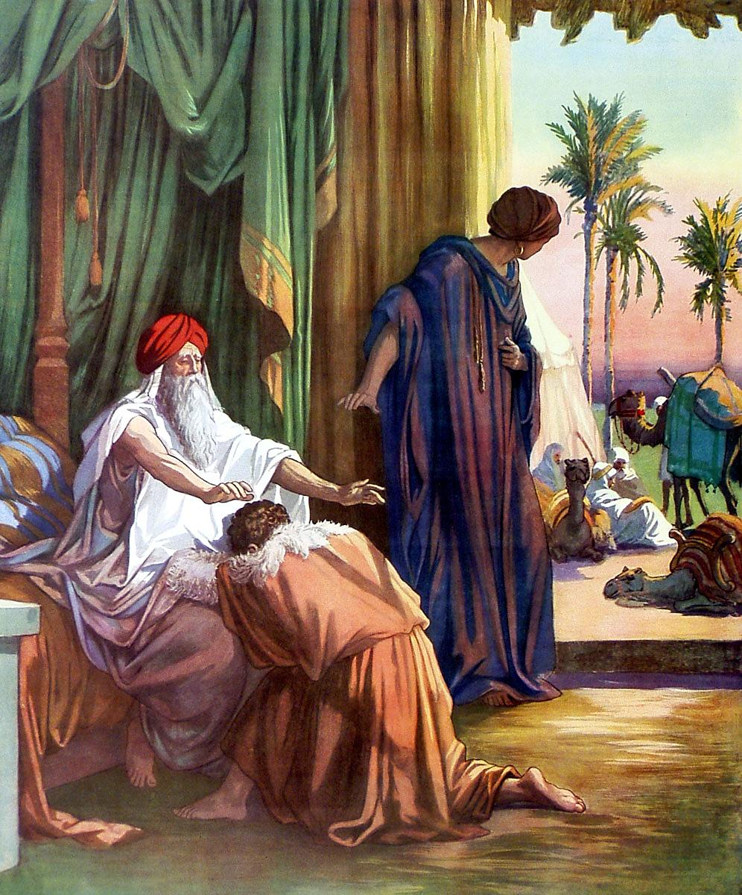
Isaac asked Jacob, “Art thou my very son Esau?” and Jacob lied and said he was Esau.
She came up with a plan to deceive her husband.
She cooked savory meat (two kids of the goats) and had Jacob take it to Isaac.
His blind father, Isaac was deceived and blessed Jacob instead of Esau.
Jacob wore Esau’s clothing and skin from the kids on his arms to appear to be Esau when Isaac touched him.

Slide 22
Rebekah’s plan worked, but it destroyed her family.

Slide 23
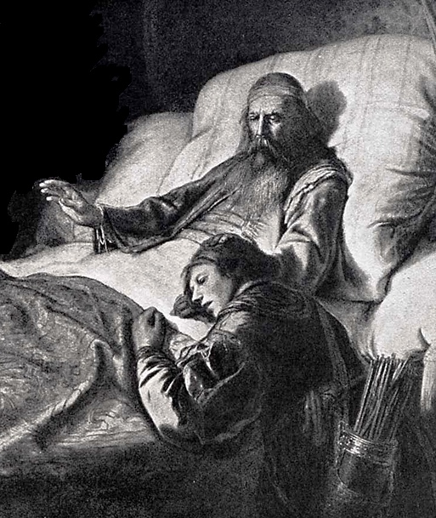
When Esau returned from hunting and heard that Jacob had stolen his blessing—
Genesis 27
“³⁶. . . he took away my birthright; and, behold, now he hath taken away my blessing. And he said, Hast thou not reserved a blessing for me?”
Esau was so angry he threatened to kill his brother.
Genesis 27
“³⁶And he said, Is not he rightly named Jacob? for he hath supplanted me these two times . . .”
Genesis 27
“³⁴. . . he cried with a great and exceeding bitter cry, and said unto his father, Bless me, even me also, O my father. ³⁵And he said, Thy brother came with subtilty, and hath taken away thy blessing.”

Slide 24
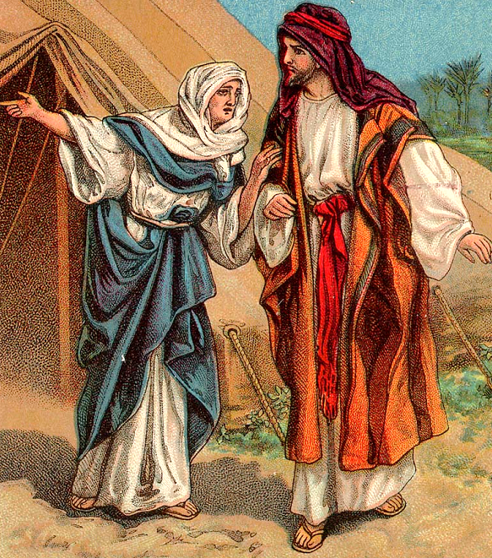
Rebekah was afraid Esau would kill Jacob so she sent Jacob away away—
Genesis 27
“⁴³Now therefore, my son, obey my voice; arise, flee thou to Laban my brother to Haran.”

Slide 25
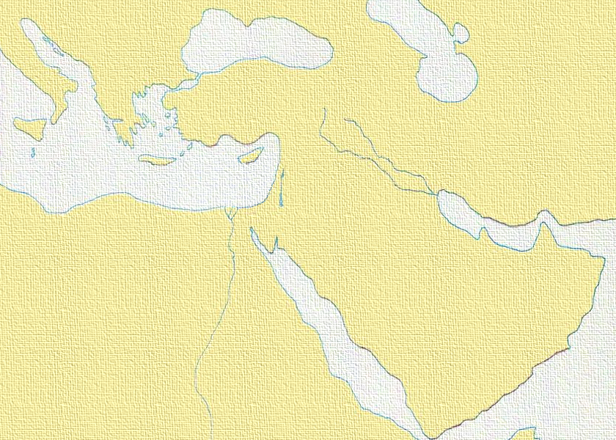
ITALY
ASIA
Haran
CANAAN
Ur
EGYPT
ARABIA
Rebecca’s son, Jacob, whom she loved enough to help betray her family, must live far, far away in Haran. She would not see his face or that of his children, and he would not be there to comfort her as she grew old. He would not even be present for her burial.

Slide 26
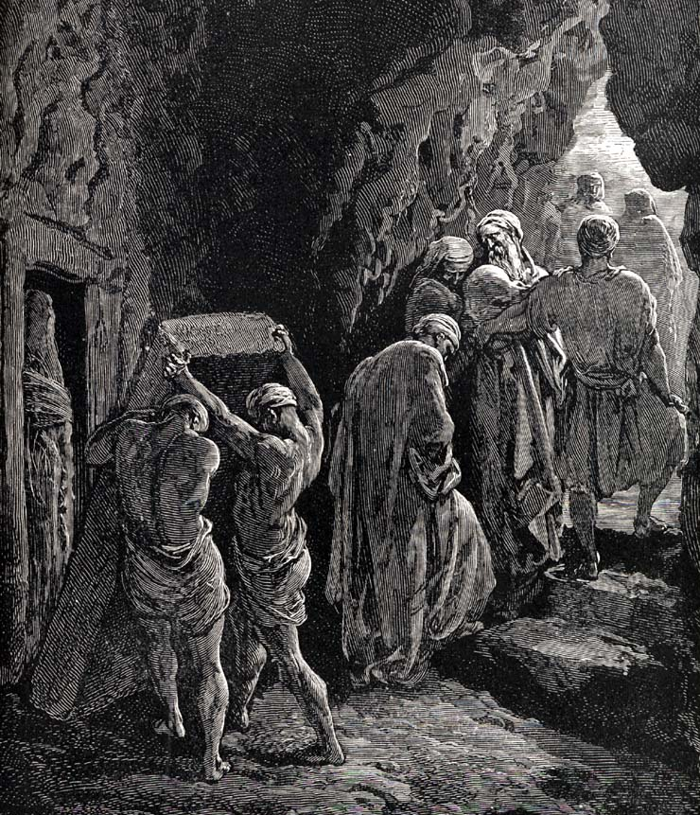
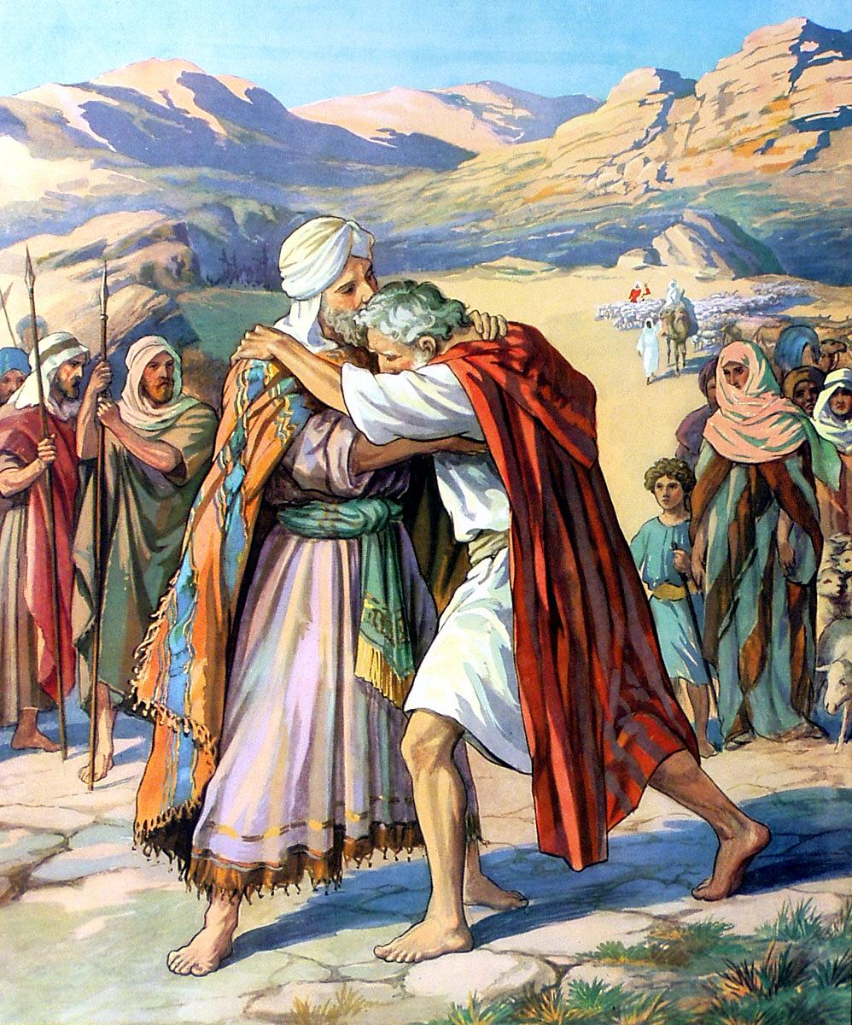
Rebekah never saw Jacob again.
She died before he returned to Canaan and was reunited with his brother.
Ironically, Isaac lived to “see” his sons forgive each other.

Slide 27
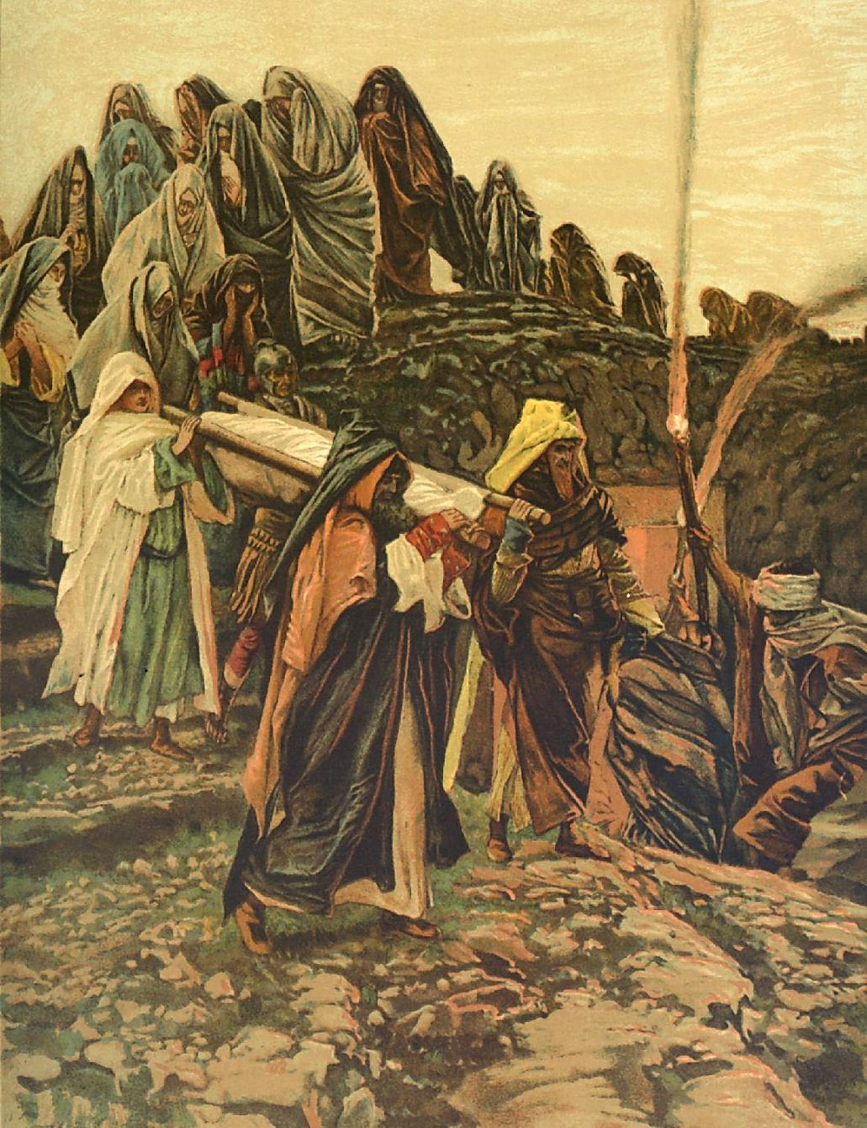
Genesis 35
“²⁹And Isaac gave up the ghost, and died, and was gathered unto his people, being old and full of days: and his sons Esau and Jacob buried him.”

Slide 28
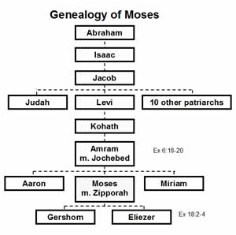
25 generations from Adam to Moses
Ishmael
Esau -----Edomites, Herods
Kings
Priests

Slide 29
What can we learn from Jacob and Esau?
love / hate
Sorrow of father, mother, son, and son
partiality
deception
reconciliation
God uses people in spite of,
not because of

