Slide 1
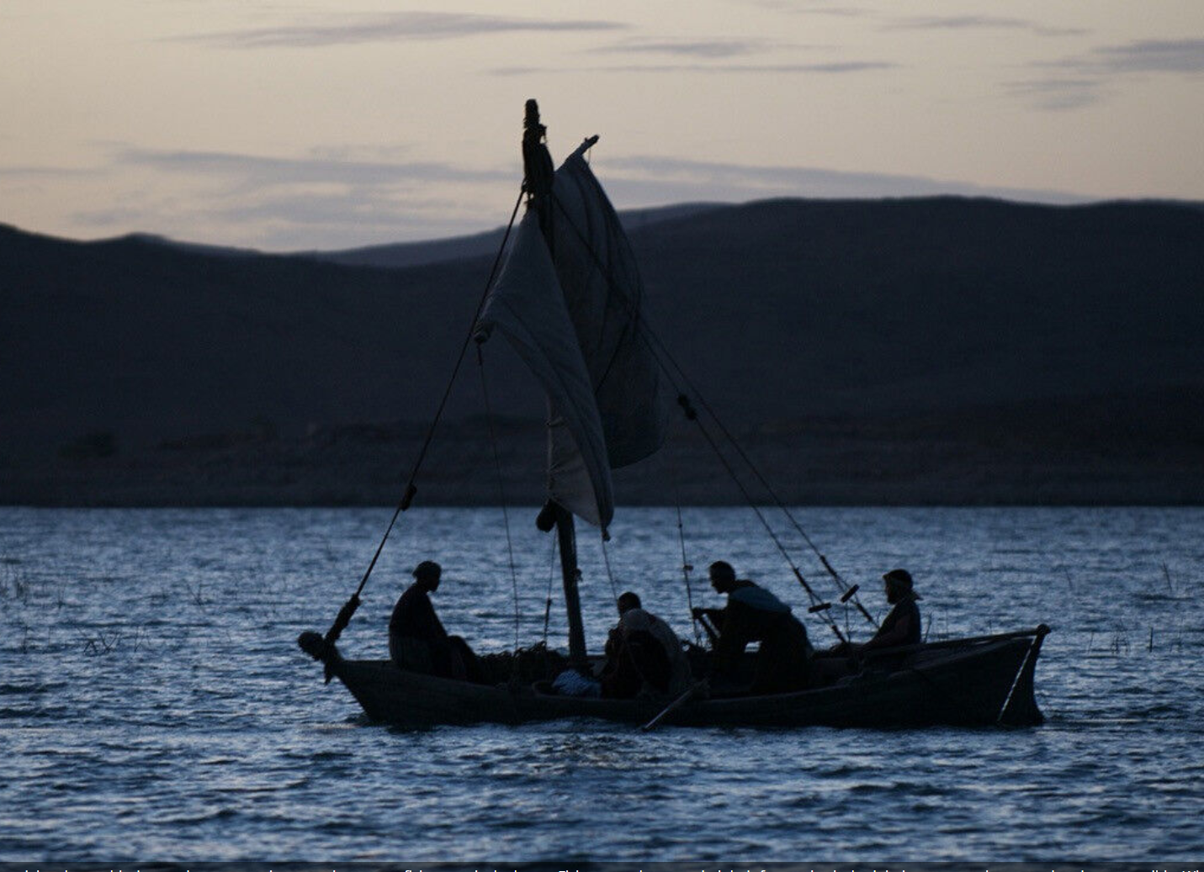
Depart From Me For I Am A Sinful Man
Luke 5:8 When Simon Peter saw it, he fell down at Jesus' knees, saying, "Depart from me, for I am a sinful man, O Lord!"
Luke 5:1-11
1

Slide 2
Depart From Me For I Am A Sinful Man
Luke 5:1-11
2

Slide 3
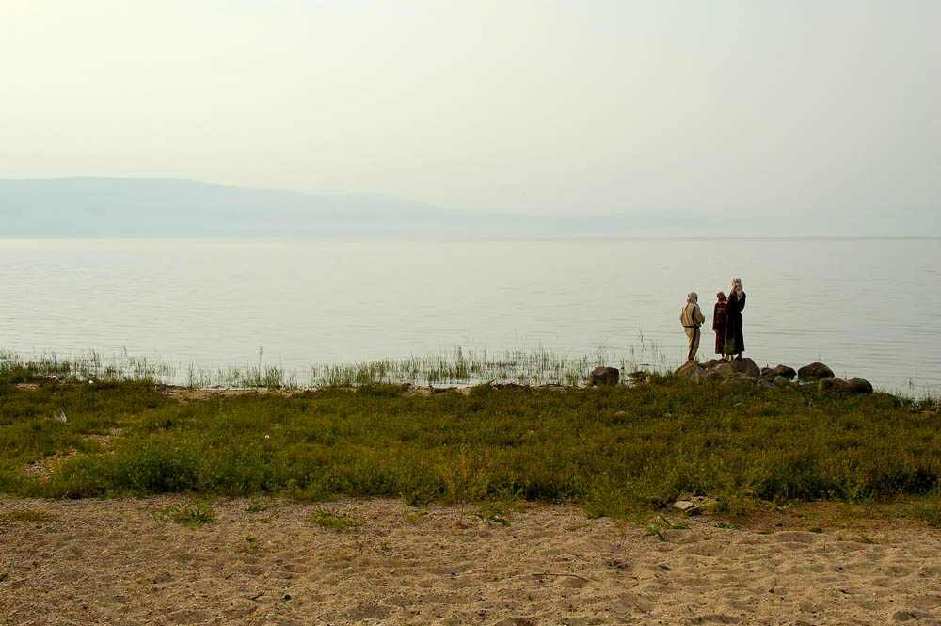
Background
Luke is the longest book in the New Testament and “is the most comprehensive and precise of the Gospels”
24 chapters, 1,151 verses
Consider , Luke and Paul wrote the majority of the New Testament
Son of Man 26 times
Humanity, he can relate to us, understand us
3
Notes:
This photograph was taken on the eastern shoreline of the Sea of Galilee.
tb040706255

Slide 4
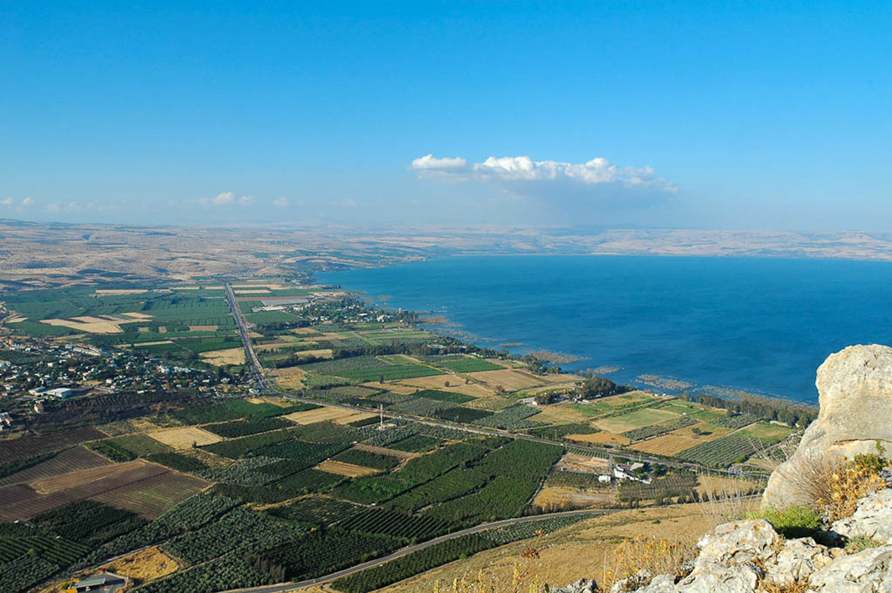
He was standing by the Lake of Gennesaret
4
Northern shoreline of the Sea of Galilee (from the southeast)
5:1
Notes:
The Lake of Gennesaret is an alternate name for the Sea of Galilee. Most of Jesus’s recorded ministry took place along the northern shore of the Sea of Galilee (shown here). This photo is looking northwest from the mountain of Arbel on the western side of the lake. See the next slide for labels.
tb053005508

Slide 5
He was standing by the Lake of Gennesaret
Capernaum
Bethsaida
Golan Heights
Mt. of Beatitudes
Plain of Gennesaret
Magdala
5
Northern shoreline of the Sea of Galilee (from the southeast)
5:1
Notes:
The Lake of Gennesaret is an alternate name for the Sea of Galilee. Most of Jesus’s recorded ministry took place along the northern shore of the Sea of Galilee (shown here). This photo is looking northwest from the mountain of Arbel on the western side of the lake.
tb053005508

Slide 6
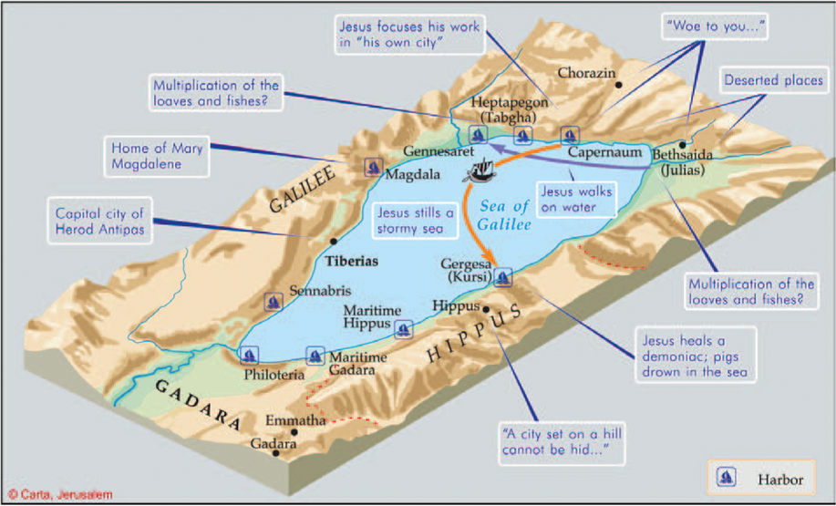
1. Sea of Chinnereth (Num 34:11; Josh 12:3; 13:27)
2. Sea of Gennesaret (Luke 5:1; Josephus, Antiquities 13)
3. Sea of Tiberias (John 6:1; 21:1)
4. Sea of Galilee (Matt 4:18)
6

Slide 7
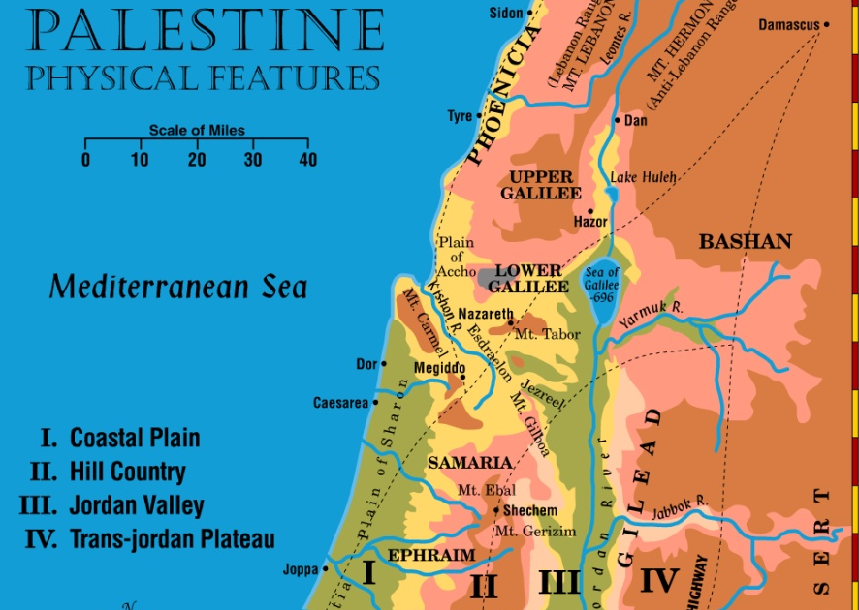
Way Of The Sea
Way Of Shur
King’s Highway
Asia and Africa

Slide 8
Depart From Me For I Am A Sinful Man
Events leading up to our story –
Luke 4:40 When the sun was setting, all those who had any that were sick with various diseases brought them to Him; and He laid His hands on every one of them and healed them.
41 And demons also came out of many, crying out and saying, "You are the Christ, the Son of God!" And He, rebuking them, did not allow them to speak, for they knew that He was the Christ.
42 Now when it was day, He departed and went into a deserted place. And the crowd sought Him and came to Him, and tried to keep Him from leaving them;
43 but He said to them, "I must preach the kingdom of God to the other cities also, because for this purpose I have been sent."
44 And He was preaching in the synagogues of Galilee.

Slide 9
Depart From Me For I Am A Sinful Man
Luke 5:1 So it was, as the multitude pressed about Him to hear the word of God, that He stood by the Lake of Gennesaret,
2 and saw two boats standing by the lake; but the fishermen had gone from them and were washing their nets.
3 Then He got into one of the boats, which was Simon's, and asked him to put out a little from the land. And He sat down and taught the multitudes from the boat.

Slide 10
Depart From Me For I Am A Sinful Man
4 When He had stopped speaking, He said to Simon, "Launch out into the deep and let down your nets for a catch."
5 But Simon answered and said to Him, "Master, we have toiled all night and caught nothing; nevertheless at Your word I will let down the net."
6 And when they had done this, they caught a great number of fish, and their net was breaking.

Slide 11
Depart From Me For I Am A Sinful Man
Luke 5:7 So they signaled to their partners in the other boat to come and help them. And they came and filled both the boats, so that they began to sink.
8 When Simon Peter saw it, he fell down at Jesus' knees, saying, "Depart from me, for I am a sinful man, O Lord!"
9 For he and all who were with him were astonished at the catch of fish which they had taken;
10 and so also were James and John, the sons of Zebedee, who were partners with Simon. And Jesus said to Simon, "Do not be afraid. From now on you will catch men."
11 So when they had brought their boats to land, they forsook all and followed Him.
11

Slide 12
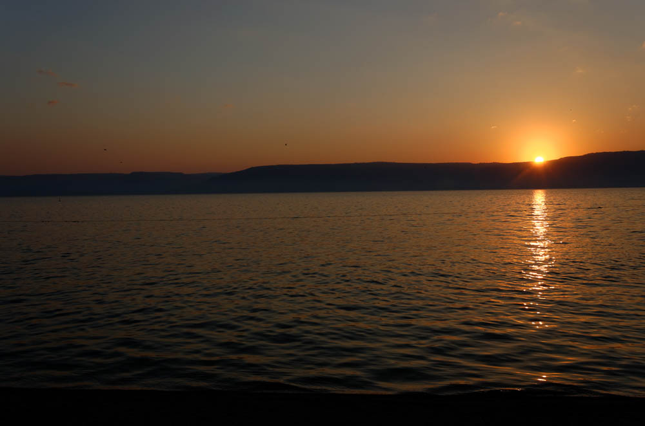
Depart From Me For I Am A Sinful Man
A Devoted Possession (boat ) - v3
3 Then He got into one of the boats, which was Simon's
12
Notes:
tb031514748

Slide 13
Depart From Me For I Am A Sinful Man
A Command (launch out) - v4
v.4 He said to Simon, "Launch out into the deep and let down your nets for a catch."
13
Notes:
tb031514748

Slide 14
Depart From Me For I Am A Sinful Man
A Humble Response - v 5
5 But Simon answered and said to Him, "Master, we have toiled all night and caught nothing; nevertheless at Your word I will let down the net."
14
Notes:
tb031514748

Slide 15
Depart From Me For I Am A Sinful Man
A God honoring obedience - v5
5 But Simon answered and said to Him, "Master, we have toiled all night and caught nothing; nevertheless at Your word I will let down the net."
15
Notes:
tb031514748

Slide 16
Depart From Me For I Am A Sinful Man
An Amazing Result - v6
6 And when they had done this, they caught a great number of fish, and their net was breaking.
16
Notes:
tb031514748

Slide 17
Depart From Me For I Am A Sinful Man
A Unified Effort - v7
Luke 5:7 So they signaled to their partners in the other boat to come and help them. And they came and filled both the boats, so that they began to sink.
17
Notes:
tb031514748

Slide 18
Depart From Me For I Am A Sinful Man
A Humble Recognition - v8
8 When Simon Peter saw it, he fell down at Jesus' knees, saying, "Depart from me, for I am a sinful man, O Lord!"
18
Notes:
tb031514748

Slide 19
Depart From Me For I Am A Sinful Man
Complete Consecration - v11
11 So when they had brought their boats to land, they forsook all and followed Him.
19
Notes:
tb031514748

Slide 20
Depart From Me For I Am A Sinful Man
A Devoted Possession (boat ) - v3
A Command (launch out) - v4
A Humble Response - v 5
A God honoring obedience - v5
An Amazing Result - v6
A Unified Effort - v7
A Humble Recognition - v8
A Complete Consecration - v11
20
Notes:
tb031514748

Slide 21
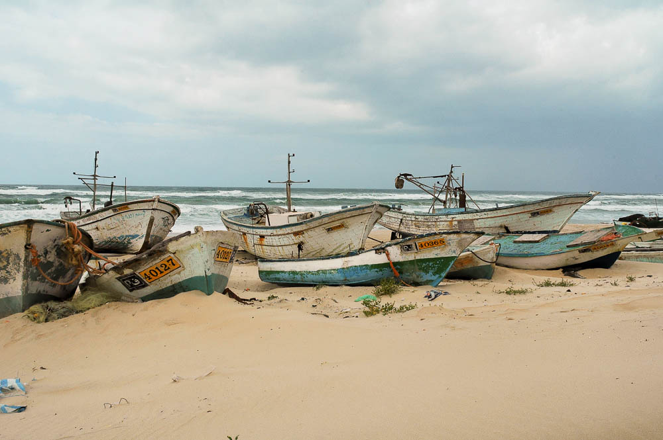
Depart From Me For I Am A Sinful Man
Luke 5:11 So when they had brought their boats
to land, they forsook all and followed Him.
21
Notes:
Gaza is located on the southern shore of Israel. The city once belonged to the Philistines and is now inhabited by Palestinians.
tb040305547

Slide 22
Are you ready to leave all and follow Jesus?
Hear the Gospel (Rom.10:14).
Believe the Gospel (Heb. 11:6).
Repent of Sins (Acts 3:19).
Confess Christ (Rom.10:9).
Be Baptized Into Christ (1 Cor.12:13).
22

