Slide 1
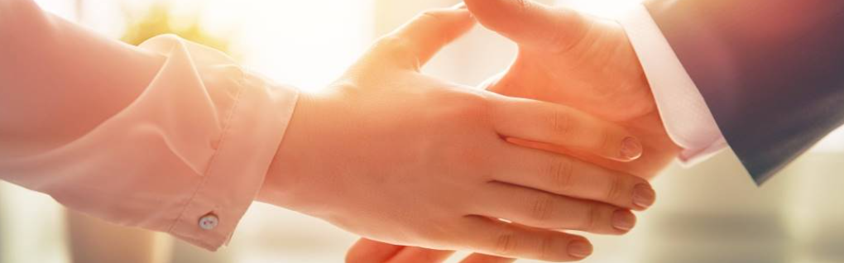
Welcome to our services
New Lebanon Church of Christ
We are Simply Christians.
Our Emphasis is Spiritual, Not Material or Social.
We are striving to be The Same Church as Described in The New Testament.
Please Come Back Again

Slide 2

Sent Into The World
John 17:15-18 "I do not pray that You should take them out of the world, but that You should keep them from the evil one. "They are not of the world, just as I am not of the world. "Sanctify them by Your truth. Your word is truth. "As You sent Me into the world, I also have sent them into the world.

Slide 3
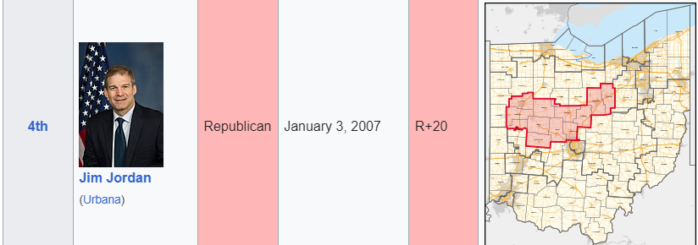
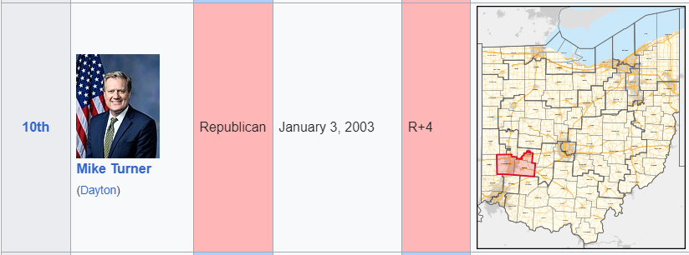
Representatives sent to Columbus, Washington DC, etc.

Slide 4
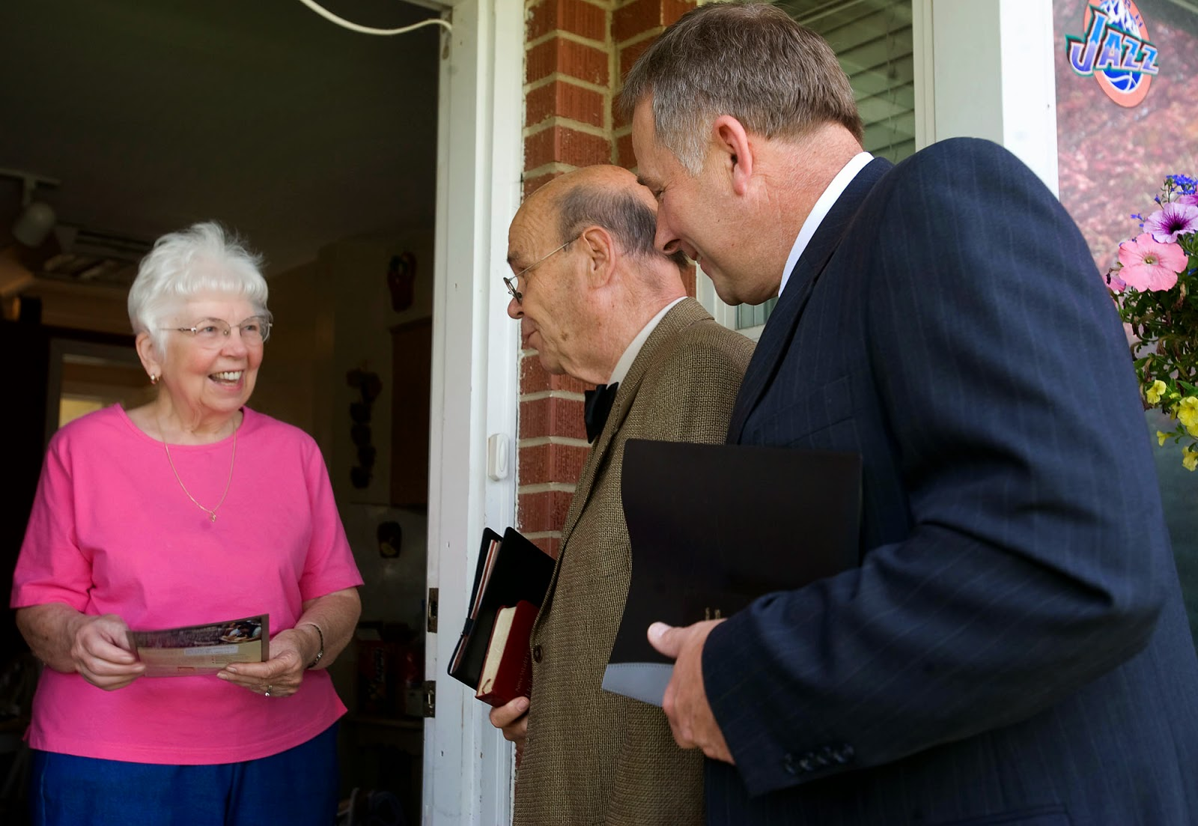
Our denominational neighbors are busy taking the word to the world.
Acts 5:42 And daily in the temple, and in every house, they ceased not to teach and preach Jesus Christ.

Slide 5
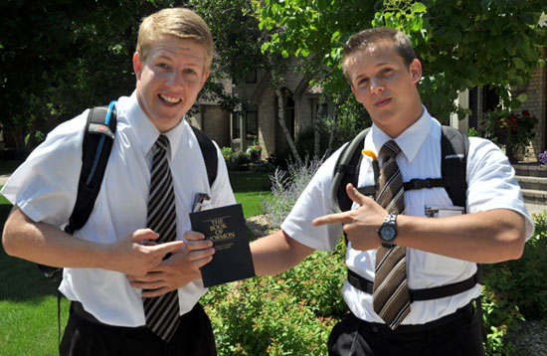
Our denominational neighbors are busy taking the word to the world.

Slide 6


Slide 7

Sent Into The World
Christians As Sent Ones
John 17:18 "As You sent Me into the world, I also have sent them into the world.
John 20:21. So Jesus said to them again, "Peace to you! As the Father has sent Me, I also send you."

Slide 8
Sent Into The World
Have we ever realized that as Christians we take the place of Christ in the world? We are to occupy in His stead till He comes.
2 Cor. 5:20. Now then, we are ambassadors for Christ, as though God were pleading through us: we implore you on Christ's behalf, be reconciled to God.

Slide 9

Sent Into The World
As the Father sent the Son,
so has the Son sent you—
after the same manner,
and for the same purpose.
We need to see our true relationship to the world as sent ones,
let us see how the Father sent the Son.

Slide 10
Sent Into The World
Jesus was Sent as One who did not belong to the World.
He made the world, but the world knew Him not.
He came as the Son of God. “This is My beloved Son.”
“As My Father sent Me, even so send I you.”
“Now are we the sons of God.”

Slide 11
Sent Into The World
Jesus was Sent as One who did not belong to the World.
Phil.2:15 that you may become blameless and harmless, children of God without fault in the midst of a crooked and perverse generation, among whom you shine as lights in the world,
1 John 3:1-2 Behold what manner of love the Father has bestowed on us, that we should be called children of God! Therefore the world does not know us, because it did not know Him. 2 Beloved, now we are children of God; and it has not yet been revealed what we shall be, but we know that when He is revealed, we shall be like Him, for we shall see Him as He is.

Slide 12
Sent Into The World
Jesus was Sent in Love to the World.
John 3:16-18. "For God so loved the world that He gave His only begotten Son, that whoever believes in Him should not perish but have everlasting life.
17 "For God did not send His Son into the world to condemn the world, but that the world through Him might be saved.
18 "He who believes in Him is not condemned; but he who does not believe is condemned already, because he has not believed in the name of the only begotten Son of God.

Slide 13
Sent Into The World
Jesus was Sent in Love to the World.
Love for the perishing constrained the Father to send His Son. “As My Father sent Me, even so send I you.” The love of the Father still burns in the heart of His Son. (Mark 16:15). And He said to them, "Go into all the world and preach the gospel to every creature.
Does this love constrain you? Is the love of God shed abroad in your heart? Do you have the same motives for serving God that Christ had? Would you be equally zealous in your Christian work if you received no wages nor any favor from man? (WIIFM)

Slide 14
Sent Into The World
Jesus was Sent to Reveal the Character of God.
John 17:6 "They are not of the world, just as I am not of the world.
“He that hath seen Me hath seen the Father.” “I and My Father are One”—One in nature, likeness, and purpose. “As My Father sent Me, even so send I you.”
Does the world see Christ in you? Can you say, “He that hath seen me hath seen Christ Jesus?” Did Paul not mean this when he wrote, “To me to live is Christ?”

Slide 15
Sent Into The World
Jesus was Sent to Reveal the Character of God.
1 Cor. 11:1. Imitate me, just as I also imitate Christ.
Gal. 2:20. "I have been crucified with Christ; it is no longer I who live, but Christ lives in me; and the life which I now live in the flesh I live by faith in the Son of God, who loved me and gave Himself for me.

Slide 16
Sent Into The World
Jesus was Sent to Declare the Word of God.
John 17:8 "For I have given to them the words which You have given Me; and they have received them, and have known surely that I came forth from You; and they have believed that You sent Me. 9 "I pray for them. I do not pray for the world but for those whom You have given Me, for they are Yours.
10 "And all Mine are Yours, and Yours are Mine, and I am glorified in them. 11 "Now I am no longer in the world, but these are in the world, and I come to You. Holy Father, keep through Your name those whom You have given Me, that they may be one as We are. >>>

Slide 17
Sent Into The World
Jesus was Sent to Declare the Word of God.
John 17:12."While I was with them in the world, I kept them in Your name. Those whom You gave Me I have kept; and none of them is lost except the son of perdition, that the Scripture might be fulfilled. 13 "But now I come to You, and these things I speak in the world, that they may have My joy fulfilled in themselves. 14 "I have given them Your word; and the world has hated them because they are not of the world, just as I am not of the world.

Slide 18
Sent Into The World
Jesus was Sent to Declare the Word of God.
“I have given them the words which Thou hast given Me.” Oh, how faithfully did Jesus deliver the words which the Father gave Him to speak! “As My Father sent Me, even so send I you.” Are we declaring the whole counsel of God as Jesus Christ did? See how like their Lord in this respect Peter and John were:
Acts 4:20. "For we cannot but speak the things which we have seen and heard."

Slide 19
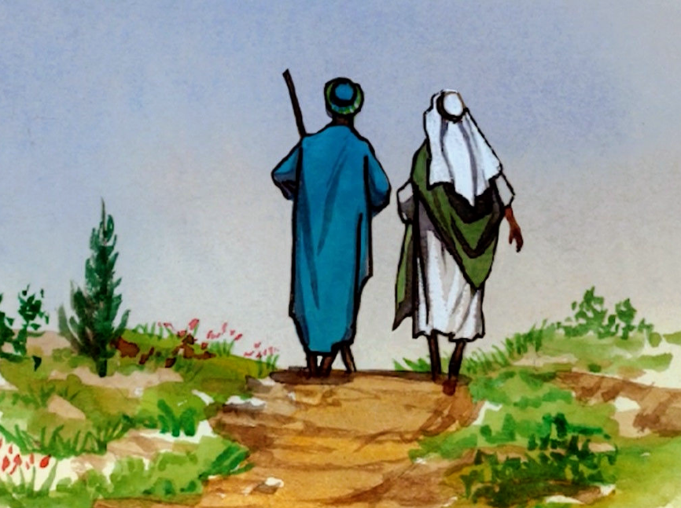
Sent Into The World
Jesus was Sent to Give His Life a Ransom.
Mark 10:45. "For even the Son of Man did not come to be served, but to serve, and to give His life a ransom for many.“
“He came not to be ministered unto, but to give His life.” “As My Father sent Me, even so send I you.”

Slide 20
Sent Into The World
Jesus was Sent to Give His Life a Ransom.
Are we willing and ready, as He was, to yield up our lives wholly for the glory of God the Father?

Slide 21
Sent Into The World
Jesus was Sent to Give His Life a Ransom.
Our Lord and Master girded Himself with the towel of lowly service, and was obedient unto death.
Have we girded ourselves with that lowly mind which was in Him? What a privilege is ours to give our lives that we might minister the things of God to weary, perishing souls around us!

Slide 22
Sent Into The World
Jesus was Sent Equipped with Power from on High.
Matt. 3:16 When He had been baptized, Jesus came up immediately from the water; and behold, the heavens were opened to Him, and He saw the Spirit of God descending like a dove and alighting upon Him.

Slide 23
Sent Into The World
Jesus was Sent Equipped with Power from on High.
The Lord anointed Him with the Holy Ghost that He might preach, heal, deliver, and recover - Luke 4:18-19. "The Spirit of the LORD is upon Me, Because He has anointed Me To preach the gospel to the poor; He has sent Me to heal the brokenhearted, To proclaim liberty to the captives And recovery of sight to the blind, To set at liberty those who are oppressed; 19 To proclaim the acceptable year of the LORD."

Slide 24
Sent Into The World
Jesus was Sent Equipped with Power from on High.
He was empowered by Him who sent Him for the work given Him to do. “As My Father sent Me, even so send I you.” Ye shall receive power by the Holy Ghost coming upon you. If the sinless Savior, Jesus, could not accomplish all the will of God concerning us without this endowment, no more can you. Are you sowing to the flesh or to the Spirit?

Slide 25
Sent Into The World
We are Sent as Ones who do not belong to the World.
We are Sent in Love to the World.
We are Sent to Reveal the Character of God.
We are Sent to Declare the Word of God.
We are Sent to Give our Life a Ransom.
We are Sent Equipped with Power from on High.

Slide 26
Are You A New Testament Christian?
Hear the Gospel (Rom.10:14).
Believe the Gospel (Heb. 11:6).
Repent of Sins (Acts 3:19).
Confess Christ (Rom.10:9).
Be Baptized Into Christ (1 Cor.12:13).
1 Timothy 4:16
“Take heed unto thyself, and unto the doctrine; continue in them: for in doing this thou shalt both save thyself, and them that hear thee.”

