Slide 1
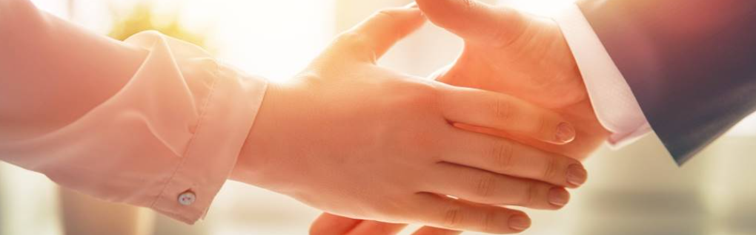
Welcome to our services
New Lebanon Church of Christ
We are Simply Christians.
Our Emphasis is Spiritual, Not Material or Social.
We are striving to be The Same Church as Described in The New Testament.
Please Come Back Again

Slide 2
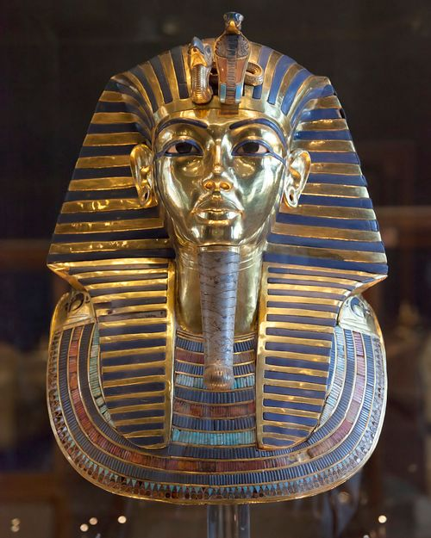
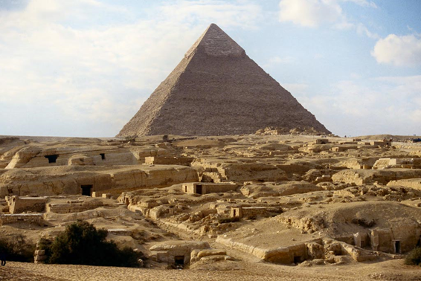
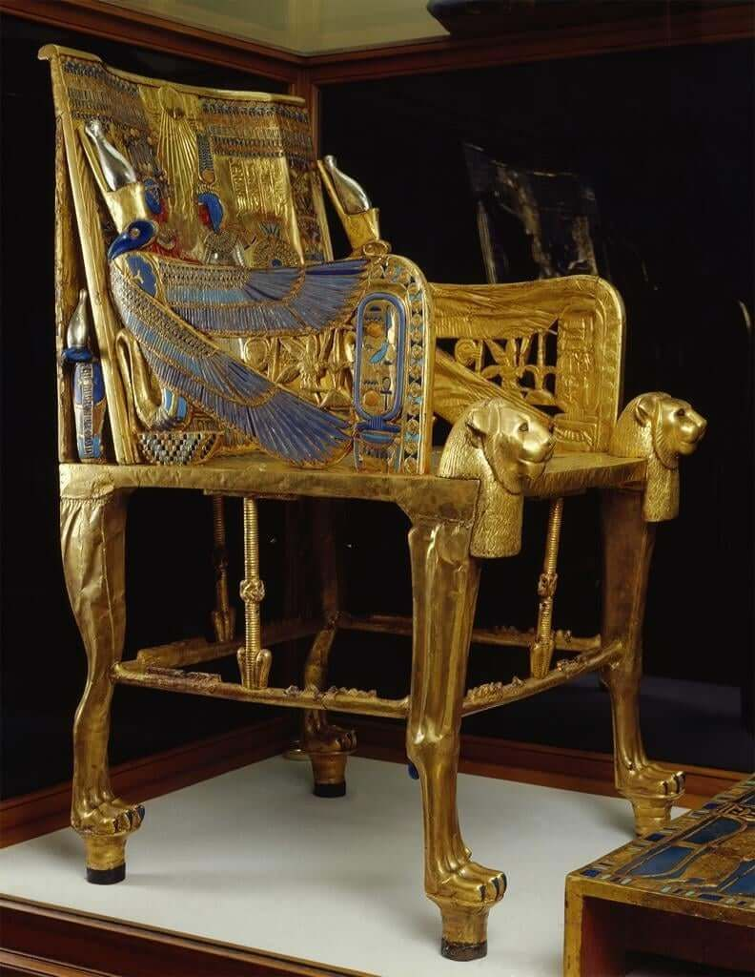
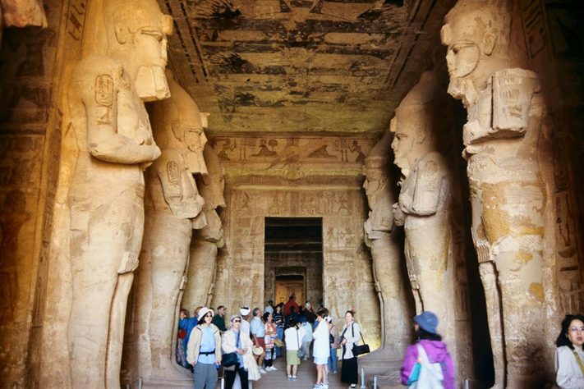
By Faith Moses, Heb.11:23-29
Notes:
tbs89249701

Slide 3
By Faith Moses, Heb.11:23-29
Heb.11:23 By faith Moses, when he was born, was hidden three months by his parents, because they saw he was a beautiful child; and they were not afraid of the king's command. 24 By faith Moses, when he became of age, refused to be called the son of Pharaoh's daughter,
25 choosing rather to suffer affliction with the people of God than to enjoy the passing pleasures of sin, 26 esteeming the reproach of Christ greater riches than the treasures in Egypt; for he looked to the reward.

Slide 4
By Faith Moses, Heb.11:23-29
27 By faith he forsook Egypt, not fearing the wrath of the king; for he endured as seeing Him who is invisible.
28 By faith he kept the Passover and the sprinkling of blood, lest he who destroyed the firstborn should touch them.
29 By faith they passed through the Red Sea as by dry land, whereas the Egyptians, attempting to do so, were drowned.

Slide 8
By Faith Moses, Heb.11:23-29
Heb. 11:6 But without faith it is impossible to please Him, for he who comes to God must believe that He is, and that He is a rewarder of those who diligently seek Him.
Rom. 10:15 And how shall they preach unless they are sent? As it is written: "How beautiful are the feet of those who preach the gospel of peace, Who bring glad tidings of good things!"
16 But they have not all obeyed the gospel. For Isaiah says, "Lord, who has believed our report?"
17 So then faith comes by hearing, and hearing by the word of God.

Slide 9
By Faith Moses, Heb.11:23-29
Take a look at Moses,
How he lived, and how we can emulate him in our lives those characteristics which got him listed in the Hall of Faith.
Moses was one of the greatest characters of the O.T………
Focus on a few passage from the NT, which provides a simple outline on the life of this Godly man.

Slide 10
By Faith Moses, Heb.11:23-29
The story of his faith begins with his parents.
During the time of the birth of Moses, we learn from EX 1:22 that Pharaoh commanded “every son that is born shall be cast into the river.” To disobey this command could have had serious consequences for the parents of Moses - Amram and Jochebed. But, they disobeyed the command anyway.
First, they hid him – (most likely in their own house ) for the space of 3 months.
Think how we just read over that and don’t let it sink in. For 3 months - they would have lived in fear of being discovered ---of being punished and one or all of them being put to death.

Slide 11
By Faith Moses, Heb.11:23-29
Not only could they not tell anybody that he was born - but they had to keep his existence a secret.
Here we have a biblical principle .
God expects man to do everything he can for himself….and not until man does all he can for himself – then, God will step in and fill the gap.
We are told to pray for our daily bread
We don’t sit at the table and wait for it to fall out of the sky.
God expects us to work for it – even work hard for it - and do everything within our power to accomplish what we are praying for.
Amram and Jochebed did all they could to save Moses – and then they trusted in God to step in and fill the gap.

Slide 12
By Faith Moses, Heb.11:23-29
When they could no longer protect Moses on their own - they made an ark to place him in --and then placed him in a location where he would be found ….according to Exodus 2:3
By the providence of God - Moses was not only saved from death – but he was raised in a position of privilege. He was instructed in the wisdom of The Egyptians and was honored as the son of Pharaoh’s daughter.

Slide 13
By Faith Moses, Heb.11:23-29
He gave up a position of STATUS and POWER.
Is status and power wrong? Not in and of themselves. Moses went on to have a hundred times the status and power as the leader of God’s chosen people. But he gave up a position of UNGODLY and WORDLY status and power. And I’m convinced he was persuaded to do so because of the Godly faith of his parents and his sister. Moses did not want the honor…..and luxuries…..of a corrupt and idolatrous society.

Slide 14
By Faith Moses, Heb.11:23-29
What did Moses give up?
He Gave Up The Passing Pleasure Of Sin.
Is sin Pleasurable? Yes…we just read that – and we need to be honest with people about that.
If you tell a teenage boy or young man that there is no pleasure in illicit sexual acts – then he will wonder what else are you lying to him about.
If you tell a teenage girl or young woman that there is no pleasure in wearing the skin tight blouses and slacks - that package her body to get everyman’s eyes to turn and linger – and do her bidding …..if you tell her there is no pleasure in that, she will wonder what else are you lying about.

Slide 15
By Faith Moses, Heb.11:23-29
3) Moses GAVE UP RICHES.
How his riches were described - the treasures of Egypt. Moses could have had anything he wanted. unfortunately – we live with that same temptation every day because we live in America. Not only are we one of the wealthiest nations on the earth – on top of that – we can have access to whatever we want because of CREDIT.
There is almost nothing we can’t have. But Moses gave up riches. He realized that riches are not the ultimate goal. He realized the COST of riches – and he considered the reproach of CHRIST – greater than all the treasures of EGYPT.

Slide 16
By Faith Moses, Heb.11:23-29
What did he choose?
1) He Chose To Endure Ill Treatment.
Moses understood the difference between pleasure for the moment compared to pleasure for an eternity. He was fully convinced that ill treatment for a season would gain him joy forever. Have we learned this lesson? Or…do we give in to the pleasure of the world to avoid any present discomfort?
Moses understood that our present light afflictions which are but for a moment - serve to work out for us a far more exceeding and eternal weight of glory.
What ill treatment am I enduring today?

Slide 17
By Faith Moses, Heb.11:23-29
What did he choose?
He Chose To Be Included With The Despised People.
Moses would have been allowed to enjoy the honor and luxury of pharaohs court. The Egyptians were at that time the most educated – powerful – and influential nation on the earth….And the Hebrews…were among the most oppressed and degraded. This is a continuation and reinforcement of the previous point. Moses knew the long term consequences of short term actions.

Slide 18
By Faith Moses, Heb.11:23-29
What did he choose?
He Chose The Reward Of Christ.
By faith, he looked forward to the great and final reward – the true and abiding pleasure of heaven – and the rest which waits for the people of God. And with his mind set on this - he esteemed the reproach of Christ as more valuable than all the treasures of Egypt.

Slide 19
By Faith Moses, Heb.11:23-29
The Motivation;
So what was the driving force, what was the motivation, what was the POWER behind the reason Moses gave up these three great influences in his life…and what was the driving force, the motivation, and what was the power behind the three great choices he made in his life.
Hopefully it is the same motivation as in our life…..FAITH.

Slide 20
By Faith Moses, Heb.11:23-29
By faith, he was protected v.23
By faith he refused v24
By faith he left v.27
By faith he worshipped v.28
By faith he was delivered (SAVED) v.29
….and it was
not faith in himself
not faith in HIS abilities
not faith in his family
not faith in his possession
but it was faith in GOD.

Slide 21
By Faith Moses, Heb.11:23-29
Faith is not just mental ascent….it is action….and action can be scary.
It can be scary because God is going to test it. How would you like to go to the Dayton airport to catch a flight….and as you’re going down the runway….you hear the captain announce that they just replaced the engine in the plane and had to make some changes that weren’t normal or expected…but if and after they land on this test flight they are making – then they will know if and how the different parts held up under the test.
Friend, you can count on God testing us…with some changes that aren’t normal, and aren’t expected. And, the ONLY way we can pass this test, is if we have FAITH.

Slide 22
By Faith Moses, Heb.11:23-29
The Lessons.
Choose JEHOVAH
Have FAITH
We have briefly looked at 5 major events in the life of Moses. All were accomplished by Faith. What role does faith play in our lives. It is the MOTIVATOR, the DRIVING FORCE, the REASON BEHIND WHY WE DO WHAT WE DO. As we go thru life do we share that faith and explain it to others that we come in contact with.
Also, once God tests our faith so that he teaches us to trust in him….the next time he tests our faith, the test is going to be stronger an harder. If you were one of the Israelites, and you made it to the Red Sea, would you have crossed? What if you were on the front line? And remember - they didn’t know how the story was going to end. Would you have had faith while you were passing thru this event that God was there right beside you, or would you have been wondering - why did God forsake me?

Slide 23
By Faith Moses, Heb.11:23-29
V29 says Moses was saved by faith.
1Cor. 10:1 we find…For I do not want you to be unaware, brethren, that our fathers were all under the cloud, and all passed through the sea: and all were baptized into Moses in the cloud and in the sea:
Paul by the inspiration of the Holy Spirit says that this deliverance was a type of baptism. They were buried in water, they were immersed in water, they were surrounded by water. The cloud of water was over them….the walls of water were all around them….And they were saved by faith.

Slide 24
By Faith Moses, Heb.11:23-29
Was it faith only? Absolutely not!
When they got to the Red Sea and looked at all the water could they say…ok Jehovah I believe you already saved us – take us home to the promised land NOW. No they had to get into the water.
Can we sit here this morning and look at the Bapistry and say ok God, I believed you already saved me – take me home to the promised land NOW. No we have to get into the water.
Were they saved when they got into the water?.....No….not until they came out on the other side….to live a new life.
Are we saved when we get into the water? That’s only the first part of baptism - the other part is coming out of the water after we buried the old man of sin and arising to walk in newness of life.

Slide 25
By Faith Moses, Heb.11:23-29
We can’t leave this discussion without making one other point.
And the point was made many years earlier with NOAH.
And the point is the same water that saves us can also condemn us.

Slide 26
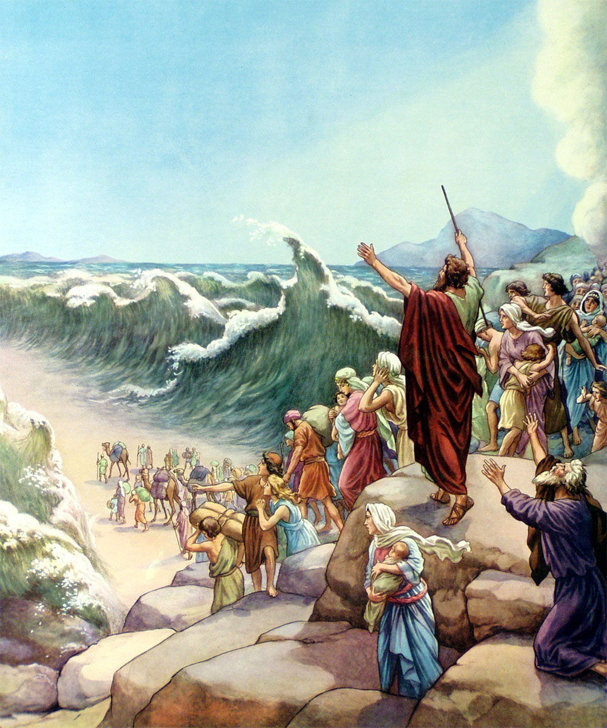
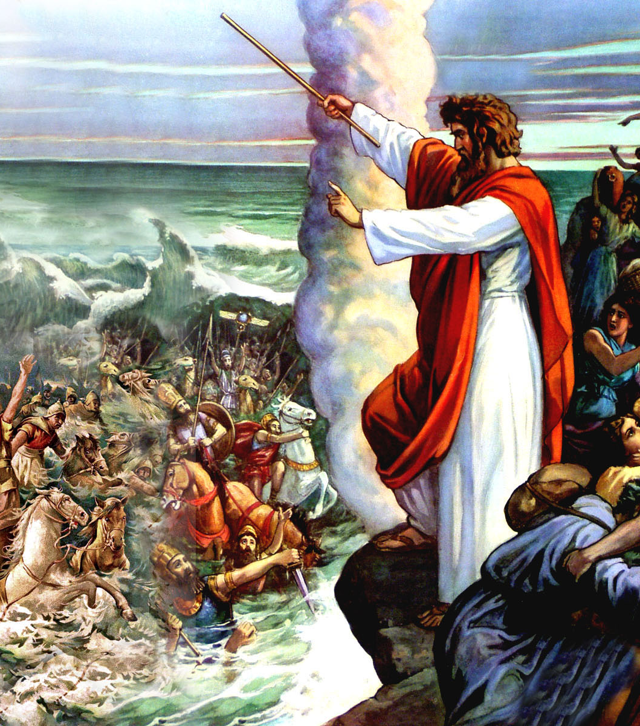
Water saves us.
or
Water condemns us.

