Slide 1
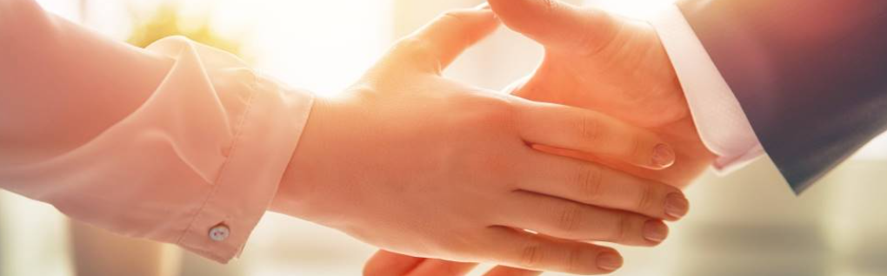
Welcome to our services
New Lebanon Church of Christ
We are Simply Christians.
Our Emphasis is Spiritual, Not Material or Social.
We are striving to be The Same Church as Described in The New Testament.
Please Come Back Again

Slide 2
Growing Up – Marks of Maturity
Phil. 3:12 Not that I have already attained, or am already perfected; but I press on, that I may lay hold of that for which Christ Jesus has also laid hold of me.
13 Brethren, I do not count myself to have apprehended; but one thing I do, forgetting those things which are behind and reaching forward to those things which are ahead,
14 I press toward the goal for the prize of the upward call of God in Christ Jesus.
15 Therefore let us, as many as are mature, have this mind; and if in anything you think otherwise, God will reveal even this to you.

Slide 3

Growing up. Phil.3:12-15
Marks of maturity

Slide 4
Growing Up – Marks of Maturity
With our children, we are eager for them to grow and mature. It is only natural. If they do not grow and mature, something is wrong with them.
Children are eager to grow. Children don't want to stay little. If you suggest they remain the same size, you’ll get a frown. Children want to grow. Sometimes they will measure themselves every day to see if they are getting bigger.

Slide 5
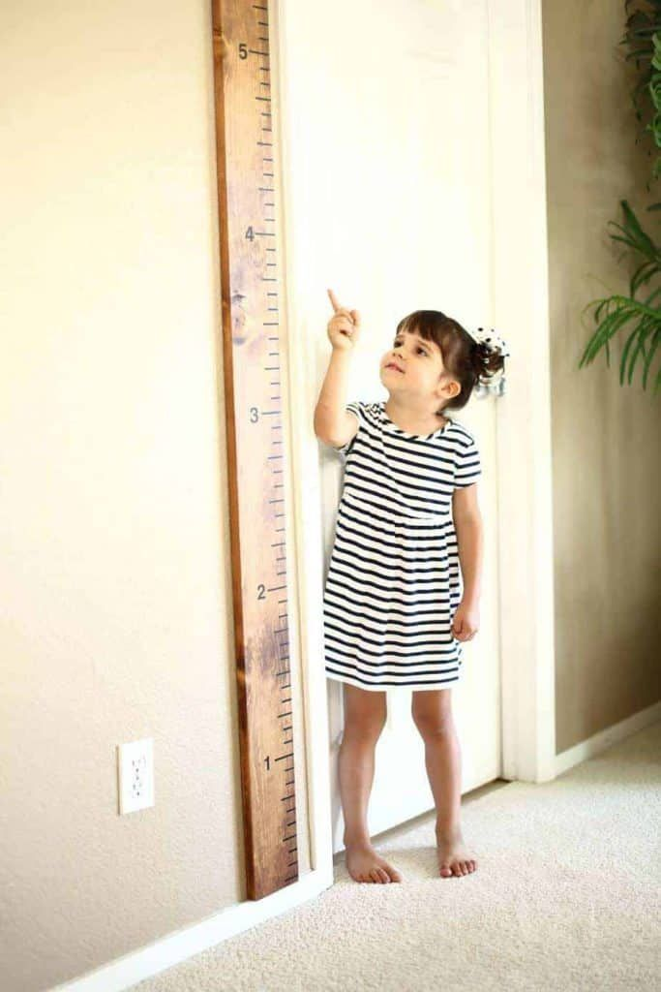

Growth is observable.
Growth is measurable.

Slide 6
Growing Up – Marks of Maturity
As children of God, Our father expects us to grow and mature spiritually. If we do not, something is wrong. We should be eager to grow up, to mature, and to grow closer to God.
At baptism, our old man dies that we might rise to walk in newness of life. Grow and walk every day after we rise from the water.
Each day we make a choice whether or not to allow God full access to our lives. We either fill our self with God or with Self. And God does not allow a little of both. God does not allow a divided mind. There is no room for compromise when it comes to faith.

Slide 7
Growing Up – Marks of Maturity
How much?
Assembly time
Daily
11
Sun. AM. Bible study = 45 minutes
Wed. PM. Bible study = 45 minutes
Sun. AM. Sermon = 30 minutes
Sun. PM. Sermon = 30 minutes
Cross bearing
Prayer
Ask for daily bread.
Study
Exhortation
Teaching
Gratitude
Total time spent in word =150 min. per week
60 minutes in an hour x
24 hours per day x
7 days per week =10,080 total min. per week
1.48 %
150
10,080 = .0148 =
time spent in God’s word for the week

Slide 8

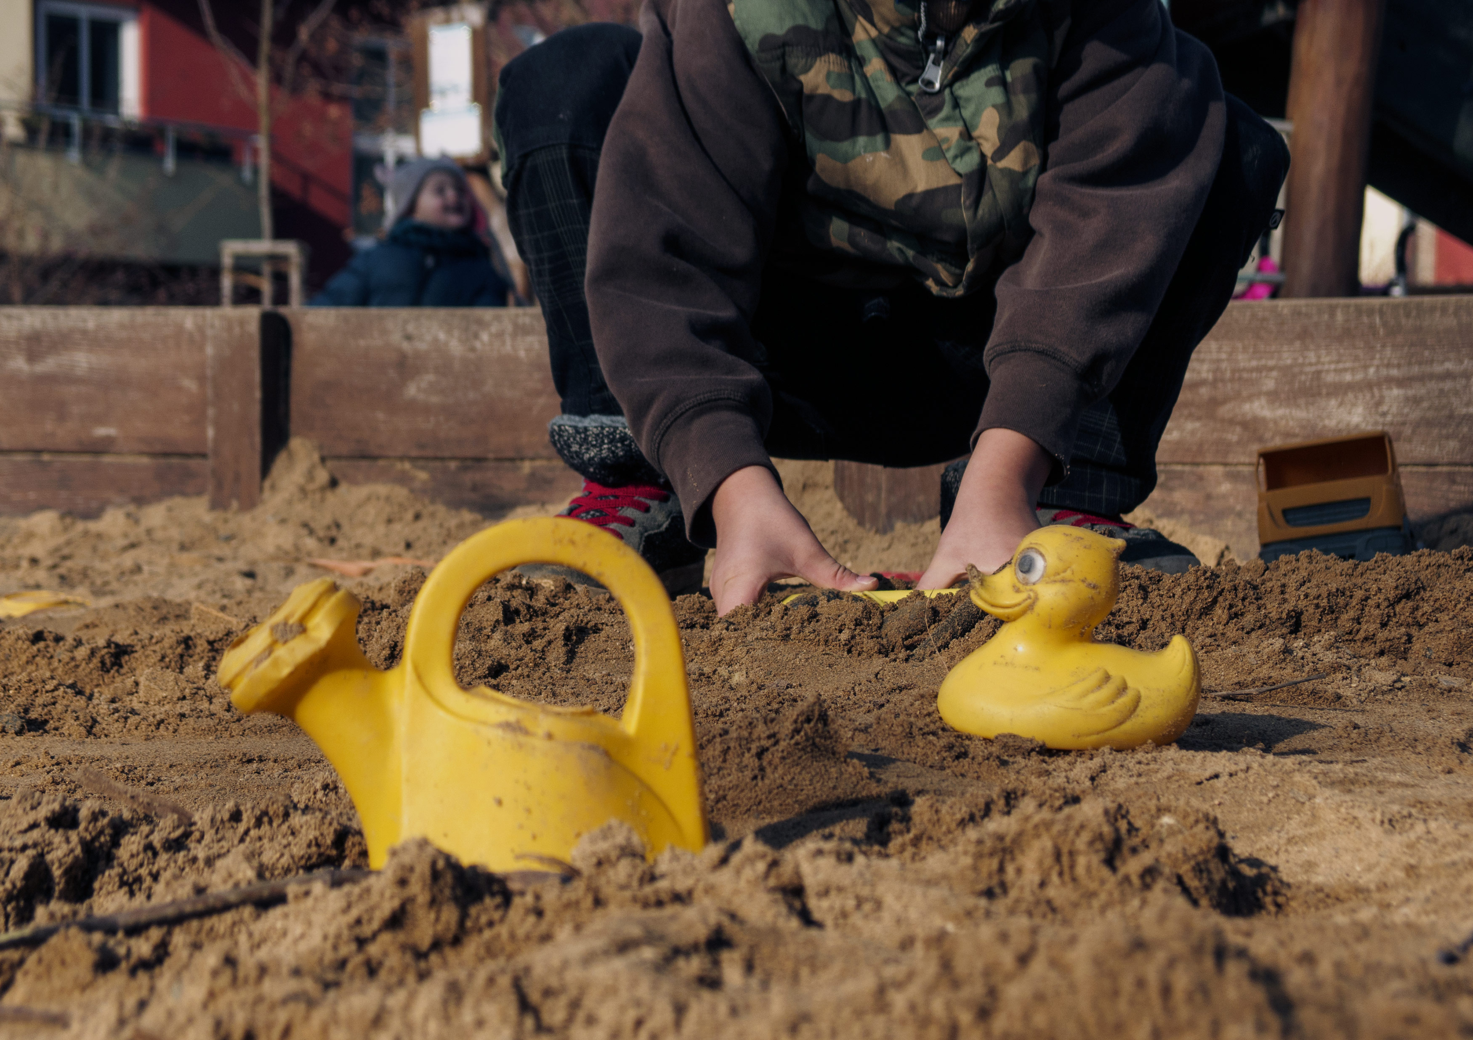
Growing Up – Marks of Maturity
1Cor. 13:11 When I was a child,
I spoke as a child,
I understood as a child,
I thought as a child;
but when I became a man,
I put away childish things.
-the apostle Paul

Slide 9
Growing Up – Marks of Maturity
The ability to discern between good and evil.
(Heb. 5:14) But solid food belongs to those who are of full age, that is, those who by reason of use have their senses exercised to discern both good and evil.

Slide 10

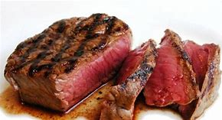
Growing Up – Marks of Maturity
The ability to receive strong meat
(Heb. 5:14) For though by this time you ought to be teachers, you need someone to teach you again the first principles of the oracles of God; and you have come to need milk and not solid food.

Slide 11
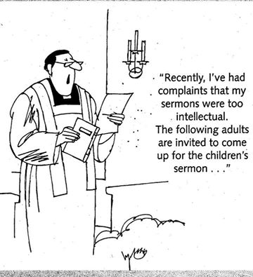
Growing Up – Marks of Maturity

Slide 12
Growing Up – Marks of Maturity
The Mark of Humility
Humble enough to receive instruction. (Col.1:28) Him we preach, warning every man and teaching every man in all wisdom, that we may present every man perfect in Christ Jesus.
Humble enough to be admonished. (Col.1:28)

Slide 13
Growing Up – Marks of Maturity
Humble enough to see own faults. (Matt7:3-5) And why do you look at the speck in your brother's eye, but do not consider the plank in your own eye?
4 "Or how can you say to your brother, 'Let me remove the speck from your eye'; and look, a plank is in your own eye?
5 "Hypocrite! First remove the plank from your own eye, and then you will see clearly to remove the speck from your brother's eye.
Surrender and humility are marks of a person who learn to wait on the Lord.

Slide 14
Growing Up – Marks of Maturity
The Mark of The Tongue
Not speaking against one another. (James 4:11) Do not speak evil of one another, brethren. He who speaks evil of a brother and judges his brother, speaks evil of the law and judges the law. But if you judge the law, you are not a doer of the law but a judge.

Slide 15
Growing Up – Marks of Maturity
Refraining from murmuring. (1Cor. 10:9-11) nor let us tempt Christ, as some of them also tempted, and were destroyed by serpents;
10 nor complain, as some of them also complained, and were destroyed by the destroyer. 11 Now all these things happened to them as examples, and they were written for our admonition, upon whom the ends of the ages have come.

Slide 16
Growing Up – Marks of Maturity
(Phil.2:14) Do all things without complaining and disputing,
Refraining from corrupt speech.
(Eph. 4:25-29) Therefore, putting away lying, "Let each one of you speak truth with his neighbor," for we are members of one another.
26 "Be angry, and do not sin": do not let the sun go down on your wrath,
27 nor give place to the devil.28 Let him who stole steal no longer, but rather let him labor, working with his hands what is good, that he may have something to give him who has need. 29 Let no corrupt word proceed out of your mouth, but what is good for necessary edification, that it may impart grace to the hearers.

Slide 17

Growing Up – Marks of Maturity
The Mark of Steadfastness
Steadfast in trials. (James 1:2-4) My brethren, do not hold the faith of our Lord Jesus Christ, the Lord of glory, with partiality.
2 For if there should come into your assembly a man with gold rings, in fine apparel, and there should also come in a poor man in filthy clothes,3 and you pay attention to the one wearing the fine clothes and say to him, "You sit here in a good place," and say to the poor man, "You stand there," or, "Sit here at my footstool," 4 have you not shown partiality among yourselves, and become judges with evil thoughts?

Slide 18
Growing Up – Marks of Maturity
Steadfast in Temptations
(James 1:12-15) Blessed is the man who endures temptation; for when he has been approved, he will receive the crown of life which the Lord has promised to those who love Him. 13 Let no one say when he is tempted, "I am tempted by God"; for God cannot be tempted by evil, nor does He Himself tempt anyone. 14 But each one is tempted when he is drawn away by his own desires and enticed. 15 Then, when desire has conceived, it gives birth to sin; and sin, when it is full-grown, brings forth death.

Slide 19
Growing Up – Marks of Maturity
Steadfast in service to God
(1Cor.15:58) Therefore, my beloved brethren, be steadfast, immovable, always abounding in the work of the Lord, knowing that your labor is not in vain in the Lord.

Slide 20
Growing Up – Marks of Maturity
The Mark Of Fervent love
Fervent Love for God. (1John 4:17-21) Love has been perfected among us in this: that we may have boldness in the day of judgment; because as He is, so are we in this world. 18 There is no fear in love; but perfect love casts out fear, because fear involves torment. But he who fears has not been made perfect in love. 19 We love Him because He first loved us.
20 If someone says, "I love God," and hates his brother, he is a liar; for he who does not love his brother whom he has seen, how can he love God whom he has not seen? 21 And this commandment we have from Him: that he who loves God must love his brother also.

Slide 21
Growing Up – Marks of Maturity
Fervent Love For The Brethren. (John 13:35) "A new commandment I give to you, that you love one another; as I have loved you, that you also love one another. 35 "By this all will know that you are My disciples, if you have love for one another."
Fervent Love For Souls. (Matt 16:24-27) Then Jesus said to His disciples, "If anyone desires to come after Me, let him deny himself, and take up his cross, and follow Me. 25 "For whoever desires to save his life will lose it, but whoever loses his life for My sake will find it. 26 "For what profit is it to a man if he gains the whole world, and loses his own soul? Or what will a man give in exchange for his soul? 27 "For the Son of Man will come in the glory of His Father with His angels, and then He will reward each according to his works.

Slide 22
Growing Up – Marks of Maturity
How much?
Assembly time
Daily
11
?
Sun. AM. Bible study = 45 minutes
Wed. PM. Bible study = 45 minutes
Sun. AM. Sermon = 30 minutes
Sun. PM. Sermon = 30 minutes
Cross bearing
Prayer
Ask for daily bread.
Study
Exhortation
Teaching
Gratitude
?
Total time spent in word =150 min. per week
?
60 minutes in an hour x
24 hours per day x
7 days per week =10,080 total min. per week
?
?
1.48 %
150
10,080 = .0148 =
time spent in God’s word for the week

Slide 23
Growing Up – Marks of Maturity
Let’s make sure we are growing as God would have us to. To not stay as children but grow to maturity.
(Eph. 4:11) And He Himself gave some to be apostles, some prophets, some evangelists, and some pastors and teachers,
12 for the equipping of the saints for the work of ministry, for the edifying of the body of Christ, 13 till we all come to the unity of the faith and of the knowledge of the Son of God, to a perfect man, to the measure of the stature of the fullness of Christ; 14 that we should no longer be children, tossed to and fro

Slide 24


Slide 25
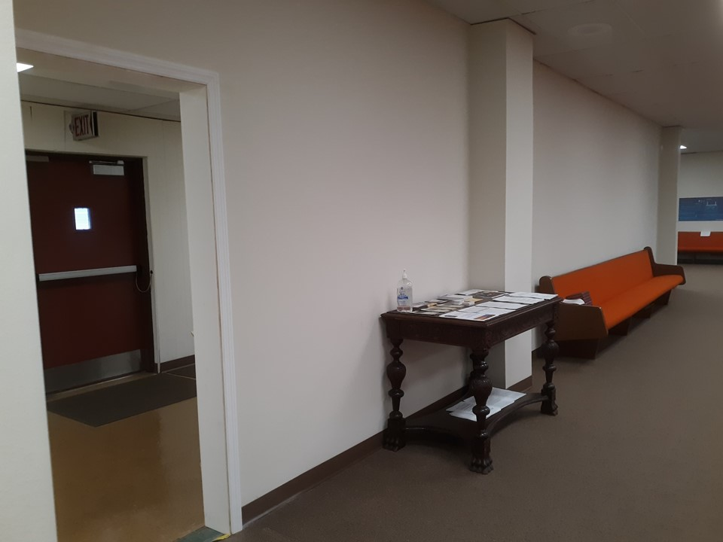
Am I growing?
How much?
Growth is observable.
Growth is measurable.

Slide 26

The choices you make each day determine your soul’s destiny.
BEST
better
good
neutral
Not so good
deadly
Why would you choose less than the best?

