Slide 1
Welcome to our services
New Lebanon Church of Christ
We are Simply Christians.
Our Emphasis is Spiritual, Not Material or Social.
We are striving to be The Same Church as Described in The New Testament.
Please Come Back Again

Slide 2
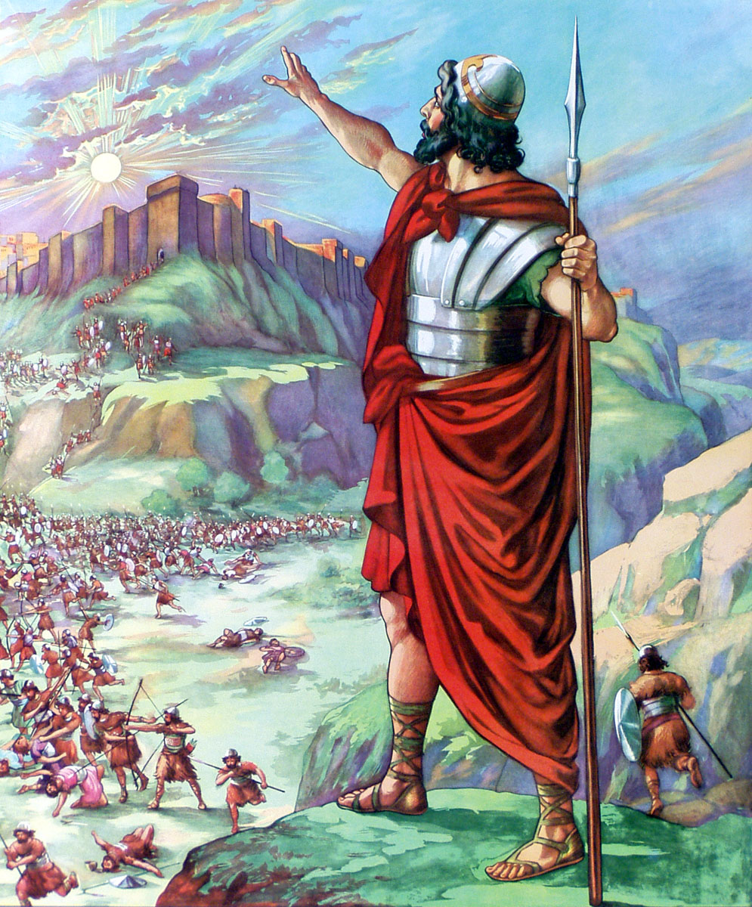
Joshua – Be Strong And Of Good Courage. .. Joshua chapter 1
Joshua 10:13 So the sun stood still, And the moon stopped, Till the people had revenge Upon their enemies. Is this not written in the Book of Jasher? So the sun stood still in the midst of heaven, and did not hasten to go down for about a whole day.
14 And there has been no day like that, before it or after it, that the LORD heeded the voice of a man; for the LORD fought for Israel.
(NKJV)

Slide 3
Joshua 10
“²⁵And Joshua said unto them, Fear not, nor be dismayed, be strong and of good courage: for thus shall the LORD do to all your enemies against whom ye fight. ²⁶And afterward Joshua smote them, and slew them, and hanged them on five trees: and they were hanging upon the trees until the evening.”

Slide 4
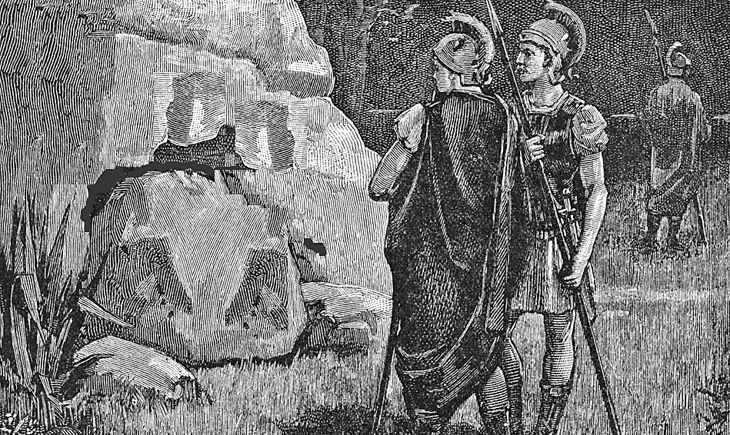
Joshua 10
“²⁷And it came to pass at the time of the going down of the sun, that Joshua commanded, and they took them down off the trees, and cast them into the cave wherein they had been hid, and laid great stones in the cave’s mouth, which remain until this very day.”

Slide 5
JOSHUA Chapter 1
1 Now after the death of Moses the servant of the LORD it came to pass, that the LORD spake unto Joshua the son of Nun, Moses’ minister, saying,
2 Moses my servant is dead; now therefore arise, go over this Jordan, thou, and all this people, unto the land which I do give to them, even to the children of Israel.
Every place that the sole of your foot shall tread upon, that
have I given unto you, as I said unto Moses.
4 From the wilderness and this Lebanon even unto the great river, the river Euphrates, all the land of the Hittites, and unto the great sea toward the going down of the sun, shall be your coast.
5 There shall not any man be able to stand before thee all the days of thy life: as I was with Moses, so I will be with thee: I will not fail thee, nor forsake thee.
6 Be strong and of a good courage: for unto this people shalt thou divide for an inheritance the land, which I sware unto their fathers to give them.
7 Only be thou strong and very courageous, that thou mayest observe to do according to all the law, which Moses my servant commanded thee: turn not from it to the right hand or to the left, that thou mayest prosper whithersoever thou goest.
8 This book of the law shall not depart out of thy mouth; but thou shalt meditate therein day and night, that thou mayest observe to do according to all that is written therein: for then thou shalt make thy way prosperous, and then thou shalt have good success.
9 Have not I commanded thee? Be strong and of a good courage; be not afraid, neither be thou dismayed: for the LORD thy God is with thee whithersoever thou goest.
10 Then Joshua commanded the officers of the people, saying,
11 Pass through the host, and command the people, saying, Prepare you victuals; for within three days ye shall pass over this Jordan, to go in to possess the land, which the LORD your God giveth you to possess it.
12 And to the Reubenites, and to the Gadites, and to half the tribe of Manasseh, spake Joshua, saying,
13 Remember the word which Moses the servant of the LORD commanded you, saying, The LORD your God hath given you rest, and hath given you this land.
14 Your wives, your little ones, and your cattle, shall remain in the land which Moses gave you on this side Jordan; but ye shall pass before your brethren armed, all the mighty men of valour, and help them;
15 Until the LORD have given your brethren rest, as he hath given you, and they also have possessed the land which the LORD your God giveth them: then ye shall return unto the land of your possession, and enjoy it, which Moses the LORD’S servant gave you on this side Jordan toward the sunrising.
16 And they answered Joshua, saying, All that thou commandest us we will do, and whithersoever thou sendest us, we will go.
17 According as we hearkened unto Moses in all things, so will we hearken unto thee: only the LORD thy God be with thee, as he was with Moses.
18 Whosoever he be that doth rebel against thy commandment, and will not hearken unto thy words in all that thou commandest him, he shall be put to death: only be strong and of a good courage.

Slide 6
JOSHUA Chapter 1
1 Now after the death of Moses the servant of the LORD it came to pass, that the LORD spake unto Joshua the son of Nun, Moses’ minister, saying,
2 Moses my servant is dead; now therefore arise, go over this Jordan, thou, and all this people, unto the land which I do give to them, even to the children of Israel.
Every place that the sole of your foot shall tread upon, that
have I given unto you, as I said unto Moses.
4 From the wilderness and this Lebanon even unto the great river, the river Euphrates, all the land of the Hittites, and unto the great sea toward the going down of the sun, shall be your coast.
5 There shall not any man be able to stand before thee all the days of thy life: as I was with Moses, so I will be with thee: I will not fail thee, nor forsake thee.
6 Be strong and of a good courage: for unto this people shalt thou divide for an inheritance the land, which I sware unto their fathers to give them.
7 Only be thou strong and very courageous, that thou mayest observe to do according to all the law, which Moses my servant commanded thee: turn not from it to the right hand or to the left, that thou mayest prosper whithersoever thou goest.
8 This book of the law shall not depart out of thy mouth; but thou shalt meditate therein day and night, that thou mayest observe to do according to all that is written therein: for then thou shalt make thy way prosperous, and then thou shalt have good success.
9 Have not I commanded thee? Be strong and of a good courage; be not afraid, neither be thou dismayed: for the LORD thy God is with thee whithersoever thou goest.
10 Then Joshua commanded the officers of the people, saying,
11 Pass through the host, and command the people, saying, Prepare you victuals; for within three days ye shall pass over this Jordan, to go in to possess the land, which the LORD your God giveth you to possess it.
12 And to the Reubenites, and to the Gadites, and to half the tribe of Manasseh, spake Joshua, saying,
13 Remember the word which Moses the servant of the LORD commanded you, saying, The LORD your God hath given you rest, and hath given you this land.
14 Your wives, your little ones, and your cattle, shall remain in the land which Moses gave you on this side Jordan; but ye shall pass before your brethren armed, all the mighty men of valour, and help them;
15 Until the LORD have given your brethren rest, as he hath given you, and they also have possessed the land which the LORD your God giveth them: then ye shall return unto the land of your possession, and enjoy it, which Moses the LORD’S servant gave you on this side Jordan toward the sunrising.
16 And they answered Joshua, saying, All that thou commandest us we will do, and whithersoever thou sendest us, we will go.
17 According as we hearkened unto Moses in all things, so will we hearken unto thee: only the LORD thy God be with thee, as he was with Moses.
18 Whosoever he be that doth rebel against thy commandment, and will not hearken unto thy words in all that thou commandest him, he shall be put to death: only be strong and of a good courage.

Slide 7
Joshua – Be Strong And Of Good Courage
(Joshua 1:1-9) After the death of Moses the servant of the LORD, it came to pass that the LORD spoke to Joshua the son of Nun, Moses' assistant, saying:
Moses My servant is dead.
(all of us are going to die -but God was not dead)….
God’s work did not end with Moses, he commissioned Joshua.
God’s work did not end with Christ. He commissioned us. The GREAT commission.
We Need Strength and Courage Today!

Slide 8
Joshua – Be Strong And Of Good Courage
We learn our duty unto God is crystal clear.
V2. Now therefore, arise, go over this Jordan, you and all this people, to the land which I am giving to them-the children of Israel.
There may be some mysteries hard to understand, but if it relates to God wants us to do- it is crystal clear.
We can know the truth on a matter. Jesus said” Ye shall know the truth”
Some know absolutely -“we cannot know.”
(wishy-washy Christians that won’t take a stand)

Slide 9
Joshua – Be Strong And Of Good Courage
(John 7:17) If anyone wants to do His will, he shall know concerning the doctrine, whether it is from God or whether I speak on My own authority.
The Lord said I can know his doctrine. There are people today teaching you cannot know, you cannot understand.
Some people will make fun of us and say “you church of Christ people think you know everything.”
Well we know what we need to do:
To be saved to worship God to live a pure and holy life
We know the work of the church

Slide 10
Joshua – Be Strong And Of Good Courage
We know the work of the individual in spreading the gospel.
1Tim. 4:16 Take heed to yourself and to the doctrine. Continue in them, for in doing this you will save both yourself and those who hear you.
Joshua understood his duty, and we can understand our duty.
The will of God is clear.

Slide 11
Joshua – Be Strong And Of Good Courage
We learn we can trust in God’s promises.
V3- "Every place that the sole of your foot will tread upon I have given you, as I said to Moses. ( Deut. 11:24)
4 "From the wilderness and this Lebanon as far as the great river, the River Euphrates, all the land of the Hittites, and to the Great Sea toward the going down of the sun, shall be your territory.

Slide 12
Joshua – Be Strong And Of Good Courage
Whatever God promises us, we can count on it if we will accept it and lay hold of it. A promise doesn’t do anybody good if we don’t lay hold of it.
(Eph.1:3) Blessed be the God and Father of our Lord Jesus Christ, who has blessed us with every spiritual blessing in the heavenly places in Christ,
(Eph.1:7) In Him we have redemption through His blood, the forgiveness of sins, according to the riches of His grace
Must claim it.
Access to God in prayer Everlasting life Physical blessings.
You hear stories about rich people dying, but for some reason the family doesn’t know and they never receive the inheritance.

Slide 13
Joshua – Be Strong And Of Good Courage
(2 Peter 3:9) The Lord is not slack concerning His promise, as some count slackness, but is longsuffering toward us, not willing that any should perish but that all should come to repentance.
It took hundreds of years for the promise to Abraham to be fulfilled – but to God, time means nothing………..

Slide 14
Joshua – Be Strong And Of Good Courage
We learn the assurance of God’s presence.
v.5 "No man shall be able to stand before you all the days of your life; as I was with Moses, so I will be with you. I will not leave you nor forsake you.
Heb.13:5-6 Let your conduct be without covetousness; be content with such things as you have. For He Himself has said, "I will never leave you nor forsake you." (said that to Joshua) 6 So we may boldly say: "The LORD is my helper; I will not fear. What can man do to me?"
Boldly say

Slide 15
Joshua – Be Strong And Of Good Courage
Compare 2 Tim.4:16-17 At my first defense no one stood with me, but all forsook me. May it not be charged against them.
17 But the Lord stood with me and strengthened me, so that the message might be preached fully through me, and that all the Gentiles might hear. And I was delivered out of the mouth of the lion.
God did not abandon Joshua
God did not abandon Christ
God will not abandon you or me.
Songs I will never leave thee or forsake thee. God will take care of you… God is at our side.

Slide 16
Joshua – Be Strong And Of Good Courage
Psalm 23:4 Yea, though I walk through the valley of the shadow of death, I will fear no evil; For You are with me; Your rod and Your staff, they comfort me.
We don’t know everything about how God is with us but friend we need to remember if we are walking with him – God is with us!!!
John 8:29 "And He who sent Me is with Me. The Father has not left Me alone, for I always do those things that please Him."

Slide 17
Joshua – Be Strong And Of Good Courage
Psalm 118:6 The LORD is on my side; I will not fear. What can man do to me?
Song – God will take care of you.”

Slide 18
Joshua – Be Strong And Of Good Courage
Courage in God’s name
Be of good courage (3xs). Be very courageous.
Courage = strength of purpose, steadfastness of will, in the presence of threats and tribulations.
Be steadfast, strong.
Matt 10:28 "And do not fear those who kill the body but cannot kill the soul. But rather fear Him who is able to destroy both soul and body in hell.
We must endure in persecution

Slide 19
Joshua – Be Strong And Of Good Courage
Courage to stand for Lord, his kingdom, his word…
How are we going to react to threats?
Flee? Run? Keep quiet? Renounce being a Christian?
Or are we going to stand? Most of us have never been tried.
Some have gone bankrupt because of their convictions?
Some have lost their job because of convictions? (me?)
We MUST have courage to stand.

Slide 20
Joshua – Be Strong And Of Good Courage
Eph. 6:10 Finally, my brethren, be strong in the Lord and in the power of His might.11 Put on the whole armor of God, that you may be able to stand against the wiles of the devil.
12 For we do not wrestle against flesh and blood, but against principalities, against powers, against the rulers of the darkness of this age, against spiritual hosts of wickedness in the heavenly places. 13 Therefore take up the whole armor of God, that you may be able to withstand in the evil day, and having done all, to stand.
14 Stand therefore, having girded your waist with truth, having put on the breastplate of righteousness, 15 and having shod your feet with the preparation of the gospel of peace;

Slide 21
Joshua – Be Strong And Of Good Courage
And we must be EQUIPPED to stand . We need courage to stand.
Would we stand like the early Christian martyrs that were put to death?
Acts 5:27 And when they had brought them, they set them before the council. And the high priest asked them, 28 saying, "Did we not strictly command you not to teach in this name? And look, you have filled Jerusalem with your doctrine, and intend to bring this Man's blood on us!"
29 But Peter and the other apostles answered and said: We ought to obey God rather than men.

Slide 22
Joshua – Be Strong And Of Good Courage
Acts 8:1 Now Saul was consenting to his death. At that time a great persecution arose against the church which was at Jerusalem; and they were all scattered throughout the regions of Judea and Samaria, except the apostles.
(dangerous for apostles to stay in Jerusalem.)
What would we do?
Acts 4:1 Now as they spoke to the people, the priests, the captain of the temple, and the Sadducees came upon them, 2 being greatly disturbed that they taught the people and preached in Jesus the resurrection from the dead. 3 And they laid hands on them, and put them in custody until the next day, for it was already evening.

Slide 23
Joshua – Be Strong And Of Good Courage
Acts 15:24 Since we have heard that some who went out from us have troubled you with words, unsettling your souls, saying, "You must be circumcised and keep the law" --to whom we gave no such commandment--
25 it seemed good to us, being assembled with one accord, to send chosen men to you with our beloved Barnabas and Paul,
26 men who have risked their lives for the name of our Lord Jesus Christ.

Slide 24
Joshua – Be Strong And Of Good Courage
Do YOU have the COURAGE to be a Christian. Christianity isn’t for cowards.
Rev. 21:8 "But the cowardly, unbelieving, abominable, murderers, sexually immoral, sorcerers, idolaters, and all liars shall have their part in the lake which burns with fire and brimstone, which is the second death."
1Cor.16:13 Watch ye, stand fast in the faith, quit you like men, be strong. kjv
1Cor.16:13 Watch, stand fast in the faith, be brave, be strong.

Slide 25
Joshua – Be Strong And Of Good Courage
Do you have courage to stand up to sin and say show me BCV for what you want to practice???
Friend we can have courage IN God. God will stand with us!!
It is the attitude that we have toward someone that gives us the courage
(me and brothers)
God is standing with us.
God has all power and strength and might!

Slide 26
Joshua – Be Strong And Of Good Courage
Prosperity in following God’s word.
V.7-8 "Only be strong and very courageous, that you may observe to do according to all the law which Moses My servant commanded you; do not turn from it to the right hand or to the left, that you may prosper wherever you go.
8 "This Book of the Law shall not depart from your mouth, but you shall meditate in it day and night, that you may observe to do according to all that is written in it. For then you will make your way prosperous, and then you will have good success.

Slide 27
Joshua – Be Strong And Of Good Courage
If we are going to prosper and succeed we are going to have to follow the word of God.
Not the philosophy of men….books….how to succeed.
What is our manual for success??? God’s word – the Bible.
Don’t deviate from the right or left.
Don’t just listen to God’s word. Speak God’s word! We’ve got a lot of Christians content to listen to God’s word but not speak it.
V8 Meditate day and night. (digest our food).

Slide 28
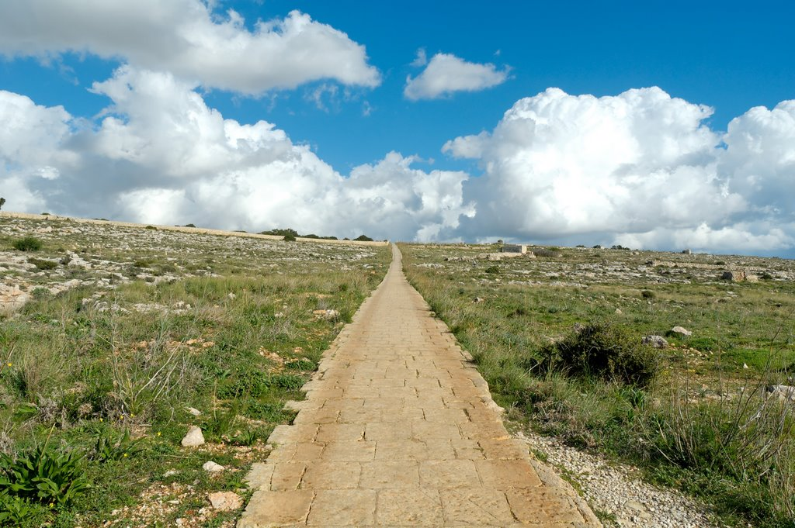
Turn not from it to the right hand or to the left
Straight path through the Malta countryside
Joshua 1:7
Notes:
This path is located near the Hagar Qim temple on the island of Malta. It illustrates the straight path that the Israelites were to walk in their obedience to God, straying in neither direction.
tb112005821

Slide 29
Joshua – Be Strong And Of Good Courage
We are not here today to warm a bench.
We are not here to be spectators.
We are here to worship God and learn so that we can DO what God wants us to do to prosper and succeed.
We are here to learn, meditate, and then DO.

Slide 30
Joshua – Be Strong And Of Good Courage
Psalm 1:1 Blessed is the man Who walks not in the counsel of the ungodly, Nor stands in the path of sinners, Nor sits in the seat of the scornful; 2 But his delight is in the law of the LORD, And in His law he meditates day and night.
3 He shall be like a tree Planted by the rivers of water, That brings forth its fruit in its season, Whose leaf also shall not wither; And whatever he does shall prosper.
4 The ungodly are not so, But are like the chaff which the wind drives away.

Slide 31
Joshua – Be Strong And Of Good Courage
1. We learn our duty unto God is crystal clear.
2. We learn we can trust in God’s promises.
3. We learn the assurance of God’s presence.
4. Courage in God’s name
5. Prosperity in following God’s word.

Slide 32
Are You A New Testament Christian?
Hear the Gospel (Rom.10:14).
Believe the Gospel (Heb. 11:6).
Repent of Sins (Acts 3:19).
Confess Christ (Rom.10:9).
Be Baptized Into Christ (1 Cor.12:13).
"And if it seems evil to you to serve the LORD, choose for yourselves this day whom you will serve, whether the gods which your fathers served that were on the other side of the River, or the gods of the Amorites, in whose land you dwell. But as for me and my house, we will serve the LORD.“ (Joshua 24:15)

