Slide 1
Welcome to our services
New Lebanon Church of Christ
We are Simply Christians.
Our Emphasis is Spiritual, Not Material or Social.
We are striving to be The Same Church as Described in The New Testament.
Please Come Back Again

Slide 2
Fathers and their Children. Eph.6:4
Eph 6:4 And you, fathers, do not provoke your children to wrath,
but bring them up
in the training
and admonition of the Lord.

Slide 3
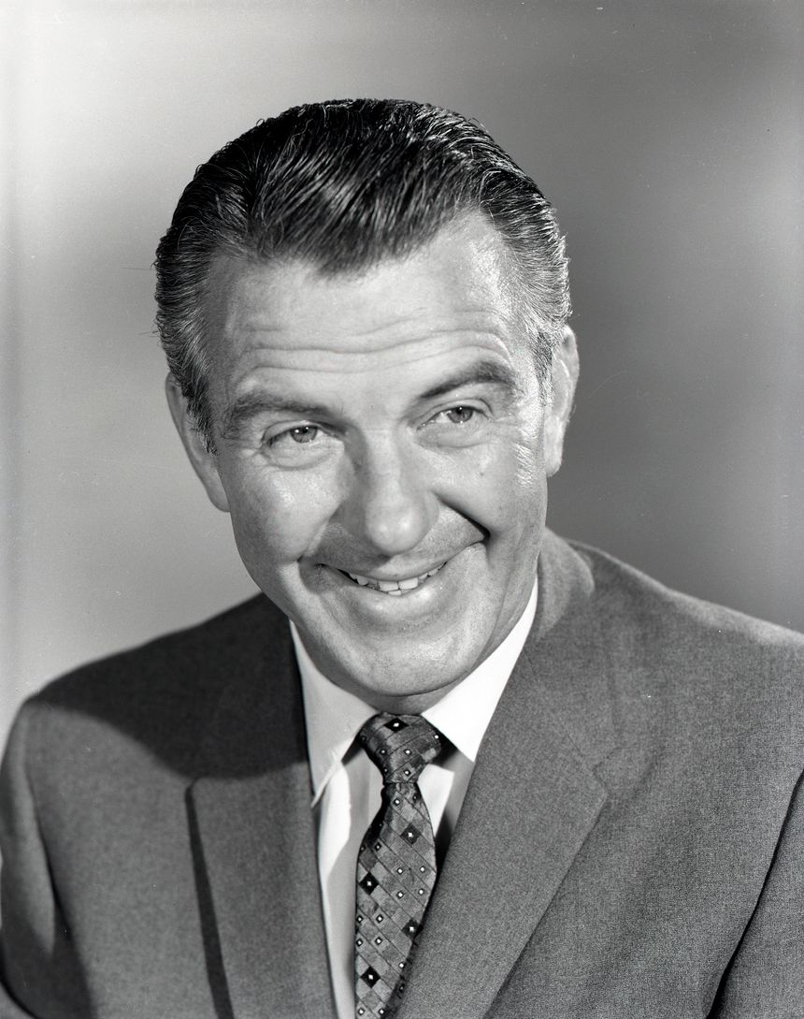
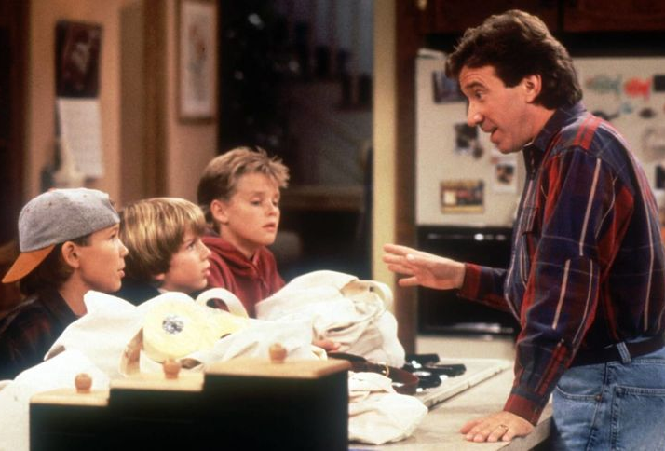
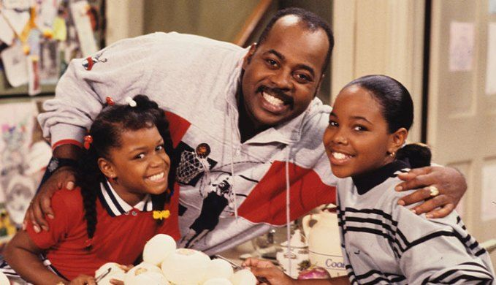
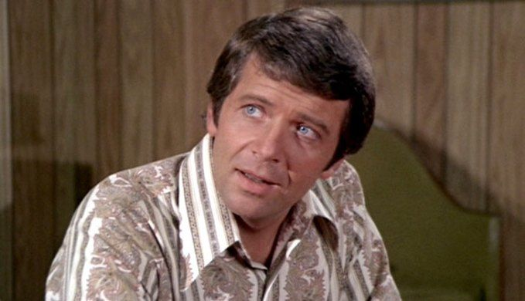

Slide 4
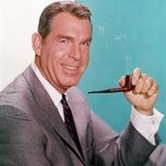
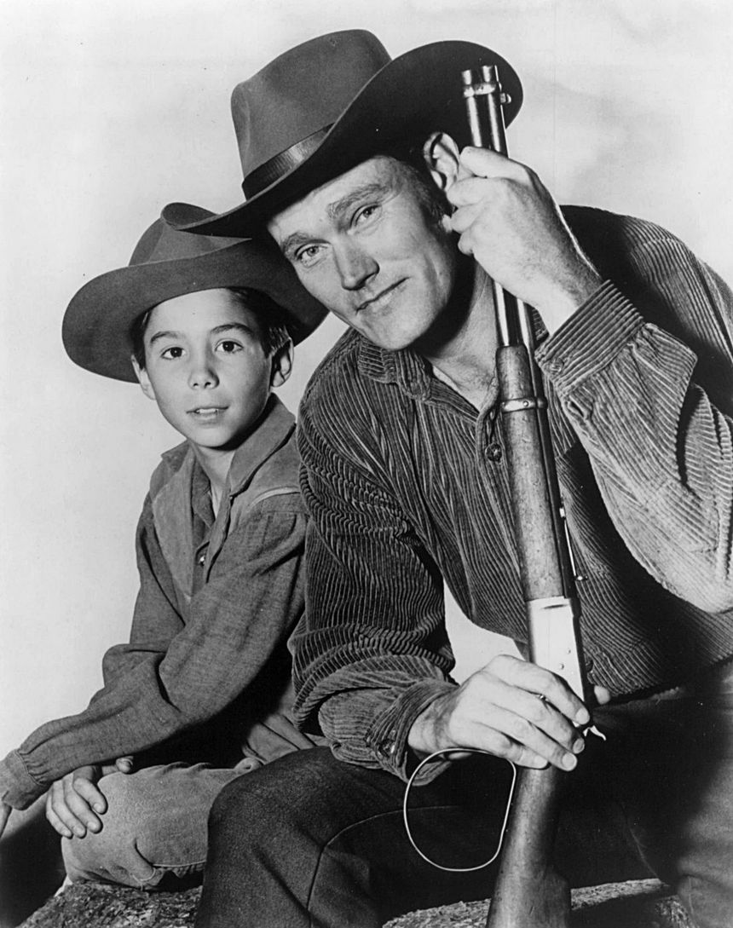
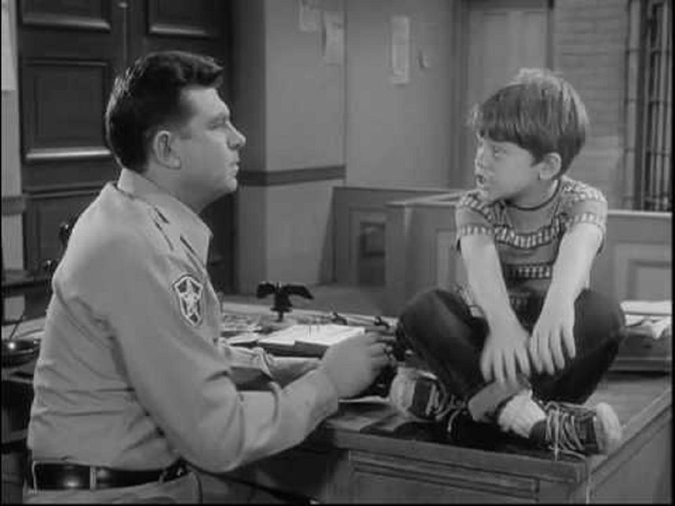

Slide 5
Fathers and their Children. Eph.6:4
Do you know
more about tv fathers
or
Bible fathers?

Slide 6
Fathers and their Children. Eph.6:4
Adam
Noah
Abraham
Lot
Job
Isaac
Jacob
Moses
Aaron
David

Slide 7
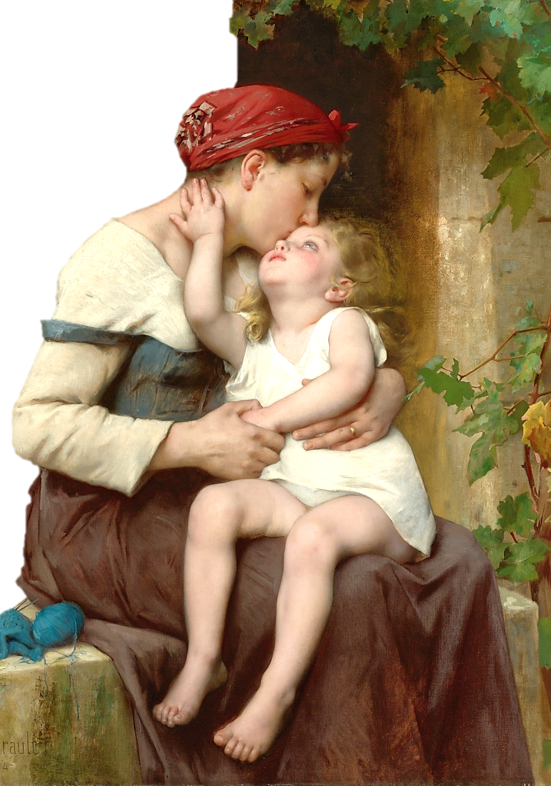
EPHESIANS
Chapter 6
1 Children, obey your parents in the Lord: for this is right.
2 Honour thy father and mother; (which is the first commandment with promise;)
3 That it may be well with thee, and thou mayest live long on the earth.
4 And, ye fathers, provoke not your children to wrath: but bring them up in the nurture and admonition of the Lord.
Wikimedia: Public Domain over 100 years old, USA

Slide 8
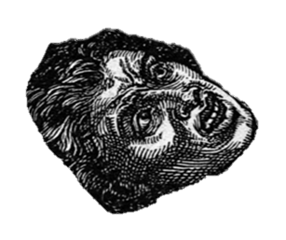
Under the old law a child that was guilty of smiting or cursing a parent, or that was stubborn or rebellious, or that was a glutton or drunkard was to be stoned to death.
REFERENCES: Exodus 21:15-17, Leviticus 20:9
Deuteronomy 21:18-21

Slide 9
Ex. 21:15-17 "And he who strikes his father or his mother shall surely be put to death. 16 "He who kidnaps a man and sells him, or if he is found in his hand, shall surely be put to death. 17 "And he who curses his father or his mother shall surely be put to death.
Lev. 20:9 For everyone who curses his father or his mother shall surely be put to death. He has cursed his father or his mother. His blood shall be upon him.
Deut. 21:18-21 "If a man has a stubborn and rebellious son who will not obey the voice of his father or the voice of his mother, and who, when they have chastened him, will not heed them, 19 "then his father and his mother shall take hold of him and bring him out to the elders of his city, to the gate of his city.
20 "And they shall say to the elders of his city, 'This son of ours is stubborn and rebellious; he will not obey our voice; he is a glutton and a drunkard.' 21 "Then all the men of his city shall stone him to death with stones; so you shall put away the evil from among you, and all Israel shall hear and fear.

Slide 10
Fathers and their Children. Eph.6:4
I am not an expert. My father was not an expert. Our heavenly father is and has revealed to us how to be a father.
"Children are an heritage of the Lord" (Ps. 127:3) and as such should be considered gifts from God who have been placed in our hands to mold and fashion into worth-while citizens in his kingdom.
So, it is our responsibility to "train up a child in the way he should go, and even when he is old he will not depart from it" (Prov. 22:6).

Slide 11
Fathers and their Children. Eph.6:4
Note the word "train." Far too many times this is thought to be accomplished simply by telling how to act, etc. However, there is much more than simply telling.
Telling is definitely important.
(Deut. 6:6-7)." "And these words which I command you today shall be in your heart. 7 "You shall teach them diligently to your children, and shall talk of them when you sit in your house, when you walk by the way, when you lie down, and when you rise up.

Slide 12
Fathers and their Children. Eph.6:4
Fathers need to Know, Show, and Train their children
Being a father is a “Show Me” job. But practice and application are also required. This can be seen even in secular matters. One may attend school where he is told the information he needs, but then he needs on-the-job training, and some are hired as trainees.
He needs the experience. Congregations have training classes in which instruction is given, but training is gained by practice and experience.
This is brought out in the N.T. in Eph. 6:4. "And ye fathers, provoke not your children to wrath: but bring them up in the nurture and admonition of the Lord."

Slide 13
Fathers and their Children. Eph.6:4
Nurture and admonition defined.
Nurture = Train (chastise, discipline, correction).
Admonition = putting in mind by words.
To warn
To correct by discipline
To train.
Admonition. Admonish. Teach and admonish.

Slide 14
Eph. 6:4 And, ye fathers, provoke not your children to wrath: but bring them up in the nurture and admonition of the Lord. (love and control)
love
love
control
control
Lot
control
love
love
control
Abram

Slide 15
Fathers and their Children. Eph.6:4
Col.3:16 Let the word of Christ dwell in you richly in all wisdom; teaching and admonishing one another in psalms and hymns and spiritual songs, singing with grace in your hearts to the Lord.
Teach deals with positive truth...Reason
Admonish deals with things wrong – warning…Power

Slide 16
Fathers and their Children. Eph.6:4
Sometimes we fathers leave this to mothers, but in doing so we have neglected the fact that the passage explicitly gives this to the father!
So, it is his responsibility to do the "nurture and admonition." He can do this by reading the Bible and Bible stories to and with his children and help them to make application of its truth to various aspects of life.
He doesn't merely tell them but helps them in preparing their Bible class lessons.

Slide 17
Fathers and their Children. Eph.6:4
He is involved in training them when he sees to it that they go with him to worship services and participate as much as possible in its activities.
It is his responsibility that they are taught the word of God, to train them in proper behavior,
……and when needed he is to administer discipline, correction, and punishment,
(Prov. 13:24). But he who loves him disciplines him promptly.
If a father is not actively involved in this, he is neglecting his role as father. Thus he is the principal trainer of his children.

Slide 18
Fathers and their Children. Eph.6:4
Nevertheless, (Eph. 5:23). "the husband is the head of the wife as Christ also is head of the church"
So, in addition to being involved in the actual teaching and training, it is his responsibility and God has given him the authority to see that all such nurturing and admonishing is done properly.

Slide 19
Fathers and their Children. Eph.6:4
A father has certain rules by to train his children, and he enforces those rules. He makes them pray and teaches them who gives us all things.
He makes them do to their lessons at home, that they may know that they have got to work and not be lazy.
He makes them be selective as to their companionships. The father knows his children may not be able to get out of evil associations.
He sets certain hours, deadlines, and curfews for the house, that they may learn order and punctuality. (all of this spills over into the church).

Slide 20
Fathers and their Children. Eph.6:4
He does not ask them if they want to go to bible class or go to worship, but he makes them go to worship with him.
That is the kind of nurture and admonition that is meant here, and when it is necessary it must be backed up by wise chastening, or punishment for good."
With admonition, It is not necessary that a parent should always explain to a child the reasons of his procedure.

Slide 21
Fathers and their Children. Eph.6:4
But it is important that, as a rule, children should have explained to them the evil of the way they are asked to avoid, and the advantages of the way they are asked to follow."
They gotta understand the WHY.
Again observe that the text places the responsibility to do this on the fathers.
The wording of this may seem somewhat harsh, but remember the same verse (Eph. 6:4) lets us know that it is to be administered in such a way as not to provoke the children to wrath. – done with love!

Slide 22
Fathers and their Children. Eph.6:4
A lot of parents today are having problems with their children.
This is not a new problem.
We have many examples in the Bible of parents that had problems with their children. We should learn from their mistakes.
We should never give up on our children.
We should always lovingly teach them at all stages of their life to follow God.

Slide 23
Eph. 6:4 And, ye fathers, provoke not your children to wrath: but bring them up in the nurture and admonition of the Lord. (love and control)
love
love
control
control
Lot
control
love
love
control
Abram

Slide 24
