Slide 1
Welcome to our services
New Lebanon Church of Christ
We are Simply Christians.
Our Emphasis is Spiritual, Not Material or Social.
We are striving to be The Same Church as Described in The New Testament.
Please Come Back Again

Slide 2
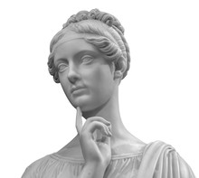
Distracted By Much Serving. Luke 10:40-42
Martha, Martha, you are worried and troubled about many things. But one thing is needed, and Mary has chosen that good part, Luke 10:42

Slide 3
Distracted By Much Serving. Luke 10:40-42
Luke 10:38 Now it happened as they went that He entered a certain village; and a certain woman named Martha welcomed Him into her house.
39 And she had a sister called Mary, who also sat at Jesus' feet and heard His word.
40 But Martha was distracted with much serving, and she approached Him and said, "Lord, do You not care that my sister has left me to serve alone? Therefore tell her to help me."
41 And Jesus answered and said to her, "Martha, Martha, you are worried and troubled about many things.
42 "But one thing is needed, and Mary has chosen that good part, which will not be taken away from her."

Slide 4
Distracted By Much Serving. Luke 10:40-42
One of the lessons we need to learn from this is - The heart that is only half-conquered by Christ’s peace will be easily tossed about when assaulted with the “cares of this world.”
Martha is one cumbered and troubled about her work. A weary, burdened servant, just at the point of breaking down.
What to her was duty has become drudgery. There is some food for thought here for every servant of Christ. Martha—

Slide 5
Distracted By Much Serving. Luke 10:40-42
Sometimes
we get so distracted
by things of the world
that we never even get
around to serving Him
as we ought to.

Slide 6
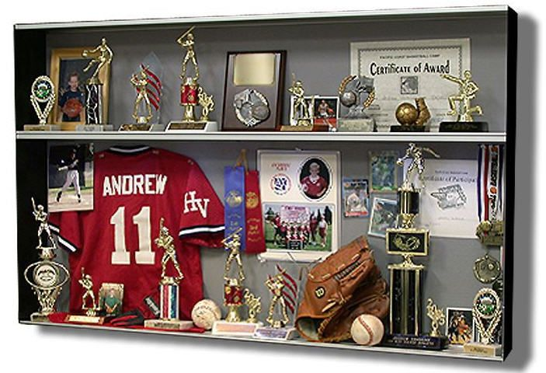

Slide 7
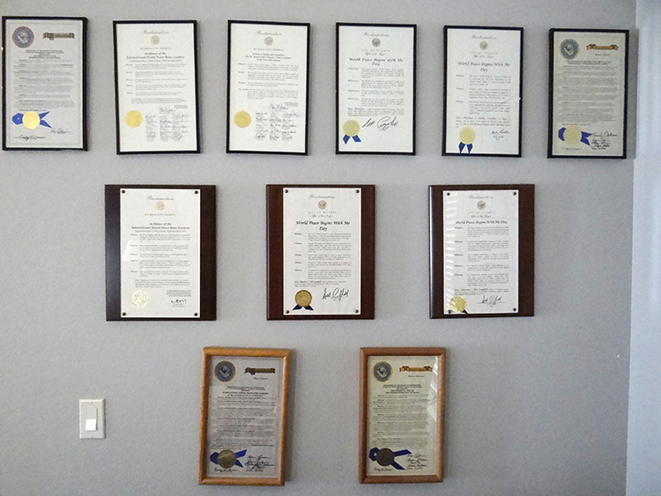

Slide 8
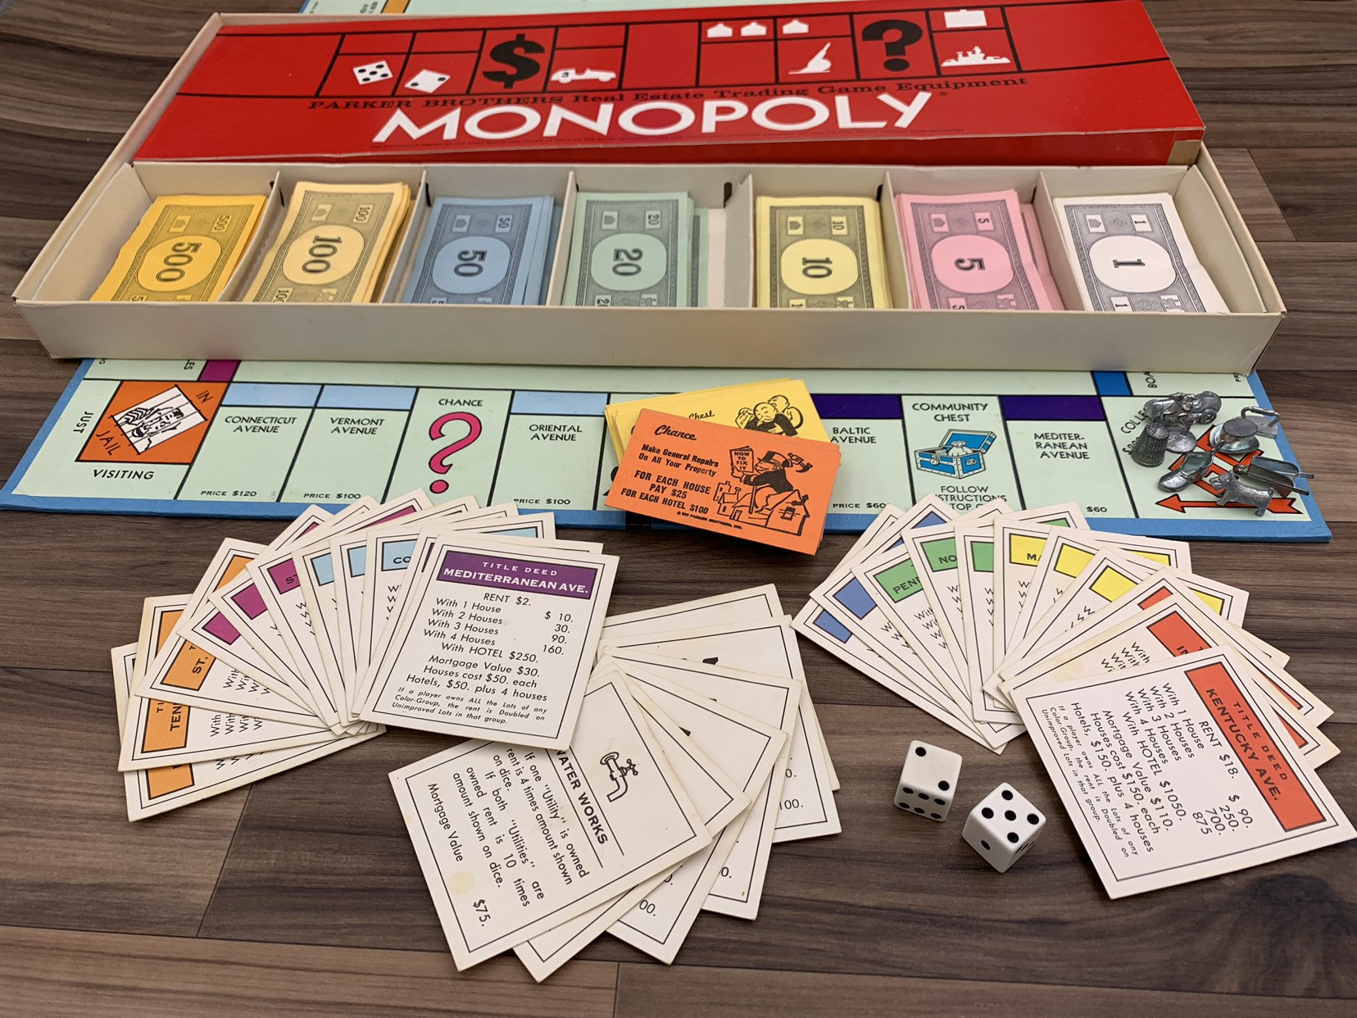

Slide 10
Distracted By Much Serving. Luke 10:40-42
Martha Received Jesus.
“Martha received Him into her house.” Her receiving Him was the proof of her faith in Him. It is vain and presumptuous for us to talk about our faith in Christ if we have not actually received Him into the house of the heart
John 1:12 But as many as received Him, to them He gave the right to become children of God, to those who believe in His name:

Slide 11
Distracted By Much Serving. Luke 10:40-42
Martha Sat at His Feet.
39 And she had a sister called Mary, who also sat at Jesus' feet and heard His word. This word also proves that Martha had sat and listened to His words as well as Mary.
sat--"seated herself." From the custom of sitting beneath an instructor, the phrase "sitting at one's feet" came to mean being a disciple of any one (Acts 22:3).
Very little is said about Mary; in fact, these sisters are mentioned only three times in gospel history. Mary "sat at the Lord's feet, and heard his word."

Slide 12
Distracted By Much Serving. Luke 10:40-42
Martha Sat at His Feet.
Acts 22:3 "I am indeed a Jew, born in Tarsus of Cilicia, but brought up in this city at the feet of Gamaliel, taught according to the strictness of our fathers' law, and was zealous toward God as you all are today.

Slide 13
Distracted By Much Serving. Luke 10:40-42
Martha Was an Active Worker
She busied herself with “much serving.” She was none of those spongy Christians who can do nothing but drink in. There are many whose sole conception of the Christian life is to hear.
Martha was not only a hearer, but a doer.
She had listened to His words, and she would minister to Him. Her service, too, was no ordinary service. She had planned to do much. The honest, earnest design of her generous heart was to accomplish much for the honor of Jesus.

Slide 14
Distracted By Much Serving. Luke 10:40-42
Martha Became Worried over her Work
“Martha was cumbered about much serving.”
“We are not always to be seeking, we must come to finding Him.
The seeker works actively; the finder enjoys quietly.”
40 But Martha was cumbered about much serving;—In contrast to Mary at her Master's feet is Martha bustling amid anxious cares and overburdened with much labor.
She is "cumbered," which means "perplexed, overoccupied"; with her domestic duties weighing heavily upon her in preparing the table for the entertainment of Jesus,
she complains to Jesus about her sister Mary.

Slide 15
Distracted By Much Serving. Luke 10:40-42
Jesus frequently visited this home; He was not a stranger. Martha came quickly to Jesus in the room where he was sitting and asked that he tell Mary to help her.
There seems to be a reproach to Jesus in her speech as she asked if he did not care that Mary had left her alone to serve. It was an explosive act of Martha to speak this way to Jesus.

Slide 16
Distracted By Much Serving. Luke 10:40-42
Whenever work for the Lord brings upon us the worry of “carefulness and trouble,” we may be assured that we have somehow got out of Christ’s yoke.
Jesus said, “My yoke is easy, and My burden is light. Take My yoke upon you, and ye shall find rest unto your souls.”

Slide 17
Distracted By Much Serving. Luke 10:40-42
Martha Began to Complain
40 But Martha was distracted with much serving, and she approached Him and said, "Lord, do You not care that my sister has left me to serve alone? Therefore tell her to help me."
The worried and cumbered worker will soon be found in the ranks of the grumblers.
Martha’s big task of “much serving” was self-imposed, and she, like all those in similar circumstances, soon got burdened and wearied.

Slide 18
Distracted By Much Serving. Luke 10:40-42
God-given work will never be cumbersome when done in His strength.
Those cumbered and grumbling workers who are continually pouring their grievances into the ears of their fellow-servants ought to consider Martha.
Dare to be honest, and say as she did, “Lord, dost Thou not care?” Have the question of worry settled with your Master.
Find out whether your harassing anxiety about His service is pleasing to Him, or whether there is not some one that He might come and help you,
or whether you are not “careful and troubled” about things which the Lord has no interest in.

Slide 19
Distracted By Much Serving. Luke 10:40-42
Martha Was Rebuked by the Lord
41 And Jesus answered and said to her, "Martha, Martha, you are worried and troubled about many things.
This was an impressive and emphatic repetition, calling her attention to the important truth he was about to utter. Martha was fretted with work, and Jesus kindly and calmly answered her outburst of feeling and said that she was "anxious and troubled about many things."

Slide 20
Distracted By Much Serving. Luke 10:40-42
The many cares in providing for his entertainment were not necessary. Jesus reproved her, not so much to the entertaining of him as to her state of mind; not to the mere providing for the company, but to her needless restless agitation of spirit which could well have been spared on that occasion.
careful and cumbered—
the one word expressing the inward worrying anxiety that her preparations should be worthy of her Lord;
the other, the outward bustle of those preparations.
many things--"much service" (Luke 10:40); too elaborate preparation, which so engrossed her attention that she missed her Lord's teaching.

Slide 21
Distracted By Much Serving. Luke 10:40-42
Martha was anxious about "many things," but Jesus informed her that only "one thing is needful." Here Jesus puts in contrast the "many things" with the "one thing"; that contrast is not only in regard to number, but also in regard to kind. Martha was absorbed with the physical and earthly.
Jesus points her to the spiritual and heavenly. The one thing needful was a proper state of heart for receiving Jesus, and also the receiving of his truth. With proper attention to the one thing needful, Martha as well as Mary could have done well in attending to her

Slide 22
Distracted By Much Serving. Luke 10:40-42
It is no honor to the Prince of Peace that His servants’ hearts should be filled with restlessness about His business.
(John 14:27) "Peace I leave with you, My peace I give to you; not as the world gives do I give to you. Let not your heart be troubled, neither let it be afraid.
(1 Cor. 7:32) But I want you to be without care. He who is unmarried cares for the things of the Lord--how he may please the Lord.

Slide 23
Distracted By Much Serving. Luke 10:40-42
“Take no thought (anxious concern) for your life.” Your Father knows (Matt. 6:25). "Therefore I say to you, do not worry about your life, what you will eat or what you will drink; nor about your body, what you will put on. Is not life more than food and the body more than clothing?
If the Lord had told Mary go and help Martha He would have partly justified her in her complaint, but, no, He said in substance, “You take too much upon you. The one thing you need is not a helping hand, but a restful heart.”
Mary had chosen that good part, and He will not take it from her.

Slide 24
Distracted By Much Serving. Luke 10:40-42
There are many Marthas, whose faces bear the traces of a worried and troubled heart, even while they are seeking to serve Jesus.
“Cumbered about much serving.”
Cast all your care upon Him, for He cares for you.
Rest in the Lord.
The daughter of Martha---

Slide 25
Distracted By Much Serving. Luke 10:40-42
Martha, Martha, you are worried and troubled about many things. But one thing is needed, and Mary has chosen that good part, Luke 10:42

Slide 26
Distracted By Much Serving. Luke 10:40-42
Don’t be anxious about many things.
Put Christ first in your life.
He already is King of kings and Lord of lords. Do we let Him reign and rule our heart?

