Slide 1
Welcome to our services
New Lebanon Church of Christ
We are Simply Christians.
Our Emphasis is Spiritual, Not Material or Social.
We are striving to be The Same Church as Described in The New Testament.
Please Come Back Again

Slide 2
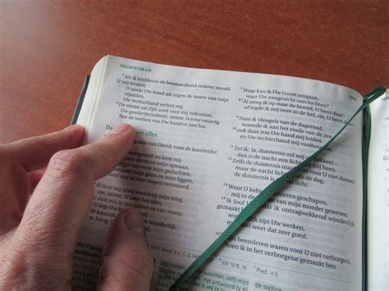
What Is Death?
2 Timothy 4:6

Slide 3
What Is Death 2 Timothy 4:6
2Tim. 4:6 For I am already being poured out as a drink offering, and the time of my departure is at hand.
7 I have fought the good fight, I have finished the race, I have kept the faith.
8 Finally, there is laid up for me the crown of righteousness, which the Lord, the righteous Judge, will give to me on that Day, and not to me only but also to all who have loved His appearing.

Slide 4
What Is Death 2 Timothy 4:6
1. Death is not:
Not The means of converting a wicked person into a Christian
Lk,16 :19-31. As one dies so is he.
Not the extinction of man Lk.16 :19-31. Both the good and the bad continued to live after death.

Slide 5
Luke 16
“²²And it came to pass, that the beggar died, and was carried by the angels into Abraham’s bosom: the rich man also died, and was buried;
Wikimedia / Public Domain US – 100 years old

Slide 6
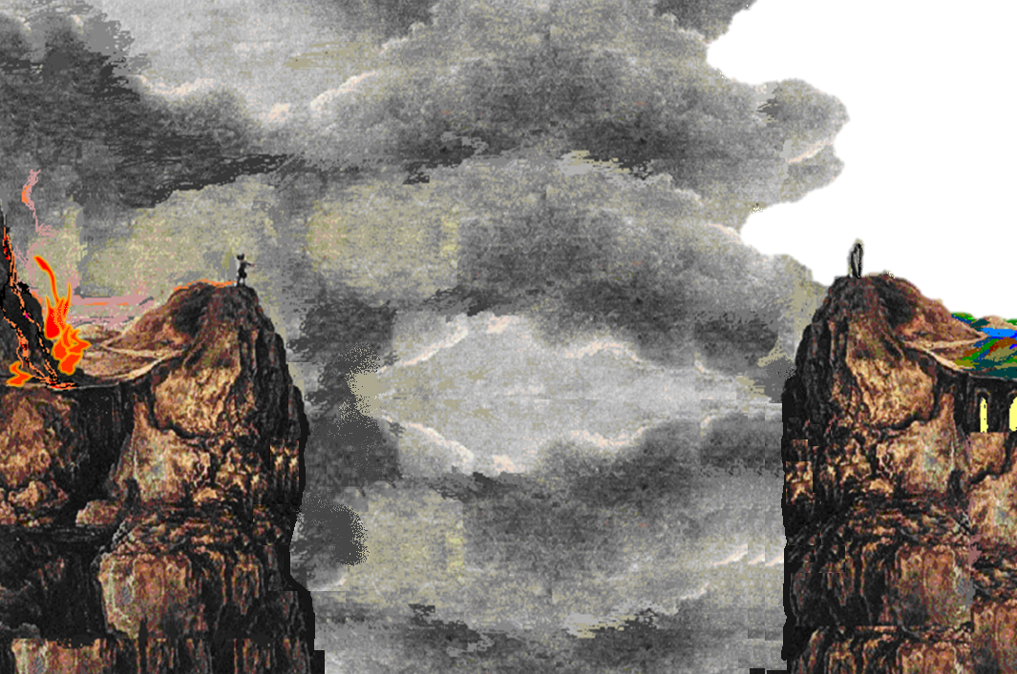
Luke 16
“²⁷Then he said, I pray thee therefore, father, that thou wouldest send him to my father’s house: ²⁸For I have five brethren; that he may testify unto them, lest they also come into this place of torment.”
Luke 16
“²⁵But Abraham said, Son, remember that thou in thy lifetime receivedst thy good things, and likewise Lazarus evil things: but now he is comforted, and thou art tormented. ²⁶And beside all this, between us and you there is a great gulf fixed: so that they which would pass from hence to you cannot; neither can they pass to us, that would come from thence.”
Luke 16
“²⁹Abraham saith unto him, They have Moses and the prophets; let them hear them.”
Luke 16
“²⁴And he cried and said, Father Abraham, have mercy on me, and send Lazarus, that he may dip the tip of his finger in water, and cool my tongue; for I am tormented in this flame.”
Luke 16
“³¹And he said unto him, If they hear not Moses and the prophets, neither will they be persuaded, though one rose from the dead.”
Luke 16
“³⁰And he said, Nay, father Abraham: but if one went unto them from the dead, they will repent.”

Slide 7
Hades
[“Sheol” in the Hebrew]

Slide 8
Hades
GREAT GULF
Rich Man
in
Tartarus
Lazarus
in
Paradise

Slide 9
What Is Death 2 Timothy 4:6
2. Death is: an appointment God has made for us
(Heb. 9:27). And as it is appointed for men to die once, but after this the judgment,

Slide 10
What Is Death 2 Timothy 4:6
We are pilgrims on earth.
(Heb. 11:13). These all died in faith, not having received the promises, but having seen them afar off were assured of them, embraced them and confessed that they were strangers and pilgrims on the earth.

Slide 11
What Is Death 2 Timothy 4:6
3. Death is: both certain and uncertain.
It is certain to come Gen. 3 :3, "but of the fruit of the tree which is in the midst of the garden, God has said, 'You shall not eat it, nor shall you touch it, lest you die.'"
but the time is uncertain
James 4 :14. whereas you do not know what will happen tomorrow. For what is your life? It is even a vapor that appears for a little time and then vanishes away.

Slide 12
What Is Death 2 Timothy 4:6
4. Death is: the end of labors that will be rewarded.
John. 9 :4 I must work the works of Him who sent Me while it is day; the night is coming when no one can work.
The rich man waited too late Lk.16:26. 'And besides all this, between us and you there is a great gulf fixed, so that those who want to pass from here to you cannot, nor can those from there pass to us.'

Slide 13
What Is Death 2 Timothy 4:6
5.Death is: a state over which the Lord has power.
The Lord will raise the dead 1Cor.15 :51-55
John 5:28,29 "Do not marvel at this; for the hour is coming in which all who are in the graves will hear His voice 29 "and come forth--those who have done good, to the resurrection of life, and those who have done evil, to the resurrection of condemnation.
1Thess.4:16. For the Lord Himself will descend from heaven with a shout, with the voice of an archangel, and with the trumpet of God. And the dead in Christ will rise first.

Slide 14
What Is Death 2 Timothy 4:6
6. Death is: the last enemy of man to be conquered by the Lord
1 Cor.15:25,26. For He must reign till He has put all enemies under His feet. 26 The last enemy that will be destroyed is death.
Enemies

Slide 15
What Is Death 2 Timothy 4:6
7. Death is a departure. (2Tim 4:6)
For I am already being poured out as a drink offering, and the time of my departure is at hand.
7 I have fought the good fight, I have finished the race, I have kept the faith.
8 Finally, there is laid up for me the crown of righteousness, which the Lord, the righteous Judge, will give to me on that Day, and not to me only but also to all who have loved His appearing.

Slide 16
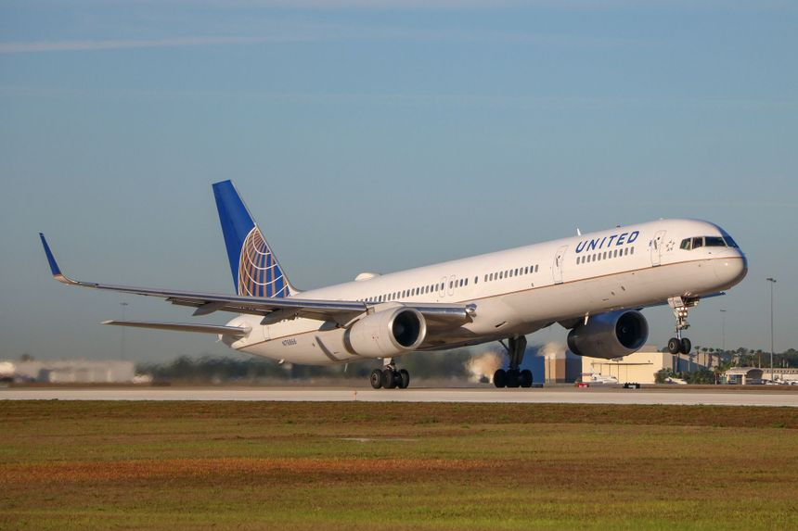
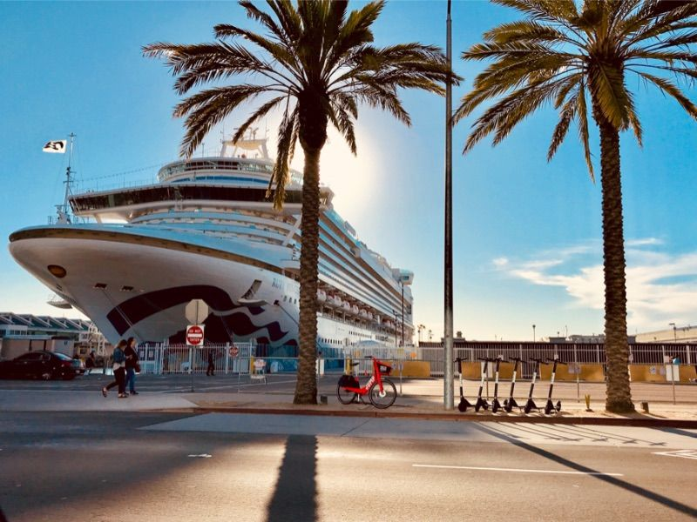
What Is Death 2 Timothy 4:6
7. Death is a departure. (2Tim 4:6)

Slide 17
What Is Death 2 Timothy 4:6
Death is a departure From the world
Eccl.12:5. Also they are afraid of height, And of terrors in the way; When the almond tree blossoms, The grasshopper is a burden, And desire fails. For man goes to his eternal home, And the mourners go about the streets.

Slide 18
What Is Death 2 Timothy 4:6
Death is a departure From the body
Eccl.12:7 Then the dust will return to the earth as it was, And the spirit will return to God who gave it.
James 2:26. For as the body without the spirit is dead, so faith without works is dead also.

Slide 19
What Is Death 2 Timothy 4:6
8. Death serves as transportation, an exit from this world and an entrance into another world
Gen.35:16 Then they journeyed from Bethel. And when there was but a little distance to go to Ephrath, Rachel labored in childbirth, and she had hard labor. 17 Now it came to pass, when she was in hard labor, that the midwife said to her, "Do not fear; you will have this son also."
18 And so it was, as her soul was departing (for she died), that she called his name Ben-Oni; but his father called him Benjamin. 19 So Rachel died and was buried on the way to Ephrath (that is, Bethlehem).

Slide 20
What Is Death 2 Timothy 4:6
It is necessary that we put off this physical body of flesh and blood
1 Cor. 15:50. Now this I say, brethren, that flesh and blood cannot inherit the kingdom of God; nor does corruption inherit incorruption.
51 Behold, I tell you a mystery: We shall not all sleep, but we shall all be changed-- 52 in a moment, in the twinkling of an eye, at the last trumpet. For the trumpet will sound, and the dead will be raised incorruptible, and we shall be changed.
53 For this corruptible must put on incorruption, and this mortal must put on immortality. 54 So when this corruptible has put on incorruption, and this mortal has put on immortality, then shall be brought to pass the saying that is written: "Death is swallowed up in victory."
55 "O Death, where is your sting? O Hades, where is your victory?"56 The sting of death is sin, and the strength of sin is the law.
57 But thanks be to God, who gives us the victory through our Lord Jesus Christ.58 Therefore, my beloved brethren, be steadfast, immovable, always abounding in the work of the Lord, knowing that your labor is not in vain in the Lord.

Slide 21
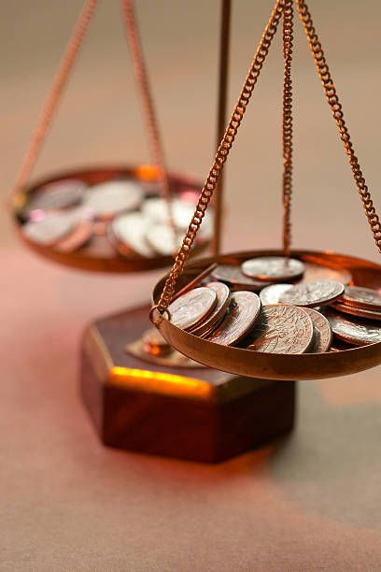
What Is Death 2 Timothy 4:6
9. Death is designed to be gain
Phil. 1:21. For to me, to live is Christ, and to die is gain.

Slide 22
What Is Death 2 Timothy 4:6
10. Death is an emancipation for the righteous. Heb.4:1-11
Rest from labors - Therefore, since a promise remains of entering His rest, let us fear lest any of you seem to have come short of it.2 For indeed the gospel was preached to us as well as to them; but the word which they heard did not profit them, not being mixed with faith in those who heard it.
3 For we who have believed do enter that rest, as He has said: "So I swore in My wrath, 'They shall not enter My rest,'" although the works were finished from the foundation of the world.
4 For He has spoken in a certain place of the seventh day in this way: "And God rested on the seventh day from all His works"; 5 and again in this place: "They shall not enter My rest."

Slide 23
What Is Death 2 Timothy 4:6
10. Death is an emancipation for the righteous.
Heb.4:1-11
Rest from labors - Therefore, since a promise remains of entering His rest, let us fear lest any of you seem to have come short of it.2 For indeed the gospel was preached to us as well as to them; but the word which they heard did not profit them, not being mixed with faith in those who heard it.

Slide 24
What Is Death 2 Timothy 4:6
10. Death is an emancipation for the righteous.
Heb.4:1-11
3 For we who have believed do enter that rest, as He has said: "So I swore in My wrath, 'They shall not enter My rest,'" although the works were finished from the foundation of the world.
4 For He has spoken in a certain place of the seventh day in this way: "And God rested on the seventh day from all His works"; 5 and again in this place: "They shall not enter My rest."

Slide 25
What Is Death 2 Timothy 4:6
6 Since therefore it remains that some must enter it, and those to whom it was first preached did not enter because of disobedience, (The Israelites that did not enter Canaan)
7 again He designates a certain day, saying in David, "Today," after such a long time, as it has been said: "Today, if you will hear His voice, Do not harden your hearts."
8 For if Joshua had given them rest, then He would not afterward have spoken of another day. 9 There remains therefore a rest for the people of God.
10 For he who has entered His rest has himself also ceased from his works as God did from His.11 Let us therefore be diligent to enter that rest, lest anyone fall according to the same example of disobedience.

Slide 26
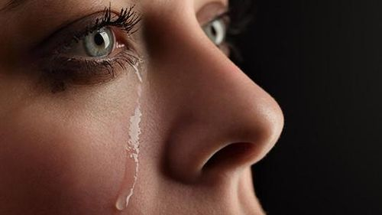
What Is Death 2 Timothy 4:6
No pain, sorrow, death, tears - those former things are passed away.
Rev. 21:4 "And God will wipe away every tear from their eyes; there shall be no more death, nor sorrow, nor crying. There shall be no more pain, for the former things have passed away."

Slide 27
What Is Death 2 Timothy 4:6
11. Death is not the end of man's influence
Rev.14:13. Then I heard a voice from heaven saying to me, "Write: 'Blessed are the dead who die in the Lord from now on.'" "Yes," says the Spirit, "that they may rest from their labors, and their works follow them."

Slide 28
What Is Death 2 Timothy 4:6
12. Death is sure.
Psa. 90:10 The days of our lives are seventy years; And if by reason of strength they are eighty years, Yet their boast is only labor and sorrow; For it is soon cut off, and we fly away.
Job.14:1,2 "Man who is born of woman Is of few days and full of trouble. 2 He comes forth like a flower and fades away; He flees like a shadow and does not continue.

Slide 29
What Is Death 2 Timothy 4:6
13. Death is in the good interest of man.
The earth is not man's eternal home Eccl.12:7,
2 Cor.5:1. For we know that if our earthly house, this tent, is destroyed, we have a building from God, a house not made with hands, eternal in the heavens.
Why should you be sad? Death only husks the corn. Why should you fear to meet the thresher of the wheat?

Slide 30
What Is Death 2 Timothy 4:6
These bodies are not adapted to heaven. Flesh and blood cannot inherit the kingdom of God 1Cor.15 :50.
He will give us a new body like his own
Phil.3:20-21. For our citizenship is in heaven, from which we also eagerly wait for the Savior, the Lord Jesus Christ,
21 who will transform our lowly body that it may be conformed to His glorious body, according to the working by which He is able even to subdue all things to Himself.

Slide 31
What Is Death 2 Timothy 4:6
Story of the rich man and Lazarus Lk.16:19.31.
Rich man wanted to go to heaven, but waited too late to make the preparation.
Rich man wanted to become a soul winner, but waited too late.
He waited too late to hear and obey God's word.
Now" and today" are great words in the Bible

Slide 32
What Is Death 2 Timothy 4:6
2Cor. 6:2 For He says: "In an acceptable time I have heard you, And in the day of salvation I have helped you." Behold, now is the accepted time; behold, now is the day of salvation.

Slide 33
What Is Death 2 Timothy 4:6
Let us perform our duties now lest time run out on us.
Psalm116:15. Precious in the sight of the LORD Is the death of His saints.

Slide 34
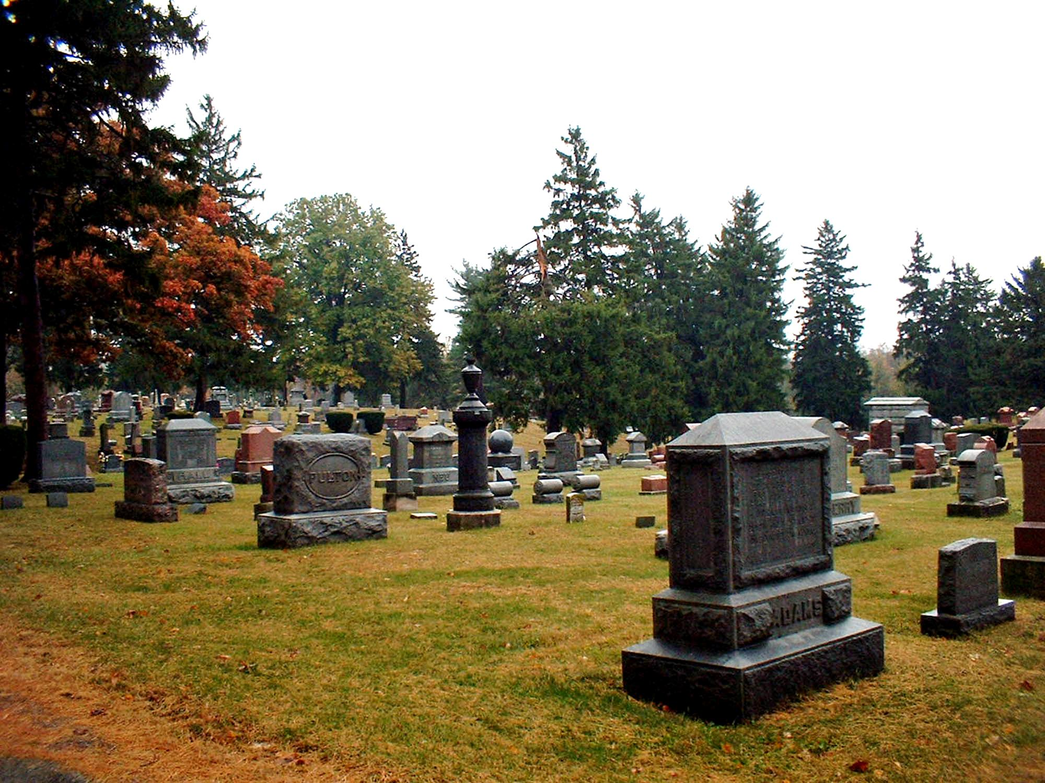
Everyone who lived and died on this earth is now in Hades and awaits God’s judgment according to their works (Rev. 20:12).

Slide 35
Rev. 20:11–15
¹¹ Then I saw a great white throne and Him who sat on it, from whose face the earth and the heaven fled away. And there was found no place for them. ¹² And I saw the dead, small and great, standing before God, and books were opened. And another book was opened, which is the Book of Life. And the dead were judged according to their works, by the things which were written in the books.
¹³ The sea gave up the dead who were in it, and Death and Hades delivered up the dead who were in them. And they were judged, each one according to his works. ¹⁴ Then Death and Hades were cast into the lake of fire. This is the second death. ¹⁵ And anyone not found written in the Book of Life was cast into the lake of fire.

Slide 36
How will YOU leave this world?
Wikimedia / Public Domain US – 100 years old

