Slide 1
Welcome to our services
New Lebanon Church of Christ
We are Simply Christians.
Our Emphasis is Spiritual, Not Material or Social.
We are striving to be The Same Church as Described in The New Testament.
Please Come Back Again

Slide 2
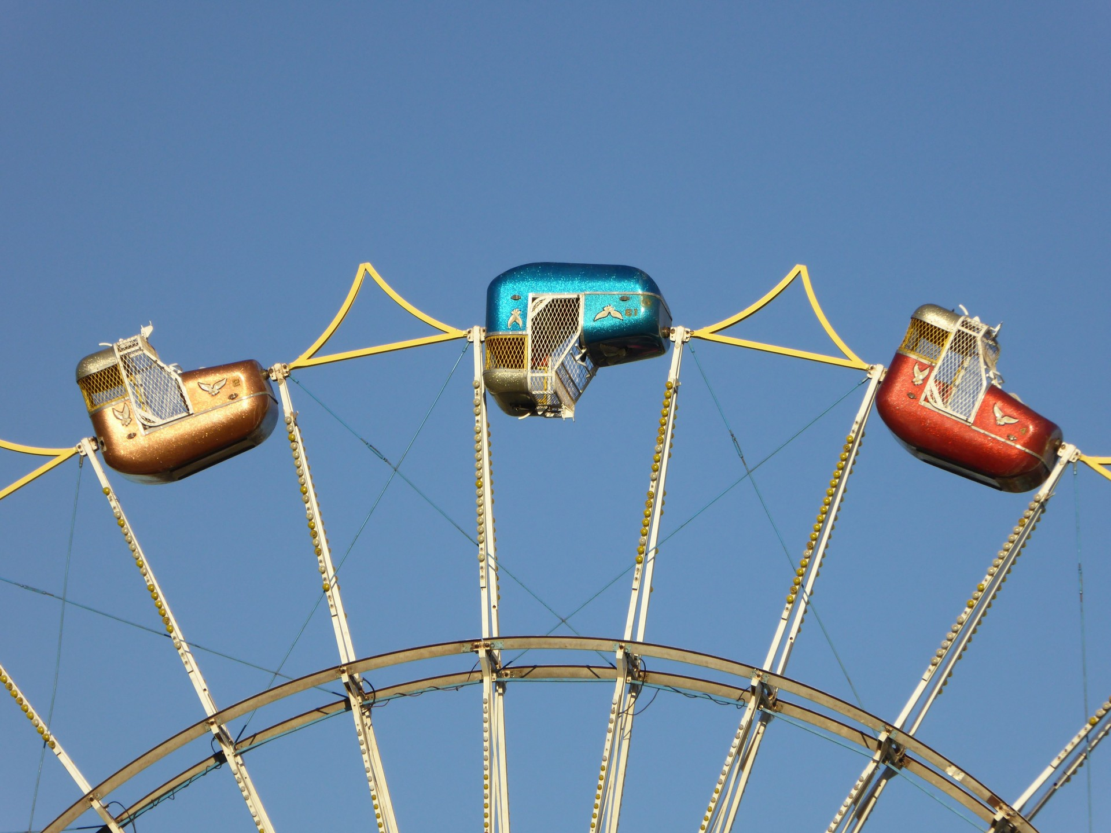
The Church In An Upside Down World
Acts 17:1-6

Slide 3
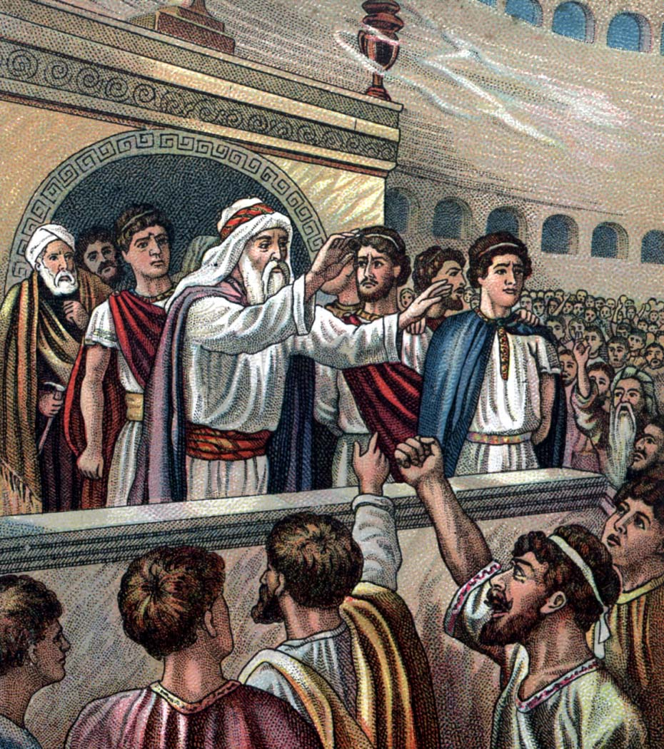
Acts 17:1 Now when they had passed through Amphipolis and Apollonia, they came to Thessalonica, where there was a synagogue of the Jews.
2 Then Paul, as his custom was, went in to them, and for three Sabbaths reasoned with them from the Scriptures,
3 explaining and demonstrating that the Christ had to suffer and rise again from the dead, and saying, "This Jesus whom I preach to you is the Christ."
4 And some of them were persuaded; and a great multitude of the devout Greeks, and not a few of the leading women, joined Paul and Silas.
5 But the Jews who were not persuaded, becoming envious, took some of the evil men from the marketplace, and gathering a mob, set all the city in an uproar and attacked the house of Jason, and sought to bring them out to the people.
6. But when they did not find them, they dragged Jason and some brethren to the rulers of the city, crying out, "These who have turned the world upside down have come here too.

Slide 4
The Church In An Upside Down World
We live in an upside down world. It is chaotic, turbulent, filled with disorder and unrest.
But the church of the Lord and the sin-filled world are diametrically opposite. They stand apart on every moral and spiritual issue.
People of God and people of the world have different aims in life.

Slide 5
The Church In An Upside Down World
What is the Aim of the people of the World: They want more and more materialism and pleasure They are filled with pride and want fullness of bread and abundance of idleness –

Slide 6
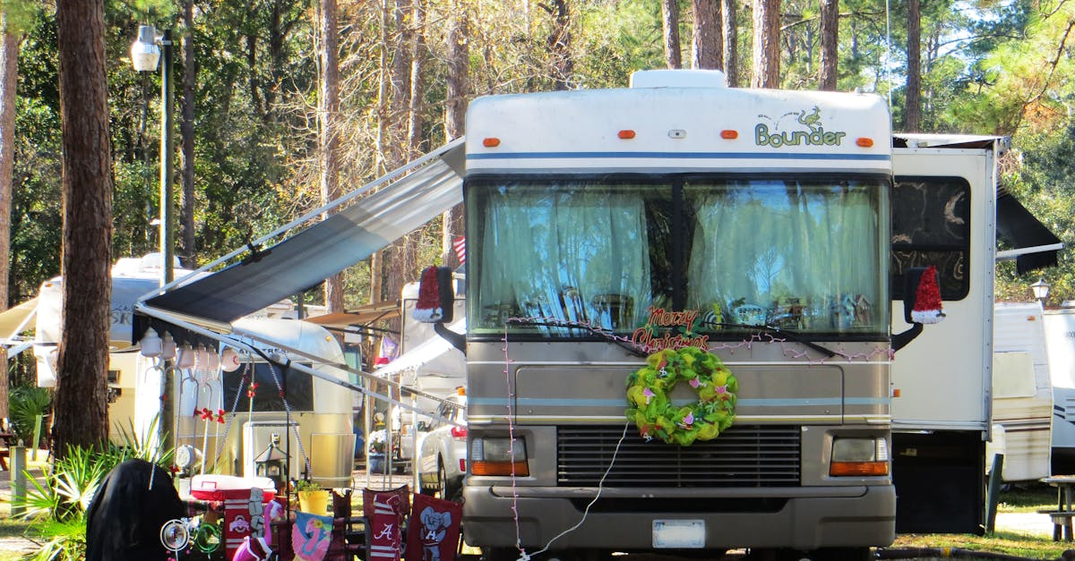
The Church In An Upside Down World
Ezek. 16: 49-50 “Look, this was the iniquity of your sister Sodom: She and her daughter had pride, fullness of food, and abundance of idleness; neither did she strengthen the hand of the poor and needy. 50 "And they were haughty and committed abomination before Me; therefore I took them away as I saw fit.

Slide 7
The Church In An Upside Down World
They want lifestyles to be what the individual wants.
Judges 21: 25 In those days there was no king in Israel; everyone did what was right in his own eyes.
They want rules and values that can be broken as easily as they were made.

Slide 8
The Church In An Upside Down World
They want a selfish lifestyle. They want to be able to engage in all kinds of sexual immorality and unlawful lust. They want to ignore and reject God's laws on sex and marriage.

Slide 9
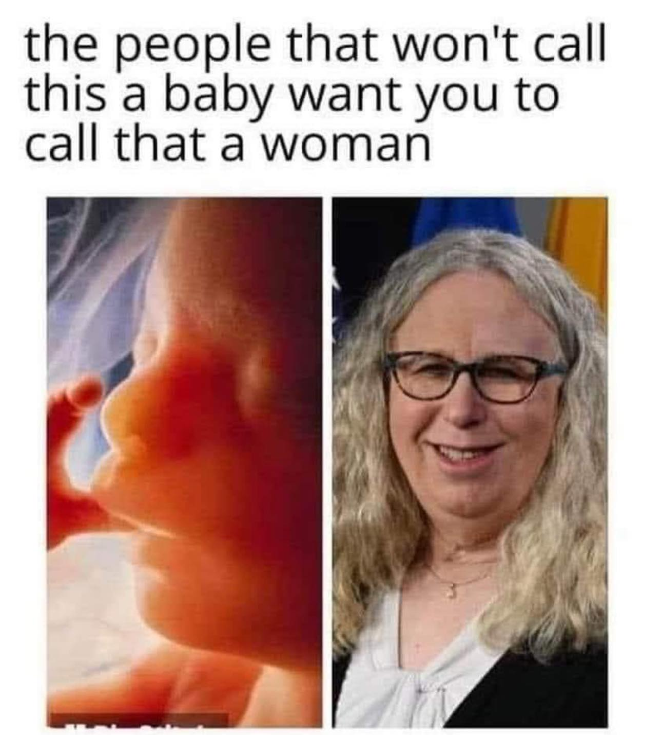
“America is sick in all ramification that sickness have taken over her political power . Destruction within is God response to the attack on his sovereignty”

Slide 11
The Church In An Upside Down World
But, the people of God want to obey and please God
Heb. 5:9; And having been perfected, He became the author of eternal salvation to all who obey Him,

Slide 12
The Church In An Upside Down World
1 Pet. 4:2 that he no longer should live the rest of his time in the flesh for the lusts of men, but for the will of God.
We want to seek first the Kingdom of God -- Matt. 6:33; Col. 3: 1- 2

Slide 13
The Church In An Upside Down World
We want Not to be conformed to this world -- Rom. 12: 1 - 2; 2 Cor. 6:17
We want to have a lifestyle that is in harmony with God's will.
We believe that marriage is a God-planned relationship for man's happiness -- Heb. 13:4; Matt.19:3-9

Slide 14
The Church In An Upside Down World
We believe God has given laws prohibiting prostitution, fornication, adultery, homosexuality, incest, bestiality, and other sexual uncleanness
1 Cor. 6:18; 6:9-10; Eph. 5:5
We believe the Church and the World can NEVER dovetail together
We believe Their purposes and aims and ultimate goals are different.

Slide 15
The Church In An Upside Down World
The world is too near and dear to too many members of the church today –
James 4:4 Ye adulterers and adulteresses, know ye not that the friendship of the world is enmity with God? whosoever therefore will be a friend of the world is the enemy of God.

Slide 16
The Church In An Upside Down World
What Does It Mean To Be Different From The World It means to be in the MINORITY
Matt. 22:14 For many are called, but few are chosen.
Eph. 1:4 According as he hath chosen us in him before the foundation of the world, that we should be holy and without blame before him in love:
It means to be UNPOPULAR. Matt. 10:22; And ye shall be hated of all men for my name's sake: but he that endures to the end shall be saved.

Slide 17
The Church In An Upside Down World
It means to be
MISUNDERSTOOD and MISREPRESENTED
Acts 28:22 But we desire to hear of thee what thou thinkest: for as concerning this sect, we know that everywhere it is spoken against.
It means to be constantly ON THE DEFENSIVE -- Phil. 1:17; But the other of love, knowing that I am set for the defense of the gospel.
Jude 3; Beloved, when I gave all diligence to write unto you of the common salvation, it was needful for me to write unto you, and exhort you that ye should earnestly contend for the faith which was once delivered unto the saints.

Slide 18
The Church In An Upside Down World
The World Constantly Tries To Compromise The Church And Its Purity
Church at Corinth -- 1 Cor. 5: 1 – 5
Church of Thyatira -- Rev. 2:20 Notwithstanding I have a few things against thee, because thou sufferest that woman Jezebel, which calleth herself a prophetess, to teach and to seduce my servants to commit fornication, and to eat things sacrificed unto idols.

Slide 19
The Church In An Upside Down World
Church at Laodicea -- Rev. 3: 15 I know thy works, that thou art neither cold nor hot: I would thou wert cold or hot. 16 So then because thou art lukewarm, and neither cold nor hot, I will spew thee out of my mouth.
Church at Pergamum -- Rev. 2:14 – But I have a few things against thee, because thou hast there them that hold the doctrine of Balaam, who taught Balak to cast a stumbling block before the children of Israel,

Slide 20
The Church In An Upside Down World
The membership in some churches has grown
to embrace many people who are NOT CONVERTED
To Christ.

Slide 21
The Church In An Upside Down World
The membership in some churches has grown to embrace many people who are NOT CONVERTED

Slide 22
The Church In An Upside Down World
Too many members are in love with the world, and the gospel is DILUTED and FLAVORED to make it appealing to the masses.
2 Tim. 4:2-5 Preach the word! Be ready in season and out of season. Convince, rebuke, exhort, with all longsuffering and teaching. 3 For the time will come when they will not endure sound doctrine, but according to their own desires, because they have itching ears, they will heap up for themselves teachers; 4 and they will turn their ears away from the truth, and be turned aside to fables.
5 But you be watchful in all things, endure afflictions, do the work of an evangelist, fulfill your ministry.

Slide 23
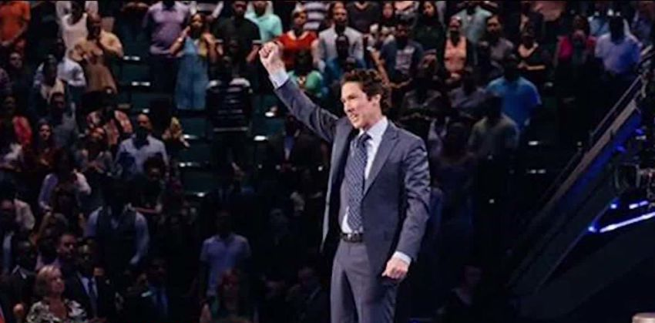
The Church In An Upside Down World
The Church Does Not Try To Please The World - It Tries To Convert The World.
Preaching that pleases the world helps no one
Gal. 1:10 For do I now persuade men, or God? or do I seek to please men? for if I yet pleased men, I should not be the servant of Christ.

Slide 24
The Church In An Upside Down World
Conversion separates people from old relationships
Matt. 10: 34 -37; "Do not think that I came to bring peace on earth. I did not come to bring peace but a sword.35 "For I have come to 'set a man against his father, a daughter against her mother, and a daughter-in-law against her mother-in-law’;
36 "and 'a man's enemies will be those of his own household.'37 "He who loves father or mother more than Me is not worthy of Me. And he who loves son or daughter more than Me is not worthy of Me.

Slide 25
The Church In An Upside Down World
To be a follower of Christ, one must pay a PRICE –
Luke 14:25-33;
The gospel is about CHANGE and COMMITMENT. (1) Religion, if it is to be worth anything to you, will have to be sacrificed for -- Luke 9:23; Then He said to them all, "If anyone desires to come after Me, let him deny himself, and take up his cross daily, and follow Me. (2) You will have to INVEST your life in it -- Matt. 6:33

Slide 26
The Church In An Upside Down World
Christians MUST serve Christ with SINGLENESS OF HEART Matt. 6:24 "No one can serve two masters; for either he will hate the one and love the other, or else he will be loyal to the one and despise the other. You cannot serve God and mammon.

Slide 27
The Church In An Upside Down World
What is the solution for the church to flourish in the world?
What is the solution to turn the world “right –side-up”?
We want to obey and please God
We want to seek first the Kingdom of God
We want to be transformed from the world, not conformed to this world.
We want to have a lifestyle that is in harmony with God's will
We want to "Come Out And Be Separate From The World"
We want to convert the world, not try to please the world.

Slide 28
The Church In An Upside Down World
We cannot turn the world right-side up by positive preaching only.
Jeremiah 1:10 See, I have this day set you over the nations
and over the kingdoms,
To root out
and to pull down,
To destroy
and to throw down,
To build and to plant."

Slide 29
Are You A New Testament Christian?
Hear the Gospel (Rom.10:14).
Believe the Gospel (Heb. 11:6).
Repent of Sins (Acts 3:19).
Confess Christ (Rom.10:9).
Be Baptized Into Christ (1 Cor.12:13).
1 Timothy 4:16
“Take heed unto thyself, and unto the doctrine; continue in them: for in doing this thou shalt both save thyself, and them that hear thee.”

