Slide 1
Welcome to our services
New Lebanon Church of Christ
We are Simply Christians.
Our Emphasis is Spiritual, Not Material or Social.
We are striving to be The Same Church as Described in The New Testament.
Please Come Back Again

Slide 2
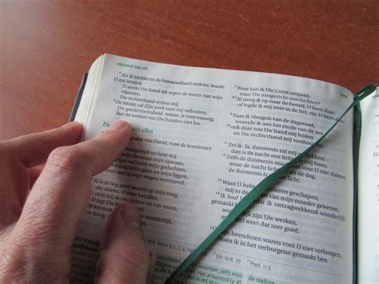
The Value
of the church.
1Peter 1:18-19

Slide 3
The Value Of The Church. 1Peter 1:18-19
1Peter 1:18 knowing that you were not redeemed with corruptible things, like silver or gold, from your aimless conduct received by tradition from your fathers,
19 but with the precious blood of Christ, as of a lamb without blemish and without spot.

Slide 4
The Value Of The Church. 1Peter 1:18-19
THE church is a divine institution. Jesus said: "I will build my church.“ (Matt. 16:18.)
He is the only one that has a right to speak of it as "my church." When men say "my church," they are not thinking clearly.
Hundreds of religious organizations in the world started by men.
There is no salvation in any human institution, be it religious, fraternal, social, or political.

Slide 5
The Value Of The Church. 1Peter 1:18-19
1. The church is valuable because of what it cost. It cost God his Son, and it cost the Son his blood.
The church was made possible by the blood of
Christ. We are bought with his precious blood. Paul told the Ephesian elders that the church was purchased with the blood of Christ. (Acts 20:28.)
And the same inspired man wrote to the church in Corinth telling it that we are bought with a price. (1 Cor. 6:20.)

Slide 6
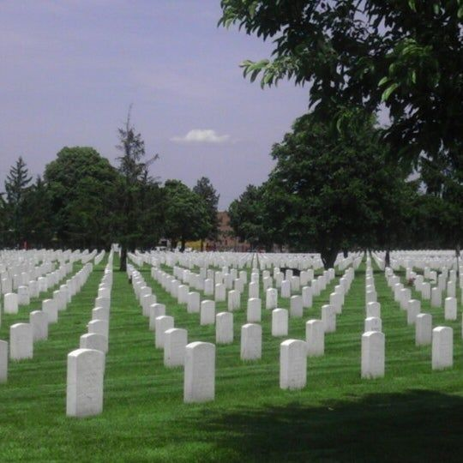

Slide 7
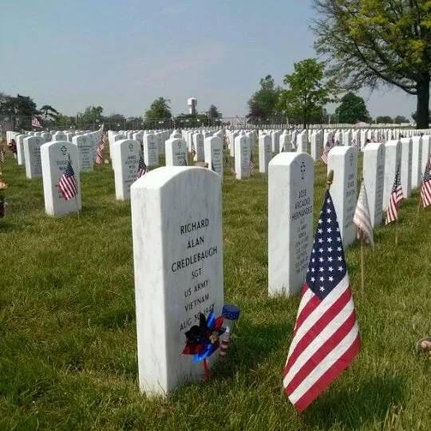

Slide 8
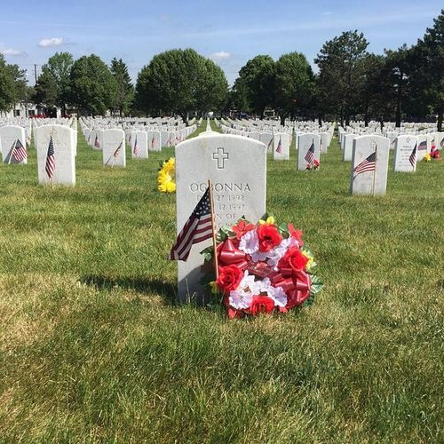

Slide 9
The Value Of The Church. 1Peter 1:18-19
We do value things somewhat in proportion to what they cost.
So we should look upon the church. We have not been redeemed with corruptible things, such as silver and gold, but by the precious blood of Christ. (1 Pet. 1:18, 19.)
Our souls are valuable in the sight of God.

Slide 10
The Value Of The Church. 1Peter 1:18-19
2. The church is valuable because salvation is in it. There is no salvation for any of us outside of Christ. There is no salvation in any other name other than the name of Christ. (Acts 4:12.)
The same thing that saves us makes us members of the church. Just as fast as we are saved the Lord adds us to the church. (Acts 2:46, 47) We are saved just as fast as we obey God.

Slide 11
What can wash away my sin?
Nothing but the blood of Jesus;
What can make me whole again?
Nothing but the blood of Jesus.
Oh! precious is the flow
That makes me white as snow;
No other fount I know,
Nothing but the blood of Jesus.
For my cleansing this I see—
Nothing but the blood of Jesus!
For my pardon this my plea—
Nothing but the blood of Jesus!

Slide 12
The Value Of The Church. 1Peter 1:18-19
Some want to be baptized, but do not want to be a member of the church of Christ. No one is ready for baptism with such an idea of the plan of salvation.
We must get it into the heads of people that when they do the things that God commands them to do, that will save them and make them members of the church.

Slide 13
The Value Of The Church. 1Peter 1:18-19
And if we do the things that will save us, it will make us all members of the same church.
Doing something else will make us members of something else, but it will not save us.
The church is in the saving business. "And the Spirit and the bride say, Come. And let him that heareth say, Come. And let him that is athirst come. And whosoever will, let him take the water of life freely." (Rev. 22:17)

Slide 14
The Value Of The Church. 1Peter 1:18-19
Sometimes people will say that the church never saved anyone. We may grant that, but the saved are in the church.
Christ is the Savior, but he is the Savior of the body, and the body is the church. Eph. 5:23 Eph. 1:22, 23 Col. 1:18.

Slide 15
The Value Of The Church. 1Peter 1:18-19
3. The church is valuable because it wears the name of Christ. No other organization or institution has the divine right to wear the name of Christ. He called it his church.
Paul, in writing the different congregations of the church, spoke of them as the churches of Christ. (Rom. 16:16.) What a grand privilege
to be in the church that honors Christ as its head and wears his name.

Slide 16
The Value Of The Church. 1Peter 1:18-19
The faithful wife loves to wear the name of her husband. The church is the bride of Christ and faithfully wears his name. The Christian wants no other name but the name of Christ.
A faithful wife would wear no other name but that of her husband. So a faithful Christian wears no other name but the name of Christ

Slide 17
The Value Of The Church. 1Peter 1:18-19
It is an honor to wear that name. We should be jealous of the name. We stand before the world as representatives of Christ. We should be careful to leave no wrong impressions. About the only impressions that some have of Christ are the impressions that they get from us.
Also consider -
The church is the only kingdom that will stand forever. The kingdoms of men rise and fall. They are here today, but in a few hundred years they have fallen.

Slide 18
The Value Of The Church. 1Peter 1:18-19
4. The church is valuable because it will stand forever.
The God of heaven set up a Kingdom that shall never be destroyed. (Dan. 2:44.)
The gates of Hades shall not prevail against it. (Matt. 16:18.)
"Wherefore we receiving a kingdom which cannot be moved, let us have grace, whereby we may serve God acceptably with reverence and godly fear." (Heb. 12:28.)

Slide 19
The Value Of The Church. 1Peter 1:18-19
In the destruction of empires today, the Christian can rest assured that the kingdom of Christ will stand forever. It cannot be moved.
The thing for us to do is to be true and faithful to the God of heaven. He has power to take care of his own; and, thanks be to God, this he will do.
We must not get discouraged too much. Every soul that we bring into the kingdom that remains faithful to God is one less for Satan and his kingdom. We must be true to the King.

Slide 20
The Value Of The Church. 1Peter 1:18-19
We are now in the kingdom. Before the kingdom was established, Jesus taught his disciples to pray for the kingdom to come. That prayer was in order then. It is not now.
The kingdom has been here for 2000 years.
Paul wrote to the Colossians brethren after this manner: "Who hath delivered us from the power of darkness, and hath translated us into the kingdom of his dear Son." (Col. 1:13.)

Slide 21
The Value Of The Church. 1Peter 1:18-19
We can understand that it would not be possible to be translated into a kingdom that did not exist.
Yes, the kingdom was in existence in the days of Paul, and folks were being translated into it.

Slide 22
The Value Of The Church. 1Peter 1:18-19
The apostle John said he was in the kingdom: "I John, who also am your brother, and companion in tribulation, and in the kingdom and patience of Jesus Christ." (Rev. 1:9.)
He said that he was a brother in the kingdom. It would be pretty hard to be a brother in something that did not exist! If there was no Masonic Lodge, it would hardly be possible to be a "brother" in it.

Slide 23
The Value Of The Church. 1Peter 1:18-19
We are living in the last age. When Jesus comes again, it will not be to set up a kingdom, but it will be to deliver one up to the Father. (Eph. 5:27.)
Christ is now reigning. Jesus is coming again; but when he comes the next time, he is coming without an offering for sin. (Heb. 9:27, 28.) "For as in Adam all die, even so in Christ shall all be made alive.

Slide 24
The Value Of The Church. 1Peter 1:18-19
But every man in his own order: Christ the firstfruits; afterward they that are Christ's at his coming. Then cometh the end, when he shall have delivered up the kingdom to God, even the Father; when he shall have put down all rule and all authority and power. For he must reign, till he hath put all enemies under his feet. The last enemy that shall be
destroyed is death." (1 Cor 15:22-26.) Please note, "then cometh the end."

Slide 25
The Value Of The Church. 1Peter 1:18-19
How do we treat what we value?
Protect it.
Safeguard it.
Cherish it.
Maintain it and care for it.

Slide 26
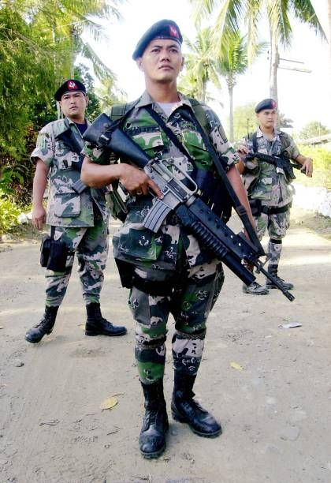
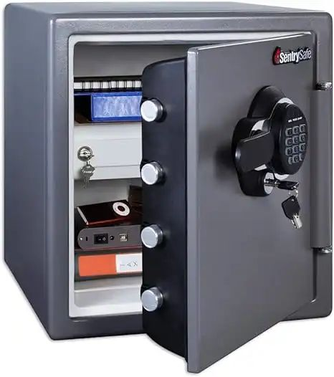
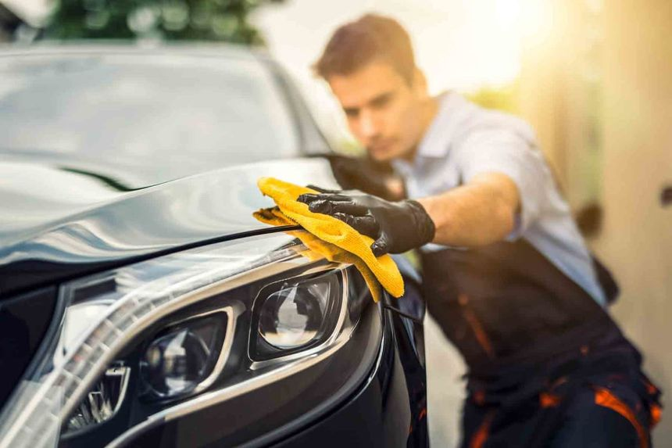

Slide 27
The Value Of The Church. 1Peter 1:18-19
How do we treat the church?
Protect it.
Safeguard it.
Cherish it.
Maintain it and care for it.

Slide 28
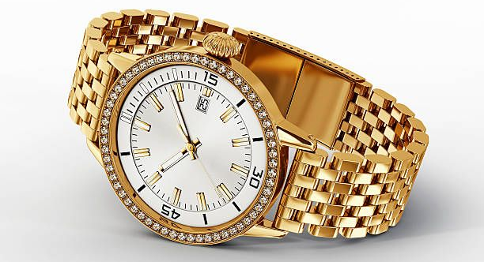
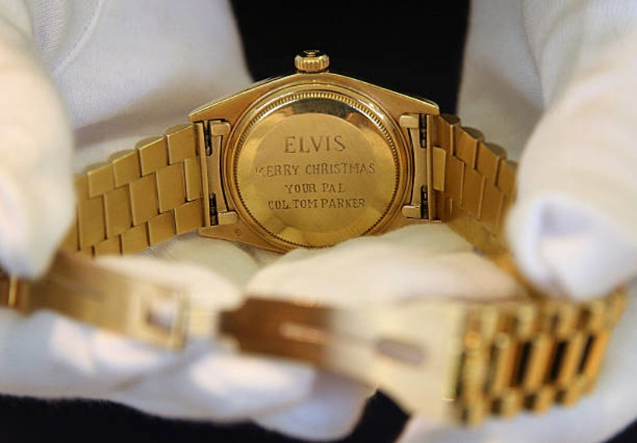
Which gold watch is worth more?

Slide 30
The Value Of The Church. 1Peter 1:18-19
Why is the church valuable?
Because of what it cost (Blood of the Lamb)
Because salvation is in it
Because it wears the name of Christ
Because it will stand forever

Slide 31
Are You A Member Of The Church?
Hear the Gospel (Rom.10:14).
Believe the Gospel (Heb. 11:6).
Repent of Sins (Acts 3:19).
Confess Christ (Rom.10:9).
Be Baptized Into Christ (1 Cor.12:13).
1 Timothy 4:16
“Take heed unto thyself, and unto the doctrine; continue in them: for in doing this thou shalt both save thyself, and them that hear thee.”

