Slide 1
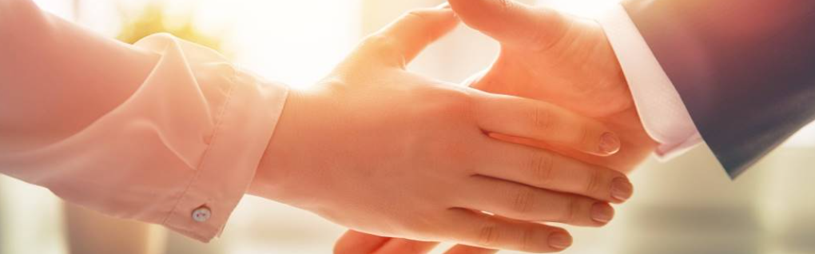
Welcome to our services
New Lebanon Church of Christ
We are Simply Christians.
Our Emphasis is Spiritual, Not Material or Social.
We are striving to be The Same Church as Described in The New Testament.
Please Come Back Again

Slide 2
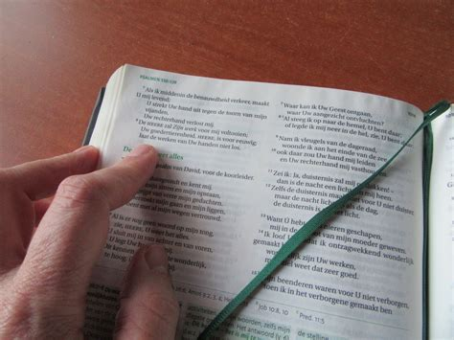
The
Gospel of Christ
Romans 1:14-16

Slide 3


Slide 4
The Gospel Of Christ Romans 1:16
Rom. 1:14 I am a debtor both to Greeks and to barbarians, both to wise and to unwise.
15 So, as much as is in me, I am ready to preach the gospel to you who are in Rome also.
16 For I am not ashamed of the gospel of Christ, for it is the power of God to salvation for everyone who believes, for the Jew first and also for the Greek.

Slide 5
The Gospel Of Christ Romans 1:16
Rom. 10:1 Brethren, my heart's desire and prayer to God for Israel is that they may be saved.
Rom. 10:16 But they have not all obeyed the gospel. For Isaiah says, "Lord, who has believed our report?"

Slide 6
The Gospel Of Christ Romans 1:16
In Romans 1:14 this shows the dual classification of all people in the world of that era.
The Hebrews classified all people as Jews and Gentiles;
The Romans classified the whole world as Romans and pagans;
The Greeks included everyone as Greeks or Barbarians.
The wise and the unwise
Such classifications simply mean “us and everybody else”! Paul’s evident meaning is simply that he felt indebted to all people.

Slide 7
The Gospel Of Christ Romans 1:16
Nothing that any man had done had laid this burden of debt upon Paul’s heart to preach; but it was what Christ had done for Paul which had made him debtor to all people of all races and nations.
Christ had died for Paul, appeared to him, commissioned him as an apostle, saved his soul from sin. Such a mighty weight of blessing had produced Paul’s feeling of indebtedness,
We should all feel a similar debt, a debt of such weight and nature that the greatest limits of one’s ability, resources, and time should be spent in spreading the gospel?

Slide 8
The Gospel Of Christ Romans 1:16
A lesser man than Paul might indeed have melted before the intimidation and arrogant sophistication of Rome, but Paul was a man absolutely beyond the reach of such intimidation.
What Rome meant then is like Washington DC, New York. London and Tokyo might mean to us today. He, the prisoner-Jewish-preacher, is to conquer Rome for Christ. By what means? By the message Christ who was executed as a criminal!
There is no inferiority complex here, and no false humility, but an unbroken consciousness of power. “I am not ashamed; for it is the power of God.” The gospel is not only for salvation now; its effect reaches into eternity, just as itself came from eternity.

Slide 9
The Gospel Of Christ Romans 1:16
It is the power of God unto salvation … the power to save people from sin, from the inevitable fate of the wicked, and from eternal death.
This gospel is power unlimited, eternal, and within the framework of God’s eternal purpose, and fully sufficient to achieve all that God intended.

Slide 10
The Gospel Of Christ Romans 1:16
This power in the gospel is salvation from the wrath of God and eternal death of the soul, a salvation of such a nature that only God could provide it or make it available to people.
No human scheme or device could ever be effectual for such a purpose as salvation from sin and death and the endowment of mortals with the glory of eternal life.

Slide 11
The Gospel Of Christ Romans 1:16
THE gospel of Christ is the power of God unto salvation to everyone that believes it. (Rom. 1:16.) (not belief only)
Men and women are saved by the power that is in the gospel.
The power is not in the preacher, but in the gospel that he preaches.
When the gospel is preached. Christians are made; when no gospel is preached, there are no Christians made.

Slide 12
The Gospel Of Christ Romans 1:16
The righteousness of God is revealed in the gospel of Christ. (Rom. 1:17.)
Jesus Christ is the author of the gospel of Christ. Paul said: "But I certify you. brethren, that the gospel which was preached of me is not after man. For I neither received it of man. neither was I taught it. but by the revelation of Jesus Christ." (Gal. 1:11. 12.)

Slide 13
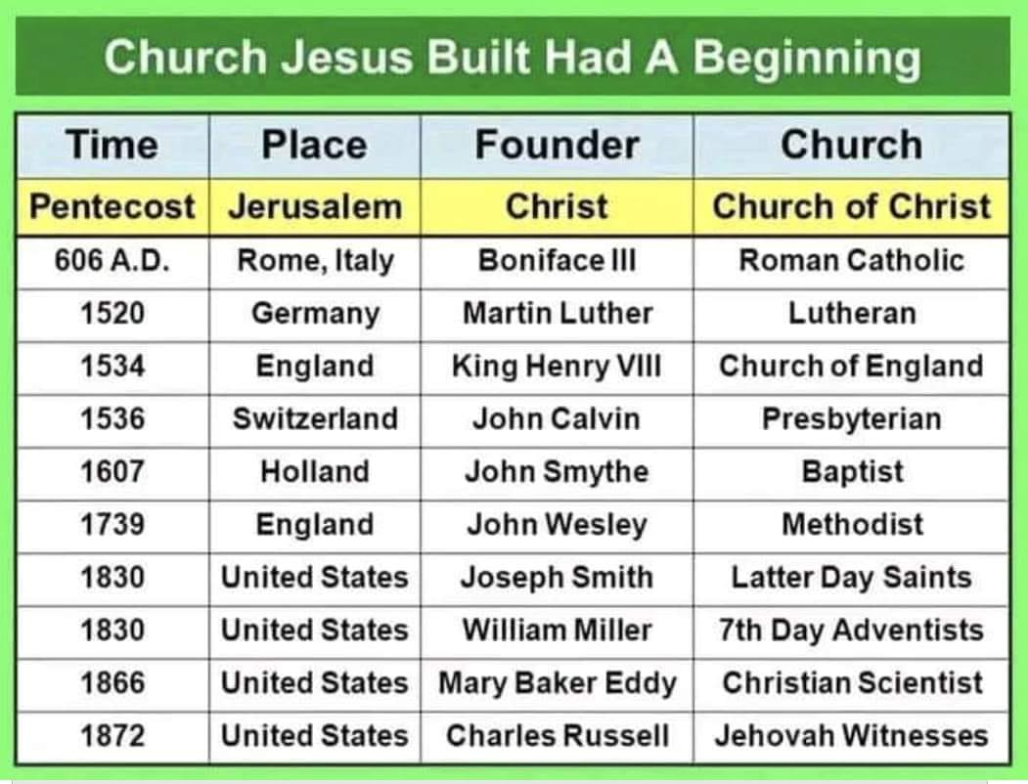
I received it not of man. Galatians 1:11-12

Slide 14
The Gospel Of Christ Romans 1:16
We today should be sure that what we preach is the gospel of Christ, and that we do not receive it of man.
Jesus Christ is the author, not Moses or David or some other man---
"How shall we escape, if we neglect so great salvation: which at the first began to be spoken by the Lord, and was confirmed unto us by them that heard him?" (Heb. 2:3.)

Slide 15
The Gospel Of Christ Romans 1:16
We are further taught to look "unto Jesus the author and finisher of our faith: who for the joy that was set before him endured the cross, despising the shame, and is set down at the right hand of the throne of God." (Heb. 12:2.)
Jesus commanded the apostles to preach the gospel to every creature. (Mark 16:15. 16.)

Slide 16
The Gospel Of Christ Romans 1:16
The seed of the kingdom is the word of God. (Luke 8:11.) This good seed must be planted in good soil. The good soil is honest hearts.
When the seed is planted in this good soil, a good crop is produced. The inspired Paul says that we are begotten by the gospel. (1 Cor. 4:15.)

Slide 17
The Gospel Of Christ Romans 1:16
The same thought is expressed by Peter when he says: "Being born again, not of corruptible seed, but of incorruptible, by the word of God. which lives and abides forever." (1 Pet. 1:23.)
"Of his own will begat he us with the word of truth." (James 1:18.)

Slide 18
The Gospel Of Christ Romans 1:16
There are three fundamental facts of the gospel of Christ. (1 Cor. 15:1-4.)
1st, Christ died for our sins according to the Scriptures:
2nd, he was buried:
3rd, he rose again the third day according to the Scriptures.

Slide 19

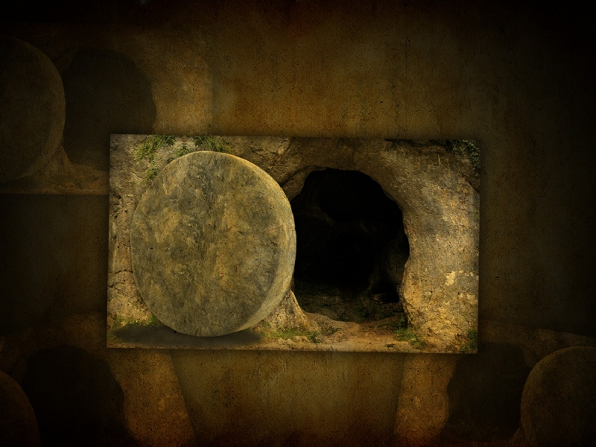


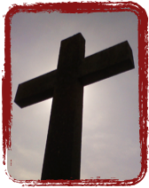
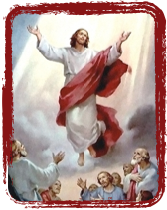
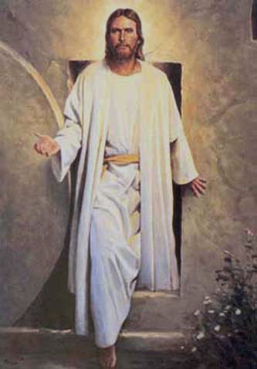
Christ’s death, burial and resurrection are the heart of the gospel!
Death & Burial
Resurrection
He was declared to be the Son of God with power according to the Spirit of holiness, by the resurrection from the dead.
Romans 1:4

Slide 20
The Gospel Of Christ Romans 1:16
Facts cannot be obeyed, but they can be and must be believed.
We believe the facts of the gospel.
These basic facts were proclaimed for the first time on the first Pentecost after the death, burial, resurrection, and ascension of Jesus Christ.

Slide 21
The Gospel Of Christ Romans 1:16
This took place in the city of Jerusalem. "Out of Zion shall go forth the law, and the word of the Lord from Jerusalem." (Isa. 2:3.)
In our search for the truth this is one way of finding the true church. Any church that had its beginning at any other place than Jerusalem, and its time of beginning any other time than Pentecost, could not be the New Testament church.

Slide 22
I received it not of man. Galatians 1:11-12

Slide 23
The Gospel Of Christ Romans 1:16
Jesus said to his apostles just before he was taken up that "repentance and remission of sins should be preached in his name among all nations, beginning at Jerusalem." (Luke 24:47.)
Please note that word beginning.

Slide 24
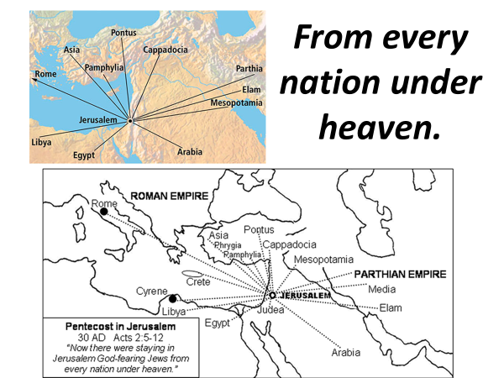
Col 1:5 because of the hope which is laid up for you in heaven, of which you heard before in the word of the truth of the gospel,
6 which has come to you, as it has also in all the world, and is bringing forth fruit, as it is also among you since the day you heard and knew the grace of God in truth; (NKJV)

Slide 25
The Gospel Of Christ Romans 1:16
So the apostles tarried in the city of Jerusalem until the day of Pentecost. Then for the first time the basic facts of the gospel of Christ were preached.
When the gospel is so preached, it causes men to believe that Jesus Christ is the Son of God.
Then they will want to know what they must do to be saved.

Slide 26
The Gospel Of Christ Romans 1:16
So it was on Pentecost. "Now when they heard this, they were pricked in their heart, and said unto Peter and to the rest of the apostles, Men and brethren, what shall we do?" (Acts 2:37.) These believers in Christ were told to "repent, and be baptized every one of you in the name of Jesus Christ for the remission of sins." (Acts 2:38.) This is in exact accord with what Jesus said should be preached, beginning at Jerusalem.

Slide 27
The Gospel Of Christ Romans 1:16
So we have the three commands of the gospel of Christ.
1st, we must believe that Jesus Christ is the Son of God (Acts 16:31);
2nd, must repent of our sins (Acts 17:30);
3rd, and we must be baptized for the remission of our sins (Acts 2:38).
Jesus Christ gave every one of these commands. To be saved we must obey his commandments. If we believe the facts of the gospel and obey the commands of the gospel, we then can enjoy the promises of the gospel.

Slide 28
The Gospel Of Christ Romans 1:16
On the birthday of the church Peter held out two promises to all who would believe and obey.
They were promised the remission of sins and the gift of the Holy Ghost. (Acts 2:38.)
The gift of the Holy Ghost is not the baptism of the Holy Ghost.

Slide 29
The Gospel Of Christ Romans 1:16
Acts 2:38 – remission of sins, salvation, eternal life not eternal destruction.
We learn from Acts 8 of a man who was taught the facts of the gospel, and then he obeyed the commands. What followed? "And he went on his way rejoicing." (Acts 8:39.)

Slide 30
The Gospel Of Christ Romans 1:16
God will perform faithfully his part. We should do our part. And we are promised life eternal. "And this is the promise that he hath promised us, even eternal life." (1 John 2:25.) We shall realize the enjoyment of this promise at the end of a faithful Christian life.

Slide 31
The Gospel Of Christ Romans 1:16
Jesus Christ is not only the author of the gospel, but "being made perfect, he became the author of eternal salvation unto all them that obey him." (Heb. 5:9.)
Lord, help us all to obey him.

Slide 32
The Gospel Of Christ Romans 1:16
Luke 4:18 The Spirit of the Lord is upon me, because he hath anointed me to preach the gospel to the poor; he hath sent me to heal the brokenhearted, to preach deliverance to the captives, and recovering of sight to the blind, to set at liberty them that are bruised,
Luke 7:22 Then Jesus answering said unto them, Go your way, and tell John what things ye have seen and heard; how that the blind see, the lame walk, the lepers are cleansed, the deaf hear, the dead are raised, to the poor the gospel is preached.
Luke 9:6 And they departed, and went through the towns, preaching the gospel, and healing every where.
Luke 20:1 And it came to pass, that on one of those days, as he taught the people in the temple, and preached the gospel, the chief priests and the scribes came upon him with the elders,

Slide 33
The Gospel Of Christ Romans 1:16
Gal. 1:1 Paul, an apostle (not from men nor through man, but through Jesus Christ and God the Father who raised Him from the dead),
2 and all the brethren who are with me, To the churches of Galatia:
3 Grace to you and peace from God the Father and our Lord Jesus Christ,
4 who gave Himself for our sins, that He might deliver us from this present evil age, according to the will of our God and Father,
5 to whom be glory forever and ever. Amen.
6 I marvel that you are turning away so soon from Him who called you in the grace of Christ, to a different gospel,

Slide 34
The Gospel Of Christ Romans 1:16
Gal 1:7 which is not another; but there are some who trouble you and want to pervert the gospel of Christ.
8 But even if we, or an angel from heaven, preach any other gospel to you than what we have preached to you, let him be accursed.
9 As we have said before, so now I say again, if anyone preaches any other gospel to you than what you have received, let him be accursed.
10 For do I now persuade men, or God? Or do I seek to please men? For if I still pleased men, I would not be a bondservant of Christ.
11 But I make known to you, brethren, that the gospel which was preached by me is not according to man.
12 For I neither received it from man, nor was I taught it, but it came through the revelation of Jesus Christ.

Slide 35
Are You A New Testament Christian?
Hear the Gospel (Rom.10:14).
Believe the Gospel (Heb. 11:6).
Repent of Sins (Acts 3:19).
Confess Christ (Rom.10:9).
Be Baptized Into Christ (1 Cor.12:13).
1 Timothy 4:16
“Take heed unto thyself, and unto the doctrine; continue in them: for in doing this thou shalt both save thyself, and them that hear thee.”

Slide 36
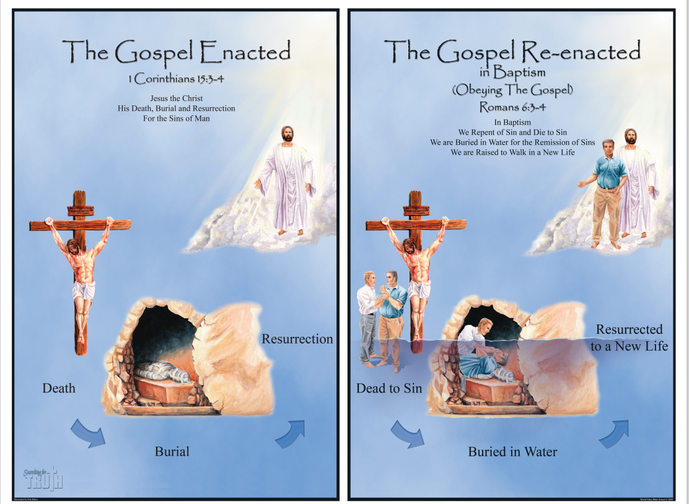
The Gospel Of Christ Romans 1:16

