Slide 1
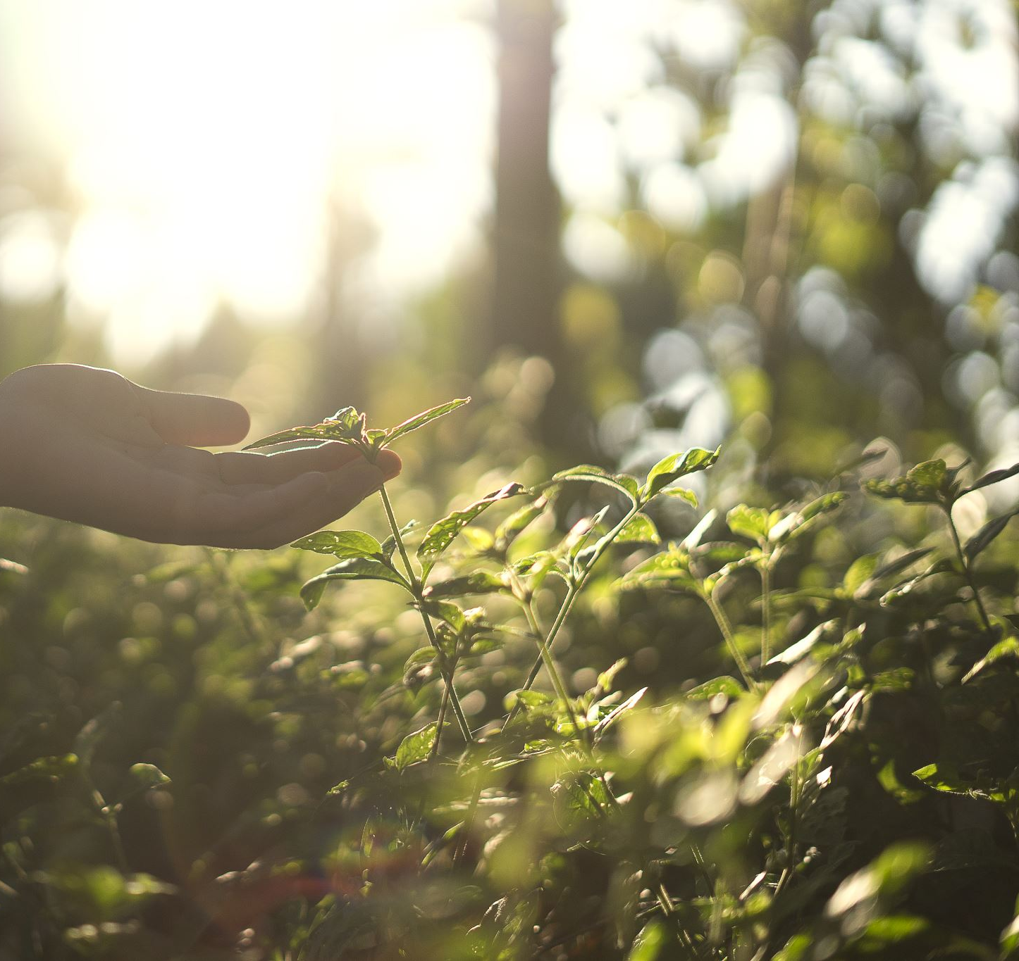
Tending Our Gardens

Slide 2
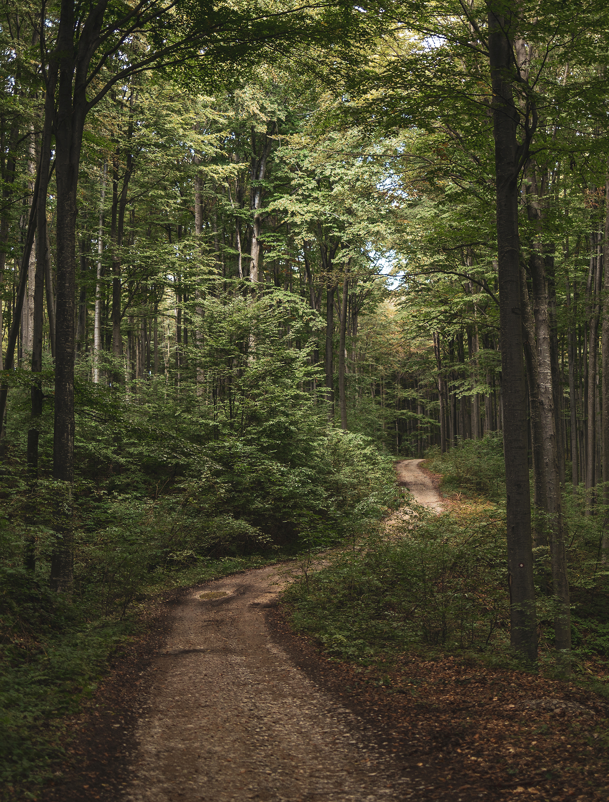
Seed By the Wayside
Matthew 13:18-19
Biblical Character Example: King Agrippa
Acts 26-24-32

Slide 3
Seed in the Stony Soil
Matthew 13:20-21
Biblical Character Example: The Israelites during their journey after leaving Egypt
Numbers 13:31-14:4

Slide 4
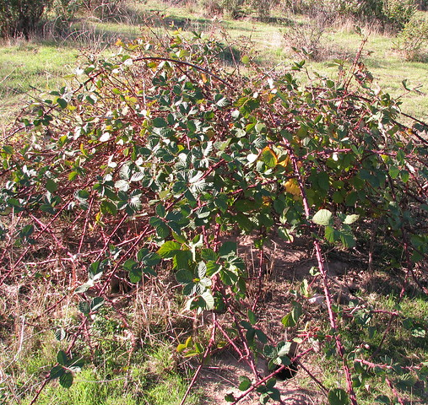
Seed Among Thorns
Matthew 13:22
Biblical Character Example: Judas Iscariot
Matthew 26:14-16
John 12:6
This Photo by Unknown Author is licensed under CC BY-NC

Slide 5
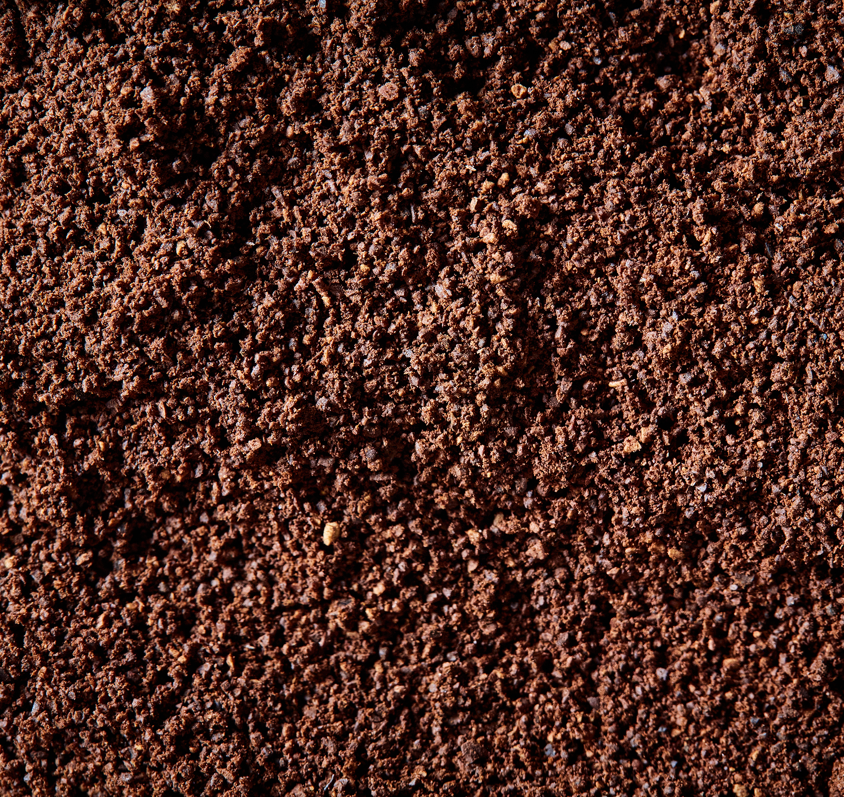
Seed on Good Ground
Matthew 13:23
Biblical Character Example: Paul
Philippians 3:3-6
Acts 9:1-6
Acts 9:17-18

Slide 6
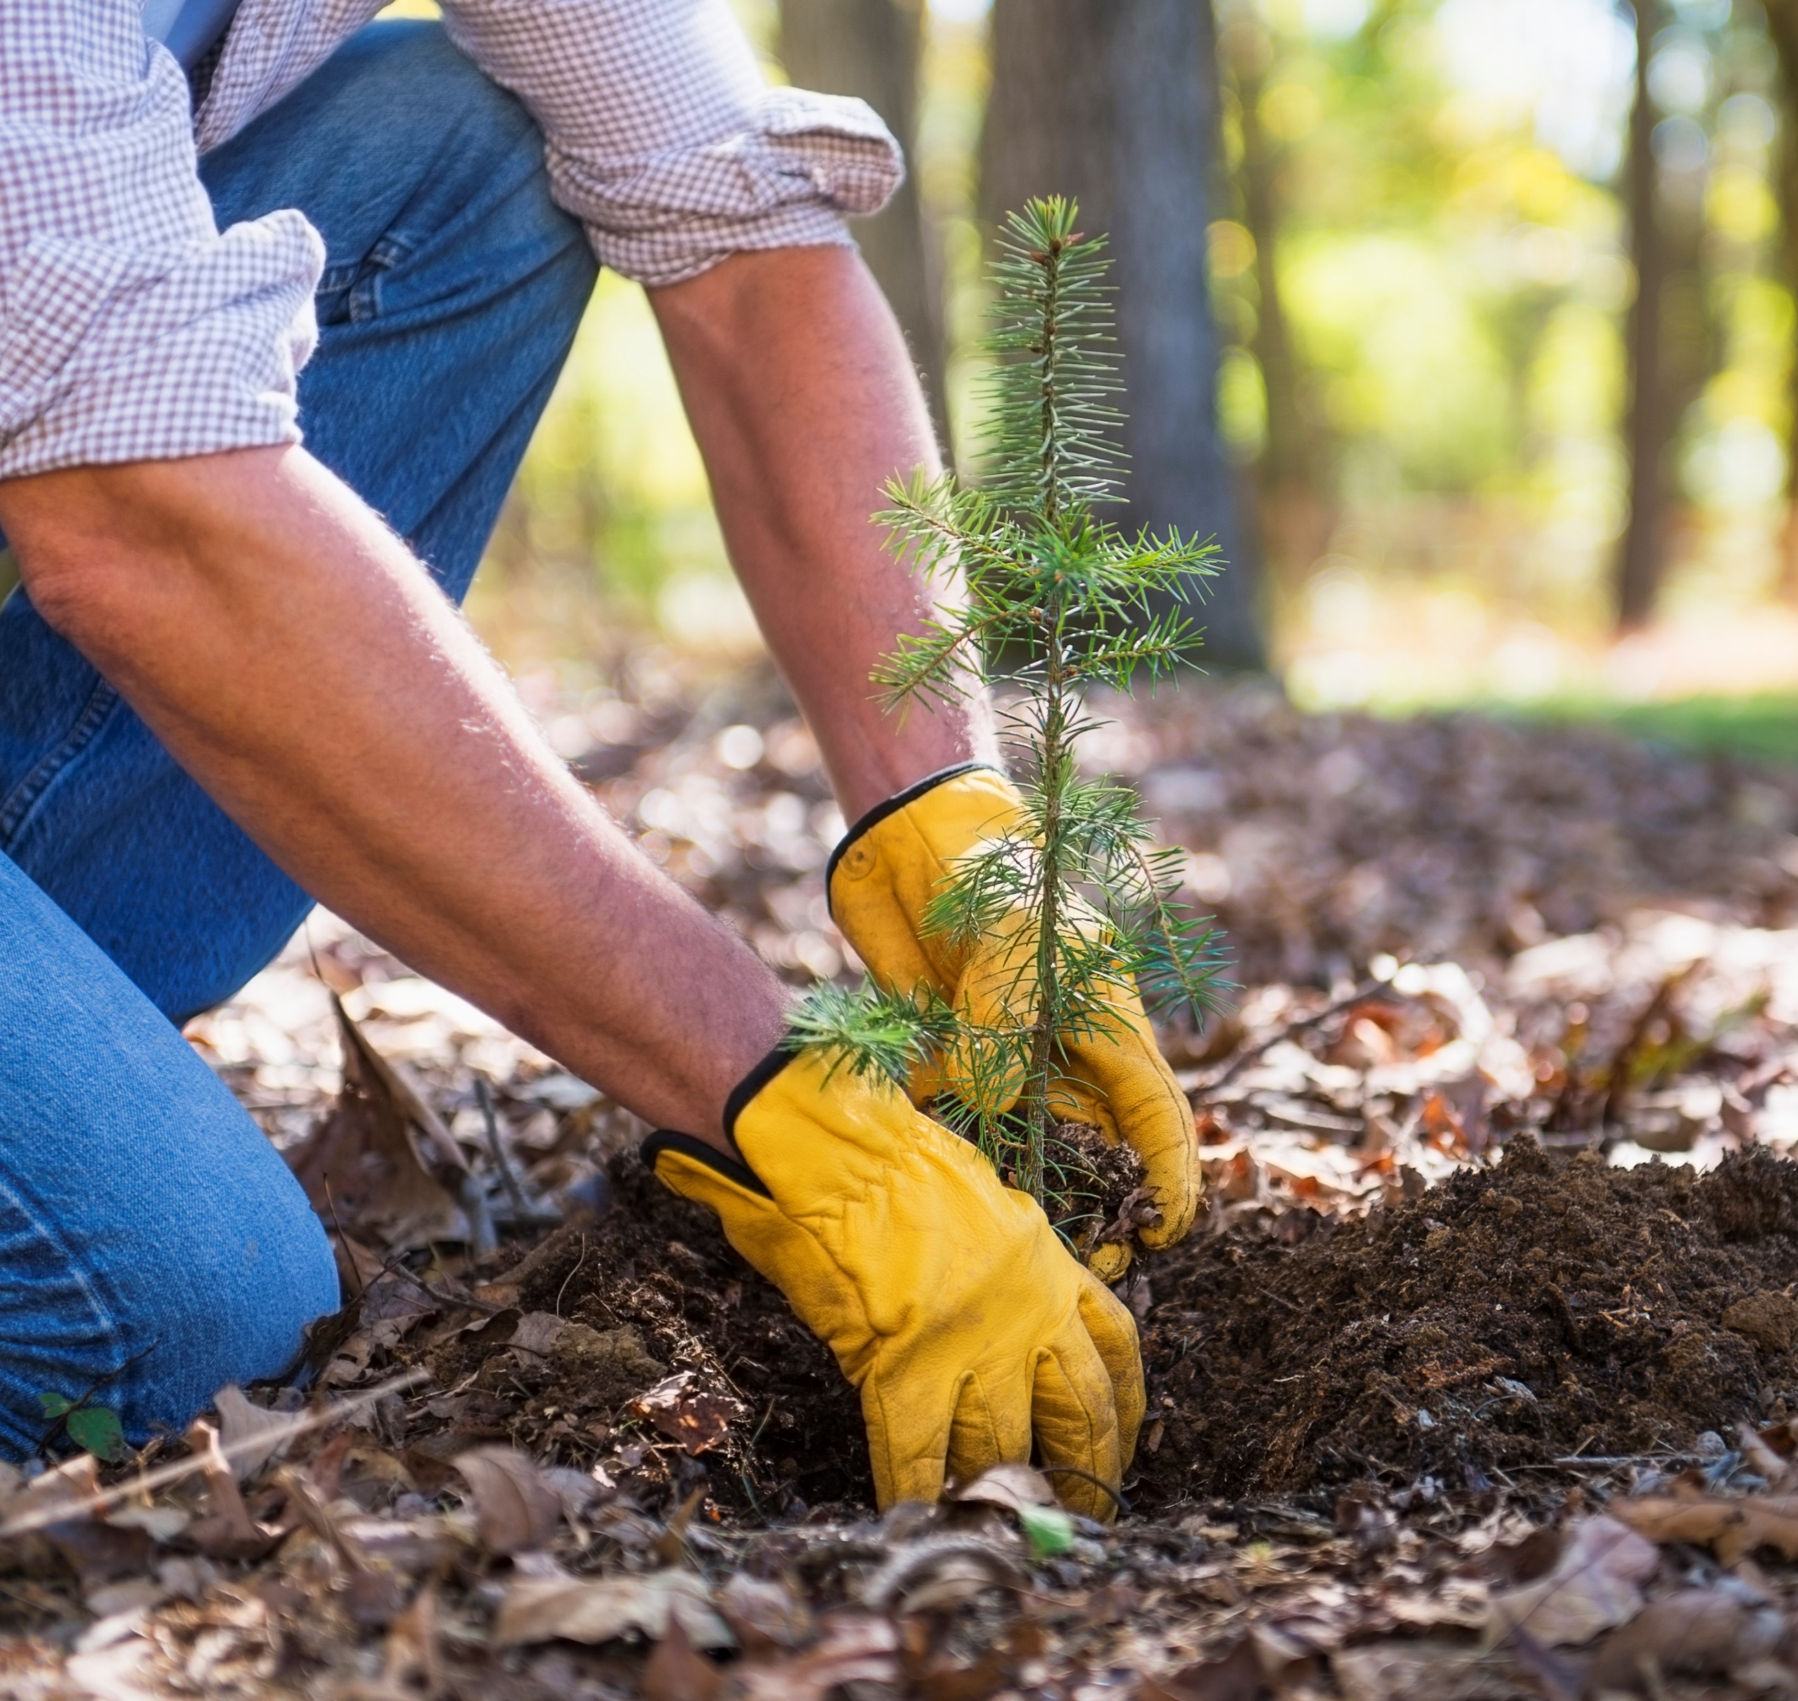
Tending to the Soil

