Slide 1
Welcome to our services
New Lebanon Church of Christ
We are Simply Christians.
Our Emphasis is Spiritual, Not Material or Social.
We are striving to be The Same Church as Described in The New Testament.
Please Come Back Again

Slide 2
Some Things The Lord’s Church Is Not Romans 14:17
Romans 14:17 for the kingdom of God is not eating and drinking, but righteousness and peace
and joy
in the Holy Spirit.

Slide 3
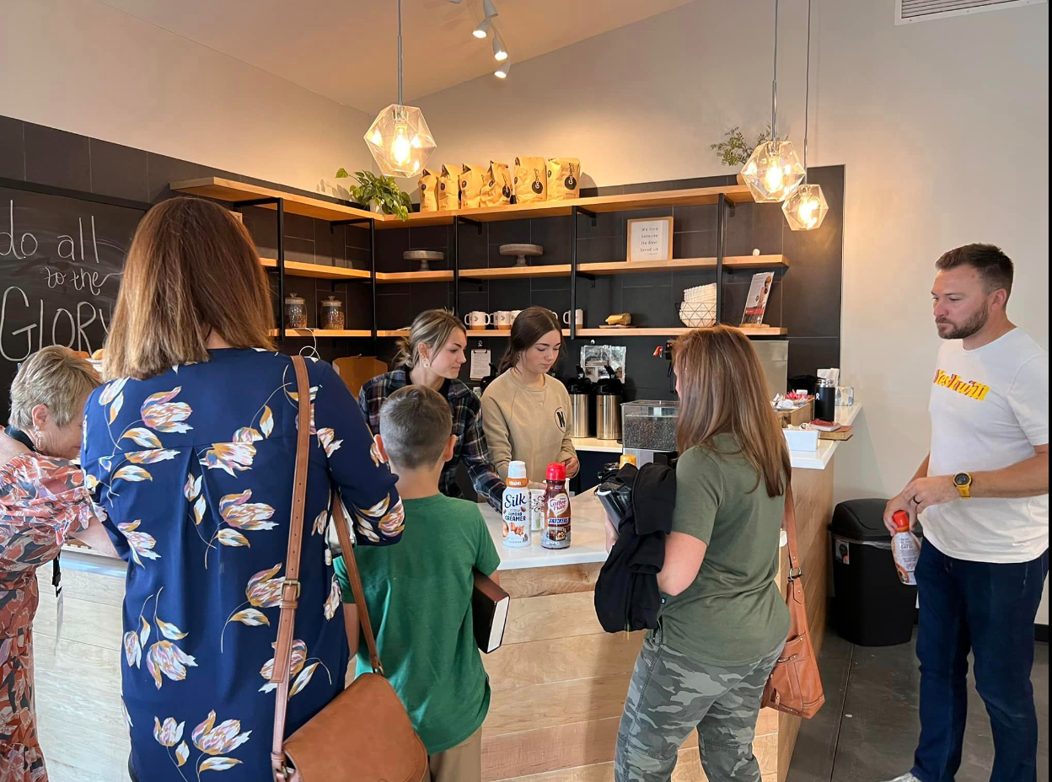
Some Things The Lord’s Church Is Not Romans 14:17

Slide 4
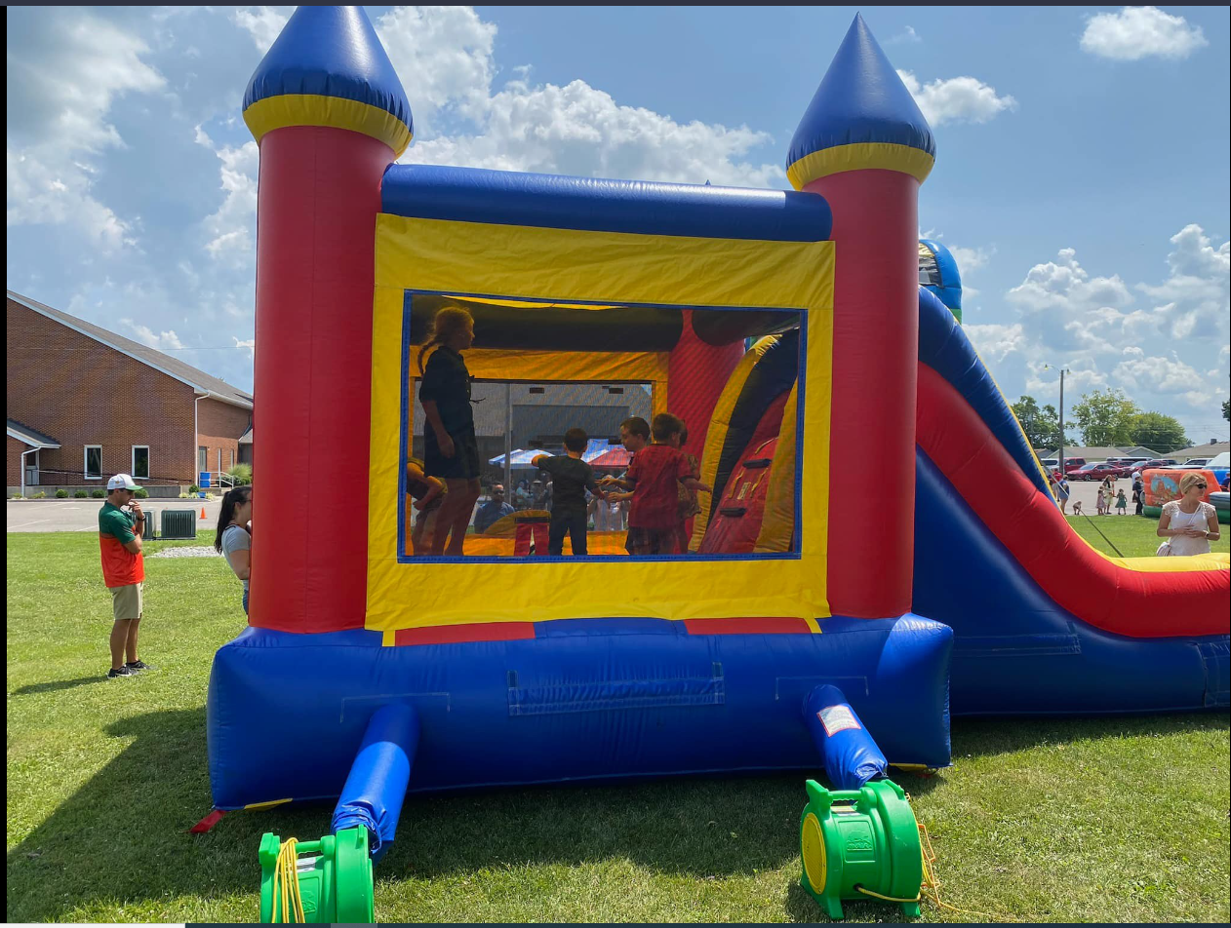
Some Things The Lord’s Church Is Not Romans 14:17

Slide 5
Some Things The Lord’s Church Is Not Romans 14:17
Eph 3:14 For this reason I bow my knees to the Father of our Lord Jesus Christ, 15 from whom the whole family in heaven and earth is named,
16 that He would grant you, according to the riches of His glory, to be strengthened with might through His Spirit in the inner man, 17 that Christ may dwell in your hearts through faith; that you, being rooted and grounded in love,
18 may be able to comprehend with all the saints what is the width and length and depth and height--19 to know the love of Christ which passes knowledge; that you may be filled with all the fullness of God.
20 Now to Him who is able to do exceedingly abundantly above all that we ask or think, according to the power that works in us,21 to Him be glory in the church by Christ Jesus to all generations, forever and ever. Amen.

Slide 6
Some Things The Lord’s Church Is Not Romans 14:17
Since has God ordained the church as the home of the saved, and the institution thru which the gospel is to be preached Eph. 3:21, the organization which is to show forth his glory,…
it is important that we have an accurate understanding of the nature, purpose, mission, of the Lord’s church – the church of Jesus Christ.

Slide 7
Some Things The Lord’s Church Is Not Romans 14:17
Because of this, it is imperative for us to understand what the church is. To understand what our privileges and responsibilities are, and to take advantage of our opportunities.
Since the church is a NT institution – only the NT can speak about the church with authority and finality.
Let’s look at some misunderstandings about the church and compare them with NT teaching.

Slide 8
Some Things The Lord’s Church Is Not Romans 14:17

Slide 9
Some Things The Lord’s Church Is Not Romans 14:17

Slide 10
Some Things The Lord’s Church Is Not Romans 14:17
1.The church is NOT a physical building.
Some people talk about painting the church
Having a wedding or funeral in the church
Going to church
Eating in the church.
All of those phrases show a misunderstanding of what the blood bought-heaven sent- spirit filled church is.
The church of the NT is not a physical building; it is a spiritual building and should be spoken of as such.

Slide 11
Some Things The Lord’s Church Is Not Romans 14:17
1.The church is NOT a physical building.
1Peter 2:5 you also, as living stones, are being built up a spiritual house, a holy priesthood, to offer up spiritual sacrifices acceptable to God through Jesus Christ.
Heb.3:6 but Christ as a Son over His own house, whose house we are if we hold fast the confidence and the rejoicing of the hope firm to the end.
Eph. 2:21 in whom the whole building, being joined together, grows into a holy temple in the Lord, 22 in whom you also are being built together for a dwelling place of God in the Spirit.

Slide 12
Some Things The Lord’s Church Is Not Romans 14:17
1.The church is NOT a physical building.
(1Cor.3)
God does not dwell in the building but in Christians who have been redeemed by the blood of Christ.
Some people believe that the building takes on a holy significance. They talk about the Sanctuary – sacred.
This auditorium is not sacred, this table is not sacred, and this podium is not sacred. Friends the church is sacred. The people who have been set apart by divine redemption – called out of the world. We are sacred – not this meeting house. This building is not a sacred building.
Some people treat the building like God dwells in the building.

Slide 13
Some Things The Lord’s Church Is Not Romans 14:17
1.The church is NOT a physical building.
Friends, God dwells in the hearts and minds of men and women who have repented of their sinful ways and who walk in the light of our heavenly father.
(Acts 17)…
God dwells not in a building made with human hands- God cannot be confined within these walls. The physical building is not the church. The church is made up of individuals washed, redeemed.

Slide 14
Some Things The Lord’s Church Is Not Romans 14:17
2.The church of the NT is NOT a group of denominations.
Some believe the church is composed of all the religious groups of men. Even some brethren believe the church is made up of every group with the name church of Christ over the door. (“You know, we are all the same.”)
The non-institutional congregations, the institutional congregations, the premillennial congregations, and on and on and on. Some believe that everybody that has ever been baptized compose the NT church…that is denominationalism. The Lord’s church is not made up this way.

Slide 15
Some Things The Lord’s Church Is Not Romans 14:17
2.The church of the NT is NOT a group of denominations.
1Cor. 14:33 For God is not the author of confusion but of peace, as in all the churches of the saints.
We are to be one in purpose and plan, we follow that plan and we will be in harmony with the NT church.
Some brethren think the COC is just another denomination.
DANGER

Slide 16
Some Things The Lord’s Church Is Not Romans 14:17
2.The church of the NT is NOT a group of denominations.
Some say none of us are 100% right…we should just all get along with everybody. …we are all wrong on something….unity in diversity.
Eph.4:4 There is one body and one Spirit, just as you were called in one hope of your calling;
Eph.1:22 And He put all things under His feet, and gave Him to be head over all things to the church,

Slide 17
Some Things The Lord’s Church Is Not Romans 14:17
2.The church of the NT is NOT a group of denominations.
1Cor.1:10 Now I plead with you, brethren, by the name of our Lord Jesus Christ, that you all speak the same thing, and that there be no divisions among you, but that you be perfectly joined together in the same mind and in the same judgment.
Be no division.
Was Christ divided? NO
The NT church is not a group of denominations. Denominationalism means division. A denomination is part of the whole. We aren’t a part of, we are the church.

Slide 18
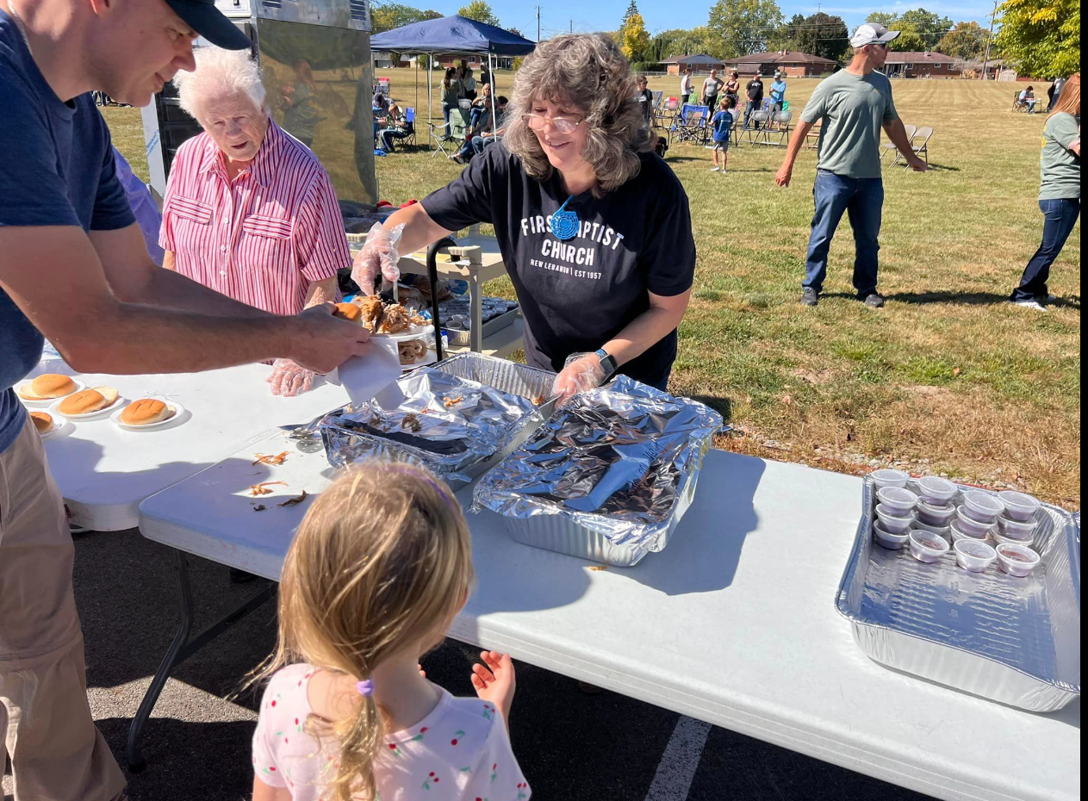
Some Things The Lord’s Church Is Not Romans 14:17

Slide 19
Some Things The Lord’s Church Is Not Romans 14:17
3.The NT church is not a social club.
Some people look at the church as an opportunity to associate with other for social enrichment. Some to promote busine$$ interest$. Some to promote political career.
I heard one real estate agent one time talking about another very rich real estate agent and the person was talking about the church (denomination) the agent was a member of. I would guess her decision to be a member where she was, was based more on how much money she could make instead of saving her soul.

Slide 20
Some Things The Lord’s Church Is Not Romans 14:17
3.The NT church is not a social club.
Why do some people go where they go? Because of the people that are there. They approach the church as a means to improve their status.
We do have some social relationship when we come together but that is secondary. Our primary relationship is spiritual….not business…not politics.
The church of Jesus Christ is not a social institution it is a relationship of people redeemed by the blood of Christ who share a common faith.

Slide 21
Some Things The Lord’s Church Is Not Romans 14:17
3.The NT church is not a social club.
2Peter1:1 Simon Peter, a bondservant and apostle of Jesus Christ, To those who have obtained like precious faith with us by the righteousness of our God and Savior Jesus Christ:
We should look on the people bought out of sin and have a common faith and believe Jesus is king…and believes he’s coming back again to deliver his church up to his father.
1Peter 2:9 But you are a chosen generation, a royal priesthood, a holy nation, His own special people, that you may proclaim the praises of Him who called you out of darkness into His marvelous light;

Slide 22
Some Things The Lord’s Church Is Not Romans 14:17
3.The NT church is not a social club.
Called out ecclesia
Purpose is spiritual in nature, but many people want to turn the church over to social activities. That is their main emphasis – activities.
???What kind of activities do you have for young people???
We have all the activities the Lord has assigned to the church for Young people, Middle aged people
Elderly people.

Slide 23
There is an idea if we don’t have something that interest young people – entertain and amuse them ---we will lose them. But the more important question is: Where is THEIR Spiritual Interests?
Their interest should be the same as mine and yours. Their interest should be in the Lord Jesus Christ. Converted and dedicated to the Lord.

Slide 24
Some Things The Lord’s Church Is Not Romans 14:17
3.The NT church is not a social club.
It is great to have get togethers…young people…old people…great to have social activities. But that is a function of the home. Some have the misconception that’s a function of the church. That’s a wrong understanding of the Lord’s church.

Slide 25
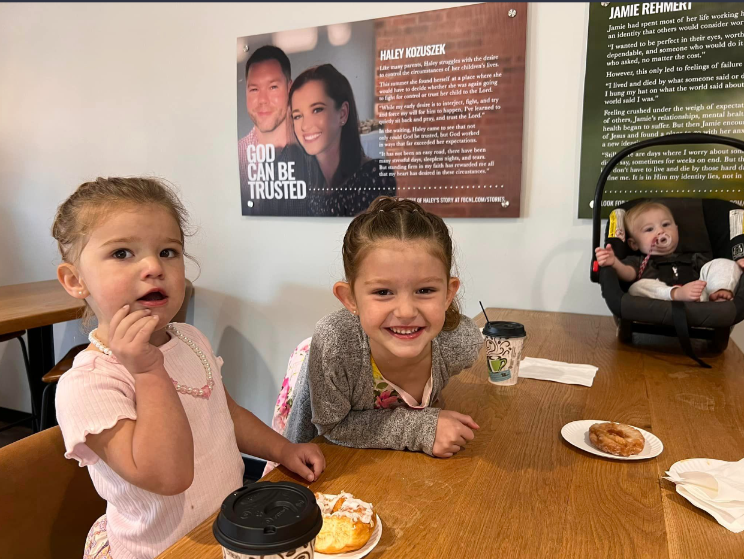
Some Things The Lord’s Church Is Not Romans 14:17

Slide 26
Some Things The Lord’s Church Is Not Romans 14:17
3.The NT church is not a social club.
Recreation, gymnasiums, church kindergartens, ball clubs….nothing wrong with these things. But what is wrong is when the church gets involved with these things. It is not the mission of the church to promote and provide these things. Are you following me?
The church is not a social club. It is the saved. The redeemed. The house of God. Put in the world for the purpose of saving souls of men and women.
Misconception of function and activities.
Rom. 14:17 for the kingdom of God is not eating and drinking, but righteousness and peace and joy in the Holy Spirit.

Slide 27
Some Things The Lord’s Church Is Not Romans 14:17
Until We Eat Again
God be with you till we eat again
Between the sales and suppers, we might get religion in
Gather round the table and we’ll have a smorgasbord.
Later, we might even praise the Lord!

Slide 28
Some Things The Lord’s Church Is Not Romans 14:17
4.The church is NOT a substitute.
Christ came to establish a kingdom. The Jews rejected him. Some say Jesus postponed his plan and set up the church as a substitute till he returns to establish the kingdom.
This makes the church a temporary arrangement. This makes the church an accident.
Eph.3:10 to the intent that now the manifold wisdom of God might be made known by the church to the principalities and powers in the heavenly places, - in the mind of God. The angels could see the manifold wisdom. When we read today, we can see the manifold wisdom.
v.11 according to the eternal purpose which He accomplished in Christ Jesus our Lord, - eternal purpose – right on schedule.

Slide 29
Some Things The Lord’s Church Is Not Romans 14:17
4.The church is NOT a substitute.
Isaiah 2:2 Now it shall come to pass in the latter days That the mountain of the LORD'S house Shall be established on the top of the mountains, And shall be exalted above the hills; And all nations shall flow to it. - 700 years before Christ – in prophecy
1Tim.3:15 of Lord’s house. - but if I am delayed, I write so that you may know how you ought to conduct yourself in the house of God, which is the church of the living God, the pillar and ground of the truth.

Slide 30
Some Things The Lord’s Church Is Not Romans 14:17
4.The church is NOT a substitute.
Matt.16:18 And I also say to you that you are Peter, and on this rock I will build My church, and the gates of Hades shall not prevail against it.
Christ established the church – the kingdom
Subjects
Law
Territory no difference in kingdom and church
Head
*therefore church and kingdom must be the same

Slide 31
Some Things The Lord’s Church Is Not Romans 14:17
4.The church is NOT a substitute.
Many premillennialists make a liar out of the Lord. Make the church nothing more than a substitute. They dethrone Jesus
???Fellowship somebody like that????

Slide 32
Some Things The Lord’s Church Is Not Romans 14:17

Slide 33
Some Things The Lord’s Church Is Not Romans 14:17
5.The church is not an unstructured group of individuals
Some say the church has no organization. Say here is no required pattern for carrying out work. Just come and go as you please. That leaves you not accountable to anybody.
Phil.1:1 Paul and Timothy, bondservants of Jesus Christ, To all the saints in Christ Jesus who are in Philippi, with the bishops and deacons:
We need to pray for this church that someday there will be qualified elders as the Lord desires. That is part of his pattern. That is part of his plan. His intention.

Slide 34
Some Things The Lord’s Church Is Not Romans 14:17
5.The church is not an unstructured group of individuals
A lack of elders can even destroy a congregation.
Acts 14:23 So when they had appointed elders in every church, and prayed with fasting, they commended them to the Lord in whom they had believed.
Titus 1:5 For this reason I left you in Crete, that you should set in order the things that are lacking, and appoint elders in every city as I commanded you--

Slide 35
Some Things The Lord’s Church Is Not Romans 14:17
5.The church is not an unstructured group of individuals
1Peter 5:2 Shepherd the flock of God which is among you, serving as overseers, not by compulsion but willingly, not for dishonest gain but eagerly;
Heb.13:17 Obey those who rule over you, and be submissive, for they watch out for your souls, as those who must give account. Let them do so with joy and not with grief, for that would be unprofitable for you.

Slide 36
Some Things The Lord’s Church Is Not Romans 14:17
All of us need to be members of the Lord’s church. We don’t need to be confused about the Lord’s church.
When we are taught right, baptized right, we are added to the right church Acts 2:47 praising God and having favor with all the people. And the Lord added to the church daily those who were being saved.
Not added to Methodist church.
Not added to Baptist church.
We cannot believe in error.
We cannot walk in darkness.
And be in fellowship with God 1 John1:6 If we say that we have fellowship with Him, and walk in darkness, we lie and do not practice the truth.

Slide 37
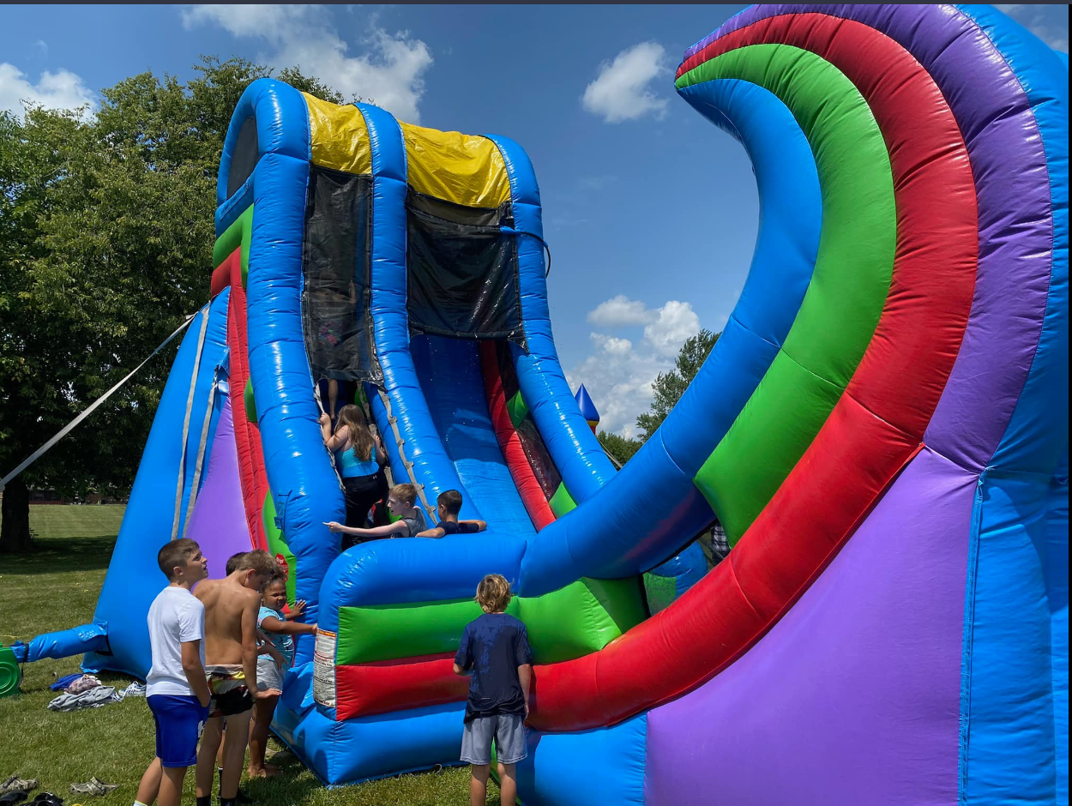
Some Things The Lord’s Church Is Not Romans 14:17

Slide 38
Some Things The Lord’s Church Is Not Romans 14:17

Slide 39
Some Things The Lord’s Church Is Not Romans 14:17

Slide 40
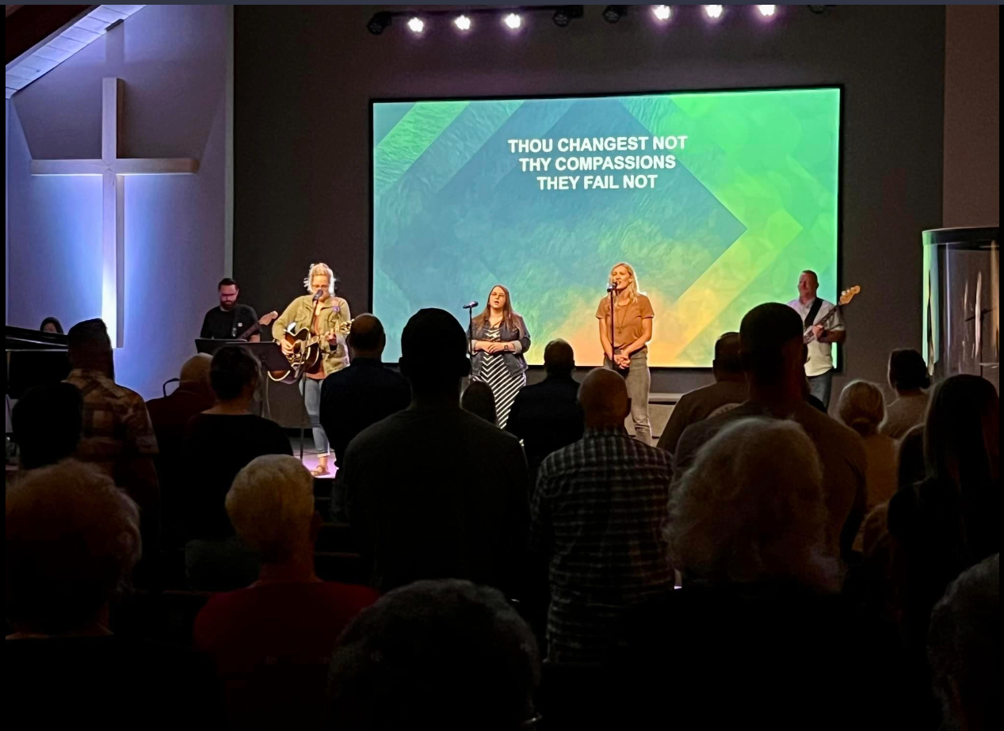
Some Things The Lord’s Church Is Not Romans 14:17

Slide 41
Some Things The Lord’s Church Is Not Romans 14:17

Slide 42
Some Things The Lord’s Church Is Not Romans 14:17

Slide 43
Some Things The Lord’s Church Is Not Romans 14:17
Mt 7:21 "Not everyone who says to Me, 'Lord, Lord,' shall enter the kingdom of heaven, but he who does the will of My Father in heaven. 22 "Many will say to Me in that day, 'Lord, Lord, have we not prophesied in Your name, cast out demons in Your name, and done many wonders in Your name?’ 23 "And then I will declare to them, 'I never knew you; depart from Me, you who practice lawlessness!’
24 "Therefore whoever hears these sayings of Mine, and does them, I will liken him to a wise man who built his house on the rock: 25 "and the rain descended, the floods came, and the winds blew and beat on that house; and it did not fall, for it was founded on the rock. 26 "But everyone who hears these sayings of Mine, and does not do them, will be like a foolish man who built his house on the sand: 27 "and the rain descended, the floods came, and the winds blew and beat on that house; and it fell. And great was its fall."

Slide 44
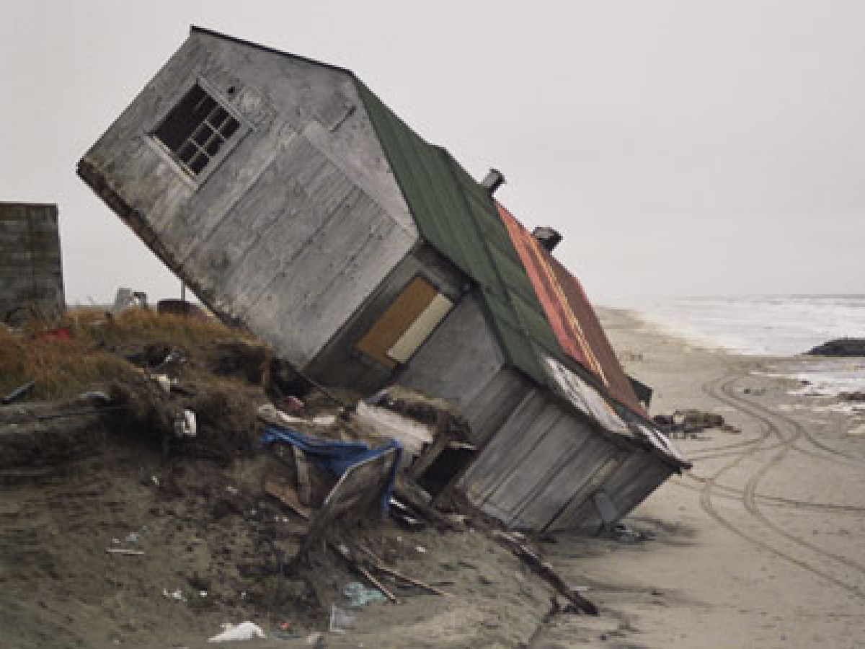
Some Things The Lord’s Church Is Not Romans 14:17
Is your church built on the Rock
Or on the sand?

