Slide 1
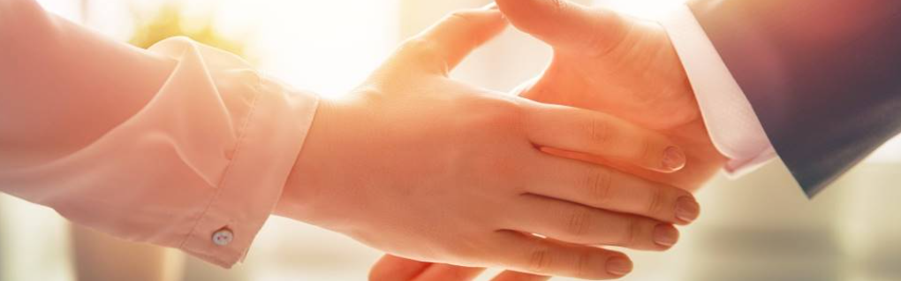
Welcome to our services
New Lebanon Church of Christ
We are Simply Christians.
Our Emphasis is Spiritual, Not Material or Social.
We are striving to be The Same Church as Described in The New Testament.
Please Come Back Again

Slide 2
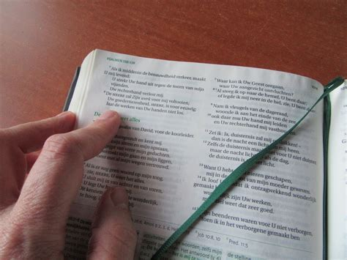
But after this the judgment. Heb. 9:27

Slide 3
But after this the judgment. Heb. 9:27
Hebrews 9:27 And as it is appointed for men to die once, but after this the judgment,
28 so Christ was offered once to bear the sins of many. To those who eagerly wait for Him He will appear a second time, apart from sin, for salvation.

Slide 4
But after this the judgment. Heb. 9:27
Certainty of It
PAUL stood in the midst of Mars' Hill, in Athens, and preached to those philosophers. Among other things, he said to them:
"And the times of this ignorance God winked at; but now commands all men every where to repent: because he hath appointed a day, in the which he will judge the world in righteousness by that man whom he hath ordained; whereof he hath given assurance unto all men, in that he hath raised him from the dead."(Acts 17:30, 31.)

Slide 5
But after this the judgment. Heb. 9:27
Certainty of It
God has appointed this judgment day. It is coming.
"And as it is appointed unto men once to die, but after this the judgment." (Heb. 9:27.)
God made this appointment. God keeps his appointments.

Slide 6
But after this the judgment. Heb. 9:27
Who will be Judged?
We have learned "he will judge the world in righteousness." All shall be judged.
Jesus said: "When the Son of man shall come in his glory, and all the holy angels with him, then shall he sit upon the throne of his glory: and before him shall be gathered all nations: and he shall separate them one from another, as a shepherd divides his sheep from the goats." (Matt. 25:31, 32.)

Slide 7
But after this the judgment. Heb. 9:27
Who will be Judged?
''Marvel not at this: for the hour is coming, in the which all that are in the graves shall hear his voice, and shall come forth; they that have done good, unto the resurrection of life; and they that have done evil, unto the resurrection of damnation." (John 5:28, 29.)

Slide 8
But after this the judgment. Heb. 9:27
What is the standard we will be judged by?
We shall be judged for the things that we did while we were in the. body. –
"For we must all appear before the judgment seat of Christ; that every one may receive the things done in his body. according to that he hath done, whether it be good or bad." (2 Cor. 5:10.)

Slide 9
But after this the judgment. Heb. 9:27
What is the standard we will be judged by?
Secret things will be judged in that great day. "In the day when God shall judge the secrets of men by Jesus Christ according to my gospel." (Rom. 2:16.)
We may be able now to cover up some things from the eyes of men. but we cannot cover them from the eyes of the Lord. Secret things will be made manifest at the judgment bar of Christ. Many things that would not bear the light of open day here shall be brought to light at the judgment.

Slide 10
But after this the judgment. Heb. 9:27
What is the standard we will be judged by?
We shall be judged by our words. We say many things here that we would not say if we knew we were going to be thrust into eternity within the next hour. We are too careless in our use of words.
"But I say unto you, That every idle word that men shall speak, they shall give account thereof in the day of judgment. For by thy words thou shalt be justified, and by thy words thou shalt be condemned." (Matt. 12:36, 37.)

Slide 11
But after this the judgment. Heb. 9:27
What is the standard we will be judged by?
Is it any wonder that the wise man, Solomon, said "The words of a wise man's mouth are gracious: but the lips of thy words be few." (Ecc. 5:2.)
"If any man offend not in a fool will swallow up himself. The beginning of the words of his mouth is foolishness: and the end of his talk is mischievous madness. A fool also is full of words"? (Ecc. 10:12-14.) There must be a lot of fools in the world!

Slide 12
But after this the judgment. Heb. 9:27
What is the standard we will be judged by?
My brethren, let not many of you become teachers, knowing that we shall receive a stricter judgment.
2 For we all stumble in many things. If anyone does not stumble in word, he is a perfect man, able also to bridle the whole body.
(James 3:1-2.)

Slide 13
But after this the judgment. Heb. 9:27
What is the standard we will be judged by?
Another thing that will be the basis of judgment is what we did with Jesus. What we do with Jesus now determines what he will do with us then. "He that believes on him is not condemned: but he that believes not is condemned already, because he hath not believed in the name of the only begotten Son of God. And this is the condemnation, that light is come into the world, and men loved darkness rather than light, because their deeds were evil." (John 3:18, 19.)

Slide 14
But after this the judgment. Heb. 9:27
What is the standard we will be judged by?
Pilate had Jesus on his hands and did not know what to do with him. He knew he had to do something with him. And so do we.
Pilate asked: "What shall I do then with Jesus which is called Christ?" (Matt. 27:22.) May God help us all to do the right thing with him. Of course the right thing is to obey him completely, 100%.

Slide 15
But after this the judgment. Heb. 9:27
Who will be our judge?
Jesus will be our Judge. We have already read in Acts 17:30-31 that God will judge the world by Jesus. "For the Father judges no man. but hath committed all judgment unto the Son." (John 5:22.)
For this we ought to be profoundly thankful. He will be a just, righteous, and merciful Judge. We shall receive our just deserts. We cannot fool the Judge. He knows all about us.

Slide 16
But after this the judgment. Heb. 9:27
Who will be our judge?
Jesus will be our Judge. We have already read in Acts 17:30. 31 that God will judge the world by Jesus. "For the Father judges no man. but hath committed all judgment unto the Son." (John 5:22.)
John 12:48 "He who rejects Me, and does not receive My words, has that which judges him--the word that I have spoken will judge him in the last day.

Slide 17
But after this the judgment. Heb. 9:27
Jesus will be our Judge. Acts 17:30. 31, John 5:22.
The word that Jesus spoke will judge us in the last day. John 12:48
Why do so many people not believe this???

Slide 18
But after this the judgment. Heb. 9:27
What will be the consequences?
The issues of the judgment will be eternal in their nature.
Think what it will be when we stand at the judgment bar of Christ to receive our eternal sentence! "Then shall he say also unto them on the left hand. Depart from me. ye cursed, into everlasting fire, prepared for the devil and his angels . . . And these shall go away into everlasting punishment: but the righteous into life eternal." (Matt. 25:41-46.)

Slide 19
But after this the judgment. Heb. 9:27
What will be the consequences?
"And to you who are troubled rest with us. when the Lord Jesus shall be revealed from heaven with his mighty angels, in flaming fire taking vengeance on them that know not God. and that obey not the gospel of our Lord Jesus Christ: who shall be punished with everlasting destruction from the presence of the Lord, and from the glory of his power, when he shall come to be glorified in his saints, and to be admired in all them that believe (because our testimony among you was believed) in that day." (2 Thes. 1:7-10.)

Slide 20
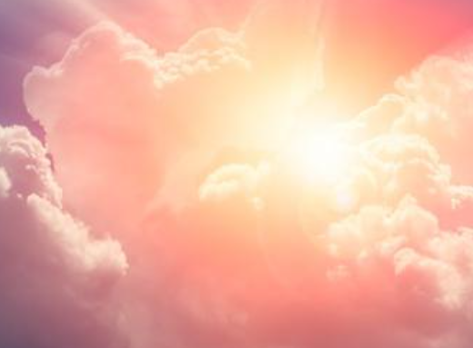

Slide 21
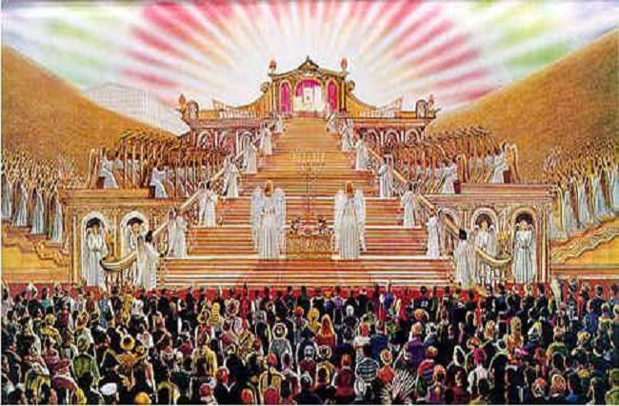

Slide 22
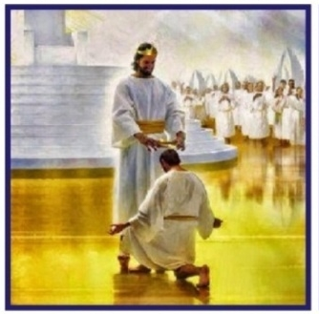
Romans 14:11 For it is written: "As I live, says the LORD, Every knee shall bow to Me, And every tongue shall confess to God."

Slide 23
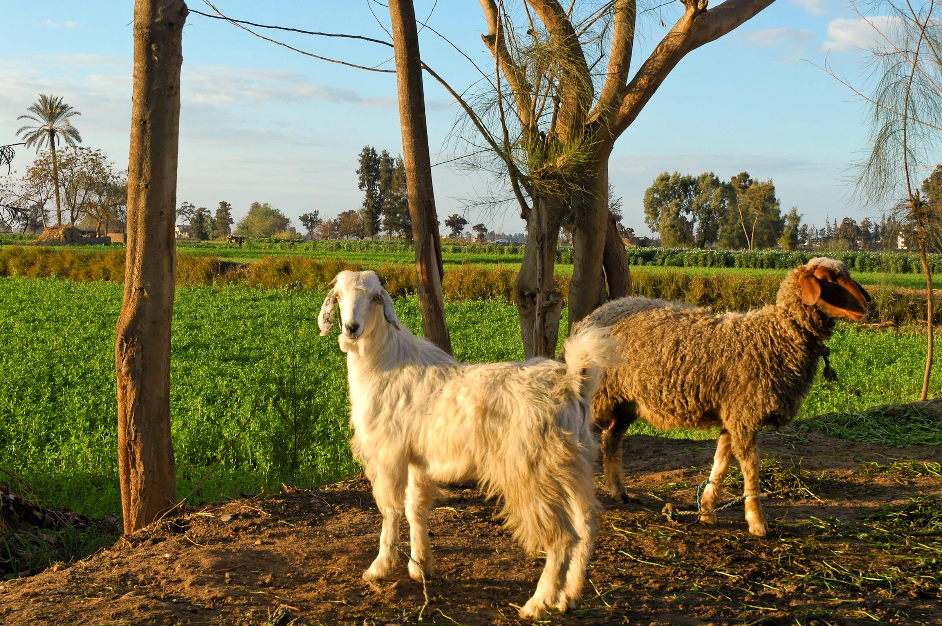
And He will separate them from one another, as a shepherd separates the sheep from the goats
Goat and sheep near Tell el-Daba, Egypt
Matthew 25:32
Notes:
In the Middle East, goats and sheep look similar, and they are often pastured together. A simple rule for distinguishing is that a goat’s tail goes up, and a sheep’s tail goes down. The goat is in the front, with the white tail up and blending in with the sheep behind.
tb010605764

Slide 24
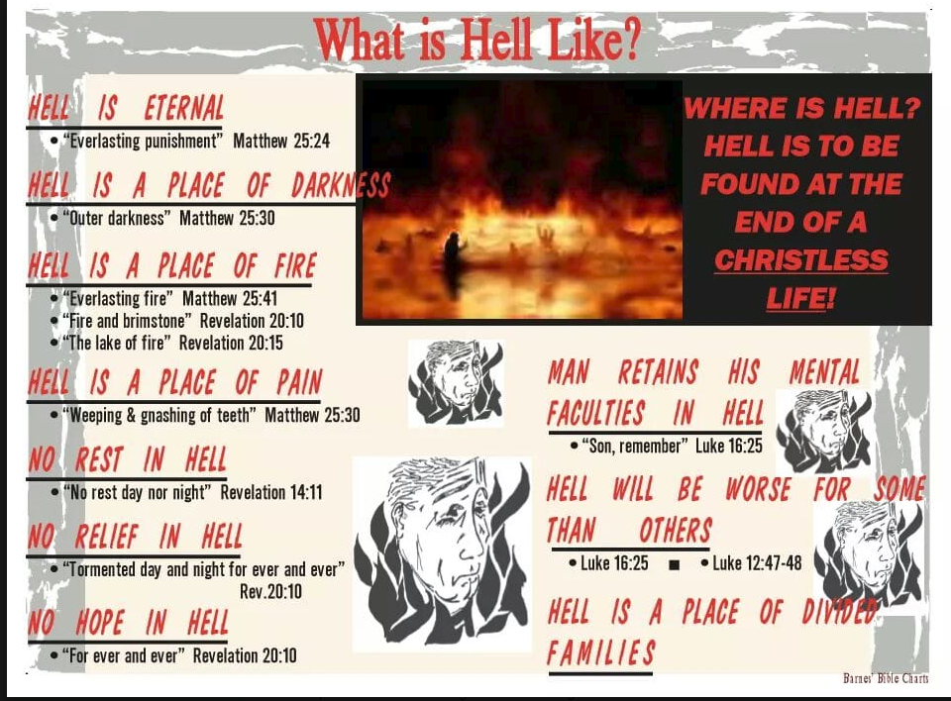

Slide 25
Are You Ready For The Judgment?
Hear the Gospel (Rom.10:14).
Believe the Gospel (Heb. 11:6).
Repent of Sins (Acts 3:19).
Confess Christ (Rom.10:9).
Be Baptized Into Christ (1 Cor.12:13).
1 Timothy 4:16
“Take heed unto thyself, and unto the doctrine; continue in them: for in doing this thou shalt both save thyself, and them that hear thee.”

