Slide 1
Welcome to our services
New Lebanon Church of Christ
We are Simply Christians.
Our Emphasis is Spiritual, Not Material or Social.
We are striving to be The Same Church as Described in The New Testament.
Please Come Back Again

Slide 2
Who Do The Crowds Say That I Am? Lk.9:18-27
Luke 9:18 And it happened, as He was alone praying, that His disciples joined Him, and He asked them, saying, "Who do the crowds say that I am?“
19 So they answered and said, "John the Baptist, but some say Elijah; and others say that one of the old prophets has risen again.“
20 He said to them, "But who do you say that I am?" Peter answered and said, "The Christ of God."

Slide 3
Who Do The Crowds Say That I Am? Lk.9:18-27
Luke 9:21 And He strictly warned and commanded them to tell this to no one,
22 saying, "The Son of Man must suffer many things, and be rejected by the elders and chief priests and scribes, and be killed, and be raised the third day."
23 Then He said to them all, "If anyone desires to come after Me, let him deny himself, and take up his cross daily, and follow Me.

Slide 4
Who Do The Crowds Say That I Am? Lk.9:18-27
Luke 9:24 "For whoever desires to save his life will lose it, but whoever loses his life for My sake will save it.
25 "For what profit is it to a man if he gains the whole world, and is himself destroyed or lost?
26 "For whoever is ashamed of Me and My words, of him the Son of Man will be ashamed when He comes in His own glory, and in His Father's, and of the holy angels.
27 "But I tell you truly, there are some standing here who shall not taste death till they see the kingdom of God."

Slide 5
Who Do The Crowds Say That I Am? Lk.9:18-27
Who is Christ? consider
Christ and Private Prayer.
Christ and Public Opinion.
Christ and Personal Conviction.
Christ and Suffering.
Christ and Discipleship.
Christ and Service.
Christ and His Coming Glory.

Slide 6
Who Do The Crowds Say That I Am? Lk.9:18-27
1. Christ and Private Prayer.
Luke 9:18 And it happened, as He was alone praying, that His disciples joined Him, and He asked them, saying,
"Who do the crowds say that I am?"

Slide 7
Who Do The Crowds Say That I Am? Lk.9:18-27
1. Christ and Private Prayer.
Alone praying… These words indicate the secluded scene of this episode, more fully identified as the coast of Caesarea Philippi (Matt. 16:13)
The crowds … stresses the widespread interest of the people in the identity of Jesus, who was demonstrating in the most emphatic manner his supernatural power. Luke alone records the detail that prayer was the purpose in our Lord’s withdrawal to this place.

Slide 8
Who Do The Crowds Say That I Am? Lk.9:18-27
1. Christ and Private Prayer.
“He was alone praying” (v. 18). Some don’t like to be alone to pray because they don’t like prayer.
Jesus often sought for privacy so that He could be alone with His Father who He loved so much.
If Jesus found it needful to pray in secret, how much more do we need it? Those who pray in secret will have their open reward (Matt. 6:6).

Slide 9
Who Do The Crowds Say That I Am? Lk.9:18-27
2. Christ and Public Opinion.
Luke 9:18 And it happened, as He was alone praying, that His disciples joined Him, and He asked them, saying, "Who do the crowds say that I am?"
19 So they answered and said, "John the Baptist, but some say Elijah; and others say that one of the old prophets has risen again.

Slide 10
Who Do The Crowds Say That I Am? Lk.9:18-27
2. Christ and Public Opinion.
It appears the multitudes were no longer suggesting that Jesus was the Christ, due to a campaign of the religious leaders against the Lord. (filled with rage against Him)
At the beginning of his ministry, John the Baptist had announced Jesus as “the Lamb of God that taketh away the sin of the world,” and, at first, Jesus was widely hailed as the Messiah.
However, having determined that Jesus was not the type of Messiah they wanted, the priestly leaders of the people used every charge they could make up in an all-out campaign to convince the people that Jesus was not the Christ.

Slide 11
Who Do The Crowds Say That I Am? Lk.9:18-27
2. Christ and Public Opinion.
Here is a short list of their charges:
They said Jesus was a glutton (Matt. 11:18, 19).
They said he was a winebibber (Matt. 11:18, 19).
They said he cast out demons by the prince of demons (Matt. 9:34).
They called him Beelzebul (Matt. 10:25).
They called him a sinner (John 9:24).
They said he had a demon (John 7:20).
They said he violated the sabbath (Matt. 12:2).
They said he was a Samaritan (John 8:48).
They referred to him as a deceiver (Matt. 27:63).
They accused him of friendship with publicans and sinners (Luke 15:2).
They said that no prophet could come out of Galilee (John 7:52).

Slide 12
Who Do The Crowds Say That I Am? Lk.9:18-27
2. Christ and Public Opinion.
v 18, 19. Reports are not always to be trusted. “The voice of the people” is not always “the voice of God.” In this case it was the voice of willful ignorance and unbelief,
It is always more easy for us to say what others think of Christ than to say honestly what we ourselves think of Him.

Slide 13
Who Do The Crowds Say That I Am? Lk.9:18-27
2. Christ and Public Opinion.
In the face of such opposition the people still clung to the conviction that Jesus was someone sacred.
No living person being worthy of comparison with him, and that he must be Elijah, Jeremiah, or John the Baptist risen from the dead!
The Twelve had not been swayed by the lies of the priestly leaders. The apostle Peter, leading all the rest, firmly acknowledged him as the Christ of God.

Slide 14
Who Do The Crowds Say That I Am? Lk.9:18-27
3. Christ and Personal Conviction.
Luke 9:20
He said to them, But who do you say that I am?" Peter answered and said, "The Christ of God. And He strictly warned and commanded them to tell this to no one,

Slide 15
Who Do The Crowds Say That I Am? Lk.9:18-27
3. Christ and Personal Conviction.
“But whom say ye that I am?” (v. 20). It will not satisfy the Savior to tell Him what our fathers, and mothers, and teachers said about Him. This question is one that we have all to answer individually for ourselves. “WHAT DO YOU THINK of Christ?” Peter’s answer, “Thou art the Christ - anointed, of God,” (Matt. 16:16, 17). “If thou shall confess with thy mouth the Lord Jesus, and believe in thine heart, thou shalt be saved” (Rom. 10:9).

Slide 16
Who Do The Crowds Say That I Am? Lk.9:18-27
4. Christ and Suffering.
Luke 9:22 saying, "The Son of Man must suffer many things, and be rejected by the elders and chief priests and scribes, and be killed, and be raised the third day."

Slide 17
Who Do The Crowds Say That I Am? Lk.9:18-27
4. Christ and Suffering.
“The Son of Man must suffer,” etc. (v. 22). As the Captain of our Salvation, Christ was made perfect through suffering. He was “rejected by the elders and chief scribes,” showing that the carnal mind, even though religious, is enmity against God.
With wicked hands they put Him to death, but by the authority of the Father He laid down His life and took it again (John 10:18). It was according to the Scriptures that He died for our sins, and rose again for our justification.

Slide 18
Who Do The Crowds Say That I Am? Lk.9:18-27
4. Christ and Suffering.
Many things … This announcement of the Lord’s death was given several times by Matthew, each in a different context, and disclosing, a number of events and conditions foretold by the Lord.
(Matt 16:21 Matt 17:9 Matt 17:12 Matt 17:22-23)
Jesus repeatedly instructed the Twelve regarding the full details of his death and resurrection

Slide 19
Who Do The Crowds Say That I Am? Lk.9:18-27
5. Christ and Discipleship.
Luke 9:23 Then He said to them all, "If anyone desires to come after Me, let him deny himself, and take up his cross daily, and follow Me.

Slide 20
Who Do The Crowds Say That I Am? Lk.9:18-27
5. Christ and Discipleship.
In this verse, Jesus made the cross central to his religion. Our Lord’s death was an absolute requirement and condition of human redemption.
And, if it was central for Jesus, it is central for his followers also, as the verse states.
As long as the will of man opposes the will of the Lord, salvation for such a man remains impossible

Slide 21
Who Do The Crowds Say That I Am? Lk.9:18-27
5. Christ and Discipleship.
(v. 23). Our sinful self acts the part of the elders and chief priests in rejecting Christ.
Self must be denied if we would follow the steps of Him who “pleased not Himself.”
It is absolutely necessary to a life of fellowship with Him.
(2 Tim. 2:11, 12). This is a faithful saying: For if we died with Him, We shall also live with Him.
12 If we endure, We shall also reign with Him. If we deny Him, He also will deny us.

Slide 22
Who Do The Crowds Say That I Am? Lk.9:18-27
5. Christ and Discipleship.
(v. 23). The Cross of Christ will always be a shameful thing in the eyes of the world, but God forbid that we should glory, except in the Cross of our Lord Jesus Christ, by which we are crucified unto the world. This cross of discipleship is not thrust upon us, we are to take it up daily.

Slide 23
Who Do The Crowds Say That I Am? Lk.9:18-27
6. Christ and Service.
Luke 9:24 "For whoever desires to save his life will lose it, but whoever loses his life for My sake will save it.

Slide 24
Who Do The Crowds Say That I Am? Lk.9:18-27
6. Christ and Service.
Whosoever shall lose His life for My sake shall save it” (v. 24). This losing our life by saving it, and saving our life by losing it, is very paradoxical to all who are strangers to the Power of the Cross.
The life that is spent in the service of Christ is a saved life; the life that is spent for self is a lost life. We may have a saved soul by trusting the Cross of Christ, and yet have a lost life through not living for Christ (1 Cor. 3:15) All the riches of this world will bring us nothing worth calling an advantage unless we ourselves are saved (v. 25).

Slide 25
Who Do The Crowds Say That I Am? Lk.9:18-27
7. Christ and His Coming Glory.
Luke 9:25 "For what profit is it to a man if he gains the whole world, and is himself destroyed or lost?
26 "For whoever is ashamed of Me and My words, of him the Son of Man will be ashamed when He comes in His own glory, and in His Father's, and of the holy angels.
27 "But I tell you truly, there are some standing here who shall not taste death till they see the kingdom of God."

Slide 26
Who Do The Crowds Say That I Am? Lk.9:18-27
7. Christ and His Coming Glory.
“Whosoever is ashamed of Me and My words,” (26, 27). Christ and His Word stand or fall together. We cannot trifle with His words without trifling with Him. - He who emptied Himself that He might become obedient unto death for us shall yet come in His own glory to reward all who have been faithful to Him in the days of His rejection (2 Cor. 5:10).
Are we able to say with Paul, the bond-servant of Christ, “I am not ashamed of the Gospel of Christ?”

Slide 27
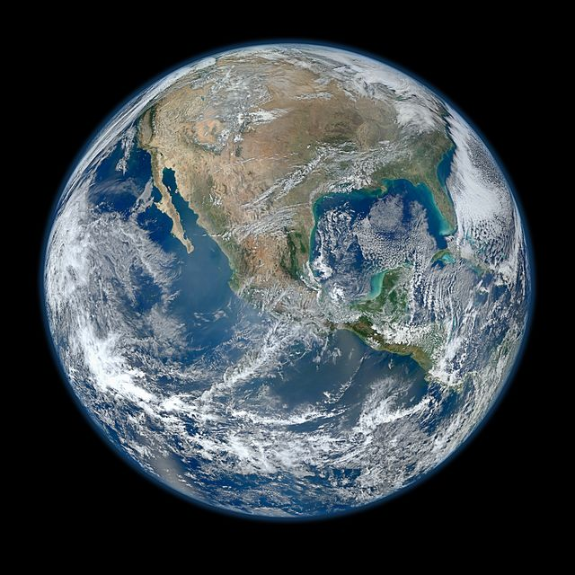
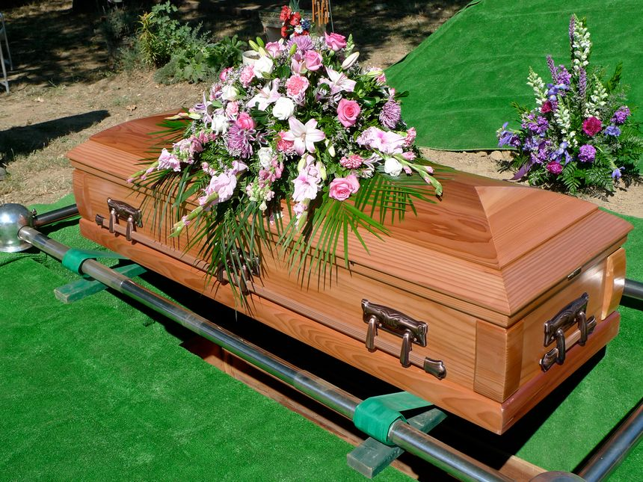
Luke 9:25 "For what profit is it to a man if he gains the whole world, and is himself destroyed or lost?

Slide 28
The sad truth is many people sell their soul for a whole lot less than the whole world.

Slide 29
Are you a New Testament Christian?
Hear the Gospel (Rom.10:14)
Believe the Gospel (Heb. 11:6)
Repent of Sins (Acts 3:19)
Confess Christ (Rom.10:9)
Be Baptized Into Christ (1 Cor.12:13)
Serve our Lord the rest of our lives (Rev.2:10)
You Must Be Born Again. John 3:1-7

Slide 30
Who Do The Crowds Say That I Am? Lk.9:18-27
Who do YOU say that Christ is?
We say who He is by how we spend our day.
Does He have 1st place in your life?
Does He have 1st place with your time?
Does He have 1st place with your schedule?
Does He have 1st place with your money?
Does He have 1st place with your energy?
Does He have 1st place with your talents?

