Slide 1
Welcome to our services
New Lebanon Church of Christ
We are Simply Christians.
Our Emphasis is Spiritual, Not Material or Social.
We are striving to be The Same Church as Described in The New Testament.
Please Come Back Again

Slide 2
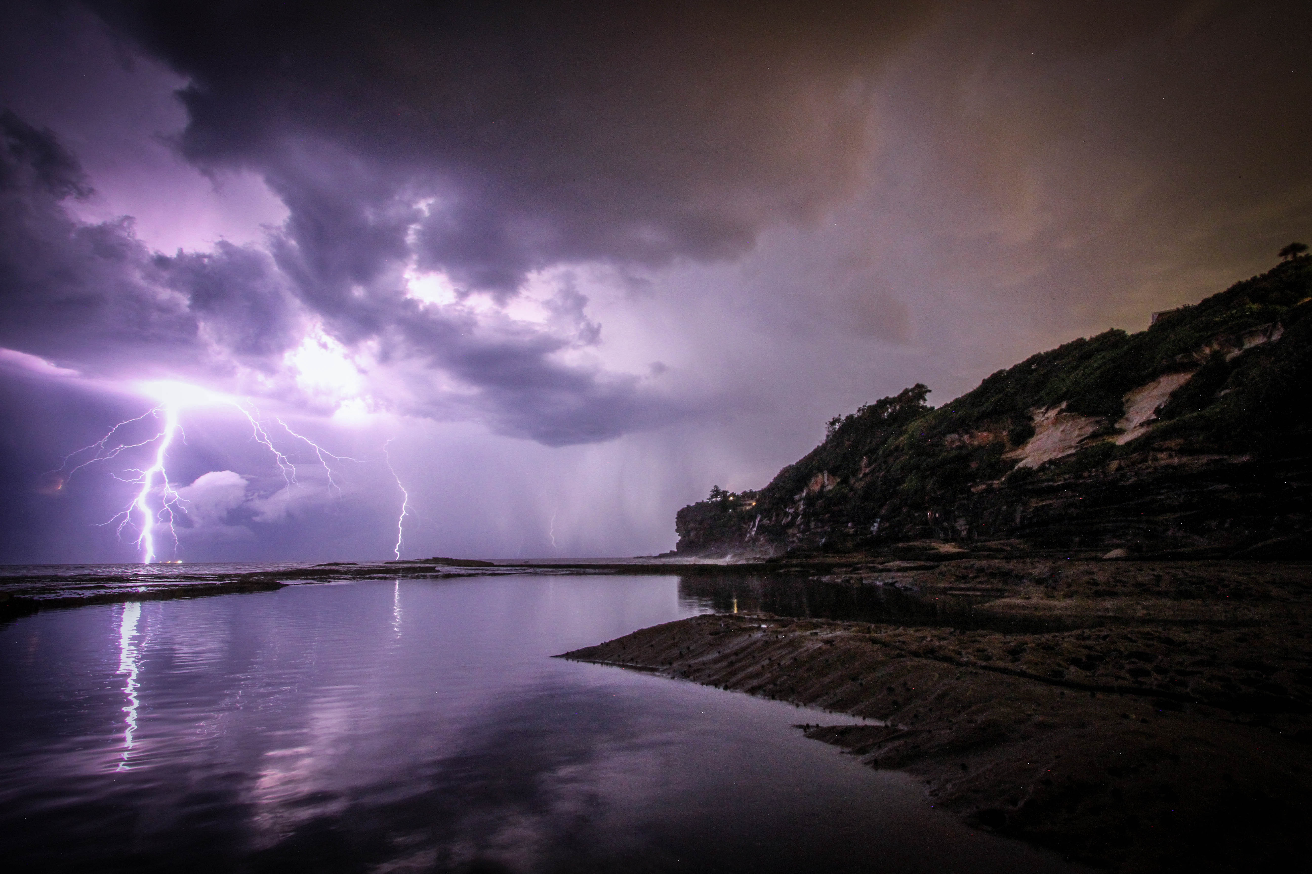
The Psalm Of 7 Thunders. Psalm 29
(The voice of the Lord)

Slide 3
How Great Thou Art
O Lord my God, When I in awesome wonder, Consider all the worlds Thy Hands have made; I see the stars, I hear the rolling thunder, Thy power throughout the universe displayed.
When through the woods, and forest glades I wander, And hear the birds sing sweetly in the trees. When I look down, from lofty mountain grandeur And see the brook, and feel the gentle breeze.
And when I think, that God, His Son not sparing; Sent Him to die, I scarce can take it in; That on the Cross, my burden gladly bearing, He bled and died to take away my sin.

Slide 4
When Christ shall come, with shout of acclamation, And take me home, what joy shall fill my heart. Then I shall bow, in humble adoration, And then proclaim: "My God, how great Thou art!“
Then sings my soul, My Savior God, to Thee, How great Thou art, How great Thou art. Then sings my soul, My Savior God, to Thee, How great Thou art, How great Thou art!

Slide 5
The Psalm Of 7 Thunders. Psalm 29
Psalm 29:1 <<A Psalm of David.>> Give unto the LORD, O you mighty ones, Give unto the LORD glory and strength.
2 Give unto the LORD the glory due to His name; Worship the LORD in the beauty of holiness.
3 The voice of the LORD is over the waters; The God of glory thunders; The LORD is over many waters.
4 The voice of the LORD is powerful; The voice of the LORD is full of majesty.

Slide 6
The Psalm Of 7 Thunders. Psalm 29
Psalm 29:5 The voice of the LORD breaks the cedars, Yes, the LORD splinters the cedars of Lebanon.
6 He makes them also skip like a calf, Lebanon and Sirion like a young wild ox.
7 The voice of the LORD divides the flames of fire.
8 The voice of the LORD shakes the wilderness; The LORD shakes the Wilderness of Kadesh.

Slide 7
The Psalm Of 7 Thunders. Psalm 29
9 The voice of the LORD makes the deer give birth, And strips the forests bare; And in His temple everyone says, "Glory!“
10 The LORD sat enthroned at the Flood, And the LORD sits as King forever.
11 The LORD will give strength to His people; The LORD will bless His people with peace.

Slide 8
The Psalm Of 7 Thunders. Psalm 29
“The voice of Jehovah is upon the waters” (Ps. 29:3).
In the land of Palestine, where David lived, such a statement clearly means that “It is thundering out in the Mediterranean Sea as a great thunderstorm approaches the land.”
It is really frightening to see first hand what tremendous energies are unleashed in the rumble of thunder and a bolt of lightning.

Slide 9
Encyclopedia Britannica
…The potential difference between cloud and ground is of the order of 10 to 100 million volts, and the peak currents in return strokes to negative leaders are typically about 30,000 amperes. The peak temperatures in the return-stroke channel are on the order of 30,000 °C (50,000 °F).
The entire process is very rapid; the leader stroke reaches the ground in about 30 milliseconds, and the return stroke reaches the centre of the cloud in about 100 microseconds. During this stage, approximately 105 joules of energy per metre are dissipated within the lightning channel. This sudden dissipation splits air molecules in the channel—principally those of nitrogen, oxygen, and water—into their respective atoms, and, on average, one electron is removed from each atom. The conversion from neutral air molecules to a completely ionized plasma occurs in a few microseconds.

Slide 10
The Psalm Of 7 Thunders. Psalm 29
Maybe the best understanding of, ‘The voice of Jehovah is upon the waters,’ is to take it as meaning the mass of water gathered together in the thick, black storm clouds,” then moving on to the land.
“The voice of Jehovah” (Ps. 29:3–4 (twice), 29:5, 7, 8). This remarkable phrase appears no less than 7 times in the passage before us.
That voice is here metaphorically presented as the thunder, bringing to mind instantly the reference in Revelation to the effect that, “The seven thunders uttered their voices” (Rev. 10:3).

Slide 11
The Psalm Of 7 Thunders. Psalm 29
Perhaps the occasion for this psalm as that of the celebration, “Of that abundant rain which fell in the days of David, after the heavens had been shut up for three years” (2 Sam. 21:1–10)
Also, one of the beautiful lessons of this psalm is the transition, at the end - “From nature in an uproar to the people of God in peace.”
This is one of the most beautiful psalms in the Bible.
“Awe-inspiring poetry,” A magnificent description of a thunder-storm rolling over the land,”

Slide 12
The Psalm Of 7 Thunders. Psalm 29
Anyone who has ever been in a really violent thunderstorm can truly appreciate this reference to nature in a violent mood.
Psalm 29:1-11. Trust in God is encouraged by the celebration of His mighty power as illustrated in His dominion over the natural world, in some of its most terrible and wonderful exhibitions.

Slide 13
The Psalm Of 7 Thunders. Psalm 29
Ps 29:1 Give unto the LORD, O you mighty ones, Give unto the LORD glory and strength.
2 Give unto the LORD the glory due to His name; Worship the LORD in the beauty of holiness.
(Do we ask for more than we give???)
Do not treat God like a vending machine.

Slide 14
The Psalm Of 7 Thunders. Psalm 29
though the earth be removed, yet will we not fear…
David calls upon the great ones of the world to give glory to God, Ps 29:1-2.
So, to convince them:
he takes notice of God’s power and terror in the thunder, and lightning, and thunder-showers (Ps 29:3-9),
his sovereign dominion over the world (Ps 29:10),
and his special favor to his church, (Ps 29:11).
Every clap of thunder David interpreted as a call to himself and other princes to give glory to the great God… Observe,

Slide 15
The Psalm Of 7 Thunders. Psalm 29
Description of the Thunderstorm
Psalms 29:3 The voice of the LORD is over the waters; The God of glory thunders; The LORD is over many waters.
The voice of the Lord--audible exhibition of His power in the tempest, of which thunder the example.
The waters--the clouds or vapors.
Jer. 10:13 When He utters His voice, There is a multitude of waters in the heavens: "And He causes the vapors to ascend from the ends of the earth. He makes lightning for the rain, He brings the wind out of His treasuries."

Slide 16
The Psalm Of 7 Thunders. Psalm 29
What they are called to-
-to give unto the Lord, not as if he needed any thing, or could be benefited by any gifts of ours, nor as if we had any thing to give him that is not his own already,
But the recognition of his glory, and of his dominion over us, he is pleased to accept as a gift to him:

Slide 17
The Psalm Of 7 Thunders. Psalm 29
"Give unto the Lord your ownselves, in the first place, and then your services.
Give unto the Lord glory and strength; acknowledge his glory and strength, and give praise to him as a God of infinite majesty and irresistible power; and whatever glory or strength he has entrusted you with offer it to him, to be used for his honor, in his service.
Give him your crowns; let them be laid at his feet; give him your swords, your keys, put all into his hand, that you, in the use of them, may be pleasing to Him.

Slide 18
The Psalm Of 7 Thunders. Psalm 29
Princes value themselves by their glory and strength; these they must ascribe to God, owning him to be infinitely more glorious and powerful than they.
Crowned heads must bow before the King of kings. What is here said to the mighty is said to all: Worship God; it is the sum and substance of the everlasting gospel,
Rev. 14:6-7. Then I saw another angel flying in the midst of heaven, having the everlasting gospel to preach to those who dwell on the earth--to every nation, tribe, tongue, and people-- 7 saying with a loud voice, "Fear God and give glory to Him, for the hour of His judgment has come; and worship Him who made heaven and earth, the sea and springs of water."

Slide 19
The Psalm Of 7 Thunders. Psalm 29
There is a glory due to his name. It is impossible that we should give him all the glory due to his name; when we have said and done our best for the honor of God's name, still we come infinitely short on the subject;
but when we answer that revelation which he has made of himself, with suitable affections and adoration,
then we give him some of that glory which is due to his name. In acts of devotion and worship, we must make it our business to give glory to God.

Slide 20
The Psalm Of 7 Thunders. Psalm 29
The rule - Worship the Lord in the beauty of holiness, which denotes,
The object of our worship; the glorious majesty of God is called the beauty of holiness, 2Chron 20:21.
In the worship of God we must have an eye to his beauty, and adore him, not only as infinitely “awful” and therefore to be feared above all, but as infinitely loving and therefore to be loved and delighted in above all; especially we must have an eye to the beauty of his holiness;

Slide 21
The Psalm Of 7 Thunders. Psalm 29
We must have an eye to the beauty of his holiness; the angels focused upon this in their praises,
Rev. 4:8. The four living creatures, each having six wings, were full of eyes around and within. And they do not rest day or night, saying: "Holy, holy, holy, Lord God Almighty, Who was and is and is to come!"

Slide 22
The Psalm Of 7 Thunders. Psalm 29
The voice of the God of glory,
it is here said to be upon the water, upon many waters (Ps 29:3);
it reaches over the vast ocean, the waters under the firmament;
it rattles among the thick clouds,
the waters above the firmament.
Every one that hears the thunder will must accept that the voice of the Lord is full of majesty (Psalm 29:4),
Every time we hear it thunder, let our hearts be filled with great, and high, and honorable thoughts of God, and praise to God.
O Lord our God! thou art very great.

Slide 23
The Psalm Of 7 Thunders. Psalm 29
Rev. 10:1 I saw still another mighty angel coming down from heaven, clothed with a cloud. And a rainbow was on his head, his face was like the sun, and his feet like pillars of fire.
2 He had a little book open in his hand. And he set his right foot on the sea and his left foot on the land,
3 and cried with a loud voice, as when a lion roars. When he cried out, seven thunders uttered their voices.

Slide 24
The Psalm Of 7 Thunders. Psalm 29
The voice of the seven thunders-
The voice of Jehovah is upon the waters (Ps.29:3).
The voice of Jehovah is powerful (Ps.29:4).
The voice of Jehovah is full of majesty (Ps.29:4).
The voice of Jehovah breaks the cedars (Ps.29:5).
The voice of Jehovah divides the flames of fire (Ps.29:7).
The voice of Jehovah shakes the wilderness (Ps.29:8).
The voice of Jehovah makes the deer to give birth (Ps. 29:9).

Slide 25
The Psalm Of 7 Thunders. Psalm 29
“The voice of Jehovah is powerful”(Ps.29:4).
His voice hurled the suns in space, His voice lifted up the Cross, His voice stilled the sea! It is His voice that shall at last summon the dead before the Great White Throne for the Final Judgment.

Slide 26
The Psalm Of 7 Thunders. Psalm 29
It is that voice which shall sound over the tombs of land and sea, and the myriads of the dead shall “Come Forth,” even as Lazarus did at Bethany.
It is important to understand that the psalmist here sees the hand and hears the voice of God in Nature, and especially in this great thunderstorm.

Slide 27
The Psalm Of 7 Thunders. Psalm29
Psalm 29:6 He makes them also skip like a calf, Lebanon and Sirion like a young wild ox. 7 The voice of the LORD divides the flames of fire. 8 The voice of the LORD shakes the wilderness; The LORD shakes the Wilderness of Kadesh.
There is a suggestion here of the final judgment of the Great Day. In these lines, the great mountains of Lebanon and Hermon are moved out of their places, or at least are made to appear as doing so. Also, there is a mighty earthquake that shakes the wilderness of Kadesh.
compare with (Rev. 6:12-14). I looked when He opened the sixth seal, and behold, there was a great earthquake; and the sun became black as sackcloth of hair, and the moon became like blood. 13 And the stars of heaven fell to the earth, as a fig tree drops its late figs when it is shaken by a mighty wind. 14 Then the sky receded as a scroll when it is rolled up, and every mountain and island was moved out of its place.

Slide 28
The Psalm Of 7 Thunders. Psalm 29
“Jehovah shakes the wilderness of Kadesh” (Ps. 29:8). This is the third time that the distinction is made in this psalm between the thunder (the voice of Jehovah) and Jehovah himself, namely at the end of Psalm. 29:3, 5, 8.
David is not really thinking of a thunderstorm but of Jehovah!

Slide 29
The Psalm Of 7 Thunders. Psalm29
Psalms 29:9 The voice of the LORD makes the deer give birth, And strips the forests bare; And in His temple everyone says, "Glory!"
This is usually interpreted to mean that wild animals, mammals, living in the forests were caused to bring forth their young prematurely because of their terror of the violent thunderstorm.

Slide 30
The Psalm Of 7 Thunders. Psalm 29
“Jehovah will bless his people with peace” (Ps. 29:11). Just as the Great flood was a judgment of mankind in which God’s wrath was poured out upon the wicked, and his mercy was extended to the righteous in the person of Noah and his family, so does it appear in this psalm.
The same pattern is found here. The lightnings flash, the thunders roar, the trees come crashing down, the forests are stripped, the wilderness trembles, and the mountains jump around like young antelopes, but God provides peace for his people!

Slide 31
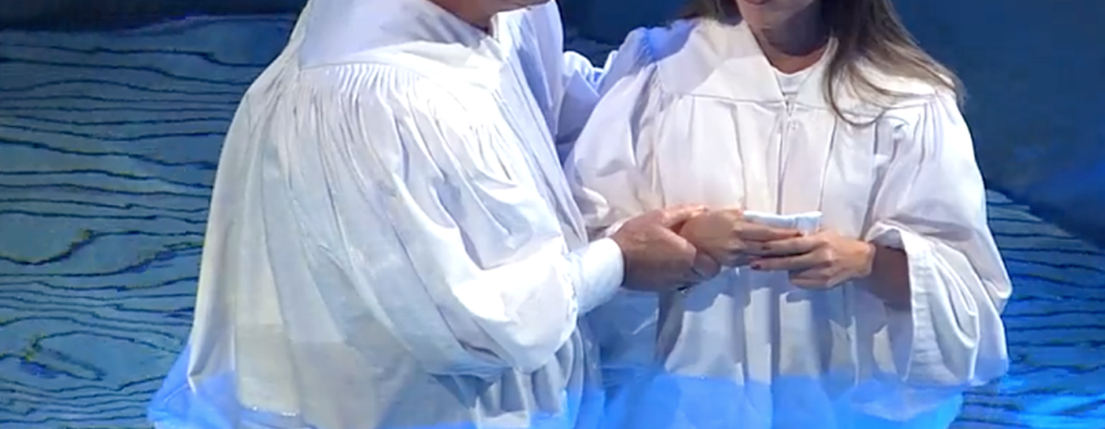
Are you a New Testament Christian?
Hear the Gospel (Rom.10:14)
Believe the Gospel (Heb. 11:6)
Repent of Sins (Acts 3:19)
Confess Christ (Rom.10:9)
Be Baptized Into Christ (1 Cor.12:13)
Serve our Lord the rest of our lives (Rev.2:10)
You Must Be Born Again. John 3:1-7

Slide 32
The Psalm Of 7 Thunders. Psalm 29
In the blessings he bestows upon the subjects of that kingdom, Ps 29:11. First, He will qualify them for his service: He will give strength to his people, to fortify them against every evil work and to furnish them for every good work; out of weakness they shall be made strong.
Secondly, He will encourage them in his service: He will bless his people with peace. Peace is a blessing of inestimable value, which God designs for all his people.
The work of righteousness is peace (great peace have those that love thy law); but much more the crown of righteousness: the end of righteousness is peace; it is endless peace. When the thunder of God's wrath shall make sinners tremble the saints shall lift up their heads with joy.

Slide 33
The Psalm Of 7 Thunders. Psalm29
(The voice of the Lord)
water
powerful
full of majesty
breaks the cedars
divides the flames of fire
shakes the wilderness
makes the deer give birth

