Slide 1
Welcome to our services
New Lebanon Church of Christ
We are Simply Christians.
Our Emphasis is Spiritual, Not Material or Social.
We are striving to be The Same Church as Described in The New Testament.
Please Come Back Again

Slide 2
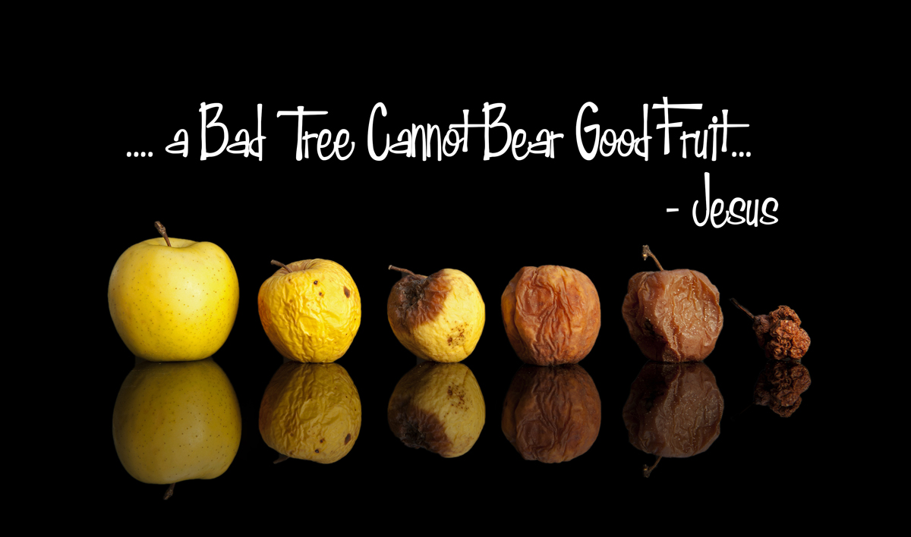
Matt. 12:33 "Either make the tree good and its fruit good, or else make the tree bad and its fruit bad; for a tree is known by its fruit.
Out Of The Treasure Of The Heart

Slide 3
Out Of The Treasure Of The Heart
Matt. 12:33 "Either make the tree good and its fruit good, or else make the tree bad and its fruit bad; for a tree is known by its fruit.
34 "Brood of vipers! How can you, being evil, speak good things? For out of the abundance of the heart the mouth speaks.
35 "A good man out of the good treasure of his heart brings forth good things, and an evil man out of the evil treasure brings forth evil things.
36 "But I say to you that for every idle word men may speak, they will give account of it in the day of judgment.
37 "For by your words you will be justified, and by your words you will be condemned."

Slide 4
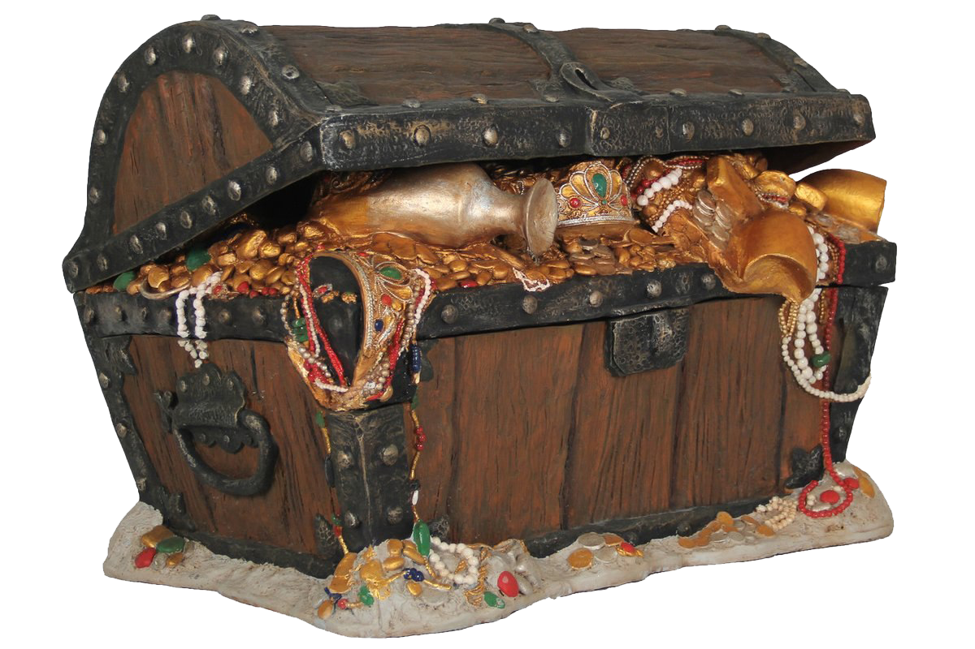
Out Of The Treasure Of The Heart
Matt. 12:35 "A good man out of the good treasure of his heart brings forth good things, and an evil man out of the evil treasure brings forth evil things.

Slide 5
Out Of The Treasure Of The Heart
Matt. 12:34 "Brood of vipers! How can you, being evil, speak good things? For out of the abundance of the heart the mouth speaks.
35 "A good man out of the good treasure of his heart brings forth good things, and an evil man out of the evil treasure brings forth evil things.
What things do you have in your heart ????

Slide 6
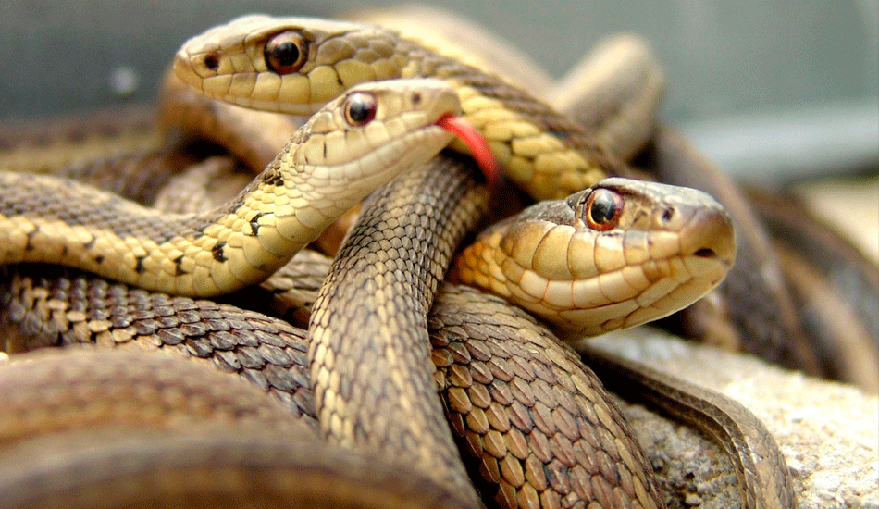
Matt. 12:34 "Brood of vipers! How can you, being evil, speak good things? For out of the abundance of the heart the mouth speaks.

Slide 7
Out Of The Treasure Of The Heart
v.33 Either make the tree good, and its fruit good; or make the tree bad, and its fruit bad; for the tree is known by its fruit.
Only the rotten tree will produce rotten fruit and their hearts are so rotten they are speaking these things against Jesus.
This is also an appeal for them to be honest. If it’s a good tree then call it a good tree. If I am good, then say I am good. My works show I am good.
(and our works show our nature)

Slide 8
Out Of The Treasure Of The Heart
34 You brood of vipers, how can you, being evil, speak what is good? For the mouth speaks out of that which fills the heart.
These people were wicked; like poisonous snakes, with corrupt natures. For the mouth speaks out of that which fills the heart.
The prince of this world knows that the message you allow into your heart will forever shape you. He will be busy everyday filling your heart with his messages. Messages that if you allow to dwell in your heart will damn your soul.

Slide 9
Out Of The Treasure Of The Heart
(Prov. 23:7) For as he thinks in his heart, so is he. "Eat and drink!" he says to you, But his heart is not with you.
(Prov. 4:20-22) My son, give attention to my words; Incline your ear to my sayings. 21 Do not let them depart from your eyes; Keep them in the midst of your heart; 22 For they are life to those who find them, And health to all their flesh.

Slide 10
Out Of The Treasure Of The Heart
35 The good man out of his good treasure brings forth what is good, and the evil man out of his evil treasure brings forth what is evil.
The treasure is what a person values in his heart. What a man does and says (“brings forth”) is a clear indication whether he is a good man or an evil man.

Slide 11
Out Of The Treasure Of The Heart
Jesus said back in chapter 6
Mt 6:19 "Do not lay up for yourselves treasures on earth, where moth and rust destroy and where thieves break in and steal; 20 "but lay up for yourselves treasures in heaven, where neither moth nor rust destroys and where thieves do not break in and steal.
21 "For where your treasure is, there your heart will be also.
A concern in the first century as it is today is the protection of wealth. Two areas of their wealth they worried about; clothes and money. Clothes would be destroyed by moths and money would rust. Their houses were made of mud, which could be dug through and easily broken into.

Slide 12
Out Of The Treasure Of The Heart
We should not fall in love with our clothes, our houses, our cars, our material possessions. Everything in this world is corruptible. …Falling apart….wearing out…fading away…
But (contrast)
God is forever. He will not become obsolete, He will not wear out. God will keep His promises when the lifetime warranties of this world are ashes. God will not fail or falter. If we have given ourselves to Him and belong to Him ,we can rely on the truth that He will never leave us or forsake us.

Slide 13
Out Of The Treasure Of The Heart
v20 But lay up for yourselves treasures in heaven, where neither moth nor rust destroys, and where thieves do not break in or steal;
The real emphasis in life is not accumulating things….
but doing the will of God,
practicing our righteousness to be seen not of men but of God.
When our righteousness is approved by God, and not done to be seen of men, then we are making a deposit in God’s “heavenly bank.”

Slide 14
Out Of The Treasure Of The Heart
Our emphasis should be on spiritual things and doing things with spiritual purposes.
Our deeds do have a way of being “stockpiled” Lay up for yourselves –
do it, and do it again,
having the security of not ever losing that reward.
It is guaranteed in God’s “bank.”

Slide 15
Out Of The Treasure Of The Heart
v.21 for where your treasure is, there will your heart be also.
If we’re spending our lives and energies on earthly things, then our lives are not what God wants. We cannot spend all our time on earthly things and say that our hearts are with God. This is a revealing passage because you can tell a person’s love and interests by looking at his treasures.
Almost everything people do shows where their treasure is. Whatever that treasure may be - money, boats, houses, diplomas.
Some people 40-50-60 years later- still worship the school they went to…

Slide 16
Out Of The Treasure Of The Heart
Even in the church…when you talk to some preachers they sound as if they are more full of school spirit than the holy spirit
(pride of life).
Where our hearts lie, our interests lie.
Where our interest lie, is where our heart is.

Slide 17
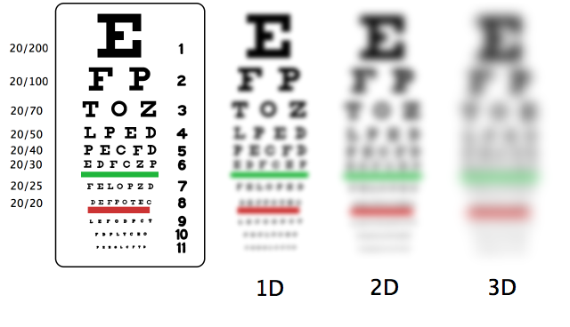
v.22 The lamp of the body is the eye; if therefore your eye is clear, your whole body will be full of light.
23 But if your eye is bad, your whole body will be full of darkness. If therefore the light that is in you is darkness, how great is the darkness!

Slide 18
Out Of The Treasure Of The Heart
The lamp of the body is the eye. The eye allows images inside the body.
If it is clear...light. “Clear” = “sound” or “healthy,” allowing us to see things correctly.
If your eye is bad...darkness. “Darkness” in the Bible represents sin and ignorance.
This is what Jesus is talking about. We will not see things the way they should be and, as a result, will be filled with things that are ungodly.

Slide 19
Out Of The Treasure Of The Heart
Seeing things from Satan’s point of view, we grow more like him. One may start out with a clear eye, but it can become dimmer and dimmer until it is full of evil; greed, sin, money as those in
(2 Tim.3:2-5) For men will be lovers of themselves, lovers of money, boasters, proud, blasphemers, disobedient to parents, unthankful, unholy,
3 unloving, unforgiving, slanderers, without self-control, brutal, despisers of good,
4 traitors, headstrong, haughty, lovers of pleasure rather than lovers of God,
5 having a form of godliness but denying its power. And from such people turn away!

Slide 20
Out Of The Treasure Of The Heart
We must be careful. None of us can serve two masters.
The one who has a clear eye is serving God;
the one who has a dark eye is serving Satan.
No man can serve both God and Satan.
What we love is what we give our devotion and attention to;
not what we say we love, but what we show we love. Very few people will say they love money and hate God. I may say, “I love God.” Do I?
Why is it that I cannot attend worship because I am doing this, that, and the other ?

Slide 21
Out Of The Treasure Of The Heart
Do our actions match our words???
What we do shows what we love.
What is your treasure? Matt. 6.
Life is not about the stuff you have, but about the stuff you are made of. It’s about out Character, our Desires, our Passions. We hear people say “My passion is_____”
Life is about the stuff we put in our heart and fill our mind with. Life is about the things God wants us to fill our heart and mind with. And what does God want us to fill our heart and mind with??? Jesus Christ.

Slide 22
Out Of The Treasure Of The Heart
Life must be defined by the heart of God and our heart becoming like God’s heart.
God longs to fill the emptiness that echoes in our heart. God created us for our hearts to hunger for Him. God wants us to open our hearts for Him to move in and dwell there.
The limits of time require us to make choices. Who will we help? Where will be go? We can’t be everywhere at once. Time presses us every day. What do we fill our day with??? What do we fill our heart with???

Slide 23
Out Of The Treasure Of The Heart
We have to take one minute at a time and choose how to use that one minute. Once it is past, it is gone. The only minute that is real and available for us to act on is the minute we have right now.
Do we give people we meet each day our time? If not, how will we influence them?...
A good man out of the good treasure of his heart brings forth good things,
Our relationships are measured against time.
Your relationship with your mailman is different than the person you work side by side with 8 hours a day, 5 days a week. How do we use our time to teach people about God? A good man out of the good treasure of his heart brings forth good things,

Slide 24
Out Of The Treasure Of The Heart
v.36 And I say to you, that every careless word that men shall speak, they shall render account for it in the day of judgment.
Words indicate the feeling of the heart. Jesus says one will not speak what is not in the heart. That is why men will render accounts for what they say.
Our mouth does not say something unless our heart is thinking it.

Slide 25
Out Of The Treasure Of The Heart
The opposite is also true…We will not speak to the lost about the need for them to change their life…unless that is on our minds.
A good man out of the good treasure of his heart brings forth good things
v. 37 For by your words you shall be justified, and by your words you shall be condemned.”

Slide 26
Out Of The Treasure Of The Heart
Compare Matt.15:11-20. Judgment will be based upon a man’s words. Those words will either prove him to be a righteous man or an evil man.
Negative- Silence
Positive –
(Matt. 10:32) "Therefore whoever confesses Me before men, him I will also confess before My Father who is in heaven.33 "But whoever denies Me before men, him I will also deny before My Father who is in heaven.

Slide 27
Out Of The Treasure Of The Heart
We speak His words.
We sing His songs.
We introduce others to our heavenly father.
There should be a fire in our hearts that we can’t keep quiet about our master and savior.

Slide 28
Out Of The Treasure Of The Heart
(Eph. 3:14) For this reason I bow my knees to the Father of our Lord Jesus Christ,
15 from whom the whole family in heaven and earth is named,16 that He would grant you, according to the riches of His glory, to be strengthened with might through His Spirit in the inner man,
17 that Christ may dwell in your hearts through faith; that you, being rooted and grounded in love,
God is our owner.
He paid a great price to redeem us and sacrificed himself to make you his own.

Slide 29
Out Of The Treasure Of The Heart
He purchased us with His Blood.
He has the right to set our steps and determine our purpose. God is our master and owner. His position in our lives makes it clear the responsibility of those call by his name. We are to obey.
Obey right away… obey all the way… obey in a happy way!
Obedience is a tool of transformation and the way in which God shapes us into the image of Christ . (God owns us, He owns our heart)

Slide 30
Out Of The Treasure Of The Heart
(Col.3:15) And let the peace of God rule in your hearts, to which also you were called in one body; and be thankful.
(1Peter 3:15) But sanctify the Lord God in your hearts, and always be ready to give a defense to everyone who asks you a reason for the hope that is in you, with meekness and fear;

Slide 31
Out Of The Treasure Of The Heart
We must lift God higher than everything else that we love or desire. We must exalt Him, acknowledge His authority and seat Him on the throne of our hearts. We allow the brightness of His holiness to cause everything else that distracts us or sparkles for our attention to fade in the light of His glory. When we exalt the Lord, we see His holiness, causing us to bow before Him in adoration and praise.
A good man out of the good treasure of his heart brings forth good things,

Slide 34
Out Of The Treasure Of The Heart
Every battle has a Victor and one who stands defeated… in the battle between good and evil, light and dark, the contest is over…
Jesus wins. Satan is utterly defeated…
the question for you and me is, on which side will we choose to stand…
our victory is certain, is already determined, if we choose Jesus…
we can live victoriously because Jesus wins…
if we choose darkness we already stand defeated because the Prince of this world has already lost.

Slide 35
Are You A New Testament Christian?
Hear the Gospel (Rom.10:14).
Believe the Gospel (Heb. 11:6).
Repent of Sins (Acts 3:19).
Confess Christ (Rom.10:9).
Be Baptized Into Christ (1 Cor.12:13).
1 Timothy 4:16
“Take heed unto thyself, and unto the doctrine; continue in them: for in doing this thou shalt both save thyself, and them that hear thee.”

Slide 36
Out Of The Treasure Of The Heart
24 No one can serve two masters; for either he will hate the one and love the other, or he will hold to one and despise the other. You cannot serve God and mammon.

