Slide 1
Welcome to our services
New Lebanon Church of Christ
We are Simply Christians.
Our Emphasis is Spiritual, Not Material or Social.
We are striving to be The Same Church as Described in The New Testament.
Please Come Back Again

Slide 2
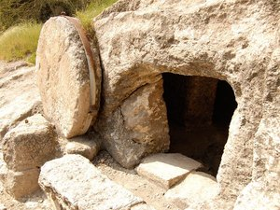
Observing The Resurrection
What does the Bible say?

Slide 3
What does the Bible say?
?
John 12:48 He that rejects me, and receives not my words, hath one that judges him: the word that I have spoken, the same shall judge him in the last day.

Slide 4
Observing The Resurrection
Many people celebrate / observe the resurrection
by dressing up, and “going to church” one day out of the year,
and think that is pleasing to God
and makes them a good person.
What does God say
about pleasing Him
and making us a good person?

Slide 5
Observing The Resurrection
"Easter Sunday" is an annual holiday celebrated by many...
Millions of people commemorate the resurrection of Jesus on this day.
Many consider it as "the most holy" of religious holidays.
For some, it marks the only time they attend church services (although Christmas runs a close second)

Slide 7
Observing The Resurrection
1. What did Jesus say about the food issue?
John 6:1 After these things Jesus went over the Sea of Galilee, which is the Sea of Tiberias.
2 Then a great multitude followed Him, because they saw His signs which He performed on those who were diseased.
3 And Jesus went up on the mountain, and there He sat with His disciples.
4 Now the Passover, a feast of the Jews, was near.
5 Then Jesus lifted up His eyes, and seeing a great multitude coming toward Him, He said to Philip, "Where shall we buy bread, that these may eat?“
Matt.14:21 Now those who had eaten were about five thousand men, besides women and children.

Slide 8
Observing The Resurrection
1. What did Jesus say about the food issue?
John 6:24 when the people therefore saw that Jesus was not there, nor His disciples, they also got into boats and came to Capernaum, seeking Jesus.
25 And when they found Him on the other side of the sea, they said to Him, "Rabbi, when did You come here?"
26 Jesus answered them and said, "Most assuredly, I say to you, you seek Me, not because you saw the signs, but because you ate of the loaves and were filled.
27 "Do not labor for the food which perishes, but for the food which endures to everlasting life, which the Son of Man will give you, because God the Father has set His seal on Him."

Slide 9
Observing The Resurrection
1. What did Paul say about the food issue?
1Cor. 11:22 What! Do you not have houses to eat and drink in? Or do you despise the church of God and shame those who have nothing? What shall I say to you? Shall I praise you in this? I do not praise you.

Slide 10
Observing The Resurrection
2. Is Easter in the Bible?
EASTER
pascha (πάσχα, 3957), mistranslated “Easter” in Acts 12:4, kjv, denotes the Passover (rv). The phrase “after the Passover” signifies after the whole festival was at an end. The term “Easter” is not of Christian origin. It is another form of Astarte, one of the titles of the Chaldean goddess, the queen of heaven. The festival of Pasch held by Christians in post-apostolic times was a continuation of the Jewish feast, but was not instituted by Christ, nor was it connected with Lent. From this Pasch the pagan festival of “Easter” was quite distinct and was introduced into the apostate Western religion, as part of the attempt to adapt pagan festivals to Christianity. See passover.
W. E. Vine, Merrill F. Unger, and William White Jr., (Nashville, TN: T. Nelson, 1996), 192.

Slide 11
Observing The Resurrection
2. Is Easter in the Bible?
Acts 12:4 intending after Easter to bring him forth to the people. (KJV) 1604-1611-influence of Catholic church
Acts 12:4 intending after the Passover to bring him forth to the people. (ASV)
Acts 12:4 intending after the Passover to bring him out to the people. (RSV)
Acts 12:4 intending to bring him before the people after Passover. (NKJV)

Slide 12
When he had taken him (piasas). See on Ac 3:7 for same form. He put him in prison (etheto eis phulakên). Second aorist middle indicative of tithêmi, common verb. This is the third imprisonment of Peter (Ac 4:3; 5:18). To four quaternions of soldiers (tessarsin tetradiois stratiôtôn). Four soldiers in each quaternion (tetradion from tetras, four), two on the inside with the prisoner (chained to him) and two on the outside, in shifts of six hours each, sixteen soldiers in all, the usual Roman custom.
Probably Agrippa had heard of Peter's previous escape (Ac 5:19) and so took no chances for connivance of the jailors. After the passover (meta to pascha). The passover feast of eight days. "The stricter Jews regarded it as a profanation to put a person to death during a religious festival" (Hackett). So Agrippa is more scrupulous than the Sanhedrin was about Jesus.
(When Paul was chained he also would have a captive audience of 16 soldiers each day.)

Slide 13
Observing The Resurrection
3. What is Easter?
The Yearly Observance Of Christ’s Resurrection...according to secular history ---
1. The practice began early, in the form of a "Christian“ Passover.
The Passover was already an important feast to the Jews.
2. Instituted by Moses, commemorating their deliverance
from Egypt.
3. It was during this feast that Jesus instituted the "Lord’s Supper."
4. Many Jews continued to keep their Jewish customs and
religious festivals after their conversion to Christ.
5. Paul was not opposed to observing such Jewish customs.
- Acts 18:18-21; 21:17-26

Slide 14
Observing The Resurrection
3. What is Easter?
The word "Easter" is found only once in the Bible – in the King James Version Acts 12:4 .
The word in the Greek is actually "Passover", and so translated elsewhere in the KJV. The word Easter was used because of the influence of the Roman catholic church….Not because it was in the original.
The updated KJV (The New King James) makes this correction so it is true to the original Greek.

Slide 15
Observing The Resurrection
3. What is Easter?
Easter is a moveable Holiday, meaning it is not fixed in relation to the civil calendar. The First Council of Nicaea* (325) established the date of Easter as the first Sunday after the full moon (the Paschal Full Moon) following the northern hemisphere's vernal equinox. on March 21.
The date of Easter therefore varies between March 22 and April 25.
Easter is linked to the Jewish Passover by much of its symbolism, as well as by its position in the calendar. In some languages, the words for "Easter" and "Passover" are related or the same.

Slide 16
Observing The Resurrection
The NT contains
no reference to a YEARLY celebration
of the resurrection of Christ”
If it does,…. please tell me the verse so I can read it in my bible and read HOW they celebrated it.

Slide 17
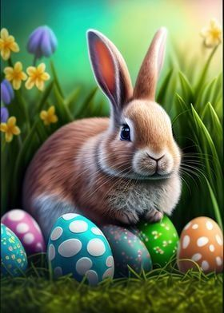
Observing The Resurrection
3. What is Easter?
The word "Easter" comes from "EASTRE", the
Anglo-Saxon name of a goddess of spring and fertility.
Her festival was celebrated on the day of vernal equinox.

Slide 18
Observing The Resurrection
3. What is Easter?
Many of the customs associated with Easter illustrate this and other pagan connections.
The rabbit was sacred to the goddess 'Eastre', the goddess of fertility and springtime...
It appears there was a custom among ancient Egyptians and Romans to give eggs as presents at this time of year. That was intended to insure that the recipient would have a very fertile or productive year."

Slide 19
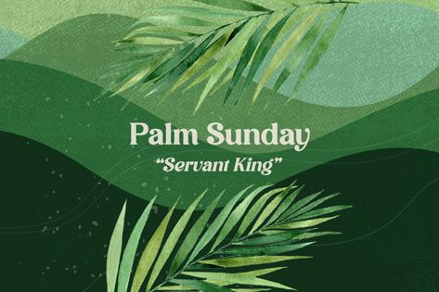
Observing The Resurrection
3. What is Easter?
The yearly "Christian Passover" soon included other
observances as well...

Slide 20
Observing The Resurrection
3. What is Easter?
Palm Sunday, the day Jesus made His triumphant entry into Jerusalem prior to His death
Good Friday, the day He was crucified
Resurrection Sunday, the day He arose and which came to be known as "Easter“
It’s interesting that if God wanted us to observe these days, He did not tell us to do so, nor did he give instruction HOW to do so.

Slide 21
Observing The Resurrection
4. Can a Christian participate in Easter?
Paul was not against observing certain feast days himself
He kept Jewish customs when expedient - 1Cor.9:19-20
He had Timothy circumcised - Acts 16:1-3
He took a vow - Acts 18:18
He sought to keep a Jewish feast in Jerusalem - Acts 18:19-21
He participated in purification ceremonies, which included animal sacrifices - Acts 21:17-26;
However, in his teaching it was made clear:
1) It should be kept on an individual basis - Rom.14:5-6
2) It should not be bound on others - Gal.2:3-5
3) It had nothing to do with our justification in Christ. Gal.5:4-6
-- Where Paul drew the line was in making such matters church
doctrine or practice, where people were compelled to do
them.

Slide 22
Observing The Resurrection
4. Can a Christian participate in Easter?
Jesus Warned Of The Danger Of Human Traditions...
He rebuked the scribes Pharisees for their use of traditions
- Mark 7:1-13
They made their traditions necessary for all to observe
- Mark 7:7
In keeping their traditions, they laid aside the commands
of God - Mark 7:8-9
Traditions of men are wrong, then, when they:
Become matters of doctrine or required practice, bound upon all.
Displace the commands of God by the very keeping of the
traditions.

Slide 23
Observing The Resurrection
4. Can a Christian participate in Easter?
On an individual basis, however, if one wishes to esteem one day above another:
It is between him and the Lord – Rom.14:5-6
Be careful not to condemn those who differ – Rom.14:4,10-12
Be sensitive to the convictions of others – Rom. 14:13-19
As for the pagan elements...
Again, perhaps this is best left on an individual basis
My own understanding is that we are free in Christ to
change what may have been a religious practice at one time
for personal use as an expediency
using circumcision for personal hygiene
using colored eggs and hiding them for family entertainment

Slide 24
Observing The Resurrection
I think it’s interesting that if God wanted us to observe these days, He did not tell us to do so, nor did he give instruction HOW to do so.
However…He did give us instructions how to celebrate His death, on the first day of the week, every first day of every week.
(remember the Sabbath and keep it holy)

Slide 25
Observing The Resurrection
5. What does the Bible say?
1Cor. 11:23 For I received from the Lord that which I also delivered to you: that the Lord Jesus on the same night in which He was betrayed took bread;
24 and when He had given thanks, He broke it and said, "Take, eat; this is My body which is broken for you; do this in remembrance of Me."
25 In the same manner He also took the cup after supper, saying, "This cup is the new covenant in My blood. This do, as often as you drink it, in remembrance of Me."

Slide 26
Observing The Resurrection
5. What does the Bible say?
26 For as often as you eat this bread and drink this cup, you proclaim the Lord's death till He comes.
27 Therefore whoever eats this bread or drinks this cup of the Lord in an unworthy manner will be guilty of the body and blood of the Lord.
28 But let a man examine himself, and so let him eat of the bread and drink of the cup.
29 For he who eats and drinks in an unworthy manner eats and drinks judgment to himself, not discerning the Lord's body.

Slide 27
Observing The Resurrection
5. What does the Bible say?
This memorial that we have represents the gospel. The DBR of our Lord and savior Jesus Christ.
1Cor. 15:1 Moreover, brethren, I declare to you the gospel which I preached to you, which also you received and in which you stand,
2 by which also you are saved, if you hold fast that word which I preached to you--unless you believed in vain.
3 For I delivered to you first of all that which I also received: that Christ died for our sins according to the Scriptures,
4 and that He was buried, and that He rose again the third day according to the Scriptures,

Slide 28
Observing The Resurrection
5. What does the Bible say?
5 and that He was seen by Cephas, then by the twelve.
6 After that He was seen by over five hundred brethren at once, of whom the greater part remain to the present, but some have fallen asleep.
7 After that He was seen by James, then by all the apostles.
8 Then last of all He was seen by me also, as by one born out of due time.

Slide 29
Observing The Resurrection
5. What does the Bible say?
9 For I am the least of the apostles, who am not worthy to be called an apostle, because I persecuted the church of God.
10 But by the grace of God I am what I am, and His grace toward me was not in vain; but I labored more abundantly than they all, yet not I, but the grace of God which was with me.

Slide 30
Observing The Resurrection
5. What does the Bible say?
Remembering the resurrection… The desire of my heart - I long to be with God.
I want every day to be filled with Him.
I want to be so aware of his presence that I don't take one step outside of his glory.
I want to keep my eyes on Him.
If God moves I want to move.
If God stays put, I want to rest in his presence.

Slide 31
Observing The Resurrection
5. What does the Bible say?
Worship is our response to our recognition that God is worthy… worship gives us an Avenue to celebrate his provisions, honor his power and be touched by his presence
Acts 20:7
And we must worship God from our heart.
Acts 20:7 And upon the first day of the week, when the disciples came together to break bread, Paul preached unto them,

Slide 32
Observing The Resurrection
5. What does the Bible say?
God is a jealous God and God desires to have a covenant relationship with you. God chose you before the foundation of the world. He looked down thru time, he settled his eyes on your face. Because of you, he moved, making a plan, and designing a destiny for your soul. Your destiny, the best path for your heart, is found in being a child of God.

Slide 33
Observing The Resurrection
6. Making Application In Regards To Easter.
The Bible is silent regarding any YEARLY observance of
Christ's resurrection
God and Jesus evidently did not see it necessary for the church.
Any yearly observance is based upon human tradition, not God's Word.

Slide 34
Observing The Resurrection
6. Making Application In Regards To Easter...
As a human tradition, we must be very careful - Mark 7:7-9
It cannot become a matter of doctrine, which is bound upon others
Why is an annual observance by the church unwise, if not wrong?
It intertwines human traditions with God's commands for His church.

Slide 35
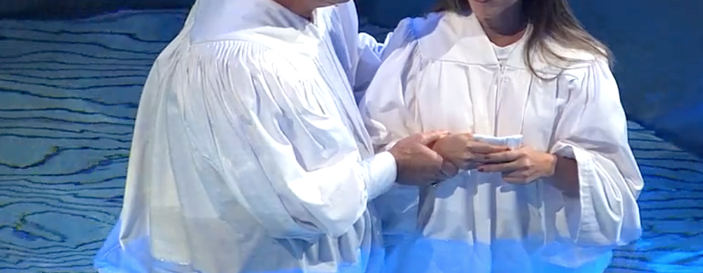
Are you a New Testament Christian?
Hear the Gospel (Rom.10:14)
Believe the Gospel (Heb. 11:6)
Repent of Sins (Acts 3:19)
Confess Christ (Rom.10:9)
Be Baptized Into Christ (1 Cor.12:13)
Serve our Lord the rest of our lives (Rev.2:10)
You Must Be Born Again. John 3:1-7

