Slide 1
Welcome to our services
New Lebanon Church of Christ
We are Simply Christians.
Our Emphasis is Spiritual, Not Material or Social.
We are striving to be The Same Church as Described in The New Testament.
Please Come Back Again

Slide 2
The temple of God. 1Cor 3:16
Title
1Cor. 3:16 Do you not know that you are the temple of God and that the Spirit of God dwells in you?
17 If anyone defiles the temple of God, God will destroy him. For the temple of God is holy, which temple you are.
b hastings newlebanoncoc.com

Slide 3
The temple of God. 1Cor 3:16
Title
God has always desired for man to meet Him and worship Him.
In the beginning,
Altars were built and consecrated where God met the worshipers.
Then the tabernacle,
then the temple in Jerusalem,
now the spiritual temple or the church of God.
b hastings newlebanoncoc.com

Slide 4
Finding the
New Testament Church
The Called Out Body.
The Household of God.
The Kingdom of God.
The Body of Christ
The Temple of God

Slide 5
The temple of God. 1Cor 3:16
God has always desired for man to meet Him and worship Him.
In the beginning,
Altars were built and consecrated where God met the worshipers.
Then the tabernacle,
then the temple in Jerusalem,
now the spiritual temple or the church of God.
Title
In the spiritual temple he makes his permanent dwelling place among men. (1 Cor. 6:19, 2 Cor. 6:16, Heb. 3:6, 1 Pet. 2:5.)
b hastings newlebanoncoc.com

Slide 6
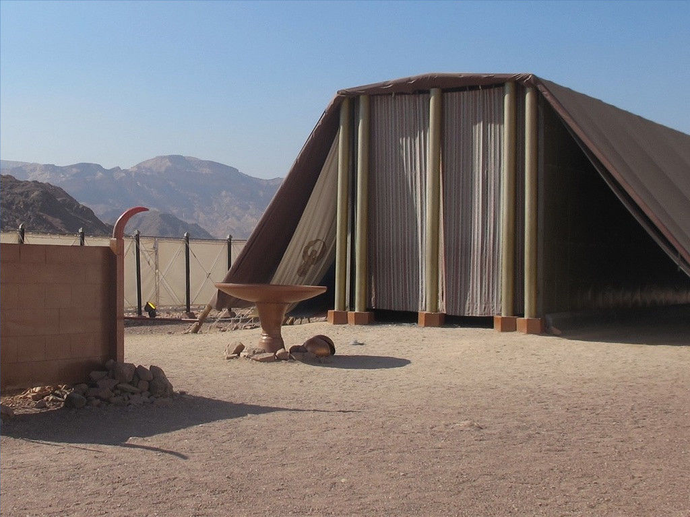
Entering God’s Presence
Hebrews 10:19-25

Slide 9
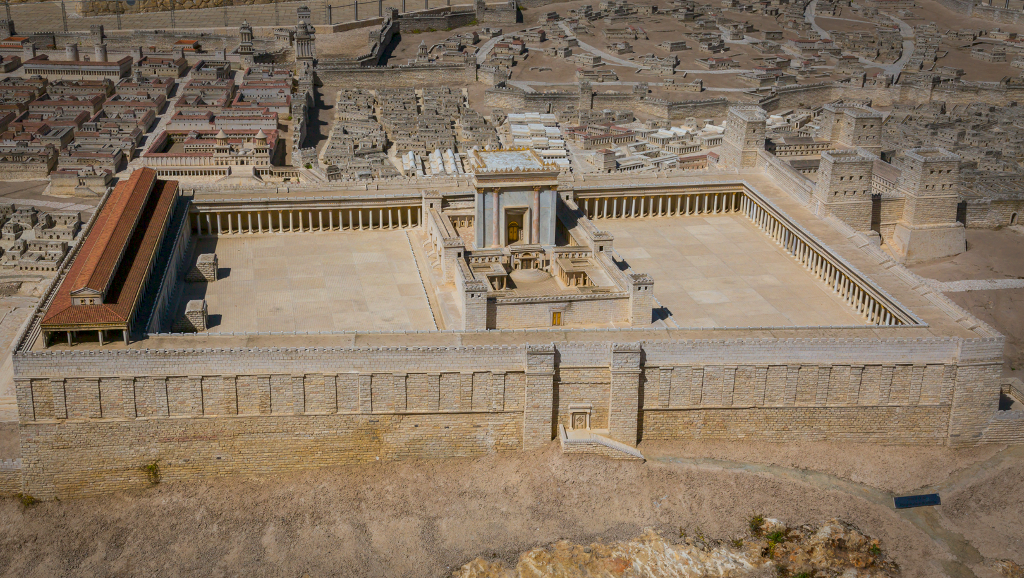

Slide 10
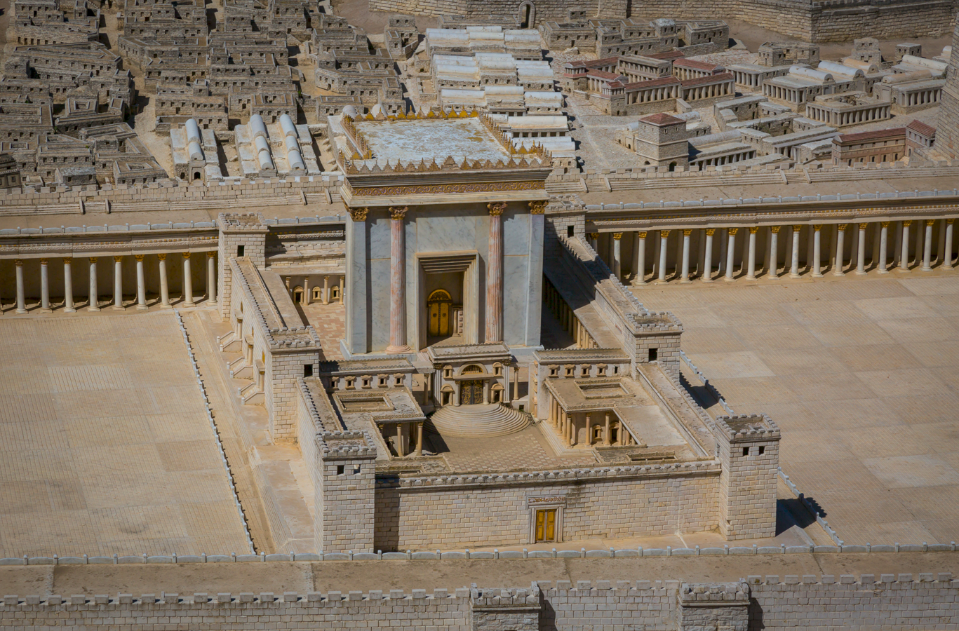

Slide 11
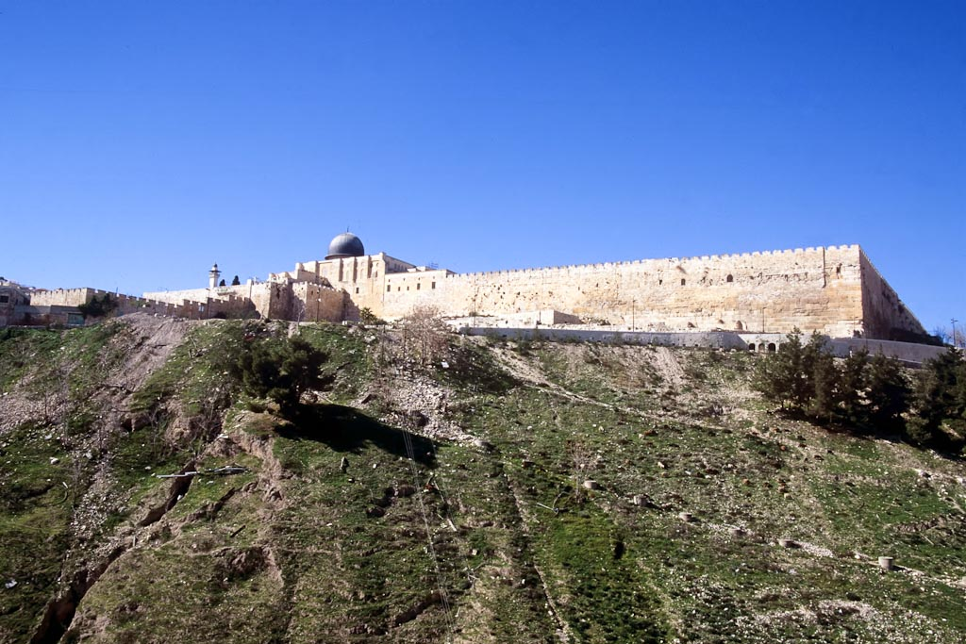
Temple Mount from southeast

Slide 12
1 Cor. 6:19 Or do you not know that your body is the temple of the Holy Spirit who is in you, whom you have from God, and you are not your own?
2 Cor. 6:16 And what agreement has the temple of God with idols? For you are the temple of the living God. As God has said: "I will dwell in them And walk among them. I will be their God, And they shall be My people."
Heb. 3:6 but Christ as a Son over His own house, whose house we are if we hold fast the confidence and the rejoicing of the hope firm to the end.
1 Pet. 2:5 you also, as living stones, are being built up a spiritual house, a holy priesthood, to offer up spiritual sacrifices acceptable to God through Jesus Christ.

Slide 13
The temple of God. 1Cor 3:16
God dwelt with Adam in the garden,
with Israel in the wilderness,
in the temple among His worshippers,
and in the Person of His Son.
Now He abides in His believing people.
Title
b hastings newlebanoncoc.com

Slide 14
The temple of God. 1Cor 3:16
Title
Solomon erected a temple in Jerusalem, that was recognized as “the house of Jehovah,” “the house of God,” and “Jehovah’s house.”
In it was Jehovah’s name, in it was the mercy seat; in it worship was offered.
The temple itself, with its corner and foundation stones and the stones of its walls, was typical of the spiritual temple, the church, “built upon the foundation of the apostles and prophets, Christ Jesus himself being the chief corner stone” (Eph. 2:19-20), of which every Christian is a living stone “built together for a habitation of God in the Spirit
b hastings newlebanoncoc.com

Slide 15
The temple of God. 1Cor 3:16
Title
We learn the lessons of care and reverence taught concerning the temple of God in Jerusalem.
They are examples to teach how reverential and careful we must be in reference to the spiritual temple.
It must not be neglected; it must not be defiled; it must not be made secondary to anything in the world.
b hastings newlebanoncoc.com

Slide 16
The temple of God. 1Cor 3:16
17 If any man defiles the temple of God,—The church can become defiled as God’s temple. God will not dwell in it. (7 churches of Asia)
In the tabernacle, and the temple in Jerusalem, every person who served, and every vessel and instrument of service were sanctified by the typical blood of bulls and goats.
To bring persons or things not sealed by this blood into the temple defiled it that God would not dwell in it.
b hastings newlebanoncoc.com

Slide 17
The temple of God. 1Cor 3:16
Title
Every person built into the spiritual temple of God must be sanctified by the blood of Christ.
Every teaching and practice is consecrated by that blood. (work, worship, organization)
To bring a person or practice into the church not sealed by the blood defiles it.
b hastings newlebanoncoc.com

Slide 18
The temple of God. 1Cor 3:16
Title
Examples:
Members not baptized for the right reasons…
Members accepted from denominations where repentance and obedience to God’s word is not carried out.
Members who are living ungodly lives (1 Cor. 5, 6, )
Members that are living in adultery.
Elders that are not qualified.
Deacons that are not qualified.
Preachers that are not qualified.
These defile God’s temple today.
b hastings newlebanoncoc.com

Slide 19
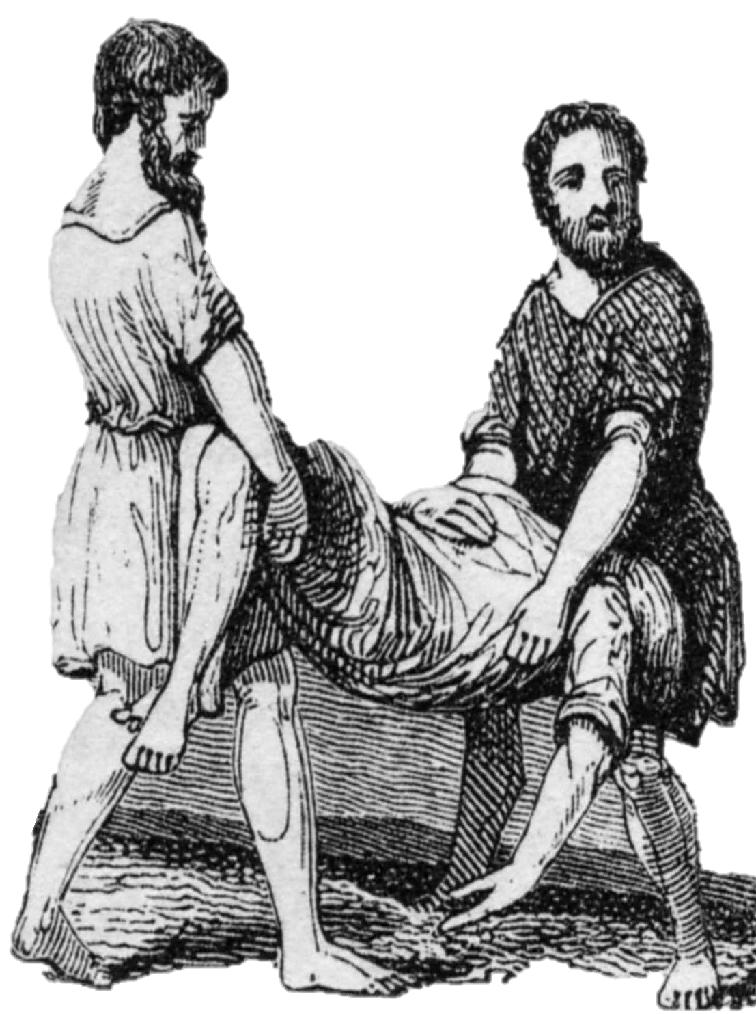
Leviticus 10:2-3
So fire went out from the LORD and devoured them, and they died before the LORD.
3 And Moses said to Aaron, "This is what the LORD spoke, saying: 'By those who come near Me I must be regarded as holy; And before all the people I must be glorified.'" So Aaron held his peace.(NKJV)
Moses warned Nadab and Abihu’s father, Aaron, and the other priests that they would die if they expressed their grief.
2

Slide 20
The temple of God. 1Cor 3:16
Title
The Building of the Temple.
2. The Purpose of the Temple.
3. The Possessing of the Temple.
b hastings newlebanoncoc.com

Slide 21
The temple of God. 1Cor 3:16
1. The Building of the Temple.
The thought originated with God. -
Ex.25:8 "And let them make Me a sanctuary, that I may dwell among them.
SANCTUARY
hagion (ἅγιον, 39), the neuter of the adjective hagios, “holy,” is used of those structures which are set apart to God, (a) of “the tabernacle” in the wilderness, Heb. 9:1, rv, “its sanctuary, a sanctuary of this world” (kjv, “a worldly sanctuary”); in v. 2 the outer part is called “the Holy place,” rv (kjv, “the sanctuary”); here the neuter plural hagia is used, as in v. 3.
b hastings newlebanoncoc.com

Slide 22
The temple of God. 1Cor 3:16
Title
1. The Building of the Temple.
2. The foundation was laid by God.
1Cor. 3:11 For no other foundation can anyone lay than that which is laid, which is Jesus Christ.
Both the place and the stone were His own choosing.
We can not do the choosing today either.
b hastings newlebanoncoc.com

Slide 23
The temple of God. 1Cor 3:16
Title
1. The Building of the Temple.
3. The material was unfit to begin with
1Ch. 22:8 "but the word of the LORD came to me, saying, 'You have shed much blood and have made great wars; you shall not build a house for My name, because you have shed much blood on the earth in My sight.
9 'Behold, a son shall be born to you, who shall be a man of rest; and I will give him rest from all his enemies all around. His name shall be Solomon, for I will give peace and quietness to Israel in his days.
At that time you were (1 Cor. 6:9, 11), but you are washed.
b hastings newlebanoncoc.com

Slide 24
The temple of God. 1Cor 3:16
Title
1. The Building of the Temple.
4. Some of the materials were won in battle.
1Ch. 26:27 Some of the spoils won in battles they dedicated to maintain the house of the LORD.
Every thought is to be brought into captivity to the obedience of Christ. 2Cor. 10:5 Casting down imaginations, and every high thing that exalteth itself against the knowledge of God, and bringing into captivity every thought to the obedience of Christ;
b hastings newlebanoncoc.com

Slide 25
The temple of God. 1Cor 3:16
Title
1. The Building of the Temple.
5. There was a great variety of materials. Gold, silver, brass, iron, wood, stone. All sorts.
Many members, but one body; many gifts, but one Master.
b hastings newlebanoncoc.com

Slide 26
The temple of God. 1Cor 3:16
Title
1. The Building of the Temple.
6. The stones were prepared beforehand.
1Kings 6:7 And the temple, when it was being built, was built with stone finished at the quarry, so that no hammer or chisel or any iron tool was heard in the temple while it was being built.
You hath He quickened who were dead, and now as lively stones are built up (1 Peter 2:5).
b hastings newlebanoncoc.com

Slide 27
The temple of God. 1Cor 3:16
Title
1. The Building of the Temple.
7. They were fitly framed together (Eph. 2:21).
So we are builded together for an habitation of God (Eph. 2:22). All one in Christ Jesus.
8. The temple was built according to a divine pattern (1 Chron. 28).
Christ is the image of the invisible God, and believers are created anew after the image of Christ. “As He is, so are we.”
b hastings newlebanoncoc.com

Slide 28
The temple of God. 1Cor 3:16
Title
1. The Building of the Temple.
8. The temple was built according to a divine pattern (1 Chron. 28).
Heb 8:5 Who serve unto the example and shadow of heavenly things, as Moses was admonished of God when he was about to make the tabernacle: for, See, saith he, that thou make all things according to the pattern shewed to thee in the mount.
b hastings newlebanoncoc.com

Slide 29
The temple of God. 1Cor 3:16
2. The Purpose of the Temple. It was—
The habitation of God (Exod. 25:8).
Believers have been saved, not merely to be saved, but to be a spiritual house, indwelt by the Spirit of God.
Ex. 25:8 "And let them make Me a sanctuary, that I may dwell among them.
b hastings newlebanoncoc.com

Slide 30
The temple of God. 1Cor 3:16
2. The Purpose of the Temple. It was—
2. The place in which God walked (2 Cor. 6:16).
As God walked in the tabernacle of old, so in grace doth He desire to walk in His people. “Ye are the temple of God.” “I will dwell in them, and walk in them.”
2Cor. 6:16 And what agreement has the temple of God with idols? For you are the temple of the living God. As God has said: "I will dwell in them And walk among them. I will be their God, And they shall be My people."
b hastings newlebanoncoc.com

Slide 31
The temple of God. 1Cor 3:16
2. The Purpose of the Temple. It was—
3. The place of holiness. Psa. 93:1 The LORD reigns, He is clothed with majesty; The LORD is clothed, He has girded Himself with strength. Surely the world is established, so that it cannot be moved.
2 Your throne is established from of old; You are from everlasting.
3 The floods have lifted up, O LORD, The floods have lifted up their voice; The floods lift up their waves.
4 The LORD on high is mightier Than the noise of many waters, Than the mighty waves of the sea.
5 Your testimonies are very sure; Holiness adorns Your house, O LORD, forever.
b hastings newlebanoncoc.com

Slide 32
The temple of God. 1Cor 3:16
2. The Purpose of the Temple. It was—
4. The place of peace.
“In this place will I give peace” (Haggai 2:9). Those indwelt by the Spirit of God have their hearts filled with the peace of God.
b hastings newlebanoncoc.com

Slide 33
The temple of God. 1Cor 3:16
2. The Purpose of the Temple. It was—
5. The place of strength and beauty (Psa. 96:6).
Strength of character and beauty of life characterize all who are filled with the Holy Spirit; they are strengthened with might by His Spirit in the inner man (Eph. 3:16).
b hastings newlebanoncoc.com

Slide 34
The temple of God. 1Cor 3:16
2. The Purpose of the Temple. It was—
6. The place where His glory was revealed.
“I will fill this house with glory (Haggai 2:7), and will be the glory in the midst of her” (Zech. 2:5).
May Christ so dwell in our hearts by faith that we might be filled with all the fulness of God ( Eph. 3:16, 20).
b hastings newlebanoncoc.com

Slide 35
The temple of God. 1Cor 3:16
2. The Purpose of the Temple. It was—
7. The place where everything said “Glory”
Psalm 29:9 The voice of the LORD makes the deer give birth, And strips the forests bare; And in His temple everyone says, "Glory!“
Does everything in you and me say “Glory?” If everything has been given to Him it will.
b hastings newlebanoncoc.com

Slide 36
The temple of God. 1Cor 3:16
3. The Possessing of the Temple.
The temple was finished; man had done everything he could, but he could not fill it with glory.
The glory of His presence—
b hastings newlebanoncoc.com

Slide 37
The temple of God. 1Cor 3:16
3. The Possessing of the Temple.
The glory of His presence
Was needed in it (2 Chron. 7).
It was still an empty house till He possessed it. Oh, may God fill us; we are empty indeed, till He fills.
2. Filled It (2 Chron. 7:1).
As soon as it was finished it was filled.
b hastings newlebanoncoc.com

Slide 38
The temple of God. 1Cor 3:16
3. The Possessing of the Temple.
The glory of His presence
3. Transformed it.
It became a spiritual house when possessed by God the Spirit (1 Peter 2:5). Ye are not carnal but spiritual if God dwell in you.
b hastings newlebanoncoc.com

Slide 39
The temple of God. 1Cor 3:16
3. The Possessing of the Temple.
The glory of His presence
4. Claimed it (Psa. 132:14). "This is My resting place forever; Here I will dwell, for I have desired it.
If your body is the temple of the Holy Ghost ye are not your own (1 Cor. 6:19). “Your body and your spirit, which are God’s.”
b hastings newlebanoncoc.com

Slide 40
The temple of God. 1Cor 3:16
Title
1Cor. 3:16 Do you not know that you are the temple of God and that the Spirit of God dwells in you?
17 If anyone defiles the temple of God, God will destroy him. For the temple of God is holy, which temple you are.
b hastings newlebanoncoc.com

Slide 41
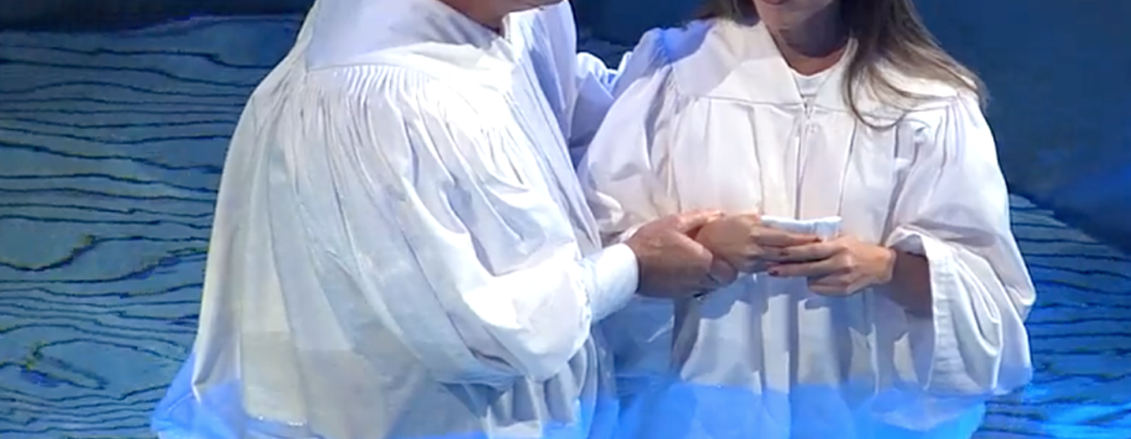
Are you a New Testament Christian?
Hear the Gospel (Rom.10:14)
Believe the Gospel (Heb. 11:6)
Repent of Sins (Acts 3:19)
Confess Christ (Rom.10:9)
Be Baptized Into Christ (1 Cor.12:13)
Serve our Lord the rest of our lives (Rev.2:10)
You Must Be Born Again. John 3:1-7

