Slide 1
Welcome to our services
New Lebanon Church of Christ
We are Simply Christians.
Our Emphasis is Spiritual, Not Material or Social.
We are striving to be The Same Church as Described in The New Testament.
Please Come Back Again

Slide 2
The Two Debtors. Luke 7:41-43
Luke 7:45 "You gave Me no kiss, but this woman has not ceased to kiss My feet since the time I came in.
46 "You did not anoint My head with oil, but this woman has anointed My feet with fragrant oil.
(The heart of a sinner that finds the Christ)

Slide 3
The Two Debtors. Luke 7:41-43
As we go through this parable ask yourself,
Do I relate to the religious man
Or the sinner woman?

Slide 4
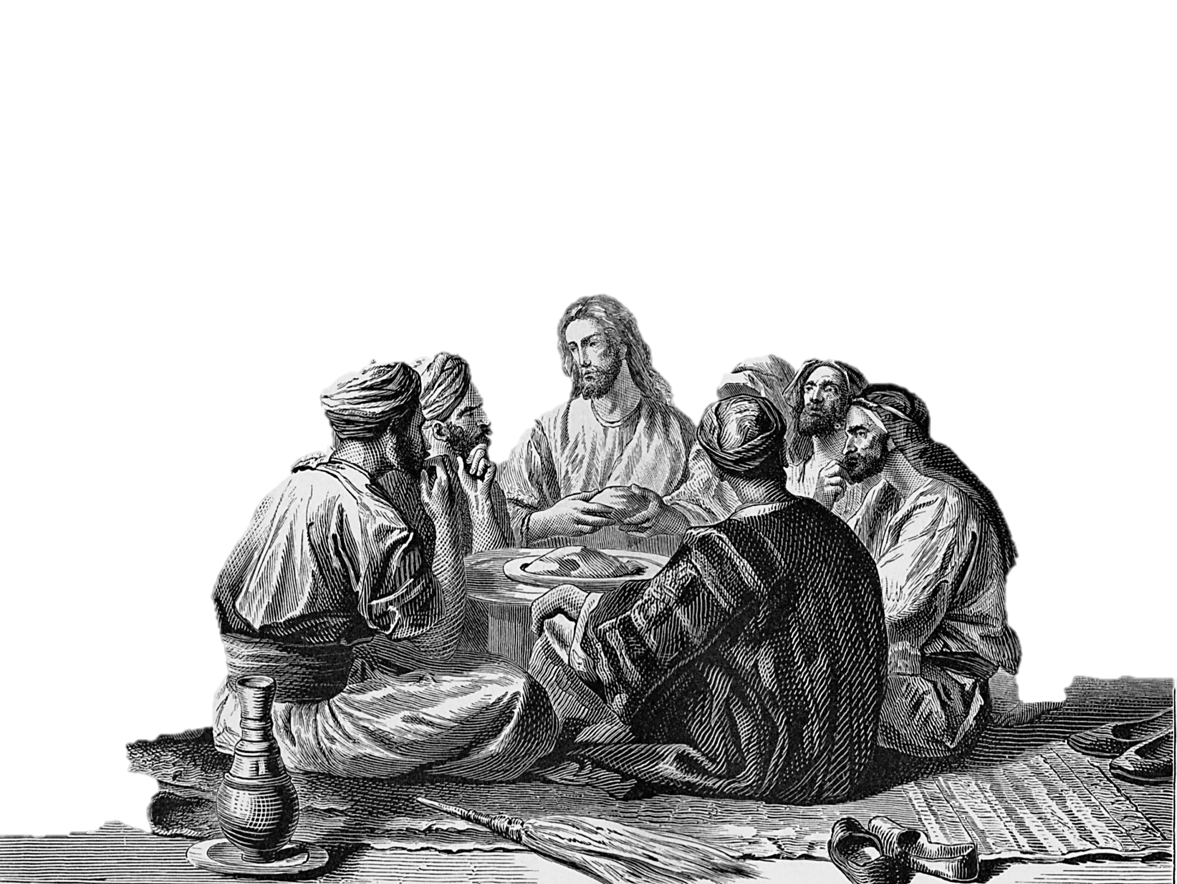
Luke 7
“³⁶And one of the Pharisees desired him that he would eat with him. And he went into the Pharisee’s house, and sat down to meat.”

Slide 5
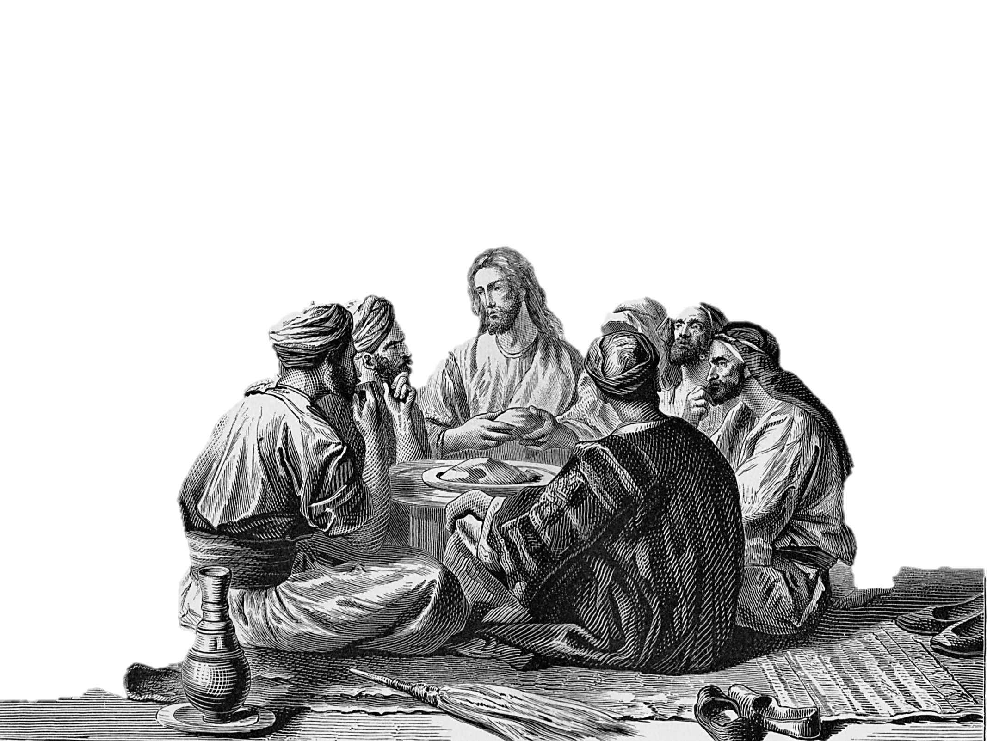
Luke 7
“³⁷And, behold, a woman in the city, which was a sinner, when she knew that Jesus sat at meat in the Pharisee’s house, brought an alabaster box of ointment,”

Slide 6
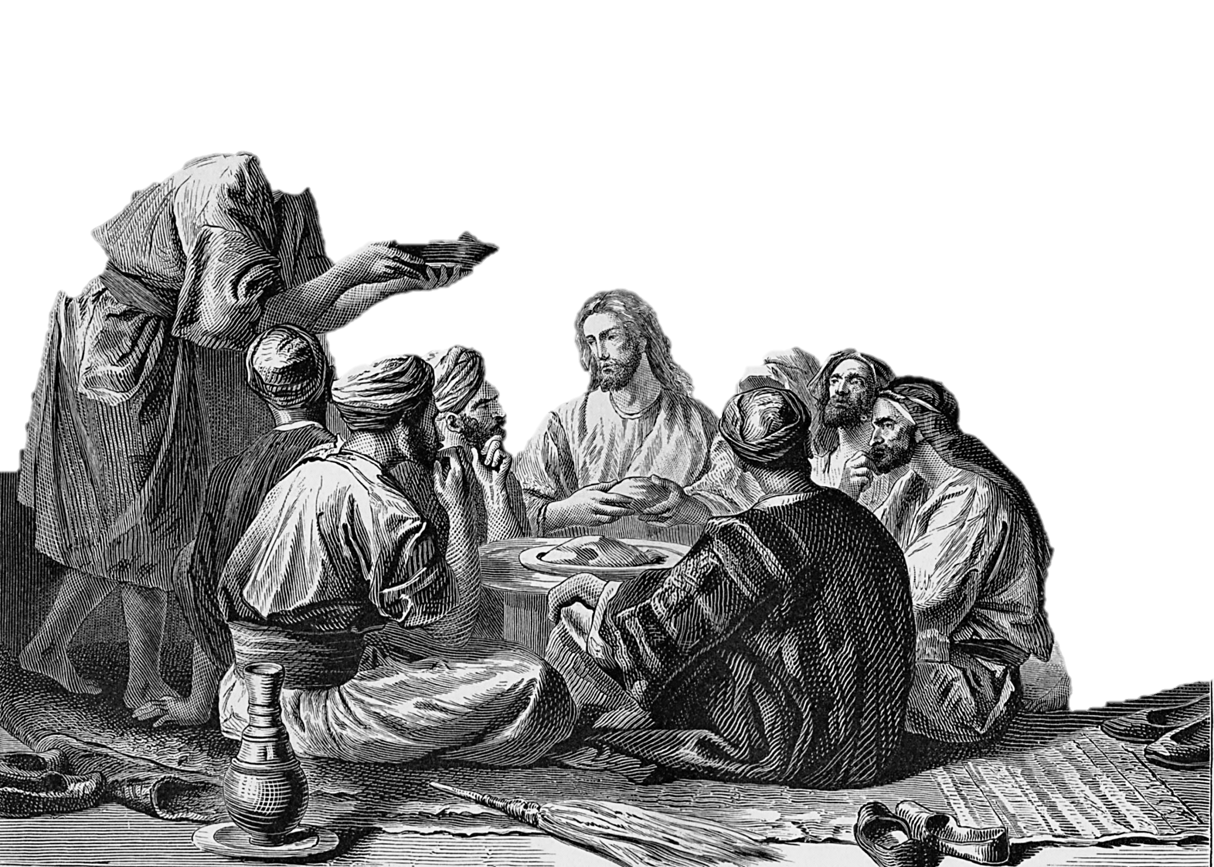
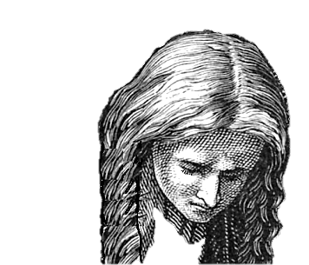
Luke 7
“³⁸And stood at his feet behind him weeping, and began to wash his feet with tears, and did wipe them with the hairs of her head, and kissed his feet, and anointed them
with the
ointment.”

Slide 7
Luke 7
“³⁹Now when the Pharisee which had bidden him saw it, he spake within himself, saying, This man, if he were a prophet, would have known who and what manner of woman this is that toucheth him: for she is a sinner. ⁴⁰And Jesus answering said unto him, Simon, I have somewhat to say unto thee. And he saith, Master, say on.”

Slide 8
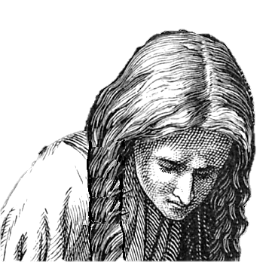
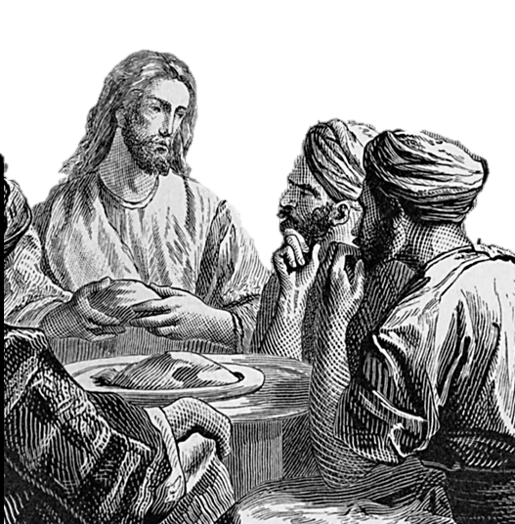
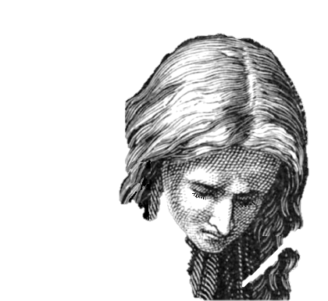
Luke 7
“⁴⁵Thou gavest me no kiss: but this woman since the time I came in hath not ceased to kiss my feet. ⁴⁶My head with oil thou didst not anoint: but this woman hath anointed my feet with ointment. ⁴⁷Wherefore I say unto thee, Her sins, which are many, are forgiven; for she loved much: but to whom little is forgiven, the same loveth little. ⁴⁸And he said unto her, Thy sins are forgiven.”
Luke 7
“⁴³Simon answered and said, I suppose that he, to whom he forgave most. And he said unto him, Thou hast rightly judged. ⁴⁴And he turned to the woman, and said unto Simon, Seest thou this woman? I entered into thine house, thou gavest me no water for my feet: but she hath washed my feet with tears, and wiped them with the hairs of her head.”
Luke 7
“⁴¹There was a certain creditor which had two debtors: the one owed five hundred pence, and the other fifty. ⁴²And when they had nothing to pay, he frankly forgave them both. Tell me therefore, which of them will love him most?”

Slide 9
Luke 7
“⁴⁹And they that sat at meat with him began to say within themselves, Who is this that forgiveth sins also? ⁵⁰And he said to the woman, Thy faith hath saved thee; go in peace.”

Slide 10
Christ was a friend of publicans and sinners.
He went to the Pharisees home to eat though it appears the Pharisee did not believe Christ was a prophet (v. 39). This is an example of our Savior’s wisdom, grace, and willingness to instruct and dispute with those who were prejudiced against him.
We are not told who this woman was that demonstrated her affection and acknowledged her obligations to Christ, only that she was known to be a sinner.
She did not look Christ in the face but came behind him with deep humiliation and tears of repentance and did the part of a servant.

Slide 11
The Two Debtors. Luke 7:41-43
This parable was spoken in Simon’s house, he wanted Jesus to eat with him, and Jesus did not refuse.
Then Simon sat in judgment on Him in allowing this woman (a sinner) to touch Him (v. 39).
Simon’s heart was a stranger to the love of Christ. Like many a modern Pharisee his religion was an outward form.

Slide 12
The Two Debtors. Luke 7:41-43
But Jesus had meat to eat that Simon knew not of. The woman’s love was more precious to Him than Simon’s feast.
This is the heart that Jesus seeks. Worship without the heart is not worship. There are many Simons who show outward respect to religion, but who have no heart sympathy with Jesus Christ in His saving mission.
Jesus to Peter – Do You Love Me??? John 21:15-17

Slide 13
The Two Debtors. Luke 7:41-43
The question of who “loved” the most focuses on the most important element in determining who shall be saved.
Luke 7:43 Simon answered and said, He, I suppose, to whom he forgave the most. And he said unto him, Thou hast rightly judged. - Simon, so he thought, was merely going along with the little game; his “I suppose” is in the same vein of condescension as the “say on” of Luke 7:40.
Jesus said, “Thou hast rightly judged.”

Slide 14
The Two Debtors. Luke 7:41-43
Luke 7:44 Then He turned to the woman and said to Simon, "Do you see this woman? I entered your house; you gave Me no water for My feet, but she has washed My feet with her tears and wiped them with the hair of her head.

Slide 15
The Two Debtors. Luke 7:41-43
Simon had slighted and insulted Jesus by withholding the basin of water and the towel normally extended to a visitor.
Did he suppose that the humble Prophet of the poor would not recognize the omission of such a customary courtesy?
Whatever his reason, it must be viewed as an intentional slight, a discourtesy that this Pharisee would not have allowed toward any of his priestly friends; yet he has snubbed the great High Priest.

Slide 16
The Two Debtors. Luke 7:41-43
What the proud Pharisee withheld, the sinful woman gave. Her tears replace the basin of water and her hair the towel.
The heart of Simon the hypocrite must have fallen before such a criticism.
As the Judge of all men pronounced sentence upon him in his own house and in the presence of one whom he despised and who was a witness to his humiliation.

Slide 17
The Two Debtors. Luke 7:41-43
Luke 7:45 "You gave Me no kiss, but this woman has not ceased to kiss My feet since the time I came in.
This was a triple insult that Simon had directed against the Lord of life; not merely the basin and the towel, but the customary greeting of a guest with a kiss, and the anointing of the head with oil had also been withheld.
But the woman supplied, out of love, all three!

Slide 18
The Two Debtors. Luke 7:41-43
Luke 7:47 "Therefore I say to you, her sins, which are many, are forgiven, for she loved much. But to whom little is forgiven, the same loves little."
Simon who thought he was judging the Lord suddenly found himself the judged, Jesus claiming in his presence the divine right of judging all men, and announcing the forgiveness of the woman who Simon despised. And Jesus conspicuously omitted any reference at all to the forgiveness of Simon.
There is not a more dramatic incident in the Scriptures than this. What did Simon say to such a thing? No response was recorded. The focus shifted to what the other guests were saying “within themselves,”

Slide 19
The Two Debtors. Luke 7:41-43
Luke 7:49 And they that sat at meat with him began to say within themselves, Who is this that even forgives sins?
While the dinner guests were taking this all in, Jesus reiterated what he had already said.
Luke 7:50 And he said unto the woman, Thy faith hath saved thee; go in peace.
Forgiveness and salvation were extended to Simon’s guest. What about her obedience? It was assured. “If you love me, you will keep my commandments,” Jesus said; and here was one who truly loved him. She was not saved by “faith only.”

Slide 20
The Two Debtors. Luke 7:41-43
1. The Certain Creditor (v. 41).
The great Creditor represents God Himself. There is something very beautiful about this thought, because—
1. A creditor is one who is supposed to have a good reputation. Can God deceive? Is His character not trustworthy? He cannot lie.
2. A creditor is one who has sufficiency for others. Our sufficiency is of God. Human need can be fully met only in Him. The sinner’s needs are deep and many, but the fulness of His mercy is enough. “Come unto Me.”

Slide 21
The Two Debtors. Luke 7:41-43
1. The Certain Creditor (v. 41).
3. A creditor is one who looks for some return for his money.
A creditor gives only on loan. God gives His best, and expects our best; but, we have returned Him evil for good.
Evil is poor payment for good; hatred is a miserable return for love. Could you count up the good He has given? How much do YOU owe the Lord?

Slide 22
The Two Debtors. Luke 7:41-43
2. The Different Debtors (v. 41).
“Two” (v. 41). The 500 and the 50. Representing two classes of actual transgressors, the great and the little, and implying all the grades that lie between.
But all with whom the Great Creditor has been dealing with are His debtors.
All have sinned
all have come short.
He that offends in one point is guilty of all.

Slide 23
The Two Debtors. Luke 7:41-43
3. The Helpless Bankrupt People.
“They had nothing to pay” (v. 42). The great and the little debtor were both alike in they had nothing to pay with.
No difference. Just so with every sinner in God’s sight.
Our responsibilities to God may be different, but the hopelessness of our condition in His sight is the same.
All outside of the ark were treated alike in His judgment. They had nothing.
There is no other creditor from whom we can borrow.
So one of two things must follow—a pardon or a prison.

Slide 24
The Two Debtors. Luke 7:41-43
4. The Joyful Forgiveness.
“He frankly forgave them both” (v. 42). These few words reveal the heart of God as big with abounding grace. Notice—
What He Did. “He forgave.”
He did not compromise. Forgiveness is God’s gracious remedy for the sinner’s debt.
Oh, that men would believe God’s willingness and readiness to forgive!

Slide 25
The Two Debtors. Luke 7:41-43
4. The Joyful Forgiveness.
2. Who He Forgave. “Both.” Both alike needed it. The church-going sinner and the worldly sinner need forgiveness. One can have no more claim than another, both are debtors.
3. How He Forgave. “Frankly.” In a free, liberal, loving manner, not grudgingly, just as the father forgave the prodigal, with open arms and joyful heart. “He delights in mercy.”
When God pardons a sinner He does it as Joseph forgave his brethren, with a heart ready to burst with deep, unutterable compassion.

Slide 26
The Two Debtors. Luke 7:41-43
4. The Joyful Forgiveness.
4. When He Forgave. “When they had nothing to pay.”
It was when the prodigal had spent all that he had that he came and was accepted.
When Joseph’s brethren had nothing to eat, then they were enriched by him whom they had despised.
The young ruler came with a great price in his hand, and he went away sorrowful.
The Laodicean Church “had need of nothing” while Christ stood outside.

Slide 27
The Two Debtors. Luke 7:41-43
5. The Grateful Evidence
The Grateful Evidence. “Love.” Which of them will love Him most? “He to whom He forgave most,” says Simon. “Thou hast rightly judged,” says Jesus. It is right judgment, then, to expect the forgiven to manifest in some way or other their love for Him who frankly forgives all. The poor woman had been forgiven much, and she loved much, and showed it.
1. Much love Weeps (v. 44). Not only tears of regret for the past, but of deepest gratitude toward God, and of tender sympathy toward the lost. The world needs such tears. Christ shed them, so did Paul (Phil. 3:18).

Slide 28
The Two Debtors. Luke 7:41-43
5. The Grateful Evidence
2. Much love Washes. “She has washed My feet” (v. 44). Many a dusty foot and life, love has washed. “He loved me, and washed me.” Love covers a multitude of sins.
3. Much love Stoops. “She wipes His feet with her hair” (v. 44). She puts her glory at His feet. The heart must bow if Jesus is to be served.
4. Much love Kisses. Her lips of affection are pressed to His feet (v. 45). The feet of the body of Christ, the dusty, naked members, are often neglected. Love seeks contact with them.

Slide 29
The Two Debtors. Luke 7:41-43
5. The Grateful Evidence
5. Much love Anoints. The Father anoints His head, but the forgiven one must anoint His feet (v. 46).
6. Much love Follows. She followed Him into Simon’s house. She heeded not the criticism of others. Love constrained her (1 John 4:19).
7. Much love Gives. “She brought her box of ointment” (v. 37). This was all her treasure, and she laid it at His feet, not only her ointment, but herself.

Slide 30
The Two Debtors. Luke 7:41-43
Luke 7:47 "Therefore I say to you, her sins, which are many, are forgiven, for she loved much. But to whom little is forgiven, the same loves little."
If your sins were forgiven on the basis of how much you love and how much you demonstrate your love for Christ, how many unforgiven sins would you have?
her sins, which are many, are forgiven, for she loved much. But to whom little is forgiven, the same loves little

Slide 31
Are you a New Testament Christian?
Hear the Gospel (Rom.10:14)
Believe the Gospel (Heb. 11:6)
Repent of Sins (Acts 3:19)
Confess Christ (Rom.10:9)
Be Baptized Into Christ (1 Cor.12:13)
Serve our Lord the rest of our lives (Rev.2:10)
You Must Be Born Again. John 3:1-7

