Slide 1
Welcome to our services
New Lebanon Church of Christ
We are Simply Christians.
Our Emphasis is Spiritual, Not Material or Social.
We are striving to be The Same Church as Described in The New Testament.
Please Come Back Again

Slide 2
Study To Show Thyself Approved. 2 Tim.2:15
2Tim. 2:15 Study to show thyself approved unto God,
a workman that needs not to be ashamed,
rightly dividing the word of truth.

Slide 3
Study To Show Thyself Approved. 2 Tim.2:15
2 Tim 2:15 Give diligence to present thyself approved unto God, a workman that needs not to be ashamed, handling aright the word of truth.
Practically all of the exegesis one encounters on this verse regards the Greek words here rendered “handling aright,” and in the KJV, “rightly dividing” the word of truth.
The words have the following basic meaning:
The compound verb (rightly dividing) means to “cut straight.” Vincent defines the word, “to hold a straight course” (as plowing a straight furrow); and the Greeks used the word for “expound soundly.”

Slide 4
Study To Show Thyself Approved. 2 Tim.2:15
The old expositors understood this as a reference to making the proper division between the law and the gospel, between the Old Testament and the New Testament.
In view of the basic meaning of the words here rendered “handling aright,” there is absolutely nothing wrong with such an exegesis. Certainly no preacher can “cut it straight,” “tell it like it is,” or employ “sound exegesis,” without making these very distinctions clear in his preaching.

Slide 7
Study To Show Thyself Approved. 2 Tim.2:15
15 Give diligence to present thyself approved unto God,—
The study of the word of God that he might understand and obey it was the way to show himself approved of God. When God approved he would be with and bless and strengthen him.
Jesus Christ was the specially appointed of God who was approved because it was his meat to do his Father’s will. All who, like Jesus, have no other will except the will of the Father, are approved of God. If you stand approved of God, you will have no cause of shame, no matter who disapproves.

Slide 8
Study To Show Thyself Approved. 2 Tim.2:15
David says: “Oh that my ways were established to observe thy statutes! Then shall I not be put to shame, when I have respect unto all thy commandments.” (Psalm 119:5, 6.)
If we will learn and keep the commandments of God, we will never have cause for shame. Being approved implies being tried and proved as precious metals are proved before they are accepted as genuine.
“Blessed is the man that endures temptation; for when he hath been approved, he shall receive the crown of life, which the Lord promised to them that love him.” (James 1:12.)

Slide 10
Study To Show Thyself Approved. 2 Tim.2:15
2 Tim 2:16 But shun profane babblings: for they will proceed further in ungodliness,
Shun … “This is means literally to make a circuit so as to avoid.”
Profane babblings … This refers especially to the striving about words to no profit, mentioned above. There are many religious discussions which fall squarely into this category.
They will proceed further … The end result of such disputations is not righteousness, but ungodliness.

Slide 11
Study To Show Thyself Approved. 2 Tim.2:15
…a workman that needs not to be ashamed,—
This indicates that ceaseless, serious, earnest zeal, which was one of his chief characteristic traits. And certainly if the standard is to be reached, an abundance of zeal will be required.
The goal is that of presenting himself to God in such a way as to receive his approval without fear of incurring the reproach of being a workman who fell short of his responsibility.

Slide 12
Study To Show Thyself Approved. 2 Tim.2:15
2Tim 2:15 Study to show thyself approved unto God, a workman that needeth not to be ashamed, rightly dividing the word of truth.16 But shun profane and vain babblings: for they will increase unto more ungodliness.
Why is this important? We will be judged by God’s word. Attitude is important.
To Know, Love, and Enjoy God more fully will lead to greater obedience.
Read the bible as if you were reading a letter addressed to you from someone that loves you very, very, very much. You Are!
Read the Bible as if you have discovered a treasure. You have.

Slide 13
Study To Show Thyself Approved. 2 Tim.2:15
Gen. 1:1 In the beginning God created the heavens and the earth. 2 The earth was without form, and void; and darkness was on the face of the deep. And the Spirit of God was hovering over the face of the waters. 3 Then God said, "Let there be light"; and there was light. 4 And God saw the light, that it was good; and God divided the light from the darkness. 5 God called the light Day, and the darkness He called Night. So the evening and the morning were the first day. 6 Then God said, "Let there be a firmament in the midst of the waters, and let it divide the waters from the waters.“
We see from the very beginning of the bible that God is a God of order and logic. We should use those same qualities (order and logic) in studying His word.

Slide 14
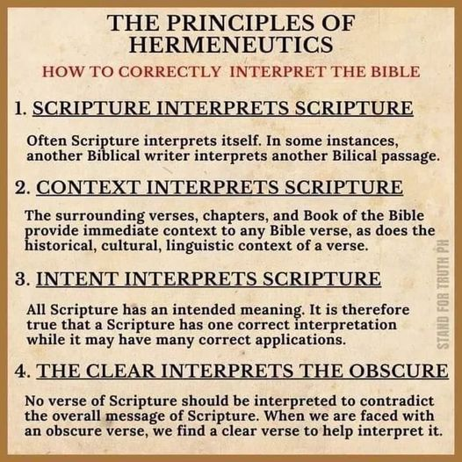

Slide 15
Bible study post found on Craigslist
5. Foster a respectful and inclusive environment: Emphasize the importance of maintaining a respectful and inclusive environment within the study group. Encourage open-mindedness, active listening, and constructive dialogue among members to ensure everyone feels comfortable sharing their perspectives. 6. Provide study materials: Prepare study materials or suggested readings related to specific topics or passages. This will help guide the discussions and ensure everyone is on the same page. 7. Encourage participation and engagement: Actively engage members in the study sessions by encouraging their participation, asking thought-provoking questions, and facilitating discussions. Create an atmosphere where people feel comfortable sharing their thoughts and seeking guidance. Remember, studying the Bible is a personal journey for each individual, so it's important to respect diverse interpretations and perspectives. By fostering an environment of open-mindedness and collaboration, your study group can provide a valuable space for individuals to explore biblical teachings and find practical solutions to their daily challenges. Will be studying on the biblical structure of a family And being said apart as a people

Slide 16
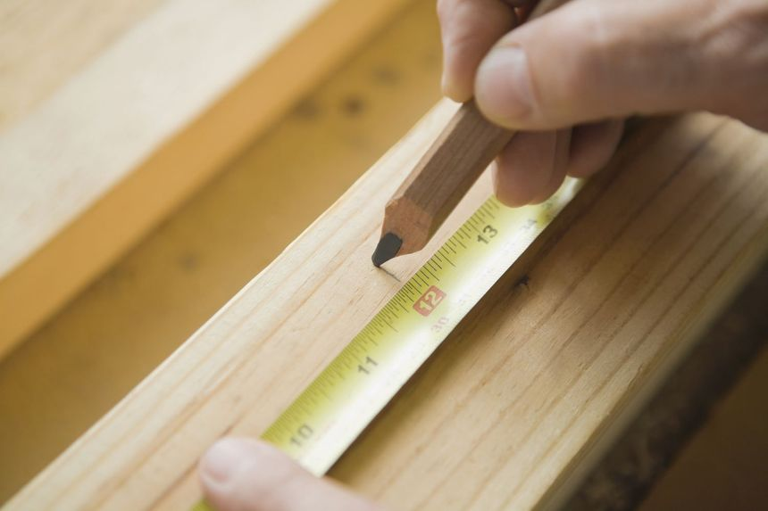
Study To Show Thyself Approved. 2 Tim.2:15
1. Study the Content
a workman that needs not to be ashamed
Study the Content
Content is the truth on the subject matter.
The bible cannot mean something it does not say.

Slide 17
Study To Show Thyself Approved. 2 Tim.2:15
1. Study the Content
a workman that needs not to be ashamed,
Example -Saved by faith alone.
2Peter 3:15 and consider that the longsuffering of our Lord is salvation--as also our beloved brother Paul, according to the wisdom given to him, has written to you, 16 as also in all his epistles, speaking in them of these things, in which are some things hard to understand, which untaught and unstable people twist to their own destruction, as they do also the rest of the Scriptures. (WARNING)

Slide 18
Eph.2:8,9 For by grace you have been saved through faith, and that not of yourselves; it is the gift of God, 9 not of works, lest anyone should boast.
Acts 19:1 And it happened, while Apollos was at Corinth, that Paul, having passed through the upper regions, came to Ephesus. And finding some disciples ---
Acts 19:5 When they heard this, they were baptized in the name of the Lord Jesus.
6 And when Paul had laid hands on them, the Holy Spirit came upon them, and they spoke with tongues and prophesied.

Slide 19
Acts 16:15 And when she and her household were baptized, she begged us, saying, "If you have judged me to be faithful to the Lord, come to my house and stay." So she persuaded us.
Can a baby believe? Mark 16:16
Can a baby repent ?? Acts 2:38
Can a baby be taught to observe all things??? Matt.28:20
Is a baby baptized by immersion ???? Acts 8:38-39
Does a baby have sin ????? Ezekiel 18:20
Is infant baptism in the name of Jesus????? Col.3:17

Slide 20
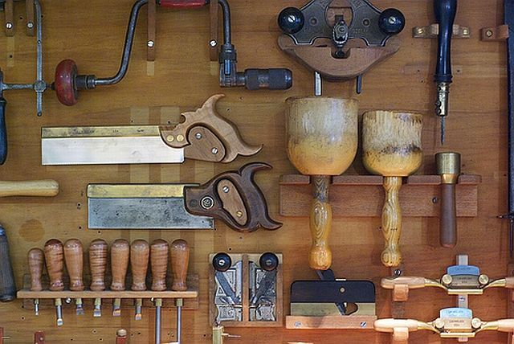
Study To Show Thyself Approved. 2 Tim.2:15
2. Study for key words
Know keynote word of book. (Summary of the book)
Look for Key words in book.
Luke – Son of man
John – Believe
Revelation - overcome
a workman that needs not to be ashamed,

Slide 21
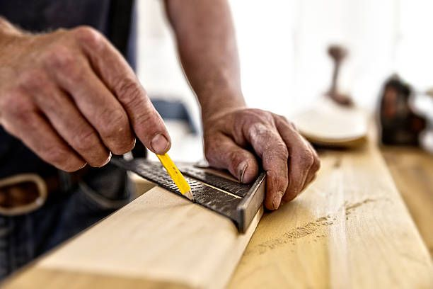
Study To Show Thyself Approved. 2 Tim.2:15
2. Study for key words
a workman that needs not to be ashamed,
Look for “hinge words” (something small that controls something large).
1. for
2. in
3. and
4. if
5. except
6. therefore, etc

Slide 22
Study To Show Thyself Approved. 2 Tim.2:15
3.Study Context
a workman that needs not to be ashamed,
Time, Place, Audience, of verse or letter.
How does that letter fit into the Bible?
O.T. / N.T.?
Consider the Audience
Jew?
Gentile?
Apostle?
Someone outside the family of God?
Individual?
Church?

Slide 24
Study To Show Thyself Approved. 2 Tim.2:15
4. Study ALL Comparable verses on subject
a workman that needs not to be ashamed,
Study ALL Comparable verses on subject
Compare with all other passages on subject, or in the letter.
Psalm 119:160 The entirety of Your word is truth, And every one of Your righteous judgments endures forever. NKJV
The sum of Thy word is truth, And every one of Thy righteous ordinances is everlasting. NASV

Slide 25
Study To Show Thyself Approved. 2 Tim.2:15
4. Study ALL Comparable verses on subject
a workman that needs not to be ashamed,
We learn and draw conclusions from the Whole to the Part. Not from individual parts.
Plan of salvation
Marriage law
Phrases: “in the Spirit,” in spirit

Slide 26
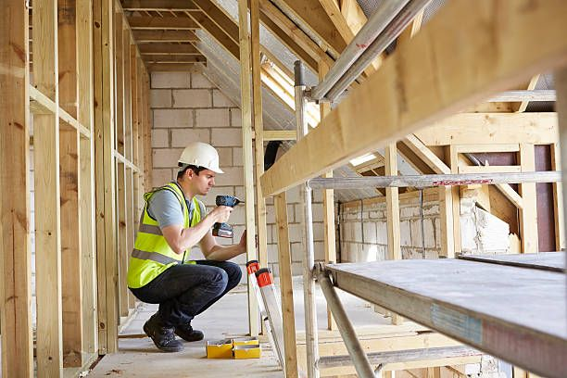
Study To Show Thyself Approved. 2 Tim.2:15
4. Consultation
a workman that needs not to be ashamed,
Consultation
Seek expert study.
Bible dictionary
Concordance
Commentaries, cautiously - and recognize author’s background.
Do not study commentaries for things the bible does not mention.
Example: Peter’s wife. 2 Tim. 2:16 But shun profane and vain babblings: for they will increase unto more ungodliness. (KJV)

Slide 27
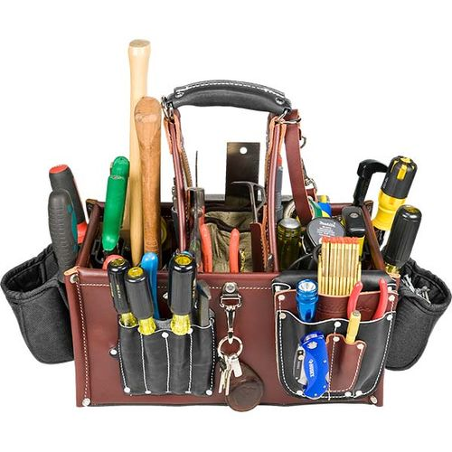
Study To Show Thyself Approved. 2 Tim.2:15
5. Application
To not make application is spiritual abortion !!!
Steps, Observation, interpretation, application.
Observation = excavation
Interpretation = laying foundation and building on it.
Application = house is built and we are living in it.
Psalm 119:97-98 Oh, how I love Your law! It is my meditation all the day. 98 You, through Your commandments, make me wiser than my enemies; For they are ever with me.
a workman that needs not to be ashamed,

Slide 28
Study To Show Thyself Approved. 2 Tim.2:15
To show our self approved unto God, a workman that needs not to be ashamed, we must rightly divide the word of truth.
We must:
Study the CONTENT.
Study the KEY WORDS.
Study the CONTEXT.
Study all verses on the subject and COMPARE.
CONSULT Bible scholars for their knowledge.
Must, Must, Must, Make APPLICATION.

Slide 30
Study To Show Thyself Approved. 2 Tim.2:15
2Tim. 2:15 Study to show thyself approved unto God,
a workman that needs not to be ashamed,
rightly dividing the word of truth.

Slide 31
Are you a New Testament Christian?
Hear the Gospel (Rom.10:14)
Believe the Gospel (Heb. 11:6)
Repent of Sins (Acts 3:19)
Confess Christ (Rom.10:9)
Be Baptized Into Christ (1 Cor.12:13)
Serve our Lord the rest of our lives (Rev.2:10)
You Must Be Born Again. John 3:1-7

