Slide 1
Welcome to our services
New Lebanon Church of Christ
We are Simply Christians.
Our Emphasis is Spiritual, Not Material or Social.
We are striving to be The Same Church as Described in The New Testament.
Please Come Back Again

Slide 2
God’s Eternal Purpose
Title
Isaiah 14:24 The LORD of hosts has sworn, saying, "Surely, as I have thought, so it shall come to pass, And as I have purposed, so it shall stand:
25 That I will break the Assyrian in My land, And on My mountains tread him underfoot. Then his yoke shall be removed from them, And his burden removed from their shoulders.
26 This is the purpose that is purposed against the whole earth, And this is the hand that is stretched out over all the nations.
27 For the LORD of hosts has purposed, And who will annul it? His hand is stretched out, And who will turn it back?"
b hastings newlebanoncoc.com

Slide 3
The Eternal Purpose Of God
Ephesians 3:10-11

Slide 4
God’s Eternal Purpose
Title
(Eph. 3:10) to the intent that now the manifold wisdom of God might be made known by the church to the principalities and powers in the heavenly places,
11 according to the eternal purpose which He accomplished in Christ Jesus our Lord,
12 in whom we have boldness and access with confidence through faith in Him.
Let’s look back in history in the Bible, concerning the eternal purpose of God, and draw some lessons from it.
b hastings newlebanoncoc.com

Slide 5
God’s Eternal Purpose
Title
Consider the text in Isaiah- "The Lord of hosts hath sworn." His word stands sure without the oath….
Men swear by the greater; and an oath for confirmation is the end of a matter.
But God, willing to abundantly show unto the heirs of promise the immutability of His word, he also confirmed it by oath."
"For the Lord of hosts hath purposed and who shall disannul it? And His hand is stretched out and who shall turn it back?"
b hastings newlebanoncoc.com

Slide 6
God’s Eternal Purpose
Title
Consider…His purpose was a mystery for thousands of years.
He started weaving a thread of his purpose all the way back at the beginning.
He had a purpose before the foundation of the world. The purpose is first partially revealed in the garden.
b hastings newlebanoncoc.com

Slide 7
God’s Eternal Purpose
Title
God created Adam and Eve. – Then they sinned.
Adam was not left alone and forever lost because of sin. There was a glimmer of light and a ray of hope in the promise,
"The seed of the woman shall bruise the serpent's head."
This seed of the woman was embodied in the promise of God, made to Abraham over 2,000 years later, and which Paul declares was Christ, and it was 4,000 years to its ultimate fulfillment.
b hastings newlebanoncoc.com

Slide 8
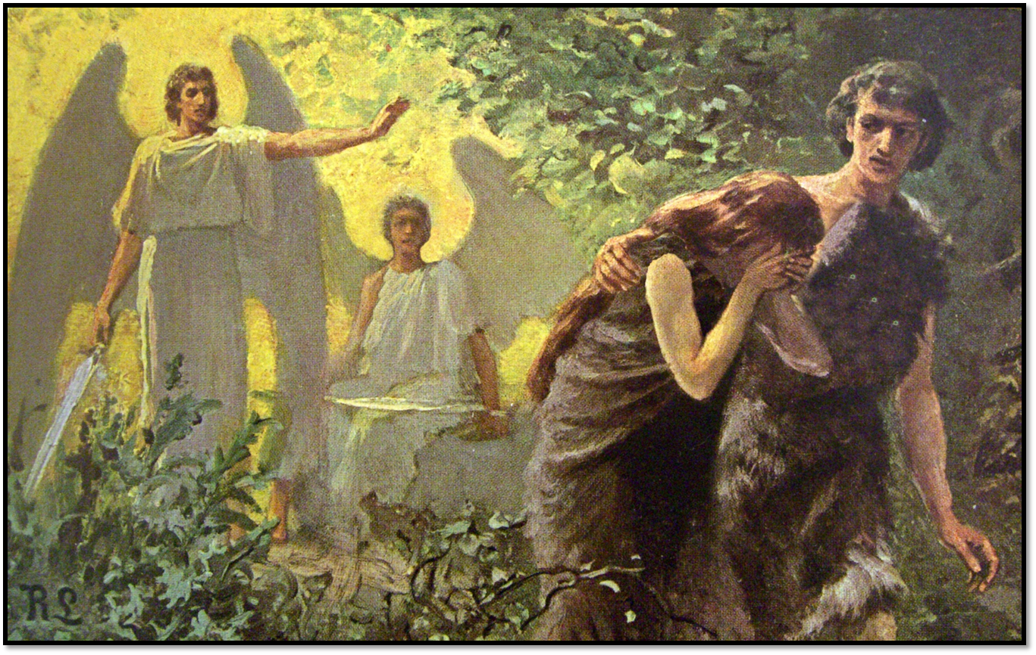
Creation of Adam and Eve. Fall of mankind
Is this
the end of the story?

Slide 9
God’s Eternal Purpose
Title
Next, consider the promise of God with reference to an heir and consider the advanced age of Abraham and that of his wife. From a human standpoint alone, it’s unreasonable!
But not so with Abraham. (Rom 4:18) Who against hope believed in hope, that he might become the father of many nations, according to that which was spoken, so shall thy seed be.
Abraham had faith that God was able to perform His will, regardless of physical infirmities,
(Rom 4:20) He staggered not at the promise of God through unbelief; but was strong in faith, giving glory to God;
b hastings newlebanoncoc.com

Slide 10
God’s Eternal Purpose
Title
After years of patient waiting, Isaac, the child of promise, is born.
But then, Abraham is commanded to offer up Isaac as a sacrifice. And we ask again: What is now to become of the promise to Abraham concerning the promised blessing of the world through his heir?
Doesn’t it look like a failure?
b hastings newlebanoncoc.com

Slide 11
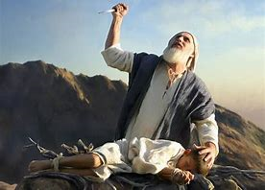
2. Promise made to Abraham he would be father of many nations.
God commands him to sacrifice his son
Is this
the end of the story?

Slide 12
God’s Eternal Purpose
Title
At the critical moment an angel calls to Abraham to stay his hand. The test is made and God receives the offering in life of the victim instead of its death.
Rom. 12:1-2 (a living sacrifice)
In this great test, Abraham understood it was God’s business to command and his business to do. God would in some way accomplish His purpose as He had said.
Do we understand today what is God’s business and what is our business???
b hastings newlebanoncoc.com

Slide 13
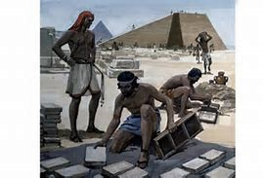
3. Isaac is spared. God tells Abraham his descendants will be slaves for 400 years.
Is this the
end of the story?

Slide 14
God’s Eternal Purpose
Title
(Gen.15:13) And he said unto Abram, know of a surety that thy seed shall be a stranger in a land that is not theirs, and shall serve them; and they shall afflict them 400 years; and also, that nation, whom they shall serve, will I judge: and afterward shall they come out with great substance.
b hastings newlebanoncoc.com

Slide 15
God’s Eternal Purpose
Title
(Gen.17:1) And when Abram was ninety years old and nine, the LORD appeared to Abram, and said unto him, I am the Almighty God; walk before me, and be thou perfect. 2 And I will make my covenant between me and thee, and will multiply thee exceedingly.
3 And Abram fell on his face: and God talked with him, saying,
4 As for me, behold, my covenant is with thee, and thou shalt be a father of many nations.
5 Neither shall thy name any more be called Abram, but thy name shall be Abraham; for a father of many nations have I made thee.
(Gen. 17:6) And I will make thee exceedingly fruitful, and I will make nations of thee, and kings shall come out of thee.
b hastings newlebanoncoc.com

Slide 16
God’s Eternal Purpose
Title
... Almost impossible from a human point of view. Not that Abraham's seed would in time be in bondage as slaves in a foreign land, but after hard servitude for four centuries they would come out freemen with "great substance."
kings coming out from a race of slaves??? Sounds unreasonable.
Well…Who would lead the heirs out of bondage? Moses
And What a huge job! No wonder that Moses was afraid and tried to excuse himself.
However, God did not accept his excuses…just as he will not accept our excuses. Moses must surrender to the purpose of God in making him a typical representative of the promised seed.
b hastings newlebanoncoc.com

Slide 17
God’s Eternal Purpose
Title
Pharaoh must now be made acquainted with God as the I Am, and His power made known to the king of Egypt in such a way as would convince the king of the superiority of the I Am over all the gods of Egypt.
The plagues came upon the land of Egypt ending with death to the first born. The Israelites were thrown out by the edict of the king, but then he changed his mind, he mobilized his army in pursuit while the Israelites were encamped by the sea.
b hastings newlebanoncoc.com

Slide 18
4. Moses delivers the heirs of promise. But they become trapped by the Red Sea when Pharoah is following with his army to destroy them.
Is this the
end of the story?

Slide 19
God’s Eternal Purpose
Title
Again, things seem impossible. Will the purpose of God fail here, and God's purpose as made known to Abraham come to an end?
Moses, in obedience to the command of God, stretches his rod over the waters and they stand up as a heap, making a pathway through which the once enslaved children of Abraham cross over and are liberated forever from their former bondage in Egypt.
And as Paul said: "Were all baptized unto Moses in the cloud and in the sea." (1 Cor. 10:2)
b hastings newlebanoncoc.com

Slide 20
God’s Eternal Purpose
Title
But now being released from Pharaoh, the redeemed encounter another enemy, and another test is before the children of Abraham. The Amalekites, the descendants of Esau, now seek to contest the will of the Almighty, and to frustrate the eternal purpose made to Abraham, to Isaac and to Jacob.
The descendants of the two brothers now form in lines of battle in deadly conflict. Will God's purpose fail at last? The test comes, and victory comes to the heirs of promise, Israel is preserved, and God, remembering their rebellion, caused their destruction 400 years later, in the days of Samuel.
b hastings newlebanoncoc.com

Slide 21
God’s Eternal Purpose
Title
Definitely, God had a purpose in bringing to pass His sworn covenant with Abraham. At every angle there was a test of faith throughout the whole procedure unto the end.
And we see God’s designs were being accomplished in the development of the "mystery hid for ages" and was not fully understood by the men of the old testament, but was revealed in its fullness by the chosen apostles of our Lord.
b hastings newlebanoncoc.com

Slide 22
God’s Eternal Purpose
Title
(Eph.1:8) which He made to abound toward us in all wisdom and prudence,
9 having made known to us the mystery of His will, according to His good pleasure which He purposed in Himself,10 that in the dispensation of the fullness of the times He might gather together in one all things in Christ, both which are in heaven and which are on earth--in Him.
11 In Him also we have obtained an inheritance, being predestined according to the purpose of Him who works all things according to the counsel of His will, 12 that we who first trusted in Christ should be to the praise of His glory.
b hastings newlebanoncoc.com

Slide 23
God’s Eternal Purpose
Title
When we understand this, there is a beauty and power far surpassing the power of mankind.
God’s providence with the Israelites, is a foreshadow, a type, a model for us to accept in our lives. "Surely as I have thought, so shall it come to pass, and as I have purposed so shall it stand."
b hastings newlebanoncoc.com

Slide 24
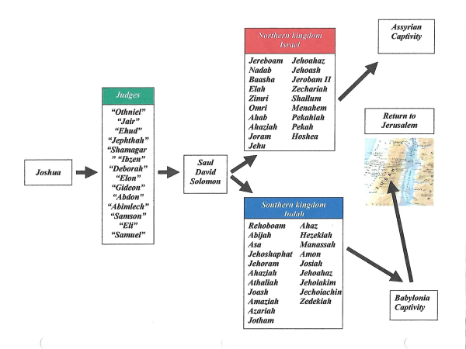
5. The heirs of promise apostatize and are in captivity again. A faithful few remain.
Is this the
end of the story?

Slide 25
God’s Eternal Purpose
Title
fast forward
Throughout all the ups and downs through which Israel passed, and although the ten tribes of Israel became absorbed and lost, yet God miraculously preserved the remnant of Judah for a light, and the promise of God to Abraham and to His seed stands sure and abiding and the scarlet thread of prophecy of a deliverer through Judah.
Consider when Isaiah gave his prophecy, Israel had existed a separate and distinct nation for a period of 800 years, yet they had been enslaved by surrounding nations to such an extent that it would seem impossible from a strictly human standpoint for the promise to Abraham regarding this people ever to materialize.
b hastings newlebanoncoc.com

Slide 26
God’s Eternal Purpose
Title
But the Ten tribes of Israel could be lost forever - yet for a remnant, the tribe of Judah that contained the world's savior would be preserved,
miraculously carried as it were on eagles’ wings, that the solemn promise of God might stand.
Jesus Christ, we know, is the center of all prophecies in relation to God's eternal purpose, made known to the apostles of our Lord and revealed to us in the gospel.
b hastings newlebanoncoc.com

Slide 27
God’s Eternal Purpose
Title
All of these events are bound together by the scarlet thread, fastened at the starting point in the eternal purpose, "kept secret," and was the hidden mystery in the mind of God, reaching over ages, and coming to completion in the earthly birth of Jesus the Christ, the beginning and the end, the first and the last, the alpha and omega.
The testimony of Stephen the first martyr that suffered for the testimony of God, bears witness to the fulfillment of the promise in speaking of David the son of Jesse says: "Of this man's seed hath God according to His promise raised unto Israel a Savior, Jesus." (Acts 13: 23.)
Of this historic fact David prophesied seven hundred years before saying, "The Lord hath sworn in truth unto David; He will not turn from it; of the fruit of thy body will I set upon thy throne." (Psalms 132: 10-11.)
b hastings newlebanoncoc.com

Slide 28
God’s Eternal Purpose
Title
And It was because of God’s compassion that this rebellious people were not completely destroyed.
(Lam. 3:22.) Through the LORD'S mercies we are not consumed, Because His compassions fail not.
700 years before the Messiah came, Isaiah catches a view of the long expected one and speaks:
b hastings newlebanoncoc.com

Slide 29
God’s Eternal Purpose
Title
(Isa. 42:1) "Behold! My Servant whom I uphold, My Elect One in whom My soul delights! I have put My Spirit upon Him; He will bring forth justice to the Gentiles.
2 He will not cry out, nor raise His voice, nor cause His voice to be heard in the street.
3 A bruised reed He will not break, and smoking flax He will not quench; He will bring forth justice for truth.
4 He will not fail nor be discouraged, Till He has established justice in the earth; And the coastlands shall wait for His law."
b hastings newlebanoncoc.com

Slide 30
God’s Eternal Purpose
Title
5 Thus says God the LORD, who created the heavens and stretched them out, who spread forth the earth and that which comes from it, who gives breath to the people on it, and spirit to those who walk on it:
6 "I, the LORD, have called You in righteousness, and will hold Your hand; I will keep You and give You as a covenant to the people, As a light to the Gentiles,
7 To open blind eyes, to bring out prisoners from the prison, those who sit in darkness from the prison house.
8 I am the LORD, that is My name; And My glory I will not give to another, Nor My praise to carved images.
b hastings newlebanoncoc.com

Slide 31
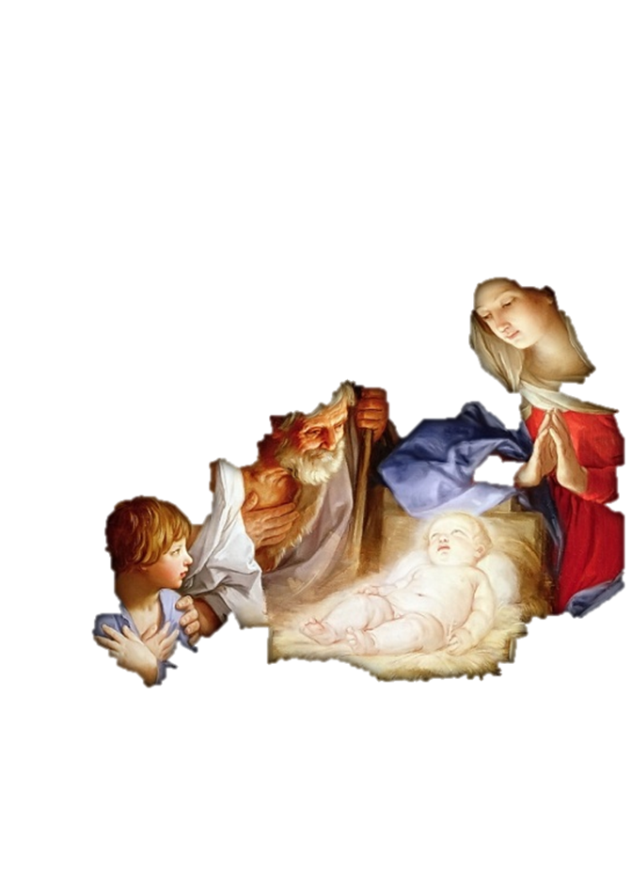
6. The Messiah is born. King Herod tries to kill him.
Is this the
end of the story?

Slide 32
God’s Eternal Purpose
Title
4,000 years has now come and passed into eternity, and a babe is born in Bethlehem in Judea, foretold by the Prophet Micah 700 hundred years before, in these words:
"But thou Bethlehem Ephratah though thou be little among the thousands of Judah yet out of thee shall He come forth unto Me, that is to be ruler in Israel, whose goings forth have been of old from everlasting.
b hastings newlebanoncoc.com

Slide 33
God’s Eternal Purpose
Title
But why choose the unimportant town of Bethlehem, rather than Jerusalem, the capital city of the Jewish nation? — and why born of poor parents and whose shelter was in a manger, rather than in the surroundings in a king's palace?
But, The little town of Bethlehem was no obstacle in the way of furnishing the place of the Messiah's birth, but it was in exact order with the Divine plan of heaven.
b hastings newlebanoncoc.com

Slide 34
God’s Eternal Purpose
Title
Among the scribes and wise men there was a belief that there was due some great person, and Herod the king, out of jealousy ordered the death of innocent children, which caused the flight into Egypt with the infant Jesus, which ended upon the death of Herod the king of Judea.
It will be seen that the purpose of God respecting His chosen and foreordained people never one time failed. His oath to Abraham must be kept sacred and was fulfilled according to the letter in every essential feature.
b hastings newlebanoncoc.com

Slide 35
God’s Eternal Purpose
Title
Back to where we started…
Here is the beginning of the promise to Adam, that the seed of the woman should bruise the serpent's head, verified when after his baptism, Jesus was owned as: "This is my Son in whom I am well pleased"
And Jesus the Christ did not take His disciples from the learned rabbis, the philosophers of the different schools, He chose plain ordinary men to be His witnesses to all classes of men.
b hastings newlebanoncoc.com

Slide 36
God’s Eternal Purpose
Title
Again, we follow the line of prophecy down the ages from Adam to Moses, a period of 2,500 years, and we hear Him saying: "A prophet shall arise of your brethren like unto Me, him ye shall hear.“
This prophet was to be God's prophet, and to speak the words of God, and all who would not hear that prophet would be destroyed.
b hastings newlebanoncoc.com

Slide 37
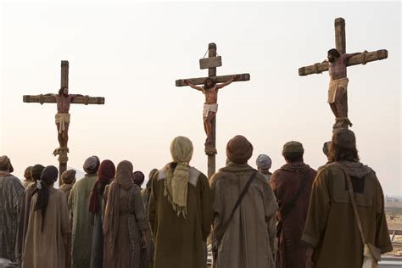
7. Later, Jesus the promised Messiah is crucified and buried.
Is this the
end of the story?

Slide 38
God’s Eternal Purpose
Title
We pass over the ministry of Christ during three and a half years, His mock trial and being condemned by a mob of wicked men, His crucifixion with lawbreakers and burial.
To prevent His body from being stolen, a Roman guard surrounded the grave of Jesus the Christ. The enemies of Jesus now think here lies the deceiver claiming to be the Messiah, and the king of the Jews.
And to His disciples all now seems to be lost ….but we thought that He was our Messiah, and was sent to redeem Israel, but now He has passed under the power of death, and our hope vanished…..
b hastings newlebanoncoc.com

Slide 39
God’s Eternal Purpose
Title
Now at this critical moment we ask, what now has become of the sworn promise of Almighty God respecting the covenant to Abraham, and His seed, with the Son of God lying under the power of death.
After 4,000 years of promise, types and shadows, and after 1,500 years preparing a people according to promise for the reception of the world's Savior, He is now dead, and lying in a grave!!!
b hastings newlebanoncoc.com

Slide 40
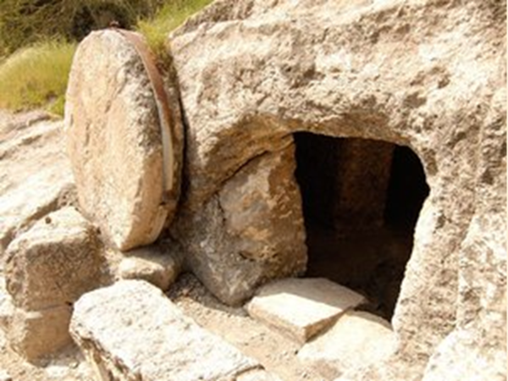
8. Jesus is victorious over death. Nothing can stop the promise of God

Slide 41
God’s Eternal Purpose
Title
On the first day of the week, the friends of Jesus come to His grave only to find the grave empty.
The glad news spreads amongst the disciples, but Thomas will not believe without convincing proof which afterward was furnished with the expression: my Lord and my God!
And the declaration of the prophet stands: "Thou wilt not leave my soul in hades nor suffer thy holy one to see corruption,'' and too, the sworn oath to David that: "Of the fruit of Thy body will I set upon Thy throne."
b hastings newlebanoncoc.com

Slide 42
God’s Eternal Purpose
Title
The mystery of the will of God was made known to the Apostle Paul which was purposed in Himself: "That in the dispensation of the fullness of time He might gather together in one all things in Christ, both which are in. heaven, and which are on earth even in Him."
Jesus is the only hope of the world.
Jesus is the answer to our problem in life….our sin problem
b hastings newlebanoncoc.com

Slide 43
God’s Eternal Purpose
Title
(Gal 4:4) But when the fullness of the time had come, God sent forth His Son, born of a woman, born under the law,
5 to redeem those who were under the law, that we might receive the adoption as sons.
6 And because you are sons, God has sent forth the Spirit of His Son into your hearts, crying out, "Abba, Father!"
7 Therefore you are no longer a slave but a son, and if a son, then an heir of God through Christ.
b hastings newlebanoncoc.com

Slide 44
God’s Eternal Purpose
Title
(Eph. 3:10) to the intent that now the manifold wisdom of God might be made known by the church to the principalities and powers in the heavenly places,
11 according to the eternal purpose which He accomplished in Christ Jesus our Lord,
12 in whom we have boldness and access with confidence through faith in Him.
Let’s look back in history in the Bible, concerning the eternal purpose of God, and draw some lessons from it.
b hastings newlebanoncoc.com

Slide 45
Are you a New Testament Christian?
Hear the Gospel (Rom.10:14)
Believe the Gospel (Heb. 11:6)
Repent of Sins (Acts 3:19)
Confess Christ (Rom.10:9)
Be Baptized Into Christ (1 Cor.12:13)
Serve our Lord the rest of our lives (Rev.2:10)
You Must Be Born Again. John 3:1-7

