Slide 1
Welcome to our services
New Lebanon Church of Christ
We are Simply Christians.
Our Emphasis is Spiritual, Not Material or Social.
We are striving to be The Same Church as Described in The New Testament.
Please Come Back Again

Slide 2
Digging Deep Luke 6:46-49
“My hope is built on nothing less
Than Jesus’ blood and righteousness,
I dare not trust the sweetest frame,
But wholly lean on Jesus’ Name,
On Christ the solid Rock I stand,
All other ground is sinking sand.”

Slide 3
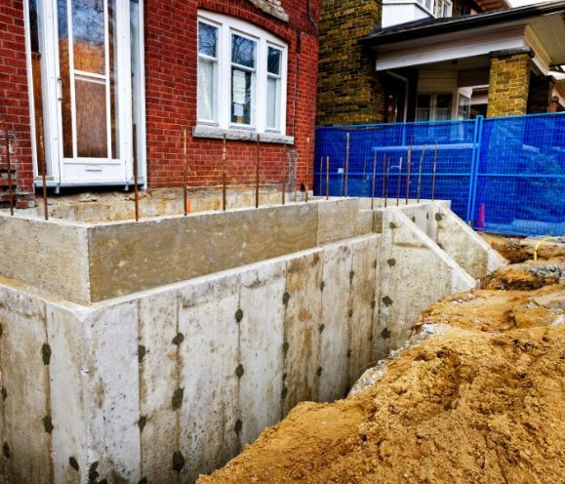
Digging Deep Luke 6:46-49
Luke 6:46 "But why do you call Me 'Lord, Lord,' and do not do the things which I say?
47 "Whoever comes to Me, and hears My sayings and does them, I will show you whom he is like:
48 "He is like a man building a house, who dug deep and laid the foundation on the rock. And when the flood arose, the stream beat vehemently against that house, and could not shake it, for it was founded on the rock.
49 "But he who heard and did nothing is like a man who built a house on the earth without a foundation, against which the stream beat vehemently; and immediately it fell. And the ruin of that house was great."

Slide 4
Digging Deep Luke 6:46-49
Jesus illustrates the benefit of obeying his words. It was not sufficient to hear them; they must be obeyed. He compares the man who should hear and obey him to a man who built his house on a rock.
Palestine was a land of hills and mountains. Like other countries of that description, it was subject to sudden and violent rains.

Slide 5
Digging Deep Luke 6:46-49
The Jordan, the primary river, would flood every year, and became overwhelming and destructive in its flood season.
The streams which ran among the hills, whose channels might have been dry during some months of the year, became suddenly swollen with the rain, and would rush violently into the plains below.

Slide 6
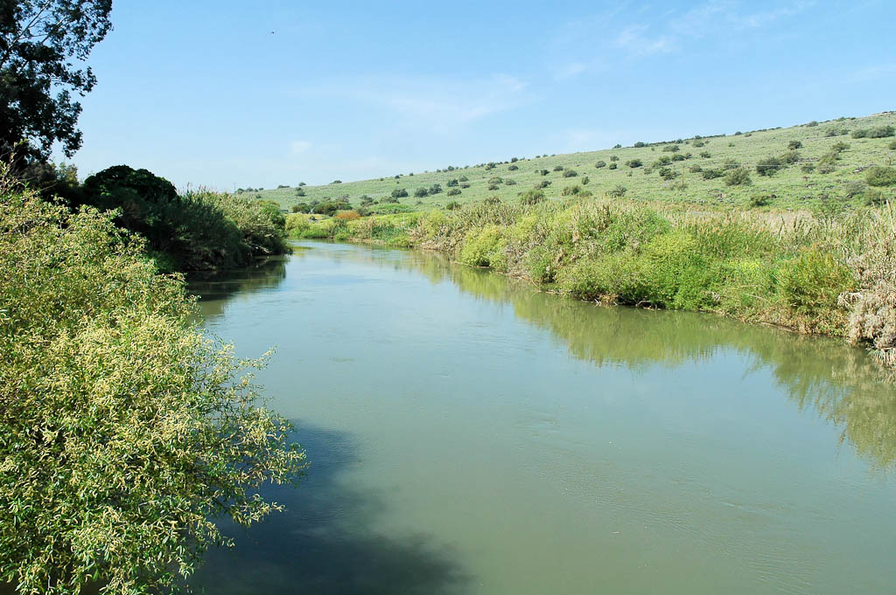
Jordan River north of Sea of Galilee
Notes:
tb032905914

Slide 7
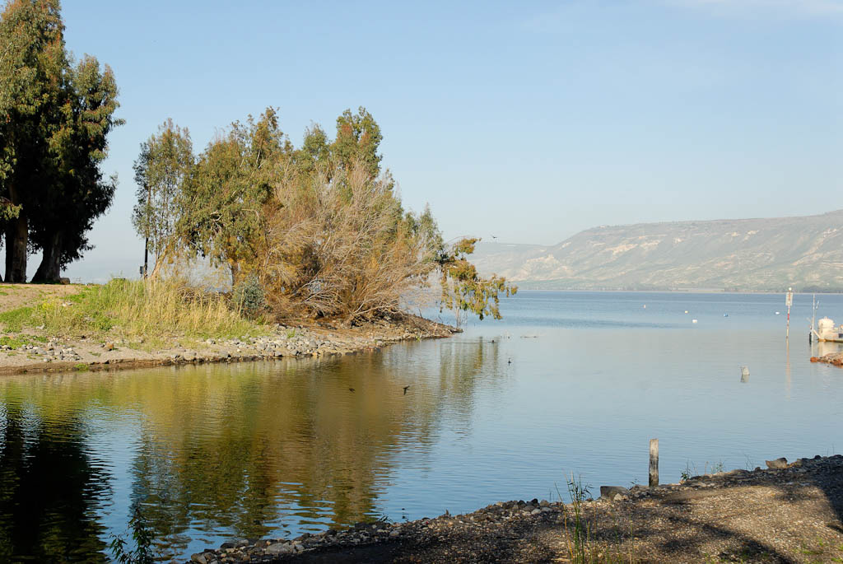
Jordan River exiting from Sea of Galilee
Notes:
Jordan River: Early History
Jacob crossed the Jordan River into Canaan (Gen 32:10).
The river parted when Joshua and the Israelites crossed it (Josh 3:1-17; 7:7; 24:11; Ps 114:3, 5), and twelve stones were erected to commemorate the event (Josh 4:1-24).
Ehud guarded the fords of the Jordan (Judg 3:28).
Gideon guarded the fords of the Jordan (Judg 7:24).
Jephthah guarded the fords of the Jordan against the Ephraimites, requiring them to say “Shibboleth” (Judg 12:5-6).
tb022107166

Slide 10
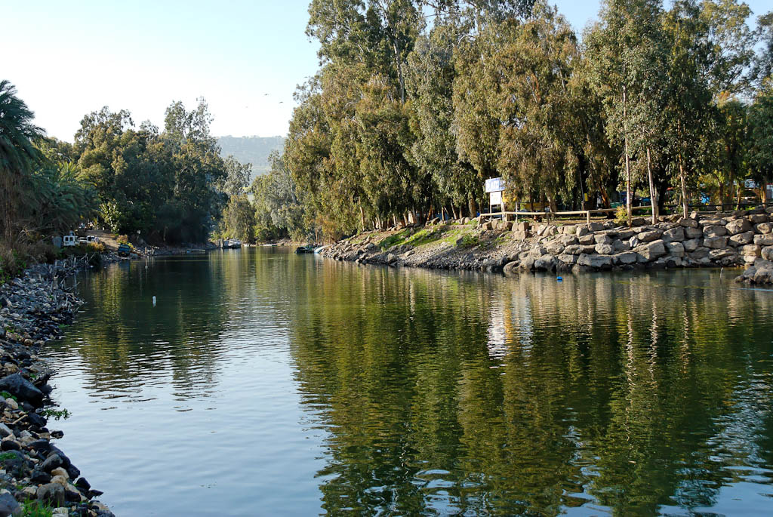
Jordan River exiting from Sea of Galilee
Notes:
Jordan River: Later History
Abner fled across the Jordan River from Joab (2 Sam 2:29).
David pursued the Arameans this way (2 Sam 10:17; 1 Chr 19:17).
David fled from Absalom across the river (2 Sam 17:16, 22; 1 Kgs 1:8) and apparently stopped here to refresh himself (2 Sam 16:14).
The Jordan River marked the limit of those who remained loyal to David after Sheba’s revolt (2 Sam 20:2).
Elijah and Elisha repeated Joshua’s feat when both split the waters of the Jordan (2 Kgs 2:6-8, 13-14).
Elisha made an axehead float after it had sunk in the Jordan River (2 Kgs 6:1-7).
Naaman was healed of leprosy after following Elisha’s instructions to dip seven times in the waters of the Jordan River (2 Kgs 5:8-14).
tb022107167

Slide 11
Digging Deep Luke 6:46-49
Rocks in that country were common, and it was easy to build their houses with a solid foundation. This would be a relatable illustration for a Jew to understand…and
a the comparison to a soul and the tempests, and storms of life that beat around the soul.

Slide 12
Digging Deep Luke 6:46-49
Everything in the way of these floods will be swept away. Even houses, and especially if they were built on sand.
The once quiet river would shake the foundation, the rapid flood would gradually wash away its base; the house would totter and fall.

Slide 13
Digging Deep Luke 6:46-49
1 The wise man built his house upon the rock. The wise man built his house upon the rock. The wise man built his house upon the rock. And the rains came tumbling down. The rains came down, and the floods came up. The rains came down, and the floods came up. The rains came down, and the floods came up. And the house on the rock stood firm.
2 The foolish man built his house upon the sand. The foolish man built his house upon the sand. The foolish man built his house upon the sand. And the rains came tumbling down. The rains came down, and the floods came up. The rains came down, and the floods came up. The rains came down, and the floods came up. And the house on the sand fell down.

Slide 14
Digging Deep Luke 6:46-49
The rains came down, and the floods came up.
Lust of the eyes and flesh
Cares of the world
Pride of Life
Things we experience because we live in this world.
Things we bring on ourself.
Are You Building Your Life On The Rock?

Slide 15
Digging Deep Luke 6:46-49
And when we think we are in safety, the flood can come and sweep us away.
In a moment, health, friends, comforts may be gone. How important it is to have something that the storm cannot reach! Such is an obedient relationship in Christ.
Earthly disasters do not reach a true disciple of Christ. The storms and tempests of life will beat harmlessly around us.

Slide 16
Digging Deep Luke 6:46-49
There are three words here that characterize a wise man in the eyes of Jesus Christ. "Whoever comes to Me, and hears My sayings and does them,
To come to Jesus as a Savior, to hear Him as a Teacher, and to obey Him as a Master is an evidence that we have been and are being taught of God and made wise in Christ.
These two builders are representatives of two great classes or conditions of men—those who live by faith on the Son of God, and those who walk in the light of their own devising.

Slide 17
Digging Deep Luke 6:46-49
Luke 6:46 And why call me, Lord, Lord, and do not the
things which I say?
It is not in mere believing, not in mere profession of faith, not in the acknowledgment of Jesus as Lord, that salvation is received but it is through doing the things he commanded.
This fundamental truth has been compromised and negated by religious error, but the scriptures cannot be broken.
There is no substitute for doing what Jesus commanded. Jesus said in the Sermon on the Mount, “Not everyone that saith unto me, Lord, Lord, shall enter the kingdom of heaven; but he that doeth the will of my Father who is in heaven” (Matt. 7:21).

Slide 18
Digging Deep Luke 6:46-49
Why Do Your Call Me “Lord, Lord” but Do Not Obey Me?
This question is not merely a question, it is also an indictment, charging men with the inconsistency of disobeying him who they acknowledged as Lord.
Jesus did not here charge his hearers with lack of faith, but with lack of action, there being not the slightest suggestion that any of them were unbelievers.
“While unbelievers must be lost, believers may be lost.” Ours is a generation which has accepted “faith only” as the “open sesame” of the gate of heaven; but “faith only” was not enough for the first generation that ever tried it; and it is not enough today.

Slide 19
Digging Deep Luke 6:46-49
But not only were they believers and confessors, they were also religious workers, not idle in any sense, being, in fact, busy with many things. It was precisely this class of persons Jesus had in mind when he said:
Many will say to me in that day, Lord, Lord, did we not prophesy by thy name, and by thy name cast out demons, and by thy name do many mighty works? And then I will profess unto them, I never knew you: depart from me, ye that work iniquity (Matt. 7:22, 23).

Slide 20
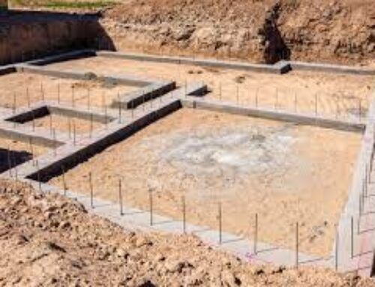
Digging Deep Luke 6:46-49
From this it is clear that the people Jesus was talking about in this text were:
believers;
confessing believers; and
working believers.
What was
their fatal sin?
They did not do
the will of the Lord.

Slide 21
Digging Deep Luke 6:46-49
Some do not his will because they are idle, doing nothing of any spiritual significance.
Others do not his will because they are doing their “own thing.” “Walking after their own lusts and denying the promise of his coming” (2 Peter 3:3, 4).
Multitudes do not his will because they are busy obeying the commandments of men,” or as Jesus said, “teaching for doctrines the commandments of men” (Matt. 15:9).

Slide 22
1. God

Slide 23
Deut. 6:5 "You shall love the LORD your God with all your heart, with all your soul, and with
all your strength.
6 "And these words which I command you today
shall be in your heart.
7 "You shall teach them diligently to your children, and shall talk of them when you sit in your house, when you walk by the way, when you lie down, and when you rise up.

Slide 24
Children (and grown-ups) can’t hear what you say, but they see what you do.
“If you set the example, you don’t have to repeat the rule.”
Church attendance
Daily Bible reading
Daily personal prayer
Where we work
Where we vacation
Where we eat
Where we recreate
Deut.6:5
Examples:

Slide 26
2 Peter 1:5-7
Love
godliness
Brotherly kindness
Self-
perseverance
control
Knowledge virtue faith

Slide 27
What have you Built? Today?
Last week? Last month? Last year?

Slide 28
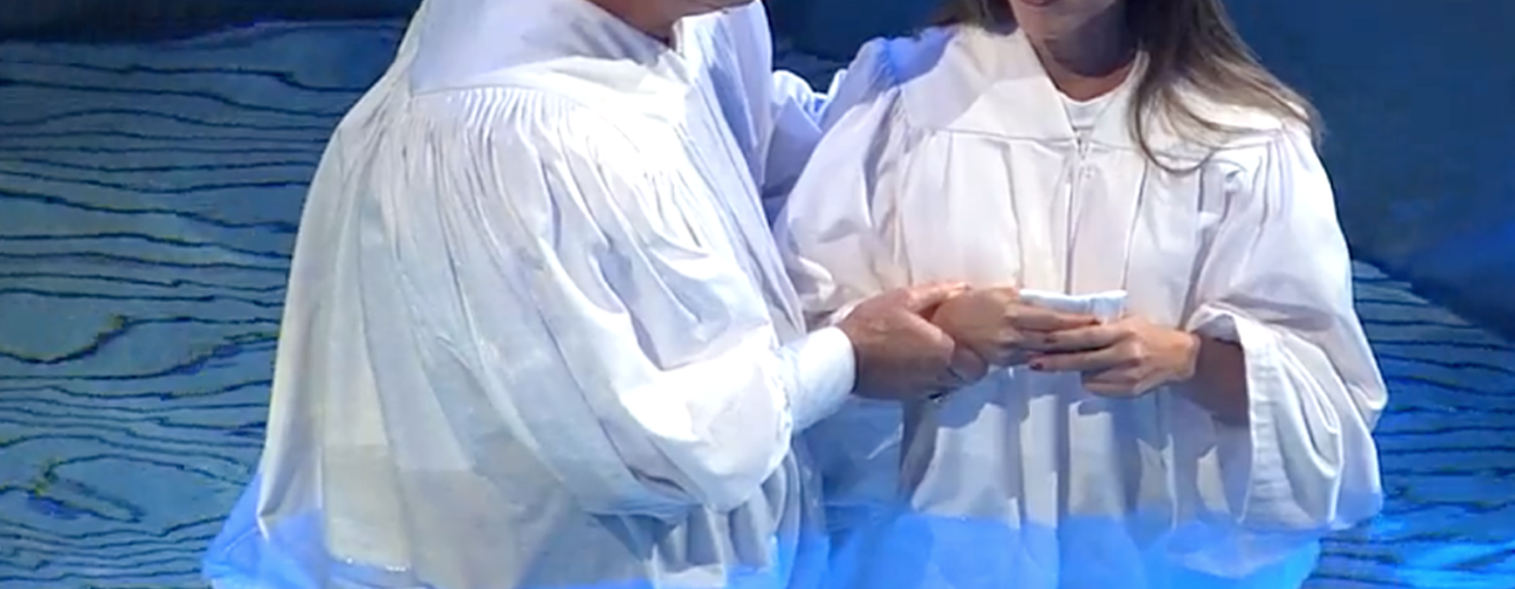
Are you a New Testament Christian?
Hear the Gospel (Rom.10:14)
Believe the Gospel (Heb. 11:6)
Repent of Sins (Acts 3:19)
Confess Christ (Rom.10:9)
Don’t stop here!
Be Baptized Into Christ
Serve our Lord the rest of our lives (Rev.2:10)
You Must Be Born Again. John 3:1-7

Slide 29
Digging Deep Luke 6:46-49
1. The Wisdom of the Obedient
Our Lord says, “He is like a (wise) man which built an house, and dug deep, and laid the foundation on a rock” (v. 48).
He is like such a man—
1. Because He Believed in the Rock. Jesus Christ is the Rock. “Apart from Me,” He says, “you can do nothing.”

Slide 30
Digging Deep Luke 6:46-49
1. The Wisdom of the Obedient
2. Because he spared no trouble to get at the rock. “He dug deep.”
There are obstructions that must be removed in digging the foundation - pride, prejudice, and false teaching. It is no loss of time for a man to examine himself and to dig deep down through everything until he reaches Christ. “Foreign matter” and obstructions must be removed so our foundation is sure.

Slide 31
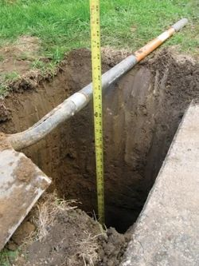
Digging Deep Luke 6:46-49
1. The Wisdom of the Obedient
3. Because he built his house upon it after he found the rock. He was not satisfied with merely finding a good foundation, he sought the rock for the purpose of building on.
There are some who seem satisfied in that they have found Christ and his promises - but they are indifferent to building once they found him.

Slide 32
Digging Deep Luke 6:46-49
1. The Wisdom of the Obedient
1Cor. 3:12 Now if anyone builds on this foundation with gold, silver, precious stones, wood, hay, straw, 13 each one's work will become clear; for the Day will declare it, because it will be revealed by fire; and the fire will test each one's work, of what sort it is.14 If anyone's work which he has built on it endures, he will receive a reward. 15 If anyone's work is burned, he will suffer loss; but he himself will be saved, yet so as through fire.

Slide 33
Digging Deep Luke 6:46-49
1. The Wisdom of the Obedient
4. Because He was not Disappointed with the Results. “The flood arose, the stream beat upon that house, and could not shake it, for it was founded upon a rock.” The life that is built on Jesus Christ will be found as stable as the Eternal Throne. “He is able to keep that which I have committed unto Him against that day.”
“The foundation of God stands sure” (2 Tim. 2:19).

Slide 34
Digging Deep Luke 6:46-49
2. The Foolishness of the Disobedient.
“He that hears, and does not, is like a man that without a foundation built an house” (v. 49). The foolishness of this man is seen in that—
1. He Disregarded the Rock. He no doubt believed about the rock, but he imagined that he could get on equally well without it. He is a type of those who have been spoiled through false philosophy and vain deceit (Col. 2:6–8). “Woe unto them that are wise in their own eyes” (Isa. 5:21). The scribes and Pharisees went on with their building, although they had rejected “the Chief Corner Stone.” If we wish to end with Christ we must begin with Him.

Slide 35
Digging Deep Luke 6:46-49
2. The Foolishness of the Disobedient.
2. He started Building too Soon. He began to plant the stones of hope before he had found the rock of safety. What a picture of many modern religious builders!
They set to the raising of a strong and beautiful life before they have ever come into contact with the saving strength of Christ the Rock. They begin building when they should be digging, they are so anxious for something pleasing to the eyes of men.

Slide 36
Digging Deep Luke 6:46-49
2. The Foolishness of the Disobedient.
3. He Built Without a Foundation. The loose sandy earth beside the rolling river was deceptive ground. He felt the need of a house of refuge for his soul, but he did not realize his absolute need of an infallible rock for his house.
We need salvation, but we need an Almighty Christ to save. “Other foundation can no man lay than that is laid, which is Jesus Christ” (1 Cor. 3:11; Isa. 28:16).

Slide 37
Digging Deep Luke 6:46-49
2. The Foolishness of the Disobedient.
4. His Hopes were Suddenly Cut Off. “The stream beat strongly, the house fell, and the ruin of that house was great.”
He did not perish because he was lazy or indifferent to his need of a shelter. He did his very best, but it was his best without the “one thing needful.”
Your works may be many and beautiful, but if Jesus Christ is not at the foundation of all, “one thing thou lack,” and the lack of this “one thing” renders useless and fruitless every other thing It is too late to build another house when the flood has come (Mal. 4:1; 2 Thess. 1:8).

Slide 38
Psalm 32:6 For this cause everyone who is godly shall pray to You In a time when You may be found; Surely in a flood of great waters they shall not come near him.

Slide 39
Digging Deep Luke 6:46-49
The rains came down, and the floods came up.
Lust of the eyes and flesh
Cares of the world
Pride of Life
Are You Building Your Life On The Rock?

Slide 40
Digging Deep Luke 6:46-49
The rains came down, and the floods came up.
Lust of the eyes and flesh
Cares of the world
Pride of Life
Things we experience because we live in this world.
Things we bring on ourself.
Are You Building Your Life On The Rock?

