Slide 1
Welcome to our services
New Lebanon Church of Christ
We are Simply Christians.
Our Emphasis is Spiritual, Not Material or Social.
We are striving to be The Same Church as Described in The New Testament.
Please Come Back Again

Slide 2
The Servant Of Christ
Gal. 1:10 For do I now persuade men, or God? or do I seek to please men? for if I yet pleased men, I should not be
the servant of Christ.

Slide 3
The Servant Of Christ
SERVANT
A. Nouns.
1. doulos (δου̂λος, 1401), an adjective, signifying “in bondage,” Rom. 6:19 (neuter plural, agreeing with mele, “members”), is used as a noun, and as the most common and general word for “servant,” frequently indicating subjection without the idea of bondage; it is used (a) of natural conditions, e.g., Matt. 8:9; 1 Cor. 7:21, 22 (1st part); Eph. 6:5; Col. 4:1; 1 Tim. 6:1; frequently in the four Gospels; (b) metaphorically of spiritual, moral and ethical conditions: “servants” (1) of God, e.g., Acts 16:17; Titus 1:1; 1 Pet. 2:16; Rev. 7:3; 15:3; the perfect example being Christ Himself, Phil. 2:7; (2) of Christ, e.g., Rom. 1:1; 1 Cor. 7:22 (2nd part); Gal. 1:10; Eph. 6:6; Phil. 1:1; Col. 4:12; Jas. 1:1; 2 Pet. 1:1; Jude 1; (3) of sin, John 8:34 (rv, “bondservants”); Rom. 6:17, 20; (4) of corruption, 2 Pet. 2:19 (rv, “bondservants”); cf. the verb douloo (see B). See bondman.
W. E. Vine, Merrill F. Unger, and William White Jr., (Nashville, TN: T. Nelson, 1996), 562.

Slide 4
The Servant Of Christ
Gal. 1:1 Paul, an apostle, (not of men, neither by man, but by Jesus Christ, and God the Father, who raised him from the dead;)
2 And all the brethren which are with me, unto the churches of Galatia:
3 Grace be to you and peace from God the Father, and from our Lord Jesus Christ,
4 Who gave himself for our sins, that he might deliver us from this present evil world, according to the will of God and our Father:

Slide 5
The Servant Of Christ
Gal. 1:6 I marvel that ye are so soon removed from him that called you into the grace of Christ unto another gospel:
7 Which is not another; but there be some that trouble you, and would pervert the gospel of Christ.
8 But though we, or an angel from heaven, preach any other gospel unto you than that which we have preached unto you, let him be accursed.

Slide 6
The Servant Of Christ
Gal. 1:9 As we said before, so say I now again, If any man preach any other gospel unto you than that ye have received, let him be accursed.
10 For do I now persuade men, or God? or do I seek to please men? for if I yet pleased men, I should not be the servant of Christ.
(KJV)

Slide 7
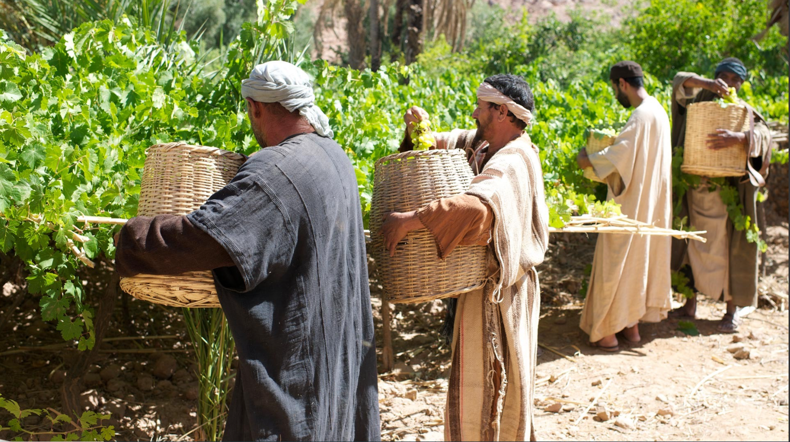
The Servant Of Christ
The good servants of the world have their distinguishing marks; the true servant of Christ has his.
He is—

Slide 8
The Servant Of Christ
1. Obedient.
What will you have me to believe rather than what will you have me to do? seems to be the question of many. The willing servant always has an open ear for the Master. “Speak, Lord, for Thy servant hears.” “My sheep hear My voice, and they follow Me.” Among the babel of the world’s voices His voice will we obey (Josh. 24:24). Christ pleased not Himself; the servant is not greater than his Lord. (Joshua 24:24 And the people said unto Joshua, The LORD our God will we serve, and his voice will we obey.)

Slide 9
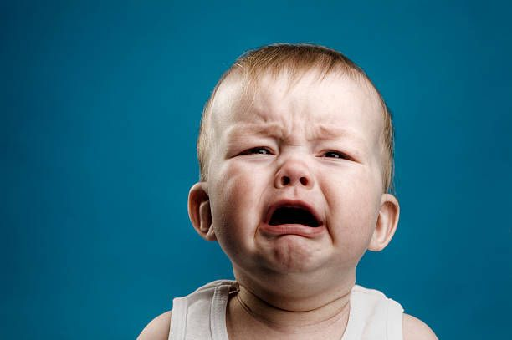
The Servant Of Christ
1. Obedient.
Many would rather complain than follow. It is easier for the flesh to offer the sacrifice of tears than to obey; but obedience is better than sacrifice. Jesus, who hath left us an example, said: “I do always those things which please Him” (John 8:29).
Are you ready to obey then, “Whatsoever He says to you, do it?”

Slide 10
The Servant Of Christ
1. Obedient.
2Samuel 15:15
And the king's servants said to the king, "We are your servants, ready to do whatever my lord the king commands."

Slide 11
The Servant Of Christ
2. Diligent.
Proverbs 12:24 The hand of the diligent will rule, But the lazy man will be put to forced labor.
25 Anxiety in the heart of man causes depression, But a good word makes it glad.
26 The righteous should choose his friends carefully, For the way of the wicked leads them astray.
27 The lazy man does not roast what he took in hunting, But diligence is man's precious possession.
28 In the way of righteousness is life, And in its pathway there is no death.
The hand of a diligent servant searches.

Slide 12
The Servant Of Christ
2. Diligent.
2Tim. 4:2 Preach the word! Be ready in season and out of season. Convince, rebuke, exhort, with all longsuffering and teaching.
Col. 3:23 And whatever you do, do it heartily, as to the Lord and not to men,

Slide 13
The Servant Of Christ
3. Humble
“In honor, preferring one another” is to be the rule among the servants; the servant of the Lord must not strive (2 Tim. 2:24).
Envy, like Miriam’s leprosy, totally unfits for service. Do we praise God as greatly for service rendered by others as by ourselves? If not, are we not seeking in some measure our own and not the Master’s glory? “

Slide 14
The Servant Of Christ
3. Humble
“Our highest place is lying low.” Uzziah was helped till he was strong; but when he was strong pride and destruction followed -
2Chron. 26:15 And he made devices in Jerusalem, invented by skillful men, to be on the towers and the corners, to shoot arrows and large stones. So his fame spread far and wide, for he was marvelously helped till he became strong.

Slide 15
The Servant Of Christ
3. Humble
The mark of Jacob, the wrestling victor. The humble servant gives himself no place, that the Master be not robbed.
Joseph, the faultless servant, said, “It is not in me.”
Paul, the successful servant, said, “Yet not I.”
Let us follow his example, serving the Lord with all humility of mind (Acts 20:19).

Slide 16
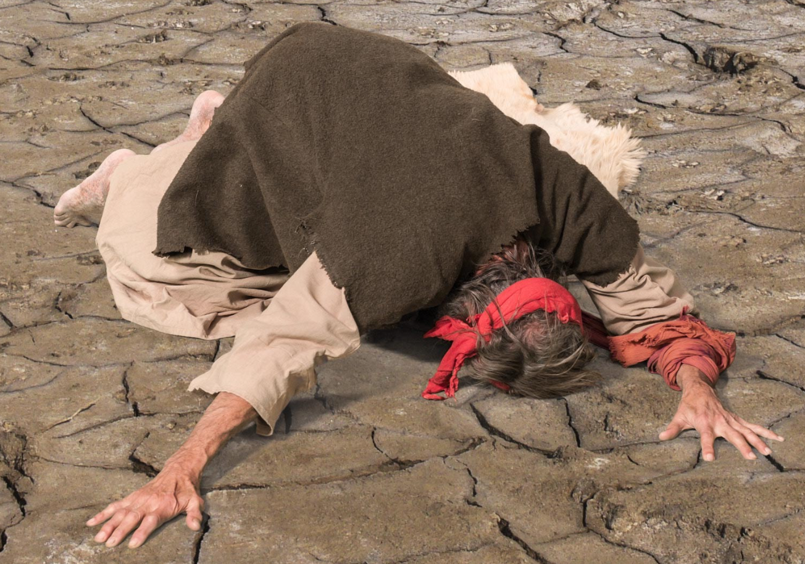
The Servant Of Christ
3. Humble
Acts 20:19 "serving the Lord with all humility, with many tears and trials which happened to me by the plotting of the Jews;

Slide 17
The Servant Of Christ
4. Persevering
Jacob (the deceiver) served fourteen years for the object of his affection.
“You shall reap if you faint not.” If the Master give us a work to do it should be ours faithfully to do it.
Elijah sent his servant seven times with the one message, and he went and murmured not. It was not the servant’s place to make the cloud, nor yet to despair at the seeming fruitlessness of his journeys; his duty was to go and look.

Slide 18
The Servant Of Christ
4. Persevering
A servant often goes discouraged because he does not see signs of coming blessing. Does the Master send? Well, go again! Be assured that He hears the sound of abundance of rain.
He shall not be discouraged. Isaiah 42:2 He will not cry out, nor raise His voice, Nor cause His voice to be heard in the street.
Psalm 100:2 Serve the LORD with gladness; Come before His presence with singing.

Slide 19
The Servant Of Christ
5. Faithful
1Cor 4:2 Moreover it is required in stewards that one be found faithful.
I am thankful that it is not that he be found successful, and yet every one that “serves with a perfect heart and a willing mind” (1 Chron. 28:9) will be successful according to the Master’s reckoning, though others may brand it as a failure.
1Chron. 28:9 "As for you, my son Solomon, know the God of your father, and serve Him with a loyal heart and with a willing mind; for the LORD searches all hearts and understands all the intent of the thoughts. If you seek Him, He will be found by you; but if you forsake Him, He will cast you off forever.

Slide 20
The Servant Of Christ
5. Faithful
He that has only $100 will not be responsible for $100,000.
We must be faithful with what God gives us before he will give us more.
The cup of cold water will not lose its reward.
Eternity gives dignity to the lowliest service.
“Be thou faithful unto death, and I will give you a crown of life.”

Slide 21
The Servant Of Christ
6. Courageous
Joshua 1:6 Be strong and of a good courage:
Joshua 1:9 Have not I commanded thee? Be strong and of a good courage; be not afraid, neither be thou dismayed: for the LORD thy God is with thee whithersoever thou goest.
Joshua 1:18 only be strong and of a good courage.
Joshua 10:25 And Joshua said unto them, Fear not, nor be dismayed, be strong and of good courage: for thus shall the LORD do to all your enemies against whom ye fight.

Slide 22
The Servant Of Christ
Be of good courage, be strong and very courageous.
Moses as a servant was very courageous when he demanded of Pharaoh the surrender of all Israel. He was a bold ambassador. And he knew that he was not sent to warfare on his own charges.
His authority was, “I AM” hath sent me.
Why are we fearful? “Lo, I am with you.”
6. Courageous

Slide 23
The Servant Of Christ
6. Courageous
The servant may tremble that goes forth in his own name, instead of having the “Thus saith the Lord.”
All of God’s servants should have the courage to make the same demand of the world that the Master makes:
entire surrender,
entire separation,
entire consecration.
Add to your faith courage.

Slide 24
The Servant Of Christ
7. Devoted
In Exodus 21:1–6 we have the confession of the devoted servant. “I love my Master; I will not go free.”
That which is devoted to the Lord shall not be redeemed.
You are not your own, for you are bought with a price, therefore glorify God.
The constraining power is the love of Christ, our Master. We love Him because He first loved us.

Slide 25
The Servant Of Christ
7. Devoted
Ex 21:1 "Now these are the judgments which you shall set before them:
2 "If you buy a Hebrew servant, he shall serve six years; and in the seventh he shall go out free and pay nothing.
3 "If he comes in by himself, he shall go out by himself; if he comes in married, then his wife shall go out with him.
4 "If his master has given him a wife, and she has borne him sons or daughters, the wife and her children shall be her master's, and he shall go out by himself.
5 "But if the servant plainly says, 'I love my master, my wife, and my children; I will not go out free,'
6 "then his master shall bring him to the judges. He shall also bring him to the door, or to the doorpost, and his master shall pierce his ear with an awl; and he shall serve him forever.

Slide 26
The Servant Of Christ
7. Devoted
The Levites were called to serve at the age of twenty-five and were discharged at fifty. They gave the best of their lives to God. God requires the best, He is worthy.
Many live in the expectation of doing God a favor by presenting Him a worthless, wasted life when they are going to die. “Present your bodies a living sacrifice unto God, which is your reasonable service” (Rom. 12:1).

Slide 27
The Servant Of Christ
8. Uncompromising
First, with the world. Pharaoh said, “Go, but you shall not go very far. Go, but leave your little ones and your flocks.” The servant’s answer was as emphatic as a thunderbolt, “Not a hoof shall be left behind.”
Let us build with you, says the world; but the whole-hearted servant answered, “Ye have nothing to do with us to build,” etc. (Ezra 4:3). “Come down to the plain of Ono.” The response of Nehemiah was, “I cannot come down.” Jephthah said, “I have opened my mouth unto the Lord, and I cannot draw back.” Let us not be among those that draw back

Slide 28
The Servant Of Christ
8. Uncompromising
Second, with sin. The command given to Israel was, “Drive out,” “Destroy,” “Dispossess.” Every spared enemy is a spared trouble, every unconquered sin is an enemy in the camp. The compromising Saul spared Agag, but the uncompromising Samuel hewed him in pieces. So let us do with every hidden sin.

Slide 29
The Servant Of Christ
8. Uncompromising
Second, with sin. “Crucify the old man with his lusts.” As servants let us stand on the dignity of God’s Word, and “dwell with the King for His work.” Then others will be constrained to say, “Happy are these Thy servants.” Remember that the eyes of the Master are on us. “I know thy service” (Rev. 2:19).

Slide 30
The Servant Of Christ
Gal. 1:9 As we said before, so say I now again, If any man preach any other gospel unto you than that ye have received, let him be accursed.
10 For do I now persuade men, or God? or do I seek to please men? for if I yet pleased men, I should not be the servant of Christ.
(KJV)

Slide 31
The Servant Of Christ
1. Obedient.
2. Diligent.
3. Humble
4. Persevering
5. Faithful
6. Courageous
7. Devoted
8. Uncompromising

Slide 32
Are you a New Testament Christian?
Hear the Gospel (Rom.10:14)
Believe the Gospel (Heb. 11:6)
Repent of Sins (Acts 3:19)
Confess Christ (Rom.10:9)
Be Baptized Into Christ (1 Cor.12:13)
Serve our Lord the rest of our lives (Rev.2:10)
You Must Be Born Again. John 3:1-7

