Slide 1
Welcome to our services
New Lebanon Church of Christ
We are Simply Christians.
Our Emphasis is Spiritual, Not Material or Social.
We are striving to be The Same Church as Described in The New Testament.
Please Come Back Again

Slide 2
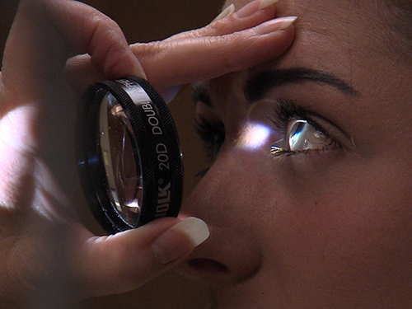
Singleness Of Eye And Fulness Of Light Luke 11:33-36
Title
Luke 11:33-36
Luke 11:34 "The lamp of the body is the eye. Therefore, when your eye is good, your whole body also is full of light. But when your eye is bad, your body also is full of darkness. 35 "Therefore take heed that the light which is in you is not darkness.
b hastings newlebanoncoc.com

Slide 4
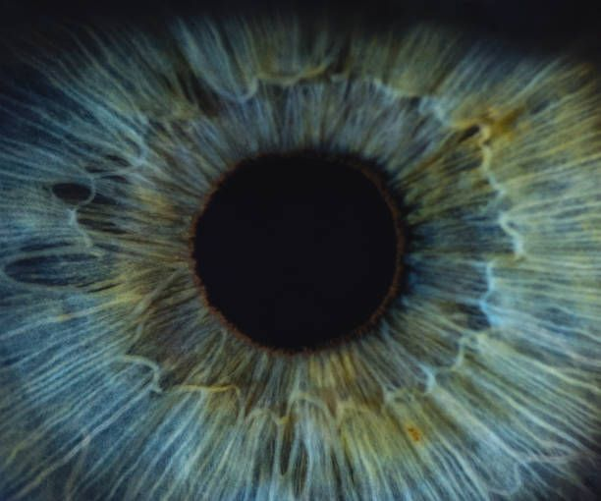
Singleness Of Eye And Fulness Of Light Luke 11:33-36
Title
Luke 11:33 "No one, when he has lit a lamp, puts it in a secret place or under a basket, but on a lampstand, that those who come in may see the light.
34 "The lamp of the body is the eye. Therefore, when your eye is good, your whole body also is full of light. But when your eye is bad, your body also is full of darkness.
35 "Therefore take heed that the light which is in you is not darkness.
36 "If then your whole body is full of light, having no part dark, the whole body will be full of light, as when the bright shining of a lamp gives you light."
b hastings newlebanoncoc.com

Slide 5
Singleness Of Eye And Fulness Of Light Luke 11:33-36
Title
“Light is sweet, and it is a pleasant thing for the eyes to behold the sun.”
So is it also with the light of truth that beams from the Son of Righteousness.
It is in His light that we see light clearly. Blessed are such eyes that see.
Our Lord Jesus Christ, who is here teaching us the blessedness of the single eye, so His whole body was full of light.
His light was not put in a “secret place” nor “under a bushel” (v. 33), but was “lifted up” on the lampstand of the Cross that all in the house of this world may see it.
b hastings newlebanoncoc.com

Slide 6
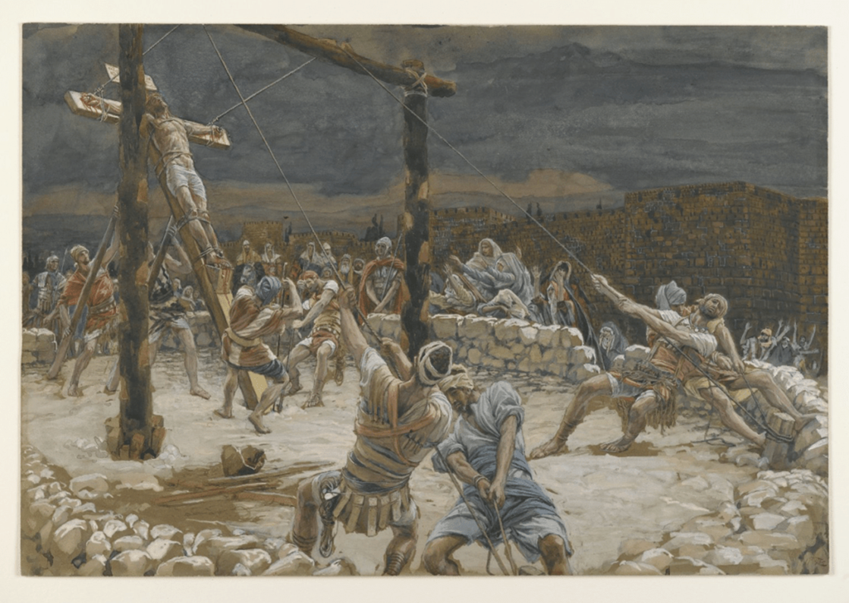
Luke 11:33 "No one, when he has lit a lamp, puts it in a secret place or under a basket, but on a lampstand, that those who come in may see the light.
John 12:32 "And I, if I am lifted up from the earth, will draw all peoples to Myself."

Slide 7
Singleness Of Eye And Fulness Of Light Luke 11:33-36
Title
John 1:6 There was a man sent from God, whose name was John.
7 This man came for a witness, to bear witness of the Light, that all through him might believe.
8 He was not that Light, but was sent to bear witness of that Light.
9 That was the true Light which gives light to every man coming into the world.
b hastings newlebanoncoc.com

Slide 8
Singleness Of Eye And Fulness Of Light Luke 11:33-36
Title
Matt. 5:14 "You are the light of the world. A city that is set on a hill cannot be hidden.
15 "Nor do they light a lamp and put it under a basket, but on a lampstand, and it gives light to all who are in the house.
16 "Let your light so shine before men, that they may see your good works and glorify your Father in heaven.
b hastings newlebanoncoc.com

Slide 9
Singleness Of Eye And Fulness Of Light Luke 11:33-36
1. The Medium. The light (lamp) of the body is the eye
34 "The lamp of the body is the eye.
1. The eye is Passive. It does not, and cannot, create the light, neither can it form or transform any object. It is simply a receiver and a reflector of outward objects to the inner consciousness of man, a channel through which visible things are revealed to the invisible spirit.
b hastings newlebanoncoc.com

Slide 10
Singleness Of Eye And Fulness Of Light Luke 11:33-36
Title
2. Very Sensitive. A little thing mars the vision of the eye. It is very easily offended. So with a tender conscience. They are blessed indeed who are as careful about their conscience as they are about the apple of the eye (Acts 24:16). Oh, that our spirits were as sensitive to the things of the Spirit of God!
Acts 24:16 This being so, I myself always strive to have a conscience without offense toward God and men.
b hastings newlebanoncoc.com

Slide 11
Singleness Of Eye And Fulness Of Light Luke 11:33-36
2. The Means. “Light.”
The light was made for the eye, and the eye for the light.
The successive waves of light that come with tenderness upon the eye prove the divine adaptation of the one to the other. (physical and spiritual)But light is not more suitable to the eye than Christ is to the soul of man.
Goethe said, “Were thine eye not sunny, how could it ever see the sun?” So were thy soul not God-like, how could it ever enjoy God?
b hastings newlebanoncoc.com

Slide 12
Singleness Of Eye And Fulness Of Light Luke 11:33-36
2. The Means. “Light.”
No one would be foolish enough to say “I have an eye of my own, I don’t need the light.” The eye is utterly useless without the light, so the spirit of man is utterly helpless and powerless to discern the things of God apart from the revelation of the Spirit of God (1 Cor. 2:14). The true Light now shines. Oh, that the eyes of the understanding might be opened (Luke 24:31, 32).
b hastings newlebanoncoc.com

Slide 13
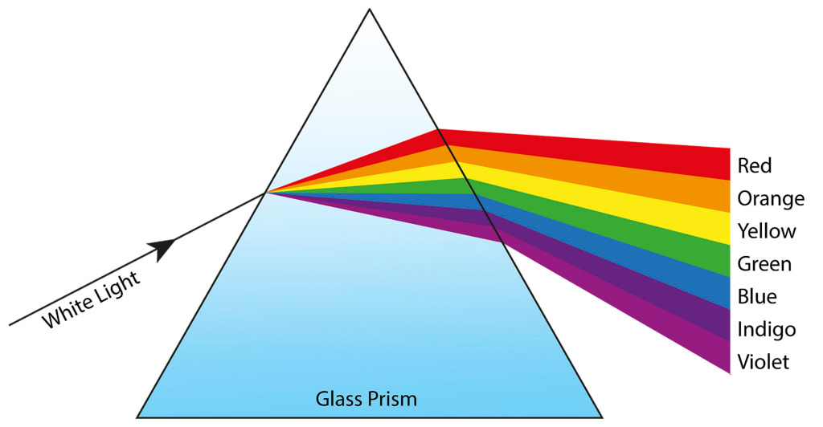
Where do colors come from?

Slide 14
Evil eye
Good eye

Slide 15
Singleness Of Eye And Fulness Of Light Luke 11:33-36
2. The Means. “Light.”
1Cor. 2:14 But the natural man does not receive the things of the Spirit of God, for they are foolishness to him; nor can he know them, because they are spiritually discerned.
Luke 24:31 Then their eyes were opened and they knew Him; and He vanished from their sight.
32 And they said to one another, "Did not our heart burn within us while He talked with us on the road, and while He opened the Scriptures to us?"
b hastings newlebanoncoc.com

Slide 16
Singleness Of Eye And Fulness Of Light Luke 11:33-36
3. The Manner
The Manner. Christ is the Light of the World, but there are two ways of looking at or dealing with this Light. These are represented by the “single eye” and the “evil eye,” the pure and the impure, the honest and the deceitful, the new heart and the old.
b hastings newlebanoncoc.com

Slide 17
Singleness Of Eye And Fulness Of Light Luke 11:33-36
Title
3. The Manner
The Single Eye and its effects.
The single eye is one that has been anointed with the heavenly eyesalve (Rev. 3:18). The blood-washed spirit that looks through this eye has been reconciled to God, and seeks to know the truth as it is in Jesus.
There is now no mixed motives in the life, no mingling of self-interest with the kingdom of God. The whole forces of the soul are now concentrated in “this one thing I do, forgetting the things that are behind, I press on toward the mark.”
b hastings newlebanoncoc.com

Slide 18
Singleness Of Eye And Fulness Of Light Luke 11:33-36
Title
3. The Manner
1. The Single Eye and its effects. Such an eye fills the whole body with light, because the Spirit of God takes the things which are Christ’s, and reveals them to those who have the pure eye for the glory of His Name.
If our motives are single, one with Christ’s, then we shall not walk in darkness, but shall have the light of His life within us.
To be filled with the Holy Spirit of Truth is to be filled with light. The spirit of wisdom and revelation in the knowledge of Him: “The eyes of your understanding being enlightened” (Eph. 1:17, 18).
b hastings newlebanoncoc.com

Slide 19
Singleness Of Eye And Fulness Of Light Luke 11:33-36
Title
3. The Manner
To be filled with the Holy Spirit of Truth is to be filled with light. The spirit of wisdom and revelation in the knowledge of Him: “The eyes of your understanding being enlightened” (Eph. 1:17, 18).
Eph 1:17 that the God of our Lord Jesus Christ, the Father of glory, may give to you the spirit of wisdom and revelation in the knowledge of Him, 18 the eyes of your understanding being enlightened; that you may know what is the hope of His calling, what are the riches of the glory of His inheritance in the saints,
b hastings newlebanoncoc.com

Slide 20
Singleness Of Eye And Fulness Of Light Luke 11:33-36
Title
3. The Manner
The Single Eye and its effects. (Eph. 1:17, 18).
Eph 1:17 that the God of our Lord Jesus Christ, the Father of glory, may give to you the spirit of wisdom and revelation in the knowledge of Him, 18 the eyes of your understanding being enlightened; that you may know what is the hope of His calling, what are the riches of the glory of His inheritance in the saints,
b hastings newlebanoncoc.com

Slide 21
Singleness Of Eye And Fulness Of Light Luke 11:33-36
Title
3. The Manner
2. The Evil Eye and its effects. The evil eye is the colored lens of an unclean heart. The eye of prejudice can only see objects in a contorted fashion. The unrenewed heart of man can no more appreciate the light of revelation than the blinking owl of the night can enjoy the sunshine.
Remember Lot’s wife. (she looked BACK)
“If thine eye be evil, thy whole body is full of darkness.” The darkness within is an evidence of an evil and doubting heart. We look to Christ with an evil eye if we look to Him only that self may be honored and gratified.
b hastings newlebanoncoc.com

Slide 22
Singleness Of Eye And Fulness Of Light Luke 11:33-36
4. The Message.
“Take heed therefore that the light which is in thee be not darkness” (v. 35). If the light that is in us is not a revelation from God it is but the flickering “spark of our own kindling,” a light that is certain to deceive.
The light that was in the Church of Laodicea was darkness, for although they said that they had need of nothing, yet was Christ, the Light, outside (Rev. 3:17–20).
b hastings newlebanoncoc.com

Slide 23
Singleness Of Eye And Fulness Of Light Luke 11:33-36
There is no darkness so great as the darkness that is mistaken for light.
Matt. 6:23 "But if your eye is bad, your whole body will be full of darkness. If therefore the light that is in you is darkness, how great is that darkness!
24 "No one can serve two masters; for either he will hate the one and love the other, or else he will be loyal to the one and despise the other. You cannot serve God and mammon.
Prov. 16:25 There is a way that seems right to a man, But its end is the way of death.
b hastings newlebanoncoc.com

Slide 24
Singleness Of Eye And Fulness Of Light Luke 11:33-36
Isaiah 5:20. Woe to those who call evil good, and good evil; Who put darkness for light, and light for darkness; Who put bitter for sweet, and sweet for bitter!
John 1:6 There was a man sent from God, whose name was John. 7 This man came for a witness, to bear witness of the Light, that all through him might believe.
8 He was not that Light, but was sent to bear witness of that Light.
9 That was the true Light which gives light to every man coming into the world. 10 He was in the world, and the world was made through Him, and the world did not know Him.
Title
b hastings newlebanoncoc.com

Slide 25
Singleness Of Eye And Fulness Of Light Luke 11:33-36
Title
Judges 17:6 In those days there was no king in Israel, but every man did that which was right in his own eyes.
Judges 21:25 In those days there was no king in Israel: every man did that which was right in his own eyes.
b hastings newlebanoncoc.com

Slide 26
Singleness Of Eye And Fulness Of Light Luke 11:33-36
Title
The lamp of the body … the eye … Jesus addressed himself to correcting his hearers’ inability (through their sins) to appreciate truth, and to read God’s sign. It was not the nature of the sign that needed correction but the heart in his sinful audience.
When people hear the words of Jesus, there are only 2 ways they respond.
1. People respond with repentance.
2. People respond with rejection.
b hastings newlebanoncoc.com

