Slide 1
Welcome to our services
New Lebanon Church of Christ
We are Simply Christians.
Our Emphasis is Spiritual, Not Material or Social.
We are striving to be The Same Church as Described in The New Testament.
Please Come Back Again

Slide 2
Seven Strange Things In Luke 5
Luke 5:26 And they were all amazed, and they glorified God and were filled with fear, saying, "We have seen strange things today!"

Slide 3
Seven Strange Things In Luke 5
“We have seen strange things to-day,” was the language of some of those who were eye-witnesses to the healing and forgiving of this poor paralyzed sinner.
Christianity will always be a “strange thing” to a godless world.
The saving, healing power of Christ will never cease to create amazement in the minds of men.

Slide 4
Seven Strange Things In Luke 5
Christ is to many the most perplexing wonder of all.
The mystery of the divine working in the soul of man is the mystery of the incarnation. It is as easy for Christ to create a world as to forgive a sinner.
Each is equally strange. But what were some of the “strange things” that they saw that day?

Slide 5
Seven Strange Things In Luke 5
Luke 5:17 Now it happened on a certain day, as He was teaching, that there were Pharisees and teachers of the law sitting by, who had come out of every town of Galilee, Judea, and Jerusalem. And the power of the Lord was present to heal them.
18 Then behold, men brought on a bed a man who was paralyzed, whom they sought to bring in and lay before Him.
19 And when they could not find how they might bring him in, because of the crowd, they went up on the housetop and let him down with his bed through the tiling into the midst before Jesus.

Slide 6
Seven Strange Things In Luke 5
Luke 5:20 When He saw their faith, He said to him, "Man, your sins are forgiven you."
21 And the scribes and the Pharisees began to reason, saying, "Who is this who speaks blasphemies? Who can forgive sins but God alone?“
22 But when Jesus perceived their thoughts, He answered and said to them, "Why are you reasoning in your hearts?
23 "Which is easier, to say, 'Your sins are forgiven you,' or to say, 'Rise up and walk'?
(NKJV)

Slide 7
Seven Strange Things In Luke 5
Luke 5:24 "But that you may know that the Son of Man has power on earth to forgive sins" --He said to the man who was paralyzed, "I say to you, arise, take up your bed, and go to your house."
25 Immediately he rose up before them, took up what he had been lying on, and departed to his own house, glorifying God.
26 And they were all amazed, and they glorified God and were filled with fear, saying, "We have seen strange things today!"

Slide 8
Seven Strange Things In Luke 5
1. An Unlettered Man Teaching
Luke 5:17 Now it happened on a certain day, as He was teaching, that there were Pharisees and teachers of the law sitting by, who had come out of every town of Galilee, Judea, and Jerusalem. And the power of the Lord was present to heal them.

Slide 9
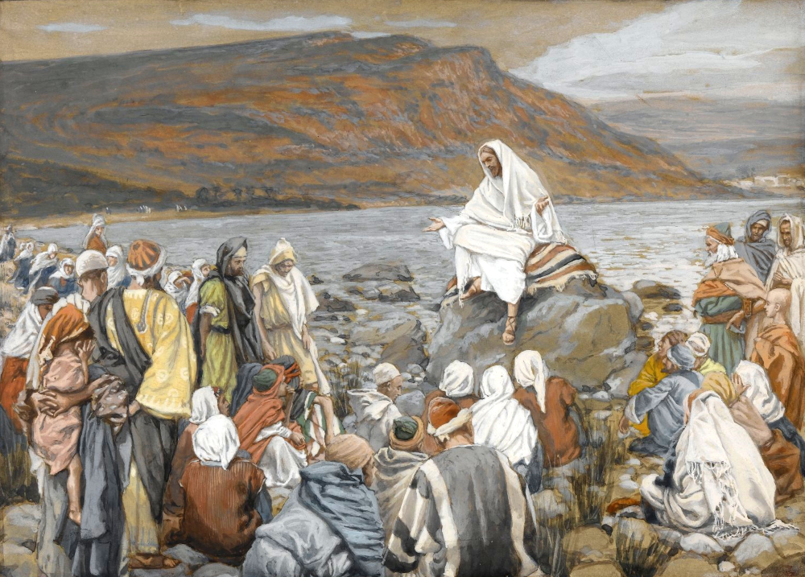
Once while the crowd was pressing upon Him . . . , He was standing by the Lake of Gennesaret
Jesus Teaches the People by the Sea, by James Tissot, circa 1891
5:1
Notes:
This image is in the public domain, via the Brooklyn Museum: https://www.brooklynmuseum.org/opencollection/objects/4484.
bm4484

Slide 10
Seven Strange Things In Luke 5
1. An Unlettered Man Teaching
Here is a glimpse of the astounding effect the words and works of Jesus had already produced. The religious hierarchy were by this time fully aware of the challenge of Jesus’ life and teaching.
Their hostility made itself evident at every opportunity. Nevertheless, the mighty works of Jesus continued unstopped.

Slide 11
Seven Strange Things In Luke 5
1. An Unlettered Man Teaching
(Matt. 13:54). And when He had come to His own country, He taught them in their synagogue, so that they were astonished and said, "Where did this Man get this wisdom and these mighty works?
(John 7:15). And the Jews marveled, saying, "How does this Man know letters, having never studied?"
Here we have Him teaching in the presence of “doctors of the law.” Christ, who is the wisdom of God, said of Himself, “I am from above, you are from beneath.” A man may be “lettered” and “scholarly,” and yet blind to the wisdom that comes from above.

Slide 12
Seven Strange Things In Luke 5
2. A Sick Man let Down through a Roof
18 Then behold, men brought on a bed a man who was paralyzed, whom they sought to bring in and lay before Him.
19 And when they could not find how they might bring him in, because of the crowd, they went up on the housetop and let him down with his bed through the tiling into the midst before Jesus.

Slide 13
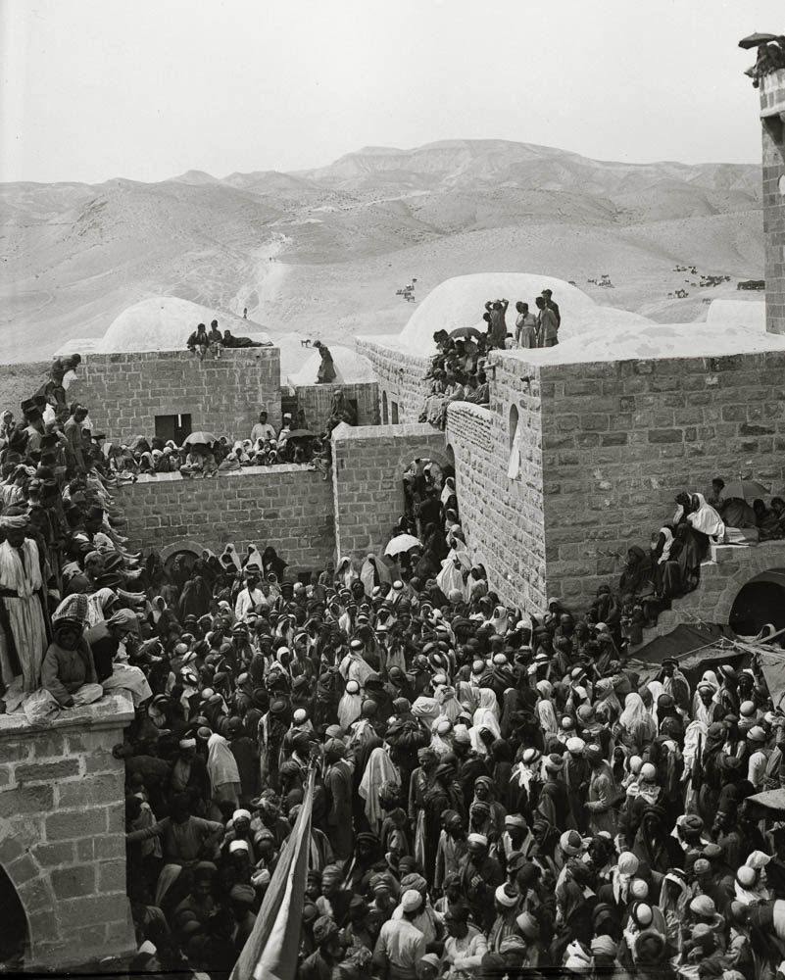
And not finding a way they might bring him in because of the crowds
Crowds gathered at Nebi Musa
5:19
Notes:
Nebi Musa is a traditional location of the burial of Moses, located in the Judean wilderness west of Jericho. The tradition cannot be accurate because Deuteronomy 34 makes it clear that Moses did not enter the land of promise but died on Mount Nebo, east of the Jordan River. This American Colony photograph was taken between 1900 and 1920 during a Muslim pilgrimage.
mat01032

Slide 14
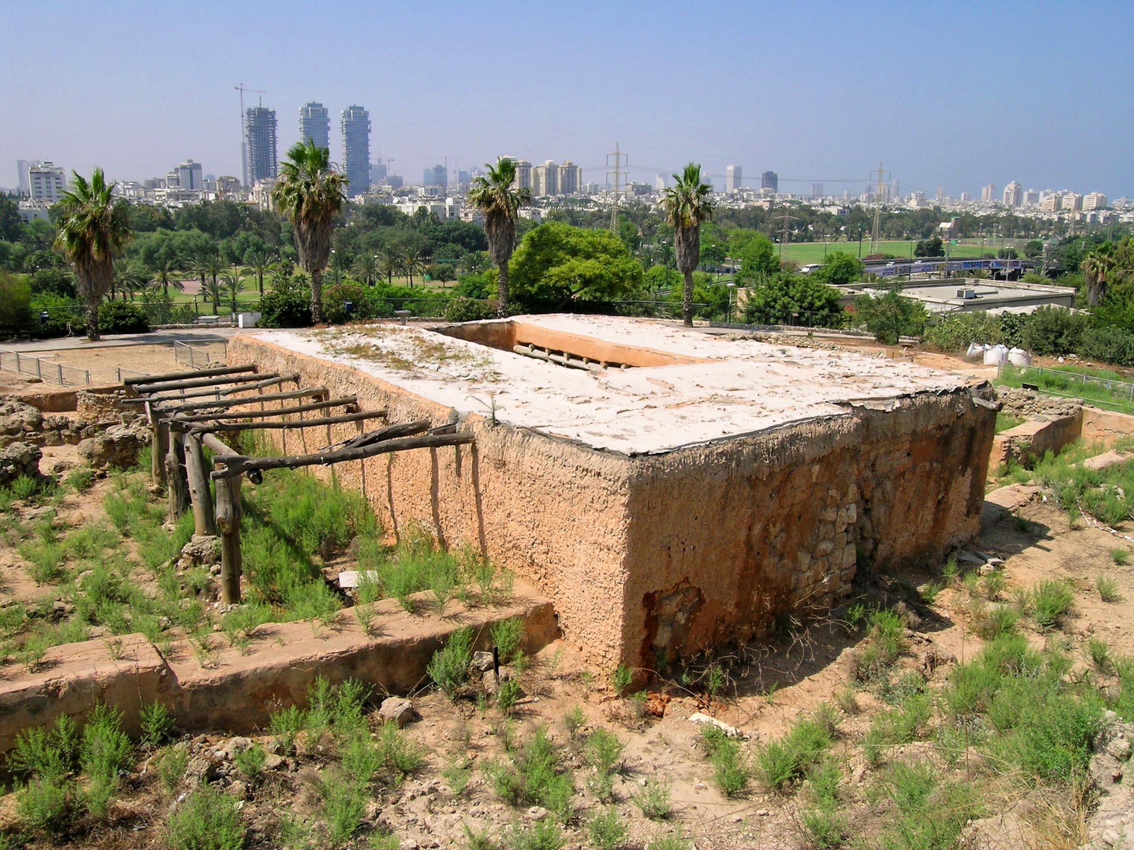
They went up on the roof and let him down through the tiles with his bed
Reconstructed four-room house at Tell Qasile
5:19
Notes:
This reconstruction shows a four-room house from the Iron Age (circa 1000 BC). While houses changed between then and the time of Jesus, the traditional building materials did not.
tb061804517

Slide 15
Seven Strange Things In Luke 5
2. A Sick Man let Down through a Roof
(v. 19) Those who really believe in Jesus will some way or other bring their burdens to His feet, as those four men brought the helpless paralytic.
Whatever burdens us should lead to the breaking up of everything that stands between us and Jesus. Such roof breaking will appear as needless to the indifferent.
If we have no burden of our own, let the need of others bring us into His presence.

Slide 16
Seven Strange Things In Luke 5
3. A Man Forgiving Sins.
20 When He saw their faith, He said to him, "Man, your sins are forgiven you."
Christ no doubt intended this to be a challenge of the religious doctors present in such large numbers.
Therefore, he announced the man’s pardon of all transgressions, no doubt foreseeing the objections that would come of it, and the eventual healing of the man’s body afterward.

Slide 17
Seven Strange Things In Luke 5
3. A Man Forgiving Sins.
What? A Man forgiving sins! “Who can forgive sins but God alone?” This is a strange thing. Had not Jehovah said, “I, even I, am He that blots out transgressions, and will not remember your sins?” (Isa. 43:25).
Who is this that forgives sins also?
The Man Christ Jesus forgiving sins is the crowning act of the matchless grace of God, and will be one of those “strange things” at which we shall marvel through all eternity.

Slide 18
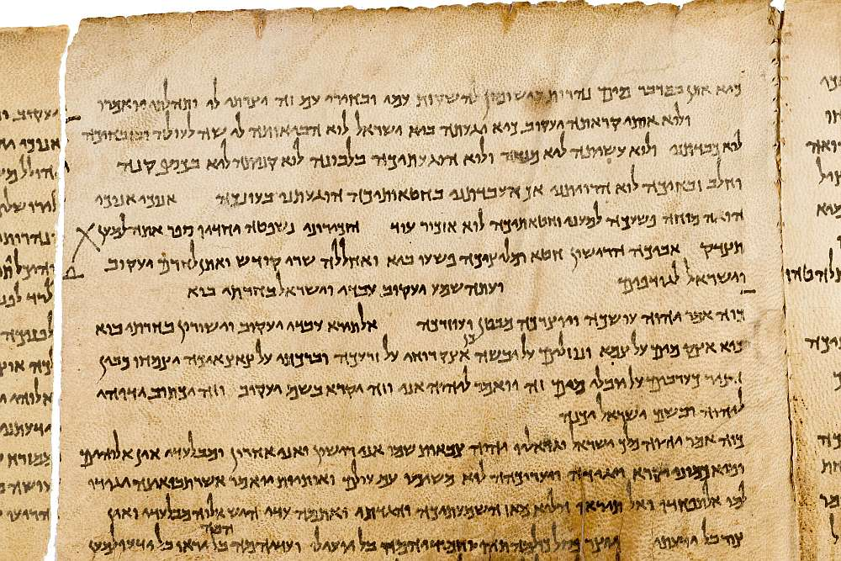
Who can forgive sins, but God alone?
The Lord’s declaration that He forgives sins, in Isaiah 43:25 on the Great Isaiah Scroll
5:21
Notes:
“I, even I, am he that blotteth out thy transgressions for mine own sake; and I will not remember thy sins” (Isa 43:25, ASV).
The Great Isaiah Scroll is owned by the Israel Museum. This image is public domain, from Wikimedia: https://commons.wikimedia.org/wiki/File:The_Great_Isaiah_Scroll_MS_A_(1QIsa)_-_Google_Art_Project-x1-y0.jpg
isax1y0

Slide 19
Seven Strange Things In Luke 5
1. An Unlettered Man Teaching
2. A Sick Man let Down through a Roof
3. A Man Forgiving Sins.

Slide 20
Seven Strange Things In Luke 5
4. A Man Receiving Forgiveness Through Faith.
20 When He saw their faith, He said to him, "Man, your sins are forgiven you."
But not by faith only - James 2:18 But someone will say, "You have faith, and I have works." Show me your faith without your works, and I will show you my faith by my works. 19 You believe that there is one God. You do well. Even the demons believe--and tremble! 20 But do you want to know, O foolish man, that faith without works is dead?

Slide 21
Seven Strange Things In Luke 5
4. A Man Receiving Forgiveness Through Faith.
“When He saw their faith He said” (v. 20). The faith of the four men who carried, as well as the faith of the anxious man lying sick on the couch.
To the self-righteous scribes and Pharisees a man receiving the forgiveness of all his sins by Jesus was a strange sight.
He saw their faith.
The eyes of Jesus are always quick to discern the trust of the heart, and His hand is equally quick to help.

Slide 22
Seven Strange Things In Luke 5
5. A Man who could Read their Thoughts.
20 When He saw their faith, He said to him, "Man, your sins are forgiven you."
21 And the scribes and the Pharisees began to reason, saying, "Who is this who speaks blasphemies? Who can forgive sins but God alone?"
22 But when Jesus perceived their thoughts, He answered and said to them, "Why are you reasoning in your hearts?

Slide 23
Seven Strange Things In Luke 5
5. A Man who could Read their Thoughts.
Luke 5:23 "Which is easier, to say, 'Your sins are forgiven you,' or to say, 'Rise up and walk'?
24 "But that you may know that the Son of Man has power on earth to forgive sins" --He said to the man who was paralyzed, "I say to you, arise, take up your bed, and go to your house."

Slide 24
Seven Strange Things In Luke 5
5. A Man who could Read their Thoughts.
(Heb. 4:13). And there is no creature hidden from His sight, but all things are naked and open to the eyes of Him to whom we must give account.
(Ezek. 11:5). Then the Spirit of the LORD fell upon me, and said to me, "Speak! 'Thus says the LORD: "Thus you have said, O house of Israel; for I know the things that come into your mind.

Slide 25
Seven Strange Things In Luke 5
1. An Unlettered Man Teaching
2. A Sick Man let Down through a Roof
3. A Man Forgiving Sins
4. A Man Receiving Forgiveness Through Faith
5. A Man who could Read their Thoughts

Slide 26
Seven Strange Things In Luke 5
6. A Man Perfectly Healed at Once.
23 "Which is easier, to say, 'Your sins are forgiven you,' or to say, 'Rise up and walk'?
24 "But that you may know that the Son of Man has power on earth to forgive sins" --He said to the man who was paralyzed, "I say to you, arise, take up your bed, and go to your house."
25 Immediately he rose up before them, took up what he had been lying on, and departed to his own house, glorifying God.

Slide 27
Seven Strange Things In Luke 5
6. A Man Perfectly Healed at Once.
“And immediately he rose up before them, and departed to his own house glorifying God” (v. 25).
This was another “strange thing” seen that day. This is not after the fashion of men, but it is very God-like. His work is perfect.
The work of healing and forgiving was done suddenly and completely. It was such a blessed work that he could rise up and go to his own house glorifying God. That man is well saved who can glorify God in his own house. Man’s chief end is to glorify God, but he cannot until he is healed and forgiven by our Lord Jesus Christ

Slide 28
Seven Strange Things In Luke 5
6. A Man Perfectly Healed at Once.
25 Immediately he rose up before them, took up what he had been lying on, and departed to his own house, glorifying God.
Glorifying God … The healed man was aware that only God could have worked such a wonder; and the same conclusion should have been made by Jesus’ enemies.

Slide 29
Seven Strange Things In Luke 5
7. Scribes and Pharisees Filled with Fear.
Luke 5:26 And they were all amazed, and they glorified God and were filled with fear, saying, "We have seen strange things today!"

Slide 30
Seven Strange Things In Luke 5
7. Scribes and Pharisees Filled with Fear.
A second time in this chapter, Jesus directed the most visible and convincing proof of his oneness with the Father toward the community of scribes and Pharisees, making every effort to enlist them as believers in his holy mission.
From John it is learned, however, that they had already rejected him and were merely stalking him with a view of putting him to death (John 5:18). That prior decision on their part was the true reason why they did not believe in this circumstance.

Slide 31
Seven Strange Things In Luke 5
7. Scribes and Pharisees Filled with Fear.
Luke 5:26 And they were all amazed, and they glorified God and were filled with fear, saying,
"We have seen strange things today!"

Slide 32
Seven Strange Things In Luke 5
1. An Unlettered Man Teaching
2. A Sick Man let Down through a Roof
3. A Man Forgiving Sins
4. A Man Receiving Forgiveness Through Faith
5. A Man who could Read their Thoughts
6. A Man Perfectly Healed at Once
7. Scribes and Pharisees Filled with Fear.

Slide 33
Are you a New Testament Christian?
Hear the Gospel (Rom.10:14)
Believe the Gospel (Heb. 11:6)
Repent of Sins (Acts 3:19)
Confess Christ (Rom.10:9)
Be Baptized Into Christ (1 Cor.12:13)
Serve our Lord the rest of our lives (Rev.2:10)
You Must Be Born Again. John 3:1-7

