Slide 1
Welcome to our services
New Lebanon Church of Christ
We are Simply Christians.
Our Emphasis is Spiritual, Not Material or Social.
We are striving to be The Same Church as Described in The New Testament.
Please Come Back Again

Slide 2
Provisions For Pilgrim People 1 Cor. 10:1-4
1Cor. 10:11 Now all these things happened to them as examples, and they were written for our admonition, upon whom the ends of the ages have come.

Slide 3
Please open your hearts, your ears, and your Bible and follow along.
If you have any questions about anything I say, if you disagree anything I say, please say something to me after the service and I will be glad to sit down with you and God’s word and study so that we can come to know His truth
Illustrated Bible verses by Ethical Media, Bible photos by bibleplaces.com

Slide 4
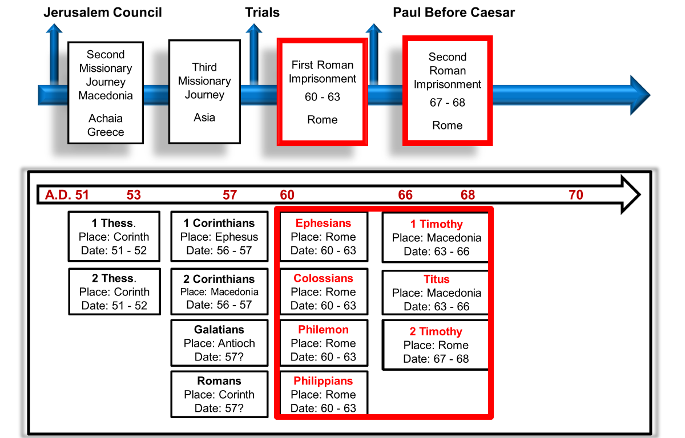
I Corinthians----- This is a letter written by Paul to the Corinthians. It deals with spirituality and morality and their lack of such. It speaks of the judgment seat of Christ, the temple of the Holy Spirit, the Lord’s Supper, Love, miraculous gifts and the resurrection.

Slide 5
Provisions For Pilgrim People 1 Cor. 10:1-4
1Cor. 10:1 Moreover, brethren, I do not want you to be unaware that all our fathers were under the cloud, all passed through the sea,
2 all were baptized into Moses in the cloud and in the sea,
3 all ate the same spiritual food,
4 and all drank the same spiritual drink. For they drank of that spiritual Rock that followed them, and that Rock was Christ.

Slide 6
Provisions For Pilgrim People 1 Cor. 10:1-4
1Cor. 10:6 Now these things became our examples, to the intent that we should not lust after evil things as they also lusted.
7 And do not become idolaters as were some of them. As it is written, "The people sat down to eat and drink, and rose up to play."
8 Nor let us commit sexual immorality, as some of them did, and in one day twenty-three thousand fell;
9 nor let us tempt Christ, as some of them also tempted, and were destroyed by serpents;
10 nor complain, as some of them also complained, and were destroyed by the destroyer.
11 Now all these things happened to them as examples, and they were written for our admonition, upon whom the ends of the ages have come.

Slide 7
Provisions For Pilgrim People 1 Cor. 10:1-4
Paul assures us twice (v. 6, 11) that these things happened unto them as types, or examples unto us, upon whom the ends of the ages are come.
We, like them, are pilgrims and strangers on the earth, enjoying great spiritual mercies.
They had the “shadows,” we have the realities.

Slide 8
Provisions For Pilgrim People 1 Cor. 10:1-4
1 Cor 10:1 For I would not, brethren, have you ignorant, that our fathers were all under the cloud, and all passed through the sea.
At the end of 1 Cor. 9, Paul had hinted that it was possible, even for himself, to be a “castaway,” after preaching to others, even Paul (who had as much “knowledge” and who knew all about Christian liberty) took the most precautions against sinning, and that such precautions required him to give up everything such as the indulgences of the Corinthians.

Slide 9
Provisions For Pilgrim People 1 Cor. 10:1-4
Apparently, some thought the Lord’s Supper and baptism had made them immune to any contamination from the idol feasts, especially in the light of their presumed “knowledge” that idols were actually nothing anyway.
Paul refuted this by reference to the allegorical nature of historic Israel, many of them, in fact most of them, being lost despite their covenant relationship to God.

Slide 10
Provisions For Pilgrim People 1 Cor. 10:1-4
I would not have you ignorant … was a favorite expression with Paul.
He used it in 1 Cor. 12:1; 2 Cor. 1:8; Rom. 1:13; 11:25, and in 1 Thess. 4:13, as well as here.
It is not likely that Paul thought his readers would have been ignorant of the history of Israel, but rather that they would not have been aware of the typical nature of that history… what the type represents

Slide 11
Provisions For Pilgrim People 1 Cor. 10:1-4
All under the cloud … all passed through the sea … The word “all,” repeated five times in these first four verses, emphasizes the fact that the entire Jewish people enjoyed the privilege of covenant relationship with God, being fed miraculously, and God’s chosen people.
Some Corinthians seem to have regarded the fact of their being baptized into Christ as some kind of blessing that made them immune from dangers, or in some way exempt from sin even while indulging themselves at idol feasts.
By the analogy of what happened historically to Israel, Paul would teach them that privilege does not mean immunity from sin and death.

Slide 12
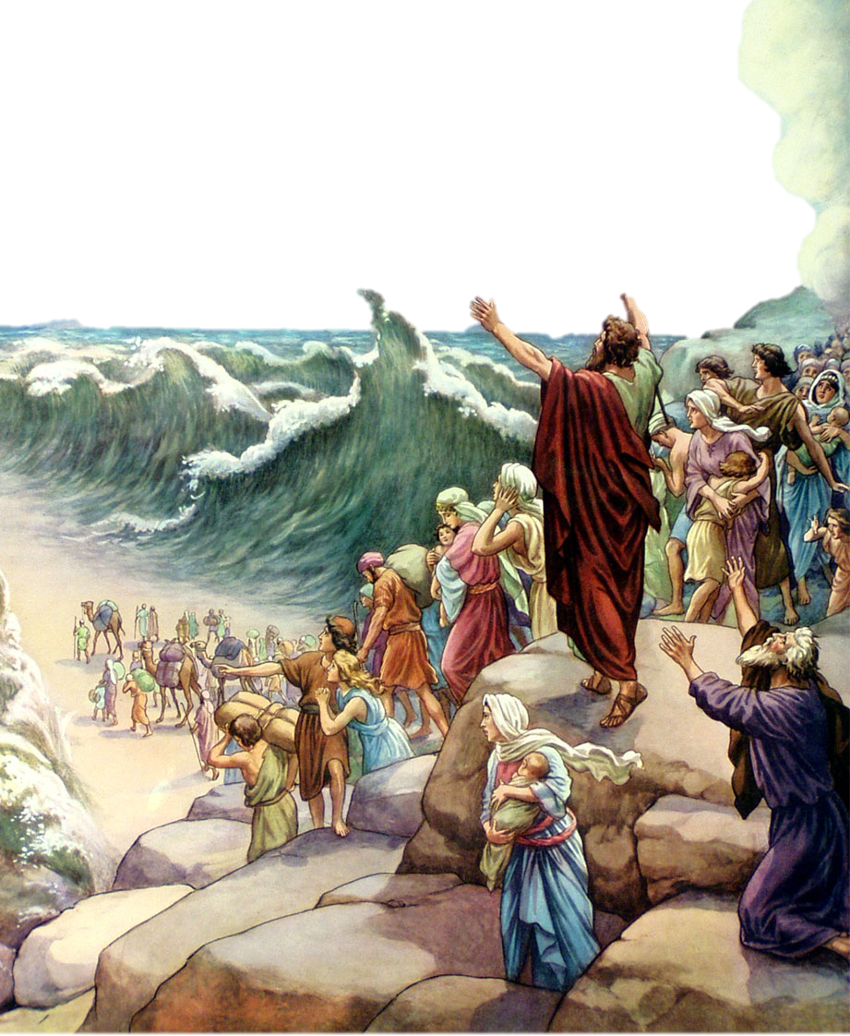
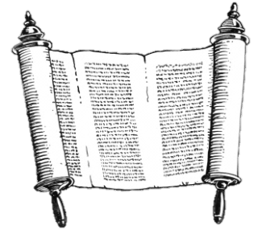
1 Corinthians
Chapter 10
1 Moreover, brethren, I would not that ye should be ignorant, how that all our fathers were under the cloud, and all passed through the sea;
2 And were all baptized unto Moses in the cloud and in the sea;

Slide 13
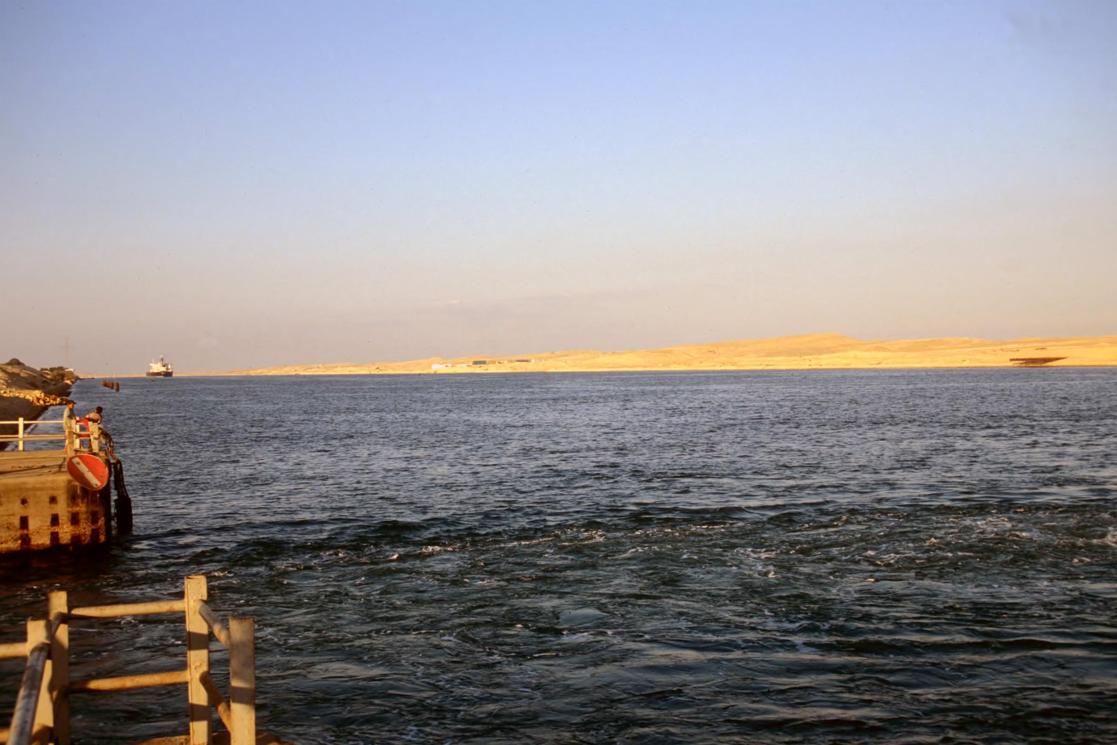
Our fathers were all under the cloud and all passed through the sea
the Red Sea (from the west)
10:1
Notes:
God’s deliverance of Israel from Egypt was, in many ways, the climax of salvation history in the Hebrew Scriptures. The event is referenced many times by those of later generations and continued to be even in the time of the New Testament. The exact location where the Israelites “passed through the sea” is uncertain. Some biblical scholars place it somewhere among the lakes that are not connected by the Suez Canal (e.g., Timsah Lake, the Great Bitter Lake, or the Little Bitter Lake).
tbs57319012

Slide 14
Provisions For Pilgrim People 1 Cor. 10:1-4
The Christians’ baptism is the antitype of Israel’s passage through the Red Sea;
The sacrificial feeding on Christ by faith is the antitype of Israel’s nourishment with manna and the water from the rock; Christ the living Rock is their guide through the wilderness;
The heavenly rest before Christians is the counterpart to the earthly Canaan which was the goal of the Israelites.
As the next verse indicates, there is also a reference to the Lord’s Supper in Paul’s analogy.
1 Cor 10:3 And did all eat the same spiritual food.

Slide 15
Provisions For Pilgrim People 1 Cor. 10:1-4
1 Cor 10:4 And did all drink the same spiritual drink: for they drank of a spiritual rock that followed them; and the rock was Christ.
… The rock to which Paul referred here was clearly stated: “The rock was Christ.” The miracle of Moses’ bringing forth water from the rock in the wilderness (Exo. 17:5) provided literal water for Israel; but much more than that is in evidence here.
NOTICE - “The rock was Christ, not ‘is’ or ‘is a type of’ … this is a clear statement of the pre-existence of Christ.”
One of the most beautiful titles of Christ in all the Bible is “Christ the Living Stone”

Slide 16
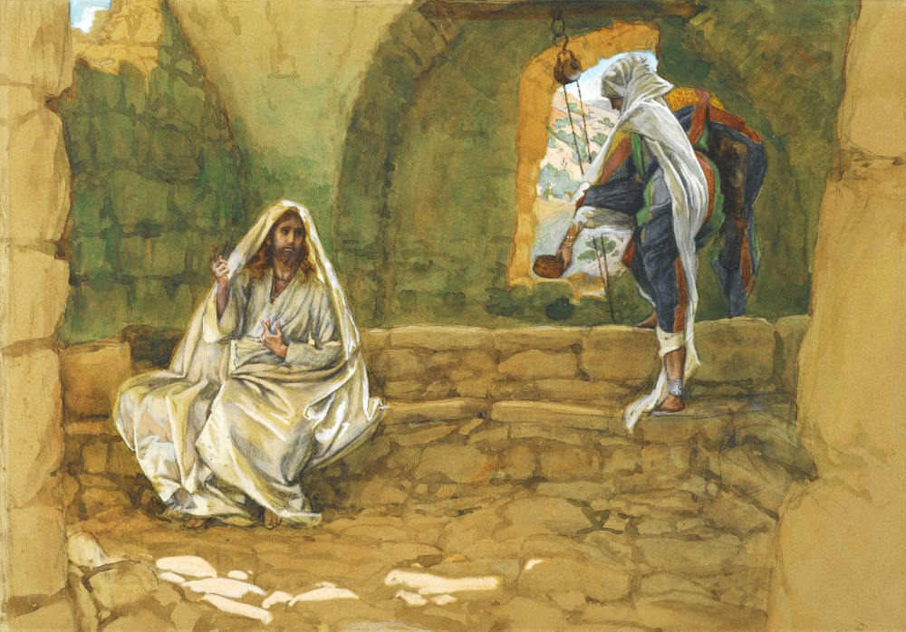
And they were drinking from a spiritual rock that followed them, which was Christ
The Woman of Samaria at the Well, by James Tissot, circa 1890
10:4
Notes:
Paul reflects the teaching of Jesus in this statement. In the well-known incident with the Samaritan woman at the well (John 4:1-42), pictured here, Jesus referred to Himself as the source of living water. “The water that I will give him will become in him a well of water springing up to eternal life” (John 4:14). This image is from the Brooklyn Museum and is in the public domain, via Wikimedia Commons: https://commons.wikimedia.org/wiki/File:Brooklyn_Museum_-_The_Woman_of_Samaria_at_the_Well_(La_Samaritaine_%C3%A0_la_fontaine)_-_James_Tissot_-_overall.jpg.
wiki0429201014080015969

Slide 17
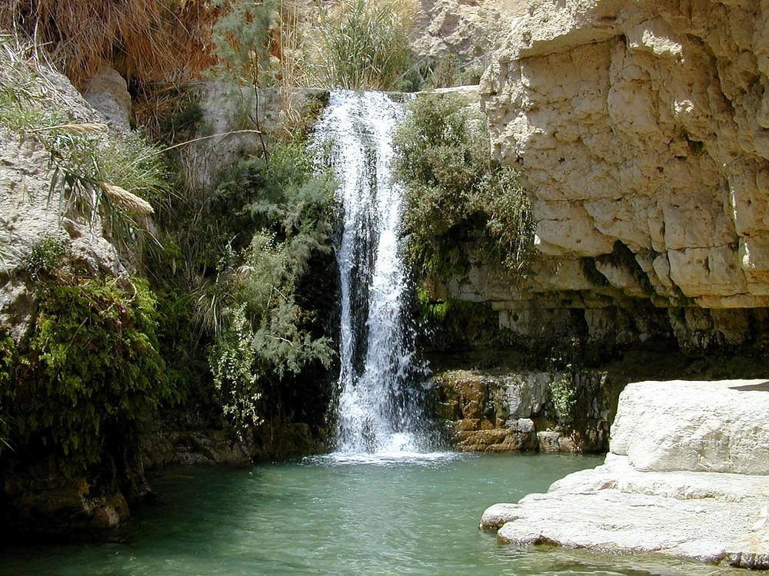
And they all drank the same spiritual drink
Waterfall in Nahal David, En Gedi
10:4
Notes:
tb040900229

Slide 18
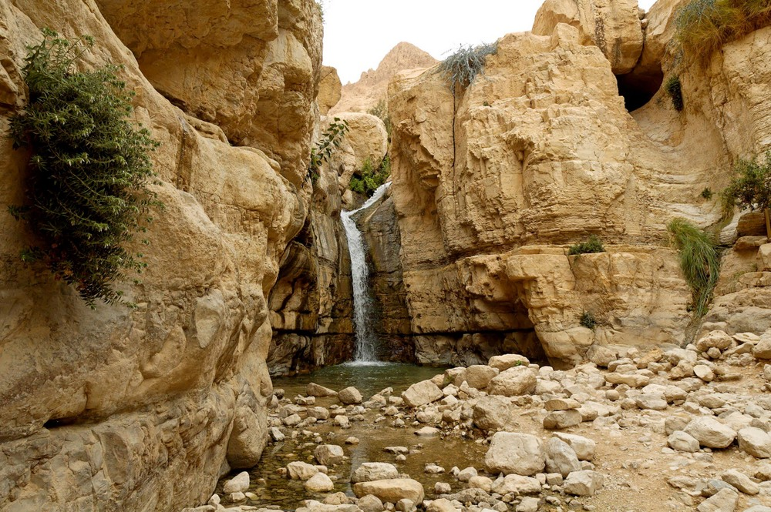
And they all drank the same spiritual drink
“Hidden Waterfall” in Nahal Arugot, En Gedi
10:4
Notes:
For most of the time that the Israelites were in the wilderness, they drank water from a stream that miraculously emerged from a dry rock (Exod 17:1-7).
tb021906285

Slide 19
Provisions For Pilgrim People 1 Cor. 10:1-4
1 The Lord's our rock, in Him we hide, A shelter in the time of storm; Secure whatever ill betide, A shelter in the time of storm. Mighty Rock in a weary land, Cooling shade on the burning sand, Faithful guide for the pilgrim band- A shelter in the time of storm.
2 A shade by day, defense by night, A shelter in the time of storm; No fears alarm, no fears affright, A shelter in the time of storm. Mighty Rock in a weary land, Cooling shade on the burning sand, Faithful guide for the pilgrim band- A shelter in the time of storm.

Slide 20
Provisions For Pilgrim People 1 Cor. 10:1-4
3 The raging storms may round us beat, A shelter in the time of storm; We'll never leave our safe retreat, A shelter in the time of storm. Mighty Rock in a weary land, Cooling shade on the burning sand, Faithful guide for the pilgrim band- A shelter in the time of storm.
4 O Rock divine, O Refuge dear, A shelter in the time of storm; Be Thou our helper ever near, A shelter in the time of storm. Mighty Rock in a weary land, Cooling shade on the burning sand, Faithful guide for the pilgrim band- A shelter in the time of storm.
Vernon J. Charlesworth

Slide 21
Provisions For Pilgrim People 1 Cor. 10:1-4
The Analogy Of Israel
So in these first four verses, the outlines of the allegory of fleshly Israel are laid down;
“The story of the Israelites and their journey from Egypt into Canaan is a type of our journey from the Egypt of sin into the everlasting Canaan.”
Egypt is a type of sin and bondage.
God’s sending Moses to deliver them is a type of God’s sending Christ to deliver us from the slavery of sin.

Slide 22
Provisions For Pilgrim People 1 Cor. 10:1-4
The Analogy Of Israel
Pharaoh is a type of the devil.
The compromises he offered Moses are like the compromises that Satan still suggests to Christians.
Moses is the type of Christ
Israel’s crossing the Red Sea is typical of baptism.
Their spiritual food is typical of the Lord’s Supper.

Slide 23
Provisions For Pilgrim People 1 Cor. 10:1-4
Israel’s entering the wilderness is typical of the Christian’s entering the church.
The wilderness is a type of the church.
That Israel sinned is typical of the sins and rebellions of Christians.
The majority of them failed to enter Canaan; and this is typical of “the many” Christians who will not enter heaven.

Slide 24
Provisions For Pilgrim People 1 Cor. 10:1-4
Canaan is a type of heaven.
Some of Israel entering Canaan is typical of the final victory of victory of Christians who shall enter into the joy of the Lord.
That some of them “fell” is typical of Christians who fall away and are lost.
God’s providential care of Israel in the wilderness is typical of his providential care of Christians till “the end of the world.”

Slide 25
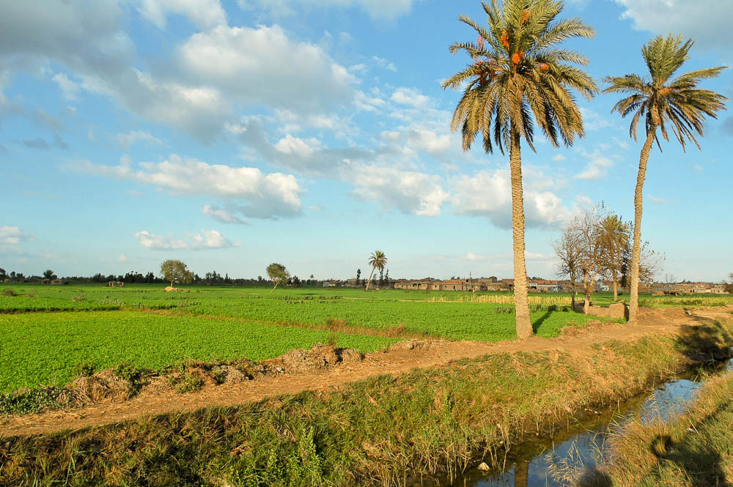
These things were examples for us, so that we would not crave bad things, as they did
Fields in the Nile Delta near Tanis, Egypt
10:6
Notes:
The delta region of Egypt, from which the Israelites had fled, was fertile and well watered by the annual inundation of the Nile. The Israelites longed for this land and the things that it produced.
tb010605711

Slide 26
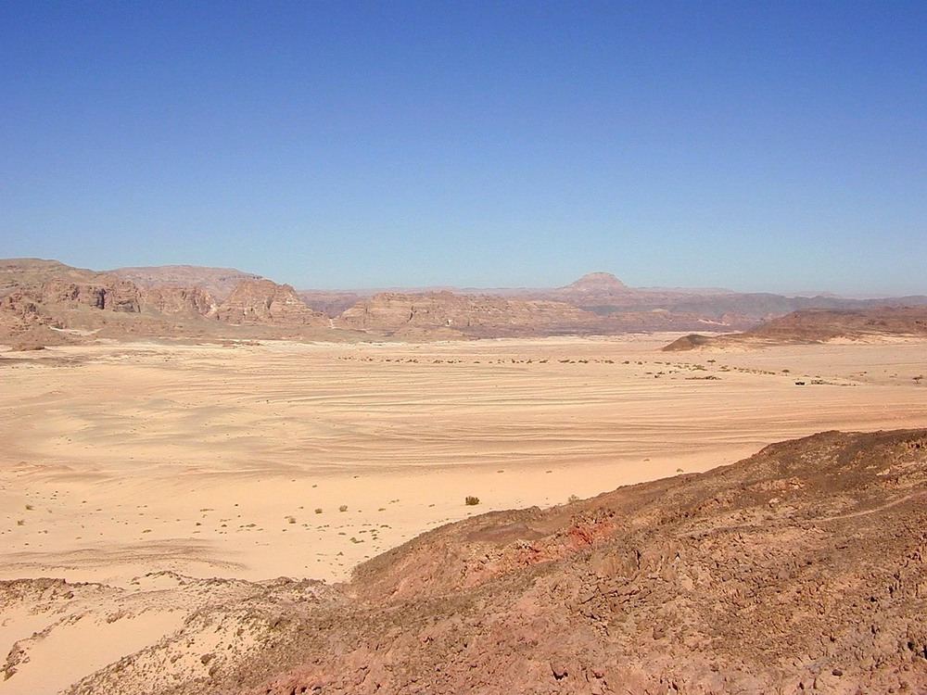
These things were examples for us, so that we would not crave bad things, as they did
Wilderness near Hazeroth (Ein Hudra) in the Sinai Peninsula
10:6
Notes:
The main events of Numbers 11 occurred at a place called Kibroth-hattaavah. The Israelites then journeyed from Kibroth-hattaavah to Hazeroth (Num 11:35). The desert region near Hazeroth (Ein Hudra) is pictured here, illustrating the contrast between the desert and the lushness of Egypt.
tb030300479

Slide 27
Provisions For Pilgrim People 1 Cor. 10:1-4
The fact of Israel’s being “baptized” and having the Lord’s Supper (in the analogy) did not make them immune to sin and death, as Paul was teaching here. The same is true of Christians now.
Canaan was entered when Israel crossed Jordan, making Jordan a type of death, beyond which Christians enter heaven.
The dangers which beset Israel in the wilderness are typical of the dangers confronting Christians. They were tempted to commit fornication, even as the Corinthians were being tempted, and by the same means, through the lustful celebrations of idol worship.

Slide 28
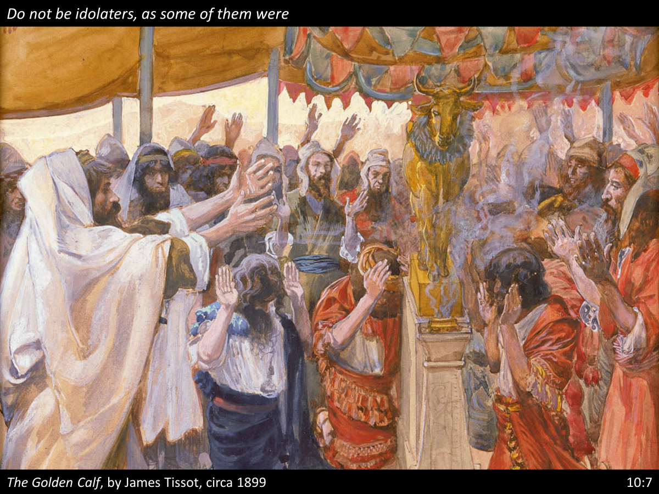
Provisions For Pilgrim People 1 Cor. 10:1-4
1Peter 2:11 Beloved, I beg you as sojourners and pilgrims, abstain from fleshly lusts which war against the soul,

Slide 29
Provisions For Pilgrim People 1 Cor. 10:1-4
I. The Moving Cloud. “All our fathers were under the cloud” (v. 1). The cloud of shelter by day, and of fire by night as their protection and guide (Exod. 13:21). The cloud was the symbol and evidence of the Divine Presence. When it moved they moved. It seemed to move easily, but nothing on earth outside could move it.
What a suggestive emblem of the revealed Word of God! They all were under it, and God was in it, and all were baptized into the one name (Moses), their leader and law-giver (v. 2).

Slide 30
Provisions For Pilgrim People 1 Cor. 10:1-4
They were led by the God-created cloud, just as we can be by His unerring Word. To move without the cloud was to go in their own name, wisdom, and strength, which would mean for them confusion and failure. This is what it means for us when we choose our way, and act without His authority.
It is because we have believed and acted on the “Word of the Lord” that we have passed from death into life, from the place of bondage into the liberty of the land of the promises.
Keep on believing. Keep your eye on the God-inspired cloud.

Slide 31
Provisions For Pilgrim People 1 Cor. 10:1-4
2. The Daily Manna.
“They did all eat the same spiritual meat” (v. 3). “He gave them bread from Heaven to eat” (John 6:31). Those who follow the Word of God will surely be fed by the “Bread of God.”
Jesus said: “I am the Living Bread which came down from Heaven” (John 6:48–51). The manna, then, is typical of Jesus Christ, who came down from Heaven as “the Bread of Life.”
The manna was like Christ in that

Slide 32
Provisions For Pilgrim People 1 Cor. 10:1-4
a. It was the Gift of God.
Of course all bread is God’s gift, whether it comes out of the earth or out of the Heavens; but the wilderness could do nothing by way of producing it.
So Christ was God’s gift to a starving world (John 3:16).
God knew what the hungry heart of man needed when He gave His Son as “the Bread of Life.”

Slide 33
Provisions For Pilgrim People 1 Cor. 10:1-4
b. It was Suited for All.
All alike found it what it pretended to be: something to satisfy the craving of hunger.
What Christ has to give is just what all the sons of men need, that which exactly suits them, the forgiveness of sins and grace to help in every time of need. Satisfied with His abundance.

Slide 34
Provisions For Pilgrim People 1 Cor. 10:1-4
c. It was Offered to All.
From the youngest to the oldest, without money, without price. The rich and the poor alike needed it. In this offer of Heaven’s bread, God is no respecter of persons, for all have sinned.
So Christ as the “Living Bread” from Heaven is offered, in God’s grace, to any man who will eat this bread (John 6:51), promising that he that eats shall live for ever.

Slide 35
Provisions For Pilgrim People 1 Cor. 10:1-4
d. It was Personally Used.
“They did all eat the same spiritual meat.” To be personally profited there must be a personal appropriation.
We may possibly gather much knowledge about Christ, and yet receive little strength and satisfaction from it, if the truth is not assimilated in our own spiritual life.

Slide 36
Provisions For Pilgrim People 1 Cor. 10:1-4
3. The Rock that Followed Them. “They drank of that Spiritual Rock that followed them, and that Rock was Christ” (v. 4).
a. Like Christ, this Rock was Revealed by God. It may only have taken God a few moments to show Moses this rock in Horeb, but it took God over 30 years to show the Rock, Christ; for all the years of His earthly life was an unveiling of His character as the Chosen One. “This is My beloved Son, in whom I am well pleased.”

Slide 37
Provisions For Pilgrim People 1 Cor. 10:1-4
b. Like Christ, this Rock was Divinely Possessed.
‘Behold I will stand before thee there upon the rock in Horeb” (Exod. 17:6).
At Christ’s baptism the Holy Spirit rested upon Him.
There was to be no mistaking Him as the God-appointed medium of blessing to His trusting people.
“God was in Christ seeking to reconcile a wandering world to Himself” (2 Cor. 5:19).

Slide 38
Provisions For Pilgrim People 1 Cor. 10:1-4
c. Like Christ, this Rock was Rich in Unrealized Blessing.
The Israelites might say, “How can any good come out of this rock?” as they said of Christ, “Can any good come out of Nazareth?” or, “How can this Man save us?” but it pleased God that in Him should all fulness dwell (Col. 1:19).
But they could say later on: “Of His fulness have all we received” (John 1:16).

Slide 39
Provisions For Pilgrim People 1 Cor. 10:1-4
d. Like Christ, this Rock must be Smitten.
“Thou shalt smite the rock, and there shall come water out of it, that the people may drink” (Exod. 17:6).
The rock was not smitten for itself, but for the salvation of the people.
He was wounded for our transgressions, the rod of God’s judgment fell upon Him, and by His stripes we are healed (Isa. 53).

Slide 40
Provisions For Pilgrim People 1 Cor. 10:1-4
e. Like Christ, the Smitten Rock Poured Forth its Hidden Treasures.
“He clave the rock, and gave them drink as out of the great depths” (Psa. 78:15).
- That from His smitten Son there should come forth streams of redeeming mercies, out of the great depths of God’s eternal purpose.
In that day in which Christ was pierced, there was opened a fountain of cleansing for a sinful world. “Ho, every one that thirsteth, come ye to the waters” (Isa. 55:1).

Slide 41
Provisions For Pilgrim People 1 Cor. 10:1-4
f. Like Christ, this Spiritual Rock followed Them.
They drank of that Spiritual Rock that followed them: and that Rock was Christ” (v. 4). This water from the Rock was to them an abiding blessing. It followed them. Something to satisfy all the way. Jesus said “The water that I shall give him shall be in him a well, springing up into everlasting life” (John 4:14). And, “Lo, I am with you, and will never leave you nor forsake you.”
He is our Rock, the Rock of our eternal salvation and eternal supply.

Slide 42
Provisions For Pilgrim People 1 Cor. 10:1-4
God provided for the Israelites,
He will provide for us today.
1. The Moving Cloud. (Word)
2. The Daily Manna.
3. The Rock that Followed Them.
Rock was revealed by God
Rock was divinely possessed
Rock rich in blessings
Rock was smitten
Smitten Rock poured out blessings

Slide 43
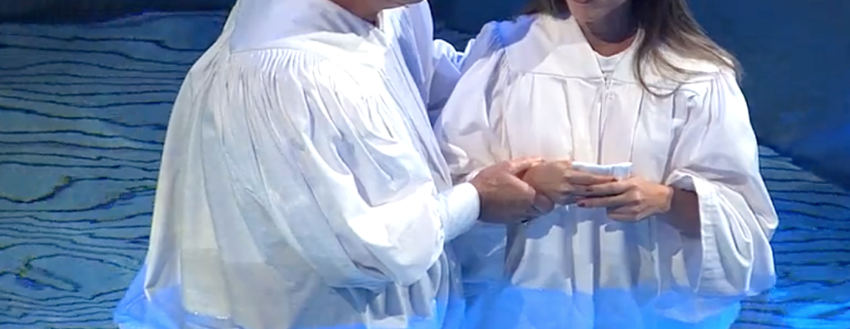
Are you a New Testament Christian?
Hear the Gospel (Rom.10:14)
Believe the Gospel (Heb. 11:6)
Repent of Sins (Acts 3:19)
Confess Christ (Rom.10:9)
Serve our Lord the rest of our lives (Rev.2:10)

