Slide 1
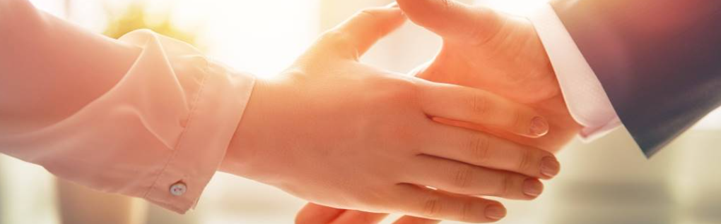
Welcome to our services
New Lebanon Church of Christ
We are Simply Christians.
Our Emphasis is Spiritual, Not Material or Social.
We are striving to be The Same Church as Described in The New Testament.
Please Come Back Again

Slide 2
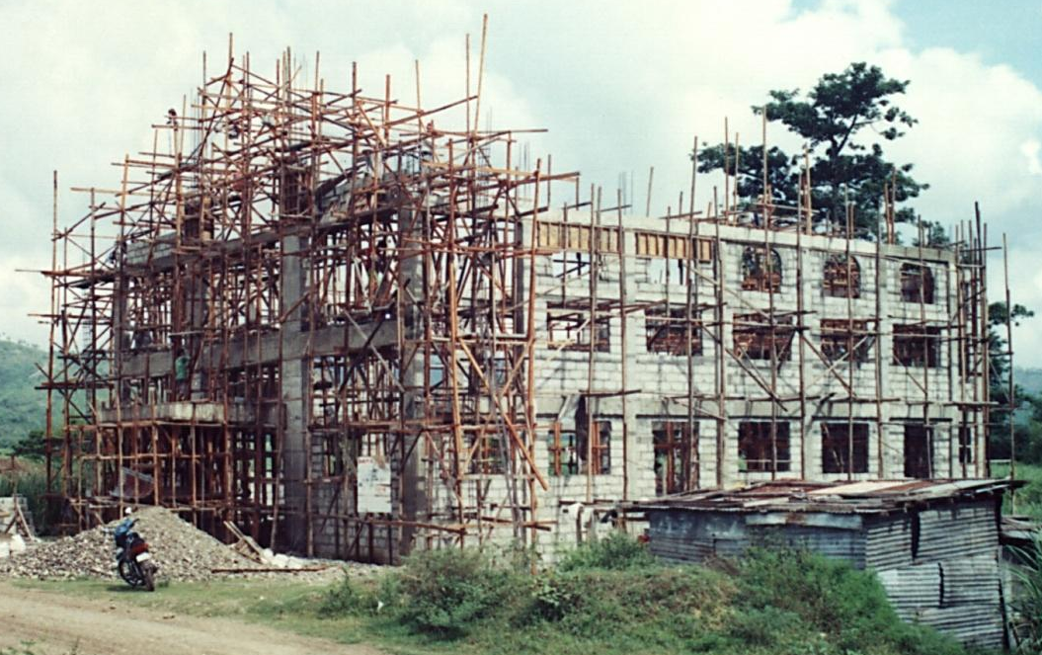
Our Life’s Work Tested. 1Cor.3
Title
1Cor. 3:9 For we are God's fellow workers; you are God's field, you are God's building.
b hastings newlebanoncoc.com

Slide 3
Our Life’s Work Tested. 1Cor.3:10-20
Title
1Cor. 3:1 And I, brethren, could not speak to you as to spiritual people but as to carnal, as to babes in Christ.
2 I fed you with milk and not with solid food; for until now you were not able to receive it, and even now you are still not able;
3 for you are still carnal. For where there are envy, strife, and divisions among you, are you not carnal and behaving like mere men?
4 For when one says, "I am of Paul," and another, "I am of Apollos," are you not carnal?
5 Who then is Paul, and who is Apollos, but ministers through whom you believed, as the Lord gave to each one?
b hastings newlebanoncoc.com

Slide 4
Our Life’s Work Tested. 1Cor.3:10-20
Title
1Cor 3:6 I planted, Apollos watered, but God gave the increase. 7 So then neither he who plants is anything, nor he who waters, but God who gives the increase.
8 Now he who plants and he who waters are one, and each one will receive his own reward according to his own labor. 9 For we are God's fellow workers; you are God's field, you are God's building.
10 According to the grace of God which was given to me, as a wise master builder I have laid the foundation, and another builds on it. But let each one take heed how he builds on it.
b hastings newlebanoncoc.com

Slide 5
Our Life’s Work Tested. 1Cor.3:10-20
1Cor. 3:11 For no other foundation can anyone lay than that which is laid, which is Jesus Christ.
12 Now if anyone builds on this foundation with gold, silver, precious stones, wood, hay, straw,
13 each one's work will become clear; for the Day will declare it, because it will be revealed by fire; and the fire will test each one's work, of what sort it is.
14 If anyone's work which he has built on it endures, he will receive a reward.
15 If anyone's work is burned, he will suffer loss; but he himself will be saved, yet so as through fire.
b hastings newlebanoncoc.com

Slide 6
Our Life’s Work Tested. 1Cor.3:10-20
Title
(There is only one foundation on which the church of Christ can be laid. Paul laid that foundation when he preached in Corinth that Jesus is the Christ.
When Peter confessed his faith in Jesus, saying: “Thou art the Christ, the Son of the living God,” Jesus said unto him: “Upon this rock I will build my church; and the gates of Hades shall not prevail against it” (Matt.16:16-18).
There is controversy as to what constitutes the rock on which Christ would build his church; but Paul says that Christ is the only foundation that can be laid.)
b hastings newlebanoncoc.com

Slide 7
Our Life’s Work Tested. 1Cor.3:10-20
Title
1Cor. 3:16 Do you not know that you are the temple of God and that the Spirit of God dwells in you?
17 If anyone defiles the temple of God, God will destroy him. For the temple of God is holy, which temple you are.
b hastings newlebanoncoc.com

Slide 8
Our Life’s Work Tested. 1Cor.3:10-20
Title
1Cor. 3:18 Let no one deceive himself. If anyone among you seems to be wise in this age, let him become a fool that he may become wise.
19 For the wisdom of this world is foolishness with God. For it is written, "He catches the wise in their own craftiness";
20 and again, "The LORD knows the thoughts of the wise, that they are futile."
21 Therefore let no one boast in men. For all things are yours:
22 whether Paul or Apollos or Cephas, or the world or life or death, or things present or things to come--all are yours.
23 And you are Christ's, and Christ is God's.
b hastings newlebanoncoc.com

Slide 9
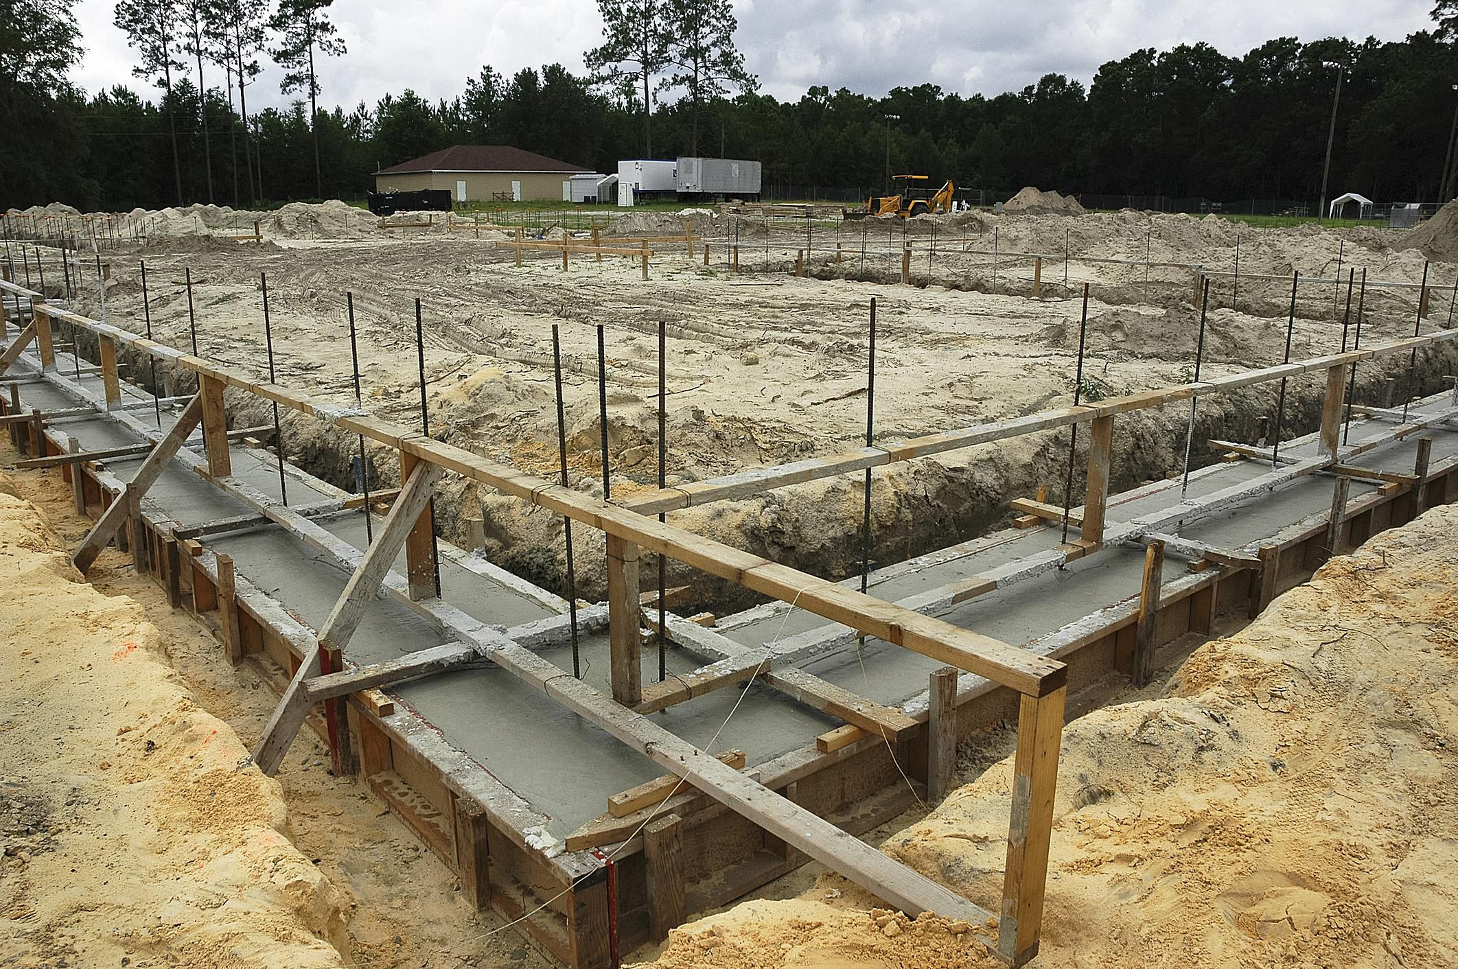

Slide 10
Our Life’s Work Tested. 1Cor.3
Title
Paul, as a master builder, is here dealing with some fundamental facts concerning the Christian’s life and work.
A foundation … The foundation which Paul laid at Corinth is Jesus Christ (1 Cor. 3:11),
The words ANOTHER and EACH MAN are too indefinite to apply to Apollos, having rather an application to all who labor in God’s building.
b hastings newlebanoncoc.com

Slide 11

Our Life’s Work Tested. 1Cor.3
Paul’s consistent teaching is that the church of Christ is “an holy temple in the Lord” (Eph. 2:21-22), and it is made up of Christians in whose hearts God seeks to make his dwelling place 1 Corinthians 6:16-18. The Greek word for “defile” is
which Thayer’s lexicon defines as
to lead away the church “from that state of knowledge and holiness in which it ought to abide” and “in an ethical sense, to corrupt deprave.”
Paul will build upon this point in chapters 5 and 6.
(6:8-11 catalog of sins)
GERMANY
b hastings newlebanoncoc.com

Slide 12
Our Life’s Work Tested. 1Cor.3
Title
No man may begin anywhere else. “This is important today when so many build their ‘Christianity’ without Christ, on a foundation of good works, humanism or emotionalism.
Of course, this is not the only metaphor of Christ’s preeminence in his kingdom.
He is also called the door of the sheepfold (John 10:7), the chief corner stone (Eph. 2:20),
the head of the body (Eph. 1:22, 23),
^{etc.}
b hastings newlebanoncoc.com

Slide 13
Our Life’s Work Tested. 1Cor.3
Paul is speaking of the church, consisting of the believers of all nations, of which church Christ is the foundation, it is evident that the materials built on this foundation (gold, silver, etc.) cannot represent the doctrines, but the disciples of Christ …
In no passage of scripture is the temple or church of God said to consist of doctrines, but of the disciples of Christ, who are called living stones built up of a spiritual house or temple (1 Pet. 2:5, 6)
b hastings newlebanoncoc.com

Slide 14
Our Life’s Work Tested. 1Cor.3
The church should be built of true Christians, the proper material; and not of worldly-minded hypocrites, or of those who place the teachings of God as on a par with the philosophies of men.
The day of judgment will reveal the true character of all who are in the church.
1 Cor 3:13 Each man’s work shall be made manifest: for the day shall declare it, because it is revealed in fire; and the fire itself shall prove each man’s work of what sort it is.
b hastings newlebanoncoc.com

Slide 15
Our Life’s Work Tested. 1Cor.3:10-20
THE DAY is clearly the day when Christ returns, the day of judgment.”
Only the judgment day will reveal what is and what is not a part of the true temple of God; and, according to Christ himself it will be a time of many surprises (Matt. 7:15–23; 25:34–46).
b hastings newlebanoncoc.com

Slide 16
Our Life’s Work Tested. 1Cor.3:10-20
Matt. 7:15–23 "Beware of false prophets, who come to you in sheep's clothing, but inwardly they are ravenous wolves. 16 "You will know them by their fruits. Do men gather grapes from thornbushes or figs from thistles?
17 "Even so, every good tree bears good fruit, but a bad tree bears bad fruit.18 "A good tree cannot bear bad fruit, nor can a bad tree bear good fruit. 19 "Every tree that does not bear good fruit is cut down and thrown into the fire.
20 "Therefore by their fruits you will know them. 21 "Not everyone who says to Me, 'Lord, Lord,' shall enter the kingdom of heaven, but he who does the will of My Father in heaven. 22 "Many will say to Me in that day, 'Lord, Lord, have we not prophesied in Your name, cast out demons in Your name, and done many wonders in Your name?'
23 "And then I will declare to them, 'I never knew you; depart from Me, you who practice lawlessness!'
b hastings newlebanoncoc.com

Slide 17
Our Life’s Work Tested. 1Cor.3:10-20
Matt.25:34–46
"Then the King will say to those on His right hand, 'Come, you blessed of My Father, inherit the kingdom prepared for you from the foundation of the world:
35 'for I was hungry and you gave Me food; I was thirsty and you gave Me drink; I was a stranger and you took Me in;
36 'I was naked and you clothed Me; I was sick and you visited Me; I was in prison and you came to Me.'
37 "Then the righteous will answer Him, saying, 'Lord, when did we see You hungry and feed You, or thirsty and give You drink?
38 'When did we see You a stranger and take You in, or naked and clothe You?
39 'Or when did we see You sick, or in prison, and come to You?'
40 "And the King will answer and say to them, 'Assuredly, I say to you, inasmuch as you did it to one of the least of these My brethren, you did it to Me.'
41 "Then He will also say to those on the left hand, 'Depart from Me, you cursed, into the everlasting fire prepared for the devil and his angels:
42 'for I was hungry and you gave Me no food; I was thirsty and you gave Me no drink;
43 'I was a stranger and you did not take Me in, naked and you did not clothe Me, sick and in prison and you did not visit Me.'
44 "Then they also will answer Him, saying, 'Lord, when did we see You hungry or thirsty or a stranger or naked or sick or in prison, and did not minister to You?'
45 "Then He will answer them, saying, 'Assuredly, I say to you, inasmuch as you did not do it to one of the least of these, you did not do it to Me.'
46 "And these will go away into everlasting punishment, but the righteous into eternal life."
b hastings newlebanoncoc.com

Slide 18
Our Life’s Work Tested. 1Cor.3
1
The Church The Temple Of God
Of all the beautiful metaphors of God’s church such as the bride of Christ, the vineyard of the Lord, the household of God, the pillar and ground of the truth, the spiritual body of Christ, and the flock of Christ, none is more beautiful or intriguing than “The Temple of God.”
b hastings newlebanoncoc.com

Slide 19
Our Life’s Work Tested. 1Cor.3
I. A Foundation has been Laid.
“Upon this Rock (Christ) I will build My Church, and the gates of Hell shall not prevail against it” (Matt. 16:18).
2Tim 2:19 Nevertheless the solid foundation of God stands, having this seal: "The Lord knows those who are His," and, "Let everyone who names the name of Christ depart from iniquity."
Since God the Father has purposed to build His Church and His Kingdom on that Rock, which is Christ, let us have the faith of God, and build our all on Him.
b hastings newlebanoncoc.com

Slide 20
Our Life’s Work Tested. 1Cor.3
1. A Foundation has been Laid.
“Other foundation can no man lay than that is laid, which is Jesus Christ” (v. 11). A foundation was needed, first, by God Himself, in which to build the structure of His redeemed Church; second, by man, on which to build his hopes for this life and the life to come.
This foundation has been well and truly laid by the hand of infinite wisdom.
Laid as deep as the grave, and as stable as the Eternal Throne.
b hastings newlebanoncoc.com

Slide 22
Our Life’s Work Tested. 1Cor.3
2. A Structure is Being Raised.
“If any man build upon this foundation, gold, silver, precious stones,” etc. (v. 2). Here are 2 different classes of builders—
1. The Wise Builder. Who builds “gold, silver, and precious stones.” He puts in this foundation that which is consistent with its precious character (Rev. 21:19).
The foundations of the wall of the city were adorned with all kinds of precious stones: the first foundation was jasper, the second sapphire, the third chalcedony, the fourth emerald,
b hastings newlebanoncoc.com

Slide 23


Slide 24
Our Life’s Work Tested. 1Cor.3
2. A Structure is Being Raised.
1. The Wise Builder. Who builds “gold, silver, and precious stones.” He puts in, he is careful about the things he teaches in God’s Name are in harmony with His Word.
He is careful also about his manner of life. In 2 Peter 1:5–7 there is laid down before us a whole load of suitable material for a wise builder.
2Pet. 1:5 But also for this very reason, giving all diligence, add to your faith virtue, to virtue knowledge, 6 to knowledge self-control, to self-control perseverance, to perseverance godliness, 7 to godliness brotherly kindness, and to brotherly kindness love.
b hastings newlebanoncoc.com

Slide 25
Our Life’s Work Tested. 1Cor.3:10-20
2. A Structure is Being Raised.
Title
2. The Foolish Builder. He uses “wood, hay, and stubble, or timber, hay and straw.” The foolish builder is wise in his own conceit. He thinks that as long as you believe in the foundation it matters little what you build upon it, and so false teaching becomes easy, and the vain philosophies of the proud in heart become attractive.
He is careless and indifferent in practice, his faith in Christ has brought no change in his life and outlook. He still believes in building with “wood, hay, and stubble.”
These are “after the tradition of men and not after Christ” (Col. 2:8). Beware lest anyone cheat you through philosophy and empty deceit, according to the tradition of men, according to the basic principles of the world, and not according to Christ.
b hastings newlebanoncoc.com

Slide 26
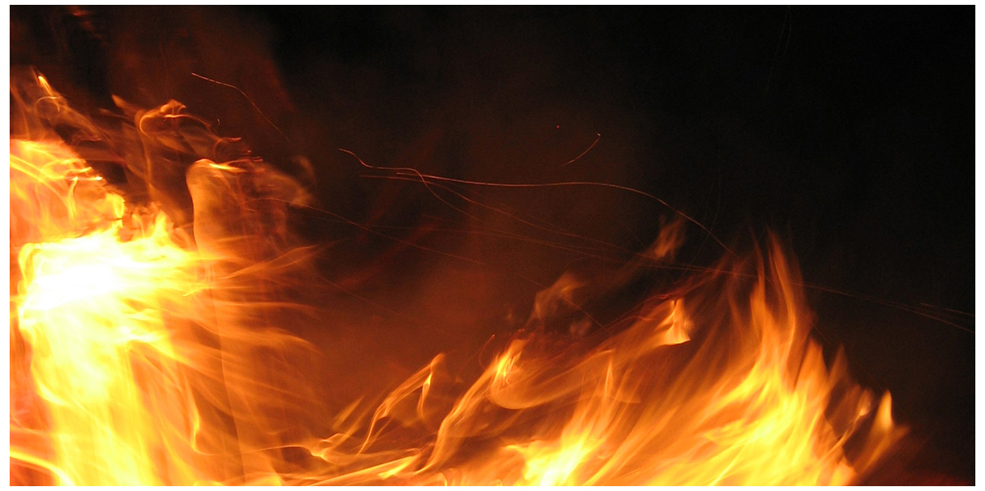
3. A Testing Time is Coming.

Slide 27
Our Life’s Work Tested. 1Cor.3
3. A Testing Time is Coming.
“That day in which the fire shall try every man’s work of what sort it is” (v. 13).
The foundation has been already tried
(Isa. 28:16). Therefore thus says the Lord GOD: "Behold, I lay in Zion a stone for a foundation, A tried stone, a precious cornerstone, a sure foundation; Whoever believes will not act hastily.
But, the work done that has been associated with His Name will be tried with the fire of God’s searching judgment. “Behold the day cometh that shall burn as an oven, when the proud and all that do iniquity shall be as stubble” (Mal. 4:1).
b hastings newlebanoncoc.com

Slide 28
Our Life’s Work Tested. 1Cor.3:10-20
3. A Testing Time is Coming.
If the proud and the workers of iniquity are reckoned as stubble, so also are the works of the proud self-seeking Christians.
This fiery test is not to reveal whether we are Christians or not, but whether our works as Christians are worthy of Christ or not. Will He own them, or will He burn then? That depends on their own intrinsic character, whether they are gold, or wood, silver or hay, precious stones or stubble. What they are will determine their destiny.
b hastings newlebanoncoc.com

Slide 29
Our Life’s Work Tested. 1Cor.3:10-20
Title
Are you building on the foundation?
Are you building everyday?
Will your building (your life’s work) stand when Christ returns to test it?
b hastings newlebanoncoc.com

Slide 30
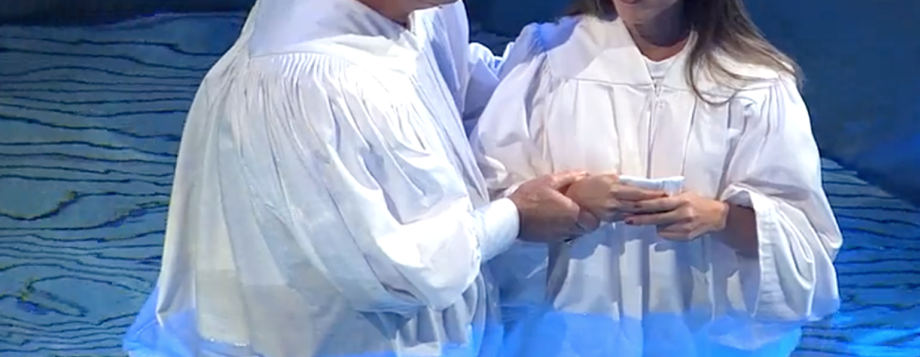
Are you a New Testament Christian?
Hear the Gospel (Rom.10:14)
Believe the Gospel (Heb. 11:6)
Repent of Sins (Acts 3:19)
Confess Christ (Rom.10:9)
Serve our Lord the rest of our lives (Rev.2:10)

Slide 31
Our Life’s Work Tested. 1Cor.3:10-20

