Slide 1
Welcome to our services
New Lebanon Church of Christ
We are Simply Christians.
Our Emphasis is Spiritual, Not Material or Social.
We are striving to be The Same Church as Described in The New Testament.
Please Come Back Again

Slide 2
Learning To Work Together Titus 3:14
Titus 3:14 And let our people also learn to maintain good works for necessary uses, that they be not unfruitful.

Slide 3
Sample business rules for working together.
RULE #1. The team must have unanimous focus on a quantifiable goal.
RULE #2. The team must have clearly defined roles.
RULE #3. The team must be willing to share its resources.
RULE #4. The team must have frequent, effective communication.
RULE #5. The team must have consistent, united and enthusiastic effort.
RULE #6. Team members must periodically suppress their own egos.
RULE #7: The team must be introspective.
RULE #8: The team must be capable of self-correction.

Slide 4
Learning To Work Together Acts 2:42-45
State the obvious -
To work together we must be together.

Slide 5
The last several years has clouded and deceived some people as to remote worship and remote work.
By definition, the virtual world is simulated; it does not physically exist. It is not an actual world. The internet is a medium (a network) by which we communicate through computer-generated codes .
I have not changed my location when I am online. I am at my keyboard in front of a monitor (or using a smartphone or some other internet device). I am in virtual reality (the virtual world), but I am actually (really) still in a physical or material location.
As the virtual world becomes more and more useful and used, we should be careful not to change the nature of the local church of Christ as we use the cyberspace.

Slide 7
Learning To Work Together Acts 2:42-45
Christians have Individual Work to do, and they have Collective Work to perform. (not either or but both)
When the Local church functions as a unit there is group action.
The church at Philippi supported Paul. Phil. 4:15 – 16
Effective Church Discipline requires action by the group as a Whole, not just a few. I Cor. 5: 4 – 5

Slide 8
Learning To Work Together Acts 2:42-45
Congregational worship involves ALL the members.
The church at Troas. Acts 20:7
The Jerusalem Church. Acts 2:42
The church at Corinth. I Cor. 11: 20; 14:23; I Tim. 5:16
Concerted effort is not designed to discourage or to take the place of personal effort.
When a church sends out a preacher, or supports a man in the field, this should not cause the members of the church to let up in their personal zeal and work.

Slide 9
Learning To Work Together Acts 2:42-45
In any kind of team endeavor, the participants must learn to work together.
Acts 2:42 And they continued steadfastly in the apostles' doctrine and fellowship, in the breaking of bread, and in prayers. 43 Then fear came upon every soul, and many wonders and signs were done through the apostles.
44 Now all who believed were together, and had all things in common, 45 and sold their possessions and goods, and divided them among all, as anyone had need.

Slide 10
Learning To Work Together Acts 2:42-45
Christians are often ensnared by church splits, discord, bitter strife, and severed relations because of not learning to work together in the Lord’s good cause.
What are some of the BASIC lessons which we must learn in order to work together harmoniously and effectively?

Slide 11
Learning To Work Together Acts 2:42-45
1. We Must Follow Rules:
Team effort necessitates rules or a standard.
Athletic teams must play according to the rules.
(2Tim.2:5) And also if anyone competes in athletics, he is not crowned unless he competes according to the rules.

Slide 12
Friend,
God has expectations of you…and so do we.
He expects you to, be present at all assemblies.
He expects you to, live a godly moral life.
He expects you to, read your Bible for faith & growth.
He expects you to, pray to Him without ceasing.
He expects you to, study with other Christians.
He expects you to, be faithful to His son Jesus.
God Expects Commitment!
Romans 12:1-2

Slide 13
Learning To Work Together Acts 2:42-45
1Cor. 9:24 Do you not know that those who run in a race all run, but one receives the prize? Run in such a way that you may obtain it.
25 And everyone who competes for the prize is temperate in all things. Now they do it to obtain a perishable crown, but we for an imperishable crown.
26 Therefore I run thus: not with uncertainty. Thus I fight: not as one who beats the air.
27 But I discipline my body and bring it into subjection, lest, when I have preached to others, I myself should become disqualified.

Slide 14
1Cor.9:24 Hindi baga ninyo nalalaman na ang mga nagsisitakbo sa takbuhan ay tumatakbong lahat, nguni't iisa lamang ang tumatanggap ng ganting-pala? Magsitakbo kayo ng gayon; upang magsipagtamo kayo.
25 At ang bawa't tao na nakikipaglaban sa mga palaruan ay mapagpigil sa lahat ng mga bagay. Ginagawa nga nila ito upang magsipagtamo ng isang putong na may pagkasira; nguni't tayo'y niyaong walang pagkasira.
26 Ako nga'y tumatakbo sa ganitong paraan, na hindi gaya ng nagsasapalaran; sa ganito rin ako'y sumusuntok, na hindi gaya ng sumusuntok sa hangin:
27 Nguni't hinahampas ko ang aking katawan, at aking sinusupil: baka sakaling sa anomang paraan, pagkapangaral ko sa iba, ay ako rin ay itakuwil.

Slide 15
Learning To Work Together Acts 2:42-45
To learn to work together we must learn to follow the precepts and principles of the New Testament.
(1Cor. 1:10) Now I plead with you, brethren, by the name of our Lord Jesus Christ, that you all speak the same thing, and that there be no divisions among you, but that you be perfectly joined together in the same mind and in the same judgment.
(1Cor.4:6) not to speak of men above what is written
One or two members, clamoring for something that is contrary to New Testament teaching, can disrupt unity.

Slide 16
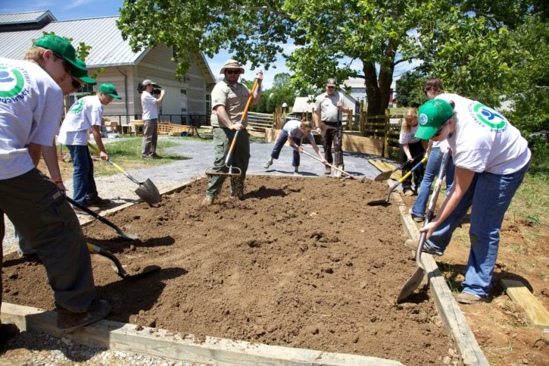
Learning To Work Together Acts 2:42-45
2. Concede Personal Preference:
To learn to work together, we must realize that in matters of judgment no one can have his way about EVERYTHING.
Some are very outspoken in pressing to have their judgment to prevail.
We are to emphasize the plainly revealed truth of Jesus Christ and MINIMIZE to EXTREME our opinions, that we may follow after and make peace among ourselves, and edify one another.
(Rom.14:19) Therefore let us pursue the things which make for peace and the things by which one may edify another.
Our opinions and matters of Personal Conviction will not edify
and cultivate love.

Slide 17
Learning To Work Together Acts 2:42-45
3. We Must Learn To Accept Criticism.
Many can not take criticism, but we must learn to take criticism IF WE ARE TO WORK TOGETHER.
Constructive suggestions and friendly rebukes can be helpful.
(1Thess. 5:14) Now we exhort you, brethren, warn those who are unruly, comfort the fainthearted, uphold the weak, be patient with all.

Slide 18
Learning To Work Together Acts 2:42-45
> Jesus criticized Martha for her anxiety over housework. Lk.10:38 – 42
> This friendly criticism was presented in the spirit of love.
> In some cases, we may receive unjust and worthless criticism.
The Pharisees and Scribes often heaped that kind of criticism on our Lord.
Anyone who does anything worthwhile is going to be criticized.

Slide 19
Learning To Work Together Acts 2:42-45
Criticism, like advice, must be weighed.
(1) If it has any merit, profit by it.
(2) If it is worthless, discard it.

Slide 20
Learning To Work Together Acts 2:42-45
4. We Must Learn To Esteem Others
We must follow Paul’s teaching in Phil. 2:3
(Phil. 2:3) Let nothing be done through selfish ambition or conceit, but in lowliness of mind let each esteem others better than himself.
We must NOT ATTEMPT to put ourselves ahead of others for the purpose of being pre-eminent.
We must elevate others and see their good qualities, esteem them, and not ourselves.
(Rom.12:10) “In honor preferring one another…”

Slide 21
Learning To Work Together Acts 2:42-45
5. We Must Learn To Be Tolerant Toward Others:
Working together in the Lord’s cause demands Patience and Forbearance.
(Eph.4:2) with all lowliness and gentleness, with longsuffering, bearing with one another in love,
(Col.3:13) bearing with one another, and forgiving one another, if anyone has a complaint against another; even as Christ forgave you, so you also must do.
It is easy for one to overlook his own faults and shortcomings, and bear down hard on the other fellow.

Slide 22
Learning To Work Together Acts 2:42-45
(Matt.7:1) "Judge not, that you be not judged.
2 "For with what judgment you judge, you will be judged; and with the measure you use, it will be measured back to you. 3 "And why do you look at the speck in your brother's eye, but do not consider the plank in your own eye?
4 "Or how can you say to your brother, 'Let me remove the speck from your eye'; and look, a plank is in your own eye? 5 "Hypocrite! First remove the plank from your own eye, and then you will see clearly to remove the speck from your brother's eye.

Slide 23
Learning To Work Together Acts 2:42-45
6. Be Dependable.
Many people in the church are not dependable.
They can be given work to do, and never get around to doing it.
Sometimes people volunteer to do a job, then never get around to it.
Effective working together demands that each one LEARN TO BE DEPENDABLE.
Paul felt that John Mark was not dependable on the first journey, so he refused to take him on the second journey.

Slide 24
Learning To Work Together Acts 2:42-45
(Acts 15:37–38) Now Barnabas was determined to take with them John called Mark. 38 But Paul insisted that they should not take with them the one who had departed from them in Pamphylia, and had not gone with them to the work.
When we agree to do something, remember that the whole team (congregation) is counting on us.

Slide 25
Learning To Work Together Acts 2:42-45
7. Communicate Effectively.
Have you ever talked on the telephone when there was a bad connection? If so, you can appreciate what it means to have a communication problem.
In the work of the church it is highly important that there be regular and clear communication.

Slide 26
Learning To Work Together Acts 2:42-45
The preacher must communicate the word of God so that it will be understood by the hearers.
Bible class teachers must clearly communicate what they mean to the class.

Slide 27
Learning To Work Together Acts 2:42-45
Job Sports Church
Attendance
Zeal
Teamwork
Reliability
Love it
Live for it
On a scale of 1-10, what would your total score be in each area?

Slide 28
Learning To Work Together Acts 2:42-45
Come together
Work together
Distribute the load
Stay together
Grow together

Slide 29
Learning To Work Together Titus 3:14
Titus 3:14 And let our people also learn to maintain good works for necessary uses, that they be not unfruitful.

