Slide 1
Welcome to our services
New Lebanon Church of Christ
We are Simply Christians.
Our Emphasis is Spiritual, Not Material or Social.
We are striving to be The Same Church as Described in The New Testament.
Please Come Back Again

Slide 2
Hezekiah – No One Was His Equal. 2Kings 18:5
2Kings 18:1 Now it came to pass in the third year of Hoshea the son of Elah, king of Israel, that Hezekiah the son of Ahaz, king of Judah, began to reign.
2 He was twenty-five years old when he became king, and he reigned twenty-nine years in Jerusalem. His mother's name was Abi the daughter of Zechariah.
3 And he did what was right in the sight of the LORD, according to all that his father David had done.
4 He removed the high places and broke the sacred pillars, cut down the wooden image and broke in pieces the bronze serpent that Moses had made; for until those days the children of Israel burned incense to it, and called it Nehushtan.
5 He trusted in the LORD God of Israel, so that after him was none like him among all the kings of Judah, nor who were before him.
6 For he held fast to the LORD; he did not depart from following Him, but kept His commandments, which the LORD had commanded Moses.
7 The LORD was with him; he prospered wherever he went. And he rebelled against the king of Assyria and did not serve him.

Slide 3
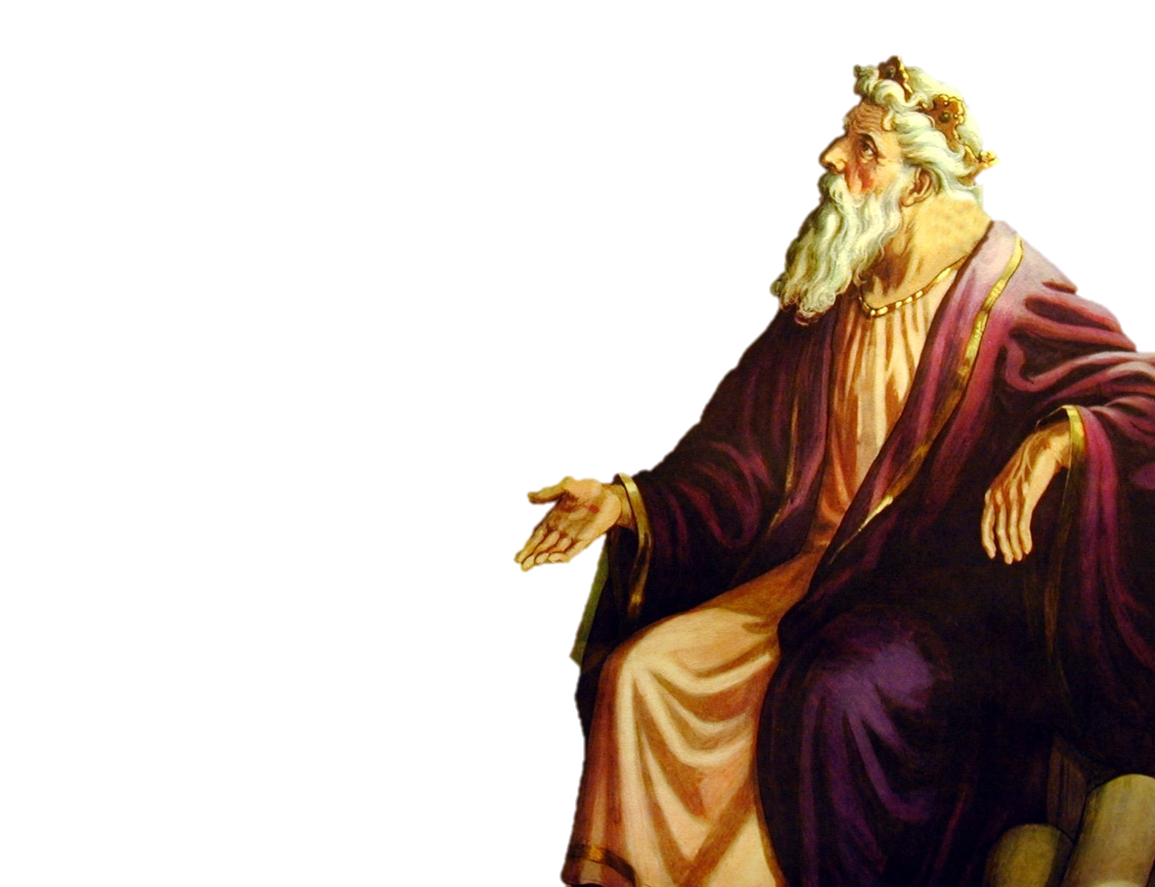
Ten tribes formed
ISRAEL
The Northern Kingdom
Reuben
Simeon
Dan
Naphtali
Gad
Asher
Issachar
Zebulun
Manasseh
Ephraim
KINGS OF ISRAEL
Jeroboam 975-954
Nadab 954-953
Baasha 953-930 Elah 930-929
Zimri 929
Omri 929-918
Ahab 918-897
Ahaziah 897-896
Joram 896-884
Jehu 884-856
Jehoahaz 856-841
Joash 841-825
Jeroboam II 825-784
Zechariah 773
Shallum 772
Menahem 772-762
Pekahiah 762-760
Pekah 760-740
Hoshea 730-721
KINGS OF JUDAH
Rehoboam
Abijah
Asa
Jehoshaphat
Jehoram
Ahaziah
Athaliah
Joash
Amaziah
Uzziah
Jotham
Ahaz
Hezekiah
Manasseh
Amon
Josiah
Jehoahaz
Jehoiakim
Jehoiachin
Zedekiah
975-958
958-955
955-914
914-892
892-884
885
885-878
878-839
839-810
810-758
758-742
742-726
726-698
698-643
643-641
641-610
610
610-599
599
599-588
Two tribes formed
JUDAH
The Southern Kingdom
Judah
Benjamin

Slide 4
KINGS OF ISRAEL
Jeroboam 975-954
Nadab 954-953
Baasha 953-930 Elah 930-929
Zimri 929
Omri 929-918
Ahab 918-897
Ahaziah 897-896
Joram 896-884
Jehu 884-856
Jehoahaz 856-841
Joash 841-825
Jeroboam II 825-784
Zechariah 773
Shallum 772
Menahem 772-762
Pekahiah 762-760
Pekah 760-740
Hoshea 730-721
KINGS OF JUDAH
Rehoboam
Abijah
Asa
Jehoshaphat
Jehoram
Ahaziah
Athaliah
Joash
Amaziah
Uzziah
Jotham
Ahaz
Hezekiah
Manasseh
Amon
Josiah
Jehoahaz
Jehoiakim
Jehoiachin
Zedekiah
975-958
958-955
955-914
914-892
892-884
885
885-878
878-839
839-810
810-758
758-742
742-726
726-698
698-643
643-641
641-610
610
610-599
599
599-588
The Northern Kingdom lasted a little over 200 years being destroyed by Assyria.
The Southern Kingdom lasted a little over 300 years and was destroyed by Babylon.

Slide 5
Dan
Religion in ISRAEL
(The Northern Kingdom)
was the worship of calves.
There were high places for the worship of calves in Dan and Bethel.
ISRAEL
Shechem
King Jeroboam
Bethel
JUDAH
Jerusalem
King Rehoboam
EGYPT

Slide 6
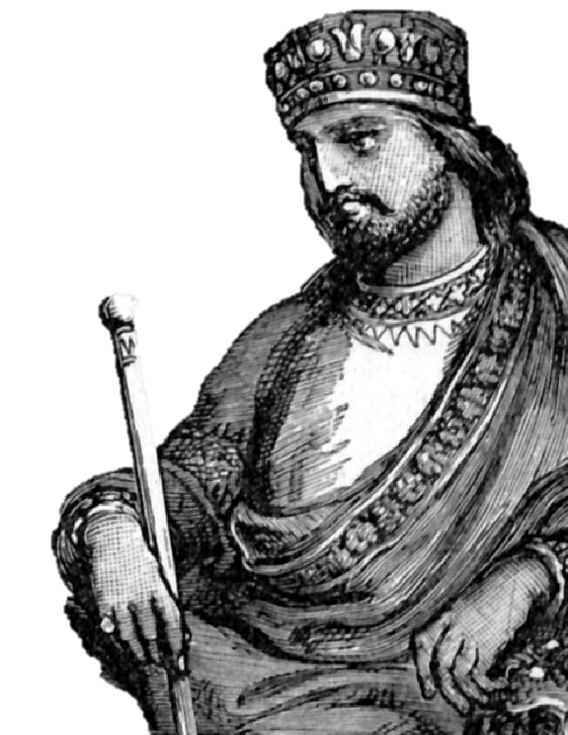
KINGS OF ISRAEL
Jeroboam 975-954
Nadab 954-953
Baasha 953-930 Elah 930-929
Zimri 929
Omri 929-918
Ahab 918-897
Ahaziah 897-896
Joram 896-884
Jehu 884-856
Jehoahaz 856-841
Joash 841-825
Jeroboam II 825-784
Zechariah 773
Shallum 772
Menahem 772-762
Pekahiah 762-760
Pekah 760-740
Hoshea 730-721
KINGS OF JUDAH
Rehoboam
Abijah
Asa
Jehoshaphat
Jehoram
Ahaziah
Athaliah
Joash
Amaziah
Uzziah
Jotham
Ahaz
Hezekiah
Manasseh
Amon
Josiah
Jehoahaz
Jehoiakim
Jehoiachin
Zedekiah
The reigns of—
Asa
Jehoshaphat
Joash
Amaziah
Uzziah
Jotham
Hezekiah
Josiah
present examples of kings who loved and served God at least part of their reign. Only these eight out of the 39 kings of Israel and Judah attempted to return to God. Sadly, even some of them were not totally devoted and strayed.
975-958
958-955
955-914
914-892
892-884
885
885-878
878-839
839-810
810-758
758-742
742-726
726-698
698-643
643-641
641-610
610
610-599
599
599-588

Slide 7
2 Chronicles 29:1
“Hezekiah began to reign when he was five and twenty years old, and he reigned nine and twenty years in Jerusalem. And his mother’s name was Abijah, the daughter of Zechariah.”
KINGS OF ISRAEL
Jeroboam 975-954
Nadab 954-953
Baasha 953-930 Elah 930-929
Zimri 929
Omri 929-918
Ahab 918-897
Ahaziah 897-896
Joram 896-884
Jehu 884-856
Jehoahaz 856-841
Joash 841-825
Jeroboam II 825-784
Zechariah 773
Shallum 772
Menahem 772-762
Pekahiah 762-760
Pekah 760-740
Hoshea 730-721
KINGS OF JUDAH
Rehoboam
Abijah
Asa
Jehoshaphat
Jehoram
Ahaziah
Athaliah
Joash
Amaziah
Uzziah
Jotham
Ahaz
Hezekiah
Manasseh
Amon
Josiah
Jehoahaz
Jehoiakim
Jehoiachin
Zedekiah
Hezekiah was contemporary with Hoshea, King of Israel.
Israel was taken into Assyrian captivity during Hezekiah’s reign.
975-958
958-955
955-914
914-892
892-884
885
885-878
878-839
839-810
810-758
758-742
742-726
726-698
698-643
643-641
641-610
610
610-599
599
599-588
Hezekiah became ill and almost died, but God granted him 15 year’s extension of life. He made a grevious error when he was flattered by rulers from Babylon and showed them his wealth. Isaiah soundly rebuked him. Judah was made to pay tribute to Assyria. God saved Judah from Assyria when an angel in one night killed 185,000 Assyrian soldiers.
Hezekiah—
His father was wicked Ahaz. He reigned for 29 years and was 25 when he became king. One of his first acts was the cleansing and reopening of the temple. Assyria conquered the Northern Kingdom during the 4th to the 6th years of Hezekiah’s reign.

Slide 8
KINGS OF ISRAEL
Jeroboam 975-954
Nadab 954-953
Baasha 953-930 Elah 930-929
Zimri 929
Omri 929-918
Ahab 918-897
Ahaziah 897-896
Joram 896-884
Jehu 884-856
Jehoahaz 856-841
Joash 841-825
Jeroboam II 825-784
Zechariah 773
Shallum 772
Menahem 772-762
Pekahiah 762-760
Pekah 760-740
Hoshea 730-721
KINGS OF JUDAH
Rehoboam
Abijah
Asa
Jehoshaphat
Jehoram
Ahaziah
Athaliah
Joash
Amaziah
Uzziah
Jotham
Ahaz
Hezekiah
Manasseh
Amon
Josiah
Jehoahaz
Jehoiakim
Jehoiachin
Zedekiah
2 Kings 21:1
“Manasseh was twelve years old when he began to reign, and reigned fifty and five years in Jerusalem. And his mother's name was Hephzibah.”
Manasseh—
Son and successor of Hezekiah. He was an idolater and persecuted those faithful to Jehovah. He brought the country to ruin. He was carried captive to Babylon and later allowed to return when he humbled himself before God. He then built up the wall around Jerusalem, repaired the altar, and took away the strange gods. However, the people still offered sacrifices in the high places. He ruled about 55 years.
975-958
958-955
955-914
914-892
892-884
885
885-878
878-839
839-810
810-758
758-742
742-726
726-698
698-643
643-641
641-610
610
610-599
599
599-588

Slide 9
Hezekiah – No One Was His Equal. 2Kings 18:5
Hezekiah was the 13th King Of Judah.
He was the best king who ever reigned in Judah …. In respect to trust and faith.
In 2 Kings 23:25 about the same thing is said about Josiah. That there was none like him before or after.
And to harmonize these two statements - Hezekiah was the best king in faith.
Josiah in his strict adherence to the law of Moses.
Hezekiah the best in faith, Josiah the best in zeal.

Slide 10
Hezekiah – No One Was His Equal. 2Kings 18:5
Hezekiah was a man full of energy, and courage, He was wise and active and had a religious disposition. As we look at Hezekiah, we are impressed with the remarkable life, especially in view of his background.
(2 kings 18:1)……… This verse says he was the son of Ahaz. And as we back up in the book of kings we find in ch. 16 , we see the kind of king that his father was.
In (v2 of ch.16 of 2nd kings)….. Hezekiah’s father was an idolater.

Slide 11
Hezekiah – No One Was His Equal. 2Kings 18:5
Certainly a lack of faithfulness on the part of parents makes it more difficult for a child to understand and see God ‘s expectation, but some parents have no interest whatsoever in God, in the Lord Jesus Christ, and each child, each individual has a responsibility before God to learn and obey truth.
Too many times we want to blame our parents for our lack of commitment our lack of dedication, But each stands or falls by himself before Jehovah. And when we get to the judgment bar of God we are not going to be able to say well my daddy, my mommy didn’t teach me about Jesus Christ .
But its going to be what did YOU do, in your service to the Lord. Each individual is obligated, is responsible before God, for his actions, or lack of actions.

Slide 12
Hezekiah – No One Was His Equal. 2Kings 18:5
We say somebody wasn’t brought up in a very good environment, and consequently he or she is weak, and we justify ourselves or justify others in the church who have been members of the body of Christ for years because of their background.
Their daddy and their mother weren’t faithful and their environment was bad and consequently we have to overlook their commitment to the Lord or lack of commitment.
I don’t believe the Lord would accept that.

Slide 13
Hezekiah – No One Was His Equal. 2Kings 18:5
Hezekiah is a constant reminder to each and everyone of us that we can overcome our background and we can serve the Lord faithfully.
So let’s not make excuses. Let’s just say I’m failing. I’m not dedicated like I ought to be. It’s me who is at fault, not my mother or father, or my environment, but it’s me. And I’m not doing what I ought to do for the Lord. And I’m not living faithful unto the Lord.
If anybody ever had an excuse , It would have been Hezekiah. But Hezekiah overcame his handicap to serve God all the days of his life.

Slide 14
Hezekiah – No One Was His Equal. 2Kings 18:5
Let’s look at this great man. his strengths, his qualities.
2Kings 18:3 And he did what was right in the sight of the LORD, according to all that his father David had done.
Here the record says he did that which was right. He was a man of action. He did right in the sight of the Lord. He wasn’t concerned about what men thought or trying to please men. But what did Jehovah say, what did Jehovah think? And so the record says he did that which was right in the sight of the Lord.

Slide 15
Hezekiah – No One Was His Equal. 2Kings 18:5
And in v4…..He removed the high places and broke the sacred pillars, cut down the wooden image and broke in pieces the bronze serpent that Moses had made; for until those days the children of Israel burned incense to it, and called it Nehushtan.
You talk about a reformer. And he got busy immediately, when he became the king of Judah , he went out and he tore down the high places . He removed the idols and he opened the temple of the Lord as you can read in 2 Chron. the 29th chapter. And he did it, the bible says in the first year and the first month of his reign.

Slide 16
Hezekiah – No One Was His Equal. 2Kings 18:5
He didn’t hesitate, he didn’t postpone, but he got busy. He hurried to open the temple of God in the restoration of worship under the OT law. And he tore down the idolatrous places. Took down the images, cut down the groves, and broke in pieces the brass serpent that Moses had made. It had been around for about 800 years…..
It had served its purpose there in the wilderness. When God sent fiery serpents and whoever had been bitten, if he looked upon that serpent he would live. But this old brass serpent came to be an object of worship.
Instead of worshipping God who healed, who provided the power, they worshipped this brass serpent. And you know if we are not careful , then we will come to the place where we worship the incidental instead of the God of heaven.

Slide 17
Hezekiah – No One Was His Equal. 2Kings 18:5
Some people have made an idol out of the book – the Bible. The book itself. The paper with ink on it. And if we can just lay the old family Bible on the coffee table, and we can see it day after day, someway, some how it will bring blessings to us.
Friend, God is not interested in this book being on the coffee table. God wants the words of this book in our hearts and minds and lived in our lives. The word is what is to be respected, not the book itself.

Slide 18
Hezekiah – No One Was His Equal. 2Kings 18:5
We might get to the place where we worship the table where the Lord’s supper is spread. The table might have special meaning to somebody because of whose it use to be… or where it came from… and when they see the table some people focus on those memories instead of the memory of Christ dying for my sins and paying the debt I could not pay.
Some people worship the baptistry. Or some people worship the building in which we meet. And if we aren’t careful, these things can become brazen serpents unto us. And Hezekiah went out and broke the brazen serpent.

Slide 19
Hezekiah – No One Was His Equal. 2Kings 18:5
In v 5………
He had his faith in God. He believed in God, he looked to God for help. He looked to God for blessings. He was a man who trusted totally and wholly after Jehovah and he said lord – RULE, you take control.
And that’s the kind of attitude that we need today in the church of our Lord Jesus Christ. We need to put our trust in Jehovah. And let him have his way with us. And the record says he held fast to the Lord and departed not from following him but kept his commandments (v6) which the Lord commanded Moses.

Slide 20
Hezekiah – No One Was His Equal. 2Kings 18:5
In v 5………
He was obedient to Jehovah.
And he saw in order to sustain his relationship with God he had to keep his commandments.
And friend, we have to do the same today.
And nobody can get too close to the word of God.
Friend we cannot separate God from his word and we show our respect and our love to Jehovah by keeping his word.

Slide 21
Hezekiah – No One Was His Equal. 2Kings 18:5
So here was this king of Judah who had these great qualities and none was like him before or after of all the kings of Judah. And as a result of that v7 says… The LORD was with him; he prospered wherever he went. And he rebelled against the king of Assyria and did not serve him.
And friend if we will serve God if we will obey his commands if we will get idols out of our hearts if we will do that which is right in the sight of the lord , God will bless us too! The manifold blessings of God.
(…count your many blessings)

Slide 22
Hezekiah – No One Was His Equal. 2Kings 18:5
We forfeit blessing because we don’t serve God as we ought to and don’t ask God to bless us.
But if we will walk in his way, the lord will be with us and just as he blessed king Hezekiah, he will bless us in like manner. At least with spiritual blessings . And God will richly supply us with all our needs and bless us in Jesus the Christ.

Slide 23
Hezekiah – No One Was His Equal. 2Kings 18:5
So we not only see his strength but in the 19th chapter he took every thing and laid out his burden , and laid it out before the lord in prayer.
And here were the Assyrians from the east. And they sent letters to Hezekiah and asked for surrender.
Chron.18:28 Then the Rabshakeh stood and called out with a loud voice in Hebrew, and spoke, saying, "Hear the word of the great king, the king of Assyria!
29 "Thus says the king: 'Do not let Hezekiah deceive you, for he shall not be able to deliver you from his hand;
30 'nor let Hezekiah make you trust in the LORD, saying, "The LORD will surely deliver us; this city shall not be given into the hand of the king of Assyria.

Slide 24
Hezekiah – No One Was His Equal. 2Kings 18:5
31 "Do not listen to Hezekiah; for thus says the king of Assyria: 'Make peace with me by a present and come out to me; and every one of you eat from his own vine and every one from his own fig tree, and every one of you drink the waters of his own cistern;
32 'until I come and take you away to a land like your own land, a land of grain and new wine, a land of bread and vineyards, a land of olive groves and honey, that you may live and not die. But do not listen to Hezekiah, lest he persuade you, saying, "The LORD will deliver us."
33 'Has any of the gods of the nations at all delivered its land from the hand of the king of Assyria?

Slide 25
Hezekiah – No One Was His Equal. 2Kings 18:5
34 'Where are the gods of Hamath and Arpad? Where are the gods of Sepharvaim and Hena and Ivah? Indeed, have they delivered Samaria from my hand?
They taunt him saying Jehovah will not be able to save you from us. So here was this letter of intimidation and this was brought to the attention of Isaiah and Isaiah says in
2Kings 19:6 And Isaiah said to them, "Thus you shall say to your master, 'Thus says the LORD: "Do not be afraid of the words which you have heard, with which the servants of the king of Assyria have blasphemed Me.

Slide 26
Hezekiah – No One Was His Equal. 2Kings 18:5
In 2Kings 19:28 Because your rage against Me and your tumult Have come up to My ears, Therefore I will put My hook in your nose And My bridle in your lips, And I will turn you back By the way which you came.
This shows what God was going to do …I will put my hook in your nose , a bridle in your lips, and turn you right around and send you back where you came from. And before he got that job done he slew by an angel of the Lord 185,000 Assyrian soldiers. …And all of this brothers and sisters was because of the prayer of Hezekiah
2Kings 19:14-15, Hezekiah received the letter at the hand of the messenger and read it and Hezekiah went up into the house of the Lord and spread it before the Lord.
And brethren when we have a problem and a burden, let’s spread it out before the Lord. God is able to answer prayer – he answered Hezekiah’s prayer and he will answer ours.

Slide 27
Hezekiah – No One Was His Equal. 2Kings 18:5
The effectual fervent prayer of a righteous man avails much. God heard Elijah and he didn’t send rain upon the earth for 3 years. God will hear our prayers as well
He heard Hezekiah’s, he will hear ours. If any among you is afflicted let him pray… Anybody here afflicted??? We need to take everything to God in prayer and God will answer and hear our prayer.
On the night of his betrayal, Jesus went to the garden of Gethsemane and he prayed his heart to God and he laid out his problems before Jehovah.
When the Jerusalem church was undergoing persecution they had a prayer meeting.

Slide 28
Hezekiah – No One Was His Equal. 2Kings 18:5
Paul and Silas were in prison and were praying at midnight according to Acts 16. They prayed and sang songs.
And we read in Phil.4:6 Be anxious for nothing, but in everything by prayer and supplication, with thanksgiving, let your requests be made know to God.
We have the idea, some of us that everything is fixed , and determined, and can not be changed. And therefore praying to God will not change things. But that is a mistake.
Let our requests be made know unto God. And he answered Hezekiah’s prayer and he will answer ours as well.

Slide 29
Hezekiah – No One Was His Equal. 2Kings 18:5
Now in chapter 20 , an unusual thing happened to Hezekiah, he became sick unto death. And Isaiah said "Thus says the LORD: 'Set your house in order, for you shall die, and not live.'
set your house in order
Get everything ready Hezekiah, because you are going to die – you are not going to live. But friends, everyone of us, unless the Lord comes first, is going to die. And we need to set our hose in order.
And the only way we can have our house in order when death comes is that we keep it in order ALL THE TIME.

Slide 30
Hezekiah – No One Was His Equal. 2Kings 18:5
…. Now Hezekiah was told he was going to die. What if you went to a doctor and the doctor told you that you are going to die. Your doctor says get your house in order – you only have one month to live. What would you do?
I know what I would do if I were not a Christian---I would obey the gospel just as quick as I could. I would want to get myself right with God, I would want my sins forgiven, I would want the burden of sin removed, I would want everybody to know that everything is well with my soul.

Slide 31
Hezekiah – No One Was His Equal. 2Kings 18:5
If I had been baptized and am a member of the church, I would attend every service of the church…PERIOD. no excuses. I wouldn’t miss a one. If I were able to come I would not miss a single service. I would come early, I would count it a joy, I would try to exhort and encourage every other member here. Because I would know I am going to meet my Lord…
I would study the Bible. I would pray to God. And I would try to squeeze as much as I possibly could into putting the kingdom first in my life, each and every day the good Lord gives to me. I would enjoy that day like I have never enjoyed any other day. Why would I want to waste it???
But friend, this might be your last day.

Slide 32
Are you a New Testament Christian?
Hear the Gospel (Rom.10:14)
Believe the Gospel (Heb. 11:6)
Repent of Sins (Acts 3:19)
Confess Christ (Rom.10:9)
Be Baptized Into Christ (1 Cor.12:13)
Serve our Lord the rest of our lives (Rev.2:10)
You Must Be Born Again. John 3:1-7

