Slide 1
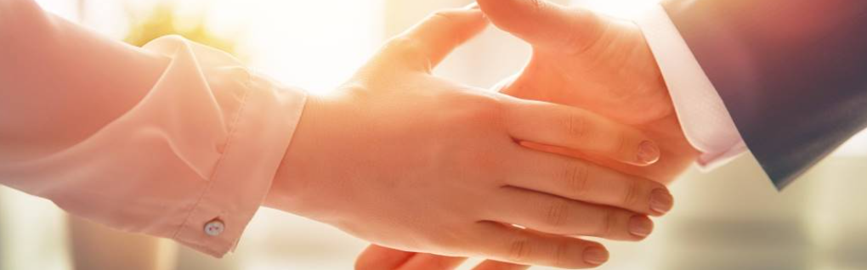
Welcome to our services
New Lebanon Church of Christ
We are Simply Christians.
Our Emphasis is Spiritual, Not Material or Social.
We are striving to be The Same Church as Described in The New Testament.
Please Come Back Again

Slide 2
For Unto Us A Child Is Born. Isaiah 9:1-7
Isaiah 9:6
For unto us a Child is born, Unto us a Son is given; And the government will be upon His shoulder. And His name will be called Wonderful, Counselor, Mighty God, Everlasting Father, Prince of Peace.

Slide 3

Please open your hearts, your ears, and your Bible and follow along.
If you have any questions about anything I say, if you disagree anything I say, please say something to me after the service and I will be glad to sit down with you and God’s word and study so that we can come to know His truth
Illustrated Bible verses by Ethical Media, Bible photos by bibleplaces.com

Slide 4
Ecclesiastes - Vanities of life, man’s whole duty before God.
Song of Solomon-- Poem of love
Isaiah - A period of time with kings of Judah, (Uzziah, Jotham, Ahaz and Hezekiah). A book of judgments and comfort, and rich Messianic prophesies. Woes pronounced on Assyria, Babylonia, Moab, Egypt and Edom.
Jeremiah - Captivity is coming. He was sensitive to the sinfulness of his nation against Jehovah. He was known as the weeping prophet.
Lamentations - Continuing the message of sorrow over Jerusalem. The ruin of the temple, city and the people of Judah is discussed.

Slide 5
For Unto Us A Child Is Born. Isaiah 9:1-7
Isaiah 9:1 Nevertheless the gloom will not be upon her who is distressed, As when at first He lightly esteemed The land of Zebulun and the land of Naphtali, And afterward more heavily oppressed her, By the way of the sea, beyond the Jordan, In Galilee of the Gentiles.
2 The people who walked in darkness Have seen a great light; Those who dwelt in the land of the shadow of death, Upon them a light has shined.
3 You have multiplied the nation And increased its joy; They rejoice before You According to the joy of harvest, As men rejoice when they divide the spoil.

Slide 6
For Unto Us A Child Is Born. Isaiah 9:1-7
4 For You have broken the yoke of his burden And the staff of his shoulder, The rod of his oppressor, As in the day of Midian. 5 For every warrior's sandal from the noisy battle, And garments rolled in blood, Will be used for burning and fuel of fire.
6 For unto us a Child is born, Unto us a Son is given; And the government will be upon His shoulder. And His name will be called Wonderful, Counselor, Mighty God, Everlasting Father, Prince of Peace.
7 Of the increase of His government and peace There will be no end, Upon the throne of David and over His kingdom, To order it and establish it with judgment and justice From that time forward, even forever. The zeal of the LORD of hosts will perform this.

Slide 7
For Unto Us A Child Is Born. Isaiah 9:1-7
Isaiah 9:6
For unto us a Child is born, Unto us a Son is given; And the government will be upon His shoulder. And His name will be called Wonderful, Counselor, Mighty God, Everlasting Father, Prince of Peace.

Slide 8
For Unto Us A Child Is Born. Isaiah 9:1-7
It is significant that the words which describe the character of the promised Messiah are on his lips often:
Wonderful
25:1; 28:29; 29:14
Counselor
19:17; 25:1; 28;29; 40:13; 40:10
Mighty God
30:29; 33:13; 40:17, 26; 42:13; 49:20-26; 60:16
Everlasting Father
26:4; 40:28;45:17; 55:3; 57:15; 60:19; 63:16; 64:8
Prince Of Peace
26:12; 45:7; 52:7; 53:5; 55:12; 57:19; 66:12

Slide 9
For Unto Us A Child Is Born. Isaiah 9:1-7
The Dawning Light. Chapter 9
“Judgment does not always bring repentance or effect conversion; more often it only hardens (8:19-22). The darkness the people experienced consisted not only of the hopelessness of their physical condition, but also of the darkness of sin and ignorance” (Hailey).

Slide 10
For Unto Us A Child Is Born. Isaiah 9:1-7
Jesus, the light of the world, began His work in the lands of Zebulun and Naphtali where the gloom had first settled centuries earlier.
This would also be a time of great rejoicing. They would rejoice as when the harvest is reaped, and as those who are victorious in battle divide the spoil.

Slide 11
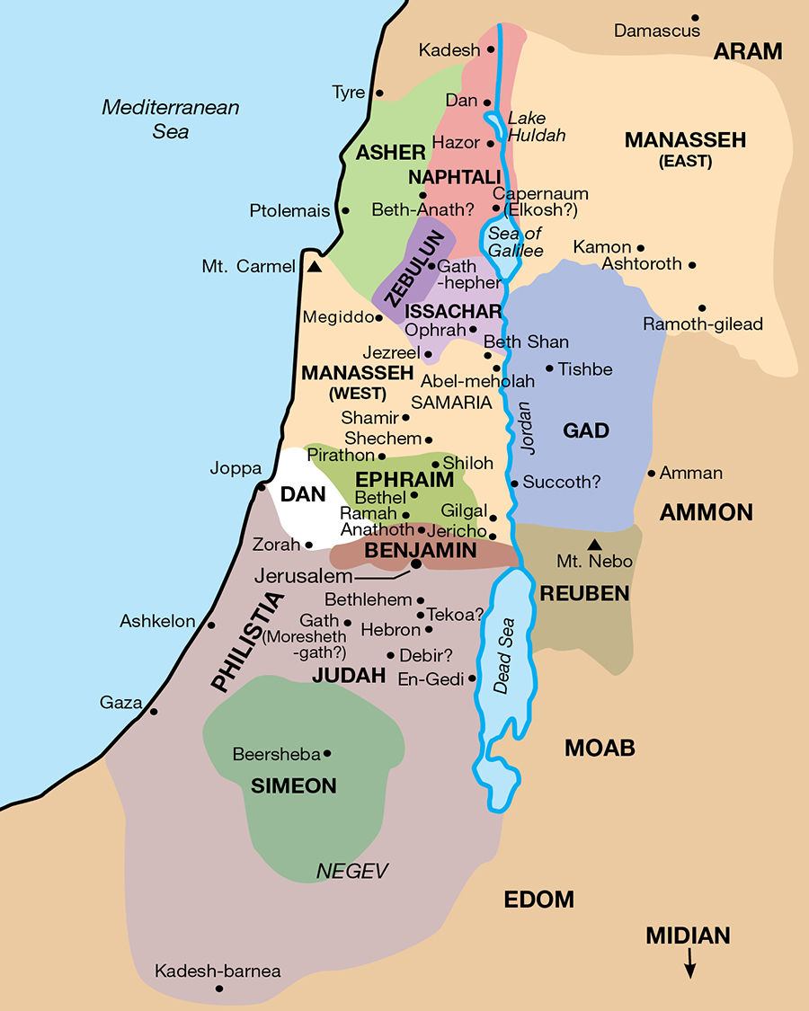

Slide 12
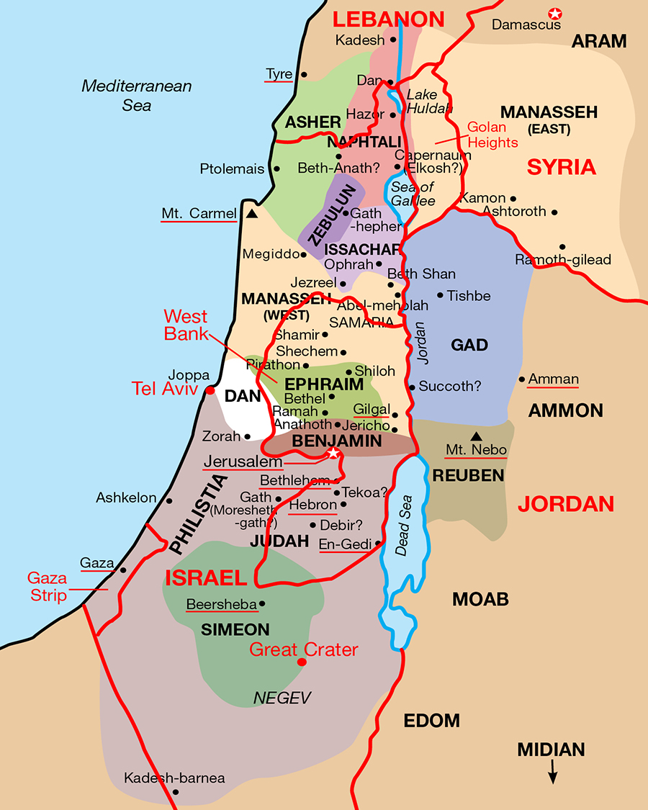

Slide 13
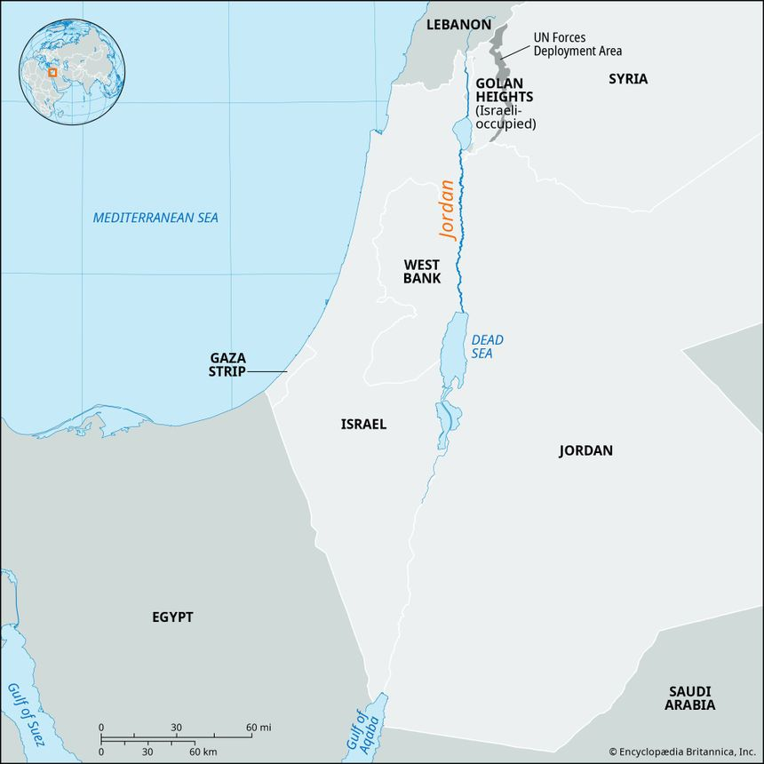
“From the River to the Sea, Palestine Will Be Free” is a rallying cry for terrorist groups and their sympathizers, from the Popular Front for the Liberation of Palestine (PFLP) to Hamas, which called for Israel’s destruction in its original governing charter in 1988 and was responsible for the October 7, 2023 terror attack on Israeli civilians, murdering over 1,200 people.”
(Source American Jewish Committee website.)

Slide 14
For Unto Us A Child Is Born. Isaiah 9:1-7
The Basis Of This Joy 9:4-7
The hold of oppressors, foreign countries (sin, Rom 6), will be broken by God
—fearful enemies, foreign countries, will be defeated—Satan, sin, death. 1 Cor 15: 57; Heb 2:14; 1 Jn 3:8.

Slide 15
For Unto Us A Child Is Born. Isaiah 9:1-7
1 Cor 15:57 But thanks be to God, who gives us the victory through our Lord Jesus Christ
Heb 2:14 Inasmuch then as the children have partaken of flesh and blood, He Himself likewise shared in the same, that through death He might destroy him who had the power of death, that is, the devil,
1 John 3:8 He who sins is of the devil, for the devil has sinned from the beginning. For this purpose the Son of God was manifested, that He might destroy the works of the devil.

Slide 16
For Unto Us A Child Is Born. Isaiah 9:1-7
Day of Midian—was the time of Gideon’s victory Judges 6 & 7. God saved them in His way, not any way men might devise. So it will be in that day, the victory then can only be attributed to Jehovah.
Military weapons and clothing will not be a part of this new economy. These things shall be done away with—2:2-4; Hos 2:18; Zech 9:10. In the spiritual kingdom coming their weapons and clothing will be of a spiritual nature also—Eph 6:10-12

Slide 17
For Unto Us A Child Is Born. Isaiah 9:1-7
Isaiah 2:2-4 Now it shall come to pass in the latter days That the mountain of the LORD'S house Shall be established on the top of the mountains, And shall be exalted above the hills; And all nations shall flow to it.
3 Many people shall come and say, "Come, and let us go up to the mountain of the LORD, To the house of the God of Jacob; He will teach us His ways, And we shall walk in His paths." For out of Zion shall go forth the law, And the word of the LORD from Jerusalem.
4 He shall judge between the nations, And rebuke many people; They shall beat their swords into plowshares, And their spears into pruning hooks; Nation shall not lift up sword against nation, Neither shall they learn war anymore
Hosea 2:18
Zech 9:10
Eph 6:10-12

Slide 18
For Unto Us A Child Is Born. Isaiah 9:1-7
Hosea 2:18
Zech 9:10
Eph 6:10-12
In that day I will make a covenant for them With the beasts of the field, With the birds of the air, And with the creeping things of the ground. Bow and sword of battle I will shatter from the earth, To make them lie down safely.
I will cut off the chariot from Ephraim And the horse from Jerusalem; The battle bow shall be cut off. He shall speak peace to the nations; His dominion shall be 'from sea to sea, And from the River to the ends of the earth.'
Eph 6:10 Finally, my brethren, be strong in the Lord and in the power of His might. 11 Put on the whole armor of God, that you may be able to stand against the wiles of the devil. 12 For we do not wrestle against flesh and blood, but against principalities, against powers, against the rulers of the darkness of this age, against spiritual hosts of wickedness in the heavenly places.

Slide 19
For Unto Us A Child Is Born. Isaiah 9:1-7
6,7. Here is the reason for the light, the rejoicing and the victory—the Child! This obviously refers to the child to be born of the virgin (7:14)—Jesus, the Messiah. He would be a “son:”
Son of man—humanity Mt 16:28 Assuredly, I say to you, there are some standing here who shall not taste death till they see the Son of Man coming in His kingdom."
Son of God—deity Matt. 8:29 And suddenly they cried out, saying, "What have we to do with You, Jesus, You Son of God? Have You come here to torment us before the time?"
Psa 2:7ff; Heb 1:5).

Slide 20
For Unto Us A Child Is Born. Isaiah 9:1-7
He would be given—the beautiful gift of God John 3:16
Government on His shoulder—rule, reign, sovereignty Eph.1:18-23. The eyes of your understanding being enlightened; that you may know what is the hope of His calling, what are the riches of the glory of His inheritance in the saints, 19 and what is the exceeding greatness of His power toward us who believe, according to the working of His mighty power
20 which He worked in Christ when He raised Him from the dead and seated Him at His right hand in the heavenly places, 21 far above all principality and power and might and dominion, and every name that is named, not only in this age but also in that which is to come.
22 And He put all things under His feet, and gave Him to be head over all things to the church, 23 which is His body, the fullness of Him who fills all in all.

Slide 21
For Unto Us A Child Is Born. Isaiah 9:1-7
These five names describe His characteristics, and His nature:
Wonderful
Counselor
Mighty God
Everlasting Father
Prince of Peace

Slide 22
For Unto Us A Child Is Born. Isaiah 9:1-7
Wonderful, Counselor, Mighty God, Everlasting Father, Prince of Peace.
Wonderful—He would cause people to wonder and be amazed
because of His greatness (Mt 7:28,29; 13:54). He will be the wonder of the ages, the full revelation of the God the Father Himself.

Slide 23
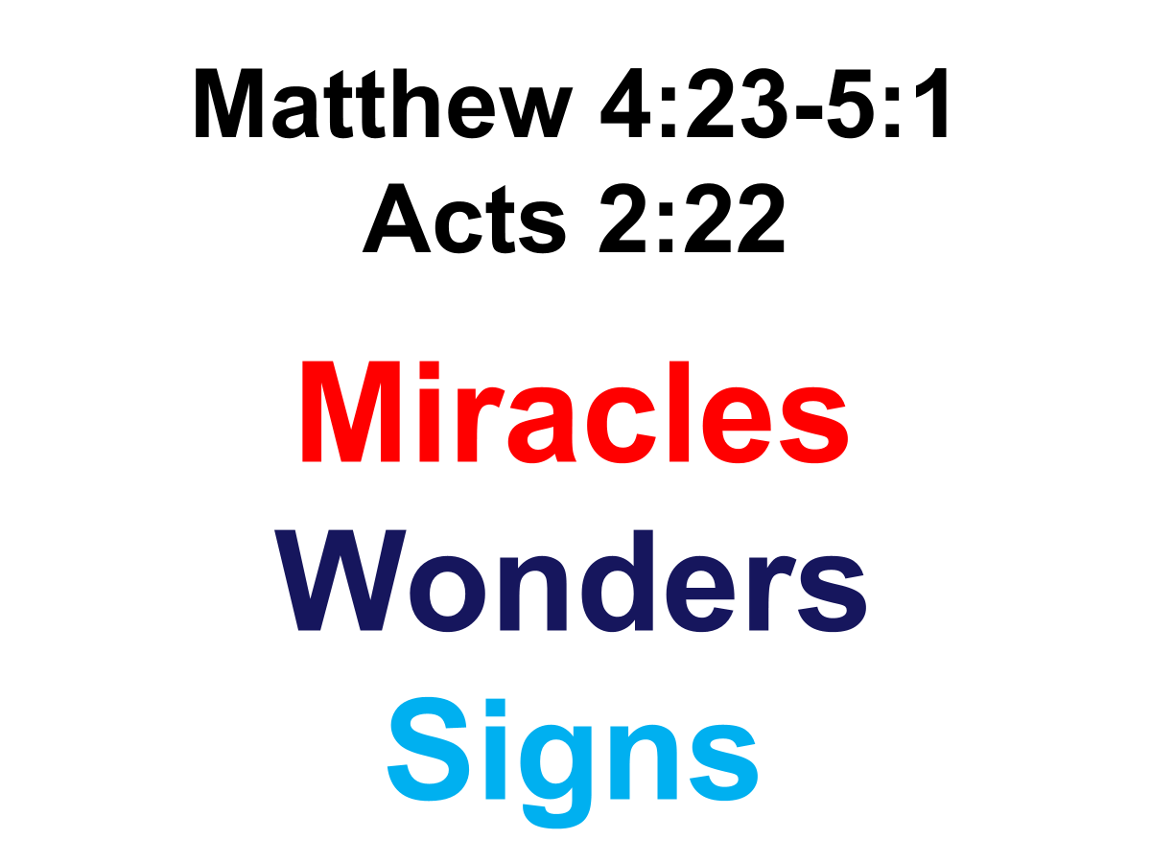
For Unto Us A Child Is Born. Isaiah 9:1-7
Wonderful, Counselor, Mighty God, Everlasting Father, Prince of Peace.

Slide 24
For Unto Us A Child Is Born. Isaiah 9:1-7
Wonderful, Counselor, Mighty God, Everlasting Father, Prince of Peace.
Wonderful
He is wonderful in his pre-existence, in his Virgin birth, in his role in Creation and in the “upholding” of our universe.
He is wonderful in his mighty miracles, his teaching, his sufferings, his prophecies, his death, burial, and resurrection.
He is wonderful in the Old Testament and his appearance as “The Angel of Jehovah!”
He is wonderful in the establishment of his kingdom, the Church, and in his blessing of his Holy Bride.
He is wonderful in what he will yet accomplish when he appears the Second Time, and shall judge the living and the dead, and assign to every man who ever lived his eternal destiny

Slide 25
For Unto Us A Child Is Born. Isaiah 9:1-7
Wonderful, Counselor, Mighty God, Everlasting Father, Prince of Peace.
Counselor
adviser, one with great wisdom (11:2; Col 2:3; 1 Cor 1:24).
As the King in His kingdom He will be a Counselor to all of His subjects.

Slide 26
For Unto Us A Child Is Born. Isaiah 9:1-7
Wonderful, Counselor, Mighty God, Everlasting Father, Prince of Peace.
Counselor
He is the only Counselor who ever had “the words of eternal life” (John 6:68); his counsel alone is described as “The Light of the World.”
His counsel only will judge men at the last day (John 12:48). The counsel of the Son of God is eternal. “Heaven and earth shall pass away,” but Christ’s word abides forever. A single line of teaching from this Counselor is more valuable than libraries stacked full of the books of human wisdom.
His counsel is the one and only true Guide to the Christian religion. No other authority exists, except through the devices of sinful men.
When at the Last Day all the nations of earth have been assembled the word of this Counselor will be enforced as the final determination of the fate of every man ever born

Slide 27
For Unto Us A Child Is Born. Isaiah 9:1-7
Wonderful, Counselor, Mighty God, Everlasting Father, Prince of Peace.
Mighty God
this identifies Him with the godhead and shows His
omnipotence (Mt 28:18; Jn 16:33; Phil 4:13). This destroys the Jehovah’s Witnesses’ doctrine that Jesus is a god, not God!

Slide 28
For Unto Us A Child Is Born. Isaiah 9:1-7
Wonderful, Counselor, Mighty God, Everlasting Father, Prince of Peace.
Mighty God
John 1:1: “In the beginning was the Word, and the Word was with God, and the Word was God.”
John 20:28: “Thomas answered and said unto him, My Lord and my God.”
Acts 20:28: “Take heed unto yourselves, and to all the flock, in which the Holy Spirit hath made you bishops to feed the church of God which he purchased with his own blood.”

Slide 29
For Unto Us A Child Is Born. Isaiah 9:1-7
Wonderful, Counselor, Mighty God, Everlasting Father, Prince of Peace.
Mighty God
1Tim. 3:16 And without controversy great is the mystery of godliness:
God was manifest in the flesh,
justified in the Spirit, seen of angels, preached unto the Gentiles,
believed on in the world,
received up into glory.

Slide 30
For Unto Us A Child Is Born. Isaiah 9:1-7
Wonderful, Counselor, Mighty God, Everlasting Father, Prince of Peace.
Everlasting Father literally “the Father of eternity.” Two things are involved here:
Not a created being, but eternal John 1:1, Col 1:16, Rev 1:18, 3:14.
Eternally watches over His people as does a father John 10:11-15.

Slide 31
For Unto Us A Child Is Born. Isaiah 9:1-7
Wonderful, Counselor, Mighty God, Everlasting Father, Prince of Peace.
Prince of Peace—He would be a ruler bringing a message of peace
and His kingdom would be peaceable kingdom 2:4; 11:6,7; Lk 1:67-79; Eph2:14
“Government,” “throne of David,” “kingdom” all refer to the reign of Christ as King over His kingdom. Does this mean premillennialism or is He reigning on David’s throne now?

Slide 32
For Unto Us A Child Is Born. Isaiah 9:1-7
Wonderful, Counselor, Mighty God, Everlasting Father, Prince of Peace.
Prince of Peace
Jesus Christ is the only true Prince of Peace the world ever knew, and the only one that shall ever be. When the angels announced his birth over the hills of Judaea, their first word was, “Glory to God in the highest. And on earth peace among men in whom he is well pleased (Luke 2:14).” Implicit in this verse, is the declaration that the promise of peace is not given to all men on earth, but only to those with whom God is pleased. Only the obedient and faithful shall know the blessedness of that peace which only the Lord can give.

Slide 33
For Unto Us A Child Is Born. Isaiah 9:1-7
Wonderful, Counselor, Mighty God, Everlasting Father, Prince of Peace.
Prince of Peace
The peace which the Lord gives is a glorious inner tranquility that has no relation whatever to any turbulence on earth, whether general or personal. It comes from a oneness with God that securely rests in the confidence that no matter what may happen to one’s person, his health, his property, his country, his family, or anything else, absolutely nothing can happen to him, because he is the Lord’s; and as Paul stated it, “For whether we live, we live unto the Lord; or whether we die, we die unto the Lord: whether we live therefore, or die, we are the Lord’s” Rom. 14:8

Slide 34
For Unto Us A Child Is Born. Isaiah 9:1-7
Isaiah 9:6
For unto us a Child is born, Unto us a Son is given; And the government will be upon His shoulder. And His name will be called Wonderful, Counselor, Mighty God, Everlasting Father, Prince of Peace.

Slide 35
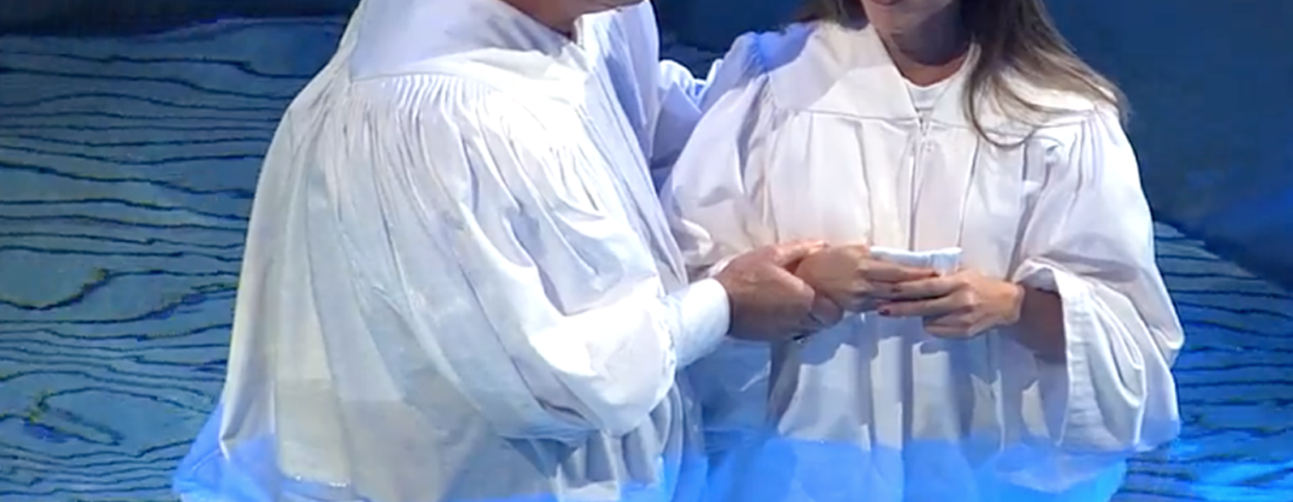
Are you a New Testament Christian?
Hear the Gospel (Rom.10:14)
Believe the Gospel (Heb. 11:6)
Repent of Sins (Acts 3:19)
Confess Christ (Rom.10:9)
Serve our Lord the rest of our lives (Rev.2:10)

