Slide 1
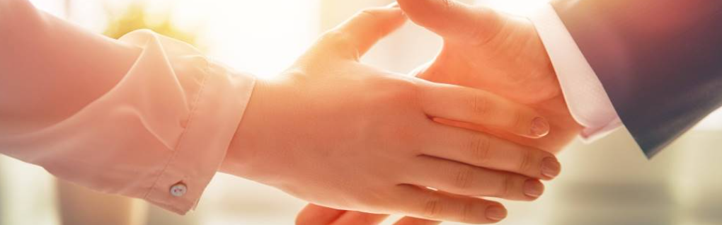
Welcome to our services
New Lebanon Church of Christ
We are Simply Christians.
Our Emphasis is Spiritual, Not Material or Social.
We are striving to be The Same Church as Described in The New Testament.
Please Come Back Again

Slide 2
Christ and the church He built.
Matt. 16:16 Simon Peter answered and said, "You are the Christ, the Son of the living God."
17 Jesus answered and said to him, "Blessed are you, Simon Bar-Jonah, for flesh and blood has not revealed this to you, but My Father who is in heaven.
18 "And I also say to you that you are Peter, and on this rock I will build My church, and the gates of Hades shall not prevail against it.

Slide 3
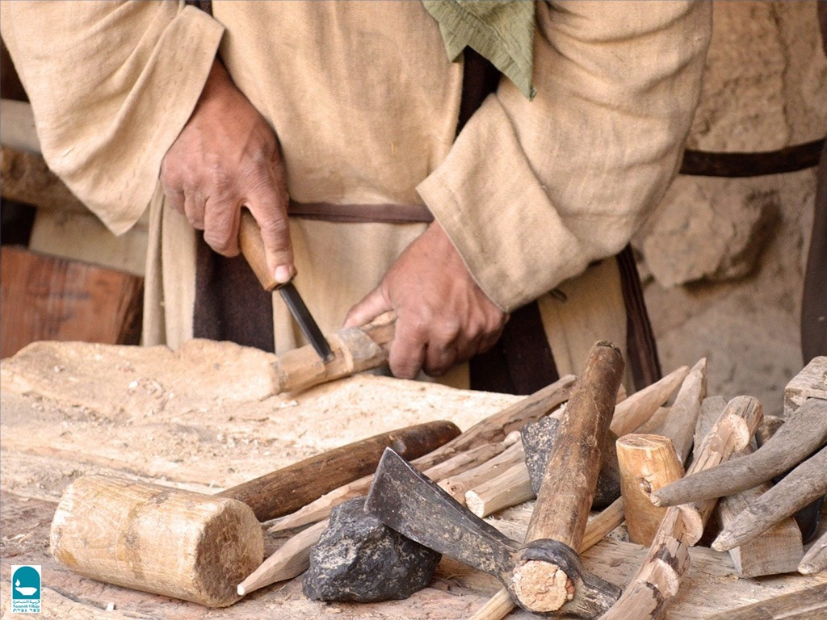

Christ and the Church He Built
Matt.16:16-18

Slide 4

Please open your hearts, your ears, and your Bible and follow along.
If you have any questions about anything I say, if you disagree anything I say, please say something to me after the service and I will be glad to sit down with you and God’s word and study so that we can come to know His truth
Illustrated Bible verses by Ethical Media, Bible photos by bibleplaces.com

Slide 5
Christ and the church He built.
Who Is Jesus the Christ?
Matt. 16:16 Simon Peter answered and said, "You are the Christ, the Son of the living God."
17 Jesus answered and said to him, "Blessed are you, Simon Bar-Jonah, for flesh and blood has not revealed this to you, but My Father who is in heaven. (prophecies of O.T.)
18 "And I also say to you that you are Peter, and on this rock (confession) I will build My church, and the gates of Hades shall not prevail against it. (church and it singular, not plural)

Slide 6
Christ and the church He built.
Church = Kingdom
Matt. 16:16 Simon Peter answered and said, "You are the Christ, the Son of the living God.“ 17 Jesus answered and said to him, "Blessed are you, Simon Bar-Jonah, for flesh and blood has not revealed this to you, but My Father who is in heaven. (prophecies of O.T.) 18 "And I also say to you that you are Peter, and on this rock I will build My church, and the gates of Hades shall not prevail against it.
Matt. 16:19 And I will give unto thee the keys of the kingdom of heaven: and whatsoever thou shalt bind on earth shall be bound in heaven: and whatsoever thou shalt loose on earth shall be loosed in heaven. 20 Then charged he his disciples that they should tell no man that he was Jesus the Christ. 21 From that time forth began Jesus to shew unto his disciples, how that he must go unto Jerusalem, and suffer many things of the elders and chief priests and scribes, and be killed, and be raised again the third day.

Slide 7
Christ and the church He built.
Who Is Jesus the Christ?
Jesus – Matt. 1:21 And she shall bring forth a son, and thou shalt call his name JESUS: for he shall save his people from their sins. (JESUS: that is, Savior, Hebrew – Joshua)
Luke 19:10 "for the Son of Man has come to seek and to save that which was lost."
Christ – The anointed one. The Messiah.

Slide 8
Christ and the church He built.
Who Is Jesus the Christ?
1 Timothy 6:13–16
¹³ I urge you in the sight of God who gives life to all things, and before Christ Jesus who witnessed the good confession before Pontius Pilate, ¹⁴ that you keep this commandment without spot, blameless until our Lord Jesus Christ’s appearing, ¹⁵ which He will manifest in His own time, He who is the blessed and only Potentate, the King of kings and Lord of lords, ¹⁶ who alone has immortality, dwelling in unapproachable light, whom no man has seen or can see, to whom be honor and everlasting power. Amen.

Slide 9
Title
Christ and the church He built.
Gospels
Matthew -J
Mark -R
Luke -G
John -U
Paul’s Letters
Romans
1st Cor
2nd Cor
Gal.
Eph.
Phil.
Col
1Thess
2Thess
1Tim
2Tim
Titus
Phil.
General letters
Hebrews
James
1Peter
2Peter
1 John
2 John
3 John
Jude
The life of Christ
History
Acts
History of the church.
How to be a Christ-ian
These 21 letters tell us how to LIVE the Christian life.
Revelation –
Tells us how to DIE in Christ.
Be faithful unto death.
b hastings newlebanoncoc.com

Slide 10
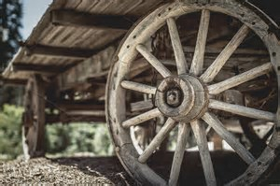
O.T. prophecies point to the establishment of the church / kingdom on the day the Holy Spirit would come
Daniel 2:31-35
Psalm 2:1-12
Acts 2. Hub of the Bible
Isaiah 2:1-4
In kingdom
today
Joel 2:28-32
Col. 1:13

Slide 11
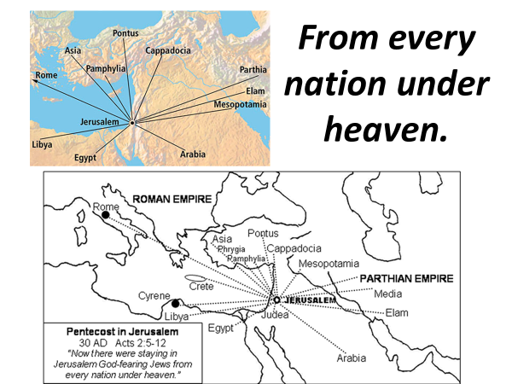
Captivity
Migration
Expulsion

Slide 12

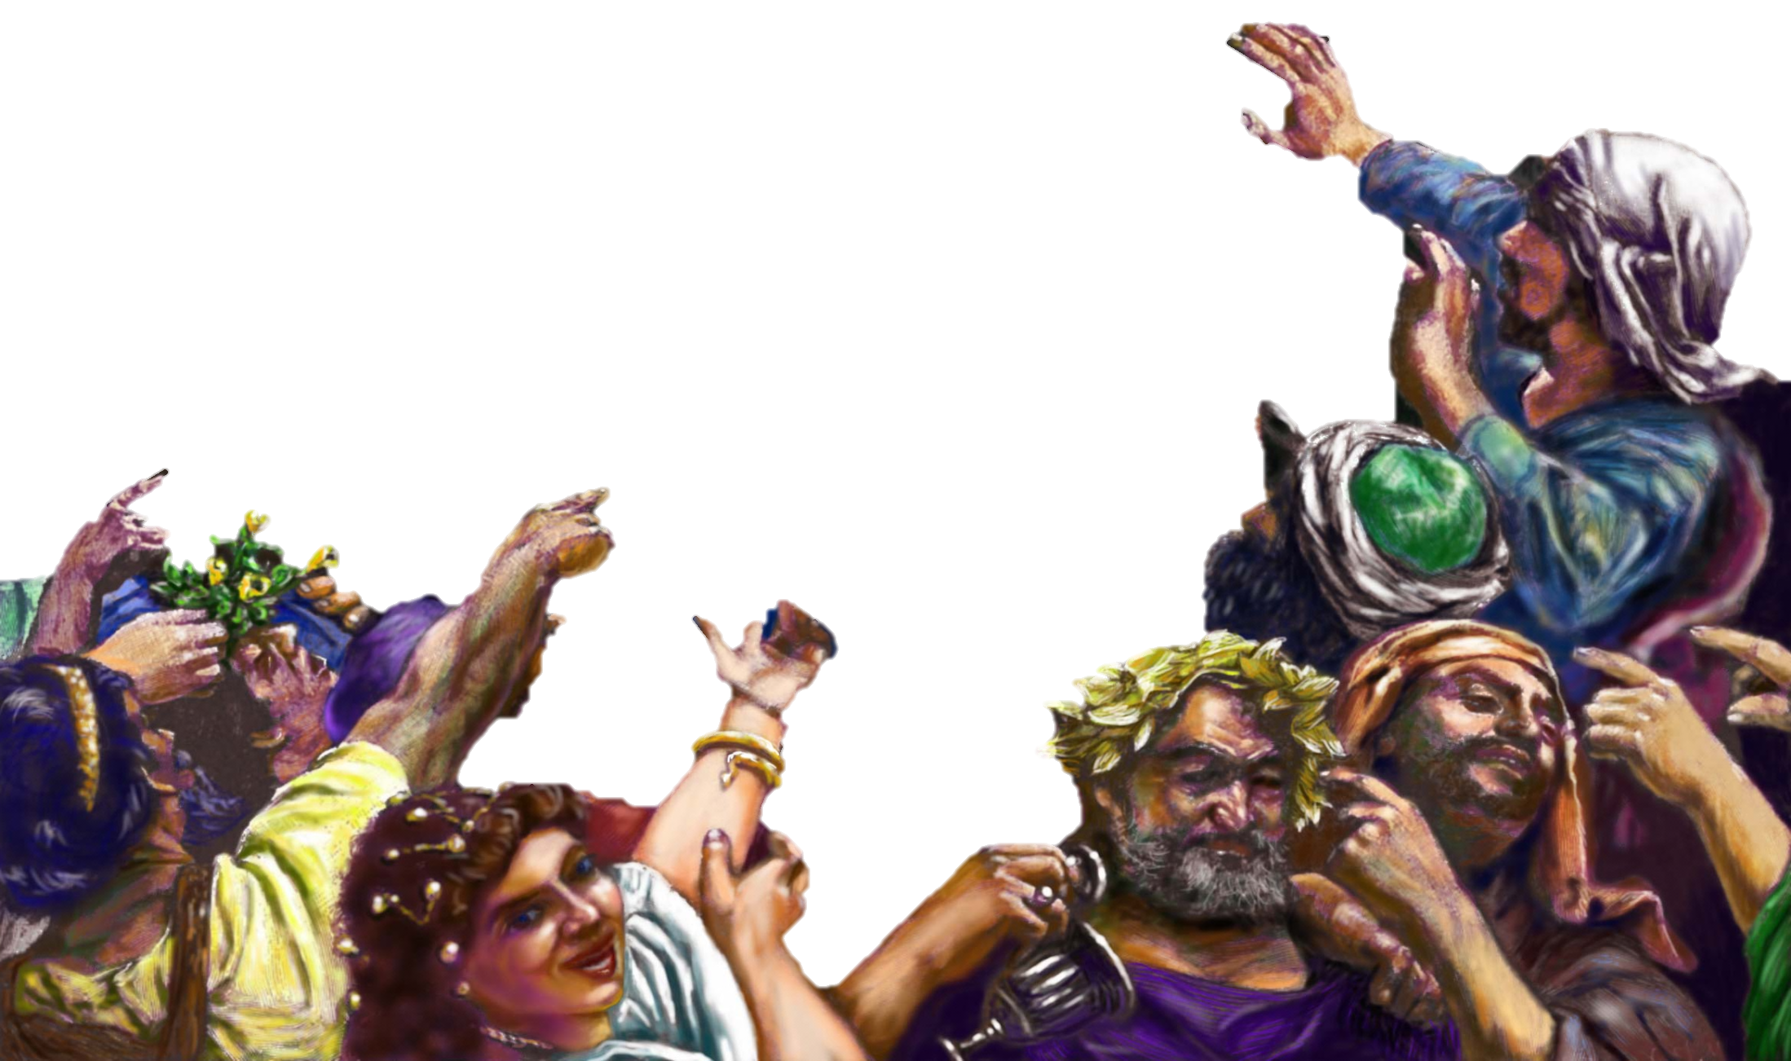
CHAPTER 2
“¹²And they were all amazed, and were in doubt, saying one to another, What meaneth this? ¹³Others mocking said, These men are full of new wine.”

Slide 13
The KINGDOM would come with POWER.
The POWER would come when the HOLY SPIRIT came.
Therefore, the KINGDOM came when the HOLY SPIRIT came.
HOW WE KNOW WHEN
THE KINGDOM CAME
Mark 9:1
“And he said unto them, Verily I say unto you, That there be some of them that stand here, which shall not taste of death, till they have seen the kingdom of God come with power. “
Mark 9:1
“And he said unto them, Verily I say unto you, That there be some of them that stand here, which shall not taste of death, till they have seen the kingdom of God come with power. “
Acts 1:8
“But ye shall receive power, after that the Holy Ghost is come upon you: and ye shall be witnesses unto me both in Jerusalem, and in all Judaea, and in Samaria, and unto the uttermost part of the earth.”
Acts 2:1-4
“¹And when the day of Pentecost was fully come, they were all with one accord in one place. ² And suddenly there came a sound from heaven as of a rushing mighty wind, and it filled all the house where they were sitting. ³ And there appeared unto them cloven tongues like as of fire, and it sat upon each of them. ⁴And they were all filled with the Holy Ghost, and began to speak with other tongues, as the Spirit gave them utterance.”

Slide 14
The KINGDOM would come with POWER.
The POWER would come when the HOLY SPIRIT came.
Therefore, the KINGDOM came when the HOLY SPIRIT came.
HOW WE KNOW WHEN
THE KINGDOM CAME
Acts 1:8
“But ye shall receive power, after that the Holy Ghost is come upon you: and ye shall be witnesses unto me both in Jerusalem, and in all Judaea, and in Samaria, and unto the uttermost part of the earth.”
Mark 9:1
“And he said unto them, Verily I say unto you, That there be some of them that stand here, which shall not taste of death, till they have seen the kingdom of God come with power. “
Acts 1:8
“But ye shall receive power, after that the Holy Ghost is come upon you: and ye shall be witnesses unto me both in Jerusalem, and in all Judaea, and in Samaria, and unto the uttermost part of the earth.”
Acts 2:1-4
“¹And when the day of Pentecost was fully come, they were all with one accord in one place. ² And suddenly there came a sound from heaven as of a rushing mighty wind, and it filled all the house where they were sitting. ³ And there appeared unto them cloven tongues like as of fire, and it sat upon each of them. ⁴And they were all filled with the Holy Ghost, and began to speak with other tongues, as the Spirit gave them utterance.”

Slide 15
The KINGDOM would come with POWER.
The POWER would come when the HOLY SPIRIT came.
Therefore, the KINGDOM came when the HOLY SPIRIT came.
Acts 2:1-4
“¹And when the day of Pentecost was fully come, they were all with one accord in one place. ²And suddenly there came a sound from heaven as of a rushing mighty wind, and it filled all the house where they were sitting. ³And there appeared unto them cloven tongues like as of fire, and it sat upon each of them. ⁴And they were all filled with the Holy Ghost, and began to speak with other tongues, as the Spirit gave them utterance.”
HOW WE KNOW WHEN
THE KINGDOM CAME
Mark 9:1
“And he said unto them, Verily I say unto you, That there be some of them that stand here, which shall not taste of death, till they have seen the kingdom of God come with power. “
Acts 1:8
“But ye shall receive power, after that the Holy Ghost is come upon you: and ye shall be witnesses unto me both in Jerusalem, and in all Judaea, and in Samaria, and unto the uttermost part of the earth.”
Acts 2:1-4
“¹And when the day of Pentecost was fully come, they were all with one accord in one place. ² And suddenly there came a sound from heaven as of a rushing mighty wind, and it filled all the house where they were sitting. ³ And there appeared unto them cloven tongues like as of fire, and it sat upon each of them. ⁴And they were all filled with the Holy Ghost, and began to speak with other tongues, as the Spirit gave them utterance.”

Slide 16
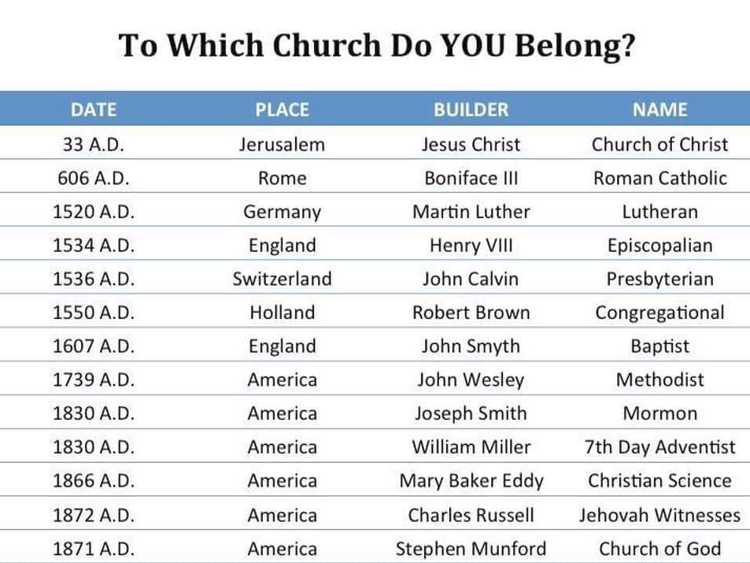
Christ and the church He built.
Acts 2:47 praising God and having favor with all the people. And the Lord added to the church daily those who were being saved.
These churches are too late to be the Lord’s church.
These churches are not the Bride of Christ (Eph.5) Christ has ONE Bride.
Which church were those in Acts 2:47 added to?

Slide 17
Christ and the church He built.
Lev. 17:11 'For the life of the flesh is in the blood, and I have given it to you upon the altar to make atonement for your souls; for it is the blood that makes atonement for the soul.'
Heb. 10:4 For it is not possible that the blood of bulls and goats could take away sins.
1Peter 1:18 knowing that you were not redeemed with corruptible things, like silver or gold, from your aimless conduct received by tradition from your fathers, 19 but with the precious blood of Christ, as of a lamb without blemish and without spot.

Slide 18
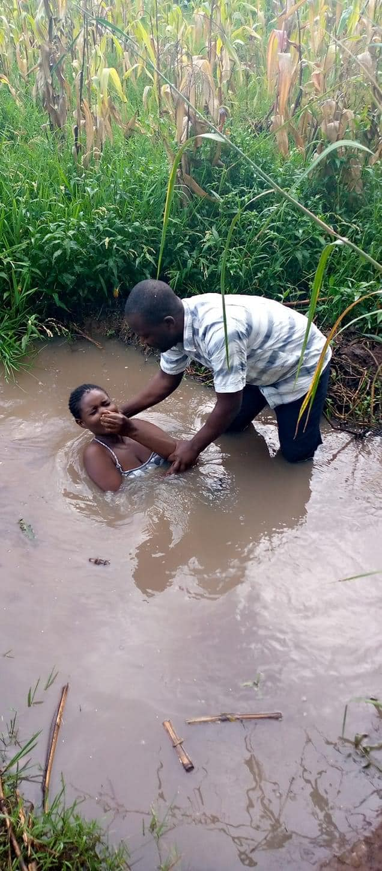
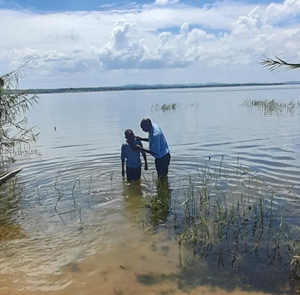
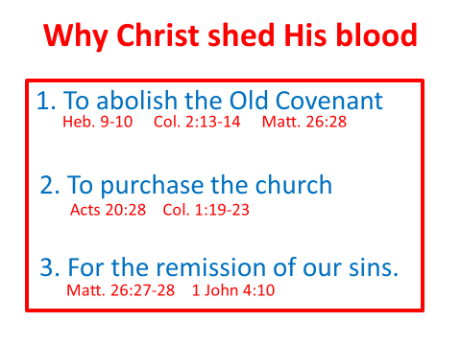
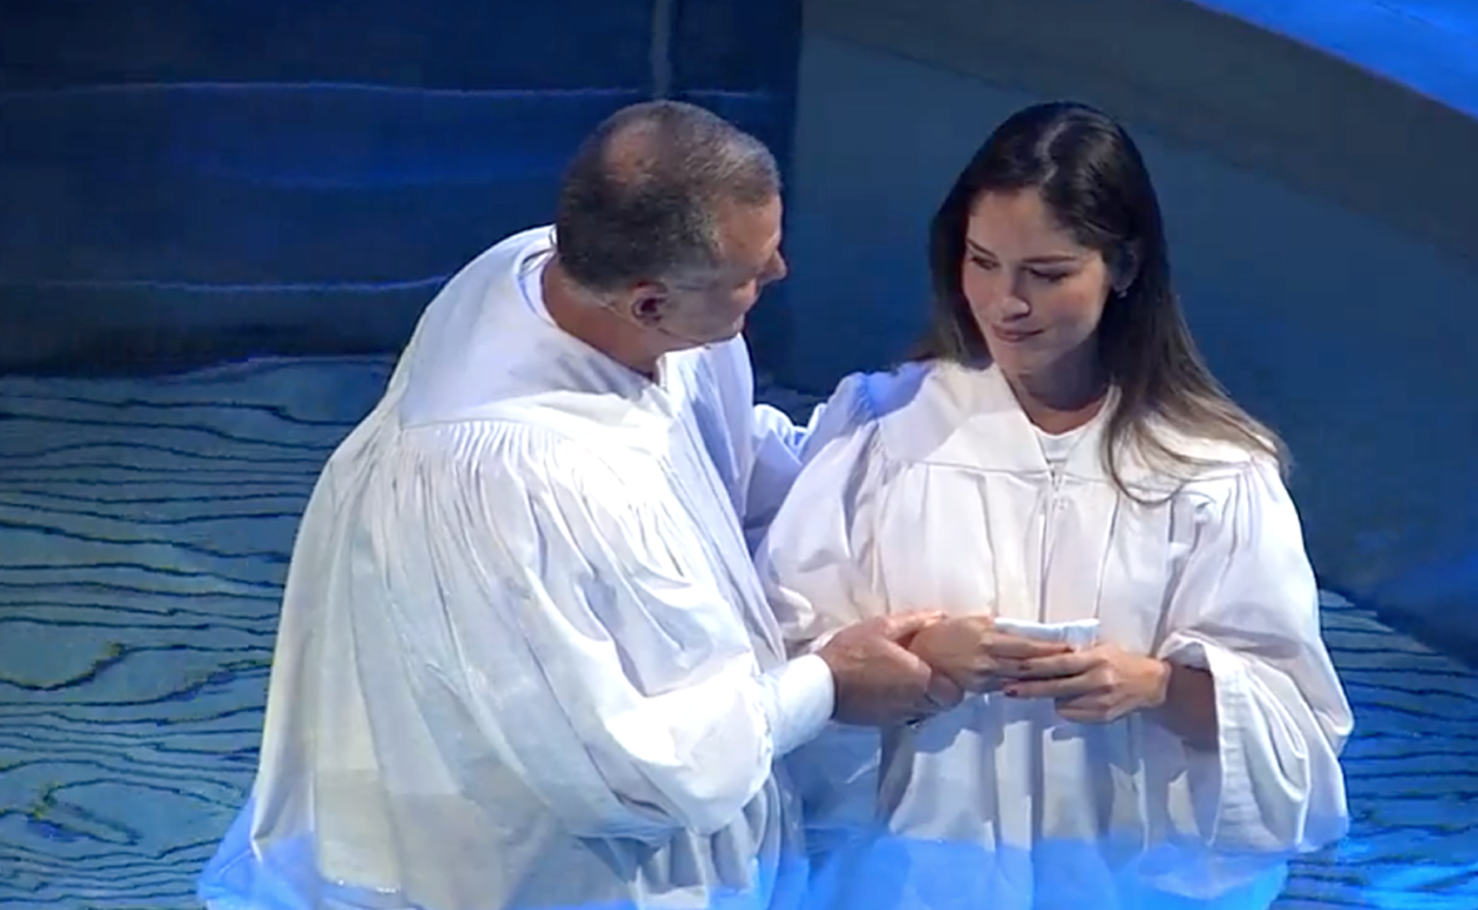
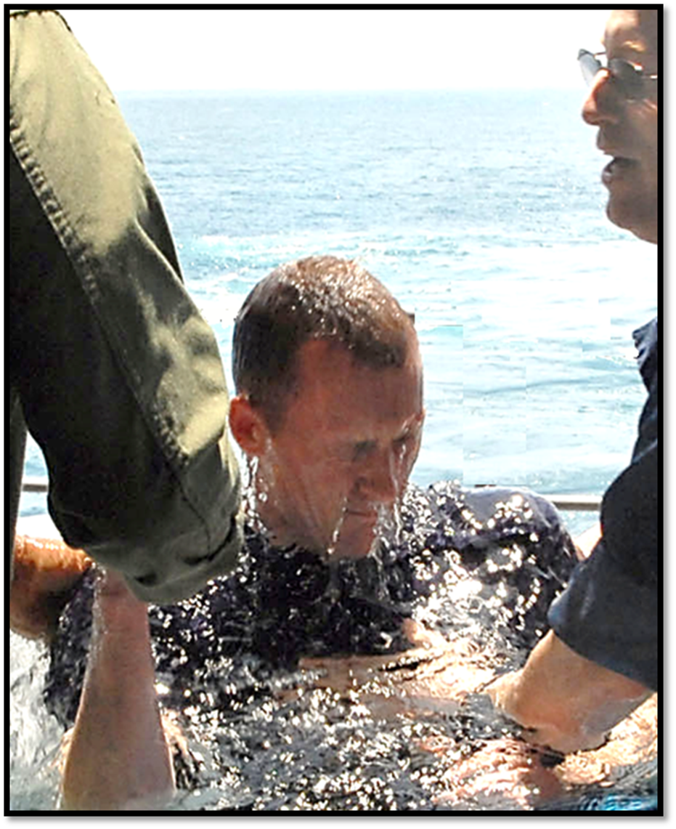
Christ and the church He built.
b hastings newlebanoncoc.com

Slide 19
The Called Out Body
Christ and the church He built.
The word “church” used in two senses in the New Testament:
Universal sense
  Referring to all those called out of the world into God’s service. Every individual.
    “And I also say to you that you are Peter, and on this rock I will build My church, and the gates of Hades shall not prevail against it.” (Mat.16:18)
4

Slide 20
The Called Out Body
Christ and the church He built.
The word “church” used in two senses in the New Testament:
Local sense
  Referring to all those called out of the world into God’s service in any definite locality.
    “To the church of God which is at Corinth, to those who are sanctified in Christ Jesus, called to be saints, with all who in every place call on the name of Jesus Christ our Lord, both theirs and ours.” (1 Cor.1:2)
5

Slide 21
Christ and the church He built.
“Jesus answered and said to him, "Most assuredly, I say to you, unless one is born again, he cannot see the kingdom of God. Nicodemus said to Him, How can a man be born when he is old? Can he enter a second time into his mother's womb and be born? Jesus answered, "Most assuredly, I say to you, unless one is born of water and the Spirit, he cannot enter the kingdom of God.” (John 3:3-5)
b hastings newlebanoncoc.com

Slide 22
Christ and the church He built.
Acts 8:12
But when they believed Philip as he preached the things concerning the kingdom of God (1)
and the name of Jesus Christ,(2)
both men and women were baptized.(3)
b hastings newlebanoncoc.com

Slide 23
CASE STUDIES OF CONVERSION
Acts | Preaching | Believed | Repented | Confessed | Baptized | Saved
2:22-41 | Pentecost |  | vv. 37-38 |  | vv. 38-41 | Remission Of Sins
8:12 | Samaritans | v. 12 |  |  | v. 12 | Believed
8:13 | Simon | v. 13 |  |  | v. 13
8:35-39 | Eunuch | vv. 36-37 |  | v. 37 | v. 38 | Rejoiced
9:17-18 | Saul |  |  |  | v. 18 | Sins Washed Away
10:34-48 | Cornelius | v. 43 |  |  | v. 48 | Remission Of Sins
16:13 | Lydia | v. 14 |  |  | v. 15
16:31-34 | The Jailer | v. 31 |  |  | v. 33 | Rejoiced
18:8 | Corinthians | v. 8 |  |  | v. 8
19:5 | Ephesians |  |  |  | v. 5
Preached
Repented
Baptized

Slide 24
Christ and the church He built.
The Called Out Body
The Body Of Christ
The Household Of God
The Temple Of God
The Kingdom Of God
The Bride of Christ
The Vineyard Of The Lord
universal / local

Slide 25
Christ and the church He built.
The work and worship that our savior and king reveals to us is carried out in the LOCAL church. Not the universal church.
The Called Out Body
The Body Of Christ
The Household Of God
The Temple Of God
The Kingdom Of God
The Bride of Christ
The Vineyard Of The Lord
The 21 letters in the Bible that tell us how to live the Christian life
universal / local

Slide 26
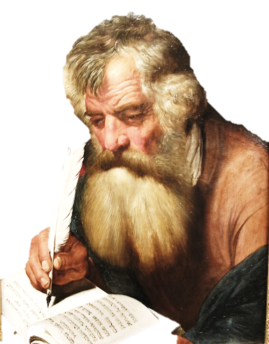
Christ and the church He built.
The church of God at Corinth
Ch.1 The Name
Ch.3 Organization
Ch.4 Doctrine
Ch.5 Discipline
Ch.11 Worship (Lord’s Supper)
Ch.14 Worship (Prayer, Singing, Edification)
Ch.16 Worship (Collection)
In the assembly

Slide 27
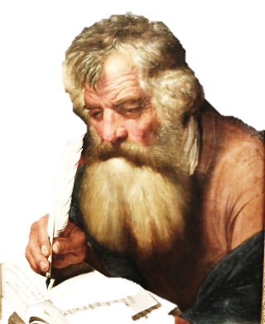
Christ and the church He built.
The church of God at Corinth
Ch.11 The Lord’s supper
1Cor. 11:17 Now in giving these instructions I do not praise you, since you come together not for the better but for the worse. 18 For first of all,
when you come together as a church, I hear that there are divisions among you, and in part I believe it. 19 For there must also be factions among you, that those who are approved may be recognized among you. 20 Therefore
when you come together in one place, it is not to eat the Lord's Supper.
If a church can be virtual or physical assembly, why not sell the building???

Slide 28
Christ and the church He built.
The Power Of Singing
Col. 3:16 Let the word of Christ dwell in you richly in all wisdom, teaching and admonishing one another in psalms and hymns and spiritual songs, singing with grace in your hearts to the Lord.
17 And whatever you do in word or deed, do all in the name of the Lord Jesus, giving thanks to God the Father through Him.
(reciprocal)

Slide 29
Christ and the church He built.
Where Does God Want To Be Worshipped ?
Altar? Tabernacle? Temple? Assembly?
Gen.22:5 (Abraham) Acts 8:27(Et. Treasurer)
Acts 20:16 (Paul) Acts 20:1-7
1st Cor. 11:17-20
Come together
Come together as the church
Come together in one place
Not The Riverside church of Christ
Not The Hunting Lodge church Of Christ
Not The Airport church of Christ
Not The Troas Cruise Ship church of Christ
Notes:
This is nothing new. You can trace it back to Jeroboam setting altars up at Dan and Bethel.

Slide 30
Christ and the church He built.
NT:1577 (Strong’s number) Thayer’s definition
ekkleesia, (from ekkleetos called out or forth, and this from ekkaleoo); properly, a gathering of citizens called out from their homes into some public place; an assembly; so used:
Heb. 10:24 And let us consider one another in order to stir up love and good works,
25 not forsaking the assembling of ourselves together, as is the manner of some, but exhorting one another, and so much the more as you see the Day approaching.
26 For if we sin willfully after we have received the knowledge of the truth, there no longer remains a sacrifice for sins,

Slide 31
Christ and the church He built.
Attendance at the services of the church is the best indicator of interest in one's own spiritual growth, and is an indication of one's own interest in the Lord's church.
One of the purposes for which God gave the church is that we might be edified as a member of the body (Eph. 4:16). The edification of the body as a whole depends upon each member contributing his individual part.
This is the object of worship and fellowship in the church. We need this strength for life's problems and temptations, and we cannot successfully live the Christian life and render an acceptable service to God without it.
Notes:
Why do churches cut services???

Slide 32
Christ and the church He built.
Eph. 4:15 but, speaking the truth in love, may grow up in all things into Him who is the head--Christ—
16 from whom
the whole body,
joined and knit together
by what every joint supplies, according to the effective working
by which every part does its share, causes growth of the body for the edifying of itself in love.

Slide 33

Matt. 28:18 "All authority has been given
to Me in heaven and on earth.”
Opinions - assertions
It is so
because
I say it is so
Silence
tradition
1Cor.4:6 Do not think of men above what is written.
My preacher said this is the answer
I read
so-and-so’s
book. He is
my favorite
writer.
My
daddy taught me
This. My mama
taught me
that
It is so
because
So-and-so
Says it is so.

Slide 34
Christ and the church He built.
Does believing or baptism save us from all sins?
Past – Present -and Future?
What does the Bible teach?
John 12:48 "He who rejects Me, and does not receive My words, has that which judges him--the word that I have spoken will judge him in the last day.

Slide 35
Christ and the church He built.
Eph.2:8,9 For by grace you have been saved through faith, and that not of yourselves; it is the gift of God, 9 not of works, lest anyone should boast.
Acts 19:1 And it happened, while Apollos was at Corinth, that Paul, having passed through the upper regions, came to Ephesus. And finding some disciples ---
Acts 19:5 When they heard this, they were baptized in the name of the Lord Jesus.

Slide 36
Christ and the church He built.
Paul’s reference to salvation in the past perfect tense as something done and accomplished already has no reference to final destiny but to the primary obedience that makes a true child of God.
Eph.2:8

Slide 37
Christ and the church He built.
2Peter 2:18 For when they speak great swelling words of emptiness, they allure through the lusts of the flesh, through lewdness, the ones who have actually escaped from those who live in error. 19 While they promise them liberty, they themselves are slaves of corruption; for by whom a person is overcome, by him also he is brought into bondage.
20 For if, after they have escaped the pollutions of the world through the knowledge of the Lord and Savior Jesus Christ, they are again entangled in them and overcome, the latter end is worse for them than the beginning.
21 For it would have been better for them not to have known the way of righteousness, than having known it, to turn from the holy commandment delivered to them.
22 But it has happened to them according to the true proverb: "A dog returns to his own vomit," and, "a sow, having washed, to her wallowing in the mire."

Slide 38
Christ and the church He built.
Commitment
Luke 9:57 Now it happened as they journeyed on the road, that someone said to Him, "Lord, I will follow You wherever You go." 58 And Jesus said to him, "Foxes have holes and birds of the air have nests, but the Son of Man has nowhere to lay His head."
59 Then He said to another, "Follow Me." But he said, "Lord, let me first go and bury my father."
60 Jesus said to him, "Let the dead bury their own dead, but you go and preach the kingdom of God."
61 And another also said, "Lord, I will follow You, but let me first go and bid them farewell who are at my house."
62 But Jesus said to him, "No one, having put his hand to the plow, and looking back, is fit for the kingdom of God."

Slide 39
Christ and the church He built.
1st Coming A mission of Mercy
2nd Coming A mission of Vengeance
God will remove sin by one of two ways
1) wrath
2) forgiveness
He leaves the choice up to us.

Slide 40
Christ and the church He built.
God will remove sin by one of two ways:
1) wrath 2) forgiveness
Rom. 1:18 For the wrath of God is revealed from heaven against all ungodliness and unrighteousness of men, who suppress the truth in unrighteousness,
2Thess 1:6 since it is a righteous thing with God to repay with tribulation those who trouble you,….
8 in flaming fire taking vengeance on those who do not know God, and on those who do not obey the gospel of our Lord Jesus Christ.
9 These shall be punished with everlasting destruction from the presence of the Lord and from the glory of His power,
Acts 22:16 'And now why are you waiting? Arise and be baptized, and wash away your sins, calling on the name of the Lord.'

Slide 41
Christ and the church He built.
Christ is coming back for His wife His church, the church of Christ, Eph.5:23-27, Matt.16:18, Rom. 16,16.
He will not be coming back for other men’s wives (denominations).
Are you ready for His return?

