Slide 1
Welcome to our services
New Lebanon Church of Christ
We are Simply Christians.
Our Emphasis is Spiritual, Not Material or Social.
We are striving to be The Same Church as Described in The New Testament.
Please Come Back Again

Slide 2
But In Everything By Prayer Phil 4:6
Phil. 4:6 Be anxious for nothing, but in everything by prayer and supplication, with thanksgiving, let your requests be made known to God;
7 and the peace of God, which surpasses all understanding, will guard your hearts and minds through Christ Jesus.
8 Finally, brethren, whatever things are true, whatever things are noble, whatever things are just, whatever things are pure, whatever things are lovely, whatever things are of good report, if there is any virtue and if there is anything praiseworthy--meditate on these things.
9 The things which you learned and received and heard and saw in me, these do, and the God of peace will be with you.

Slide 3
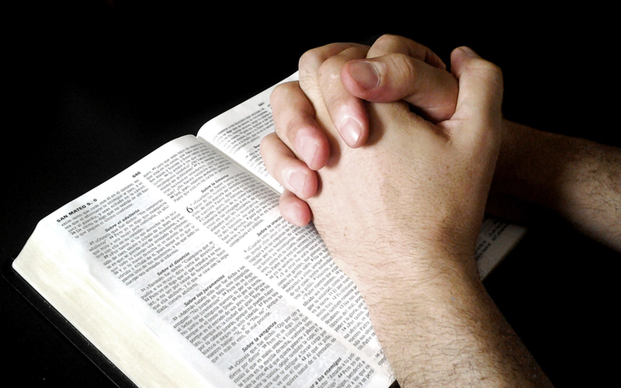
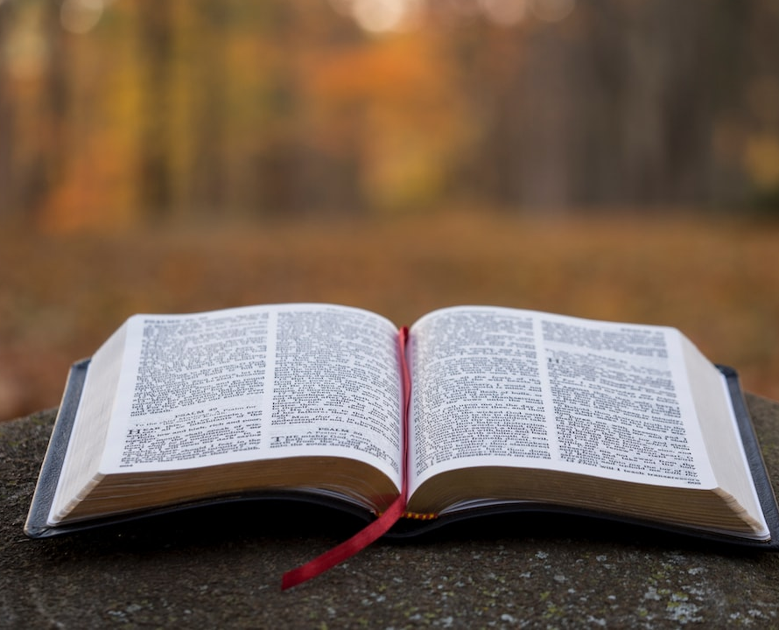
We invite you to join us for our first Wednesday of the month prayer service. Our time will be spent PRAYING.
We invite the community to
join us.
Dec.6 at 7:00pm
The
New Lebanon
Church of Christ
1973 West Main St.
newlebanoncoc.com

Slide 5
But In Everything By Prayer Phil 4:6
What should we ask God for?
How Does God Answer Prayer?
Benefits of Prayer

Slide 6
But In Everything By Prayer Phil 4:6
What should we ask God for?
How Does God Answer Prayer?
Benefits of Prayer

Slide 7
But In Everything By Prayer Phil 4:6
What should we ask God for?
The forgiveness of sins
Christians are commanded to pray for the forgiveness of their sins Acts 8:22; but the unbaptized, even if they believe, are not so commanded. The believing Saul of Tarsus had been on his knees three days and nights; but God’s messenger neither invited him to continue his petition, nor did Saul receive any answer. On the contrary, the inspired preacher commanded him to “arise and be baptized and wash away your sins” Acts 22:16.

Slide 8
But In Everything By Prayer Phil 4:6
What should we ask God for?
The forgiveness of the sins of others
Both our Lord Luke 23:34 and the martyr Stephen Acts 7:60 prayed for the forgiveness of the sins of others.

Slide 9
But In Everything By Prayer Phil 4:6
What should we ask God for?
The wisdom of God
“If any man lack wisdom, let him ask of God, that gives to all men liberally and upbraids not, and it shall be given.” James 1:5, 6.

Slide 10
But In Everything By Prayer Phil 4:6
What should we ask God for?
Relief from bitter experiences
Jesus himself prayed that
“the cup” might pass from him Matt. 26:39.

Slide 11
But In Everything By Prayer Phil 4:6
What should we ask God for?
Our daily bread
Prayer for all of life’s basic necessities, such as food, clothing and shelter, is authorized by this model prayer.

Slide 12
But In Everything By Prayer Phil 4:6
What should we ask God for?
Laborers in the vineyard
“Pray ye therefore the Lord of the harvest, that he will send forth laborers into his vineyard” Matt. 9:38

Slide 13
But In Everything By Prayer Phil 4:6
What should we ask God for?
Laborers already working
Paul admonished the Ephesians to “Pray for ME, that utterance may be given unto me that I may open my mouth boldly, to make known the mystery of the gospel” Eph. 6:19.

Slide 14
But In Everything By Prayer Phil 4:6
What should we ask God for?
For mercy
“Come boldly to the throne of grace that we may obtain mercy and find grace to help in time of need” (Heb. 4:16).

Slide 15
But In Everything By Prayer Phil 4:6
What should we ask God for?
Heal the sick
“The prayer of faith shall save the sick” James 5:14, 15.

Slide 16
But In Everything By Prayer Phil 4:6
What should we ask God for?
Deliverance from temptation
“Lead us not into temptation, but deliver us from the evil one” (Matt. 6:13).

Slide 17
But In Everything By Prayer Phil 4:6
What should we ask God for?
For those that despitefully use us
This includes prayer for enemies. Matt. 5:44.

Slide 18
But In Everything By Prayer Phil 4:6
What should we ask God for?
In everything. The text before us stresses the need of prayer in all of life’s conditions and circumstances. Any list, therefore, of things we should pray for must be partial and incomplete. “Everything” certainly covers a lot of territory. Only one specific is noted.

Slide 19
But In Everything By Prayer Phil 4:6
What should we ask God for?
For rulers and authorities
Paul singled out as an object of prayer, in all probability, because it is easily overlooked, especially in a corrupt age like that of the New Testament era. He said:
I exhort therefore, that first of all prayers, intercession and giving of thanks be made for all men, for kings, and for all that are in authority, that we might lead a quiet and peaceable life in all godliness and honesty. For this is good and acceptable in the sight of God our Savior. 1 Tim. 2:1–3.

Slide 20
But In Everything By Prayer Phil 4:6
What should we ask God for?
For rulers and authorities.
Paul singled out as an object of prayer, in all probability, because it is easily overlooked, especially in a corrupt age like that of the New Testament era. He said:
I exhort therefore, that first of all prayers, intercession and giving of thanks be made for all men, for kings, and for all that are in authority, that we might lead a quiet and peaceable life in all godliness and honesty. For this is good and acceptable in the sight of God our Savior. 1 Tim. 2:1–3.
b hastings newlebanoncoc.com

Slide 21
But In Everything By Prayer Phil 4:6
What should we ask God for?
How Does God Answer Prayer?
Benefits of Prayer

Slide 22
But In Everything By Prayer Phil 4:6
How Does God Answer Prayer?
God answers prayer literally
As when Joshua prayed for the sun to stand still, Elijah prayed for drought, or rain, and when Jonah prayed to God from the belly of the great fish. New Testament confirmation of God’s literal answer of prayer is in the following:

Slide 23
But In Everything By Prayer Phil 4:6
How Does God Answer Prayer?
God answers prayer literally
The supplication of a righteous man avails much in its working. Elijah was a man of like passions with us, and he prayed fervently that it might not rain; and it rained not on the earth for three years and six months. And he prayed again; and the heaven gave rain, and the earth brought forth her fruit (James 5:16–18).

Slide 24
But In Everything By Prayer Phil 4:6
How Does God Answer Prayer?
God answers prayer by a refusal to grant the petition
In 2 Cor. 12:7–10 Paul detailed the fact of his earnest prayers that God would take away his thorn in the flesh, a thing God declined to do.

Slide 25
But In Everything By Prayer Phil 4:6
How Does God Answer Prayer?
God also answers prayer by sending something different from what was requested.
In Gethsemane Jesus prayed for the “cup” to pass from him; instead of allowing this, God sent an angel to strengthen the Lord. Similarly, people may pray for lighter loads, but God may send them greater strength.

Slide 26
But In Everything By Prayer Phil 4:6
How Does God Answer Prayer?
God answers prayer gradually
God answers prayer after delay. It seems strange that God would delay to answer Christian prayers, but it may not be denied.

Slide 27
But In Everything By Prayer Phil 4:6
How Does God Answer Prayer?
God answers prayer gradually
The angel sent to stay the hand of Abraham about to offer Isaac delayed until the latest possible moment.
The wine had run completely out at Cana before the Lord answered his mother’s implied request.
When Jacob wrestled with an angel, day was breaking before the issue was decided.

Slide 28
But In Everything By Prayer Phil 4:6
How Does God Answer Prayer?
God answers prayer gradually
In the New Testament, Jairus came to the Lord; and during Jesus’ delay, his daughter died. Here also may be the explanation of why the Lord often delays the answer to prayer; it is that he may give something far more wonderful, or far better, than what was requested. In the case of Jairus’ daughter, a resurrection was far better and far more wonderful than a healing would have been.

Slide 29
But In Everything By Prayer Phil 4:6
How Does God Answer Prayer?
God answers prayer through natural laws and processes.
When fields yield richly; when people enjoy good health; when nature pours out abundant blessings; all of these things are God’s answer to his children’s prayers for daily bread, nor should the Giver be overlooked merely because the normal processes of nature through which his blessings were conveyed

Slide 30
But In Everything By Prayer Phil 4:6
How Does God Answer Prayer?
Summarizing the ways in which God answers prayer, some of the ways are:
He may answer it literally.
He may refuse to grant the petition.
He may send something different from what was requested.
He may answer it gradually.
He may answer it after a long delay.
He may answer through natural laws and processes.

Slide 31
But In Everything By Prayer Phil 4:6
What should we ask God for?
How Does God Answer Prayer?
Benefits of Prayer

Slide 32
But In Everything By Prayer Phil 4:6
Benefits of Prayer
Phil.4:7 and the peace of God, which surpasses all understanding, will guard your hearts and minds through Christ Jesus.

Slide 33
But In Everything By Prayer Phil 4:6
Benefits of Prayer
The peace of God … This was described by Hendriksen as “The smile of God reflected in the soul of the believer, the heart’s calm after Calvary’s storm, the conviction that God who spared not his own Son will surely also, along with him, freely give us all things (Rom. 8:32).”

Slide 34
But In Everything By Prayer Phil 4:6
Benefits of Prayer
Passes all understanding … Those who see it manifested in the lives of Christians cannot understand such peace exhibited despite the trials of this life.
We may not fully understand it; but those who have experienced it would not exchange it for anything that the world has to offer.

Slide 35
But In Everything By Prayer Phil 4:6
Benefits of Prayer
Shall guard your hearts … The scholars tell us that this is translated from a military term signifying a sentinel guarding a city. As Philippi was a Roman colony, populated with many retirees from the military establishment of Rome.

Slide 36
But In Everything By Prayer Phil 4:6
Benefits of Prayer
In Christ Jesus … Paul’s favorite expression again appears here.
Out of Christ there is nothing; in him is the life eternal; and people (let all people hear it) are “baptized into Christ,” as Paul himself declared (Rom. 6:3).
What about faith? No unbeliever can be baptized, and no believer is in Christ until he is baptized into him.

Slide 37
But In Everything By Prayer Phil 4:6
Benefits of Prayer
Phil 4:8 Finally, brethren, whatsoever things are true, whatsoever things are honorable, whatsoever things are just, whatsoever things are pure, whatsoever things are lovely, whatsoever things are of good report; if there be any virtue, and if there be any praise, think on these things.

Slide 38
But In Everything By Prayer Phil 4:6
Benefits of Prayer
Finally … Paul had written this in Phil. 3:1; Again and again he prepares to close his letter, but he cannot say goodbye to his beloved Philippians.
Thought control - If people would live correctly in God’s sight, let them think of those qualities which possess positive value. Thinking of such things will lead to speaking of them, as exemplified in the lives of associates, thus contributing to the joy and unity of Christian fellowship.
the word (logizomai) Paul used here, translated “take such things into account” is Paul’s way of saying, “Let such things shape your attitudes.”

Slide 39
But In Everything By Prayer Phil 4:6
Benefits of Prayer
Phil 4:9 The things which ye both learned and received and heard and saw in me, these things do: and the God of peace shall be with you.
This is the same as Paul’s frequent admonitions to follow (or imitate) him as he followed (or imitated) Christ.
The God of peace … In Phil. 4:7, Paul had written “the peace of God”; and, as Barry said, “The inversion is striking.” The peace of God passes all understanding, but the God of peace is more, peace being that which is given, and God being the giver.

Slide 40
But In Everything By Prayer Phil 4:6
What should we ask God for?
How Does God Answer Prayer?
Benefits of Prayer

