Slide 1
Welcome to our services
New Lebanon Church of Christ
We are Simply Christians.
Our Emphasis is Spiritual, Not Material or Social.
We are striving to be The Same Church as Described in The New Testament.
Please Come Back Again

Slide 2
A Savior Who Is Christ The Lord. Luke 2:11
Luke 2:1 And it came to pass in those days that a decree went out from Caesar Augustus that all the world should be registered. 2 This census first took place while Quirinius was governing Syria. 3 So all went to be registered, everyone to his own city.
b hastings newlebanoncoc.com

Slide 3
Please open your hearts, your ears, and your Bible and follow along.
If you have any questions about anything I say, if you disagree anything I say, please say something to me after the service and I will be glad to sit down with you and God’s word and study so that we can come to know His truth
Illustrated Bible verses by Ethical Media, Bible photos by bibleplaces.com

Slide 4
Matthew - This book gives the birth of Christ, His baptism, temptation and ministry. Written to the Jews about Christ being King. The sermon on the Mount is included. The beatitudes and the Lord’s prayer. Also found is a passage on future events.
Mark - This book was written for the Roman readers. This book centers on Christ and the sacrifice and service of the believer to Him.
Luke - The theme of this book is also Christ. Christ is spoken of as the Son of Man, and gives us a view of Christ’s compassion. This book was written with the Greek (Gentile) in mind.
John – Universal audience dealing mostly with the deity of Christ. It is a book about Him and about having faith in Him. He is the Son of God. Seven miracles of Christ: John was written that we might BELIEVE. The Holy Spirit is spoken of and the new birth.

Slide 5
A Savior Who Is Christ The Lord. Luke 2:11
Title
Luke 2:4 Joseph also went up from Galilee, out of the city of Nazareth, into Judea, to the city of David, which is called Bethlehem, because he was of the house and lineage of David,
5 to be registered with Mary, his betrothed wife, who was with child.
b hastings newlebanoncoc.com

Slide 6
A Savior Who Is Christ The Lord. Luke 2:11
Title
Luke 2:6 So it was, that while they were there, the days were completed for her to be delivered.
7 And she brought forth her firstborn Son, and wrapped Him in swaddling cloths, and laid Him in a manger, because there was no room for them in the inn.
b hastings newlebanoncoc.com

Slide 7
A Savior Who Is Christ The Lord. Luke 2:11
Title
Luke 2:8 Now there were in the same country shepherds living out in the fields, keeping watch over their flock by night.
9 And behold, an angel of the Lord stood before them, and the glory of the Lord shone around them, and they were greatly afraid.
10 Then the angel said to them, "Do not be afraid, for behold, I bring you good tidings of great joy which will be to all people.
b hastings newlebanoncoc.com

Slide 8
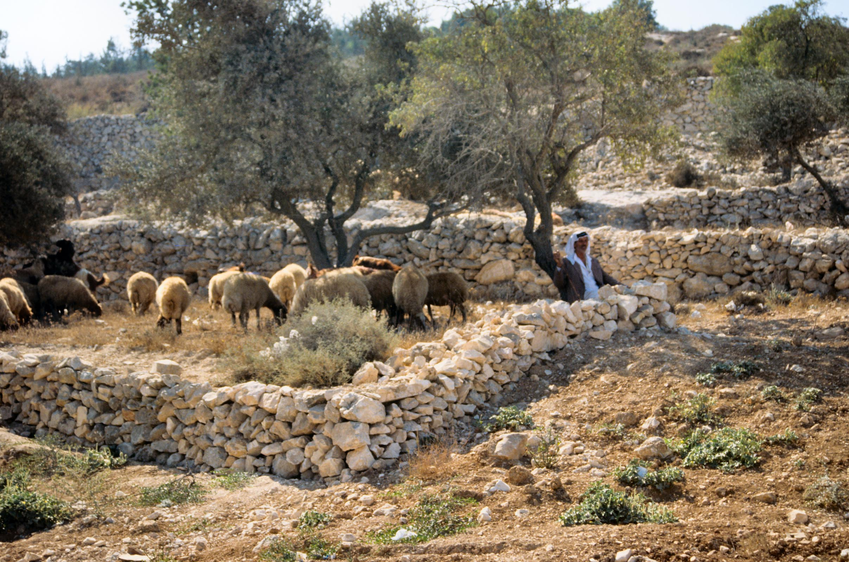
There were shepherds in the fields nearby, keeping watch over their flock
Shepherd with flock near Bethlehem
2:8
Notes:
This shepherd was grazing his flock in an olive grove east of Bethlehem in the fall of 1990.
tbs43309009

Slide 9
A Savior Who Is Christ The Lord. Luke 2:11
Title
Luke 2:11 "For there is born to you this day in the city of David a Savior, who is Christ the Lord.
12 "And this will be the sign to you: You will find a Babe wrapped in swaddling cloths, lying in a manger."
b hastings newlebanoncoc.com

Slide 10
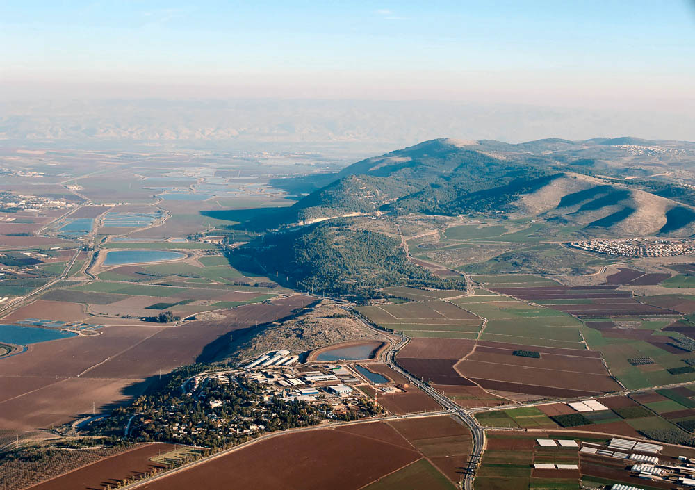
Joseph also went up from Galilee, out of the city of Nazareth
Harod Valley, Mount Gilboa, and Jezreel (aerial view from the west)
2:4
Notes:
It was common for Jews in Galilee who were traveling to Jerusalem to bypass Samaria by traveling south through the Jordan Rift. Luke 17:11 mentions that Jesus traveled between Samaria and Galilee on His way to Jerusalem. Mount Gilboa is the northernmost of the mountains of Samaria. Joseph and Mary may have skirted these mountains by passing past Jezreel and through the Harod Valley. See the following slide for labels.
tb121704019

Slide 11
A Savior Who Is Christ The Lord. Luke 2:11
Title
It was common for Jews in Galilee who were traveling to Jerusalem to bypass Samaria by traveling south through the Jordan Rift. Luke 17:11 mentions that Jesus traveled between Samaria and Galilee on His way to Jerusalem. Mount Gilboa is the northernmost of the mountains of Samaria.
Joseph and Mary may have skirted these mountains by passing past Jezreel and through the Harod Valley.
b hastings newlebanoncoc.com

Slide 12
Joseph also went up from Galilee, out of the city of Nazareth
Jordan Rift
Mount Gilboa
Harod Valley
Possible route of Joseph and Mary
Jezreel
Harod Valley, Mount Gilboa, and Jezreel (aerial view from the west)
2:4
Notes:
It was common for Jews in Galilee who were traveling to Jerusalem to bypass Samaria by traveling south through the Jordan Rift. Luke 17:11 mentions that Jesus traveled between Samaria and Galilee on His way to Jerusalem. Mount Gilboa is the northernmost of the mountains of Samaria. Joseph and Mary may have skirted these mountains by passing past Jezreel and through the Harod Valley.
tb121704019

Slide 13
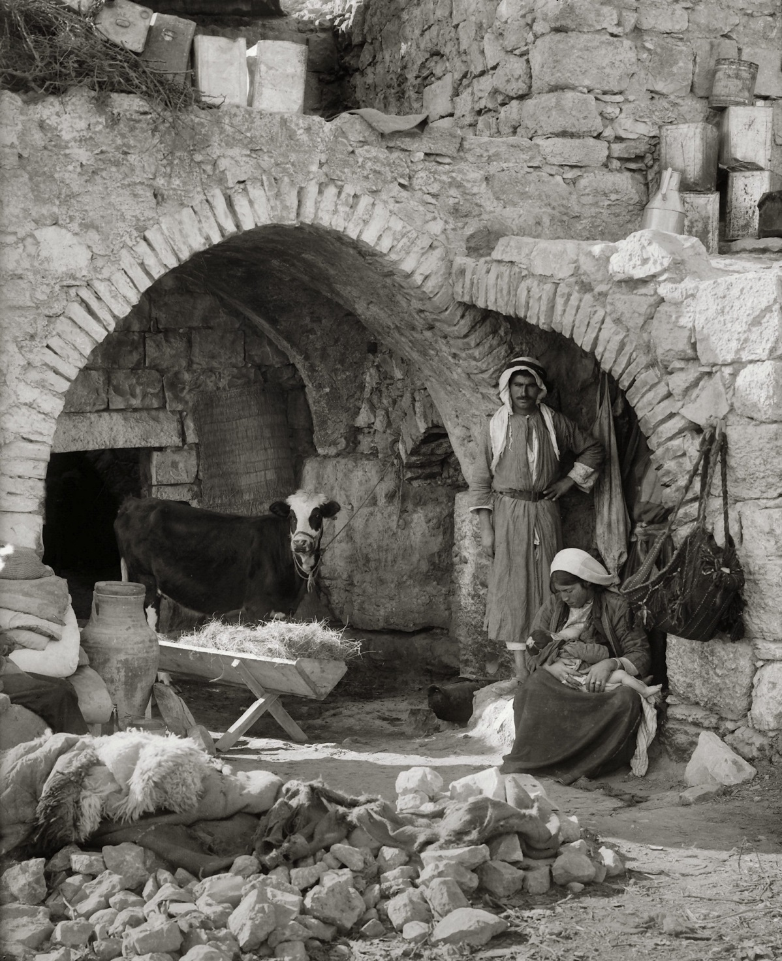
She gave birth to her firstborn son, and wrapped Him in cloths, and laid Him in a manger
Nativity scene recreated in native home near Bethlehem
Luke 2:7
Notes:
This is a reconstructed scene made by photographers from the American Colony between 1900 and 1920 to illustrate the nativity scene near Bethlehem. As shown on the previous slides, the manger was probably made of stone and not wood. For recreating scenes such as this one, wooden mangers are much easier to transport.
mat05495

Slide 14
A Savior Who Is Christ The Lord. Luke 2:11
Title
The word translated as “inn” is the Greek word kataluma, used elsewhere by Luke and always translated as “guest chamber” or “upper room” (Luke 22:11; cf. Mark 14:14).
Mark 14:15 And he will shew you a large upper room furnished and prepared: there make ready for us.
Luke 22:12 And he shall shew you a large upper room furnished: there make ready.
Acts 1:13 And when they were come in, they went up into an upper room, where abode both Peter, and James, and John, and Andrew, Philip, and Thomas, Bartholomew, and Matthew, James the son of Alphaeus, and Simon Zelotes, and Judas the brother of James.
b hastings newlebanoncoc.com

Slide 15
A Savior Who Is Christ The Lord. Luke 2:11
Title
When Luke wants to speak of a paid establishment (i.e., an inn), he uses a different Greek word, pandocheion, as in the story of the Good Samaritan (Luke 10:34).
Dozens of English translations translate kataluma as “inn” in Luke 2:7 and not as “guest room,” but some translations use this including the NIV2011, CEB, and NJB.
(This American Colony photograph was taken between 1900 and 1920.)
b hastings newlebanoncoc.com

Slide 16
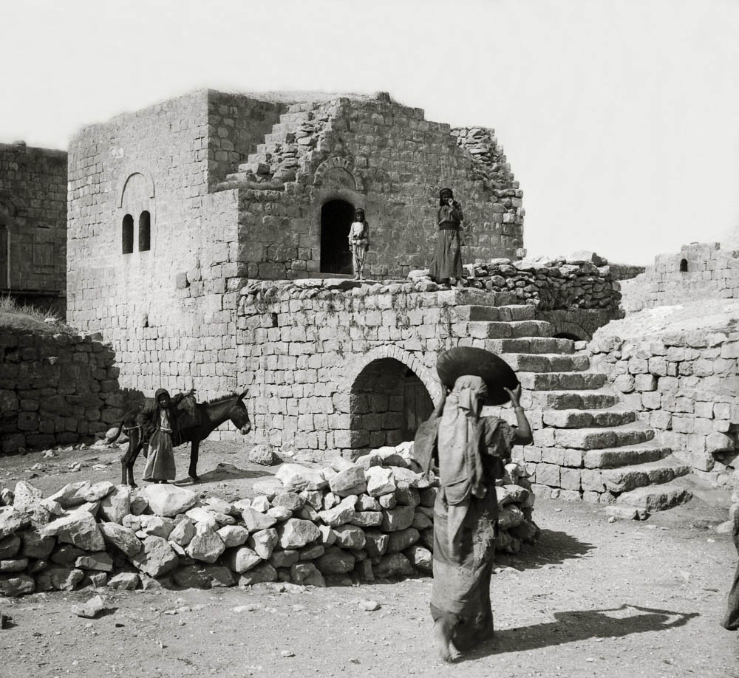
There was no room for them in the guest chamber
Village guest chamber (upper story)
2:7
Notes:
The word translated as “inn” is the Greek word kataluma, used elsewhere by Luke and always translated as “guest chamber” or “upper room” (Luke 22:11; cf. Mark 14:14). When Luke wants to speak of a paid establishment (i.e., an inn), he uses a different Greek word, pandocheion, as in the story of the Good Samaritan (Luke 10:34). Dozens of English translations translate kataluma as “inn” in Luke 2:7 and not as “guest room,” but some translations use this including the NIV2011, CEB, and NJB. This American Colony photograph was taken between 1900 and 1920.
mat05610

Slide 17
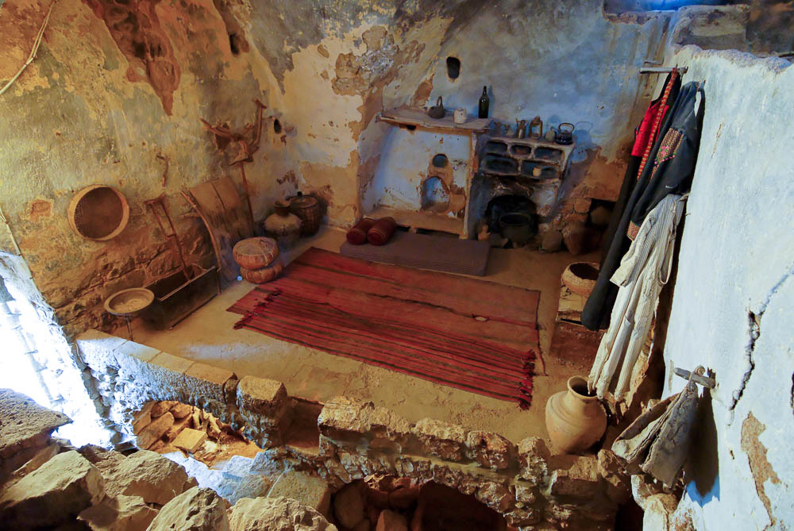
There was no room for them in the guest chamber
Guest chamber in traditional house in Taybeh
2:7
Notes:
The result of the mistranslation of kataluma as “inn” leads to a different understanding of the story. It is not that Joseph and Mary were late to town (to book a room in the local hotel), but rather they were rejected by their family (who refused to allow them to stay in the family guest chamber). It is not surprising that Joseph and Mary had family members in town, as they were returning for the census to their ancestral city. That there was no room in the guest chamber for a pregnant woman suggests that they chose not to make room for this unwedded mother. The birth of Jesus in a room where animals lived suggests shame and rejection.
tb051207375

Slide 18
A Savior Who Is Christ The Lord. Luke 2:11
Title
The result of the mistranslation of kataluma as “inn” leads to a different understanding of the story. It is not that Joseph and Mary were late to town (to book a room in the local hotel), but rather they were rejected by their family (who refused to allow them to stay in the family guest chamber).
It is not surprising that Joseph and Mary had family members in town, as they were returning for the census to their ancestral city.
That there was no room in the guest chamber for a pregnant woman suggests that they chose not to make room for this unwedded mother. The birth of Jesus in a room where animals lived suggests shame and rejection.
b hastings newlebanoncoc.com

Slide 19
A Savior Who Is Christ The Lord. Luke 2:11
Title
The birth of Christ would be the most significant birth in history and carried with it great eternal significance. Through Him would all the nations of the earth be blessed. The Lamb of God that takes away the sins of the world would be born of Mary.
The hope of Israel was coming. Israel existed as a special nation in God’s scheme of things for one primary purpose - to bring the savior into the world.
b hastings newlebanoncoc.com

Slide 20
A Savior Who Is Christ The Lord. Luke 2:11
Title
The history of Israel is the history of God’s preservation of the seed of Abraham, for through that seed would come the blessing. The law and prophets of the Old Testament all spoke of His coming.
In Peter’s sermon at Solomon’s porch he said, “Yea and all the prophets from Samuel and them that followed after, as many as have spoken, they also told of these days” (Acts 3:24).
b hastings newlebanoncoc.com

Slide 21
A Savior Who Is Christ The Lord. Luke 2:11
Title
Luke 2:13 And suddenly there was with the angel a multitude of the heavenly host praising God and saying:
14 "Glory to God in the highest, And on earth peace, goodwill toward men!“
15 So it was, when the angels had gone away from them into heaven, that the shepherds said to one another, "Let us now go to Bethlehem and see this thing that has come to pass, which the Lord has made known to us."
16 And they came with haste and found Mary and Joseph, and the Babe lying in a manger.
b hastings newlebanoncoc.com

Slide 22
A Savior Who Is Christ The Lord. Luke 2:11
Title
Luke 2:17 Now when they had seen Him, they made widely known the saying which was told them concerning this Child.
18 And all those who heard it marveled at those things which were told them by the shepherds.
19 But Mary kept all these things and pondered them in her heart.
20 Then the shepherds returned, glorifying and praising God for all the things that they had heard and seen, as it was told them.
b hastings newlebanoncoc.com

Slide 23
A Savior Who Is Christ The Lord. Luke 2:11
Title
(Simeon)
Luke 2:29 "Lord, now You are letting Your servant depart in peace, According to Your word;
30 For my eyes have seen Your salvation
31 Which You have prepared before the face of all peoples,
32 A light to bring revelation to the Gentiles, And the glory of Your people Israel."
b hastings newlebanoncoc.com

Slide 24
A Savior Who Is Christ The Lord. Luke 2:11
Title
The law and prophets had all instilled in Israel this expectant hope. Why then, when the promised Messiah finally arrived, did they desire nothing less than to kill Him?
Israel’s rejection of Christ is what makes the combined books of Luke and Acts a tragedy.
John began his account of the Gospel by saying, “He came unto his own and they that were his own received him not” (John 1:11).
Simeon said, “Behold, this child is set for the falling and the rising of many in Israel” (2:34).
b hastings newlebanoncoc.com

Slide 25
A Savior Who Is Christ The Lord. Luke 2:11
Everybody wants Christ as their savior.
Only a few want him as Lord.
He cannot be our savior if we do not submit to him as our Lord.
Title
b hastings newlebanoncoc.com

Slide 26
A Savior Who Is Christ The Lord. Luke 2:11
Title
Luke 2:11 "For there is born to you this day in the city of David a Savior, who is Christ the Lord.
12 "And this will be the sign to you: You will find a Babe wrapped in swaddling cloths, lying in a manger."
b hastings newlebanoncoc.com

Slide 27
A Savior Who Is Christ The Lord. Luke 2:11
Title
Swaddling Clothes
sparganoo (σπαργανόω, 4683), “to swathe” (from sparganon, “a swathing band”), signifies “to wrap in swaddling clothes” in Luke 2:7, 12. The idea that the word means “rags” is without foundation.¶ In the Sept., Job 38:9; Ezek. 16:4.¶
W. E. Vine,
Job 38:9 When I made the cloud the garment thereof, and thick darkness a swaddlingband for it,
(more like an Ace bandage instead of rags)
b hastings newlebanoncoc.com

Slide 28
A Savior Who Is Christ The Lord. Luke 2:11
Title
LORD
˒ādôn (אָדוֹן, 113), or ˒ădōnāy (אָדוֹן, 113), ˒adon describes the one who occupies the position of a “master” or “lord” over a slave or servant: “And the servant put his hand under the thigh of Abraham his master …” (Gen. 24:9). It is used of kings and their most powerful aides. Joseph told his brothers: “So now it was not you that sent me hither, but God: and he hath made me a father [i.e., an adviser] to Pharaoh, and lord of all his house, and a ruler throughout all the land of Egypt” (Gen. 45:8; cf. 42:30). Only once is this word used in the sense of “owner” or “possessor” (1 Kings 16:24).
When applied to God, ˒adon is used in several senses. It signifies His position as the one who has authority (like a master) over His people to reward the obedient and punish the disobedient: In such contexts God is conceived as a Being who is sovereign ruler and almighty master.
b hastings newlebanoncoc.com

Slide 29
A Savior Who Is Christ The Lord. Luke 2:11
Title
Luke 6:46 "But why do you call Me 'Lord, Lord,' and do not do the things which I say?
Matt. 28:18 And Jesus came and spoke to them, saying, "All authority has been given to Me in heaven and on earth.
19 "Go therefore and make disciples of all the nations, baptizing them in the name of the Father and of the Son and of the Holy Spirit, 20 "teaching them to observe all things that I have commanded you; and lo, I am with you always, even to the end of the age." Amen.
b hastings newlebanoncoc.com

Slide 30
A Savior Who Is Christ The Lord. Luke 2:11
Title
Title
Title
Hosea 13:4 "Yet I am the LORD your God Ever since the land of Egypt, And you shall know no God but Me; For there is no Savior besides Me.
2Peter 1:11 for so an entrance will be supplied to you abundantly into the everlasting kingdom of our Lord and Savior Jesus Christ.
2Peter 3:18 but grow in the grace and knowledge of our Lord and Savior Jesus Christ. To Him be the glory both now and forever. Amen.
b hastings newlebanoncoc.com

Slide 31
A Savior Who Is Christ The Lord. Luke 2:11
Everybody wants Christ as their savior.
Only a few want him as Lord.
2Thess. 1:6 since it is a righteous thing with God to repay with tribulation those who trouble you, 7 and to give you who are troubled rest with us when the Lord Jesus is revealed from heaven with His mighty angels,
8 in flaming fire taking vengeance on those who do not know God, and on those who do not obey the gospel of our Lord Jesus Christ.
9 These shall be punished with everlasting destruction from the presence of the Lord and from the glory of His power,
10 when He comes, in that Day, to be glorified in His saints and to be admired among all those who believe, because our testimony among you was believed.
b hastings newlebanoncoc.com

Slide 32
A Savior Who Is Christ The Lord. Luke 2:11
Everybody wants Christ as their savior.
Only a few want him as Lord.
Luke 13:3 "I tell you, no; but unless you repent you will all likewise perish.
Luke 13:5 "I tell you, no; but unless you repent you will all likewise perish.“
Luke 9:23 Then He said to them all, "If anyone desires to come after Me, let him deny himself, and take up his cross daily, and follow Me.
b hastings newlebanoncoc.com

Slide 33
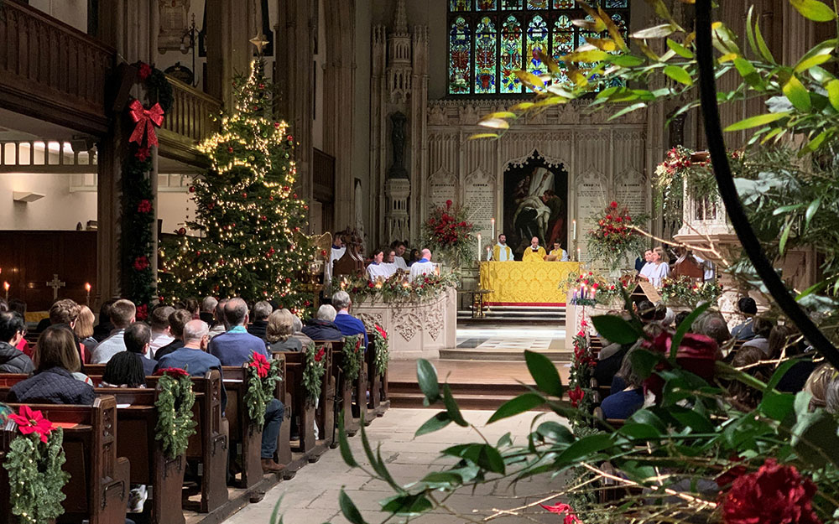

Slide 37
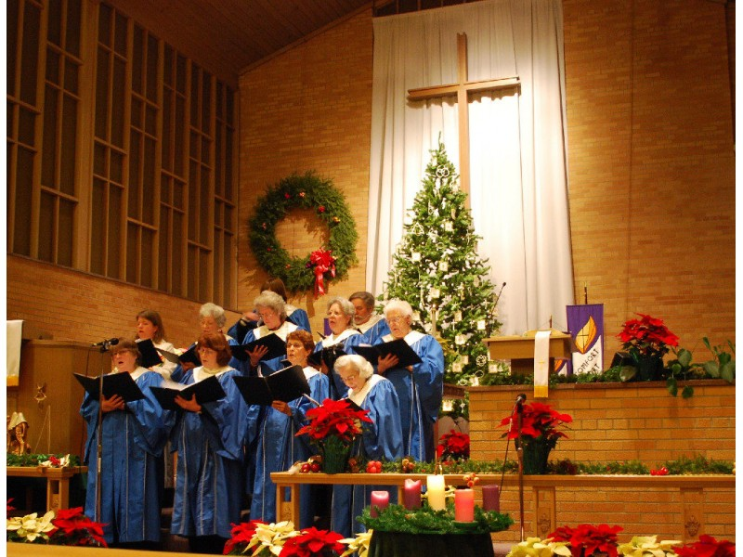

Slide 38
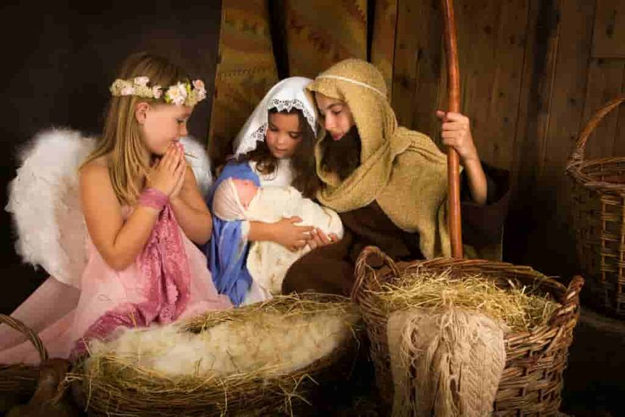

Slide 39
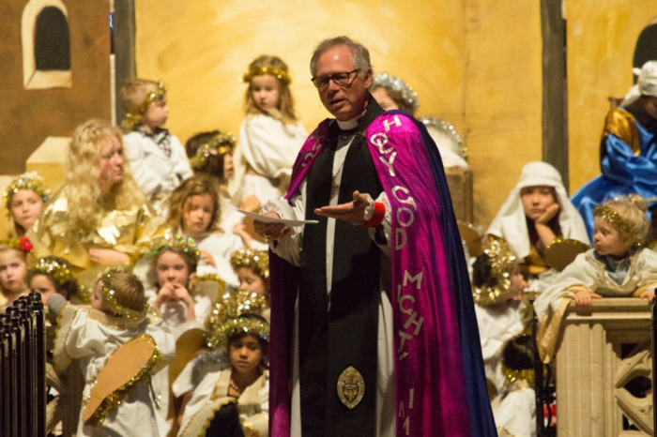

Slide 40
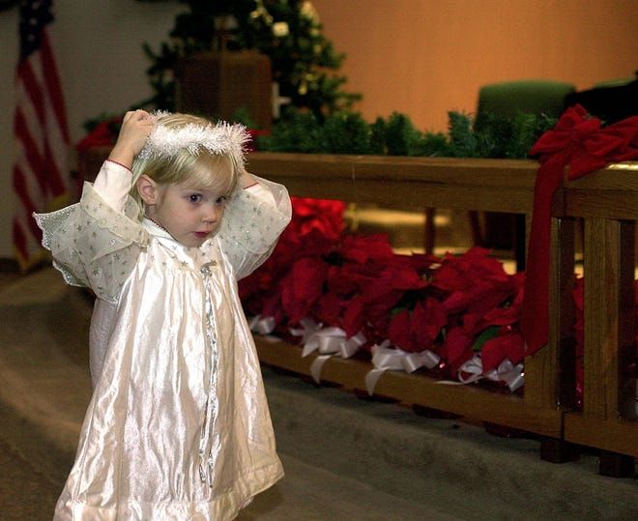

Slide 41
A Savior Who Is Christ The Lord. Luke 2:11
Title
Luke 6:46
"But why do you call Me 'Lord, Lord,’
and do not do
the things which I say?
b hastings newlebanoncoc.com

Slide 42
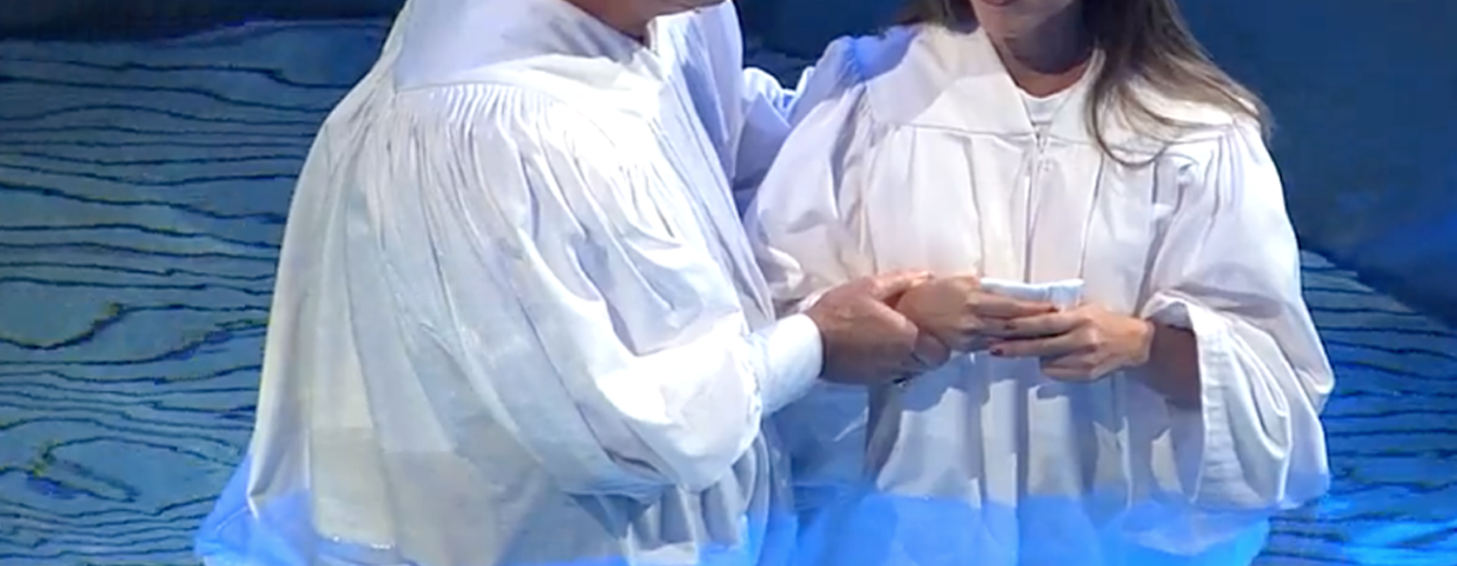
Are you a New Testament Christian?
Hear the Gospel (Rom.10:14)
Believe the Gospel (Heb. 11:6)
Repent of Sins (Acts 3:19)
Confess Christ (Rom.10:9)
Serve our Lord the rest of our lives (Rev.2:10)

