Slide 1
Welcome to our services
New Lebanon Church of Christ
We are Simply Christians.
Our Emphasis is Spiritual, Not Material or Social.
We are striving to be The Same Church as Described in The New Testament.
Please Come Back Again

Slide 2
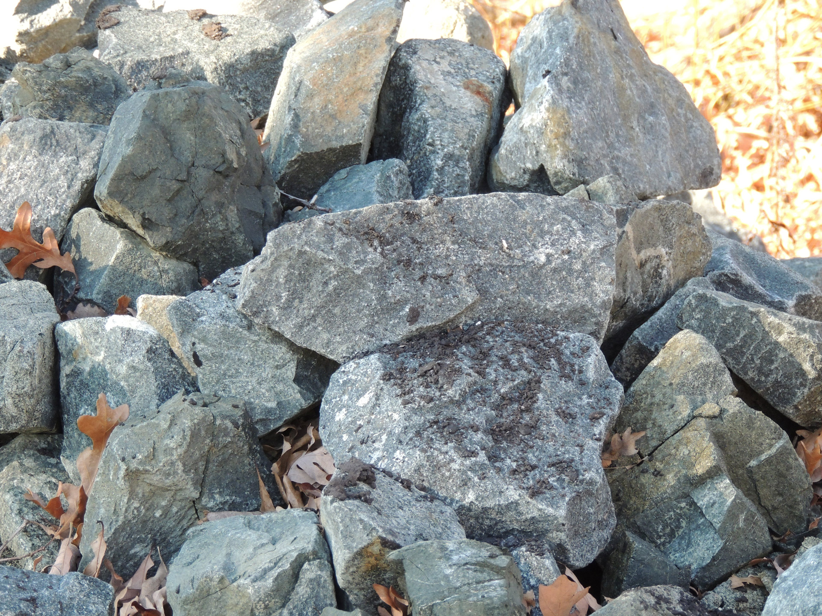

Slide 3
Yes, they made their hearts like flint.
Zechariah 7:12
Zechariah 7:12 "Yes, they made their hearts like flint, refusing to hear the law and the words which the LORD of hosts had sent by His Spirit through the former prophets. Thus great wrath came from the LORD of hosts.
b hastings newlebanoncoc.com

Slide 4
Please open your hearts, your ears, and your Bible and follow along.
If you have any questions about anything I say, if you disagree anything I say, please say something to me after the service and I will be glad to sit down with you and God’s word and study so that we can come to know His truth
Illustrated Bible verses by Ethical Media, Bible photos by bibleplaces.com

Slide 5
They Made Their Hearts Like Flint Zech 7:12
Zechariah 7:4 Then the word of the LORD of hosts came to me, saying,
5 "Say to all the people of the land, and to the priests: 'When you fasted and mourned in the fifth and seventh months during those seventy years, did you really fast for Me?
6 'When you eat and when you drink, do you not eat and drink for yourselves?
7 'Should you not have obeyed the words which the LORD proclaimed through the former prophets when Jerusalem and the cities around it were inhabited and prosperous, and the South and the Lowland were inhabited?'"
b hastings newlebanoncoc.com

Slide 6
They Made Their Hearts Like Flint Zech 7:12
8 Then the word of the LORD came to Zechariah, saying,
9 "Thus says the LORD of hosts: 'Execute true justice, Show mercy and compassion Everyone to his brother.
10 Do not oppress the widow or the fatherless, The alien or the poor. Let none of you plan evil in his heart Against his brother.'
11 "But they refused to heed, shrugged their shoulders, and stopped their ears so that they could not hear.
b hastings newlebanoncoc.com

Slide 7
They Made Their Hearts Like Flint Zech 7:12
12 "Yes, they made their hearts like flint, refusing to hear the law and the words which the LORD of hosts had sent by His Spirit through the former prophets. Thus great wrath came from the LORD of hosts.
13 "Therefore it happened, that just as He proclaimed and they would not hear, so they called out and I would not listen," says the LORD of hosts.
14 "But I scattered them with a whirlwind among all the nations which they had not known. Thus the land became desolate after them, so that no one passed through or returned; for they made the pleasant land desolate."
b hastings newlebanoncoc.com

Slide 8
They Made Their Hearts Like Flint Zech 7:12
Zec. 7:11 But they refused to hearken, and pulled away the shoulder, kjv
Zec. 7:11 "But they refused to heed, shrugged their shoulders nkjv
“They pulled away the shoulder …” This expression has come down to modern times in the description of one unwilling to hear, who is said to “give a cold shoulder” to some proposition. Perhaps the metaphor is founded upon the rebellion of a beast against his yoke.
b hastings newlebanoncoc.com

Slide 9
Ex 7:13 And Pharaoh's heart grew hard, and he did not heed them, as the LORD had said.
Ex 7:14 So the LORD said to Moses: "Pharaoh's heart is hard; he refuses to let the people go.
Ex 7:22 Then the magicians of Egypt did so with their enchantments; and Pharaoh's heart grew hard, and he did not heed them, as the LORD had said.
Ex 8:19 Then the magicians said to Pharaoh, "This is the finger of God." But Pharaoh's heart grew hard, and he did not heed them, just as the LORD had said.
Ex 9:7 Then Pharaoh sent, and indeed, not even one of the livestock of the Israelites was dead. But the heart of Pharaoh became hard, and he did not let the people go.
Ex 9:35 So the heart of Pharaoh was hard; neither would he let the children of Israel go, as the LORD had spoken by Moses.
Job 41:24 His heart is as hard as stone, Even as hard as the lower millstone.

Slide 10
Remember 4 Places, and 3 Times
Prophets before exile to get people to repent.
Prophets during the exile.
Prophets after the exile
2

Slide 11
Table Of Contents
Observe the placement of Zechariah in the
Song of Solomon
Isaiah
Jeremiah
Lamentations
Ezekiel
Daniel
Hosea
Joel
Amos
Obadiah
Jonah
Micah
Nahum
Habakkuk
Zephaniah
Haggai
Zechariah
Malachi
Genesis
Exodus
Leviticus
Numbers
Deuteronomy
Joshua
Judges
Ruth
1 & 2 Samuel
1 & 2 Kings
1 & 2 Chronicles
Ezra
Nehemiah
Esther
Job
Psalms
Proverbs
Ecclesiastes
chronological listing of the books of prophecy.
Jonah
Joel
Amos
Hosea
Isaiah
Micah
Jeremiah
Lamentations
Zephaniah
Nahum
Habakkuk
Obadiah
Daniel
Ezekiel
Haggai
Zechariah
Malachi

Slide 12
Two Periods After
The Return
1st period:
Zerubbabel—Governor
Joshua—Priest
The temple was rebuilt (Ezra 3-6)
Haggai and Zechariah—Prophets
Lasted about 20 years
Esther
2nd Period:
Nehemiah—Governor
Ezra—Priest
Rebuilt the wall; Jerusalem was restored
Malachi—Prophet
Lasted about 25 years
Ezra
gives an account of both periods.
Nehemiah
tells of the 2nd period.
Esther
comes in between the two periods.
Zechariah began his ministry 18 years after the people began to return from captivity.

Slide 13
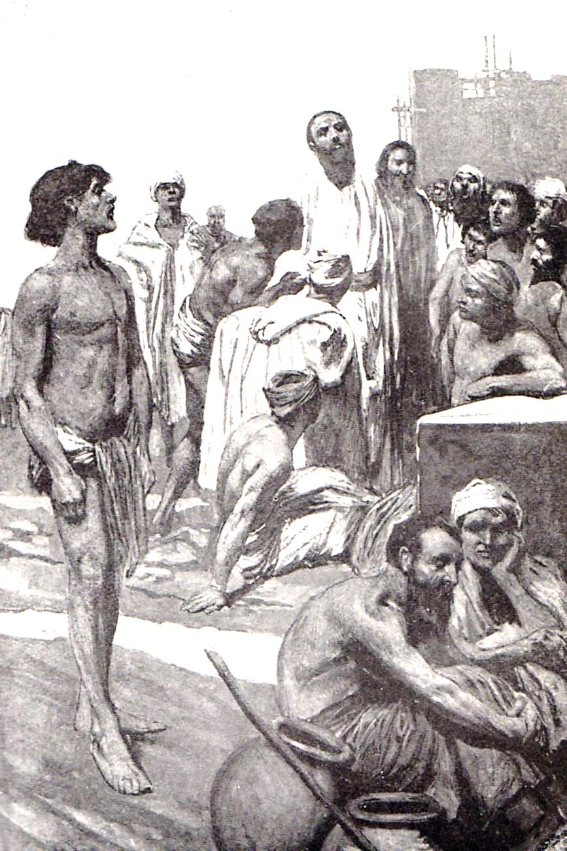
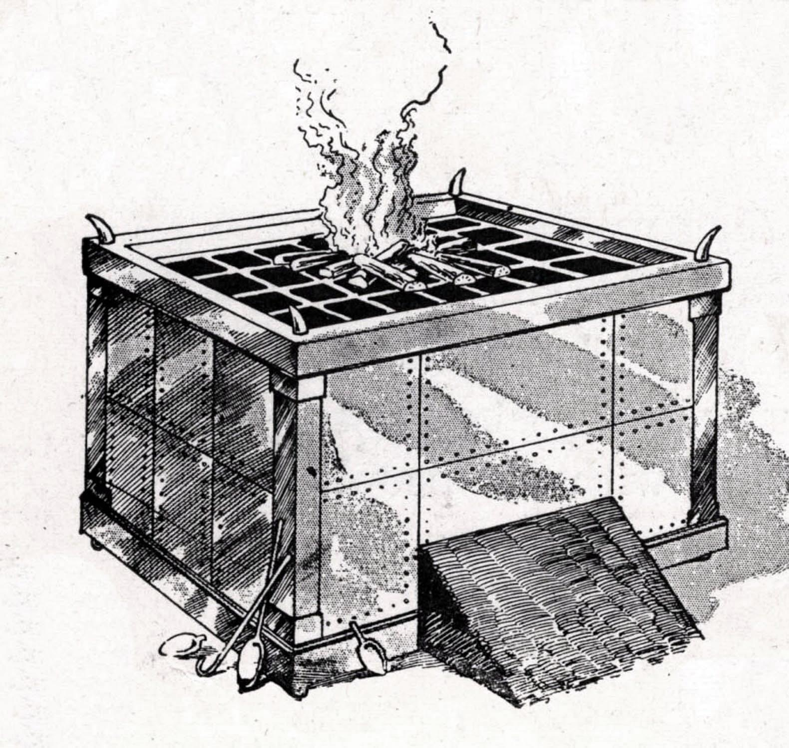
As soon as they came up out of captivity they set up an altar for sacrifice, and within a year laid the foundations of a temple (Ezra 3:10). They were served with a prohibition from the Persian court and charged not to go on with it.
The Persians forced them to stop with violence until the Jews offered no opposition. They had no spirit to set about it again, but let it stand incomplete.

Slide 14
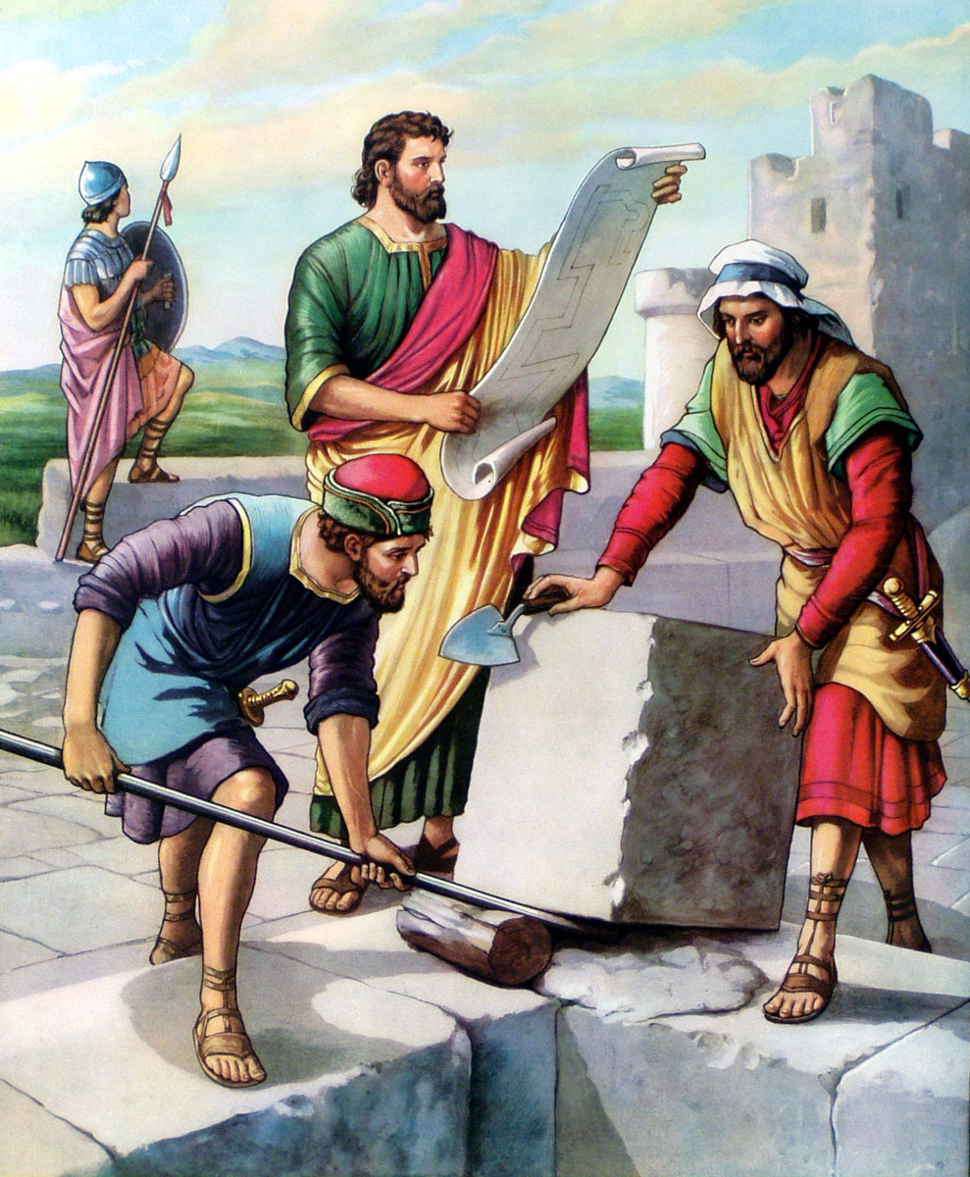
After the foundation sat for 15 years Haggai urged the Jews to again undertake the work of rebuilding the temple despite the threatening objections.
Four months later he was joined by Zechariah. In four years the temple was completed.

Slide 15
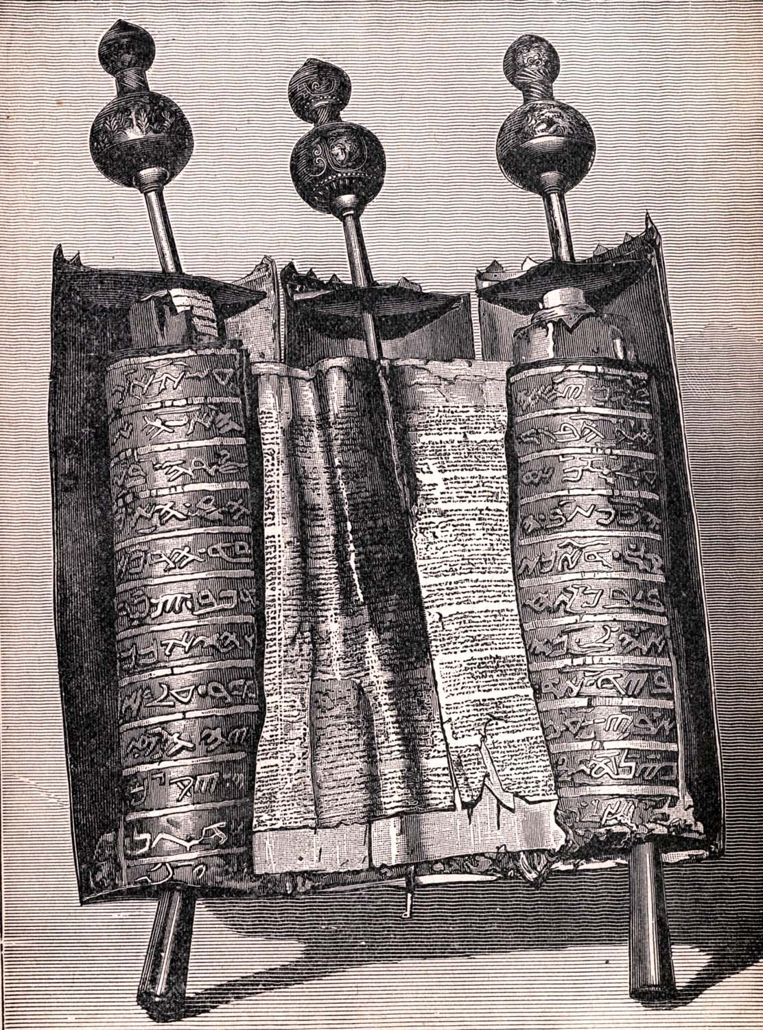
VISIONS OF ZECHARIAH
The book of Zechariah has two main points:
THE RETURN OF THE JEWS FROM BABYLON
&
THE COMING OF CHRIST

Slide 16
They Made Their Hearts Like Flint Zech 7:12
The Temple at Jerusalem was in process of building, when the question was asked: “Shall I weep and separate myself as I have done these so many years?” (v. 3).
Here we have the Lord’s answer, which is a charge against them of mere formal worship —
b hastings newlebanoncoc.com

Slide 17
They Made Their Hearts Like Flint Zech 7:12
I. Formal Worship. Formality in worship, or trusting in the form, is very prevalent.
1. Hypocritical Fasting. The Lord asks: “When ye fasted and mourned, did ye at all fast unto Me?” (v. 5). When they fasted it was not that they might get into closer fellowship with God, but, like the hypocrites in our Lord’s time, that they might appear unto men to fast (Matt. 6:16–18).
b hastings newlebanoncoc.com

Slide 18
They Made Their Hearts Like Flint Zech 7:12
2. Selfishness in Eating and Drinking. “Ye eat and drink for yourselves” (v. 6). How little do we think that in our ordinary, every-day “eating and drinking” we should do all to the glory of God (1 Cor. 10:31); thanking Him for such mercies that help to strengthen us for His work.
Even at the Lord’s table we may eat and drink judgment on our own soul by not discerning the Lord’s body (1 Cor. 11:29). Our worthiness for this is not in our moral goodness, but in our spiritual discernment.
b hastings newlebanoncoc.com

Slide 19
They Made Their Hearts Like Flint Zech 7:12
3. Neglect of the Word of the Lord. “Should ye not hear the words which the Lord hath cried?” (v. 7).
The formalist allows no special value for the Word of the Lord, but is very critical about outward acts and ceremonies. He or she may carry a Bible but they seldom or never seriously read it, or offer up their own desires unto God (1 John 5:15).
Such have need to pray the old prayer “Lord, stamp Eternity on my eyeballs.”
b hastings newlebanoncoc.com

Slide 20
They Made Their Hearts Like Flint Zech 7:12
II. Empty Prayers. There are prayers that are powerless, because God will not listen to them (v. 13), and because they come from dishonest and hardened hearts (v. 12). Note some of the causes of failure, as recorded here—
1. There was a Lack of Mercy and Compassion. “Shew mercy and compassion every man to his brother” (v. 9). Our attitude to our fellowmen has much to do with the helping or hindering of our prayers. “First be reconciled to thy brother, then offer thy gifts” (Matt. 5:24). We incur God’s displeasure if we from the heart forgive not every one his brother (Matt. 18:35). He that loveth God must love his brother also (1 John 4:21).
b hastings newlebanoncoc.com

Slide 21
They Made Their Hearts Like Flint Zech 7:12
2. They Oppressed the Helpless. “Oppress not the widow, the fatherless, nor the poor” (v. 10).
To take advantage of those because of their helplessness is a blatant insult to the God who “delights in mercy.” Surely that man’s religion is in vain
(James 1:27).
b hastings newlebanoncoc.com

Slide 22
They Made Their Hearts Like Flint Zech 7:12
3. There was Evil Thinking.
Imagining evil against another in your heart (v. 10).
Thoughts are naked things before God. Evil thoughts against your brother will poison your prayers.
As a man thinketh in his heart, so is he before God. “The pure in heart shall see God.”
b hastings newlebanoncoc.com

Slide 23
They Made Their Hearts Like Flint Zech 7:12
4. They Refused to Hearken to the Words which the Lord hath sent (v. 12, 13).
To refuse to hear the voice of His written Word is to close the door of the heart against Heaven’s call.
“If you will not hear My cry, neither will I hear your cry, saith the Lord of Hosts” (v. 13).
b hastings newlebanoncoc.com

Slide 24
They Made Their Hearts Like Flint Zech 7:12
Formal Worship.
Hypocritical Fasting.
Selfishness in Eating and Drinking
Neglect of the Word of the Lord.
Prayers without Power.
There was a Lack of Mercy and Compassion.
They Oppressed the Helpless.
There was Evil Thinking.
They Refused to Hearken to the Words which the Lord hath sent
The Final Result of Unanswered Prayers
b hastings newlebanoncoc.com

Slide 25
They Made Their Hearts Like Flint Zech 7:12
5. The Final Result of Unanswered Prayers.
A grieved God, scattered hopes, bondage and desolation (v. 14).
“You ask and receive not because you ask amiss that you may consume what you get upon your own lusts” (James 4:3). The remedy for all this is given us in James 4:8–10.
b hastings newlebanoncoc.com

Slide 26
They Made Their Hearts Like Flint Zech 7:12
5. The Final Result of Unanswered Prayers.
James 4:8–10. Draw near to God and He will draw near to you. Cleanse your hands, you sinners; and purify your hearts, you double-minded.
9 Lament and mourn and weep! Let your laughter be turned to mourning and your joy to gloom.
10 Humble yourselves in the sight of the Lord, and He will lift you up.
b hastings newlebanoncoc.com

Slide 27
They Made Their Hearts Like Flint Zech 7:12
Nothing is so hard, so unmalleable, so inflexible, as the heart of a presumptuous sinner; and those whose hearts are hard - may thank themselves; they are of their own hardening, and it is just with God to give them over to a reprobate sense, to the hardness and impenitence of their own hearts.”
Romans 1:18-32 - read
b hastings newlebanoncoc.com

Slide 28
They Made Their Hearts Like Flint Zech 7:12
James 4:8 Draw near to God and He will draw near to you. Cleanse your hands, you sinners; and purify your hearts, you double-minded.
9 Lament and mourn and weep! Let your laughter be turned to mourning and your joy to gloom.
10 Humble yourselves in the sight of the Lord, and He will lift you up.
b hastings newlebanoncoc.com

Slide 29
1 O do not let the word depart, And close thine eyes against the light; Poor sinner, harden not your heart; Be saved, O tonight.
2 Tomorrow’s sun may never rise To bless thy long deluded sight; This is the time, O then be wise, Be saved, O tonight. [Refrain]
Refrain: O why not tonight? O why not tonight? Wilt thou be saved? Then why not tonight?
3 Our Lord in pity lingers still, And wilt thou thus His love requite? Renounce at once thy stubborn will, Be saved, O tonight. [Refrain]
4 Our blessed Lord refused none Who would to Him their souls unite; Believe, obey, the work is done; Be saved, O tonight. [Refrain]

Slide 30
They Made Their Hearts Like Flint Zech 7:12
Friend, is your heart
like flint?
b hastings newlebanoncoc.com

