Slide 1
Welcome to our services
New Lebanon Church of Christ
We are Simply Christians.
Our Emphasis is Spiritual, Not Material or Social.
We are striving to be The Same Church as Described in The New Testament.
Please Come Back Again

Slide 2
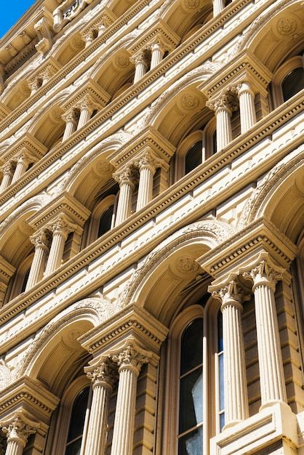
The Pillar And Ground Of Truth 1Tim.3:15
1 Tim.3:15 but if I am delayed, I write so that you may know how you ought to conduct yourself in the house of God, which is the church of the living God, the pillar and ground of the truth.

Slide 3
Please open your hearts, your ears, and your Bible and follow along.
If you have any questions about anything I say, if you disagree anything I say, please say something to me after the service and I will be glad to sit down with you and God’s word and study so that we can come to know His truth
Illustrated Bible verses by Ethical Media, Bible photos by bibleplaces.com

Slide 4
The Pillar And Ground Of Truth 1Tim.3:15
Pillar - a column supporting the weight of a building,"

Slide 5
The Pillar And Ground Of Truth 1Tim.3:15
Prov.9:1 Wisdom has built her house, She has hewn out her seven pillars.
The number "seven" means something significant or perfection.
Wisdom's house has "seven" pillars.

Slide 6
The Pillar And Ground Of Truth 1Tim.3:15
Pillar = "a column supporting the weight of a building," is used
metaphorically, of those who bear responsibility in the churches, as of the elders in the church at Jerusalem, Gal. 2:9;
of a local church as to its responsibility, in a collective capacity, to maintain the doctrines of the faith by teaching and practice, 1 Tim. 3:15,
indicating a firm and permanent position in the spiritual, heavenly and eternal Temple of God;
illustratively, of the feet of the angel in the vision in Rev. 10:1,

Slide 7
The Pillar And Ground Of Truth 1Tim.3:15
Gal.2:9 and when James, Cephas, and John, who seemed to be pillars, perceived the grace that had been given to me, they gave me and Barnabas the right hand of fellowship, that we should go to the Gentiles and they to the circumcised.

Slide 8
The Pillar And Ground Of Truth 1Tim.3:15
The Bible pictures the church as being a great spiritual building:
Eph.2:21,22 in whom the whole building, being joined together, grows into a holy temple in the Lord, 22 in whom you also are being built together for a dwelling place of God in the Spirit.
1 Peter 2:5 you also, as living stones, are being built up a spiritual house, a holy priesthood, to offer up spiritual sacrifices acceptable to God through Jesus Christ.

Slide 9
The Pillar And Ground Of Truth 1Tim.3:15
Let us look at seven pillars that must be present in the New Lebanon congregation if the Lord’s church is going to continue to be a great church.
All of these pillars are built upon the foundation of loving God, Christ, and the Holy Spirit and always putting them first in our lives.

Slide 10
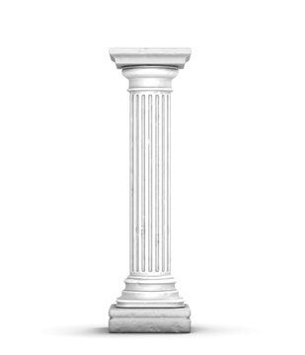
The Pillar And Ground Of Truth 1Tim.3:15
The Pillar of a converted
membership
2 Cor.5:17 Therefore, if anyone is in Christ, he is a new creation; old things have passed away; behold, all things have become new.
Col.3:1-3 If then you were raised with Christ, seek those things which are above, where Christ is, sitting at the right hand of God. 2 Set your mind on things above, not on things on the earth. 3 For you died, and your life is hidden with Christ in God.

Slide 11
The Pillar And Ground Of Truth 1Tim.3:15
Jesus wants us
To love him.
To submit to him as our lord.
To keep his commandments
To walk in his ways
To cling to him
To serve him
To serve him with all our heart, soul mind and strength.
God is a jealous God and God will not accept our scraps and leftovers.

Slide 12
The Pillar And Ground Of Truth 1Tim.3:15
A converted membership does not have to be constantly encouraged to:
Assemble.
To not lag behind.
Give of our means.
To study.
To teach others.
Put first things first.
Live a pure life.

Slide 13
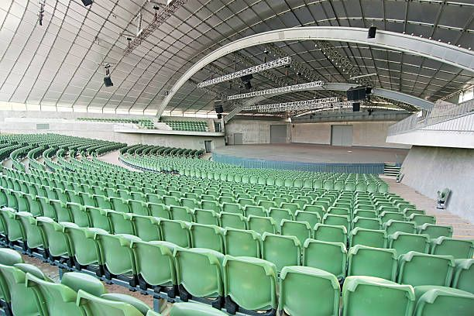
The Pillar And Ground Of Truth 1Tim.3:15
Where Would You Sit At An Event You Love To Go To?
Notes:
DISTRACTIONS !!!!!

Slide 14
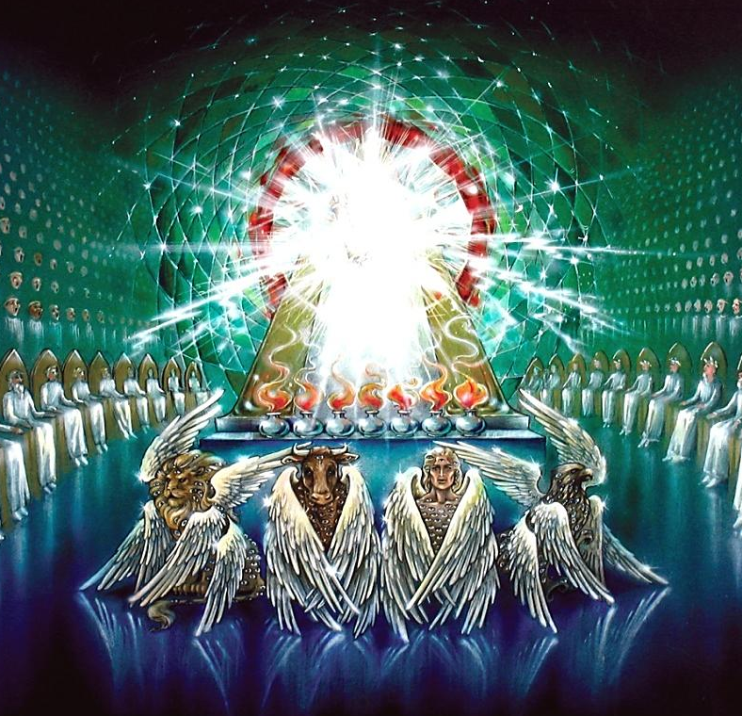
The Pillar And Ground Of Truth 1Tim.3:15
Where Would You Sit At An Event You Love To Go To?
Notes:
DISTRACTIONS !!!!!

Slide 15
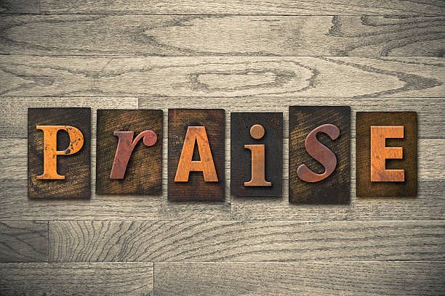
The Pillar And Ground Of Truth 1Tim.3:15
The pillar of pure and
sincere worship
John 4:24 "God is Spirit, and those who worship Him must worship in spirit and truth."
Psalm 92:1 It is good to give thanks to the LORD, And to sing praises to Your name, O Most High.
God has more in mind for you than you can possibly imagine for yourself. He longs for you to meet Him. And you meet Him in the pages of His word.

Slide 16
The Pillar And Ground Of Truth 1Tim.3:15
God is passionate about showing you His heart and he wants you to give Him your heart. He yearns for you to throw open the door of your soul and allow him to come in.
Pray for open eyes to see what God has for you. Pray for courage to walk so close to God that you lose sight of everything else. Pray for your heart to be ready to accept the joy and peace that surpasses all understanding.

Slide 17
The Pillar And Ground Of Truth 1Tim.3:15
Set our heart on praying without ceasing, set our heart on constant thanksgiving, and constant worship.
Rejoicing, praying, and giving thanks are visible characteristics of a heart that belongs to God. And as we grow as a child of God, our hearts become more tender to God’s word.
And When we recognize the power and nature of God, it should move our hearts to humility and worship. We bow down in awe and lift our hearts and minds up to God in praise.

Slide 18
The Pillar And Ground Of Truth 1Tim.3:15
The pillar of knowledge
1 Cor.10:1 Moreover, brethren, I would not that ye should be ignorant, how that all our fathers were under the cloud, and all passed through the sea;
2Tim. 3:14-17 14 But you must continue in the things which you have learned and been assured of, knowing from whom you have learned them, 15 and that from childhood you have known the Holy Scriptures, which are able to make you wise for salvation through faith which is in Christ Jesus.

Slide 19
The Pillar And Ground Of Truth 1Tim.3:15
2 Peter 3:18 But grow in grace, and in the knowledge of our Lord and Savior Jesus Christ. To him be glory both now and forever. Amen
1 Tim.3:15 But if I tarry long, that thou mayest know how thou oughtest to behave thyself in the house of God, which is the church of the living God, the pillar and ground of the truth.
Hosea 4:6 My people are destroyed for lack of knowledge. Because you have rejected knowledge, I also will reject you from being priest for Me; Because you have forgotten the law of your God, I also will forget your children.

Slide 20
The Pillar And Ground Of Truth 1Tim.3:15
To gain knowledge, we must surrender ourselves to God. It is not just about knowledge of the what but putting that what into action. We can memorize and repeat like a parrot, the fruit of the spirit – but we cannot truly know until we do.
The more we know about God, the wider our eyes are open to him. The more we see about the relationship he wants us to have with him and how his providence works in our lives. The more we know about God, the easier it is to let go of self and trust in him to provide for us.
2 Tim. 2:15 Be diligent to present yourself approved to God, a worker who does not need to be ashamed, rightly dividing the word of truth.

Slide 21
The Pillar And Ground Of Truth 1Tim.3:15
The pillar of unity
John 17:20,21 "I do not pray for these alone, but also for those who will believe in Me through their word; 21 "that they all may be one, as You, Father, are in Me, and I in You; that they also may be one in Us, that the world may believe that You sent Me.
Jesus:
Prayed for unity – John 17:20,21.
Prophesied unity – John 10:16.
Practiced unity – John 17:20,21.
Preached unity – Matt.12:25; Mark 3:24.

Slide 22
The Pillar And Ground Of Truth 1Tim.3:15
Eph. 4:3 Endeavoring to keep the unity of the Spirit in the bond of peace.
Psalm 133:1 Behold, how good and how pleasant it is for brethren to dwell together in unity!
Phil. 2:3 Let nothing be done through strife or vainglory; but in lowliness of mind let each esteem other better than themselves.
A child of God will go out of his way to get along with people.
Being a part of the family of God means more than just showing up for an hour on Sunday morning, then scooting out the back. It means opening your heart to people who make up his body and sharing your life with them.

Slide 23
The Pillar And Ground Of Truth 1Tim.3:15
A child of God will not:
Be a busybody in other men’s affairs – 2 Thess.3:11.
1 Timothy 5:13.
A carrier of tales – Prov. 11:13; 18:8.
A promoter of error.

Slide 24
The Pillar And Ground Of Truth 1Tim.3:15
Acts 2:42 And they continued steadfastly in the apostles' doctrine and fellowship, in the breaking of bread, and in prayers.
A child of God who desires to worship God in spirit and truth will:
Want Bible authority for what he does. Desire to worship.
Worship from his heart.

Slide 25
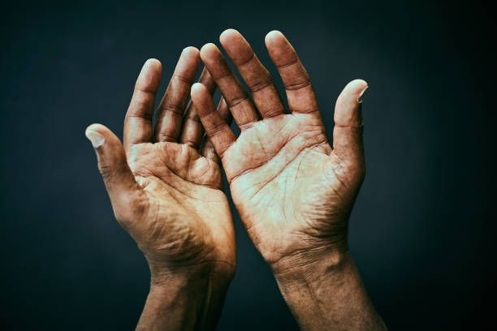
The Pillar And Ground Of Truth 1Tim.3:15
The pillar of work
1Cor 3:9 For we are God's fellow workers.
2Tim. 2:15 Be diligent to present yourself approved to God, a worker who does not need to be ashamed, rightly dividing the word of truth.
Everyone must work: Phil. 2:12 Wherefore, my beloved, as ye have always obeyed, not as in my presence only, but now much more in my absence, work out your own salvation with fear and trembling.

Slide 26
The Pillar And Ground Of Truth 1Tim.3:15
1 Cor.15:58 Therefore, my beloved brethren, be ye stedfast, unmoveable, always abounding in the work of the Lord, forasmuch as ye know that your labor is not in vain in the Lord.
Rom.1:14 I am a debtor both to Greeks and to barbarians, both to wise and to unwise.
15 So, as much as is in me, I am ready to preach the gospel to you who are in Rome also.
16 For I am not ashamed of the gospel of Christ, for it is the power of God to salvation for everyone who believes, for the Jew first and also for the Greek.

Slide 27
The Pillar And Ground Of Truth 1Tim.3:15
Matt. 28:18-20 18And Jesus came and spake unto them, saying, All power is given unto me in heaven and in earth. 19 Go ye therefore, and teach all nations, baptizing them in the name of the Father, and of the Son, and of the Holy Ghost: 20 Teaching them to observe all things whatsoever I have commanded you: and, lo, I am with you always, even unto the end of the world. Amen.

Slide 28
The Pillar And Ground Of Truth 1Tim.3:15
No angel ever taught the gospel to any man or woman in the scripture. That is not their job. God has seen fit to give men and women the task of teaching other people.
The goal of every Christian should be another Christian. The gospel has been given into our hands, and what we do with it is critical. We can either ignore it – or we can share it. To keep it to ourselves is wrong.
The gospel is the treasure that we carry, and the earthen vessel is our body that holds the gospel. We are God’s messengers. May God help us be better messengers.

Slide 29
The Pillar And Ground Of Truth 1Tim.3:15
John 9:4 I must work the works of him that sent me, while it is day: the night cometh, when no man can work.
Carry on missions:
2 Cor. 4:5 For we do not preach ourselves, but Christ Jesus the Lord, and ourselves your bondservants for Jesus' sake. 6 For it is the God who commanded light to shine out of darkness, who has shone in our hearts to give the light of the knowledge of the glory of God in the face of Jesus Christ.
7 But we have this treasure in earthen vessels, that the excellence of the power may be of God and not of us.

Slide 30
The Pillar And Ground Of Truth 1Tim.3:15
Acts 13:22 "And when He had removed him, He raised up for them David as king, to whom also He gave testimony and said, 'I have found David the son of Jesse, a man after My own heart, who will do all My will.’ –
David was called a man after God’s own heart because he wanted to do everything God had in mind for him to do. We often neglect to read “who will do all my will.” The lesson for us is easy. If we want a close relationship with the Lord like David, our supreme goal will be to do the Lord’s will – plain and simple.

Slide 31
The Pillar And Ground Of Truth 1Tim.3:15
The pillar of vision
To keep from perishing: Prov. 29:18 Where there is no vision, the people perish: but he that keeps the law, happy is he.
We must dream and plan. We do for everything else in our life. How much more important is the Lord’s church.
Acts 6:3 Wherefore, brethren, look ye out among you seven men of honest report, full of the Holy Ghost and wisdom, whom we may appoint over this business.
Col. 4:5 Walk in wisdom toward them that are without, redeeming the time.

Slide 32
The Pillar And Ground Of Truth 1Tim.3:15
The pillar of discipline
All must be walking by the same rule: Phil. 3:16 Nevertheless, whereto we have already attained, let us walk by the same rule, let us mind the same thing.
2 Thess. 3:6 Now we command you, brethren, in the name of our Lord Jesus Christ, that ye withdraw yourselves from every brother that walketh disorderly, and not after the tradition which he received of us.
It is not pleasant to do but for the purity of the Lord’s church, some brethren must be withdrawn from.

Slide 33
The Pillar And Ground Of Truth 1Tim.3:15
Friends, Truth cannot be compromised. What we think is best does not replace the truth.
God commanded certain things of His people.For the church to remain sound and strong, we must have…
Converted membership
Pure and sincere worship
Knowledge
Unity
Work
Vision
Discipline

Slide 34
The Pillar And Ground Of Truth 1Tim.3:15
Jer.31:31 "Behold, the days are coming, says the LORD, when I will make a new covenant with the house of Israel and with the house of Judah-
32 "not according to the covenant that I made with their fathers in the day that I took them by the hand to lead them out of the land of Egypt, My covenant which they broke, though I was a husband to them, says the LORD.
33 "But this is the covenant that I will make with the house of Israel after those days, says the LORD: I will put My law in their minds, and write it on their hearts; and I will be their God, and they shall be My people.

Slide 35
The Pillar And Ground Of Truth 1Tim.3:15
Am I helping to support
the weight of
this
congregation?

