Slide 1
Welcome to our services
New Lebanon Church of Christ
We are Simply Christians.
Our Emphasis is Spiritual, Not Material or Social.
We are striving to be The Same Church as Described in The New Testament.
Please Come Back Again

Slide 2
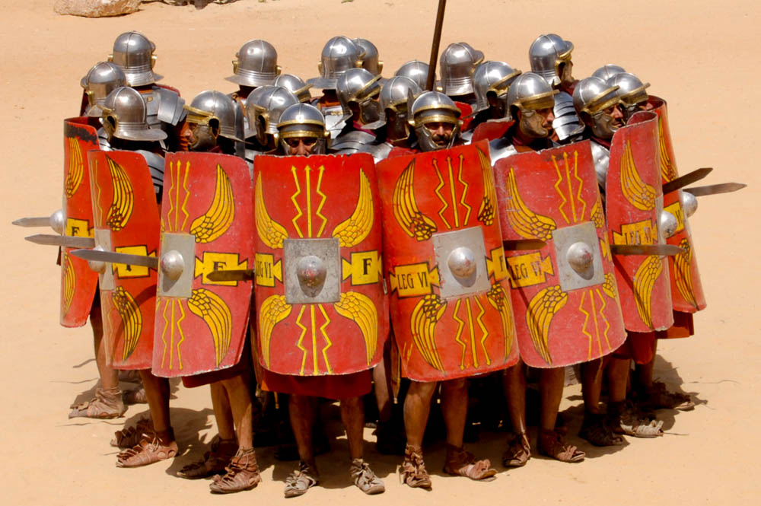
Seven Things We Must Keep Prov. 4:23
Title
Proverbs 4:23 Keep your heart with all diligence, For out of it spring the
issues of life.
b hastings newlebanoncoc.com

Slide 3
Please open your hearts, your ears, and your Bible and follow along.
If you have any questions about anything I say, if you disagree anything I say, please say something to me after the service and I will be glad to sit down with you and God’s word and study so that we can come to know His truth
Illustrated Bible verses by Ethical Media, Bible photos by bibleplaces.com

Slide 4
Seven Things We Must Keep Prov. 4:23
Title
Proverbs 4:23 Keep your heart with all diligence, For out of it
spring the
issues of life.
b hastings newlebanoncoc.com

Slide 5
Seven Things We Must Keep Prov. 4:23
We have to make the decision in life regarding the things we wish to keep and the things we wish to get rid of.
This applies physically and spiritually.
In this lesson, we will consider 7 things that we MUST keep if we want to go to heaven.
b hastings newlebanoncoc.com

Slide 6
Seven Things We Must Keep Prov. 4:23
Title
As we study the Bible we are told over and over that there are things we should "keep".
The word "keep" means "to hold, to retain, to guard, to maintain, to obey, to observe, to practice,
to adhere to"; "to retain possession of."
Let us study some things God said we are to "keep" if we are to be saved.
b hastings newlebanoncoc.com

Slide 7
Seven Things We Must Keep Prov. 4:23
Title
Keep our Hearts
Prov. 4:23 Keep your heart with all diligence, For out of it spring the issues of life.
Prov. 23:7 For as he thinks in his heart, so is he. "Eat and drink!" he says to you, But his heart is not with you.
b hastings newlebanoncoc.com

Slide 8
Seven Things We Must Keep Prov. 4:23
Title
Keep our Hearts
It is impossible to think wrong things and live right lives. If we do not think as we should, we will not live as we should.
Phil.4:8 Finally, brethren, whatever things are true, whatever things are noble, whatever things are just, whatever things are pure, whatever things are lovely, whatever things are of good report, if there is any virtue and if there is anything praiseworthy--meditate – think on these things.
b hastings newlebanoncoc.com

Slide 9
Seven Things We Must Keep Prov. 4:23
Title
2. Keep our Bodies
Must keep our bodies under control. Not always easy.
1 Cor. 9:27 But I discipline my body and bring it into subjection, lest, when I have preached to others, I myself should become disqualified.
b hastings newlebanoncoc.com

Slide 10
Seven Things We Must Keep Prov. 4:23
Title
2. Keep our Bodies
Opposite of once saved, always saved. We can become a cast away.
Lust of Flesh can ruin our lives.
Heb.2:1 Therefore we must give the more earnest heed to the things we have heard, lest we drift away.
Easy to drift away. If we don’t keep our bodies under control, it will be easy to drift into Hell.
b hastings newlebanoncoc.com

Slide 11
Seven Things We Must Keep Prov. 4:23
Title
3. Keep Pure
We are commanded to keep pure. Impurity denotes weakness.
1 Tim 5:22 Do not lay hands on anyone hastily, nor share in other people's sins; keep yourself pure.
b hastings newlebanoncoc.com

Slide 12
Seven Things We Must Keep Prov. 4:23
Title
3. Keep Pure
2 Cor.7:1 Therefore, having these promises, beloved, let us cleanse ourselves from all filthiness of the flesh and spirit, perfecting holiness in the fear of God.
Must keep hearts – words – lives, PURE.
A Christian is a pure person in an impure world.
b hastings newlebanoncoc.com

Slide 13
Seven Things We Must Keep Prov. 4:23
Title
3. Keep Pure
Psalm 24:3-4 Who may ascend into the hill of the LORD? Or who may stand in His holy place? 4 He who has clean hands and a pure heart, Who has not lifted up his soul to an idol, Nor sworn deceitfully.
Are our hands clean? Our hearts pure?
b hastings newlebanoncoc.com

Slide 14
Seven Things We Must Keep Prov. 4:23
Title
4. Keep Unspotted
(Matt. 5:8) Blessed are the pure in heart, For they shall see God.
God is pure in all His attributes. We should be also.
(Psalm 12:6) The words of the LORD are pure words, Like silver tried in a furnace of earth, Purified seven times.
(Psalm 19:8) The statutes of the LORD are right, rejoicing the heart; The commandment of the LORD is pure, enlightening the eyes;
(James 3:17) But the wisdom that is from above is first pure, then peaceable, gentle, willing to yield, full of mercy and good fruits, without partiality and without hypocrisy.
b hastings newlebanoncoc.com

Slide 15
Seven Things We Must Keep Prov. 4:23
Title
4. Keep Unspotted
We are in the world but cannot let the world rub off on us.
Can a woman enter a coal mine in a white dress and come out unspotted?
Can a man enter a bar with half naked women dancing and come out unspotted?
Those 2 are obvious. What about the less obvious?
James 1:27 Pure and undefiled religion before God and the Father is this: to visit orphans and widows in their trouble, and to keep oneself unspotted from the world.
b hastings newlebanoncoc.com

Slide 16
Seven Things We Must Keep Prov. 4:23
Title
4. Keep Unspotted
The further we travel toward heaven, and the more we become like Christ, the less attraction worldly things will have on us.
How much do worldly things attract you?
Christians are in the world, but they are not of the world John 17:14-16.
b hastings newlebanoncoc.com

Slide 17
Seven Things We Must Keep Prov. 4:23
Title
John 17:14 "I have given them Your word; and the world has hated them because they are not of the world, just as I am not of the world.
15 "I do not pray that You should take them out of the world, but that You should keep them from the evil one.
16 "They are not of the world, just as I am not of the world.
b hastings newlebanoncoc.com

Slide 18
Seven Things We Must Keep Prov. 4:23
Title
4. Keep Unspotted
What does "The World" or "Worldliness" mean?
"Worldliness" is an attitude of heart, because a man is actually what he thinks (Prov. 4:23; Prov. 23:7; Matt. 15:19-20)
What we are is the result of what we see, hear, feel and do.
If we are led by the lust of the flesh, lust of the eye and the pride of life, we are worldly! 1 John 2:15-17.
If we are led by the Spirit (the teaching of the Spirit), our conduct will be moral
b hastings newlebanoncoc.com

Slide 19
Seven Things We Must Keep Prov. 4:23
Title
4. Keep Unspotted
Many think a man's life consists of the abundance of the things he possesses.
They think true happiness comes by having things--better cars, better clothes, better houses, and more money.
Jesus said that life does not consist in the abundance of the things we possess. Luke 12:15
b hastings newlebanoncoc.com

Slide 20
Seven Things We Must Keep Prov. 4:23
Title
Luke 12:15 And He said to them, "Take heed and beware of covetousness, for one's life does not consist in the abundance of the things he possesses."
16 Then He spoke a parable to them, saying: "The ground of a certain rich man yielded plentifully.
17 "And he thought within himself, saying, 'What shall I do, since I have no room to store my crops?'
18 "So he said, 'I will do this: I will pull down my barns and build greater, and there I will store all my crops and my goods.
19 'And I will say to my soul, "Soul, you have many goods laid up for many years; take your ease; eat, drink, and be merry."'
20 "But God said to him, 'Fool! This night your soul will be required of you; then whose will those things be which you have provided?'
b hastings newlebanoncoc.com

Slide 21
Seven Things We Must Keep Prov. 4:23
Title
5. Keep The Word
Must keep word of God in our hearts. Should think on it continually. Day and Night.
Psalm 1:1-2 Blessed is the man Who walks not in the counsel of the ungodly, Nor stands in the path of sinners, Nor sits in the seat of the scornful; (2) But his delight is in the law of the LORD, And in His law he meditates day and night.
Luke 11:28 But He said, "More than that, blessed are those who hear the word of God and keep it!"
b hastings newlebanoncoc.com

Slide 22
Seven Things We Must Keep Prov. 4:23
Title
5. Keep The Word
James 1:22 But be doers of the word, and not hearers only, deceiving yourselves.
He said, "If a man keep my saying, he shall never see death.“ John 8:51.
He said, "If ye love me, keep my commandments" John 14:15.
b hastings newlebanoncoc.com

Slide 23
Seven Things We Must Keep Prov. 4:23
Title
5. Keep The Word
Paul said we are saved by the gospel if we keep in memory the gospel if we hold fast the gospel- 1 Cor. 15:2.
The Psalmist said "Blessed are they that keep his testimonies, Psalms 119:2.
Timothy was to "keep that which is committed to thy trust."
1 Tim. 6:20.
You can see from these passages that the meaning of "keep the word of God" is to be obedient to what it says.
The only way we can enjoy salvation by God's grace, and heaven after this life is to put His word into practice in our lives.
b hastings newlebanoncoc.com

Slide 24
Seven Things We Must Keep Prov. 4:23
Title
6. Keep the Unity of The Spirit
Needed badly in the church. Keep unity of word and doctrine
Too many splits- off shoots – perverted gospels and result is too many people going to HELL.
Religious diversity is not good.
Eph. 4:1-3 I, therefore, the prisoner of the Lord, beseech you to walk worthy of the calling with which you were called, (2) with all lowliness and gentleness, with longsuffering, bearing with one another in love, (3) endeavoring to keep the unity of the Spirit in the bond of peace.
Unity demands effort on the part of all Christians-
b hastings newlebanoncoc.com

Slide 25
Seven Things We Must Keep Prov. 4:23
Title
6. Keep the Unity of The Spirit
“Endeavor" means to give diligence; to put forth effort; to try.
The word of God is the only basis for unity (John 17:20-21). All of God's people are to walk in truth (I John 1:6-7; 2 John 4; 3 John 4).
We are to know the truth (John 8:32).
We can identify truth (John 17:17).
We can understand truth (Eph. 5:17; 3:4)
Truth is always consistent because God cannot lie (Titus 1:2).
When we know the truth, understand the truth, and walk in truth, we will be of the same mind and the same judgment. (1 Cor. 1:10).
b hastings newlebanoncoc.com

Slide 26
Seven Things We Must Keep Prov. 4:23
7. Keep His Commandments
John 14:15 If you love Me, keep My commandments.
This is critical test of our love.
John 14:21 "He who has My commandments and keeps them, it is he who loves Me. And he who loves Me will be loved by My Father, and I will love him and manifest Myself to him."
b hastings newlebanoncoc.com

Slide 27
Seven Things We Must Keep Prov. 4:23
7. Keep His Commandments
John 14:23 Jesus answered and said to him, "If anyone loves Me, he will keep My word; and My Father will love him, and We will come to him and make Our home with him.
Are we keeping his commandments? Do we say we love the Lord?
b hastings newlebanoncoc.com

Slide 28
Seven Things We Must Keep Prov. 4:23
Title
1. We must keep our Hearts.
2. We must keep our Bodies
3. We must keep ourselves Pure.
4. We must keep ourselves Unspotted from the world.
5. We must keep His word.
6. We must keep the Unity Of The Spirit.
7. We must keep His Commandments.
b hastings newlebanoncoc.com

