Slide 1
Welcome to our services
New Lebanon Church of Christ
We are Simply Christians.
Our Emphasis is Spiritual, Not Material or Social.
We are striving to be The Same Church as Described in The New Testament.
Please Come Back Again

Slide 2
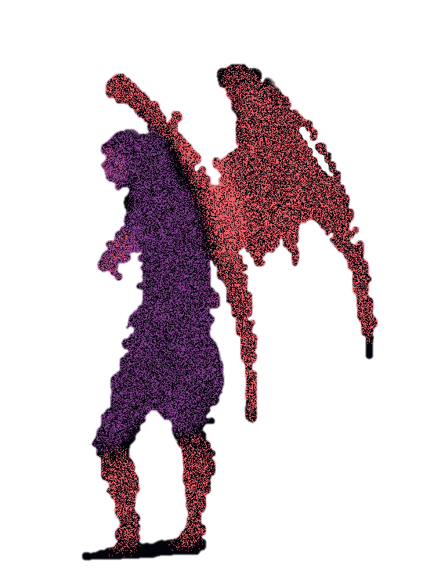
And Satan Also Came. Job 1:6
Job 1:6 Now there was a day when the sons of God came to present themselves before the LORD, and Satan also came among them.

Slide 3
Please open your hearts, your ears, and your Bible and follow along.
If you have any questions about anything I say, if you disagree anything I say, please say something to me after the service and I will be glad to sit down with you and God’s word and study so that we can come to know His truth
Illustrated Bible verses by Ethical Media, Bible photos by bibleplaces.com

Slide 4
And Satan Also Came. Job 1:6
Satan Obtains permission to Try Job 1:6-12
Job's afflictions began from the evilness of Satan, by the Lord's permission,
There is an evil spirit, the enemy of God, who is continually seeking to distress, to lead astray, and, if possible, to destroy those who love God.
How far his influence may extend, we cannot say; but probably much problems and unhappiness in Christians can be attributed to him.

Slide 5
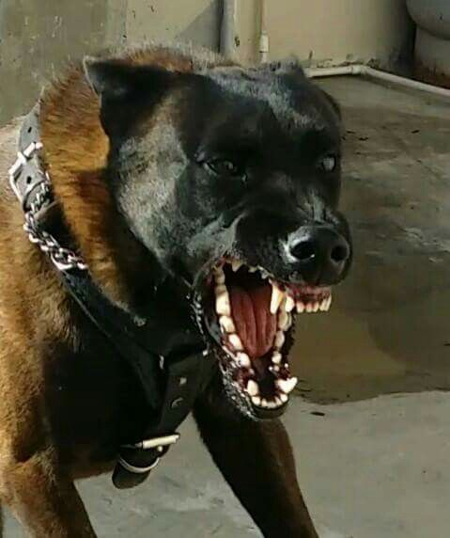
And Satan Also Came. Job 1:6
While we are on this earth we are within Satan’s reach. Hence it concerns us to be sober and vigilant, 1Peter 5:8.

Slide 6
And Satan Also Came. Job 1:6
God suffered Job to be tried, as he suffered Peter to be sifted. It is our comfort that God has the devil on a chain, Rev 20:1. (like a vicious dog)
Satan has no power to lead men to sin, but what we give him (when we step inside the chain of Satan) - Satan is after us.

Slide 7
And Satan Also Came. Job 1:6
In 1:1 Job is declared to have been altogether upright and blameless. At the very outset, therefore, the possibility that his sufferings might be punishment or discipline is thrown out of court.
Satan appeared before God in Job1:6 and challenged the truthfulness of Job's Godliness.
Satan asked the central question of the book: "Does Job fear God for nothing?"
Job lost all his wealth and children in the first affliction and his health in the second. Still, Job did not lose his faith or integrity, even after his wife lost hers. His friends visited him to comfort him, but they sat in horror for a week before anyone could speak.

Slide 8
And Satan Also Came. Job 1:6
Satan The Hebrew word שָׂטָן (satan) means to oppose, obstruct, or accuse. The Greek term (σατάν, satan) literally means “adversary.” In the New Testament, it refers to a title or a name—(the) Satan. The term שָׂטָן (satan) is rendered as diabolos in the Septuagint.
The Use of the Term “Satan” in the Hebrew Bible
In the Old Testament, the word satan is both a noun and a verb. When used as a verb, it means “to oppose as an adversary” (e.g., Pss 38:20; 71:13; 109:4, 20, 29; It is applied to a human adversary as a noun (e.g., 1 Sam 29:4; 2 Sam 19:22; 1 Kgs 5:4; ). In four books of the Old Testament, the term is attached to a supernatural being (Num 22:22, 32; Job 1:6, 7, 8; Zech 3:1; 1 Chr 21:1).

Slide 9
And Satan Also Came. Job 1:6
friend, Satan already has all the people of the world –
Now he wants YOU
Satan is more faithful in some congregations than some members –
He wants to come among us and lead us back into the world.
Satan is our most dangerous enemy.
We must never forget that our life is the target of the devil.
This lesson takes a look at when Satan came among some people.

Slide 10
And Satan Also Came. Job 1:6
1. Satan came after the woman. Gen.3
God placed the first people Adam and Eve in the Eden garden to dress and keep it, not to eat of the tree of knowledge of good and evil. If they ate they would surely die.
Satan came among them (Gen. 3:1-6) and lied to them.
Now the serpent was more cunning than any beast of the field which the LORD God had made. And he said to the woman, "Has God indeed said, 'You shall not eat of every tree of the garden’?” 2 And the woman said to the serpent, "We may eat the fruit of the trees of the garden; 3 "but of the fruit of the tree which is in the midst of the garden, God has said, 'You shall not eat it, nor shall you touch it, lest you die.'" 4 Then the serpent said to the woman, "You will not surely die. 5 "For God knows that in the day you eat of it your eyes will be opened, and you will be like God, knowing good and evil.“ 6 So when the woman saw that the tree was good for food, that it was pleasant to the eyes, and a tree desirable to make one wise, she took of its fruit and ate. She also gave to her husband with her, and he ate.
They ate and sin entered into the world (Rom.5:12)

Slide 11
And Satan Also Came. Job 1:6
6 So when the woman saw that the tree was good for food, that it was pleasant to the eyes, and a tree desirable to make one wise, she took of its fruit and ate. She also gave to her husband with her, and he ate.
They ate and sin entered into the world (Rom.5:12)
The devil used his three avenues of temptation.
1 John 2:15-17 lust of eyes
lust of flesh
pride of life.

Slide 12
And Satan Also Came. Job 1:6
2. Satan came after Job. Job 1-2
Job 1:6-2:1
Job 2:3,6 Then the LORD said to Satan, "Have you considered My servant Job, that there is none like him on the earth, a blameless and upright man, one who fears God and shuns evil? And still he holds fast to his integrity, although you incited Me against him, to destroy him without cause." 4 So Satan answered the LORD and said, "Skin for skin! Yes, all that a man has he will give for his life.
5 "But stretch out Your hand now, and touch his bone and his flesh, and he will surely curse You to Your face!"
6 And the LORD said to Satan, "Behold, he is in your hand, but spare his life."
Satan comes among the best of God's people.
When we meet to worship better watch out. Satan will come among us!

Slide 13
And Satan Also Came. Job 1:6
3. Satan came after Jesus. Matt.4
When Jesus had just been baptized.
Matt.3:13-17
What better time to try to tempt Jesus.
He had not eaten for 40 days
Matt.4:1-11 Then Jesus was led up by the Spirit into the wilderness to be tempted by the devil. 2 And when He had fasted forty days and forty nights, afterward He was hungry.
3 Now when the tempter came to Him, he said, "If You are the Son of God, command that these stones become bread."4 But He answered and said, "It is written, 'Man shall not live by bread alone, but by every word that proceeds from the mouth of God.'"
5 Then the devil took Him up into the holy city, set Him on the pinnacle of the temple,
6 and said to Him, "If You are the Son of God, throw Yourself down. For it is written: 'He shall give His angels charge over you,' and, 'In their hands they shall bear you up, Lest you dash your foot against a stone.'"
7 Jesus said to him, "It is written again, 'You shall not tempt the LORD your God.'"

Slide 14
And Satan Also Came. Job 1:6
8 Again, the devil took Him up on an exceedingly high mountain, and showed Him all the kingdoms of the world and their glory.
9 And he said to Him, "All these things I will give You if You will fall down and worship me."
10 Then Jesus said to him, "Away with you, Satan! For it is written, 'You shall worship the LORD your God, and Him only you shall serve.'"
11 Then the devil left Him, and behold, angels came and ministered to Him.
(NKJV)
Notice how Satan tempted Jesus …..

Slide 15
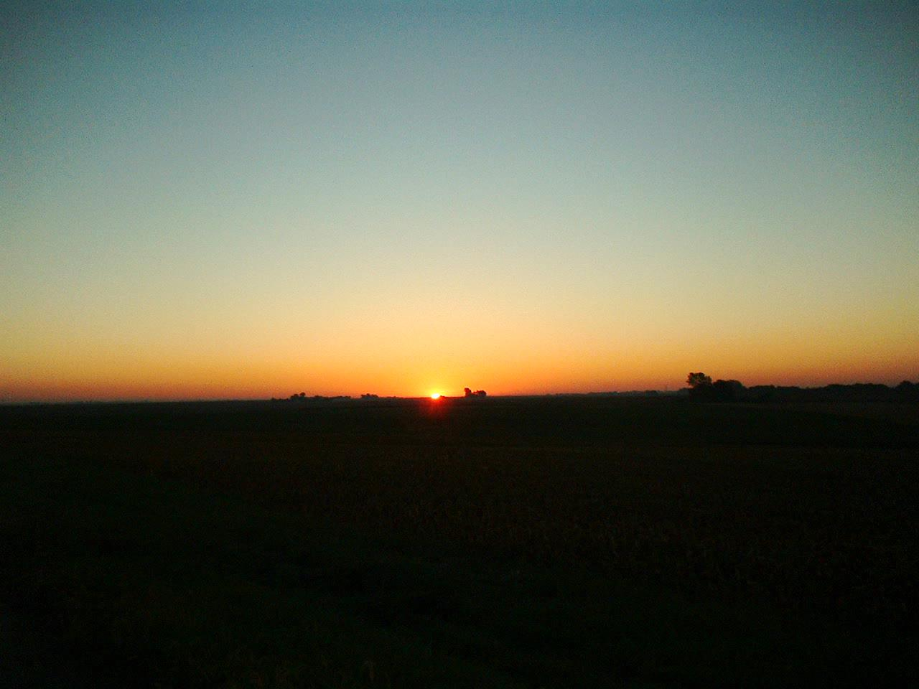
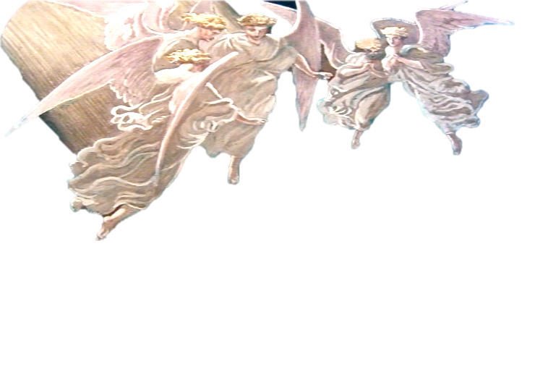
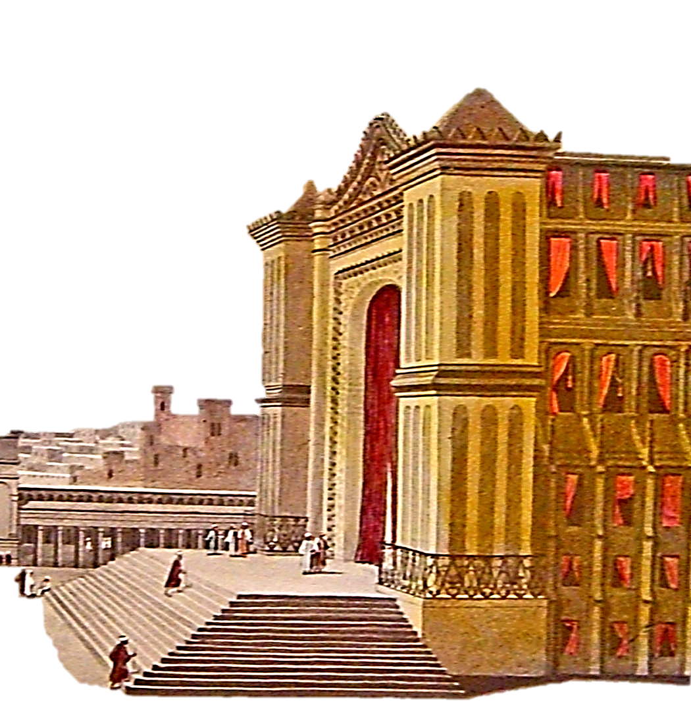
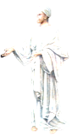
Luke 4
“⁹And he brought him to Jerusalem, and set him on a pinnacle of the temple, and said unto him, If thou be the Son of God, cast thyself down from hence: ¹⁰For it is written, He shall give his angels charge over thee, to keep thee: ¹¹And in their hands they shall bear thee up, lest at any time thou dash thy foot against a stone.”
Luke 4
“¹²And Jesus answering said unto him, It is said, Thou shalt not tempt the Lord thy God. ¹³And when the devil had ended all the temptation, he departed from him for a season.”
Matthew 4
“¹¹Then the devil leaveth him, and, behold, angels came and ministered unto him.”

Slide 16
And Satan Also Came. Job 1:6
Jesus had hid the word in his heart (Psalm 119:11)
He said it is written. He resisted Satan (James 4:7-8). We can too.
(James 4:7) Therefore submit to God. Resist the devil and he will flee from you. 8 Draw near to God and He will draw near to you. Cleanse your hands, you sinners; and purify your hearts, you double-minded.
(1 Cor.10:13)

Slide 17
And Satan Also Came. Job 1:6
4. Satan also came after the Sower. Luke 8
4) LUKE. When the sower sows the seed.
(Luke 8:5-15) "A sower went out to sow his seed. And as he sowed, some fell by the wayside; and it was trampled down, and the birds of the air devoured it.
6 "Some fell on rock; and as soon as it sprang up, it withered away because it lacked moisture.
7 "And some fell among thorns, and the thorns sprang up with it and choked it.
8 "But others fell on good ground, sprang up, and yielded a crop a hundredfold." When He had said these things He cried, "He who has ears to hear, let him hear!"

Slide 18
And Satan Also Came. Job 1:6
9 Then His disciples asked Him, saying, "What does this parable mean?"
10 And He said, "To you it has been given to know the mysteries of the kingdom of God, but to the rest it is given in parables, that 'Seeing they may not see, And hearing they may not understand.'
11 "Now the parable is this: The seed is the word of God.
12 "Those by the wayside are the ones who hear; then the devil comes and takes away the word out of their hearts, lest they should believe and be saved.
13 "But the ones on the rock are those who, when they hear, receive the word with joy; and these have no root, who believe for a while and in time of temptation fall away.
14 "Now the ones that fell among thorns are those who, when they have heard, go out and are choked with cares, riches, and pleasures of life, and bring no fruit to maturity.
15 "But the ones that fell on the good ground are those who, having heard the word with a noble and good heart, keep it and bear fruit with patience.

Slide 19
And Satan Also Came. Job 1:6
Mark 4:1-20
The devil knows that if he can steal the word out of the hearts there will be no obedience .
Mark 4:2 And he taught them many things by parables, and said unto them in his doctrine,
3 Hearken; Behold, there went out a sower to sow:
4 And it came to pass, as he sowed, some fell by the way side, and the fowls of the air came and devoured it up.

Slide 20
And Satan Also Came. Job 1:6
5. Satan came after the Apostles. John 13
What better group to work among.
(John 13:1-2) Now before the feast of the Passover, when Jesus knew that His hour had come that He should depart from this world to the Father, having loved His own who were in the world, He loved them to the end.
2 And supper being ended, the devil having already put it into the heart of Judas Iscariot, Simon's son, to betray Him,
Judas betrayed our Lord. (Matt.26:14-25)
Simon. (Luke 22:31-34)
(Luke 22:54-62)

Slide 21
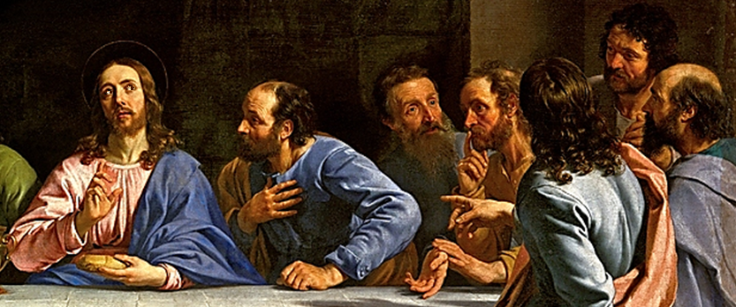
Matthew 26
“²⁴The Son of man goeth as it is written of him: but woe unto that man by whom the Son of man is betrayed! it had been good for that man if he had not been born. ²⁵Then Judas, which betrayed him, answered and said, Master, is it I? He said unto him, Thou hast said.”

Slide 22
And Satan Also Came. Job 1:6
5. Satan came after the Apostles. John 13
Luke 22:31 And the Lord said, "Simon, Simon! Indeed, Satan has asked for you, that he may sift you as wheat.
32 "But I have prayed for you, that your faith should not fail; and when you have returned to Me, strengthen your brethren."
33 But he said to Him, "Lord, I am ready to go with You, both to prison and to death."
34 Then He said, "I tell you, Peter, the rooster shall not crow this day before you will deny three times that you know Me."

Slide 23
And Satan Also Came. Job 1:6
6. Satan came after early Christians. Acts 5
When some early Christians came into some money.

Slide 24
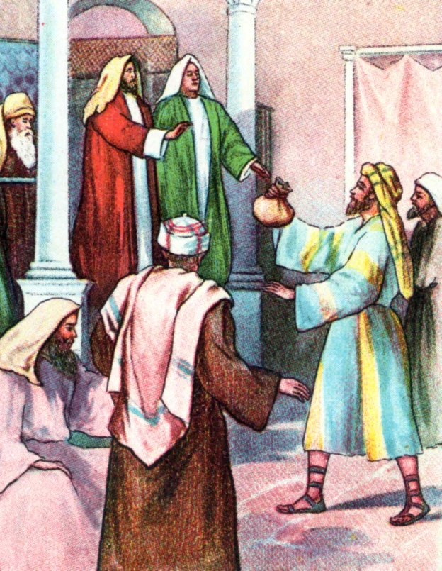
CHAPTER 5
“¹But a certain man named Ananias, with Sapphira his wife, sold a possession,
²And kept back part of the price, his wife also being privy to it, and brought a certain part, and laid it at the apostles’ feet.”

Slide 25
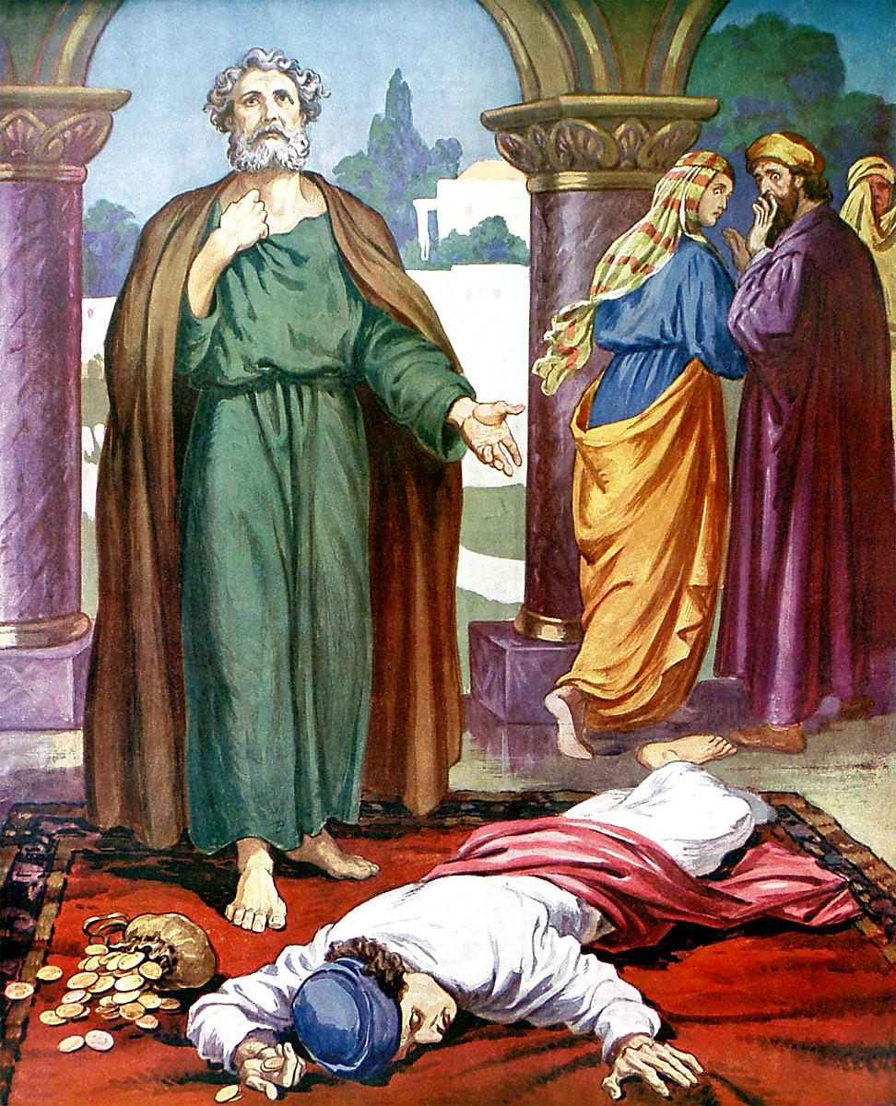
CHAPTER 5
“³But Peter said, Ananias, why hath Satan filled thine heart to lie to the Holy Ghost, and to keep back part of the price of the land? ⁴Whiles it remained, was it not thine own? and after it was sold, was it not in thine own power? why hast thou conceived this thing in thine heart? thou hast not lied unto men, but unto God.”
CHAPTER 5
“⁵And Ananias hearing these words fell down, and gave up the ghost: and great fear came on all them that heard these things.
⁶And the young men arose, wound him up, and carried him out, and buried him.”

Slide 26
Peter’s knowledge of the deception of Ananias was miraculously given to him by the Holy Spirit, but it is not likely he was prepared for Ananias to fall dead at his feet!
If Ananias had been successful at his fraud and eventually it was detected it would have caused people to have serious doubts of the power of the Holy Spirit in the apostles.
To learn that the Spirit could be deceived would have undermined the whole fabric of apostolic authority.

Slide 27
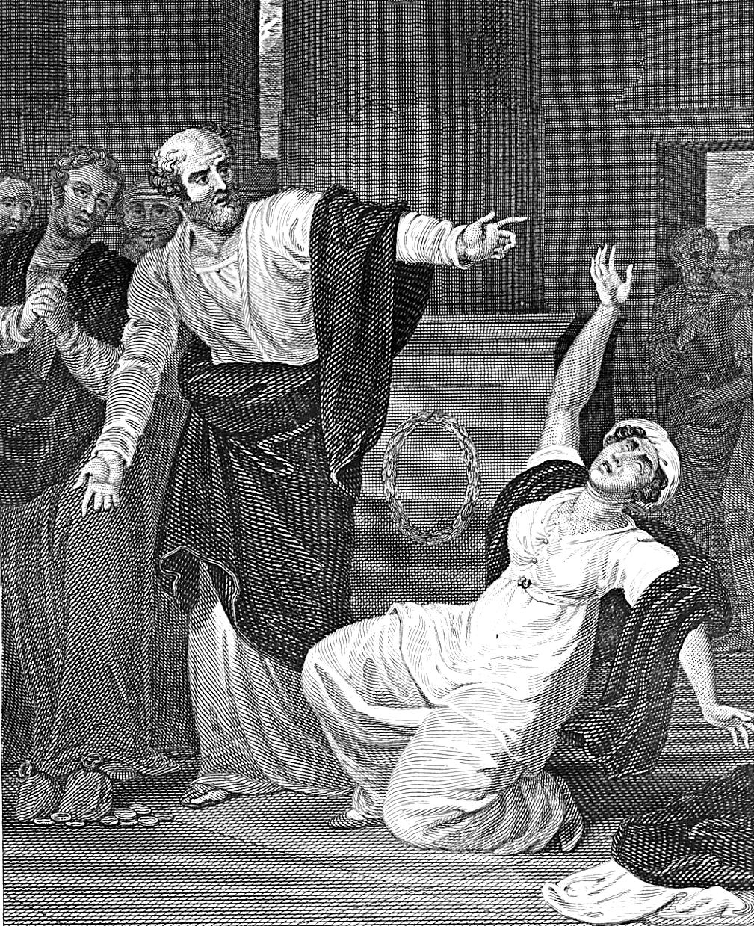
CHAPTER 5
“⁷And it was about the space of three hours after, when his wife, not knowing what was done, came in. ⁸And Peter answered unto her, Tell me whether ye sold the land for so much? And she said, Yea, for so much.
⁹Then Peter said unto her, How is it that ye have agreed together to tempt the Spirit of the Lord? behold, the feet of them which have buried thy husband are at the door, and shall carry thee out.”

Slide 28
And Satan Also Came. Job 1:6
1Tim. 6:10-11 For the love of money is a root of all kinds of evil, for which some have strayed from the faith in their greediness, and pierced themselves through with many sorrows. 11 But you, O man of God, flee these things and pursue righteousness, godliness, faith, love, patience, gentleness.
The devil knows that if he can steal the word out of the hearts there will be no obedience .
Rom.10:17 So then faith comes by hearing, and hearing by the word of God.
Therefore we must not be ignorant of Satan's devices.
Satan will take advantage of us. 2Cor. 2:11

Slide 29
And Satan Also Came. Job 1:6
He is a liar. (John 8:44) 4 "You are of your father the devil, and the desires of your father you want to do. He was a murderer from the beginning, and does not stand in the truth, because there is no truth in him. When he speaks a lie, he speaks from his own resources, for he is a liar and the father of it.
(2 Thess.2:9) The coming of the lawless one is according to the working of Satan, with all power, signs, and lying wonders,
(1 Thess. 2:18) He will Hinder us --Therefore we wanted to come to you--even I, Paul, time and again--but Satan hindered us.

Slide 30
And Satan Also Came. Job 1:6
Satan is a tempter Matt.4:1-3
Satan is subtle Gen. 3:1-- Now the serpent was more cunning than any beast of the field which the LORD God had made. And he said to the woman, "Has God indeed said, 'You shall not eat of every tree of the garden'?"
2 And the woman said to the serpent, "We may eat the fruit of the trees of the garden;
3 "but of the fruit of the tree which is in the midst of the garden, God has said, 'You shall not eat it, nor shall you touch it, lest you die.'"
4 Then the serpent said to the woman, "You will not surely die.

Slide 31
And Satan Also Came. Job 1:6
>Can be transformed into an Angel of light.
(2 Cor.11:14-15)
>Our adversary. (1 Peter 5:8-9)
>A deceiver. (Rev. 12:9)

Slide 32
And Satan Also Came. Job 1:6
God of this world.
(2 Cor.4:3) But even if our gospel is veiled, it is veiled to those who are perishing,
4 whose minds the god of this age has blinded, who do not believe, lest the light of the gospel of the glory of Christ, who is the image of God, should shine on them.
Dragon, serpent, devil, accuser. (Rev.12:9-10)

Slide 33
And Satan Also Came. Job 1:6
7. Satan comes after You and Me.

Slide 34
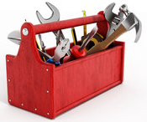
And Satan Also Came. Job 1:6
7. Satan comes after You and Me.

Slide 35
And Satan Also Came. Job 1:6
7. Satan comes after You and Me.
What are you going to do?

