Slide 1
Welcome to our services
New Lebanon Church of Christ
We are Simply Christians.
Our Emphasis is Spiritual, Not Material or Social.
We are striving to be The Same Church as Described in The New Testament.
Please Come Back Again

Slide 2
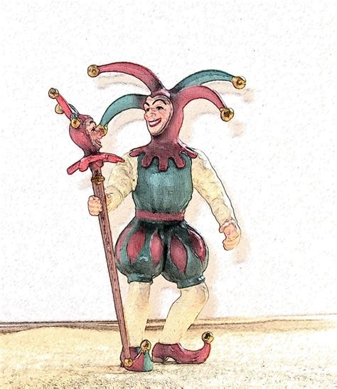
Different Types Of Fools
Psalm 14:1 The fool has said in his heart, "There is no God." They are corrupt, They have done abominable works, There is none who does good.

Slide 3
Please open your hearts, your ears, and your Bible and follow along.
If you have any questions about anything I say, if you disagree anything I say, please say something to me after the service and I will be glad to sit down with you and God’s word and study so that we can come to know His truth
Illustrated Bible verses by Ethical Media, Bible photos by bibleplaces.com

Slide 4
Different Types Of Fools Psalm 14:1
FOOL. Represented by a large number of Heb. and Gk. words. The word is used in Scripture with respect to moral more than to intellectual deficiencies. The "fool" is not so much one lacking in mental powers, as one who misuses them; not one who does not reason, but reasons wrongly.
In Scripture the "fool" primarily is the person who casts off the fear of God and thinks and acts as if he could safely disregard the eternal principles of God's righteousness (Ps 14:1; Prov 14:9; Jer 17:11; etc.).
b hastings newlebanoncoc.com

Slide 5
Different Types Of Fools Psalm 14:1
But in many passages, especially in Proverbs, the term has its ordinary use and denotes one who is rash, senseless, or unreasonable.
The expression "you fool" (Matt 5:22) is used in the moral sense, means "wicked," and seems to be equivalent to judging one as worthy of everlasting punishment.
(from The New Unger's Bible Dictionary. )
b hastings newlebanoncoc.com

Slide 6
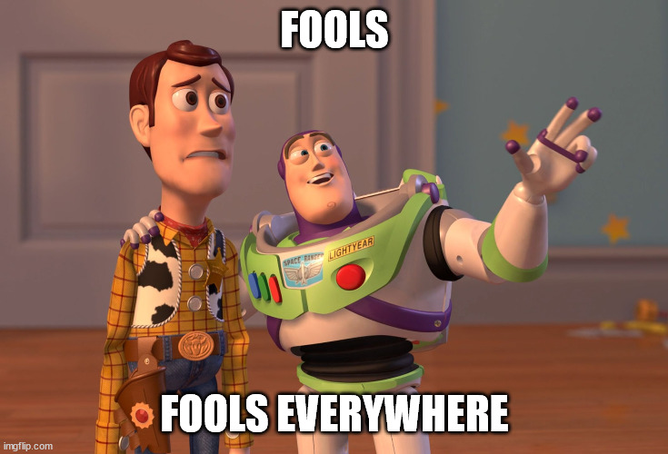

Slide 7
Different Types Of Fools Psalm 14:1
1.The Atheistic Fool.
(Psalm 14:1) To the Chief Musician. A Psalm of David.>> The fool has said in his heart, "There is no God." They are corrupt, They have done abominable works, There is none who does good.
Faith is reasonable. We have faith in appliances, cars, airplanes. These are amazing and elaborate creations and we have faith in them.
b hastings newlebanoncoc.com

Slide 8
Different Types Of Fools Psalm 14:1
If we could find an elaborate machine, and then find a book that describes the machine accurately, and to the last detail, we would rightly assume that the man who made the machine wrote the book. This is exactly the situation with the Bible, man, and God.
When we look at the intricate design of a watch, we immediately recognize that it did not come into being by chance. So also the intricate design of the universe from the beginning of gravitation to the relationship of the stars in the universe to each other to the simplest plant in our garden.---They all bear the same marks: Order, Design, Intelligence, and these marks proclaim the existence of God.
b hastings newlebanoncoc.com

Slide 9
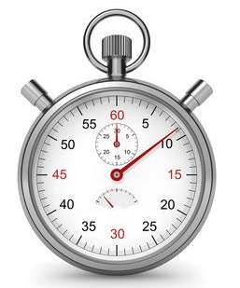
Different Types Of Fools Psalm 14:1
Order
Design
Intelligence
these marks proclaim the existence of God.
b hastings newlebanoncoc.com

Slide 10
Different Types Of Fools Psalm 14:1
2. He Who Hears the Word And Does Not Obey It Is A Fool.
(Matt 7:21-27) "Not everyone who says to Me, 'Lord, Lord,' shall enter the kingdom of heaven, but he who does the will of My Father in heaven. 22 "Many will say to Me in that day, 'Lord, Lord, have we not prophesied in Your name, cast out demons in Your name, and done many wonders in Your name?'
23 "And then I will declare to them, 'I never knew you; depart from Me, you who practice lawlessness!'
b hastings newlebanoncoc.com

Slide 11
Different Types Of Fools Psalm 14:1
24 "Therefore whoever hears these sayings of Mine, and does them, I will liken him to a wise man who built his house on the rock: 25 "and the rain descended, the floods came, and the winds blew and beat on that house; and it did not fall, for it was founded on the rock.
26 "But everyone who hears these sayings of Mine, and does not do them, will be like a foolish man who built his house on the sand:
27 "and the rain descended, the floods came, and the winds blew and beat on that house; and it fell. And great was its fall." 28 And so it was, when Jesus had ended these sayings, that the people were astonished at His teaching,
29 for He taught them as one having authority, and not as the scribes.
b hastings newlebanoncoc.com

Slide 12
Different Types Of Fools Psalm 14:1
The salvation of the soul is conditional upon obedience to the word.
The word makes us better while we live.
Acts 20:32 And now, brethren, I commend you to God, and to the word of his grace, which is able to build you up, and to give you an inheritance among all them which are sanctified.
b hastings newlebanoncoc.com

Slide 13
Different Types Of Fools Psalm 14:1
The Word comforts us in life and death
Romans 15:4 For whatever things were written before were written for our learning, that we through the patience and comfort of the Scriptures might have hope.
b hastings newlebanoncoc.com

Slide 14
Different Types Of Fools Psalm 14:1
The Word -
1Thess.4:13-18 But I do not want you to be ignorant, brethren, concerning those who have fallen asleep, lest you sorrow as others who have no hope.14 For if we believe that Jesus died and rose again, even so God will bring with Him those who sleep in Jesus.
15 For this we say to you by the word of the Lord, that we who are alive and remain until the coming of the Lord will by no means precede those who are asleep. 16 For the Lord Himself will descend from heaven with a shout, with the voice of an archangel, and with the trumpet of God. And the dead in Christ will rise first.
17 Then we who are alive and remain shall be caught up together with them in the clouds to meet the Lord in the air. And thus we shall always be with the Lord.
18 Therefore comfort one another with these words.
b hastings newlebanoncoc.com

Slide 15
Different Types Of Fools Psalm 14:1
The Word –
We will be judged by it
John 12:48 "He who rejects Me, and does not receive My words, has that which judges him--the word that I have spoken will judge him in the last day.
b hastings newlebanoncoc.com

Slide 16
Different Types Of Fools Psalm 14:1
3.The one who obeys the gospel and then does not live it.
(Gal. 3:1) O foolish Galatians! Who has bewitched you that you should not obey the truth, before whose eyes Jesus Christ was clearly portrayed among you as crucified?
b hastings newlebanoncoc.com

Slide 17
Different Types Of Fools Psalm 14:1
The alien sinner is lost - 2Thess 1:7-9 and to give you who are troubled rest with us when the Lord Jesus is revealed from heaven with His mighty angels,
8 in flaming fire taking vengeance on those who do not know God, and on those who do not obey the gospel of our Lord Jesus Christ.
9 These shall be punished with everlasting destruction from the presence of the Lord and from the glory of His power,
b hastings newlebanoncoc.com

Slide 18
Different Types Of Fools Psalm 14:1
The lost Christian is in worse condition
2 Peter 2:20-22 For if, after they have escaped the pollutions of the world through the knowledge of the Lord and Savior Jesus Christ, they are again entangled in them and overcome, the latter end is worse for them than the beginning.
21 For it would have been better for them not to have known the way of righteousness, than having known it, to turn from the holy commandment delivered to them.
22 But it has happened to them according to the true proverb: "A dog returns to his own vomit," and, "a sow, having washed, to her wallowing in the mire."
b hastings newlebanoncoc.com

Slide 19
Different Types Of Fools Psalm 14:1
Heb 6:1-8 Therefore, leaving the discussion of the elementary principles of Christ, let us go on to perfection, not laying again the foundation of repentance from dead works and of faith toward God,
2 of the doctrine of baptisms, of laying on of hands, of resurrection of the dead, and of eternal judgment.
3 And this we will do if God permits.
4 For it is impossible for those who were once enlightened, and have tasted the heavenly gift, and have become partakers of the Holy Spirit,
b hastings newlebanoncoc.com

Slide 20
Different Types Of Fools Psalm 14:1
5 and have tasted the good word of God and the powers of the age to come,
6 if they fall away, to renew them again to repentance, since they crucify again for themselves the Son of God, and put Him to an open shame.
7 For the earth which drinks in the rain that often comes upon it, and bears herbs useful for those by whom it is cultivated, receives blessing from God;
8 but if it bears thorns and briars, it is rejected and near to being cursed, whose end is to be burned.
b hastings newlebanoncoc.com

Slide 21
Different Types Of Fools Psalm 14:1
Heb 10:26-31 For if we sin willfully after we have received the knowledge of the truth, there no longer remains a sacrifice for sins,
27 but a certain fearful expectation of judgment, and fiery indignation which will devour the adversaries.
28 Anyone who has rejected Moses' law dies without mercy on the testimony of two or three witnesses.
29 Of how much worse punishment, do you suppose, will he be thought worthy who has trampled the Son of God underfoot, counted the blood of the covenant by which he was sanctified a common thing, and insulted the Spirit of grace?
30 For we know Him who said, "Vengeance is Mine, I will repay," says the Lord. And again, "The LORD will judge His people."
31 It is a fearful thing to fall into the hands of the living God.
b hastings newlebanoncoc.com

Slide 22
Different Types Of Fools Psalm 14:1
The Christian life is one of service. Contrast with Heb.2:1-3
Heb.2:1-3 Therefore we must give the more earnest heed to the things we have heard, lest we drift away. 2 For if the word spoken through angels proved steadfast, and every transgression and disobedience received a just reward,
3 how shall we escape if we neglect so great a salvation, which at the first began to be spoken by the Lord, and was confirmed to us by those who heard Him,
b hastings newlebanoncoc.com

Slide 23
Different Types Of Fools Psalm 14:1
Eternal salvation to the faithful.
Matt. 24:13 "But he who endures to the end shall be saved.
Rev 2:10 Do not fear any of those things which you are about to suffer. Indeed, the devil is about to throw some of you into prison, that you may be tested, and you will have tribulation ten days. Be faithful until death, and I will give you the crown of life.
b hastings newlebanoncoc.com

Slide 24
Different Types Of Fools Psalm 14:1
4.The Rich Fool.
(Luke 12:16-20) Then He spoke a parable to them, saying: "The ground of a certain rich man yielded plentifully.
17 "And he thought within himself, saying, 'What shall I do, since I have no room to store my crops?'
18 "So he said, 'I will do this: I will pull down my barns and build greater, and there I will store all my crops and my goods.
19 'And I will say to my soul, "Soul, you have many goods laid up for many years; take your ease; eat, drink, and be merry."'
20 "But God said to him, 'Fool! This night your soul will be required of you; then whose will those things be which you have provided?'
b hastings newlebanoncoc.com

Slide 25
Different Types Of Fools Psalm 14:1
I am glad JESUS called this man a fool. We might have called him a SUCCESS. How did Jesus know he was a fool/ Not from the man himself or from his neighbors. We cannot know a fool by what he says to his wife or preacher. Not by the way he looks, talks, or Acts.
What did his foolishness consist of?
b hastings newlebanoncoc.com

Slide 26
Different Types Of Fools Psalm 14:1
What did his foolishness consist of?
Let’s consider what it was not from.
>Not because he made money and it does not say he made it dishonestly.
>It was because he saved it.
b hastings newlebanoncoc.com

Slide 27
Different Types Of Fools Psalm 14:1
What did it consist of?
1.He left God out of his life.
2.He left his wife and children out of the picture.
3.He left his fellow man out.
4.He thought he had a guarantee on life.
5.He made no preparation for the next life.
6.He thought the material things of life would bring him happiness.
b hastings newlebanoncoc.com

Slide 28
One who does not believe in God.
One who believes in God but is not a doer of the word.
One who believes baptism is the only thing you need to do to be acceptable to God.
One that trusts in his riches.

