Slide 1
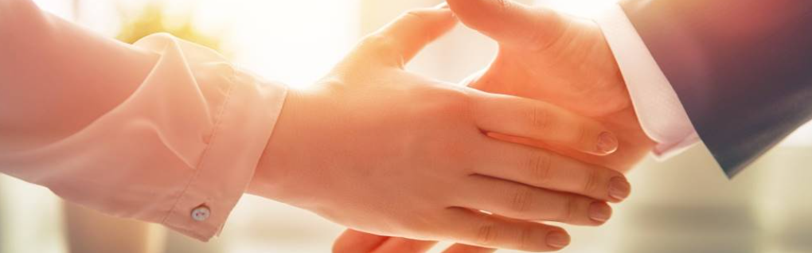
Welcome to our services
New Lebanon Church of Christ
We are Simply Christians.
Our Emphasis is Spiritual, Not Material or Social.
We are striving to be The Same Church as Described in The New Testament.
Please Come Back Again

Slide 2
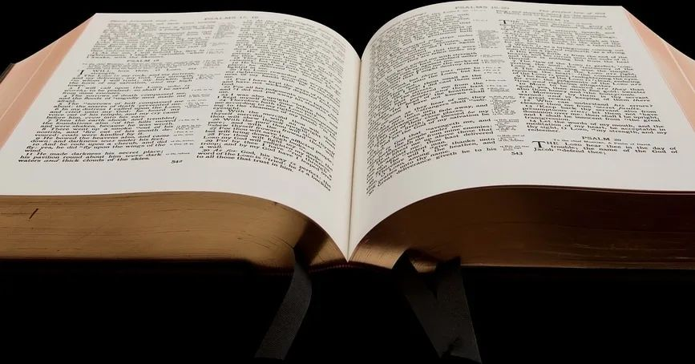
You are mistaken, not knowing the scriptures. Matt.22:29
Matt. 22:29 Jesus answered and said to them, "You are mistaken, not knowing the Scriptures nor the power of God.”

Slide 3
What is the church?
The blood bought,
Heaven sent,
Spirit filled
Body of believers that the Lord adds to when we surrender our hearts and our lives to His Word.
Acts 2:37 Now when they heard this, they were cut to the heart, and said to Peter and the rest of the apostles, "Men and brethren, what shall we do?"
38 Then Peter said to them, "Repent, and let every one of you be baptized in the name of Jesus Christ for the remission of sins; and you shall receive the gift of the Holy Spirit.
Acts 2:47 praising God and having favor with all the people. And the Lord added to the church daily those who were being saved.

Slide 4
You are mistaken, not knowing the scriptures. Matt.22:29
Matt. 22:29 Jesus answered and said to them, "You are mistaken, not knowing the Scriptures nor the power of God.
Hosea 4:6 My people are destroyed for lack of knowledge. Because you have rejected knowledge, I also will reject you from being priest for Me; Because you have forgotten the law of your God, I also will forget your children.
Amos 8:11 "Behold, the days are coming," says the Lord GOD, "That I will send a famine on the land, Not a famine of bread, Nor a thirst for water, But of hearing the words of the LORD.

Slide 5

You Are Mistaken, Not Knowing The Scriptures Matt 22:29
Mistaken-
ERR
1. planao (πλανάω, 4105), in the active voice, signifies “to cause to wander, lead astray, deceive” in the passive voice, “to be led astray, to err.” It is translated “err,” in Matt. 22:29; Mark 12:24, 27; Heb. 3:10; Jas. 1:16 (kjv, “do not err,” rv, “be not deceived”); 5:19. See deceive, seduce, wander, .
2. apoplanao (ἀποπλανάω, 635), “to cause to wander away from, to lead astray from” (apo, “from,” and No. 1), is used metaphorically of leading into error, Mark 13:22, kjv, “seduce,” rv “lead astray”; “have been led astray.” See seduce.¶
3. astocheo (ἀστοχέω, 795), “to miss the mark, fail” (a, negative, stochos, “a mark”), is used only in the Pastoral Epistles, 1 Tim. 1:6, “having swerved”; 6:21 and 2 Tim. 2:18, “have erred.” See swerve.¶
  W. E. Vine,

Slide 6
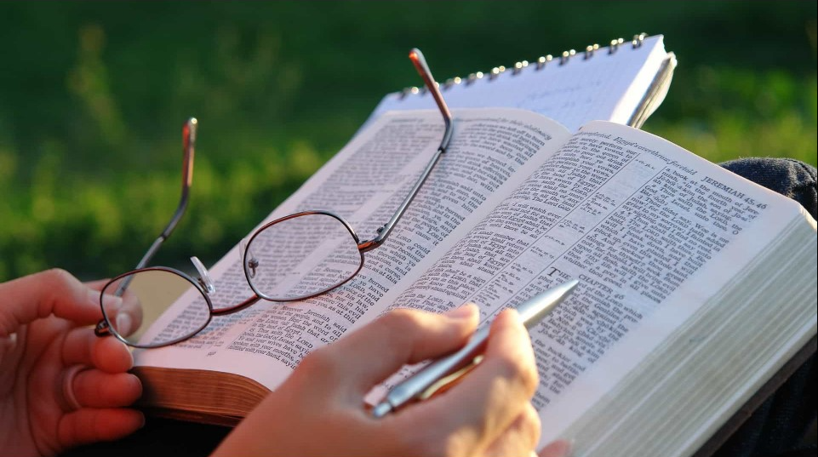
You Are Mistaken, Not Knowing The Scriptures Matt 22:29
The Bible is the world's most popular book, the world's most influential book; yet it is the world's most misunderstood book.
Some people misunderstand the whole Bible.
Some people misunderstand the Bible today. We need to help them clear up that misunderstanding

Slide 7
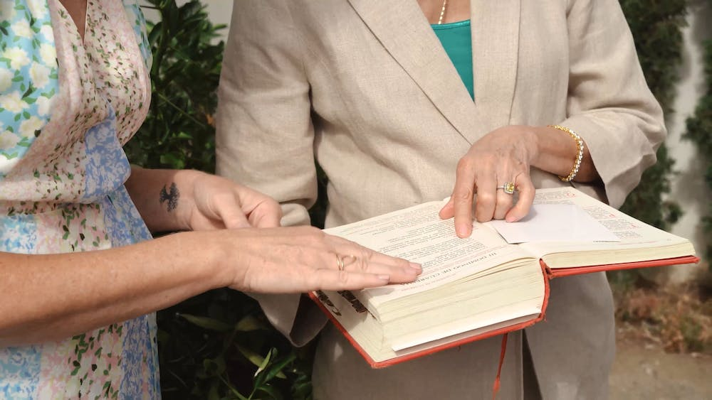
You Are Mistaken, Not Knowing The Scriptures Matt 22:29
(1) Some people misunderstand its source.
They think it is a human book but the Bible is the inspired message of God.
2 Tim. 3:16,17 All Scripture is given by inspiration of God, and is profitable for doctrine, for reproof, for correction, for instruction in righteousness, 17 that the man of God may be complete, thoroughly equipped for every good work.
2 Pet. 1:21 for prophecy never came by the will of man, but holy men of God spoke as they were moved by the Holy Spirit.

Slide 8
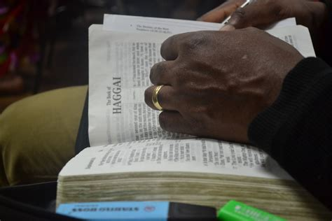
You Are Mistaken, Not Knowing The Scriptures Matt 22:29
(2) Some misunderstand the purpose of the Bible.
Some think it is a story book.
But it is here to furnish man unto every good work. 2 Tim. 3:16,17
This is reasonable; because if there is a God - and there is, then it is reasonable that He would give man a message of guidance and hope.

Slide 9
You Are Mistaken, Not Knowing The Scriptures Matt 22:29
(3) Some misunderstand its indestructibility.
Many have tried to destroy it.
But if every Bible should be destroyed, it could be reproduced easily from the thousands of other books which quote it.
And if this were not possible, it still would not be destroyed.
It would still appear at the judgment to face.

Slide 10
You Are Mistaken, Not Knowing The Scriptures Matt 22:29
Matt. 24:35
"Heaven and earth will pass away, but My words will by no means pass away.

Slide 11
You Are Mistaken, Not Knowing The Scriptures Matt 22:29
John 12:48 He who rejects Me, and does not receive My words, has that which judges him--the word that I have spoken will judge him in the last day.
Rev. 20:12 And I saw the dead, small and great, standing before God, and books were opened. And another book was opened, which is the Book of Life. And the dead were judged according to their works, by the things which were written in the books.

Slide 12
You Are Mistaken, Not Knowing The Scriptures Matt 22:29
4. Some people misunderstand the Testaments - Old and New.
Consequently, they are just as likely to go to Psalms as to Acts to find the plan of salvation.
This error is the father of many other errors.
(2) We are now living under the reign and rule of the New Testament.

Slide 13
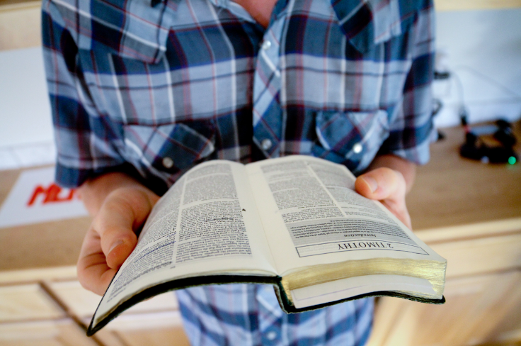
You Are Mistaken, Not Knowing The Scriptures Matt 22:29
The law of Moses was to last until Christ came Gal. 3:19 What purpose then does the law serve? It was added because of transgressions, till the Seed should come to whom the promise was made; and it was appointed through angels by the hand of a mediator. .
Jesus nailed it to the cross Col. 2 :14 having wiped out the handwriting of requirements that was against us, which was contrary to us. And He has taken it out of the way, having nailed it to the cross..
Today we must hear Christ

Slide 14
Gal. 3:19 What purpose then does the law serve? It was added because of transgressions, till the Seed should come to whom the promise was made; and it was appointed through angels by the hand of a mediator.
Luke 16:16 "The law and the prophets were until John. Since that time the kingdom of God has been preached, and everyone is pressing into it.

Slide 15
You Are Mistaken, Not Knowing The Scriptures Matt 22:29
The first covenant was taken away that we might have the second Heb.10:9, then He said, "Behold, I have come to do Your will, O God." He takes away the first that He may establish the second.

Slide 16
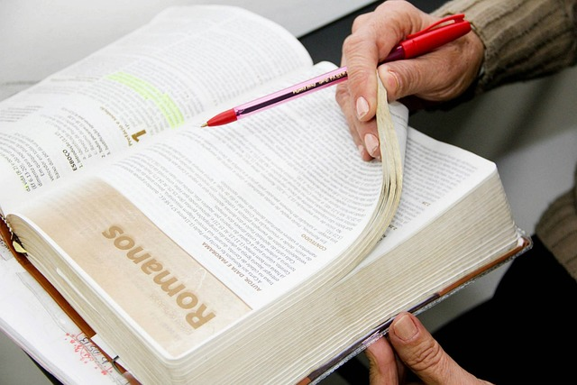
You Are Mistaken, Not Knowing The Scriptures Matt 22:29
5. Some people misunderstand the books of the Bible.
The Old Testament books point forward to Christ's coming
Gen. 3:15; And I will put enmity Between you and the woman, And between your seed and her Seed; He shall bruise your head, And you shall bruise His heel."

Slide 17
You Are Mistaken, Not Knowing The Scriptures Matt 22:29
Isaiah 53
The Mosaic law was a schoolmaster to prepare man for Christ
Gal. 3:24. Therefore the law was our tutor to bring us to Christ, that we might be justified by faith.
(2) The New Testament books point backward to Christ's having come.
The gospels are books of evidence to create faith in Christ.

Slide 18
You Are Mistaken, Not Knowing The Scriptures Matt 22:29
6. Some people misunderstand the chapters of the Bible.
(1) They think it came from God, broken down in chapters.
But man arranged it in chapters.
(2) The break for chapters often contributes to misunderstanding, because it breaks the thought.
For instance, some think the baptism of Holy Spirit came upon the 120 Acts 1; but if you read Acts 1:26 along with Acts 2 as if there were no chapter break, you will see that the apostles were the ones baptized with Holy Spirit Acts 2 :1-13.

Slide 19
You Are Mistaken, Not Knowing The Scriptures Matt 22:29
7. Some people misunderstand the verses of the Bible.
(1) They are not aware of the fact that the Bible was broken down into verses by man.
(2) They expect too much from one verse; they expect to get the whole plan of salvation from one verse.
But there is no one verse in the Bible that gives the whole plan of salvation.
We must take the whole counsel of God. Acts 20 :27
all Scripture 2.Tim.3:16,17.

Slide 20
You Are Mistaken, Not Knowing The Scriptures Matt 22:29
8. Some people misunderstand the phrases of the Bible.
(1) They misunderstand such simple phrases as, "He that believeth and is baptized shall be saved" Mk.16:16.
They try to get salvation before baptism.
(2) And they misunderstand Acts 2:38, "Repent, and be baptized every one of you in the name of Jesus Christ for the remission of sins," They try to get to the remission of sins before baptism.

Slide 21
You Are Mistaken, Not Knowing The Scriptures Matt 22:29
But repentance and baptism are joined together by the copulative conjunction ',and" - a conjunction which couples words and phrases - and points to the same object which is the remission of sins. So repentance and baptism are for the same purpose.
Also, some misunderstand "for" in the verse. They say it means "because of" - be baptized because of remission of sins.
However, it means in Acts 2:38 what it means in Matt, 26:28: ". . . blood . . . shed . . . for remission of sins" - not that Jesus shed his blood because our sins were already remitted.

Slide 22
You Are Mistaken, Not Knowing The Scriptures Matt 22:29
9. Some people misunderstand the words of the Bible:
repentance, baptism, etc.
(1) Repentance means more than reformation Matt. 3:8; it is also related to godly sorrow for sin 2 Cor.7:10.
(2) The dictionary defines baptism as sprinkling, pouring, and immersion; because the function of a dictionary is to give the usages of a word.
But this has no bearing on the original and scriptural meaning of the word, which is to immerse John. 3:23; Rom. 6:3,4; Acts 8:36·39 .

Slide 23
You Are Mistaken, Not Knowing The Scriptures Matt 22:29
10. When we misunderstand the Bible, "We do err not knowing the scriptures" Matt. 22:29

Slide 24

You Are Mistaken, Not Knowing The Scriptures Matt 22:29
11. Text implies that the Scriptures are the standard of life.
(2 Tim. 3:16,17) (2 Pet. 1:3) (Psa. 119:105).
(2) Man needs this standard (Jer. 10 :23) - just like he needs standards of time, weights, and measures.

Slide 25
You Are Mistaken, Not Knowing The Scriptures Matt 22:29
2. Text implies that we err if we deviate from the Scriptures.
Deut. 4:2;
Rev. 22 :18,19.
(2) Moses smote rock - erred by going beyond Num. 20 :7-11.
(3) Saul saved Agag and the best of the sheep and oxen - erred by falling short 1 Sam. 15:1.23. The people in the context erred because they knew not the Scriptures.

Slide 26
You Are Mistaken, Not Knowing The Scriptures Matt 22:29
(2) They erred" not knowing ... the power of God" Matt. 22:29.
When the omnipotence of God is recognized, it is easy to believe in his power to perform any supernatural work. Acts 26:8. Why should it be thought incredible by you that God raises the dead?
(3) They further erred not knowing that there will be a different type of life in the resurrected state Matt. 22 :30.
(4) The source of their error was ignorance. True of many.

Slide 27
You Are Mistaken, Not Knowing The Scriptures Matt 22:29
(12) One of the biggest delusions of the day is a dependence upon human reason for guidance instead of the Scriptures
Man must know the truth John 8:32; 5:39.
Some others who know the Scriptures also err. It is not for ignorance. It is for other reasons; for instance:

Slide 28
You Are Mistaken, Not Knowing The Scriptures Matt 22:29
(2) Prejudice Acts 7:54-60; Matt. 13:15.
(3) Preconceived ideas cause some to color the Scriptures. The Jews were unable to understand the Great Commission Mk.16:15, 16.
It took a miracle to get them to understand that it also applied to the Gentiles Acts 10, 11.
(4) Know only a fragment of Scriptures. Must take the them all.

Slide 29
You Are Mistaken, Not Knowing The Scriptures Matt 22:29
Psalm 119:160 The sum of thy word is truth; And every one of thy righteous ordinances endureth for ever. (ASV)
Acts 20:27 "For I have not shunned to declare to you the whole counsel of God.

Slide 30
Have you been mistaken?
Are you willing to do what is right?
Are you willing to do what is right, right now?
Are you willing to let the Bible determine what is right?

