Slide 1
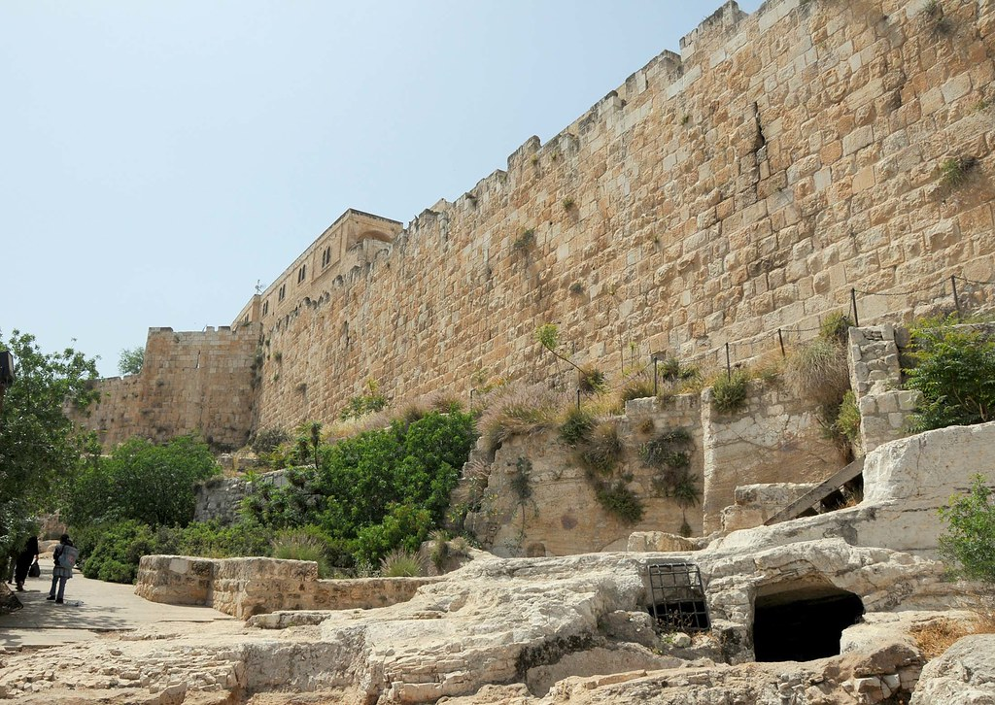
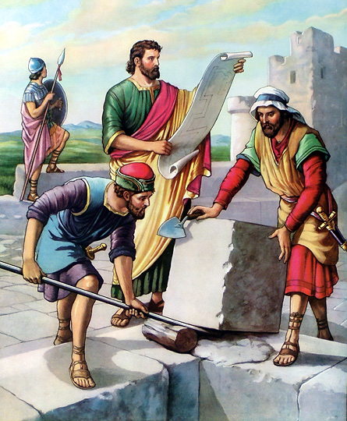
Workers
And Weapons
Neh. 4:12-23

Slide 2
Workers And Weapons Nehemiah 4:12-23
Nehemiah 4:12–23 (NKJV)
¹² So it was, when the Jews who dwelt near them came, that they told us ten times, “From whatever place you turn, they will be upon us.”
¹³ Therefore I positioned men behind the lower parts of the wall, at the openings; and I set the people according to their families, with their swords, their spears, and their bows.

Slide 3
Workers And Weapons Nehemiah 4:12-23
¹⁴ And I looked, and arose and said to the nobles, to the leaders, and to the rest of the people, “Do not be afraid of them. Remember the Lord, great and awesome, and fight for your brethren, your sons, your daughters, your wives, and your houses.”
¹⁵ And it happened, when our enemies heard that it was known to us, and that God had brought their plot to nothing, that all of us returned to the wall, everyone to his work.

Slide 4
Workers And Weapons Nehemiah 4:12-23
¹⁶ So it was, from that time on, that half of my servants worked at construction, while the other half held the spears, the shields, the bows, and wore armor; and the leaders were behind all the house of Judah.
¹⁷ Those who built on the wall, and those who carried burdens, loaded themselves so that with one hand they worked at construction, and with the other held a weapon. ¹⁸ Every one of the builders had his sword girded at his side as he built. And the one who sounded the trumpet was beside me.

Slide 5
Workers And Weapons Nehemiah 4:12-23
¹⁹ Then I said to the nobles, the rulers, and the rest of the people, “The work is great and extensive, and we are separated far from one another on the wall.
²⁰ Wherever you hear the sound of the trumpet, rally to us there. Our God will fight for us.”
²¹ So we labored in the work, and half of the men held the spears from daybreak until the stars appeared.

Slide 6
Workers And Weapons Nehemiah 4:12-23
²² At the same time I also said to the people, “Let each man and his servant stay at night in Jerusalem, that they may be our guard by night and a working party by day.”
²³ So neither I, my brethren, my servants, nor the men of the guard who followed me took off our clothes, except that everyone took them off for washing.

Slide 7
Workers And Weapons Nehemiah 4:12-23
“
This was a very critical time. The Jews were getting weary of the work; their enemies had planted fear in the workers living beyond the walls by telling them of their plans suddenly to appear and kill the workers;
the Jews from the surrounding area appealed to their neighbors at work on the wall to return home, abandoning the work. Nehemiah’s presence of mind and firmness alone saved the situation.”

Slide 8
Workers And Weapons Nehemiah 4:12-23
“
Note the manner in which Nehemiah moved to meet this crisis:
(1) He prayed to God (Neh. 4:9).
(2) He set a watch day and night (Neh. 4:9).
(3) He set armed men at “the lowest parts,” i.e., places were the walls might be most easily attacked (Neh. 4:13).
(4) He brought in the Jews with their families from the outlying areas, armed them and kept them overnight in the city.
(5) He stationed armed men throughout the city near the construction workers.
(6) He kept a close eye himself upon the situation.

Slide 9
Workers And Weapons Nehemiah 4:12-23
(7) He kept a trumpeter by his side, so that in case of an attack, he could promptly order all hands to repel it (Neh. 4:18).
(8) He called the whole assembly together, saying, “Be not afraid of them … Remember the Lord who is great and terrible” (Neh. 4:14).
(9) He commanded the people to be ready to fight (Neh. 4:14).
(10) And he ordered the work to go on full speed ahead!
What a leader he proved to be!

Slide 10
Workers And Weapons Nehemiah 4:12-23
“We prayed … and set a watch” (Neh. 4:9).
Prayer to God does not eliminate the need for Christians to be alert and prepared to face emergencies. The old song from World War II, was, Praise the Lord, and Pass the Ammunition.

Slide 11
Workers And Weapons Nehemiah 4:12-23
1. The Workers’ Position.
Nehemiah 4:13
¹³ Therefore I positioned men behind the lower parts of the wall, at the openings; and I set the people according to their families, with their swords, their spears, and their bows.

Slide 12
Workers And Weapons Nehemiah 4:12-23
2. The Workers’ Privilege.
Nehemiah 4:14
¹⁴ And I looked, and arose and said to the nobles, to the leaders, and to the rest of the people, “Do not be afraid of them. Remember the Lord, great and awesome, and fight for your brethren, your sons, your daughters, your wives, and your houses.”

Slide 13
Workers And Weapons Nehemiah 4:12-23
3. The Workers’ Encouragement.
Nehemiah 4:15
¹⁵ And it happened, when our enemies heard that it was known to us, and that God had brought their plot to nothing, that all of us returned to the wall, everyone to his work.

Slide 14
Workers And Weapons Nehemiah 4:12-23
4. The Workers’ Weapons.
Nehemiah 4:18
¹⁸ Every one of the builders had his sword girded at his side as he built. And the one who sounded the trumpet was beside me.

Slide 15
Workers And Weapons Nehemiah 4:12-23
5. The Workers’ Warning.
Nehemiah 4:20
²⁰ Wherever you hear the sound of the trumpet, rally to us there. Our God will fight for us.”

Slide 16
Workers And Weapons Nehemiah 4:12-23
6. The Workers’ Devotion. 4:21
Nehemiah 4:21
²¹ So we labored in the work, and half of the men held the spears from daybreak until the stars appeared.

Slide 17
Workers And Weapons Nehemiah 4:12-23
1. The Workers’ Position. 4:13
2. The Workers’ Privilege. 4:14
3. The Workers’ Encouragement. 4:15
4. The Workers’ Weapons. 4:18
5. The Workers’ Warning. 4:20
6. The Workers’ Devotion. 4:21

Slide 18
Workers And Weapons Nehemiah 4:12-23
What is
the lesson
for us?

Slide 19
Workers
And Weapons
Neh. 4:12-23

