Slide 1
What Happens
When You Die?
Luke 16

Slide 3
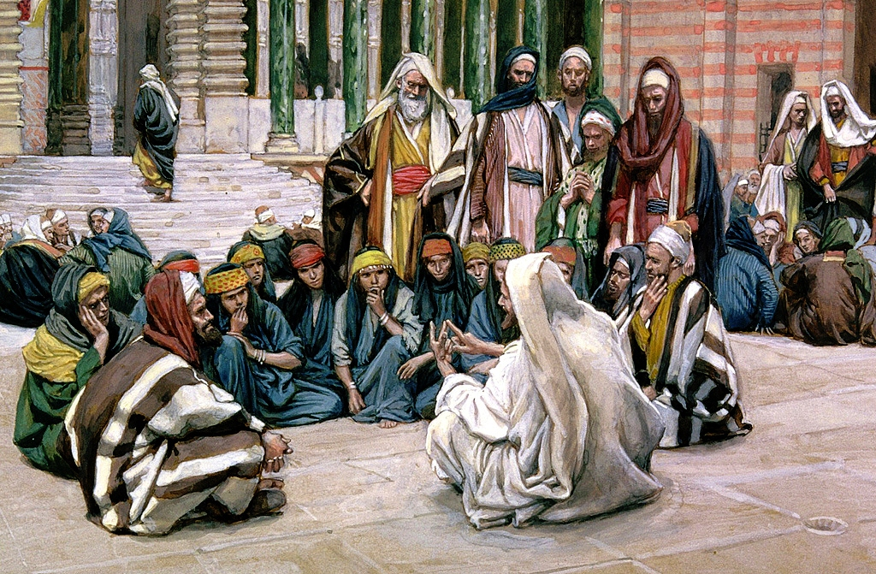
Luke 16:19-31

Slide 4
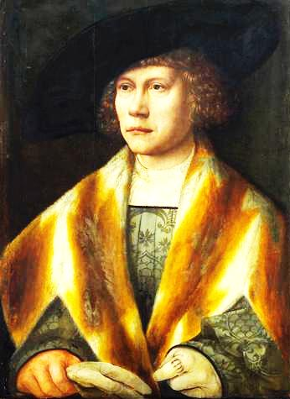
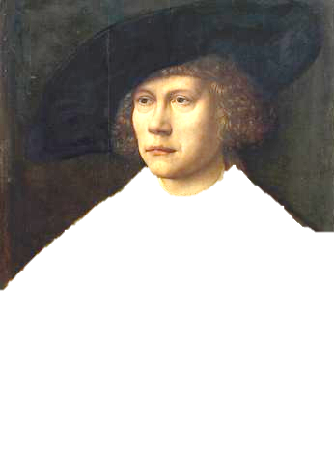
Luke 16
“¹⁹There was a certain rich man, which was clothed in purple and fine linen, and fared sumptuously every day:”
Wikimedia / Public Domain US – 100 years old

Slide 5
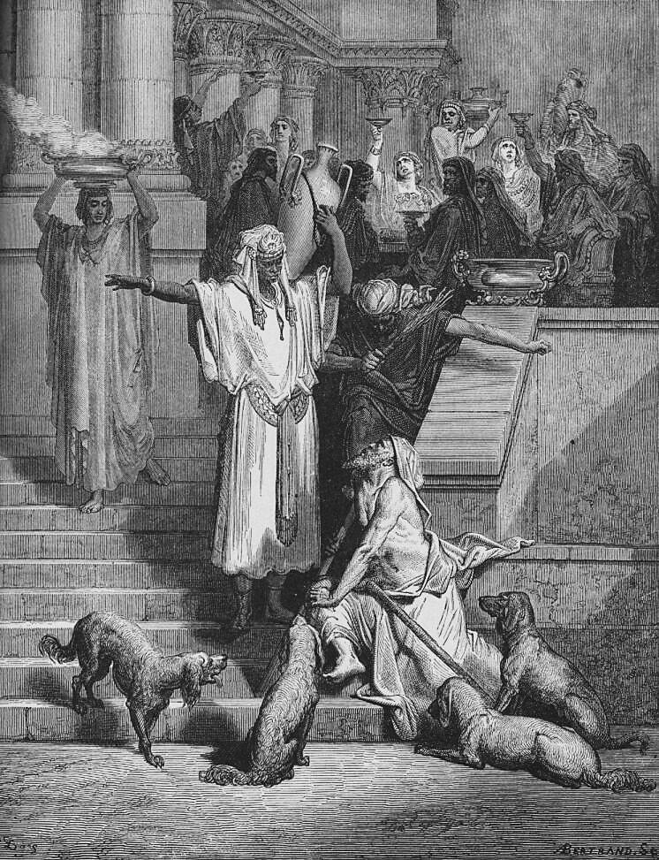
Luke 16
“²⁰And there was a certain beggar named Lazarus, which was laid at his gate, full of sores, ²¹And desiring to be fed with the crumbs which fell from the rich man’s table: moreover the dogs came and licked his sores.”

Slide 6
Luke 16
“²²And it came to pass, that the beggar died, and was carried by the angels into Abraham’s bosom: the rich man also died, and was buried;
Wikimedia / Public Domain US – 100 years old

Slide 7
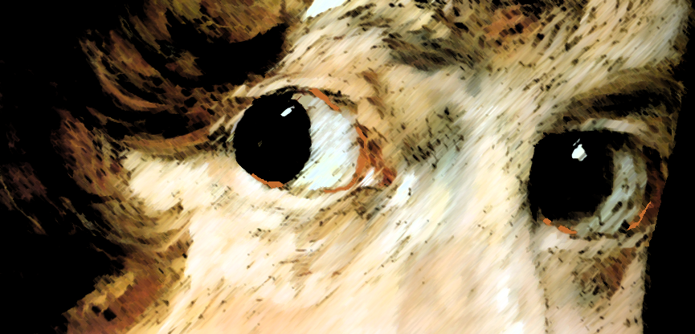
Wikimedia / Public Domain US – 100 years old
Luke 16
“²³And in Hades he lift up his eyes, being in torments, and seeth Abraham afar off, and Lazarus in his bosom.”

Slide 8
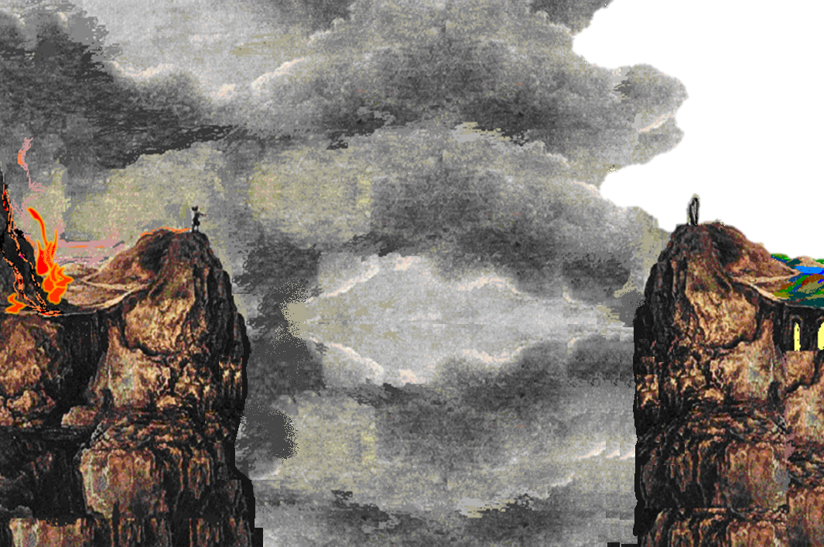
Luke 16
“²⁷Then he said, I pray thee therefore, father, that thou wouldest send him to my father’s house: ²⁸For I have five brethren; that he may testify unto them, lest they also come into this place of torment.”
Luke 16
“²⁵But Abraham said, Son, remember that thou in thy lifetime receivedst thy good things, and likewise Lazarus evil things: but now he is comforted, and thou art tormented. ²⁶And beside all this, between us and you there is a great gulf fixed: so that they which would pass from hence to you cannot; neither can they pass to us, that would come from thence.”
Luke 16
“²⁹Abraham saith unto him, They have Moses and the prophets; let them hear them.”
Luke 16
“²⁴And he cried and said, Father Abraham, have mercy on me, and send Lazarus, that he may dip the tip of his finger in water, and cool my tongue; for I am tormented in this flame.”
Luke 16
“³¹And he said unto him, If they hear not Moses and the prophets, neither will they be persuaded, though one rose from the dead.”
Luke 16
“³⁰And he said, Nay, father Abraham: but if one went unto them from the dead, they will repent.”

Slide 9
Luke 16 is the only place in the Bible that gives details regarding the mystery of death. Christ reveals that at death our destinies are determined. The obedient are separated from the disobedient with a great gulf between. There is no “second chance” for the disobedient. They can not cross over the gulf, receive comfort from Abraham, or even warn those still living. It is too late. They must await the end of time, the coming of Christ, the last judgment.
PHOTO: Wikimedia / Author- Evangeli / AP Kerk Orania

Slide 10
Verse 23 calls it “Hell” (King James Version).
The word “Hell” would be more correctly translated “Hades,” for Hell is the final place of the condemned, a place of eternal punishment. Hades is where the dead await the final judgment.
Where is this place that the wicked
dead can look “afar off” and see the righteous?
Wikimedia - Public Domain

Slide 11
Hades
[“Sheol” in the Hebrew]

Slide 12
Hades
GREAT GULF
Rich Man
in
Tartarus
Lazarus
in
Paradise

Slide 14
Matt. 25:31–33 ³¹ “When the Son of Man comes in His glory, and all the holy angels with Him, then He will sit on the throne of His glory. ³² All the nations will be gathered before Him, and He will separate them one from another, as a shepherd divides his sheep from the goats. ³³ And He will set the sheep on His right hand, but the goats on the left.
Matt. 12:38–42 ³⁸ Then some of the scribes and Pharisees answered, saying, “Teacher, we want to see a sign from You.” ³⁹ But He answered and said to them, “An evil and adulterous generation seeks after a sign, and no sign will be given to it except the sign of the prophet Jonah. ⁴⁰ For as Jonah was three days and three nights in the belly of the great fish, so will the Son of Man be three days and three nights in the heart of the earth. ⁴¹ The men of Nineveh will rise up in the judgment with this generation and condemn it, because they repented at the preaching of Jonah; and indeed a greater than Jonah is here. ⁴² The queen of the South will rise up in the judgment with this generation and condemn it, for she came from the ends of the earth to hear the wisdom of Solomon; and indeed a greater than Solomon is here.

Slide 16
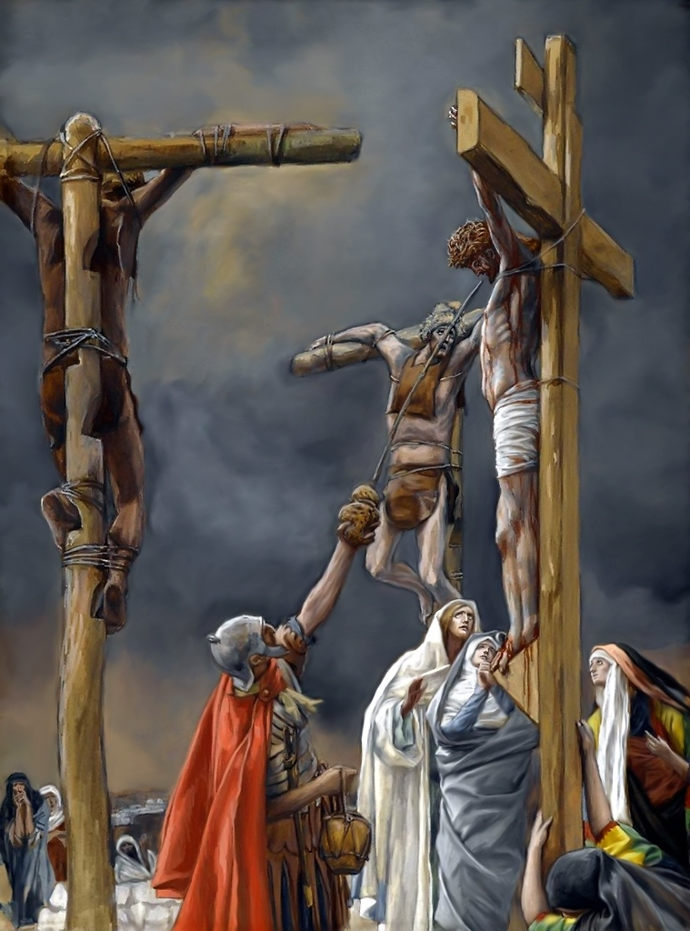
When Jesus died he went to Paradise which is in Hades.
“And Jesus said unto him, Verily I say unto thee, To day shalt thou be with me in paradise” (Luke 23:43).

Slide 17
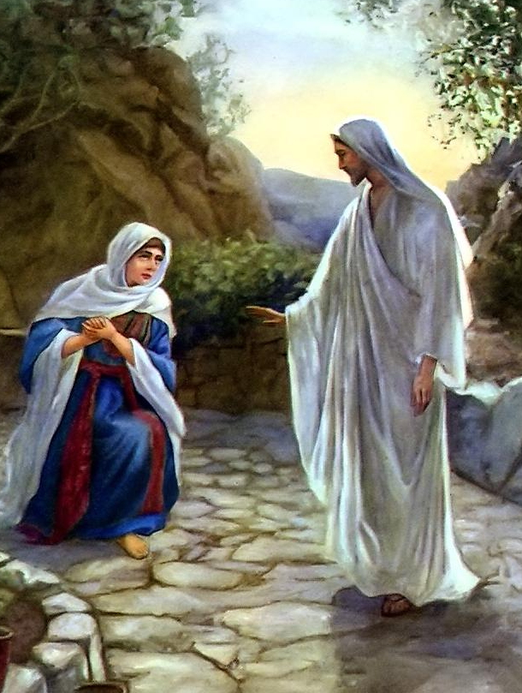
We know Jesus DID NOT GO TO HEAVEN during the 3 days he was in the tomb because:
After Mary saw he was no longer in the tomb Jesus appeared to her and told her—
John 20:17
“. . . Touch me not; for I am not yet ascended to my Father: but go to my brethren, and say unto them, I ascend unto my Father, and your Father; and to my God, and your God.”

Slide 18
Jesus was in the tomb 3 days before he rose from the dead. Therefore he was in Paradise or Hades for 3 days.

Slide 19
HADES
hades (ᾅδης, 86), “the region of departed spirits of the lost” (but including the blessed dead in periods preceding the ascension of Christ). It has been thought by some that the word etymologically meant “the unseen” (from a, negative, and eido, “to see”), but this derivation is questionable; a more probable derivation is from hado, signifying “all-receiving.” It corresponds to “Sheol” in the OT. In the kjv of the OT and NT; it has been unhappily rendered “hell,” e.g., Ps. 16:10; or “the grave,” e.g., Gen. 37:35; or “the pit,” Num. 16:30, 33; in the NT the revisers have always used the rendering “hades”; in the OT, they have not been uniform in the translation, e.g. in Isa. 14:15 “hell” (marg., “Sheol”); usually they have “Sheol” in the text and “the grave” in the margin. It never denotes the grave, nor is it the permanent region of the lost; in point of time it is, for such, intermediate between decease and the doom of Gehenna. For the condition, see Luke 16:23–31. > > >
.
Vine’s Complete Expository Dictionary

Slide 20
The word is used four times in the Gospels, and always by the Lord,
Matt. 11:23;
Matt.16:18;
Luke 10:15;
Luke 16:23;
It is used with reference to the soul of Christ, Acts 2:27, 31;
Christ declares that He has the keys of it, Rev. 1:18; in Rev. 6:8 it is personified, with the signification of the temporary destiny of the doomed;
it is to give up those who are therein, Rev 20:13, and is to be cast into the lake of fire, Rev 20:14.
Vine’s Complete Expository Dictionary

Slide 21
Matt. 16:18 And I also say to you that you are Peter, and on this rock I will build My church, and the gates of Hades shall not prevail against it.
Acts 2:25–27
²⁵ For David says concerning Him: ‘I foresaw the Lord always before my face,
For He is at my right hand, that I may not be shaken. ²⁶Therefore my heart rejoiced, and my tongue was glad; Moreover my flesh also will rest in hope. ²⁷For You will not leave my soul in Hades, Nor will You allow Your Holy One to see corruption.
Acts 2:31 ³¹ he, foreseeing this, spoke concerning the resurrection of the Christ, that His soul was not left in Hades, nor did His flesh see corruption.
John 11:39 ³⁹ Jesus said, “Take away the stone.” Martha, the sister of him who was dead, said to Him, “Lord, by this time there is a stench, for he has been dead four days.”
Mark 8:31 And he began to teach them, that the Son of man must suffer many things, and be rejected of the elders, and of the chief priests, and scribes, and be killed, and after three days rise again.
(Hades could not hold Jesus)

Slide 22
HELL
geenna (γέεννα, 1067) represents the Hebrew Ge-Hinnom (the valley of Tophet) and a corresponding Aramaic word; it is found twelve times in the NT, in every instance as uttered by the Lord Himself.
in Mark 9:43–47, is parallel; here to the word “hell” are applied the extended descriptions “the unquenchable fire” and “where their worm dieth not and the fire is not quenched.”
That God, “after He hath killed, hath power to cast into hell,” is assigned as a reason why He should be feared with the fear that keeps from evil doing, Luke 12:5; the parallel passage to this in Matt. 10:28 declares, not the casting in, but the doom which follows, namely, the destruction (not the loss of being, but of wellbeing) of “both soul and body.”
Vine’s Complete Expository Dictionary

Slide 23
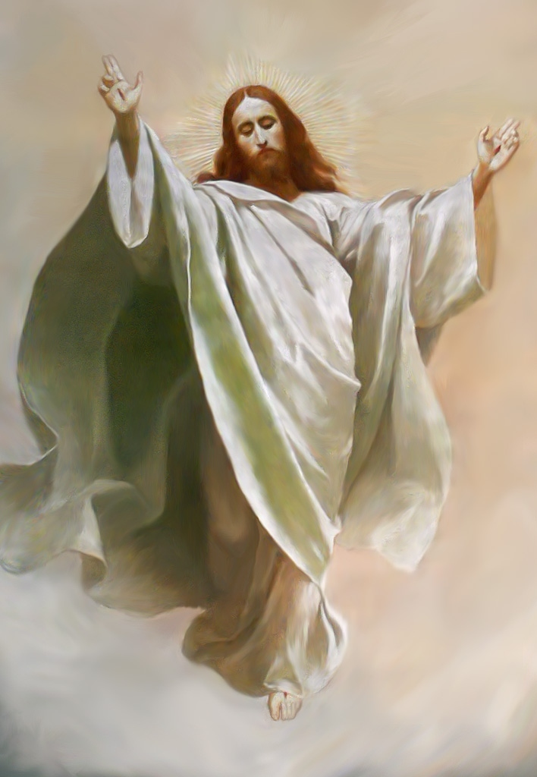
After 3 days in the tomb Christ arose from the dead, and appeared to many for 40 days after which he ascended to heaven where he now abides.

Slide 24
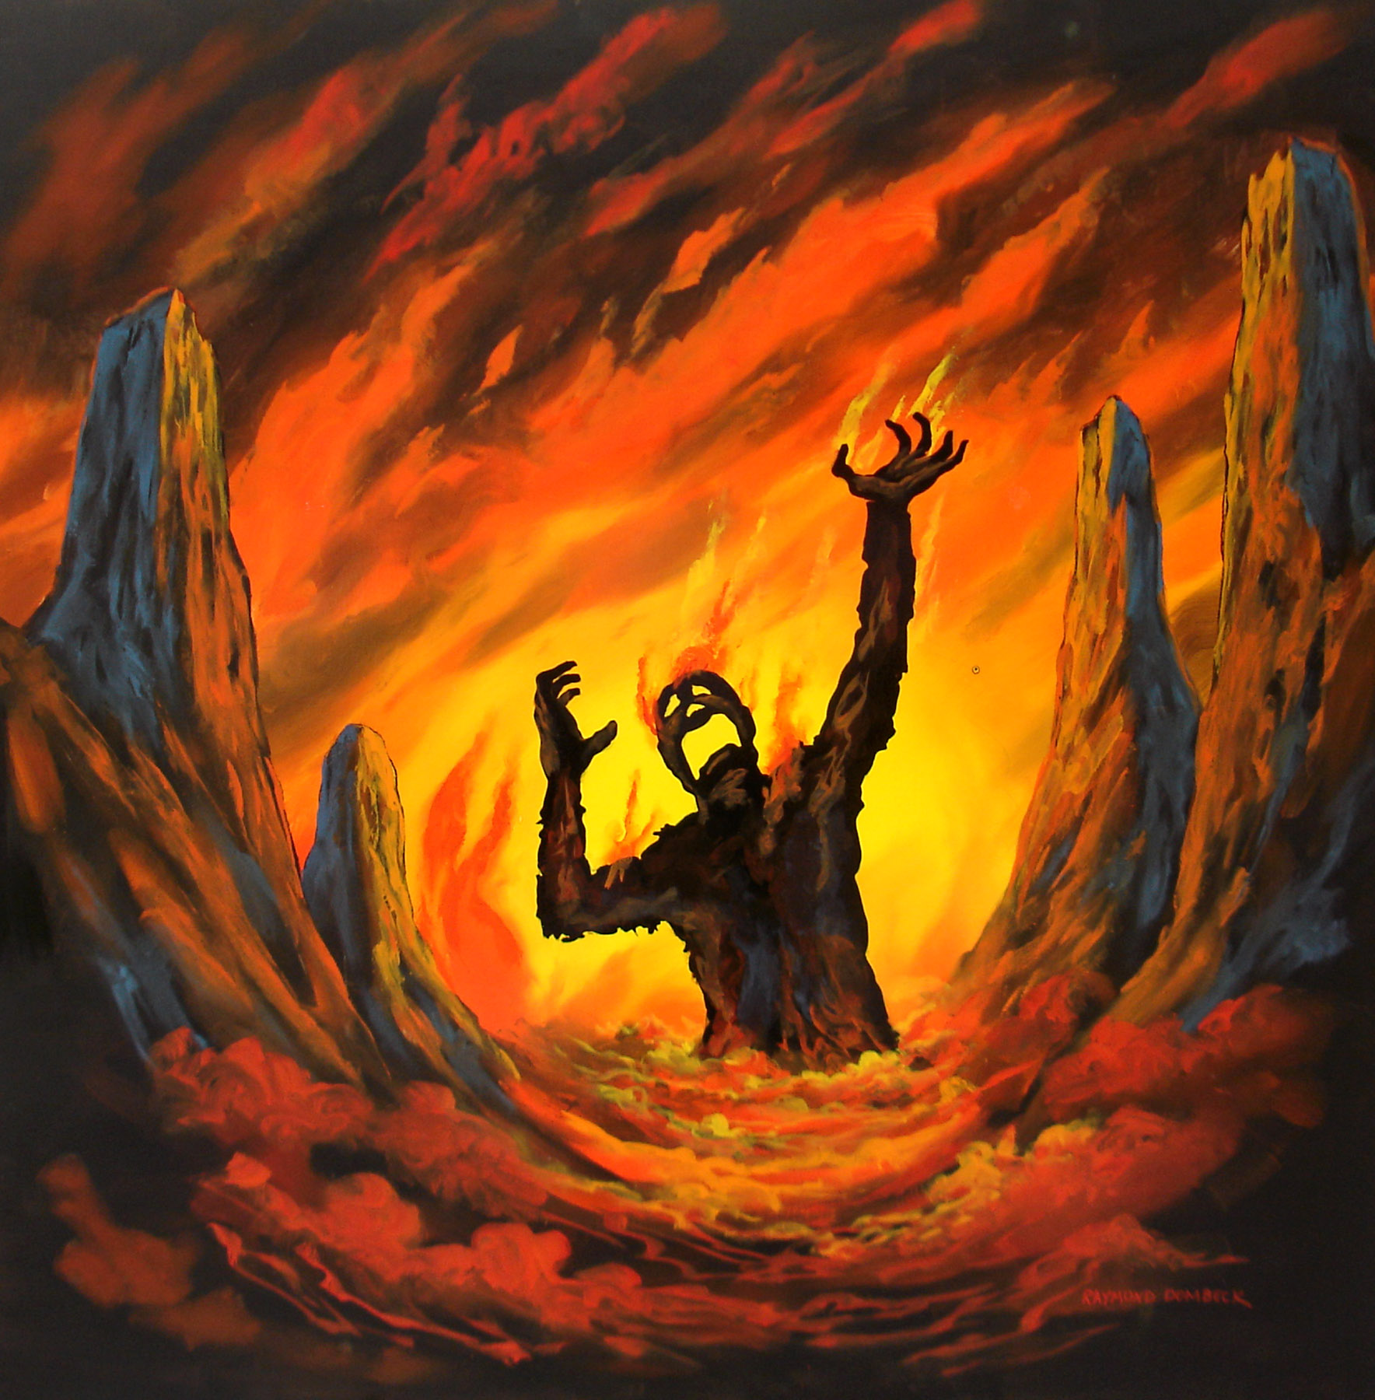
Luke 16:23—
“And in hell he lift up his eyes, being in torments . . . and he cried and said . . . I am tormented in this flame.”
What was it like for The Rich Man when he looked up in Tartarus?

Slide 25
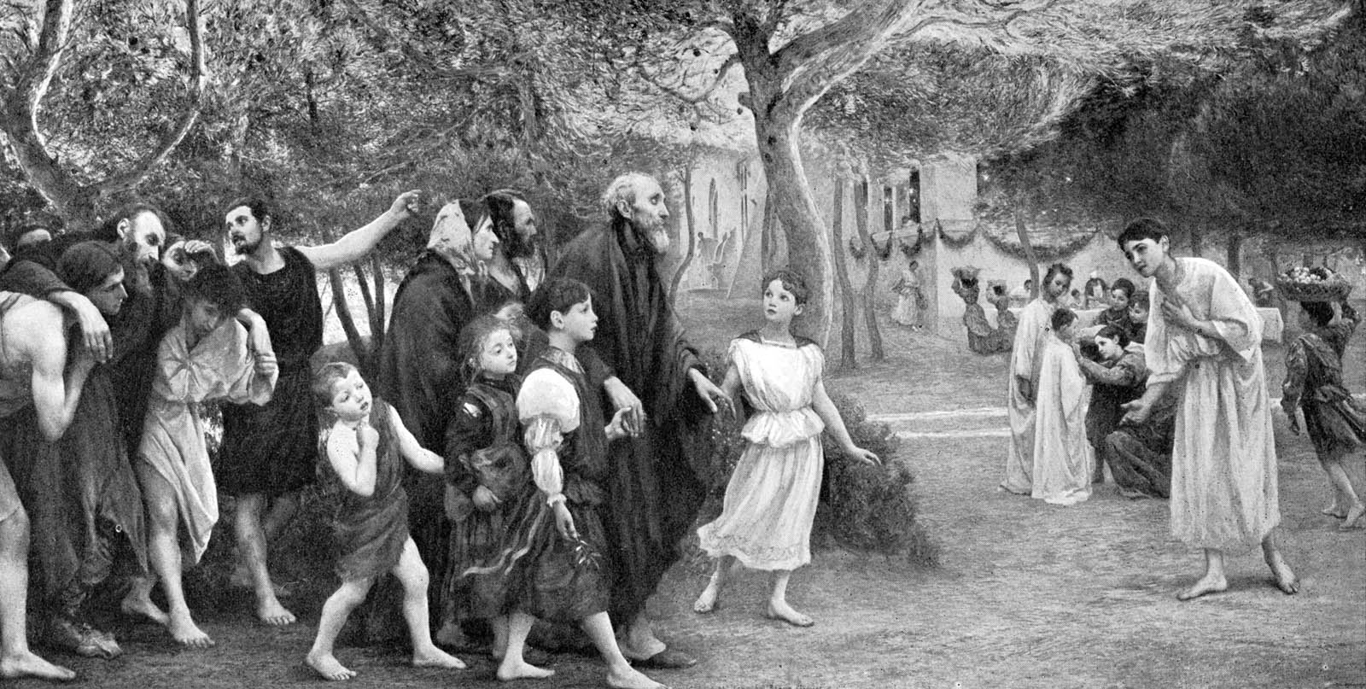
It is possible to remember your life on earth, for the rich man in Tartarus was told to “remember” the good things he’d had in his life, and he spoke of his family, begging to warn them about Tartarus.

Slide 26
V 25 Remember
You will remember what you heard in Bible classes.
You will remember what you heard in sermons.
You will remember the words of encouragement from others to make your life right.
You will remember every invitation to obey the gospel that you heard.
…but when you are in hades, it will be too late to make your life right.

Slide 27
Have you heard people say their loved one that died is in heaven? At funerals you might even hear preachers speak of death as if you immediately go either to Heaven or Hell, but they are in error for they are ignoring Luke 16 and the need to be judged by Christ before entering Heaven.
“All must appear before the judgment seat of Christ; that every one may receive the things done in his body, according to that he hath done, whether it be good or bad” 2 Cor.5:10.

Slide 28
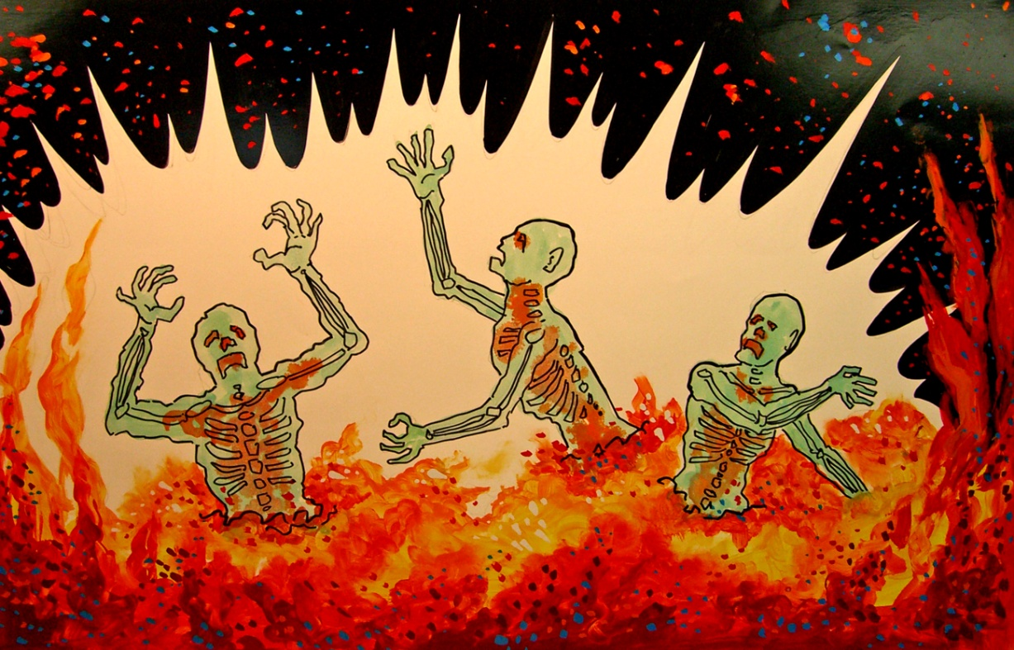
The Catholic church teaches a false doctrine regarding what happens after death. This doctrine is called Purgatory.
Purgatory—
Fiery purification of
the dead to achieve
the holiness
necessary to enter
heaven.
They believe the
dead may be aided
by the prayers and
sufferings of the faithful.

Slide 29
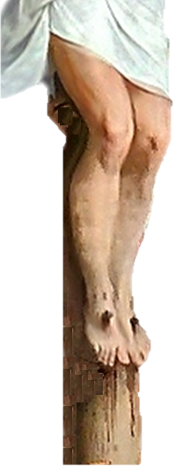
Souls are not
purified by fire.
They are purified by the blood of Jesus who suffered for our sins.

Slide 30
Isaiah 53
“⁵But he was wounded for our transgressions, he was bruised for our iniquities: the chastisement of our peace was upon him; and with his stripes we are healed. ⁶All we like sheep have gone astray; we have turned every one to his own way; and the LORD hath laid on him the iniquity of us all.
⁷He was oppressed, and he was afflicted, yet he opened not his mouth: he is brought as a lamb to the slaughter, and as a sheep before her shearers is dumb, so he openeth not his mouth. ⁸He was taken from prison and from judgment: and who shall declare his generation? for he was cut off out of the land of the living: for the transgression of my people was he stricken.
⁹And he made his grave with the wicked, and with the rich in his death; because he had done no violence, neither was any deceit in his mouth. >>>

Slide 31
Isaiah 53
¹⁰Yet it pleased the LORD to bruise him; he hath put him to grief: when thou shalt make his soul an offering for sin, he shall see his seed, he shall prolong his days, and the pleasure of the LORD shall prosper in his hand. ¹¹He shall see of the travail of his soul, and shall be satisfied: by his knowledge shall my righteous servant justify many; for he shall bear their iniquities.
¹²Therefore will I divide him a portion with the great, and he shall divide the spoil with the strong; because he hath poured out his soul unto death: and he was numbered with the transgressors; and he bare the sin of many, and made intercession for the transgressors.”

Slide 32
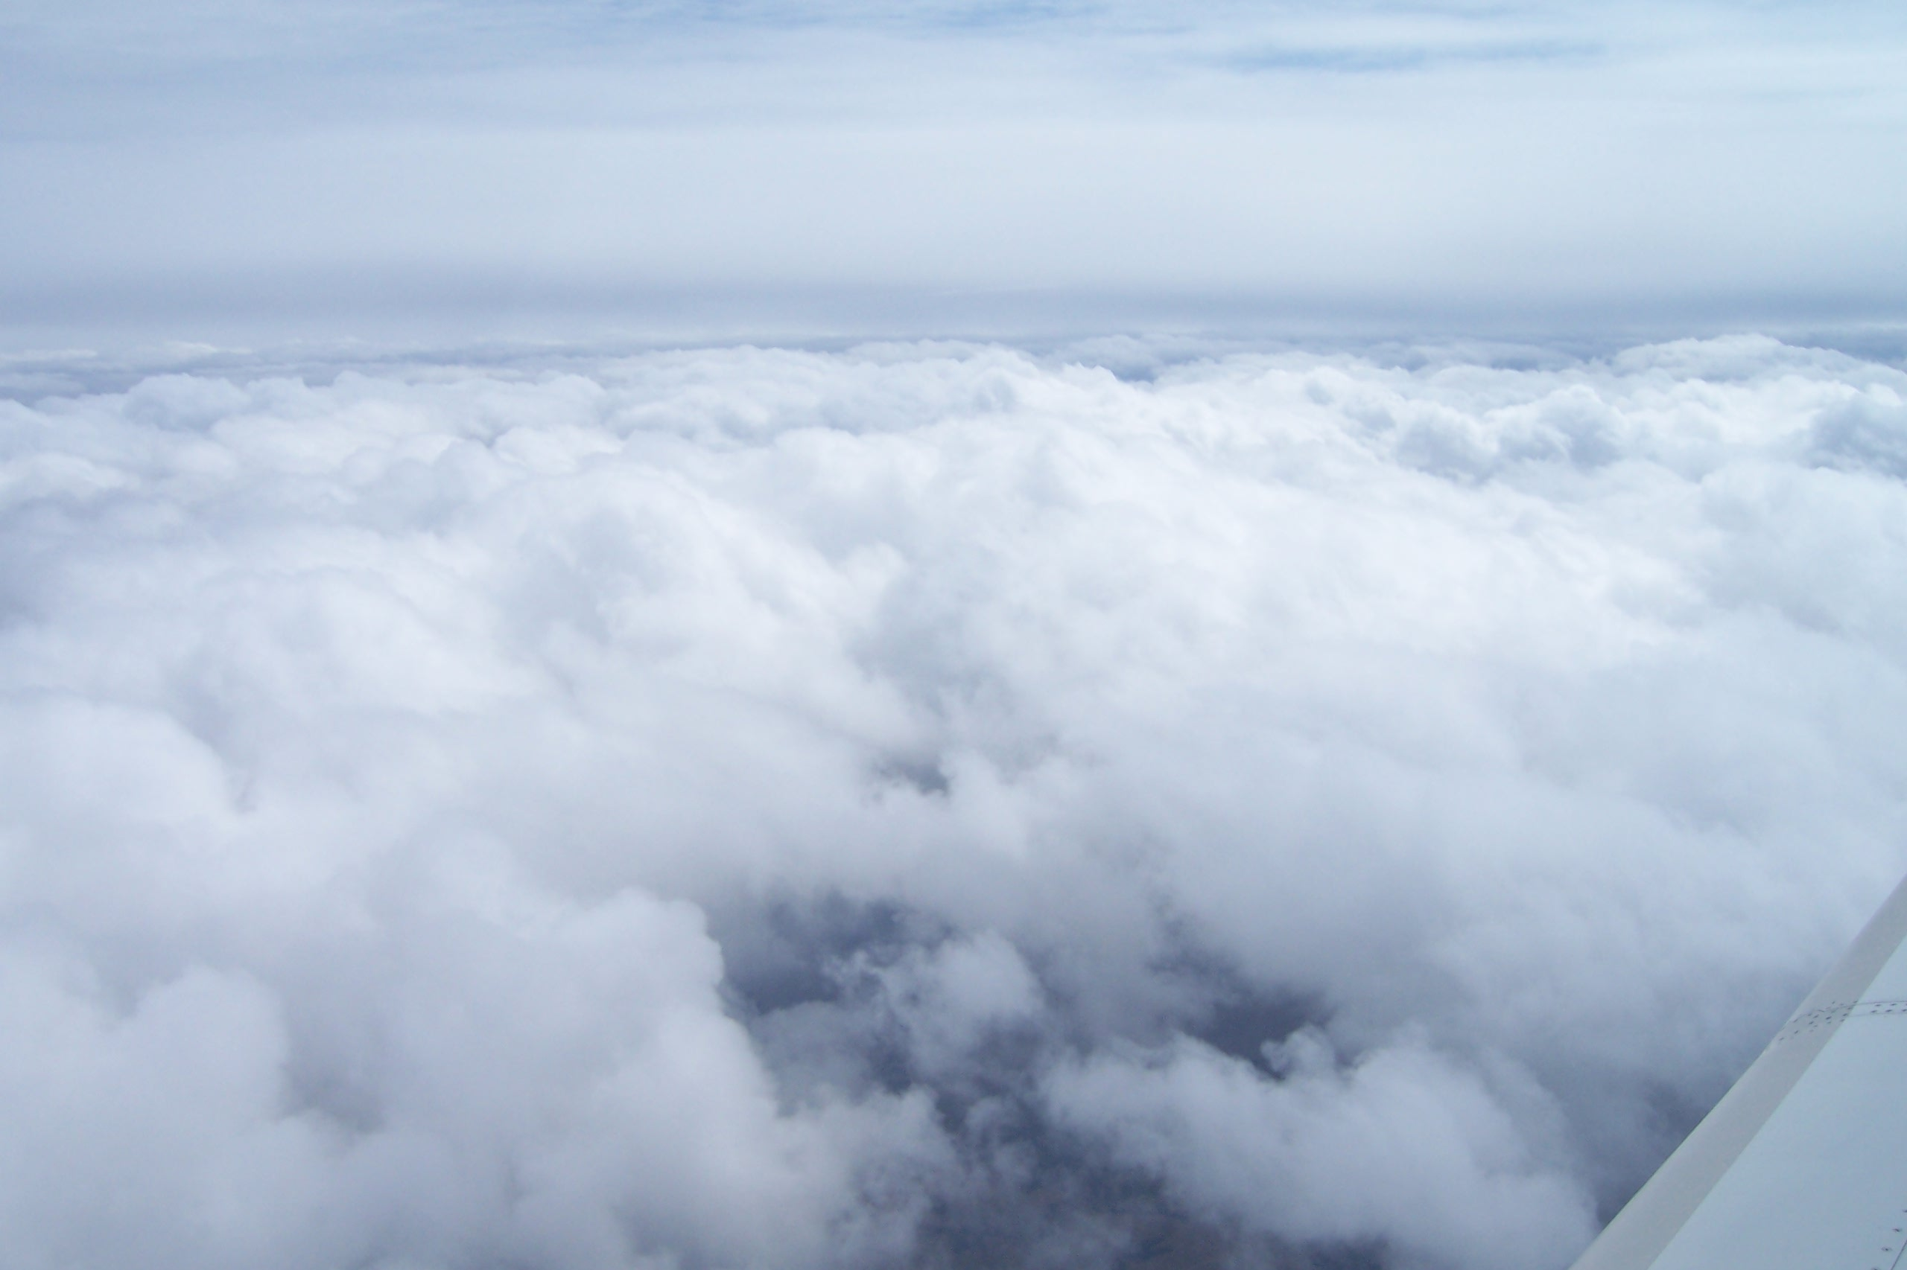
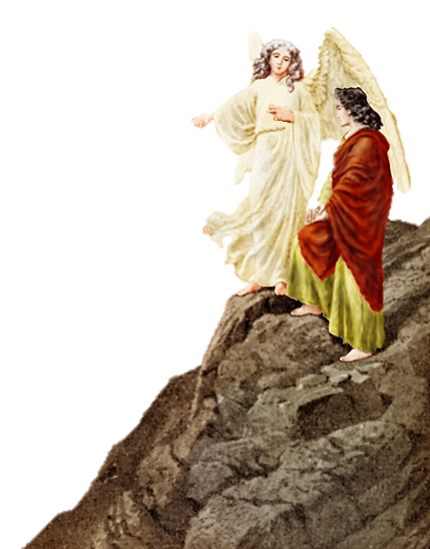
We have taken a look at the Rich Man in Tartarus, now let’s look at what it was like for Lazarus in Paradise.

Slide 33
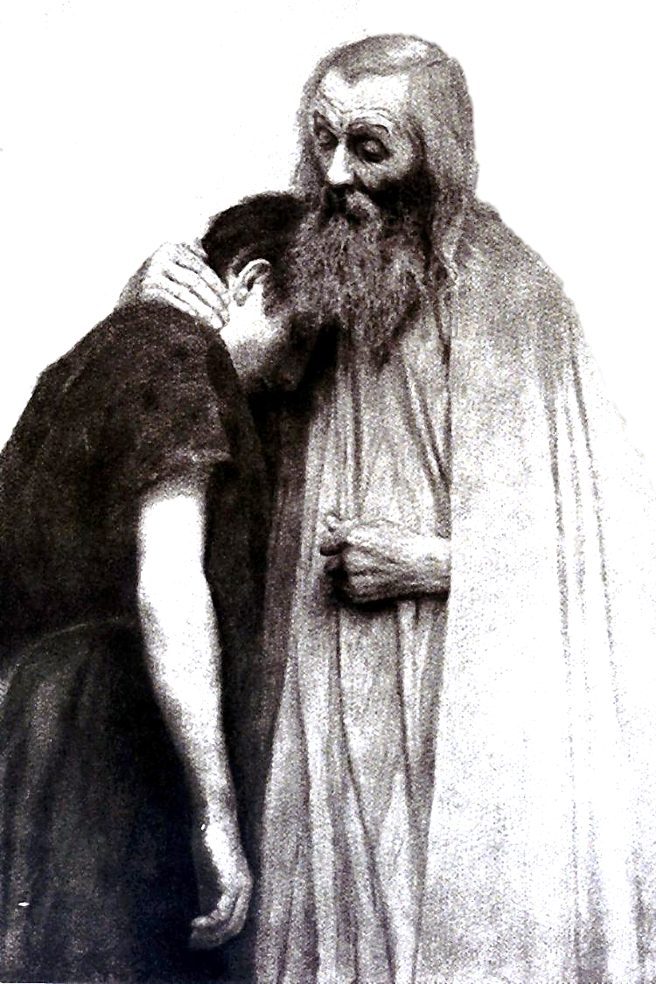
He was comforted.
Luke 16
“²⁵But Abraham said, Son, remember that thou in thy lifetime receivedst thy good things, and likewise Lazarus evil things: but now he is comforted, and thou art tormented.”

Slide 34
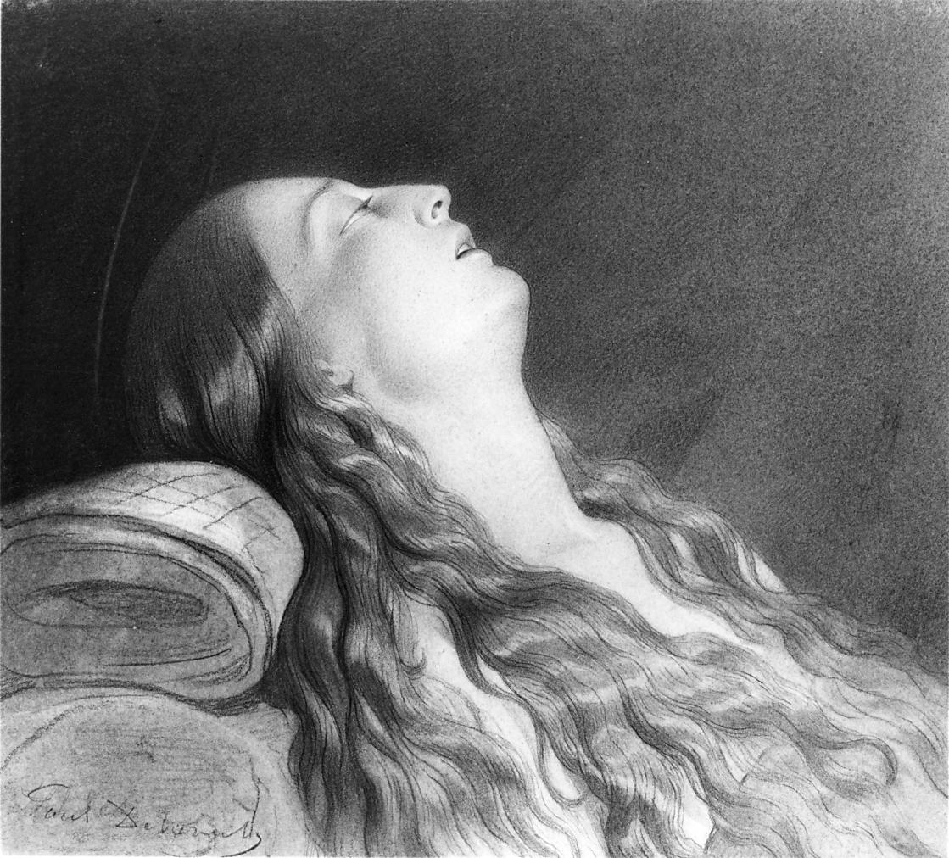
Six different verses in the New Testament describe Christians who have died as being ASLEEP which indicates comfort.
Acts 7:60
1 Corinthians 15:6
1 Corinthians 15:18
1 Thessalonians 4:13
1 Thessalonians 4:15
2 Peter 3:4
PHOTO: Wikimedia / Public Domain / America 100 years old

Slide 35
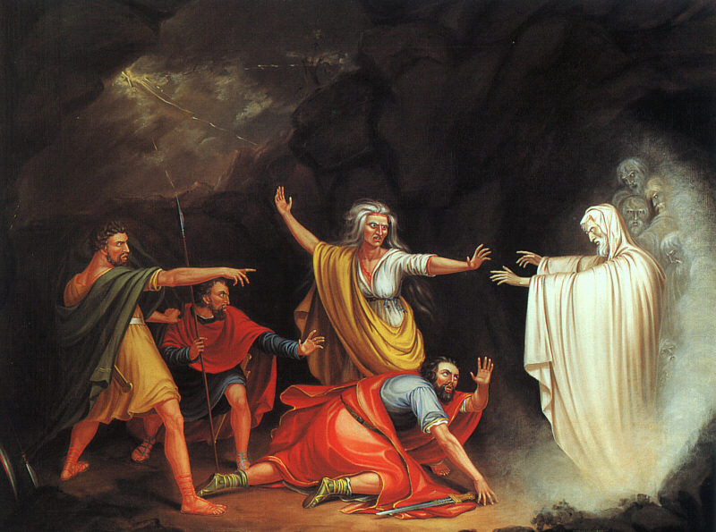
“And Samuel said to Saul, Why hast thou disquieted me, to bring me up . . .”
(1 Samuel 28:15).
In the Old Testament when King Saul asked the Witch of Endor to raise the prophet Samuel from the dead that he might prophecy to Saul, Samuel had been asleep—

Slide 36
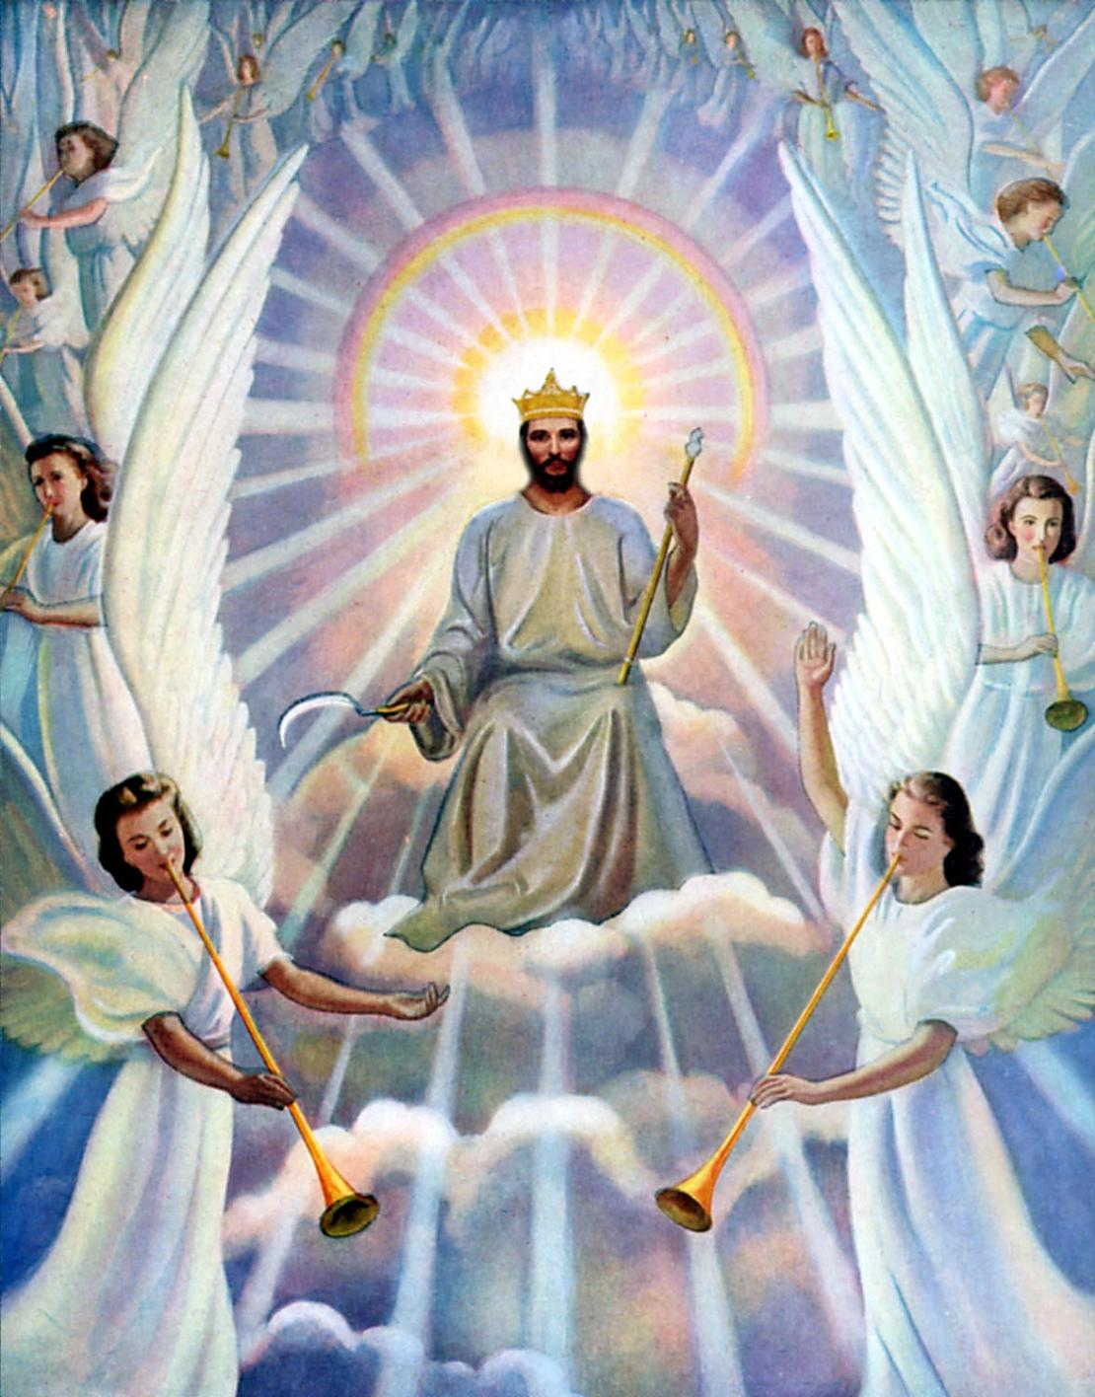
Luke 12
“⁴⁷And that servant, which knew his lord’s will, and prepared not himself, neither did according to his will, shall be beaten with many stripes.
⁴⁸But he that knew not, and did commit things worthy of stripes, shall be beaten with few stripes. For unto whomsoever much is given, of him shall be much required: and to whom men have committed much, of him they will ask the more.”
The dead will be released from Hades on Judgment Day.
Those in Paradise will receive degrees of reward at Judgment,
and
those in Tartarus will receive degrees of punishment at Judgment.

Slide 37
“Opportunity and ability measure one’s responsibility, and it seems that the reward and punishment will very according to the responsibilities.
The one who knows the will of God and does it not ‘shall be beaten with many stripes’; this implies severe punishment and degrees of punishment for different offences. . . .
The principle here seems to be that the possession of great gifts involves a corresponding responsibility. . . . Of those to whom much is given, much is required.”

Slide 38
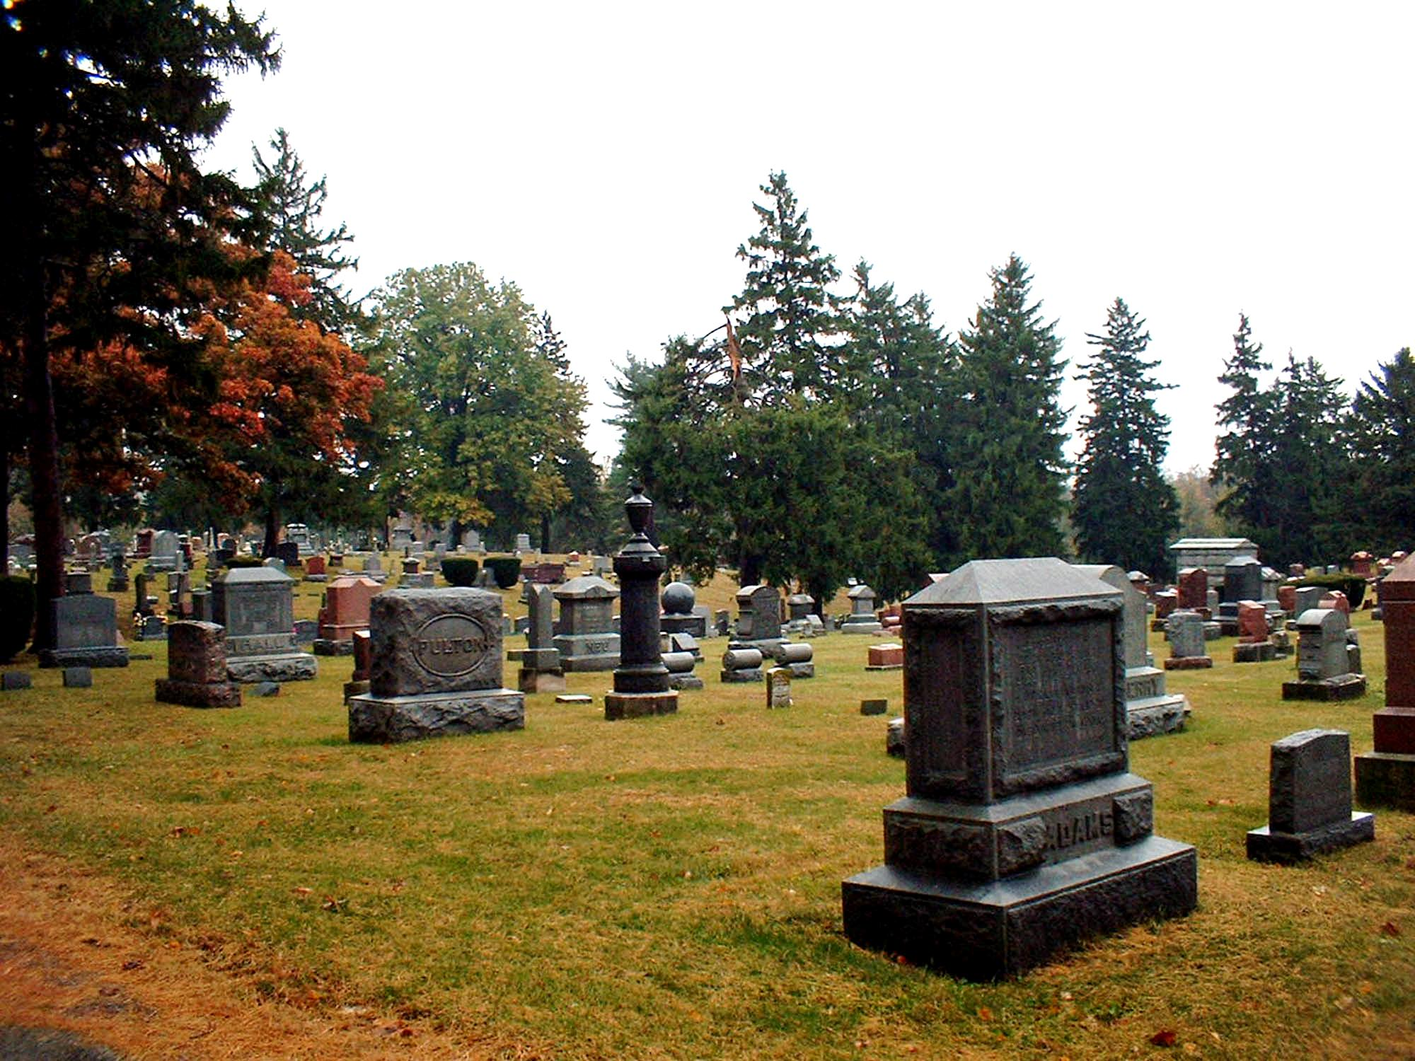
Everyone who lived and died on this earth is now in Hades and awaits God’s judgment according to their works (Rev. 20:12).

Slide 39
Rev. 20:11–15
¹¹ Then I saw a great white throne and Him who sat on it, from whose face the earth and the heaven fled away. And there was found no place for them. ¹² And I saw the dead, small and great, standing before God, and books were opened. And another book was opened, which is the Book of Life. And the dead were judged according to their works, by the things which were written in the books.
¹³ The sea gave up the dead who were in it, and Death and Hades delivered up the dead who were in them. And they were judged, each one according to his works. ¹⁴ Then Death and Hades were cast into the lake of fire. This is the second death. ¹⁵ And anyone not found written in the Book of Life was cast into the lake of fire.

Slide 40
¹⁴ Then Death and Hades were cast into the lake of fire. This is the second death.
¹⁵ And anyone not found written in the Book of Life was cast into the lake of fire.
Will your name be found in the book?

