Slide 1
Welcome to our services
New Lebanon Church of Christ
We are Simply Christians.
Our Emphasis is Spiritual, Not Material or Social.
We are striving to be The Same Church as Described in The New Testament.
Please Come Back Again

Slide 2
9 persecuted, but not forsaken; struck down, but not destroyed--
10 always carrying about in the body the dying of the Lord Jesus, that the life of Jesus also may be manifested in our body.
2Cor 4:7 But we have this treasure in earthen vessels, that the excellence of the power may be of God and not of us.
8 We are hard pressed on every side, yet not crushed; we are perplexed, but not in despair;
9 persecuted, but not forsaken; struck down, but not destroyed--
10 always carrying about in the body the dying of the Lord Jesus, that the life of Jesus also may be manifested in our body.

Slide 3
This Treasure
In Earthen Vessels
2 Cor. 4:7

Slide 4
2 Cor. written a few months to a year later than 1Cor.
Intense, emotional, passionate book.
Ministry means service - faithful and loyal in service to God and to one another.
A difficult time and place in Paul’s own ministry.
But God is the God of all comfort and encouragement.
Fruit of ministry is souls – you.
God had blessed him in his work. 1st Cor.15:58.
Chapters 4-5 motive of ministry. 4:7-10

Slide 5
This Treasure
In Earthen Vessels
2 Cor. 4:7- 5:2

Slide 6
outline of chapter
1. The hidden and the open (2 Cor. 4:1, 2).
2. The blinded and the enlightened (2 Cor. 4:3).
3. Slaves and Master (2 Cor. 4:5).
4. Darkness and Light (2 Cor. 4:6).
5. The frail and the mighty (2 Cor. 4:7).
6. Trials and triumph (2 Cor. 4:8–10).
7. Death and life (2 Cor. 4:11, 12).
8. The written and the spoken (2 Cor. 4:13).
9. The past and the future (2 Cor. 4:14).
10. Grace and thanksgiving (2 Cor. 4:15).
11. The outer and inner man (2 Cor. 4:16).
12. Affliction and glory (2 Cor. 4:17).
13. The seen and the eternal (2 Cor. 4:18b)

Slide 7
2Cor.4:7 But we have this treasure in earthen vessels, that the exceeding greatness of the power may be of God, and not from ourselves
- God entrusted the gospel to people who did not have earthly power and honor, in order that the great success of the gospel would not be accredited to its messengers as men, but unto the eternal God who inspired them.

Slide 8
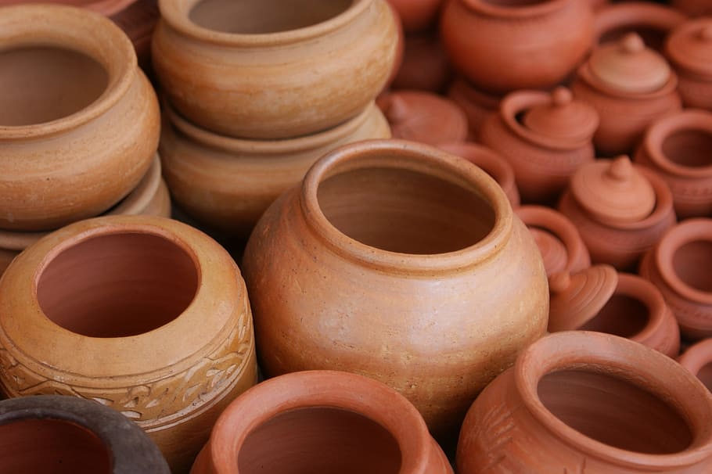
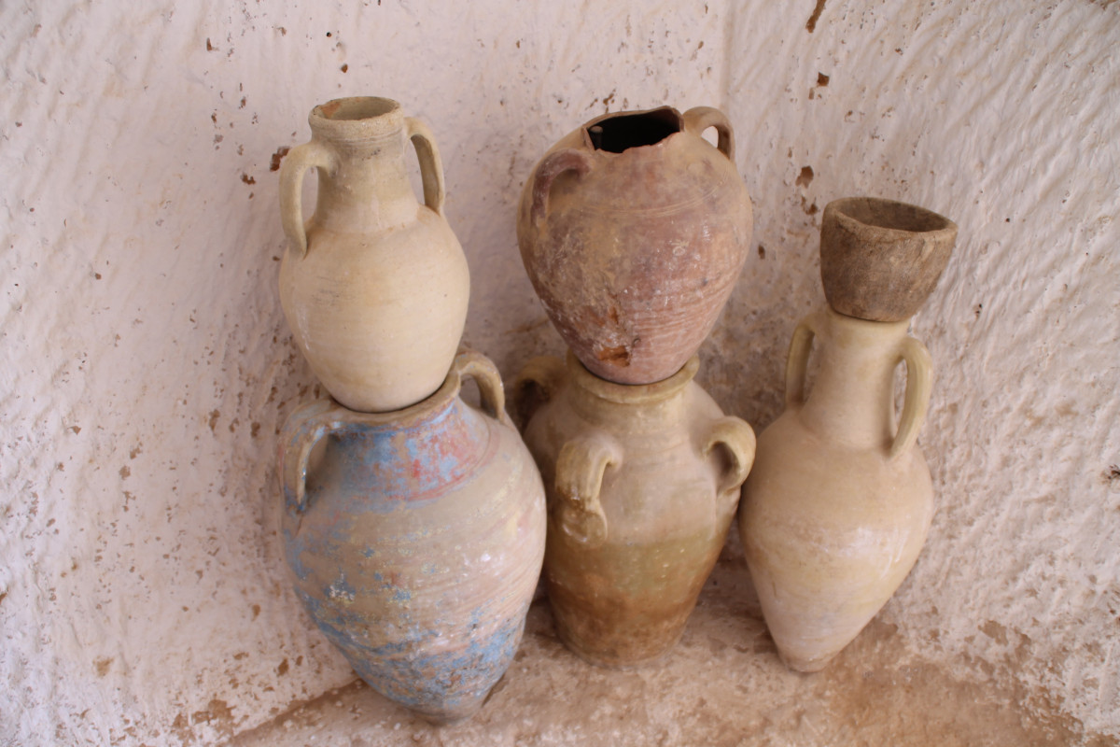
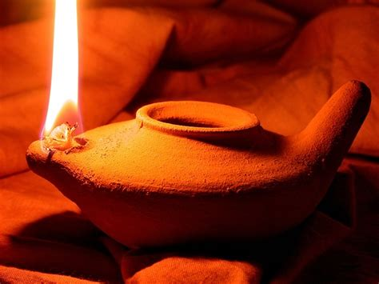

Slide 9
In earthen vessels … The figure is possibly from the “small pottery lamps, that could be bought in the shops of Corinth”; or from the custom observed in Roman triumphs, in which the silver or other precious metals looted from conquered peoples was melted down and poured into clay pots to be carried in the procession.
The melted gold into earthen pots, could be broken when the ruler wanted it

Slide 10
the apostles who had been fishermen and tax collectors, etc, were just ordinary men;
yet these men, because of their message,
literally took the whole world for Jesus Christ

Slide 11
2 Cor 4:8 We are pressed on every side, yet not straitened; perplexed, yet not unto despair; pursued, yet not forsaken; smitten down, yet not destroyed; always bearing about in the body the dying of Jesus, that the life also of Jesus may be manifested in our body.
The imagery here belongs to the soldier on active service.

Slide 12
Pressed but not straitened … “harried, but not hemmed in.” On Paul’s first missionary tour, his enemies had chased him everywhere, but were never able to hem him in.
Perplexed, yet not unto despair … The problems at Corinth were certainly perplexing to Paul, but there is no evidence that he ever despaired.

Slide 13
Pursued, yet not forsaken … Forty men pursued Paul with a view to killing him, but he was not forsaken of the Lord (Acts 23:12ff). “The image here is that of a mortal chase and flight.”
Smitten down, yet not destroyed … Paul was “Knocked down, but not out!” Paul was literally stoned and left for dead (Acts 14:19); and that is surely an example of his being knocked down but not knocked out!

Slide 14
Always bearing about in the body the dying of Jesus … the same vicious hatred of every evil element on earth which finally succeeded (with God’s permission) in nailing Jesus to the cross was now focused upon the Lord’s apostles.
This was the fulfillment of exactly what Jesus had promised. “A servant is not greater than his Lord. If they persecuted me, they will persecute you … all these things will they do unto you for my name’s sake” (John 15:20, 21).

Slide 15
That the life of Jesus may be manifested in our body … The apostles were partakers both of the sufferings of Jesus and of the life of Jesus, a life which they were able to impart to others by preaching of the gospel. Paul correctly read the two, the sufferings and the spiritual life imparted to others, as directly related to Jesus.

Slide 16
2 Cor 4:11 For we who live are always delivered unto death for Jesus’ sake, that the life also of Jesus may be manifested in our mortal flesh.
2 Cor 4:12 So then death worketh in us, but life in you.
Paul is not complaining that he suffers all of the hardships, and the Corinthians receive all of the benefits… He has reference to the effect of his persecutions with their result in many conversions.

Slide 17
Paul’s many escapes from death
and all of the other providences
which had preserved his life miraculously
through so many dangers
were a part of the irrefutable evidence that God was with him.

Slide 18
There was no denying the fact that:
The power of the risen Jesus was being revealed here and now in his own body.
The apostles were thus witnesses in deed as well as in word to the truth of their Lord’s resurrection.

Slide 19
2 Cor 4:13 But having the same spirit of faith, according to that which is written, I believed, and therefore did I speak; we also believe, and therefore also we speak.
According to that which is written … This was Paul’s formal designation of what he was about to quote as a passage from the word of God;

Slide 20
I believed, and therefore did I speak … This is from Psa. 116:10, a psalm which is titled, “Thanksgiving for Deliverance from Death” in the English Revised Version (1885). It was appropriate that Paul, who had frequently been delivered from death, should use the same words here.
This verse as reveals the secret of effective preaching. I believed, and therefore did I speak Because Paul believed, his testimony had the ring of truth.

Slide 21
In this verse Paul reveals the first of four reasons which explained his endurance of so many trials.
Reason No. 1, he truly believed God’s word.

Slide 22
2 Cor 4:14 Knowing that he that raised up the Lord Jesus shall raise up us also with Jesus, and shall present us with you.
Paul calmly faced the ultimate prospect of his own death,
This verse is reason No. 2. Paul knew that death itself would not rob him of the crown of life, nor would it rob his Corinthian converts, despite the fact that both he and his converts would pass through it.

Slide 23
2 Cor 4:15 For all things are for your sakes, that the grace, being multiplied through the many, may cause the thanksgiving to abound unto the glory of God.
2 Cor 4:16 Wherefore we faint not; but though our outward man is decaying, yet our inward man is renewed day by day.
Wherefore we faint not … has the meaning of “For the reasons just cited, he was able to endure.”

Slide 24
Our outward man is decaying … his physical body, with all of its powers, was weakening.
All of the powers and glory of mortal life are like a flower that blooms and then crumbles into dust; and how sad it would be for man if there was nothing to anticipate except the grave.????

Slide 25
Inward man is renewed day by day … The true believer in Christ is not overly disturbed by the decline and decay of all physical life, (commercials) because his soul is feasting upon that Bread which came down from heaven, even our Lord Jesus Christ.
The inner spiritual life, which is the glory of the “new creature” in Christ, does not diminish or fade. “Brighter the way groweth each day,” in the words of an old hymn. Happy indeed are they who rejoice in the growing strength of the inner man as the swift seasons roll. For those who are without this treasure, the decay of the outward is the decay of everything.

Slide 26
For all things are for your sakes …
This is reason No. 3. Paul’s hardships were actually contributing to the conversion of many souls, and also to their being grounded and established in the faith.

Slide 27
Through the many … unto the glory of God …
Here is reason No. 4. Paul endured because his sufferings glorified God by the bringing of many souls unto salvation.

Slide 28
That the power may be of God, and not from ourselves … consider the facts:
(1) of the difficulty encountered in turning pagan worshipers away from their idols, or the power required to woo people away from the fleshly things of life.
(2) the fact that none of the apostles had any standing as worldly authorities, or even as respected teachers, and having no other background except that of laborers, etc. Let any man consider all of that, and then let him declare that God’s purpose was indeed served by placing the inestimable riches of the treasures of the gospel in EARTHEN VESSELS, in order that the power of the new faith would be recognized as coming from God himself, and not from any abilities of its human advocate.

Slide 29
2 Cor 4:17 For our light affliction, which is for the moment, worketh for us more and more exceedingly an eternal weight of glory.
The sufferings of Paul should be termed “our light affliction”; This cannot mean, literally, that they were in any sense “light”; but that IN COMPARISON with the ultimate glory of Christians, they are light.

Slide 30
He calls it not glory, merely, but a weight of glory, in opposition to the light thing of our affliction, and an eternal weight of glory, in opposition to the momentary duration of our affliction, and a most exceeding eternal weight of glory, as beyond comparison greater than all the glories of riches, fame, power, pleasure, or than anything that can be possessed in the present life?
the repetition of “exceedingly” by Paul in the Greek, which is literally, “worketh for us exceedingly, exceedingly, etc.” This is an idiom meaning “exceeding the superlative.”

Slide 31
2 Cor 4:18 While we look not at the things which are seen, but at the things which are not seen: for the things which are seen are temporal; but the things which are not seen are eternal.
Seeing The Invisible
If one can see it, it cannot last. All visible things are temporal, whether flowers, suns or galaxies; and it also applies to that which one sees when he looks at himself in a mirror.

Slide 32
Everything We See Is Temporary.

Slide 33
Note the following:
Faith itself is “a conviction of things not seen” (Heb. 11:1). This does not mean things which are merely overlooked, but things which, by their very nature, cannot be seen at all.
Such things as the understanding of how the universe was created, the incarnation of Christ, the judgment of the world by the flood, the Second comming, the final judgment, and the assignment of his final destiny to every man—in fact, everything of ultimate importance relates to the things invisible.

Slide 34
1. God framed the universe itself out of things unseen (stated invertedly). “Hath not been made out of things which appear” (Heb. 11:3). Modern science has proved that atoms, the building blocks of all creation, are not merely invisible, but are also practically nothing at all, being electrically charged particles in orbit around other particles and in the total composed almost entirely of space.
It is literally true that the whole universe is made of “things unseen,” even regarding the tiniest particles of it; and, in addition to that, the great fundamental laws controlling all things in space, such as gravity, centrifugal and centripetal forces, inertia, radiation, etc., are, all of them, invisible.

Slide 35
2. Noah, acting upon God’s instructions, preserved through the flood a new beginning for the human family. “Being warned of God concerning things not seen as yet” (Heb. 11:7). Such a flood as God promised had never occurred before; and it was a sheer act of faith for Noah to believe in “thing not seen as yet.”
3. Abraham likewise trusted in the invisible; and although the word “unseen” is not used in connection with his obedience, the thought is surely in this, “For he looked for the city that hath the foundations, whose builder and maker is God” (Heb. 11:10). That city, to be sure, was invisible in any ordinary sense.

Slide 36
5. Moses forsook Egypt and cast his lot with Israel; “For he endured as seeing him who is invisible,” i.e., the invisible God (Heb. 11:27). No greater test of trusting the “unseen” was ever successfully met. The wealth, glory, power and splendor of Egypt were very visible. Moses could see the armies, orchards, palaces and pyramids which belonged to Pharaoh and might also have belonged to him; but he trusted the promises of the invisible God.

Slide 37
6. This is exactly the challenge of faith in every generation, to believe in the things which no one can see. Heaven, hell, the final judgment of all people, the Second Coming, the resurrection of the dead practically everything of importance in Christian faith, regards the “things that are unseen,” and which things are designated here by Paul as eternal.

Slide 38
2 Cor 5:1 For we know that if the earthly house of our tabernacle be dissolved, we have a building from God, a house not made with hands, eternal in the heavens.
This is Paul’s declaration of his certainty (not mere belief) of the existence of the soul after death, when clothed with a glorious new body, it shall live in eternal felicity with God.

Slide 39
We know… Such confidence did not derive from any human conclusions; but, but by divine revelation.”
Earthly house … tabernacle … The word here is actually “tent,” which is a symbol of that which is transient and temporary as could be imagined. Paul was a tentmaker, and this is exactly the type of metaphor that should have been expected from him; and, also the fact of Israel’s dwelling in tents during the forty years of the wilderness wanderings. No tent could last permanently when exposed to the elements; and the same is true of people’s mortal bodies when exposed to the inevitable passing of time.

Slide 40
A building from God … This does not deny that people’s mortal bodies are also, in a sense, “from God”; but it has special reference to that God-created spiritual body which shall replace the decaying bodies of mortal flesh.
A house not made with hands … Paul made tents with his hands; but the glorious resurrection body is far above and beyond anything that human hands might contrive.

Slide 41
Eternal in the heavens … When the soul of a Christian is clothed with that glorious spiritual body, decay and death shall be no more; and the soul of the redeemed shall enjoy eternal life.
Regarding the hope of eternal life, the deepest instincts of people’s hearts always turn to it. Man is, by terms of his existence, a being of eternity;
There is a deep and wide testimony in man’s nature to the existence of God, and of a future life.

Slide 42
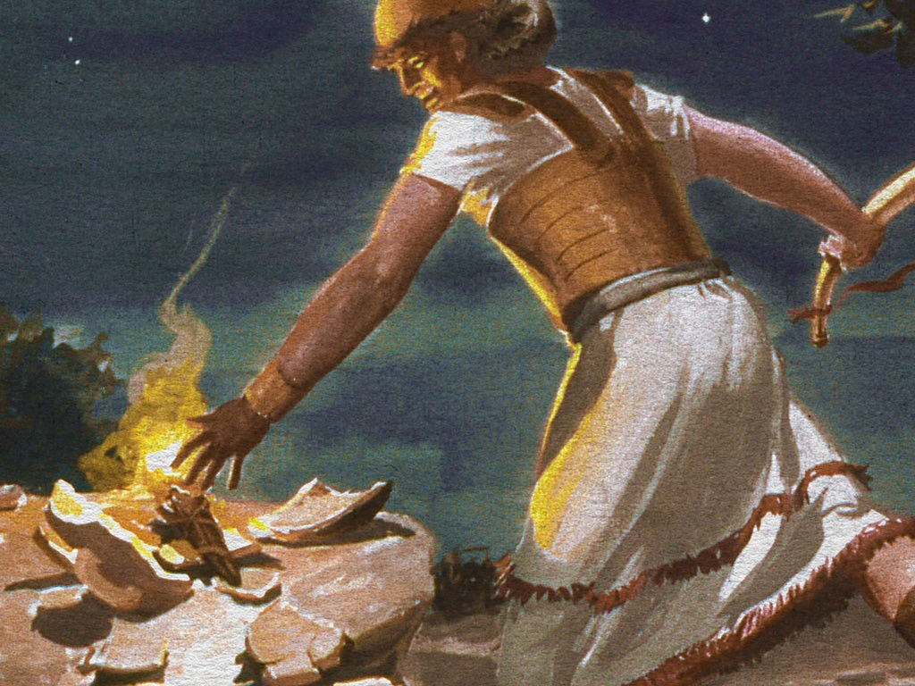
2Cor. 4:6 For it is the God who commanded light to shine out of darkness, who has shone in our hearts to give the light of the knowledge of the glory of God in the face of Jesus Christ. 7 But we have this treasure in earthen vessels, that the excellence of the power may be of God and not of us.

Slide 44
2Cor. 4:7 But we have this treasure in earthen vessels, that the excellence of the power may be of God and not of us.

