Slide 1
Welcome to our services
New Lebanon Church of Christ
We are Simply Christians.
Our Emphasis is Spiritual, Not Material or Social.
We are striving to be The Same Church as Described in The New Testament.
Please Come Back Again

Slide 3
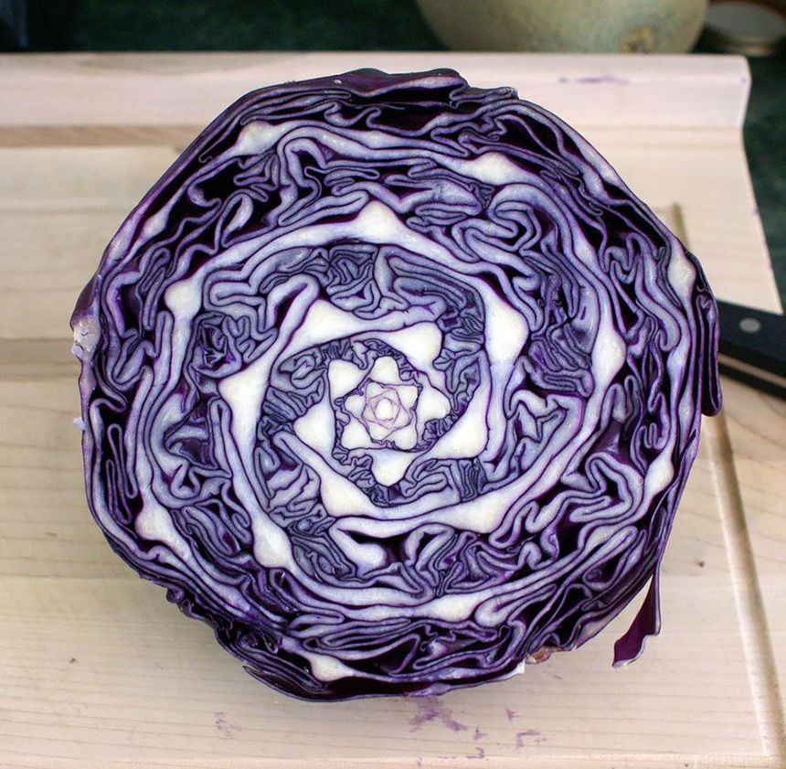

Slide 4
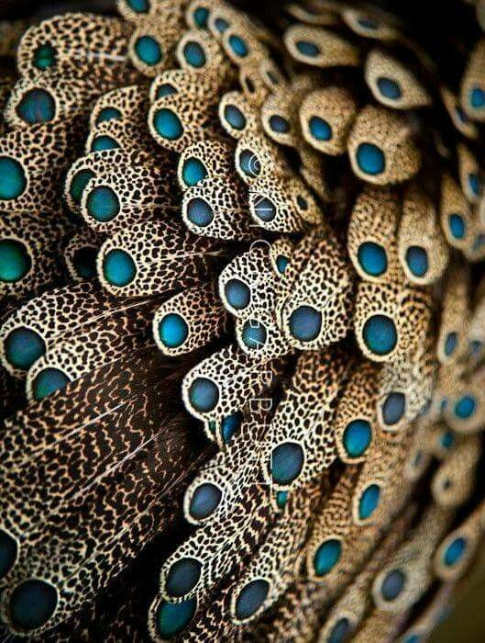

Slide 7
The seed heads of sunflowers optimize the packing of seeds by growing florets in a spiraling pattern connected to the golden ratio and Fibonacci sequence.
Gaze into the center of a sunflower and you’re bound to notice the striking pattern of spirals in the many florets there. This spiral tendency is common in the growth of plants, often seen in the way flowers, leaves, and branches are spaced around a central stem or trunk. But besides being entrancing to the eye, there is a functional value in these patterns, and there is a simple basis behind the dazzling complexity.

Slide 8
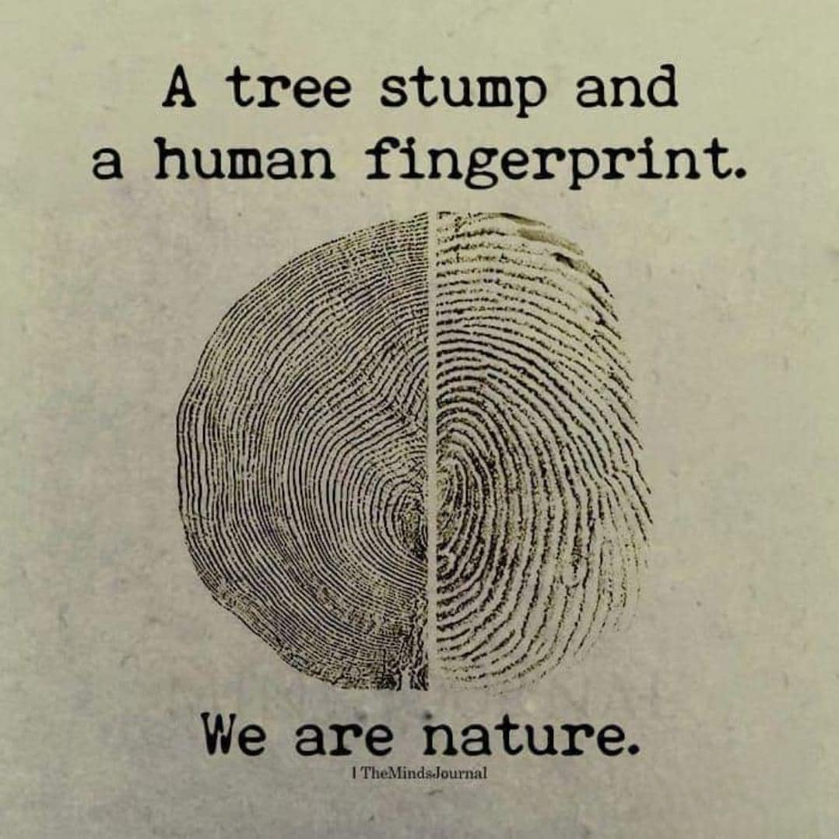

Slide 9
Ex.25:40 "And see to it that you make them according to the pattern
which was shown you on the mountain.

Slide 10
The God
Of Patterns
Exodus 25:40

Slide 11
Please open your hearts, your ears, and your Bible and follow along.
If you have any questions about anything I say, if you disagree anything I say, please say something to me after the service and I will be glad to sit down with you and God’s word and study so that we can come to know His truth

Slide 12
The God Of Patterns Exodus 25:40
Paul in 2Tim.1:13
admonishes Timothy to,
"Hold fast the pattern of sound words…"
In a very similar way we have a pattern to follow, in order to make ourselves "pleasing to God" (Eph.5:8-10).

Slide 13
The God Of Patterns Exodus 25:40
Gen.1:3 Then God said, "Let there be light"; and there was light.
4 And God saw the light, that it was good; and God divided the light from the darkness.
5 God called the light Day, and the darkness He called Night. So the evening and the morning were the first day.
God has a pattern for time: minutes, hours, days, weeks, months, years, etc.

Slide 14
The God Of Patterns Exodus 25:40
Gen.1:14 Then God said, "Let there be lights in the firmament of the heavens to divide the day from the night; and let them be for signs and seasons, and for days and years; 15 "and let them be for lights in the firmament of the heavens to give light on the earth"; and it was so.
16 Then God made two great lights: the greater light to rule the day, and the lesser light to rule the night. He made the stars also.
17 God set them in the firmament of the heavens to give light on the earth,18 and to rule over the day and over the night, and to divide the light from the darkness. And God saw that it was good.
God has a pattern for time: minutes, hours, days, weeks, months, years, etc.

Slide 15
The God Of Patterns Exodus 25:40
Gen.1:11 Then God said, "Let the earth bring forth grass, the herb that yields seed, and the fruit tree that yields fruit according to its kind, whose seed is in itself, on the earth"; and it was so.
12 And the earth brought forth grass, the herb that yields seed according to its kind, and the tree that yields fruit, whose seed is in itself according to its kind. And God saw that it was good.
God has a pattern for plant reproduction.
Seed, Sower, Field

Slide 16
The God Of Patterns Exodus 25:40
Gen.1:20 Then God said, "Let the waters abound with an abundance of living creatures, and let birds fly above the earth across the face of the firmament of the heavens."
21 So God created great sea creatures and every living thing that moves, with which the waters abounded, according to their kind, and every winged bird according to its kind. And God saw that it was good.
22 And God blessed them, saying, "Be fruitful and multiply, and fill the waters in the seas, and let birds multiply on the earth."

Slide 17
The God Of Patterns Exodus 25:40
Gen.1:24 Then God said, "Let the earth bring forth the living creature according to its kind: cattle and creeping thing and beast of the earth, each according to its kind"; and it was so.
25 And God made the beast of the earth according to its kind, cattle according to its kind, and everything that creeps on the earth according to its kind. And God saw that it was good.

Slide 18
The God Of Patterns Exodus 25:40
Gen.8:22 "While the earth remains, Seedtime and harvest, Cold and heat, Winter and summer, And day and night Shall not cease.“
Nature follows God’s pattern!

Slide 19
The God Of Patterns Exodus 25:40
Ex.25:9 According to all that I shew thee, after the pattern of the tabernacle, and the pattern ….
Ex 25:40 And look that thou make them after their pattern,
Joshua 22:28, Behold the pattern of the altar of the LORD,

Slide 20
The God Of Patterns Exodus 25:40
If there is such a thing as New Testament worship, then there is a pattern for worship. If one claims there is no pattern, he might as well just admit that New Testament worship does not exist.
Either worship is prescribed by the New Testament or it is not. If it is prescribed, then it can be called New Testament worship because it follows the prescription (pattern).
If the New Testament gives no such prescription, then no worship can be called New Testament worship. There simply is no such thing.

Slide 21
The God Of Patterns Exodus 25:40
So the real question is, does the New Testament prescribe, describe, or set forth worship and work that is distinct under the New Covenant?

Slide 22
The God Of Patterns Exodus 25:40
God has revealed the pattern for us to follow, let's determine to search it out and adhere to its following.
Part of the pattern of the New Testament is a plan of salvation, for all who will respect Him and listen to be saved. Are ready to make your life right with God?

Slide 23
Exclusive Pattern and Authority for How and When to raise money.
1Cor. 16:1
Now concerning the collection for the saints, as I have given orders to the churches of Galatia, so you must do also:
2 On the first day of the week let each one of you lay something aside, storing up as he may prosper, that there be no collections when I come.
Exclusive pattern excludes every other way of raising money.

Slide 24
Matt. 28:18 "All authority has been given
to Me in heaven and on earth.”
Opinions - assertions
It is so
because
I say it is so
Silence
tradition
My preacher said this is the answer
I read
so-and-so’s
book. He is
my favorite
writer.
My
daddy taught me
This. My mama
taught me
that
It is so
because
So-and-so
Says it is so.
1Cor.4:6 Do not think of men above what is written.

Slide 25
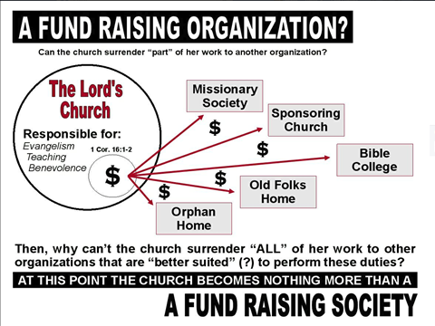

Slide 26
Matt. 7:21 Not every one that saith unto me, Lord, Lord, shall enter into the kingdom of heaven; but he that doeth the will of my Father which is in heaven.
22 Many will say to me in that day, Lord, Lord, have we not prophesied in thy name? and in thy name have cast out devils? and in thy name done many wonderful works?
23 And then will I profess unto them, I never knew you:
depart from me, ye that work iniquity.

Slide 27
The God Of Patterns Exodus 25:40
Eph 4:11-12
And he gave some, apostles; and some, prophets; and some, evangelists; and some, pastors and teachers;
12 For the perfecting of the saints, (benevolence)
for the work of the ministry, (preaching)
for the edifying of the body of Christ (edification)
The church has NO authority to divert funds from the spiritual work to secular work.
Notes:
No kitchen, no food pantry, No clothes closet, No colleges, no hospitals, no orphans homes , no widows homes

Slide 28
The God Of Patterns Exodus 25:40
Col 3:17 And whatever you do in word or deed, do all in the name of the Lord Jesus, giving thanks to God the Father through Him.
1Peter 4:11 If anyone speaks, let him speak as the oracles of God. If anyone ministers, let him do it as with the ability which God supplies, that in all things God may be glorified through Jesus Christ, to whom belong the glory and the dominion forever and ever. Amen.

Slide 31
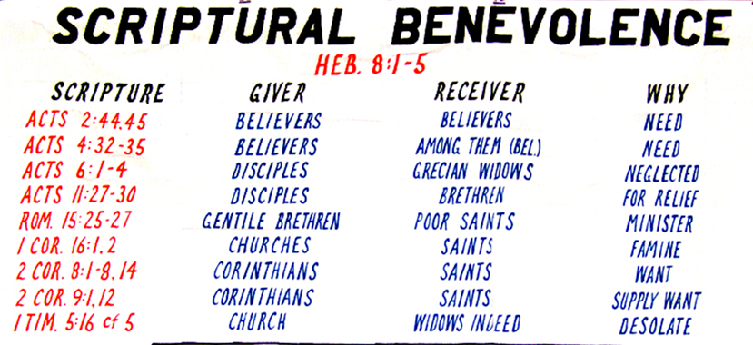
Acts 11:27-30
And in these days prophets came from Jerusalem to Antioch. 28 Then one of them, named Agabus, stood up and showed by the Spirit that there was going to be a great famine throughout all the world, which also happened in the days of Claudius Caesar.
29 Then the disciples, each according to his ability, determined to send relief to the brethren dwelling in Judea. 30 This they also did, and sent it to the elders
by the hands of Barnabas and Saul.

Slide 32
The God Of Patterns Exodus 25:40
The New Testament Pattern for Sending Money
Does the New Testament furnish us with a pattern as to how money is to be sent to a work? Yes ! When the famine arose in Judea, the disciples in Antioch determined to send relief to their destitute brethren.
The money was sent directly to the churches in need.
Acts 11:27-30. Some years later a similar collection was made by the churches in Macedonia, Achaia and Galatia for the poor saints in Jerusalem, and again the money was sent directly to the church in need by the hand of the messengers the churches had chosen. 1Cor.16:1-3. 2 Cor.8-9.
It should he observed and remembered that so far as the New Testament record is concerned, no church ever sent to another church unless the receiving church was in need
(Bigger to smaller)
Notes:
Half Way on Slides.

Slide 33
The God Of Patterns Exodus 25:40
The issue is not whether an individual or institution is worthy of receiving money.
The issue is - can we take
the $ from the Lord’s treasury?
The issue is - are we following
the Lord’s pattern?
Is it a responsibility
of the church or individual?

Slide 34
Departures in the church in America
2021-2022 | Anything you | WANT
1952 | Herald of Truth
1950s-1960s | Another major split in America | Institutional Non-institutional
 |  | Liberal conservative
Early 1900s- Late 1800s | Social Gospel | Benevolence
 |  | Orphans homes Widows homes
1849 | A.C.M.S. | Evangelism

Slide 35
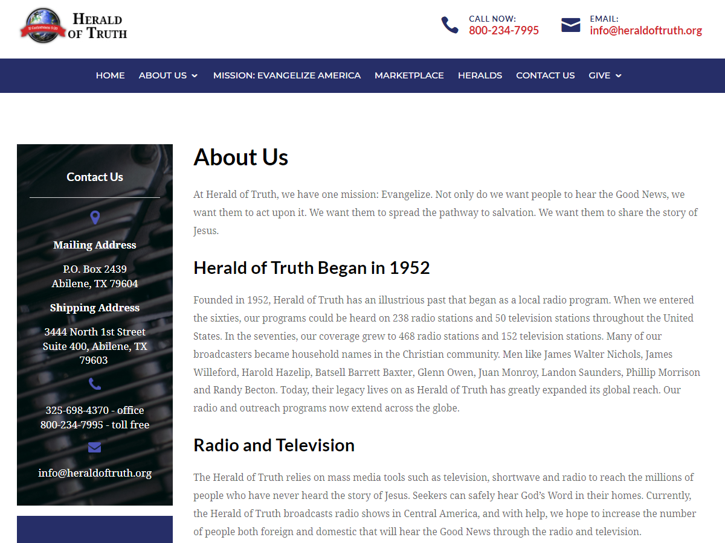

Slide 36
?
We would be happy to discuss your needs in person. We are located at:
50 South Findlay Street
Dayton, OH 45403
Christophers@widowshome.org
Started in 1872 as an organization to care for the widows of Civil War soldiers,
Notes:
Not too far from here.

Slide 37
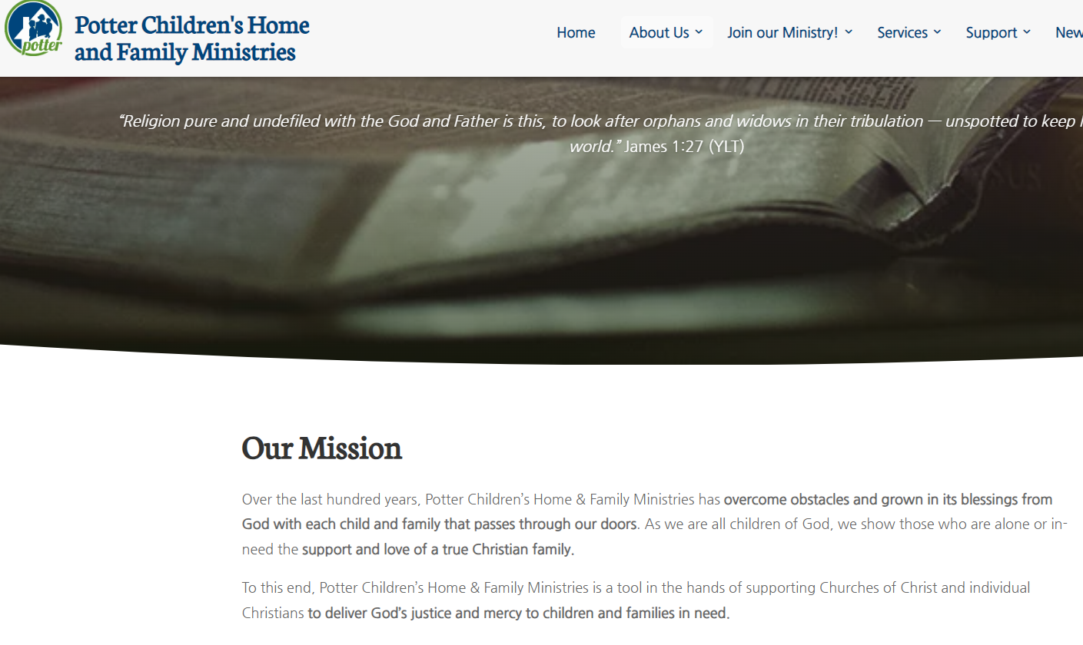
Matt 7:21-23

Slide 38
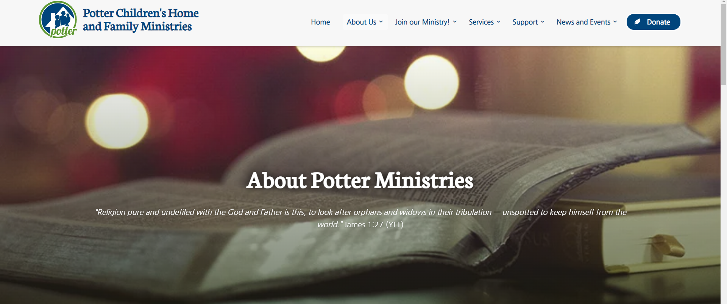
James 1:23 For if any be a hearer of the word, and not a doer, he is like unto a man beholding his natural face in a glass: 24 For he beholdeth himself, and goeth his way, and straightway forgetteth what manner of man he was.
25 But whoso looketh into the perfect law of liberty, and continueth therein, he being not a forgetful hearer, but a doer of the work, this man shall be blessed in his deed.
26 If any man among you seem to be religious, and bridleth not his tongue, but deceiveth his own heart, this man's religion is vain.
27 Pure religion and undefiled before God and the Father is this, To visit the fatherless and widows in their affliction, and to keep himself unspotted from the world. (KJV)
(Individual action not collective action)

Slide 39
$
Ben.
church
elders
$
Ben.
individual
saints
$
all
Ben.
individual
men
$
Evangl.
church
preacher
$
Evangl.
individual
preacher

Slide 40
The God Of Patterns Exodus 25:40
God gives us a pattern for
Church organization
Work of the church
Worship of the church
Raising money for the church
Spending the lord’s money

Slide 41
The God Of Patterns Exodus 25:40
To have another body or agent to do the Lord’s work is to say God failed at making the church able to do it’s work.

Slide 48
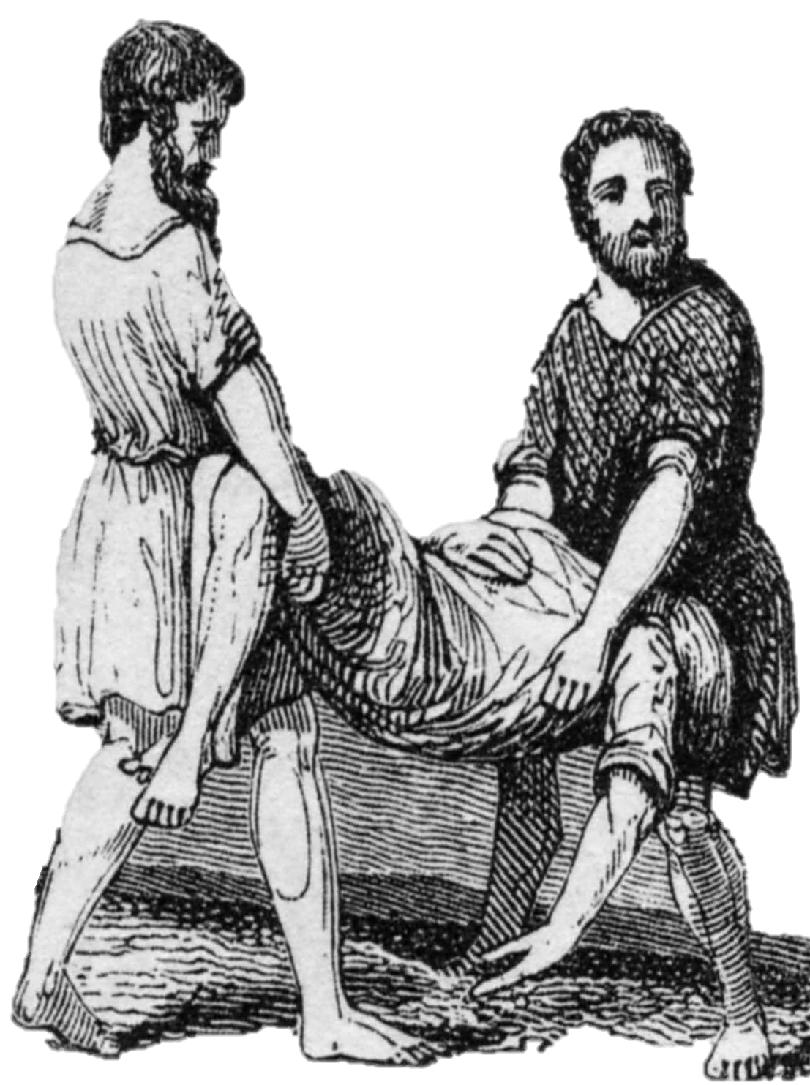
Leviticus 10:2-3
So fire went out from the LORD and devoured them, and they died before the LORD.
3 And Moses said to Aaron, "This is what the LORD spoke, saying: 'By those who come near Me I must be regarded as holy; And before all the people I must be glorified.'" So Aaron held his peace.(NKJV)
Moses warned Nadab and Abihu’s father, Aaron, and the other priests that they would die if they expressed their grief.
2

Slide 49
Romans 1:18-20 For the wrath of God is revealed from heaven against all ungodliness and unrighteousness of men, who suppress the truth in unrighteousness,
19 because what may be known of God is manifest in them, for God has shown it to them.
20 For since the creation of the world His invisible attributes are clearly seen, being understood by the things that are made, even His eternal power and Godhead, so that they are without excuse,

Slide 50
Rom. 1:18 For the wrath of God is revealed from heaven against all ungodliness and unrighteousness of men, who suppress the truth in unrighteousness,
Rom.1:32 who, knowing the righteous judgment of God, that those who practice such things are deserving of death, not only do the same but also approve of those who practice them.

Slide 52
The God
Of Patterns
Exodus 25:40

Slide 53
The God Of Patterns Exodus 25:40
We are commanded to follow the pattern.
Nature follows the pattern. Is man excused?
Does the N.T. have a pattern?
collecting money?
spending money?
wordship?
benevolence?
evangelism?
Do we dare not follow the pattern today?

Slide 54
The God Of Patterns Exodus 25:40
We are commanded to follow the pattern for Fellowship.
We can not fellowship those who Teach Error
Rom. 16:17-18
We can not have fellowship with those who Practice Error
Eph. 5:11
Nor with those who Endorse error and sin.
2 John 10-11

Slide 55
2John 1:10
If anyone comes to you and does not bring this doctrine, do not receive him into your house nor greet him;
11 for he who greets him shares in his evil deeds.

