Slide 1
Welcome to our services
New Lebanon Church of Christ
We are Simply Christians.
Our Emphasis is Spiritual, Not Material or Social.
We are striving to be The Same Church as Described in The New Testament.
Please Come Back Again

Slide 2
Sanctify The Lord God
In Your Hearts -
1 Peter 3:11-17
15 But sanctify the Lord God in your hearts, and always be ready to give a defense to everyone who asks you a reason for the hope that is in you, with meekness and fear;

Slide 3
Sanctify The Lord God In Your Hearts - 1 Peter 3:11-17
1 Peter 3:10–17 10 For "He who would love life And see good days, Let him refrain his tongue from evil, And his lips from speaking deceit.11 Let him turn away from evil and do good; Let him seek peace and pursue it. 12 For the eyes of the LORD are on the righteous, And His ears are open to their prayers; But the face of the LORD is against those who do evil."13 And who is he who will harm you if you become followers of what is good?
14 But even if you should suffer for righteousness' sake, you are blessed. "And do not be afraid of their threats, nor be troubled."15 But sanctify the Lord God in your hearts, and always be ready to give a defense to everyone who asks you a reason for the hope that is in you, with meekness and fear;
16 having a good conscience, that when they defame you as evildoers, those who revile your good conduct in Christ may be ashamed.17 For it is better, if it is the will of God, to suffer for doing good than for doing evil.

Slide 5
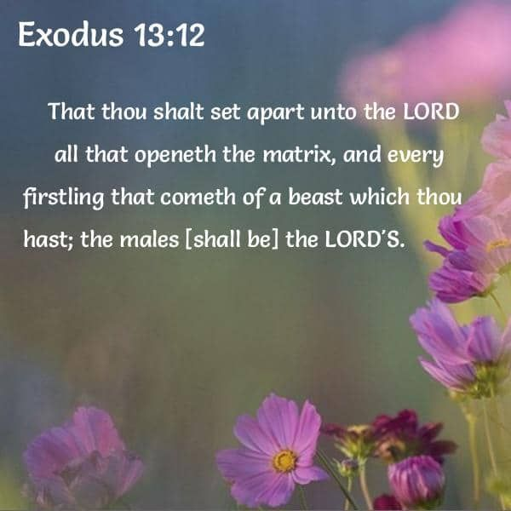

Slide 6
Sanctify The Lord God In Your Hearts - 1 Peter 3:11-17
Introduction
A Heart Religion.
Note the emphasis here upon a heart religion. This is something that has to take place in the hearts of God’s people. “Reverence Christ as Lord in your own hearts”
“In your hearts consecrate Christ as Lord”
“But love the Lord Christ in your hearts”

Slide 7
Sanctify The Lord God In Your Hearts - 1 Peter 3:11-17
Man is a Shrine. The heart of a Christian man or woman is a shrine. It is a place of worship. There is a large congregation there, consisting of wishes, motives, ambitions, desires, likes, dislikes, passions, and wishes,. And Christ also is there.
He ought to be chief, the One in command. He first comes as Guest, but ought to become supreme Master—Lord, in every sense of that word. This should be our deliberate act—place the Guest on the throne of our being, ask the Passenger to take command of the vessel. Ask our Companion to take supreme command

Slide 8
Sanctify The Lord God In Your Hearts - 1 Peter 3:11-17
Shrine - naos (ναός, 3485), “the innermost part of a temple, a shrine,” is used in the plural in Acts 19:24, of the silver models of the pagan “shrine” in which the image of Diana (Greek Artemis) was preserved.
The models were large or small, and were signs of wealth and devotion on the part of purchasers. The variety of forms connected with the embellishment of the image provided “no little business” for the silversmiths. See temple.

Slide 9
Sanctify The Lord God In Your Hearts - 1 Peter 3:11-17
HALLOW
hagiazo (ἁγιάζω, 37), “to make holy” (from hagios, “holy”), signifies to set apart for God, to sanctify, to make a person or thing the opposite of koinos, “common”; it is translated “Hallowed,” with reference to the name of God the Father in the Lord’s Prayer, Matt. 6:9; Luke 11:2. See SANCTIFY.
W. E. Vine,

Slide 10
Sanctify The Lord God In Your Hearts - 1 Peter 3:11-17
I. What it Means to Sanctify Christ.
SET Him apart from the common and ordinary to special use.
To sanctify in the Bible means to “set apart,” and in consequence to view in a different light, ceasing to use or treat as formerly.
Sanctify B. Verb.
hagiazo (ἁγιάζω, 37), “to sanctify,” “is used of (a) the gold adorning the Temple and of the gift laid on the altar, Matt. 23:17, 19; (b) food, ……….

Slide 13
Sanctify The Lord God In Your Hearts - 1 Peter 3:11-17
What is the common use made of our Lord? A Fire Escape.
We first begin to think of Him as Savior from sin and the wrath to come. He is a Fire Escape.
He is much more. He should become everything to us. Thank God that He has saved you from Hell, but also find out what He has saved you to! If a believer, He is already in your heart as Christ. Now make Him your Lord, Master, Sovereign.

Slide 14
Sanctify The Lord God In Your Hearts - 1 Peter 3:11-17
2. Worship.
To sanctify the Christ in your heart as Lord means that you do set Him on the pedestal and pinnacle of your being, and that you bow down before Him with adoring love and wonder, and with reverence and submission, worshipping Him.

Slide 15
Sanctify The Lord God In Your Hearts - 1 Peter 3:11-17
3. Hallow.
Sanctify is the same word in the Lord’s Prayer rendered “hallowed be Thy Name.” We sanctify or hallow One who is holy already, when we recognize that holiness, and honor in speech, thought and act, what we recognize. It means to hallow Him by thought, word, and service

Slide 16
What it Means to Sanctify Christ.
Set him apart from the common and ordinary to special use.
Worship
Hallow

Slide 17
Sanctify The Lord God In Your Hearts - 1 Peter 3:11-17
II. What will be the Result of such an Act on our Part?
1. Fearlessness and Calmness (14). “Be not afraid of their terror, neither be troubled.” When Christ is Master within our hearts, He calms and steadies, and gives us calmness and courage.
2. Mental Alertness (15). “And be ready” of the A.V. is in R.V. “Being ready,” that is to say, mental alertness follows the setting apart of Christ as Lord.

Slide 18
Sanctify The Lord God In Your Hearts - 1 Peter 3:11-17
II. What will be the Result of such an Act on our Part?
3. Gentleness. (15) Being ready always to “answer gently and with reverence.”
Another wonderful and impressive result of sanctifying Christ as Lord.

Slide 19
Sanctify The Lord God In Your Hearts - 1 Peter 3:11-17
II. What will be the Result of such an Act on our Part?
4. A Good Conscience (16). What a blessing. A conscience void of offence toward God and man.
5. Purity (16). Purity of heart and thought and life, so patent to our persecutors, “they may be ashamed that falsely accuse your good conversation (or life) in Christ.”

Slide 20
Sanctify The Lord God In Your Hearts - 1 Peter 3:11-17
II. What will be the Result of such an Act on our Part?
Fearlessness and Calmness (14).
Mental Alertness (15).
Good Conscience (16)
Purity (16).

Slide 21
Now let’s look at the verses again.

Slide 22
Sanctify The Lord God In Your Hearts - 1 Peter 3:11-17
1 Peter 3:10 For, He that would love life, And see good days, Let him refrain his tongue from evil, And his lips that they speak no guile: And let him turn away from evil, and do good; Let him seek peace, and pursue it. For the eyes of the Lord are upon the righteous, And his ears unto their supplication: But the face of the Lord is upon them that do evil.

Slide 23
Sanctify The Lord God In Your Hearts - 1 Peter 3:11-17
The apostle here quoted Psalm 34:12, “It seems that both the psalmist and the apostle use the word to refer to the present life on earth.”
Those who would love eternal life must heed the exhortations here; and likewise those who would have a joyful life on earth must follow the same instructions.
v.11
Let him seek peace, and pursue it … The true peacemaker is not passive but active, and must take the lead, not merely in keeping the peace himself but in the earnest inducement of others to do likewise.

Slide 24
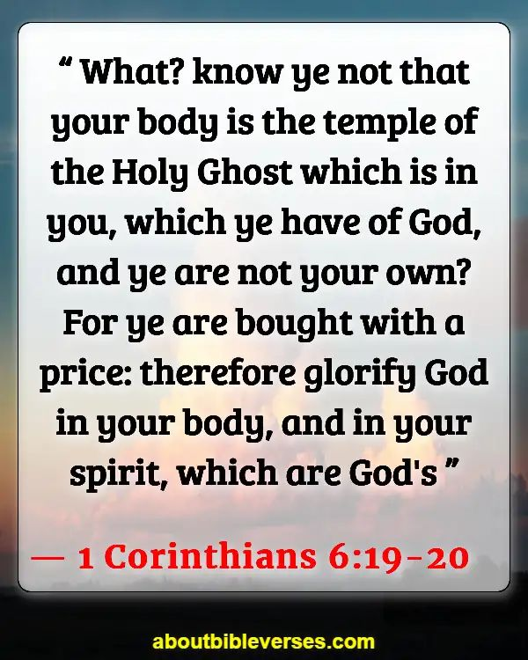

Slide 25
Sanctify The Lord God In Your Hearts - 1 Peter 3:11-17
V12
The eyes of the Lord are upon the righteous. This is a reference to the providence which God exercises over his people. Jesus said, “I am with you always, even unto the end of the world. Amen” (Matt. 28:20); and that has the same meaning as the clause here.
V 12
But the face of the Lord is upon them that do evil … Not only are wicked men denied the care of God, but their unrighteousness has actually incurred the displeasure of God. The Lord is angry with the wicked every day.

Slide 26
Sanctify The Lord God In Your Hearts - 1 Peter 3:11-17
v13 And who is he that will harm you, if ye be zealous for that which is good?
Peter begins in this paragraph to speak about the terrible persecution coming upon them. He did not mean by this question that Christians were not in any danger of bodily harm from their enemies; what it meant was that no matter what might happen to their bodies, nothing, really, could happen to them.

Slide 27
Sanctify The Lord God In Your Hearts - 1 Peter 3:11-17
Peter was in complete harmony with the Lord in such a viewpoint. “It means that men and devils may do their worst, as they did to Jesus, and cannot harm us.” Our Lord himself said:
Luke 21:16 "You will be betrayed even by parents and brothers, relatives and friends; and they will put some of you to death.
17 "And you will be hated by all for My name's sake.
18 "But not a hair of your head shall be lost.
19 "By your patience possess your souls.

Slide 28
Sanctify The Lord God In Your Hearts - 1 Peter 3:11-17
We must believe, therefore, that it was this safety through persecution that Peter had in mind here. …… regarding one who was asked if prayer would render a man invulnerable to shot and shell, and who replied that “Fellowship with God through prayer would make a man sure that though his body was shattered, his soul would be untouched.”

Slide 29
Sanctify The Lord God In Your Hearts - 1 Peter 3:11-17
v14 But even if ye should suffer for righteousness’ sake, blessed are ye: and fear not their fear, neither be troubled;
Even if ye should suffer … What does this mean? “It means the horrors of capital punishment.” The undeniable meaning of “Christ also suffered for sins once” (1 Pet. 3:18) confirms this understanding of “suffer” here.

Slide 30
Sanctify The Lord God In Your Hearts - 1 Peter 3:11-17
Fear not their fear … Christians must not fear the things that men generally fear. The terror that men can bring to those having their own value-judgments is indeed awesome; but the child of God lives by a different set of values.
Neither be troubled … Like in so many other places in this great epistle, there is a suggestion here of the words of Jesus, who said, “Let not your heart be troubled” (John 14:1).

Slide 31
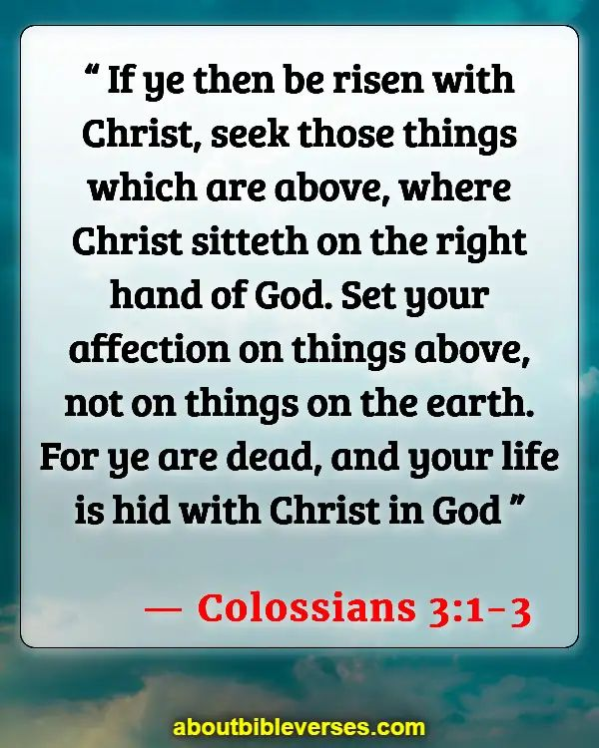

Slide 32
Sanctify The Lord God In Your Hearts - 1 Peter 3:11-17
1 Pet 3:15 but sanctify in your hearts Christ as Lord: being ready always to give an answer to every man that asks you a reason concerning the hope that is in you, yet with meekness and fear:
The prophecy of Isaiah has this: “Sanctify the Lord of hosts himself; and let him be your fear, and let him be your dread” (Isaiah 8:13). It is clear that Peter’s thought in this and the preceding verses is clearly connected with the words of Isaiah, but there is a notable difference:
Peter here substituted the Savior’s name where the prophet wrote “the Lord of hosts, Jehovah Sabaoth”—a change which would be nothing less than impious if the Lord Jesus Christ were not truly God.

Slide 33
Sanctify The Lord God In Your Hearts - 1 Peter 3:11-17
Sanctify … Christ as Lord … What is meant by sanctifying the Lord? it is closely akin to “hallowing” the name of the Father in heaven, as in the Lord’s prayer (the only other place in the New Testament where this expression occurs), defining “to sanctify” as “to recognize, in word and deed, his full holiness, and therefore to treat him with due awe.”

Slide 34
Sanctify The Lord God In Your Hearts - 1 Peter 3:11-17
Ready always to give an answer …
this admonition has special reference to the occasion of a Christian’s “being called into a law court to give an account.” There is no reason, however, to limit the meaning in such a way. All Christians, at all times, should have the full grasp of the rational basis for declaring and living the holy religion we have accepted, as well as possessing a thorough knowledge of the great doctrines of the New Testament; for there will be countless occasions in every life when such knowledge and understanding can be made a vehicle for enlisting others in the holy faith.

Slide 35
Sanctify The Lord God In Your Hearts - 1 Peter 3:11-17
Concerning the hope … The primacy of hope in the motivation of Christians shines in this, there being a glorious sense in which “We are saved by hope” (Rom. 8:24). The meaning here is exactly the same as “concerning the faith,” both expressions referring to “the Christian religion.”

Slide 36
Sanctify The Lord God In Your Hearts - 1 Peter 3:11-17
Yet with meekness and fear … Why this? There are many reasons:
(1) Christians should manifest meekness at all times.
“Blessed are the meek, for they shall inherit the earth” (Matt. 5:5); but in addition to this, there is no situation in life that demands such an attitude any more than that which appears on an occasion of religious questioning and response.
(2) A lack of meekness can prejudice judges, if one is in a court of law.
(3) A lack of it can antagonize earnest questioners whose seeking after the truth can be easily frustrated by an arrogant, overbearing, or discourteous attitude.

Slide 37
Sanctify The Lord God In Your Hearts - 1 Peter 3:11-17
And why fear?
(1) In all situations where a Christian is attempting to answer the questions of others, or to restore one who has fallen into sin, there is danger to the Christian himself. As Paul put it, “Restore such a one in a spirit of gentleness, looking to thyself, lest thou also be tempted” (Gal. 6:1).
(2) There should be fear that the answers might not be given in the right spirit, or that they might not be correct. The failure of many really to know the truth about their own religious views is widespread; and every teacher should concern himself to know the right answers, to avoid becoming himself a teacher of falsehood. Fear is a proper motive for all who presume to teach the word of the Lord.

Slide 38
Sanctify The Lord God In Your Hearts - 1 Peter 3:11-17
1 Peter 3:16 having a good conscience; that, wherein ye are spoken against, they may be put to shame who revile your good manner of life in Christ.
Having a good conscience … This key admonition recurs again and again in this epistle: “zealous for good works … for righteousness’ sake … sanctify the Lord … with meekness and fear, etc.,” all of these in this very paragraph.
Wherein ye are spoken against … They were spoken against because of the manner of their lives; but they are told to make their lives so beautiful that they will shame the evil critics.

Slide 39
Sanctify The Lord God In Your Hearts - 1 Peter 3:11-17
In Christ … This is one of the great phrases of the New Testament, being used 164–172 times (depending on the version) in the writings of Paul alone; but although Paul laid the greatest stress on it, the conception of being “in Christ” is not Pauline, going back to our Lord himself who said, “Ye are in me and I in you” (John 14:20). Also, “I am the vine and ye are the branches; he that abides in me, and I in him, the same bears much fruit” (John 15:5).
What is meant by being “in Christ”? in the Hebrew conception of corporate personality.” The church is Christ, and is called Christ’s spiritual body. “To be in Christ therefore is to be a member of the redeemed society, i.e., the church, of which Christ is head … the Bible knows nothing of solitary religion.”

Slide 41
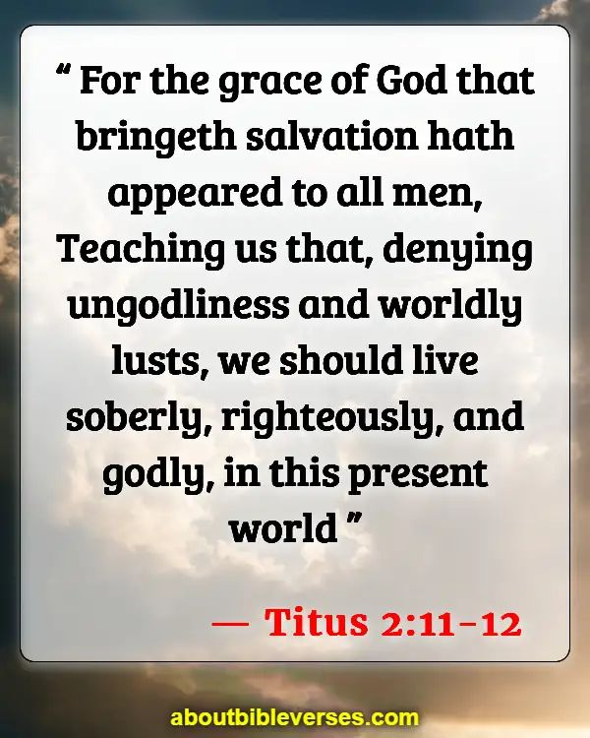

Slide 42
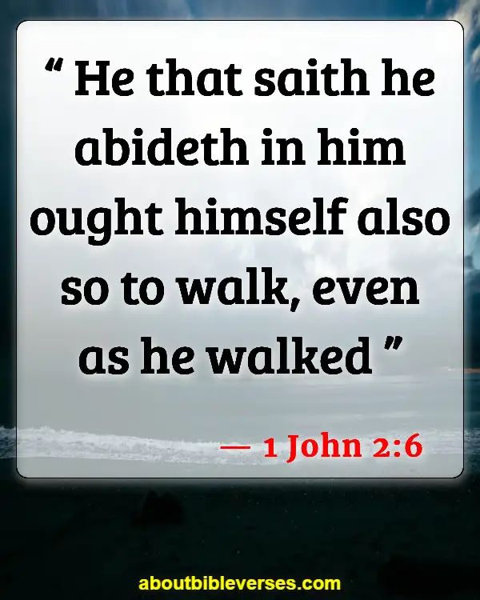

Slide 43
Sanctify Christ in YOUR HEART
“Reverence Christ as Lord in your own hearts”
“In your hearts consecrate Christ as Lord”
“But love the Lord Christ in your hearts”

