Slide 1
Welcome to our services
New Lebanon Church of Christ
We are Simply Christians.
Our Emphasis is Spiritual, Not Material or Social.
We are striving to be The Same Church as Described in The New Testament.
Please Come Back Again

Slide 2
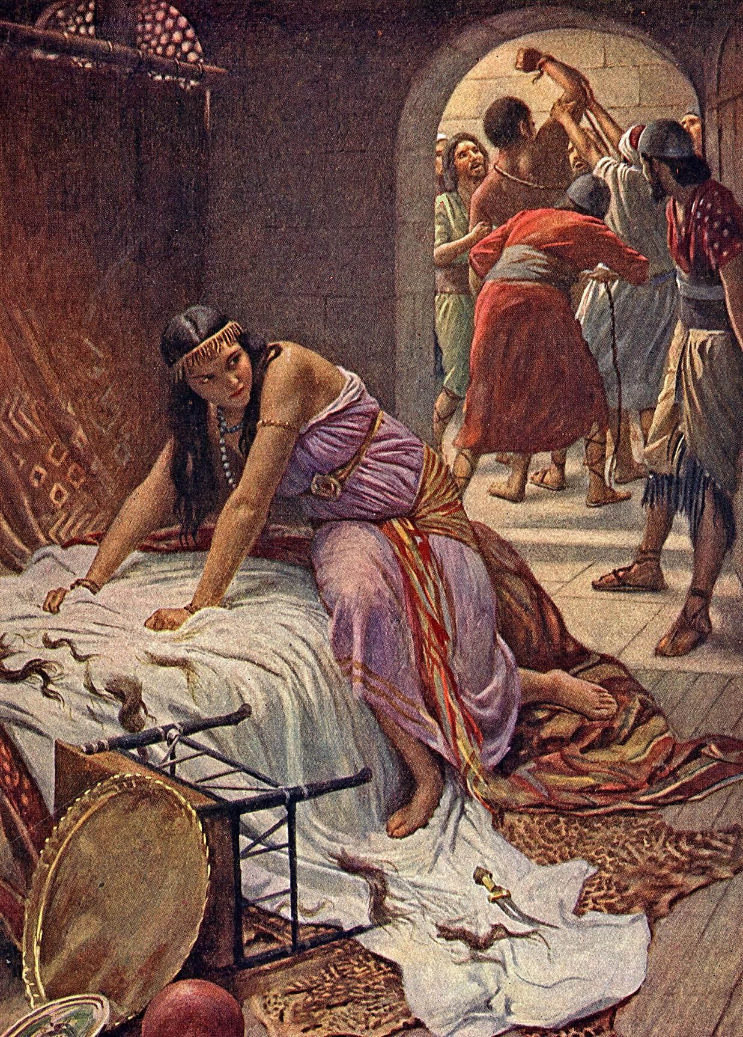
The LORD had departed from him
Judges 13-16
Judges 16:20 And she said, "The Philistines are upon you, Samson!" So he awoke from his sleep, and said, "I will go out as before, at other times, and shake myself free!" But he did not know that the LORD had departed from him.

Slide 3
The LORD had departed from him Judges 16:20
Text: Judges 13-16
Samson was from the tribe of Dan.
His father was Manoah, his mothers’s name is not mentioned.
Samson was the last Judge mentioned before the transition to Eli and Samuel.
Samson is a one man army against the Philistnes.

Slide 4
The LORD had departed from him Judges 16:20
His parents were dedicated to God. They were people of prayer.
It’s good to have praying parents. They wanted to raise Samson the right way.
Judges13:8-12 Then Manoah prayed to the LORD, and said, "O my Lord, please let the Man of God whom You sent come to us again and teach us what we shall do for the child who will be born."
9 And God listened to the voice of Manoah, and the Angel of God came to the woman again as she was sitting in the field; but Manoah her husband was not with her.

Slide 5
The LORD had departed from him Judges 16:20
Teach us
How should we order the child.
This should be the desire of every parent to raise a child properly.
But like some children with Godly parents, Samson went astray. I imagine Samson was a disappointment many times to his parents.

Slide 6
Manoah was told by the angel that Samson was to be a Nazarite, and he was special in another way . . . his great strength.
NAZARITE—
A person who takes a vow of separation which includes certain restrictions.
Not eating or drinking grapes
Not shaving their head
Not going near a dead body

Slide 7
The LORD had departed from him Judges 16:20
Judges 14:6 And the Spirit of the LORD came mightily upon him, and he tore the lion apart as one would have torn apart a young goat, though he had nothing in his hand. But he did not tell his father or his mother what he had done.
Judges 14:19 Then the Spirit of the LORD came upon him mightily, and he went down to Ashkelon and killed thirty of their men, took their apparel, and gave the changes of clothing to those who had explained the riddle. So his anger was aroused, and he went back up to his father's house.
Judges 15:14 When he came to Lehi, the Philistines came shouting against him. Then the Spirit of the LORD came mightily upon him; and the ropes that were on his arms became like flax that is burned with fire, and his bonds broke loose from his hands.

Slide 8
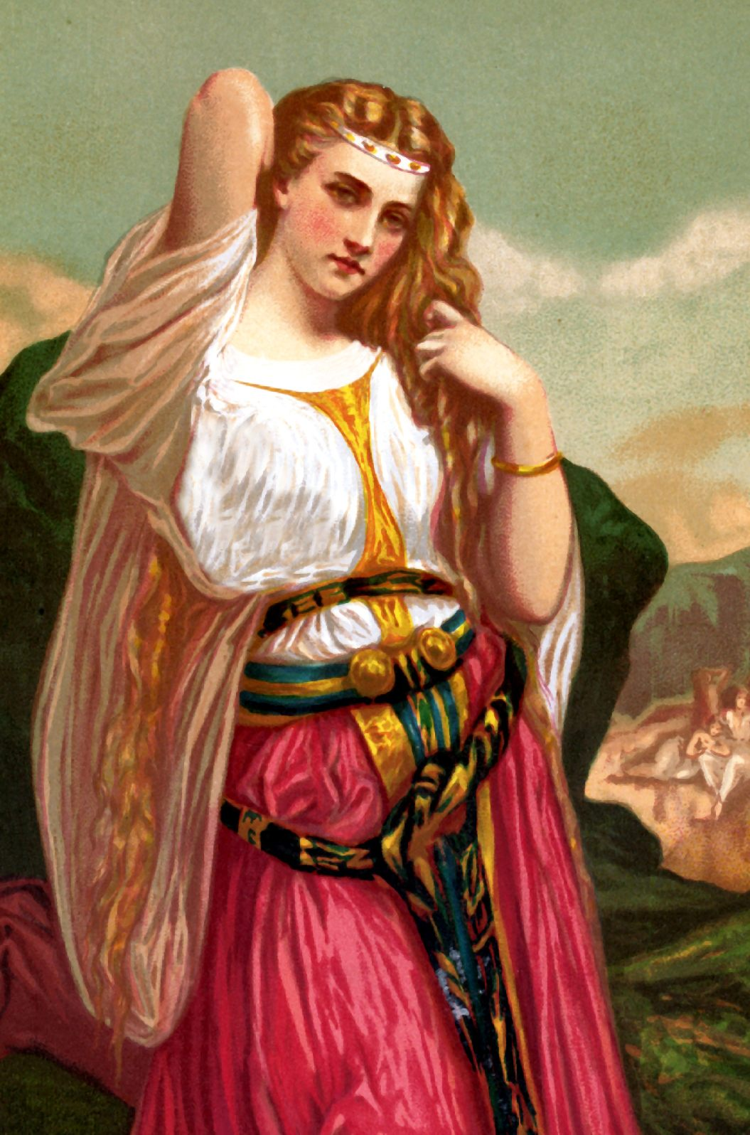
The LORD had departed from him Judges 16:20
The entire story of Samson is a story of Samson breaking his Nazarite vow. Samson had great physical strength – but he was a spiritual weakling.

Slide 9
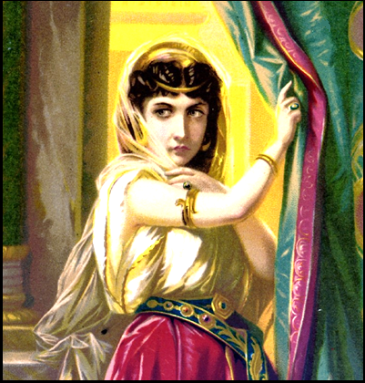
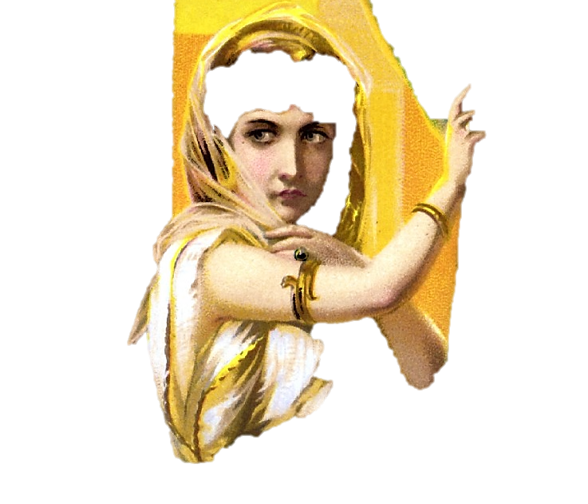
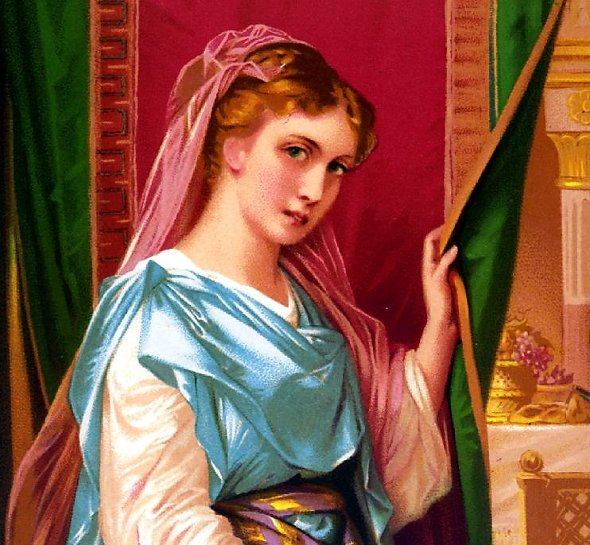
Samson’s Women
FIRST—
His Philistine wife that betrayed him and was burned to death.
SECOND—
The Philistine harlot in Gaza that most likely betrayed him by revealing his presence in Gaza.
THIRD—
Delilah who discovered his secret, and her betrayal led to his death.

Slide 10
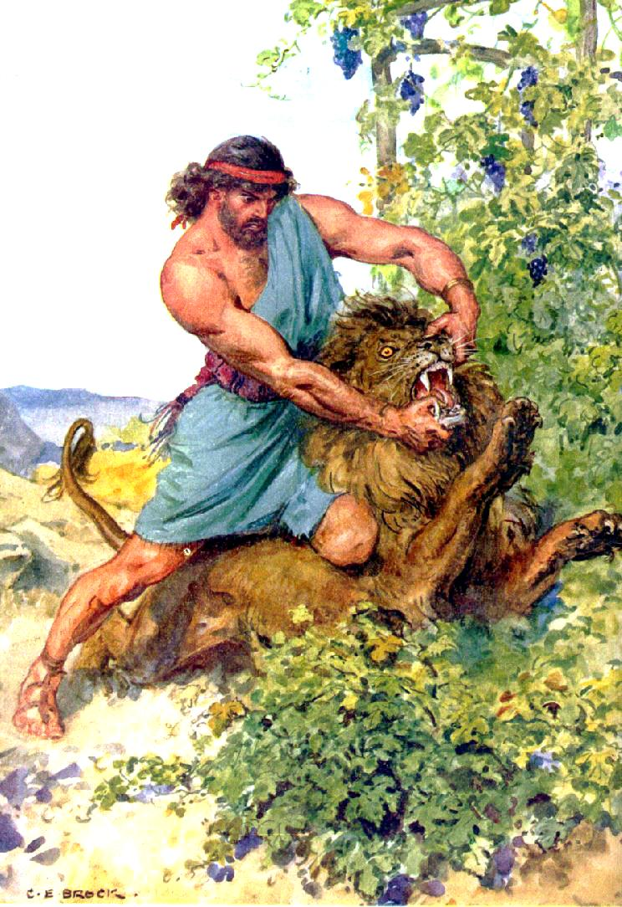
Judges 14
Samson and the lion.
Judges 14
“⁵Then went Samson down, and his father and his mother, to Timnath, and came to the vineyards of Timnath: and, behold, a young lion roared against him. ⁶And the Spirit of the LORD came mightily upon him, and he rent him as he would have rent a kid, and he had nothing in his hand: but he told not his father or his mother what he had done.”
He must have separated from his parents on this journey for they were not around when the lion came.
Possibly Samson lagged behind in the vineyard.
God let Samson know what he could do in the strength of the Spirit of the Lord, that he might never be afraid to look the greatest difficulties in the face.

Slide 11
Judges 14
“¹And Samson went down to Timnath, and saw a woman in Timnath of the daughters of the Philistines. ²And he came up, and told his father and his mother, and said,
I have seen a woman in Timnath of the daughters of the Philistines: now therefore get her for me to wife.
³Then his father and his mother said unto him,
Is there never a woman among the daughters of thy brethren, or among all my people, that thou goest to take a wife of the uncircumcised Philistines?”

Slide 12
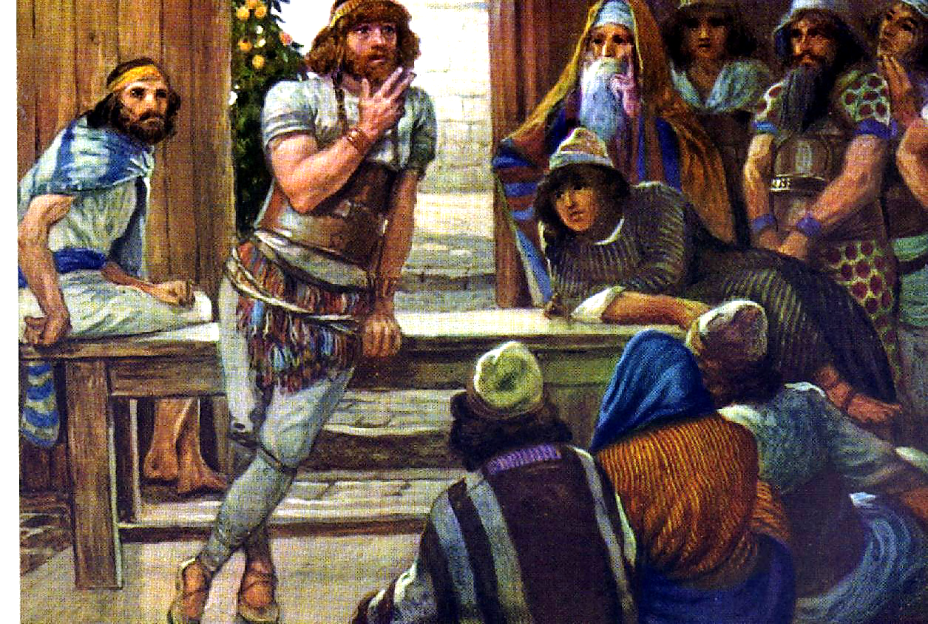
Judges 14
Verse 10-11 Feast / 30 companions

Slide 13
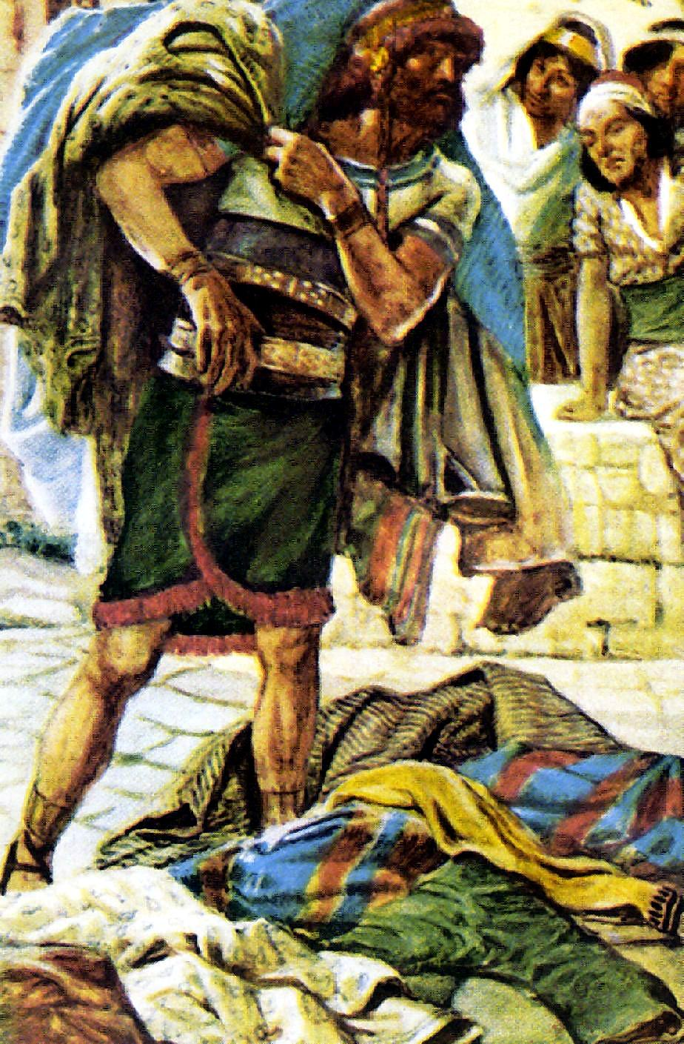
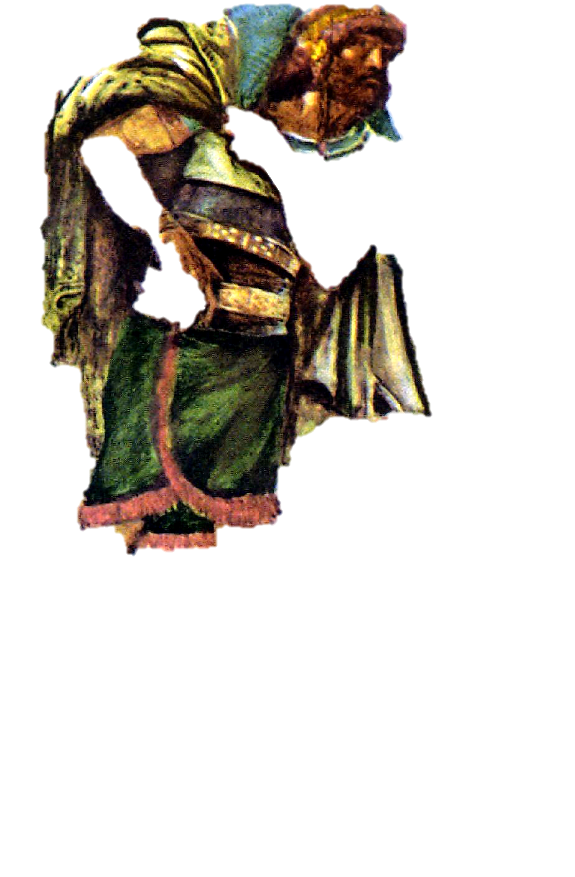
Judges 14
Verse 19
Samson killed 30 men for the 30 garments of the wager.
Judges 14
“¹⁹And the Spirit of the LORD came upon him, and he went down to Ashkelon, and slew thirty men of them, and took their spoil, and gave change of garments unto them which expounded the riddle. And his anger was kindled, and he went up to his father’s house.”

Slide 14
The LORD had departed from him Judges 16:20
Let us consider some of his sins.
Samson refused the wise counsel of his parents.
When we ignore the wise counsel of our parents, we disobey God.
Many refuse to follow their parents instructions.
Prov.13:1 A wise son heeds his father's instruction, But a scoffer does not listen to rebuke.
Prov.15:5 A fool despises his father's instruction, But he who receives correction is prudent.
The best place to learn wisdom and experience is not at the feet of some secular teacher, but at the feet of our parents.

Slide 15
The LORD had departed from him Judges 16:20
2.Samson chose evil associations
He chose a Philistine for a wife.
Later he went into a harlot at Gaza.
Then Delilah in ch.16

Slide 16
The LORD had departed from him Judges 16:20
It’s a sad day when people of God think they have to go among people of the world to have a good time. It’s not wrong to have associations with them. But they should not be our source of satisfaction and fulfillment in life.
1Cor. 15:33 Do not be deceived: "Evil company corrupts good habits.”
Remember – it’s better to be alone than to be with evil companions.

Slide 17
The LORD had departed from him Judges 16:20
Did you know… we are judged by the people we keep company with.
Let’s make friends with members of the church. People with high moral standards. Not just 1 or 2 Christians, or a clique. Let’s make friends with all Christians.
If we form the wrong associations with people of the world, there is the possibility it can destroy us spiritually.
Samson refused to obey his parents and chose evil companions.

Slide 18
The LORD had departed from him Judges 16:20
3.Samson gave in
His parents advised him against marrying the woman from Timnah… He gave in to the Philistine crying and told her the answer to his riddle..
Later he gave in to Delilah. He told Deliah where his strength lay.
Compare Samson with Daniel – who refused the king’s edict.
Compare Samson with the 3 Hebrew children cast into the firey furnace.

Slide 19
The LORD had departed from him Judges 16:20
Compare Samson with Joseph who did not yield to the advances of Potiphar’s wife.
(Daniel, Shadrack Mesach Abednigo, Joseph)
Friends, we need people today who won’t give in.
Need courage to say no. Sometimes we might be afraid to. Afraid we would be made fun of. Afraid we would be called names.
we need to stand up for our principles.
Young people need to be taught that when they are young.
Older people need to set that example for young people to follow.
We need CONVICTION in our lives.
The world respects convictions.
BFG – drinking story – George Yoder.

Slide 20
The LORD had departed from him Judges 16:20
Samson gave in.
Friend, don’t be like Samson,
be like Joseph, Daniel, and others in the Bible that did not give in.
Are you under pressure to give in? Sure.
We all are. But stand up to pressure. . Do not give in.

Slide 21
The LORD had departed from him Judges 16:20
4.Samson committed fornication.
Judges 16:1 Now Samson went to Gaza and saw a harlot there, and went in to her.
Samson violated one of the 10 commandments. Samson violated God’s law then, people are still violating God’s law today.
God’s marriage laws go all the way back to the beginning.

Slide 22
The LORD had departed from him Judges 16:20
Friends, some people have not learned that lesson today.
Some people in the church have not learned that lesson….God’s law on marriage is from the beginning. It has never changed.
God’s law on marriage is a UNIVERSAL law that applies EQUALLY to EVERYBODY – EVERY WHERE.
How do I know that ? WHOSOEVER
Whosoever:

Slide 23
The LORD had departed from him Judges 16:20
Some people believe God has a law of marriage for the Christian and a different law for the non Christian. That False doctrine is not consistent with the Bible teaching on marriage.
Does God have 2 laws for mankind on everything? No.
We are all under 1 law.
But why do people like the false teaching of 2 marriage laws? Because of adultery and fornication!

Slide 24
The LORD had departed from him Judges 16:20
People want to get around the fact that they have been married and divorced multiple times, and if they have no right to the one they are with and get baptized ---they will not put that mate away, because they will say that happened before they were baptized.
Friend wrong is wrong no matter when it happens or who it happens to.
Some will not accept the gospels today as part of the NT. They say that was teaching before the cross. Why do they say that? To ignore the teaching of Christ on MDR.

Slide 25
The LORD had departed from him Judges 16:20
Friend, whenever some asks the question is it wrong for a Christian to _________?
There is a problem.
They are making the false assumption that there is a law for the Christian and non Christian.
Can a Christian work on Sunday?
Can a Christian be a policeman?
Can a Christian serve in the military?
Friend Sin is a violation of God’s law. PERIOD.
People need to study to harmonize the scriptures.

Slide 26
The LORD had departed from him Judges 16:20
Friends, so many people are caught up in the sin of fornication (a general term for all kinds of sexual sins)
Friends, so many Christians have become unfaithful because of fornication.
Sometimes it appears that Satan is winning that battle. We need to stop him.
Samson committed fornication and it’s still as big a sin today as it was during his time.

Slide 27
The LORD had departed from him Judges 16:20
1Cor. 6:9-11 Do you not know that the unrighteous will not inherit the kingdom of God? Do not be deceived. Neither fornicators, nor idolaters, nor adulterers, nor homosexuals, nor sodomites,
10 nor thieves, nor covetous, nor drunkards, nor revilers, nor extortioners will inherit the kingdom of God.
11 And such were some of you. But you were washed, but you were sanctified, but you were justified in the name of the Lord Jesus and by the Spirit of our God.

Slide 28
The LORD had departed from him Judges 16:20
Be not deceived.
We can not live wrong and die right.
Gal.5:9-211 Now the works of the flesh are evident, which are: adultery, fornication, uncleanness, lewdness,
20 idolatry, sorcery, hatred, contentions, jealousies, outbursts of wrath, selfish ambitions, dissensions, heresies, 21 envy, murders, drunkenness, revelries, and the like; of which I tell you beforehand, just as I also told you in time past, that those who practice such things will not inherit the kingdom of God.

Slide 29
The LORD had departed from him Judges 16:20
5.Samson surrendered the source of his strength.
Judges 16:17 that he told her all his heart, and said to her, "No razor has ever come upon my head, for I have been a Nazirite to God from my mother's womb. If I am shaven, then my strength will leave me, and I shall become weak, and be like any other man."
God wants us to be strong. Morally and spiritually.

Slide 30
The LORD had departed from him Judges 16:20
Eph.6:10 Finally, my brethren, be strong in the Lord and in the power of His might.
How do we weaken ourselves and not be strong? By sin!
When we surrender our strength by sin, how can we expect people to be drawn to Christ and won to Christ by what they see in our life?
Each one of you preaches a sermon to people everyday.
How are you preaching to them to live?

Slide 31
The LORD had departed from him Judges 16:20
6.Samson became disloyal to his vow.
He touched the dead carcass of the lion.
He touched the jaw bone of a donkey.
Implied he participated in drinking party.
Allowed his hair to be cut off.

Slide 32
Instead of the weight of his hair he is experiencing the weight of guilt.
Judges 16
“²⁰And she said,
The Philistines be upon thee, Samson.
And he awoke out of his sleep, and said,
I will go out as at other times before, and shake myself.
And he wist not that the LORD was departed from him.”

Slide 33
The LORD had departed from him Judges 16:20
Friend, we have a vow to God.
We made the great confession. I believe that Jesus is the Christ the son of God – and then we turn around and violate our vows.
You say that Jesus is your Lord, but then you do what you want to do. You live for yourself, you neglect reading your Bible, you neglect sharing God’s word with others.

Slide 34
The LORD had departed from him Judges 16:20
Let’s consider the CONSEQUENCES of his sins. The price paid for his sins.
Gal. 6:7-8 Do not be deceived, God is not mocked; for whatever a man sows, that he will also reap. 8 For he who sows to his flesh will of the flesh reap corruption, but he who sows to the Spirit will of the Spirit reap everlasting life.
Judges 16:19 Then she lulled him to sleep on her knees, and called for a man and had him shave off the seven locks of his head. Then she began to torment him, and his strength left him.

Slide 35
The LORD had departed from him Judges 16:20
His sin cost him his strength.
Sin will do the same thing to us. It will zap us of our strength.
1 Cor.11:30 For this reason many are weak and sick among you, and many sleep.
We lose our influence over others because we are sick – sin makes us weak and sickly
How faithful are you?
How strong are you?

Slide 36
The LORD had departed from him Judges 16:20
2.Sin blinded Samson
Judges 16:21 Then the Philistines took him and put out his eyes, and brought him down to Gaza. They bound him with bronze fetters, and he became a grinder in the prison.
And sin will blind you.

Slide 37
The LORD had departed from him Judges 16:20
Rev. 3:17-18 "Because you say, 'I am rich, have become wealthy, and have need of nothing' --and do not know that you are wretched, miserable, poor, blind, and naked--
18 "I counsel you to buy from Me gold refined in the fire, that you may be rich; and white garments, that you may be clothed, that the shame of your nakedness may not be revealed; and anoint your eyes with eye salve, that you may see.

Slide 38
The LORD had departed from him Judges 16:20
Many today are blind.
Open your eyes to sin – to the nature of sin.- to the consequences of sin.
So much indifference to sin today.
I remember growing up seeing people come forward regularly to confess sin and request prayers. Are we holier and more righteous now than a generation ago or are we just more calloused and indifferent to sin.
We need to open our eyes to sin.

Slide 39
The LORD had departed from him Judges 16:20
3.Sin cost Samson his freedom
John 8:34 Jesus answered them, "Most assuredly, I say to you, whoever commits sin is a slave of sin.
But thanks be to God that we can throw off the shackles of sin.

Slide 40
The LORD had departed from him Judges 16:20
4.Cost him his self respect (Judges v.25)
When you sin, sin destroys your self respect.
If you sin against your spouse or your children, it damages your relationship. Whether the sin of fornication or the sin of speaking harshly.

Slide 41
The LORD had departed from him Judges 16:20
5.Cost him his life.
Sin will take us down.
Prodigal son – pig pen.
The story of Samson is well known. I’m afraid the story is known but the applications are not made. It’s like we are watching Cecil B Demille’s movie as entertainment. It’s a very interesting record but it was not recorded for entertainment.
instead it was written for…
Friend, don’t repeat the mistakes of Samson.

Slide 42
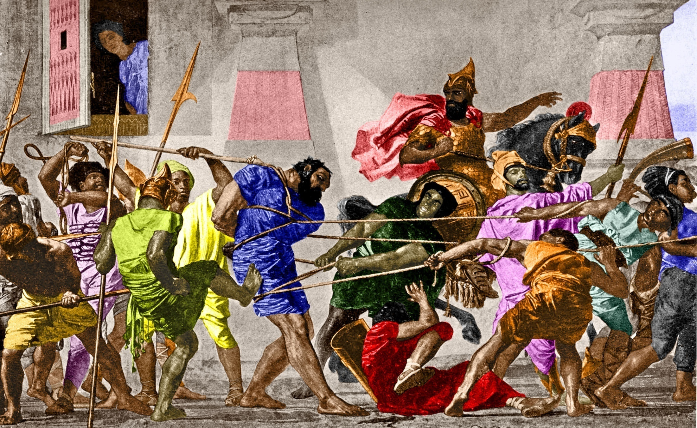
Judges 16
“²¹But the Philistines took him, and put out his eyes, and brought him down to Gaza, and bound him with fetters of brass. . . . ”
His eyes, his eyes
The inlets of his sin
That is where it all began
Judges 16
Verse 21 Put out his eyes
Bound him with chains

Slide 43
Judges 16
“²⁹And Samson took hold of the two middle pillars upon which the house stood, and on which it was borne up, of the one with his right hand, and of the other with his left.”

Slide 44
Judges 16
“³⁰And Samson said, Let me die with the Philistines. And he bowed himself with all his might; and the house fell upon the lords, and upon all the people that were therein.”

Slide 45
Judges 16
“³⁰And Samson said, Let me die with the Philistines. And he bowed himself with all his might; and the house fell upon the lords, and upon all the people that were therein.”

