Slide 1
Welcome to our services
New Lebanon Church of Christ
We are Simply Christians.
Our Emphasis is Spiritual, Not Material or Social.
We are striving to be The Same Church as Described in The New Testament.
Please Come Back Again

Slide 2
Luke 14:28 "For which of you, intending to build a tower, does not sit down first and count the cost, whether he has enough to finish it --
29 "lest, after he has laid the foundation, and is not able to finish, all who see it begin to mock him,
30 "saying, 'This man began to build and was not able to finish.'

Slide 3
Developing A Life Of Faith Heb. 10:22
Preview for tonight
Without faith it is impossible to please God. (Heb.11:6)
Faith is the element that helps us put our trust in God and do the impossible (faith’s hall of fame)
In this lesson we will look at some steps to help us develop the faith we need.

Slide 4
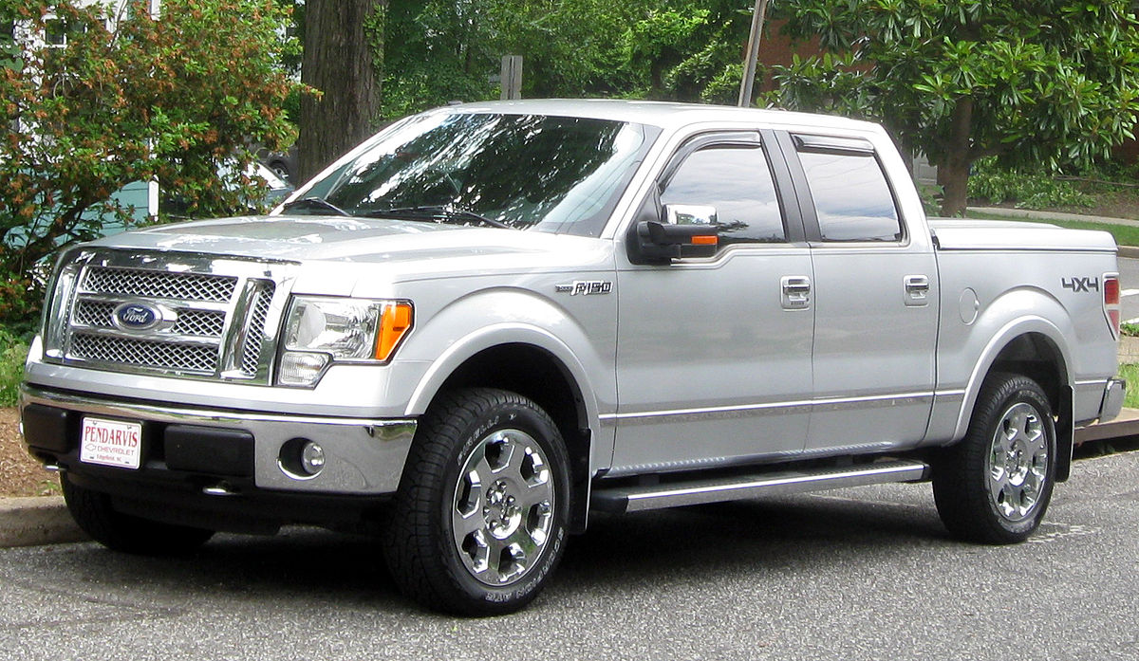
What Is The Price You Are Willing To Pay?

Slide 5
What Is The Price You Are Willing To Pay?
For Salvation???

Slide 6
What Is The Price You Are Willing To Pay?
To Keep Your Salvation???

Slide 7
Entry Cost
Ongoing Cost
Fuel
Insurance
Repairs
Tires-brakes
AC tune up
Towing expense
Washing / detailing
Utilities
Insurance
Property tax
Property updates
Property repairs
H.O.A. fees
Lawn care (mower, fertilizer, etc)

Slide 8
Entry Cost
Ongoing Cost
Fuel
Insurance
Repairs
Tires-brakes
AC tune up
Towing expense
Washing / detailing
Monthly payments
Insurance
Property tax
Property updates
Property repairs
H.O.A. fees
Lawn care (mower, fertilizer, etc)
And we recognize each year these costs are going to keep going up. We understand that. We expect that.

Slide 9
Entry Cost
Salvation
Ongoing Cost

Slide 10
Are You A New Testament Christian?
Hear the Gospel (Rom.10:14).
Believe the Gospel (Heb. 11:6).
Repent of Sins (Acts 3:19).
Confess Christ (Rom.10:9).
Entry Cost
Be Baptized Into Christ (1 Cor.12:13).
1 Timothy 4:16
“Take heed unto thyself, and unto the doctrine; continue in them: for in doing this thou shalt both save thyself, and them that hear thee.”

Slide 11
Hebrews 5:12
For though by this time you ought to be teachers, you need someone to teach you again the first principles of the oracles of God; and you have come to need milk and not solid food.

Slide 12
Luke 14:25 Now great multitudes went with Him. And He turned and said to them,
26 "If anyone comes to Me and does not hate his father and mother, wife and children, brothers and sisters, yes, and his own life also, he cannot be My disciple.
27 "And whoever does not bear his cross and come after Me cannot be My disciple.
28 "For which of you, intending to build a tower, does not sit down first and count the cost, whether he has enough to finish it --
29 "lest, after he has laid the foundation, and is not able to finish, all who see it begin to mock him,
30 "saying, 'This man began to build and was not able to finish.’ >>>

Slide 13
"Or what king, going to make war against another king, does not sit down first and consider whether he is able with ten thousand to meet him who comes against him with twenty thousand?
32 "Or else, while the other is still a great way off, he sends a delegation and asks conditions of peace.
33 "So likewise, whoever of you does not forsake all that he has cannot be My disciple.
34 "Salt is good; but if the salt has lost its flavor, how shall it be seasoned?
35 "It is neither fit for the land nor for the dunghill, but men throw it out. He who has ears to hear, let him hear!"
15:1 Then all the tax collectors and the sinners drew near to Him to hear Him.

Slide 14
33 "So likewise, whoever of you does not forsake all that he has cannot be My disciple.
34 "Salt is good; but if the salt has lost its flavor, how shall it be seasoned?
35 "It is neither fit for the land nor for the dunghill, but men throw it out. He who has ears to hear, let him hear!"

Slide 15
1. God

Slide 16
Deut. 6:5 "You shall love the LORD your God with all your heart, with all your soul, and with
all your strength.
6 "And these words which I command you today
shall be in your heart.
7 "You shall teach them diligently to your children, and shall talk of them when you sit in your house, when you walk by the way, when you lie down, and when you rise up.

Slide 17
There is a price behind everything that is worthwhile.
The things that are good do not come free.
We should not expect something for nothing.

Slide 18
The Price You Pay
1. The price for pardon?
Do God's will instead of yours
Mt 6:10 Your kingdom come. Your will be done On earth as it is in heaven.

Slide 19
The Price You Pay
To be forgiven of our sins we must:
Submit to Him
Live a life of purity
Live life of righteousness
Live a life of sacrifice
- Be a living sacrifice, Daily
There are conditions to our Pardon From Our Death Sentence/

Slide 20
The Price You Pay
2. The price for greatness?
Service
(Matt.20:27) And whosoever will be chief among you, let him be your servant:
Greatness is not derived from office, position, or uniform, but from service.

Slide 21
The Price You Pay
2. The price for greatness?
Humility
(Matt.18:4) Whosoever therefore shall humble himself as this little child, the same is greatest in the kingdom of heaven.
(Prov.16:18) Pride goeth before destruction, and an haughty spirit before a fall.

Slide 22
The Price You Pay
3. The price for friends?
(1) To have friends; be a friend .
Prov.18:24 A man who has friends must himself be friendly, But there is a friend who sticks closer than a brother.
(2) Be unselfish
Phil.2:4 Let each of you look out not only for his own interests, but also for the interests of others.
(3) Treat others as you wish to be treated
Matt.7:12 Therefore, whatever you want men to do to you, do also to them, for this is the Law and the Prophets.

Slide 23
The Price You Pay
4.The price for financial accumulation?
(1) Work.
Eph.4:28 Let him who stole steal no longer, but rather let him labor, working with his hands what is good, that he may have something to give him who has need.

Slide 24
The Price You Pay
4. The price for financial accumulation?
Prov. 6:6-11 Go to the ant, you sluggard! Consider her ways and be wise,7 Which, having no captain, Overseer or ruler,
8 Provides her supplies in the summer, and gathers her food in the harvest.
9 How long will you slumber, O sluggard? When will you rise from your sleep?10 A little sleep, a little slumber, A little folding of the hands to sleep-
11 So shall your poverty come on you like a prowler, And your need like an armed man.

Slide 25
The Price You Pay
4.The price for financial accumulation?
Save $
A loan officer is not your friend!
Proverbs 22:7 The rich rules over the poor, And the borrower is servant to the lender.
Pr 22:7 Ang mayaman ay magpupuno sa dukha, at ang manghihiram ay alipin ng nagpapahiram.

Slide 26
The Price You Pay
4.The price for financial accumulation?
(2) Be thrifty.
Prodigal wasted
Lk. 15:13 "And not many days after, the younger son gathered all together, journeyed to a far country, and there wasted his possessions with prodigal living.
Prov.18:9 He who is slothful in his work Is a brother to him who is a great destroyer.

Slide 27
The Price You Pay
5. The price for knowledge?
It is not like it was when people spoke by inspiration.
John 14:26. "But the Helper, the Holy Spirit, whom the Father will send in My name, He will teach you all things, and bring to your remembrance all things that I said to you.
Today – we Must study
2 Pet.1:5 But also for this very reason, giving all diligence, add to your faith virtue, to virtue knowledge,
2Tim.1:15 Be diligent to present yourself approved to God, a worker who does not need to be ashamed, rightly dividing the word of truth.
Psa. 1…

Slide 28
The Price You Pay
6.The price for spiritual strength?
The requirements are similar to those for physical strength:
food
1 Pet.2:2. as newborn babes, desire the pure milk of the word, that you may grow thereby,
freedom from spiritual disease or sin
exercise 1Tim. 4:7
and time Heb.5:12.

Slide 29
The Price You Pay
7. The price for heaven?
Live for Christ
Phil.1:21. For to me to live is Christ, and to die is gain.
Abide in Christ
John 15:6. If a man abide not in me, he is cast forth as a branch, and is withered; and men gather them, and cast them into the fire, and they are burned.
Die in Christ Rev.14:13 And I heard a voice from heaven saying unto me, Write, Blessed are the dead which die in the Lord from henceforth: Yea, saith the Spirit, that they may rest from their labours; and their works do follow them.

Slide 30
The Price You Pay
Are You willing to pay the price for:
Pardon
Greatness
Friends
Financial accumulation
Knowledge
Spiritual strength
Heaven

Slide 31
The Price You Pay
You cannot have everything.
You can have heaven, but at the expense of giving up the world.
Or You can have the world. But at the price of giving up heaven.

Slide 32
33 "So likewise, whoever of you does not forsake all that he has cannot be My disciple.
34 "Salt is good; but if the salt has lost its flavor, how shall it be seasoned?
35 "It is neither fit for the land nor for the dunghill, but men throw it out. He who has ears to hear, let him hear!"

Slide 33
Jesus Paid It All.
All to Him I owe.
Are YOU willing to pay the price?

